Slide 1
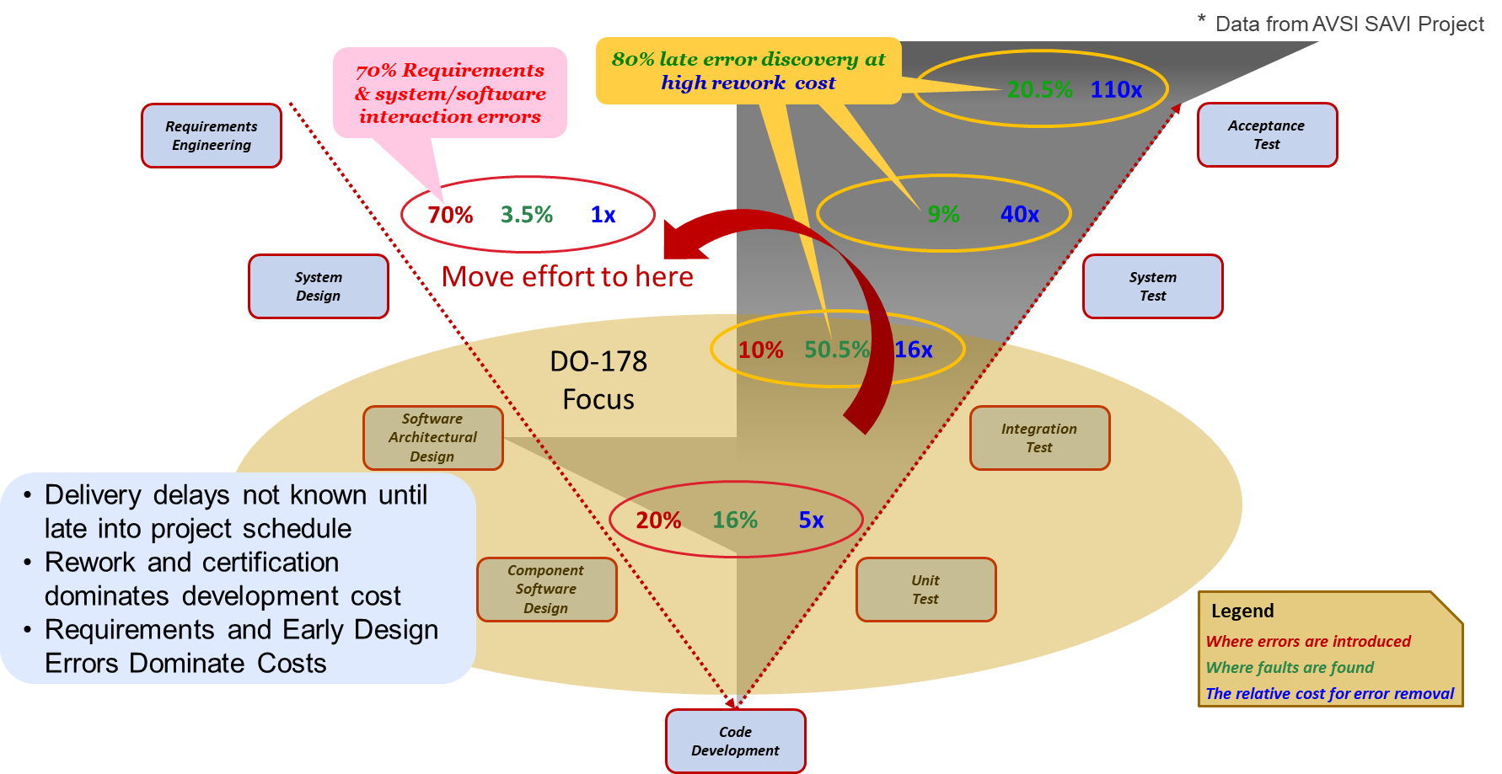
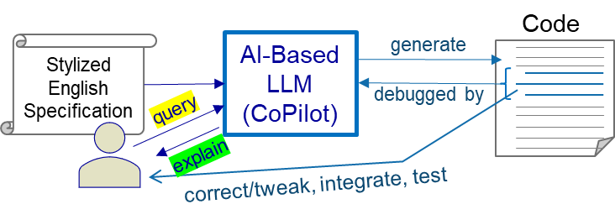
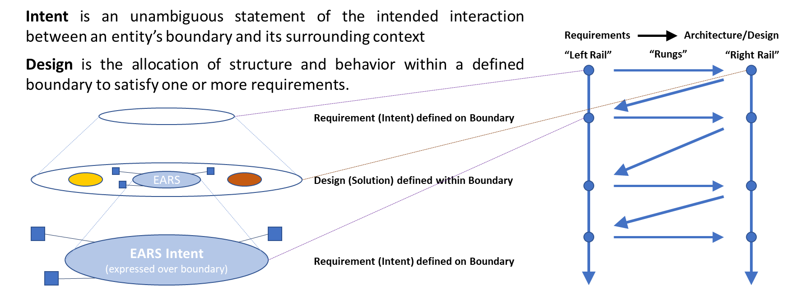
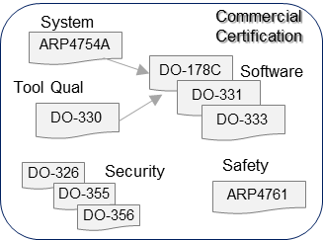
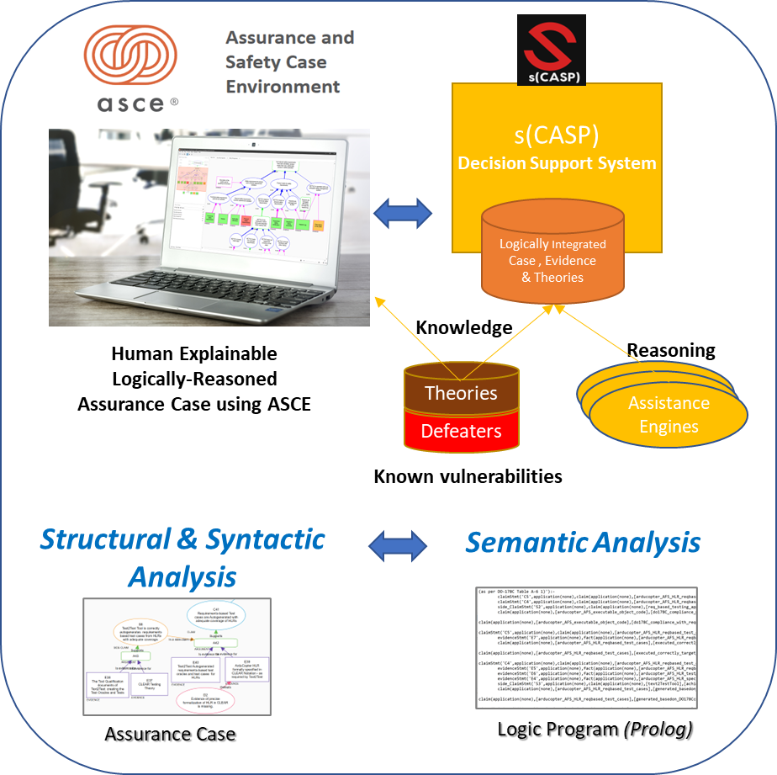
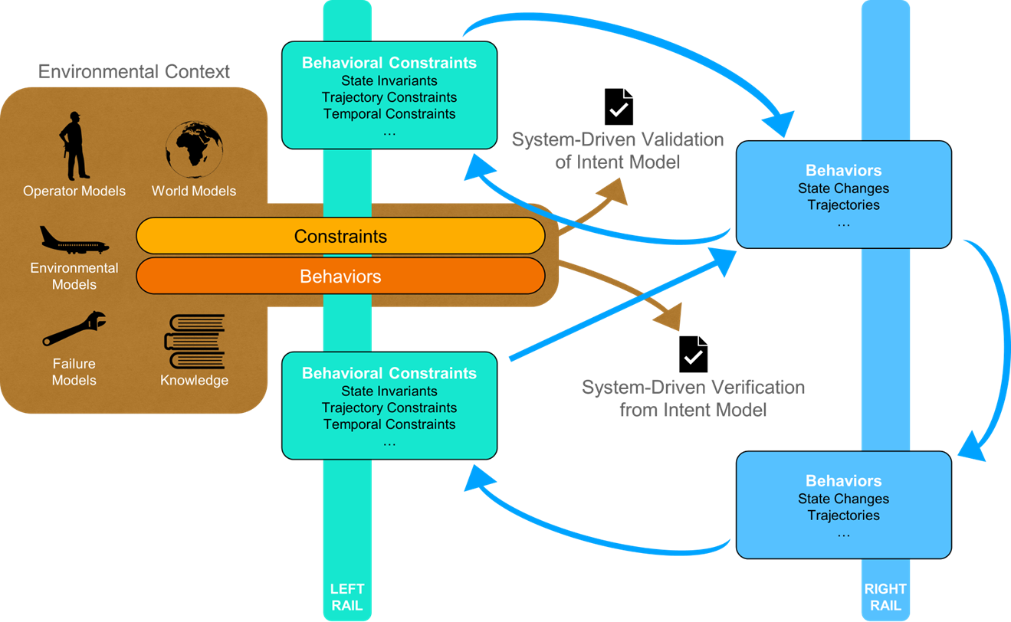
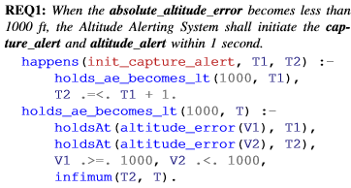
Leveraging LLMs in Assuring Next Generation Safety and Security Critical Systems
Srivatsan Varadarajan, Robin Bloomfield, Gopal Gupta, Devesh Bhatt, Hao Ren, John Rushby, Anitha Murugesan, Isaac Hong Wong
Contact: srivatsan.varadarajan@honeywell.com
Motivation
From Natural Language Specifications to Formal Requirements
Software Industry Paradigm
Aerospace Paradigm
Generative AI works as a coding assistant
Automating detailed design, coding, debugging, explaining using Generative AI
Advantages for general purpose coding
Breadth of general algorithms knowledge
Interactive chat interface
Fast response and incremental code change
A variety of handy functionalities
Software developer’s learning assistant
Limitation for safety-critical systems development
Lack of system-level understanding
Cannot handle complex behaviors and corner cases
Code piece needs to be tweaked, integrated, and reviewed in the integrated code context
Generated code can often be incorrect, human code review is not an easy job
Limited scope of domain-specific software specification and development approach
System Development : specification-based rather than coding-based
Code is generated from specification models by certified code generators
Models are direct translation of system requirement
Requirements in CLEAR (Constrained Language Enhanced Approach to Requirements) are in a more human-readable language that is closer to the Generative AI database
Requires no further training other than feeding Generative AI the requirement grammar
Generation of Assurance Case and Logic Models for Semantic Analysis
From Formal Requirements to Synthesized Executable Models for V&V
“event calculus” is a logical language for representing and reasoning about events and their effects
Cyber-physical systems can be modeled directly using event calculus
Actuator actions map to events (switch on the home heating system)
Sensor readings map to fluents (room temperature)
Conditions on sensors map to triggers (temperature exceeds 80oF)
event calculus can be elegantly coded in Answer Set Programming (ASP) and executed on s(CASP)
The encoding is used for checking feasibility & consistency of requirements by executing appropriate queries against it; Additional ASP-coded knowledge used for completeness checking
Given the close correspondence between the EARS requirements and event calculus code, generate the s(CASP) event calculus “executable” code and queries directly from English EARS description using LLMs
Event triggers and state qualifies identified using EARS keywords
Level of Temporal Abstraction elegantly represented in the event calculus
Assessing accuracy of translation and back translation
Using corpus of anonymized claims, based on actual cases
Accuracy of NL -> formalized claims, currently ~90%
A failure mode is likely to occur at 3.4% e.g. Claim is too generic where more context is needed, elaboration of existing claims or unreliable external sources
Consider transition issues, confidentiality issues and standalone LLMs – model size vs training in-session vs accuracy tradeoffs (with UTD).
Z-Ladder of Intent Refinement
Separating “what” from “how”

