Slide 1
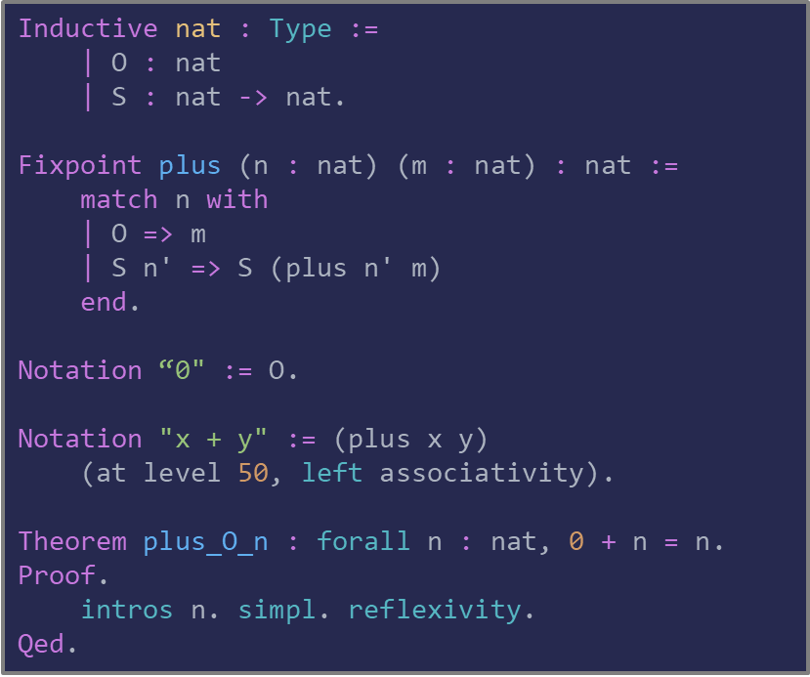
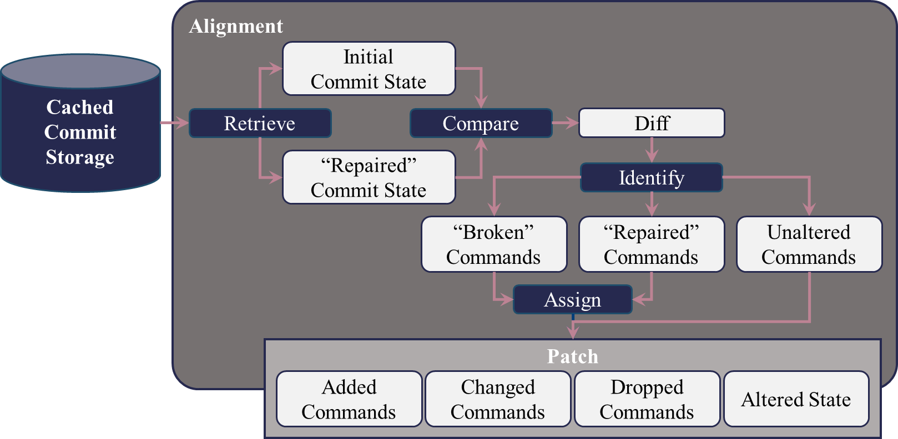
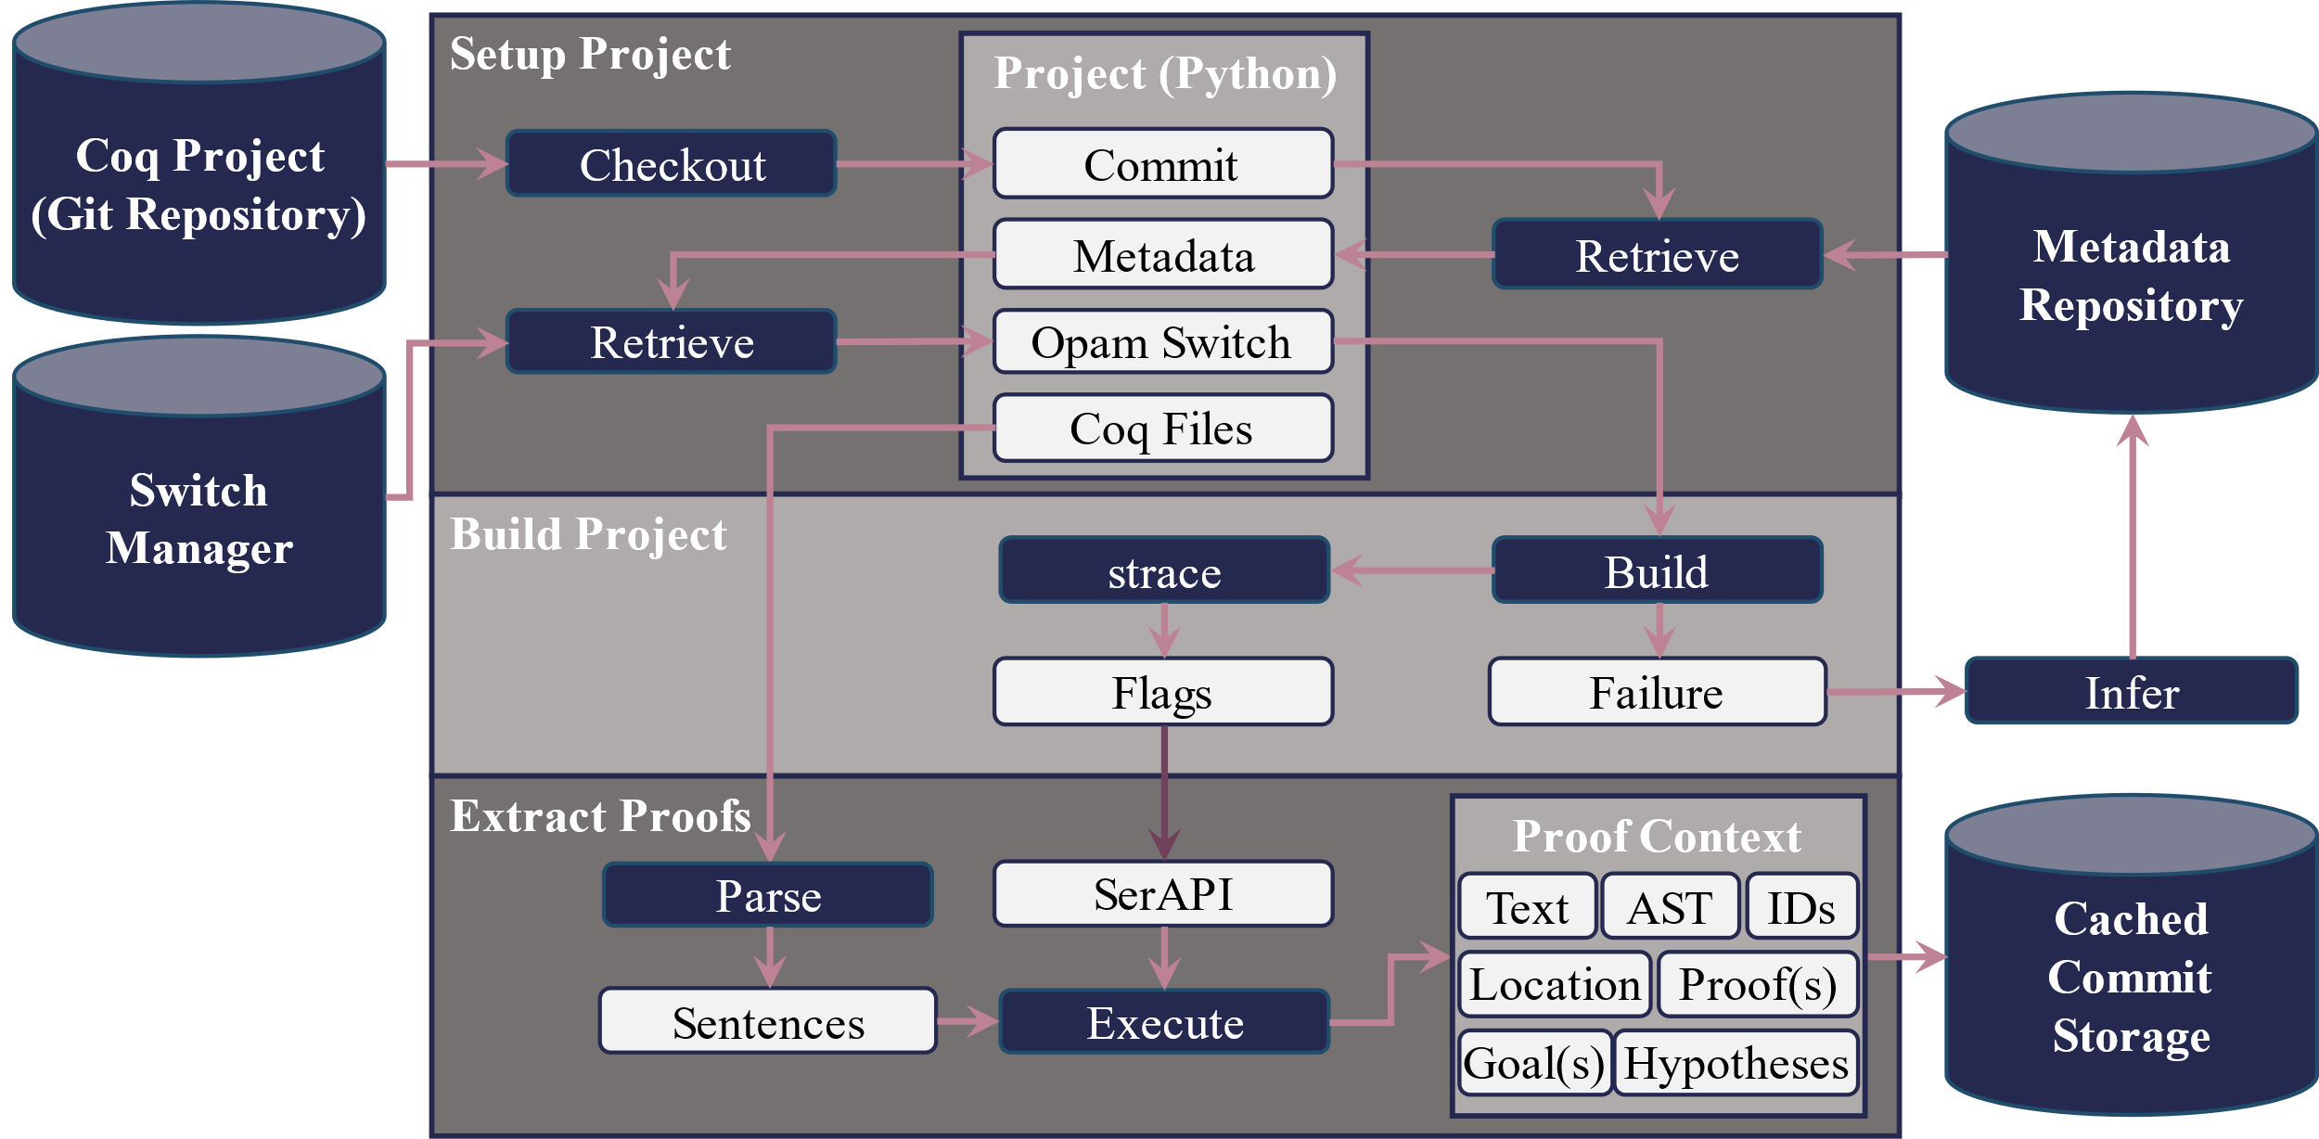
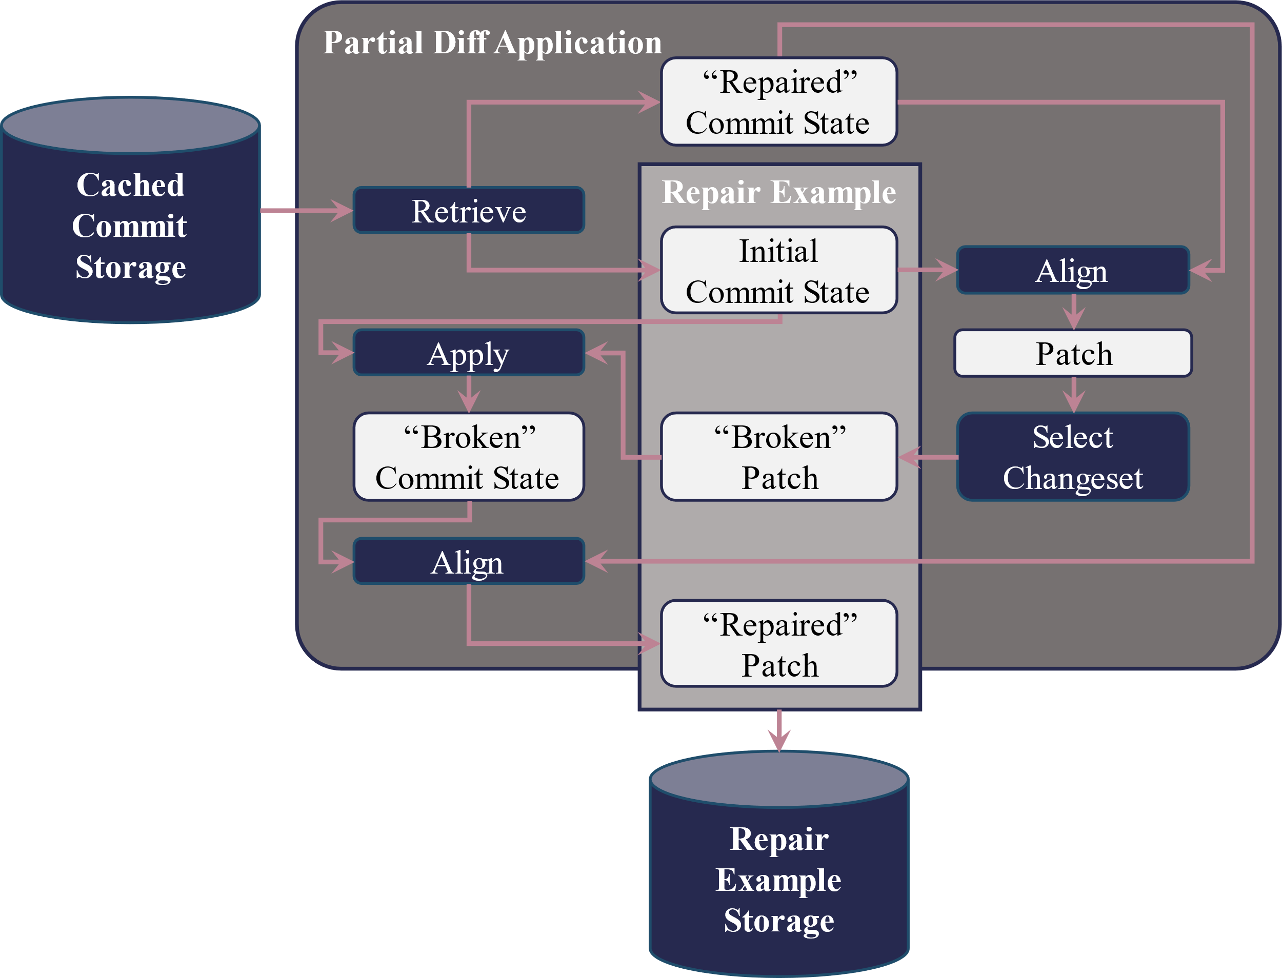
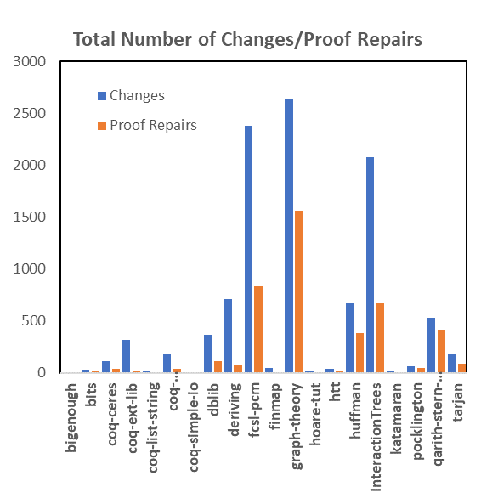

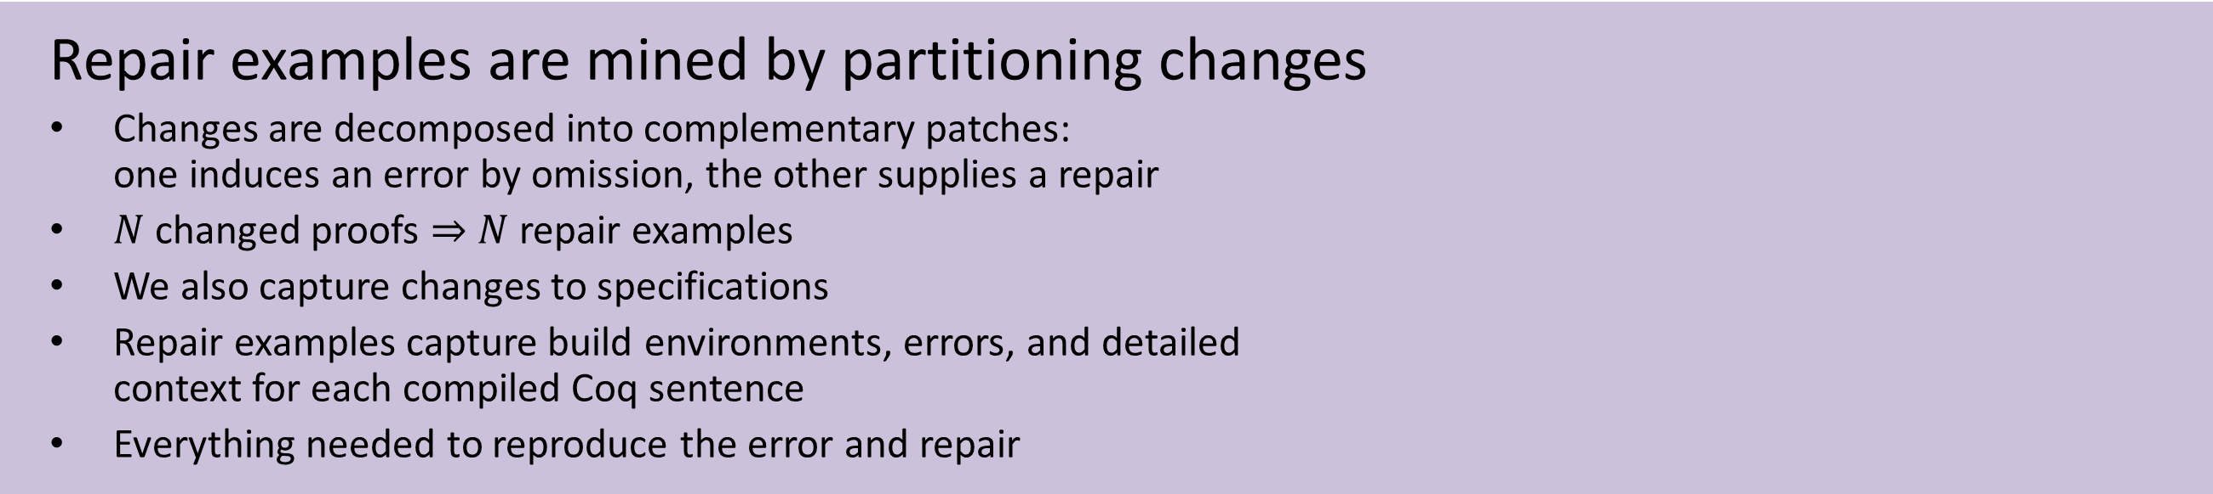
Pretraining for Proof Repair with Infrastructure for Supervised Models (P²RISM)
Distribution Statement A. Approved for public release: distribution unlimited.
PI: Andrew Gardner, Radiance Technologies, Inc.
Co-PI: Andrew Touchet, Radiance Technologies, Inc.
Paper: https://drops.dagstuhl.de/opus/frontdoor.php?source_opus=18401
Formal verification of software is expensive
Specialized proof engineers spend many hours verifying and maintaining specifications with esoteric tools
Broadening access to journeyman developers will vastly reduce costs and enable verification of novel applications
Large language models (LLMs) can help generate new and repaired proofs
Pretrain on the Coq Proof Assistant’s formal specification language (right) using open-source Git repositories
Provide LLM with sufficient context of in-scope terms to generate semantically relevant code
Perform reinforcement learning to guide and refine LLM for optimal repair
Integrate LLM into Visual Studio Code extension
But getting data can be challenging
No pre-existing large-scale proof repair datasets
Extensible grammar means parsing requires execution
No standard processes for building projects or extracting context
No standard means to specify external dependencies
Coq frequently introduces backwards incompatible changes
Resolved by novel project management infrastructure (below)
Solution based in part on experimental Coq serialization library SerAPI
Sequential Git commits supply repair examples
Requires aligning Coq commands
Commands may move, be renamed, or otherwise changed
A normalized Levenshtein distance provides cost of alignments
Alignment requires building projects first to identify command locations
Commits considered for repair mining are thus error-free
Repair examples are mined by partitioning changes
Changes are decomposed into complementary patches:
one induces an error by omission, the other supplies a repair
$N$ changed proofs $⇒$ $N$ repair examples
We also capture changes to specifications
Repair examples capture build environments, errors, and detailed
context for each compiled Coq sentence
Everything needed to reproduce the error and repair
Repair mining bears fruit
10,365 repair examples mined from 20 projects
7136 repairs to theorems
4329 repairs to
proof bodies
155,178 proofs from
182 projects
More on the way
$≈5$-$10×$ more
examples expected
Future work
Use full context in repair examples to enrich LLMs with knowledge
In-situ evaluation of LLM outputs for interactive feedback from Coq
Transition to new Coq language server protocol to support newer versions

