Slide 1
Quantitative Threat Modeling and Risk Assessment in Socio-Technical Critical Infrastructure Systems
Dr. Natalie M. Scala (PI) and Dr. Josh Dehlinger
SoS Virtual Institute (VI) Kick-off Meeting
January 2024

Slide 2
Motivation
16 critical infrastructure sectors, as defined by DHS
Assets, systems, networks – physical or virtual
Problems lead to significant impacts to national security, economic security, public health and safety, etc.
Key target for cyber attacks
Study and model systems within the sectors
Identify vulnerabilities
Develop strategies
Intent to prevent and respond to attacks, helping to safeguard infrastructure

Slide 3
Goals
Considering national critical infrastructure sociotechnical systems and processes:
Develop and disseminate a systematic threat and mitigation analysis approach
Address cyber, physical, and insider risks
Adversaries and trusted insiders
Create a framework to model a relative likelihood risk assessment
Include actions of adversaries and trusted insiders as contributors to cyber, physical, and insider threat scenarios
Develop, model, and analyze policy implications and security mitigations
Quantify ability to reduce cyber, physical, and insider risks

Slide 4
How Are We Going To Do This?
Government Facilities sector
Subsector: Election Infrastructure
Case study / test bed
Security and integrity of elections are in forefront of national discourse
Russian Federation interference in 2016
Senate Intelligence Committee (2019): Election systems in all 50 states targeted in 2016
Robert S. Mueller, III (2019): Interference ongoing
Director of National Intelligence (2020): Iran and Russia obtained US voter registration information

Slide 5
Empowering Secure Elections
Research lab at Towson University
First to define threats to elections as a systemic interplay
Cyber, physical, and insider risks
Risk analysis of mail voting
Expanded mail voting disincentivizes adversarial interference and increases voting access
Poll worker training
Increase security and integrity of critical elections infrastructure
U.S. Election Assistance Commission: Clearinghouse Award for Outstanding Innovation in Election Cybersecurity and Technology
University of Maryland Board of Regents Award for Excellence in Public Service

Slide 6
Problem Statement
Model the relative risks of adversaries and trusted insiders exploiting threat scenarios in developed attack trees, using critical infrastructure precinct count optical scanner (PCOS) in-person voting machines as a case study.
PCOS
Auditable paper trail
Will be used in almost 70% of the country in 2024 (Verified Voting)

Slide 7
Outcomes and Objectives
 | Year 1 | Year 2 | Year 3
1. A comprehensive, updated attack tree and mitigation analysis for critical infrastructure equipment and processes | √
2. A scenario analysis to categorize threat scenarios as cyber, physical, or insider with an adversarial or insider source | √
3. A risk assessment of threat scenarios on the updated attack tree that considers insider / adversarial attack costs and technical difficulties as well as information assurance assessments of the difficulties to discover an attack | √ | √
4. The identification of risks of most concern within the process across temporal phases |  | √

Slide 8
Outcomes and Objectives
 | Year 1 | Year 2 | Year 3
5. An impact analysis of suggested policy implications and security mitigations (e.g., adversarial implications, human behavior interdictions) and their ability to reduce cyber, physical, and insider risks |  |  | √
6. The dissemination of the threat and mitigation analyses results |  | √ | √
7. An assessment of the systematic threat and mitigation analysis approach's utility for use in national critical infrastructure socio-technical systems and processes, and recommendations for the adoption of the approach at the national level |  | √ | √

Slide 9
1. Attack Tree + Mitigation Analysis
Elections Assistance Commission (2009) attack tree data
Attack tree: Inventory of risks
Does not identify strength or likelihood
Decompose complex actions into hierarchical levels
Graphic representation of security problem
Much has changed
Critical infrastructure designation
COVID-19
Adaptive adversary

Slide 10
Example: Mail Voting
EAC (2009) tree
Threat scenarios
Insider = 32
External = 16
Voter error = 9
Total = 57

Slide 11
Example: Updated Attack Tree
30 new threats
Threat scenarios
Insider = 40
External = 23
Voter error = 10

Slide 12
How is PCOS different?
Much larger problem space
7 branches
1000+ threats
Three phases: Set up, voting, tear down
Broader sense of critical infrastructure
Systematic approach to building and revising trees
How do we validate a complete tree?
Failure Modes and Effects Analysis

Slide 13
2. Cyber, Physical, Insider
Each threat and systemic interplay
Framing extends beyond elections
Cyber
Digital machines and media
Regardless of Internet connection
Physical
Tampering with or disrupting equipment
Insider
Adversaries and insiders
Simple, honest mistakes
Deliberate actions with ill-harm effects

Slide 14
Sources of Threat
Supply
Chain
Flash
Drives
Ballot
Marking
Device
Memory
Cards
Forge
Reports
Chain of
Custody
Physical
Election
Judges
Cyber
Optical
Scanner
County
Tech
Challengers/
Watchers
Network
Equipment
Security
Insider
Database
Electronic
Poll Books
Election Day
Support
Staff
Board of
Elections
Staff

Slide 15
3. Risk Assessment
Relative strength or likelihood of threat
Each terminal node assessed for utility on three dimensions
Attack cost (AC) u₁
Technical difficulty (TD) u₂
Discovering difficulty (DD) u₃
Criteria adapted from Du and Zhu (2013)
Attack Cost (AC) |  | Technical Difficulty (TD) |  | Discovering Difficulty (DD)
Grade | Standard | Grade | Standard | Grade | Standard
5 | Severe consequences likely | 5 | Extremely difficult | 1 | Extremely difficult
4 | High consequences likely | 4 | Difficult | 2 | Difficult
3 | Moderate consequences likely | 3 | Moderate | 3 | Moderate
2 | Mild consequences likely | 2 | Simple | 4 | Simple
1 | Little to no consequences likely | 1 | Very simple | 5 | Very simple

Slide 16
Calculating Relative Likelihood
Relative likelihood for each terminal node $X_{j}$:
$$P\left(X_{j}\right)=w_{1}u_{1j}+w_{2}u_{2j}+w_{3}u_{3j}$$
$j∈\{1, 2, …, n\}$ , $n$ terminal nodes
$w_{k}, k∈\{1, 2, 3\}$, weight assigned to utility function $k$; $\sum{w_{k}}=1$
$w_{k}=1/3∀k$
$u∈[0, 1]$, using scale factor (0.2) to convert ordinal scales

Slide 17
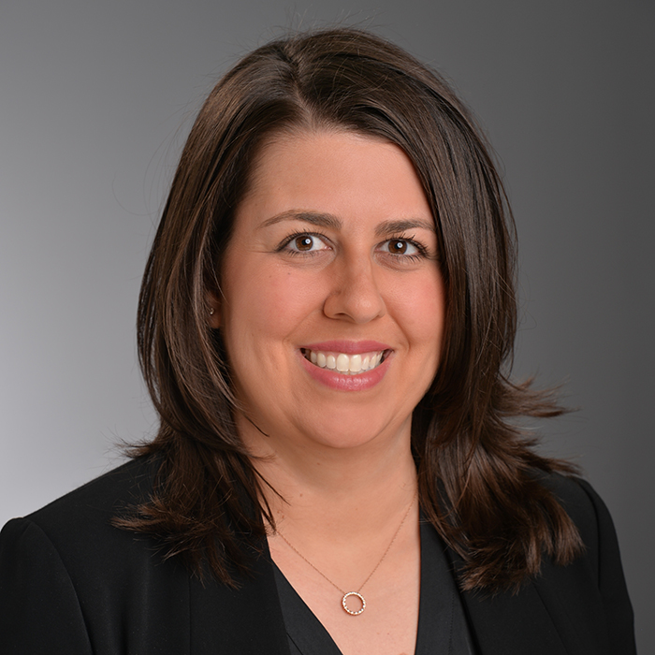
Our Team: PI
Dr. Natalie M. Scala Associate Professor Department of Business Analytics and Technology Management
Director, Graduate Program in Supply Chain Management
Faculty Affiliate: University of Maryland Applied Research Lab for Intelligence and Security
Research
Decision modeling, military applications, cybersecurity, election security

Slide 18
Our Team: Co-PI
Dr. Josh Dehlinger Professor Department of Computer and Information Sciences
Director, Undergraduate Program in Computer Science
Research
Software engineering, software safety/reliability, cybersecurity, election security

Slide 19
Our Team: Contingent Assistant
Vince Schiavone
MS Supply Chain Management, Towson University
Northrup Grumman: Operations Project Manager
Research
Collaborative scheduling, project management, statistical analysis, data mining

Slide 20
Our Team
Graduate Research Assistant: Hao Nguyen
MS Thesis Student: Skylar Gayhart
Undergraduates: Vanessa Gregorio, Erich Newman, Yavor Gray
University of Maryland Undergraduates: Noah Hibbler, Aaryan Patel
Students working on adjacent projects: Amara Offor, Sadie Barrett

Slide 21
Questions?
Dr. Natalie M. Scala
Email: nscala@towson.edu
Web: www.drnataliescala.com
Dr. Josh Dehlinger
Email: jdehlinger@towson.edu

Slide 22
Our Papers
Scala, N. M., Goethals, P. L., Dehlinger, J., Mezgebe, Y., Jilcha, B., & Bloomquist, I. (2022). Evaluating mail-in security for electoral processes using attack trees. In Risk Analysis.
Dehlinger, J., Harrison, S., & Scala, N. M. (2021). Pollworker security: Assessment and design of usability and performance. Proceedings of the 2021 IISE Annual Conference. https://tinyurl.com/hvwde2ep
Locraft, H., Gajendiran, P., Price, M., Scala, N. M., & Goethals, P. L. (2019). Sources of risk in elections security. Proceedings of the 2019 IISE Annual Conference. https://tinyurl.com/LocraftEtAl2019
Price, M., Scala, N. M., & Goethals, P. L. (2019). Protecting Maryland’s voting processes. Baltimore Business Review: A Maryland Journal. https://www.cfasociety.org/baltimore/Documents/BBR_2019%20Final.pdf#page=38
Scala, N. M., Dehlinger, J., Black, L., Harrison, S., Delgado Licona, K., & Ieromonahos, A. (2020). Empowering election judges to secure our elections. Baltimore Business Review: A Maryland Journal, 8-20.

