Slide 1
Analysis of Security Behaviors of Supply Chain Professionals
Hao Nguyen¹, Natalie M. Scala¹, Josh Dehlinger²
¹Department of Business Analytics & Technology Management
²Department of Computer & Information Sciences
Towson University

Slide 2
About Us
Empowering Secure Elections Research Lab at Towson University
  Non-partisan, interdisciplinary research lab focused understanding the risks to election processes and developing mitigations to the cyber, physical, and insider risks that can arise
  Partnered with Maryland Boards of Elections to develop targeted, poll worker training modules to develop awareness of threats in elections processes and equipment
  2020 U.S. Elections Assistance Commission Clearinghouse Award for Outstanding Innovation in Election Cybersecurity and Technology
  Analyzed risks to mail-based voting processes, updated the EAC’s attack tree, and were the first to develop a relative risk assessment for U.S. elections (Scala et al., 2022)
    Demonstrated that mail-based voting increases voter access and disincentivizes attacks from adversaries
Notes:
So, as I mentioned, our lab is interested in understanding and analyzing the cyber, physical, and insider threats within U.S. election processes and equipment. And, given the climate around this topic over the last few election cycle, it is important to us to emphasize that we are a non-partisan, interdisciplinary research lab not affiliated or funded by any political party or group.
In prior work, we have primarily focused on improving the understanding and ability for poll workers at the local, precinct level to identify and mitigate any threats that might arise. In doing so, we partnered with several Maryland Boards of Elections prior to the 2020 and 2022 elections to develop targeted training modules that could be “injected” into whatever their existing training practices where, which in some cases is very little and does not include any security training besides active shooter training. This training was research based and tied actual risks to poll worker processes.
These were used to train thousands of poll workers in Maryland, complementing Maryland’s standard poll worker training, and was recognized following the 2020 election by the Elections Assistance Commission with a Clearinghouse Award.
In the run up to the 2020 election, we also examined the rapid expansion of mail voting opportunities and the potential threats/risks to the mode of voting and quantitatively showed that mail voting increases voter access and disincentivizes attacks from adversaries.

Slide 3
Problem Motivation
In 2022, 633% year over year increase in attacks, hitting over 88,000 known instances (Sonatype, 2022)
74% of all breaches include the human element (Error, Privilege Misuse, Use of stolen credentials or Social Engineering)
Cybersecurity in supply chain cannot be viewed as an IT problem only, it’s a people, processes, and knowledge problem (NIST)

Slide 4
Problem Motivation
The research will analyze the information security behaviors of supply chain professionals:
  Which behaviors are posing threat to information security
  Which behaviors have strong relationships with each other
  Which demographics can provide more information about security behaviors
  Which behaviors bring back more efficiencies for specific groups of employees with similar characteristics

Slide 5
Background
A limited number of papers adopting quantitative research approaches to study cybersecurity in logistics and supply chain management (Chung et al., 2020)
Humans, intentionally or through negligence, are a great potential risk to the security of information assets (Safa & Maple, 2016)
Information security initiatives have a positive influence on an organization’s supply chain robustness:
  Physical and logical access controls
  Good cultural climate
  Training and awareness
  Well- documented security policies
  Open communication channels

Slide 6
Background
Most employees make more mistakes when they are stressed, over two-fifths say they are more error-prone when they are tired and distracted
Mistakes can have serious consequences for cybersecurity, especially when people are in control of so much sensitive data - such as customers, financial and employee information - and systems
Training is incredibly important in raising employee awareness, “needs to be tailored if it’s going to resonate and stick”

Slide 7
Security Behaviors and Intentions Scale Inventory
SeBIS Inventory Questions
Device Securement
F1 | I set my computer screen to automatically lock (i.e., sleep) if I don't use it for a prolonged period of time.
F2 | I use a password/passcode to unlock my laptop or tablet.
F3 | I manually lock my computer screen when I step away from it.
F4 | I use a PIN or passcode to unlock my mobile phone.
Password Generation
F5 | I do not change my passwords, unless I have to.
F6 | I use different passwords for different accounts that I have.
F7 | When I create a new online account, I try to use a password that goes beyond the site's minimum requirements.
F8 | I do not include special characters in my password if it's not required.
Proactive Awareness
F9 | When someone sends me a link, I open it without verifying where it goes.
F10 | I know what website I'm visiting based on its look and feel, rather than by looking at the URL bar.
F11 | I submit information to websites without first verifying that it will be sent securely (e.g., SSL, https, a lock icon).
.F12 | When browsing websites, I mouse over links to see where they go, before clicking them.
F13 | If I discover a security problem, I continue what I was doing because I assume someone else will fix it.
Updating
F14 | When I'm prompted about a software update, I install it right away.
F15 | I try to make sure that the programs I use are up-to-date.
F16 | I verify that my anti-virus software has been regularly updating itself.
Validated and accepted by the usable security community to create characterizations based on the respondents’ level of cyber and computer security knowledge and savvy
Measures participant intentions related to security and how those intentions may vary between individuals; it does not measure or predict actual behavior

Slide 8
Data
Likert-scale questionnaire include:
  16 SeBIS questions, measuring factors like Device Securement, Password Generation, Proactive Awareness, Updating
Data collected during Summer 2022, a final usable dataset of 763 responses was obtained, comprised individuals from various occupations
In this research, we will analyze a sub-sample N = 167, consisting of people working from different sectors within the supply chain field:
  Construction, Manufacturing, Transportation and warehousing, Retail Trade, Wholesale Trade

Slide 9
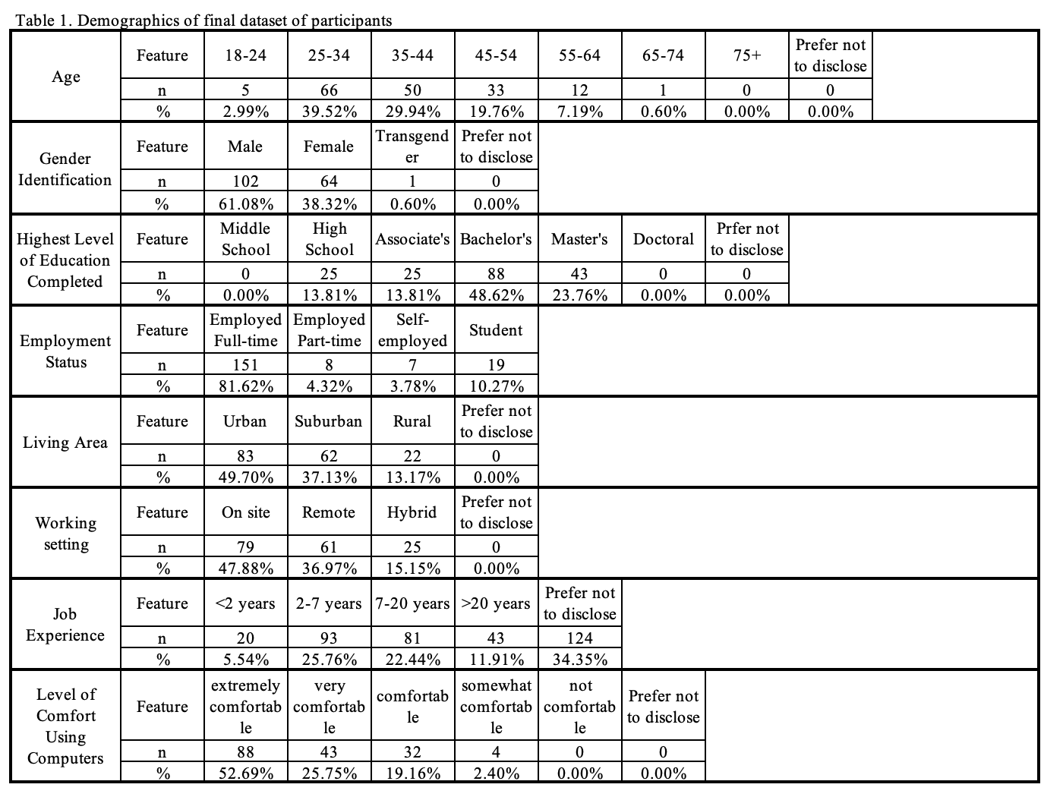
Data

Slide 10
Data Analysis
Employing Information Theory to measure the uncertainty or information content in random variables:
  A mathematical discipline concerned with quantifying and managing information
  Sidestep controversies surrounding the classification of Likert scale data (ordinal or continuous )
  Permits the exploration of relationships, patterns, and dependencies within the data without the need for rigid assumptions about the nature of the scale.

Slide 11
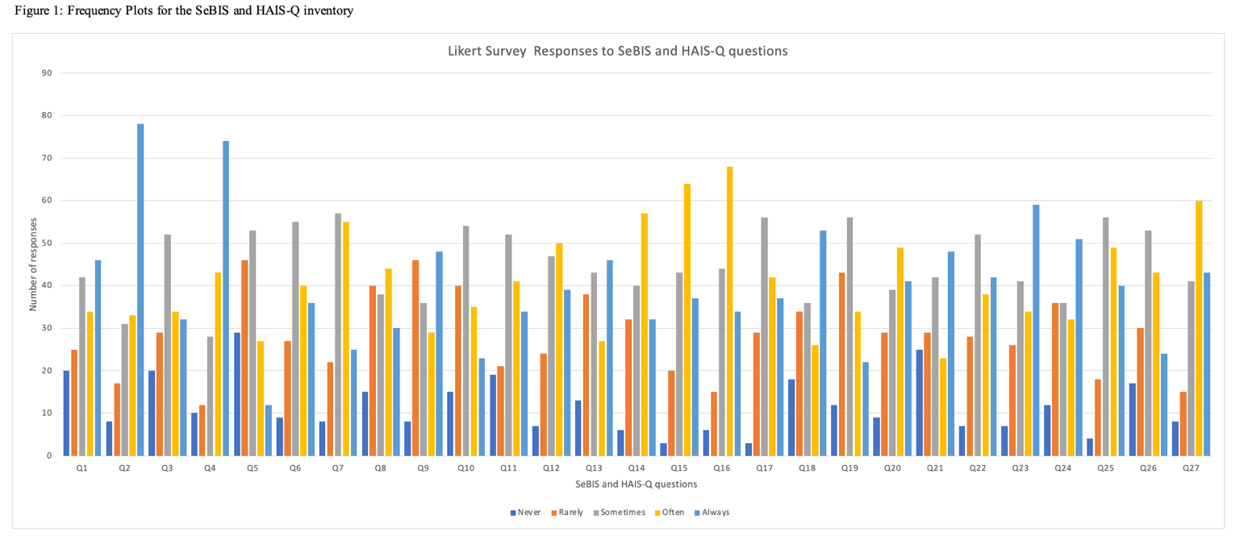
Data Analysis

Slide 12
Data Analysis
Assessing behaviors with potential risks
  Entropy (H(x)), measures the uncertainty or randomness in a set of data
  Relatively high entropy value for each question, with an average of 2.14, indicating uncertainty in security behaviors of supply chain professionals
  Average entropy value for SeBIS (2.13) is higher than that for HAIS-Q (2.15)
  The uncertainty is evident in the majority of median values being 3 (Sometimes) and 4 (Often) , implying behaviors vary and do not exhibit a clear positive toward either extreme

Slide 13
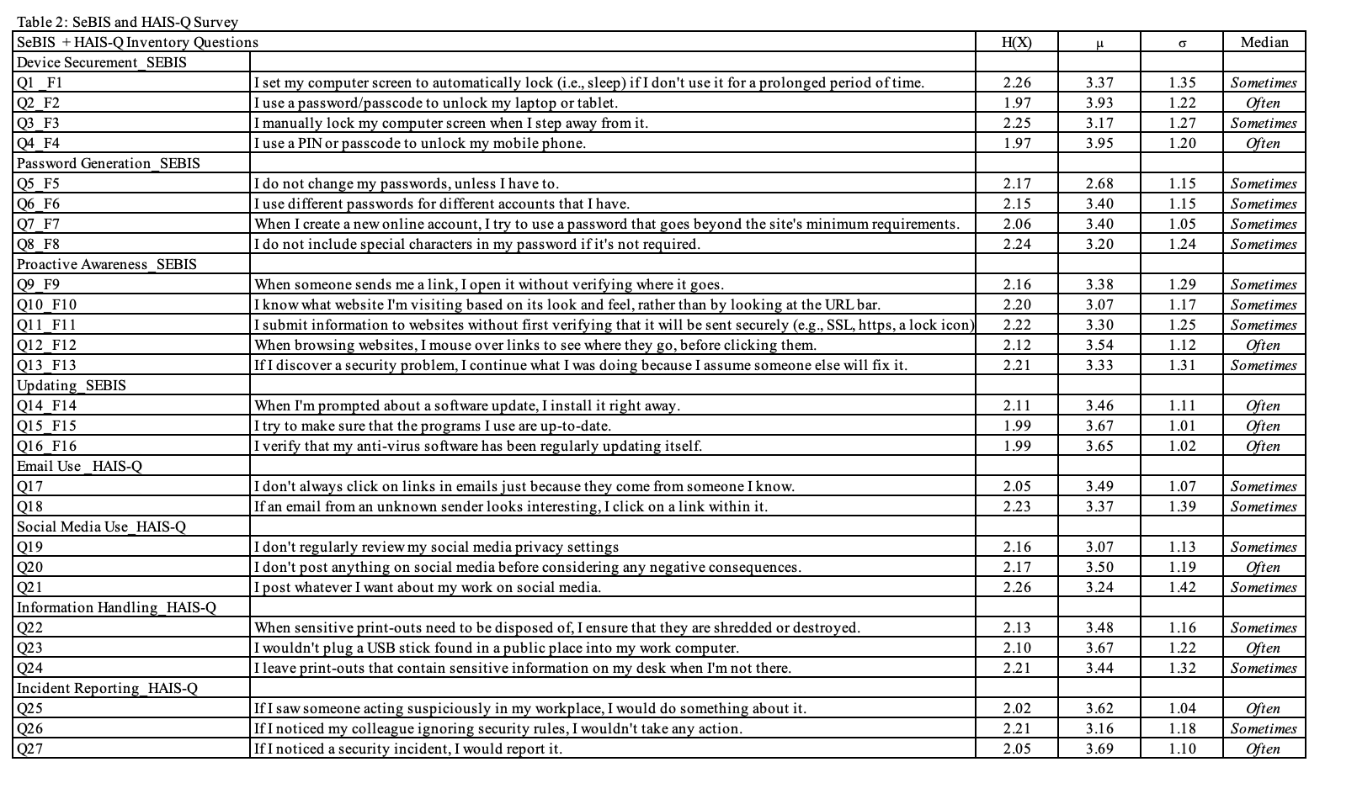
Data Analysis

Slide 14
Data Analysis
Behaviors with strong relationship
  Mutual information (MI) is the concept in information theory that measures the amount of information that two random variables share
  It is the reduction in the uncertainty of one random variable due to the knowledge of the other
  A higher MI value indicates a stronger correlation between the variables, suggesting that knowing the value of one variable provides more information about the other
  Q8 and Q9, Q18 and Q21, Q2 and Q4; Q6 and Q7; Q14 and Q15; Q25 and Q27; Q17 and Q22, their MI values rank highest in both directions

Slide 15
Data Analysis
Considering demographics connection with security behaviors
  MI values between the behavior and demographics are quite high, promising in providing information between security behaviors and demographic characteristics.
  Employment Type is the characteristic with the highest value of MI with the behaviors, followed by Level of comfort using computers
  Age and Level of Education

Slide 16
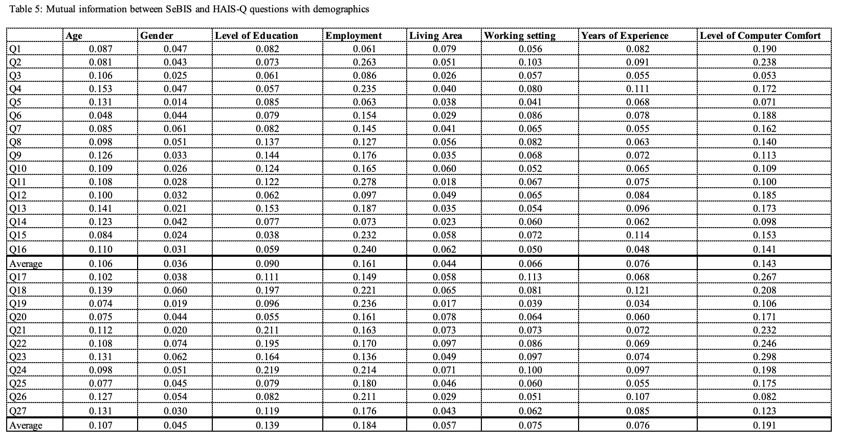
Data Analysis

Slide 17
Data Analysis
Chow-Liu tree in forming suggested security behaviors
  The Chow-Liu tree (Chow& Liu, 1968) is a graphical model used in probabilistic graphical models and machine learning
  Visually represent the conditional dependencies between variables by forming a spanning tree structure (Meila, 1999)
  Assist identifying important feature of the problem space and understanding relationships between variables (Scala, 2022)

Slide 18
Data Analysis
Chow-Liu tree in forming suggested security behaviors
  The Chow-Liu tree starts with the root node of Q4 (Using PIN/ passcode to unlock mobile phone), with the highest MI with Q2 (Using PIN/password to unlock laptop/tablet), 0.4433
  Q6 and Q7, Q8 and Q9, Q14 and Q15 are pairs with robust and bidirectional connection between them
  Device Securement group has stronger relations with the Password Generation group rather than Updating, suggesting focusing efforts on Device Securement and Password Generation aspects could yield better results

Slide 19
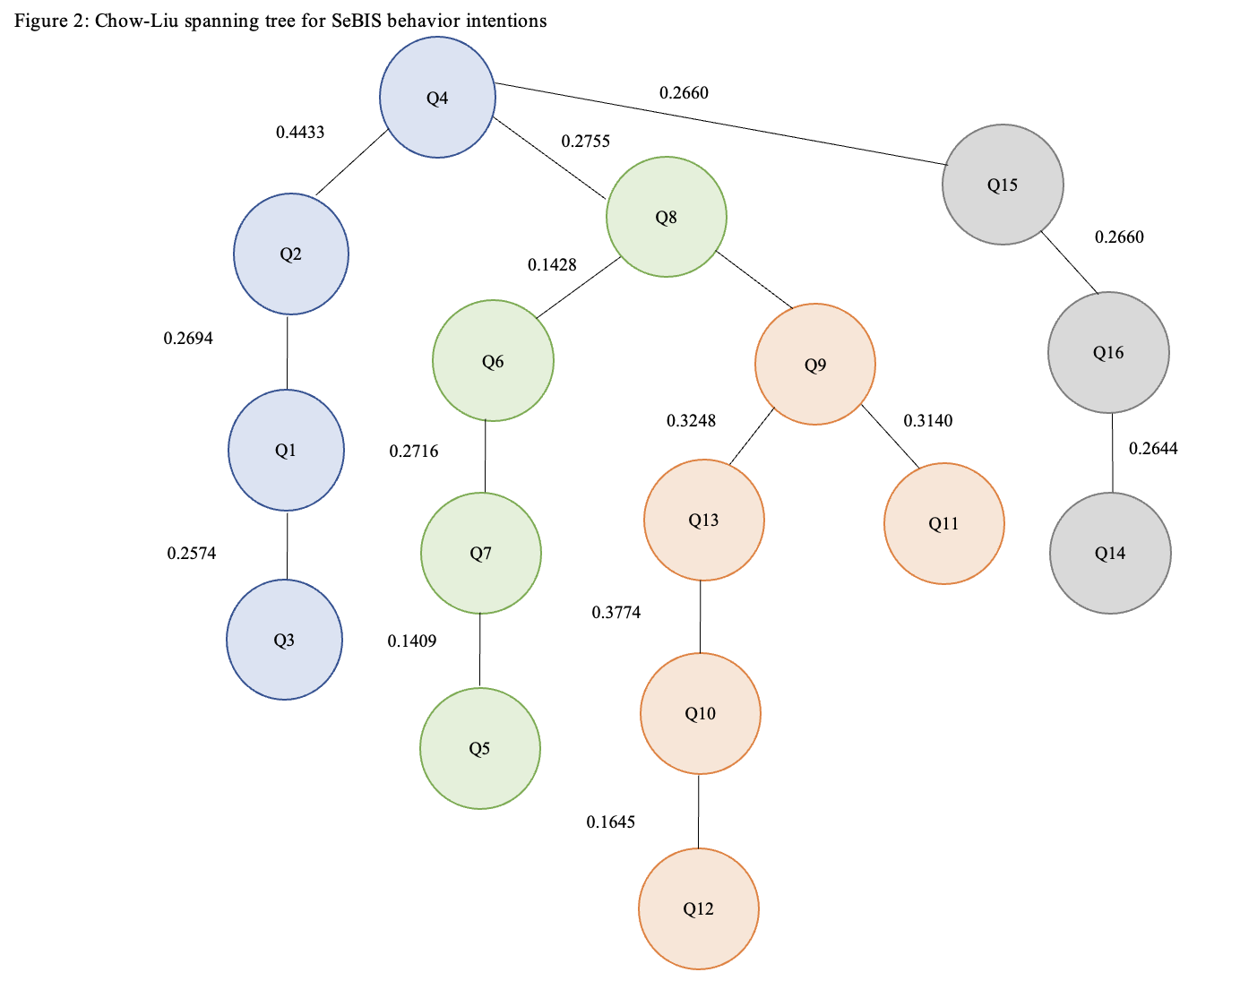
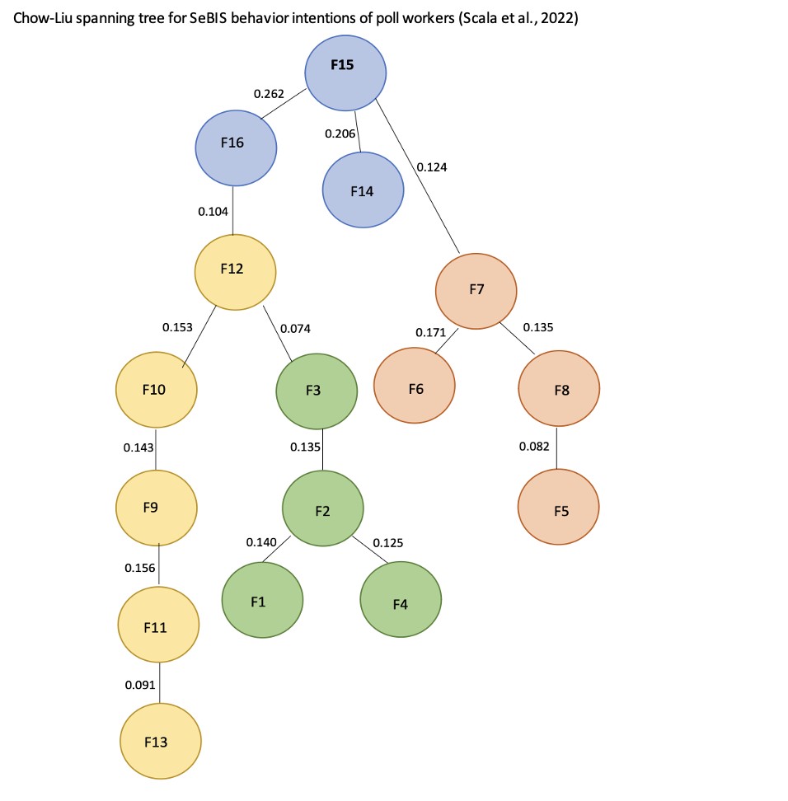
Data Analysis

Slide 20
Results and Recommendations
Considerable uncertainty in information security behaviors among professionals working in supply chain
Strong connection of Employment Type and the behaviors, particularly with Proactive Awareness and Incident Reporting
Level of comfort using computers, Age and Level of Education are the other three elements that share information about security behaviors of supply chain professionals

Slide 21
Results and Recommendations
To enhance efficiency in training programs with limited resources, corporations can prioritize the behaviors that exert greater impacts on others
Connection among behaviors is beneficial when recognizing the impact of one specific behavior on others

Slide 22
Conclusion
Considerable inconsistency the behaviors of supply chain professionals, indicated by high entropy values and occasional frequency of practice
The high MI values among the behaviors share the strong connection between them
Strong dependency between behaviors and demographics
These connections are useful for improving or designing training programs, prioritizing groups of actions for specific groups to mitigate potential cyber incidents caused by human errors

Slide 23
Dr. Josh Dehlinger
jdehlinger@towson.edu

