Slide 1


The Seven Megatrends of IT
Bob Gourley, Partner, Cognitio
October 15, 2015
How we think.

Slide 2
Disclaimer
There is a great deal of text on these slides. Don’t try to read them now, I’ll verbally summarize and will email you a copy to read slowly later.
How we think.

Slide 3
About This Presentation
What if you could know everything about the future of IT by just remembering one word?
What would you do today because of what you knew about the future?
This presentation will help you think through the future and underscore actions we all need to be taking today to ensure we have the best possible tomorrow.
How we think.

Slide 4
Background
Do you remember this scene from The Graduate?:
  Mr. McGuire: I just want to say one word to you. Just one word.
  Benjamin: Yes, sir.
  Mr. McGuire: Are you listening?
  Benjamin: Yes, I am.
  Mr. McGuire: Plastics.
Turns out Plastics was pretty hot. Great tip there Mr. McGuire.
What is the word for today? Our research all points to one word. The word is Cambric.
How we think.

Slide 5
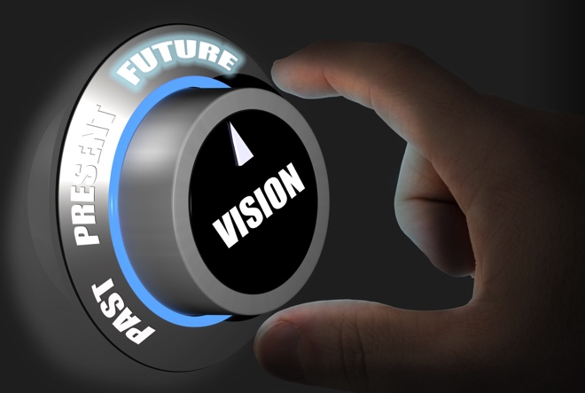
CAMBRIC
CAMBRIC stands for:
  Cloud Computing
  Artificial Intelligence
  Mobility
  Big Data
  Robotics
  Internet of Things
  CyberSecurity
How we think.

Slide 6
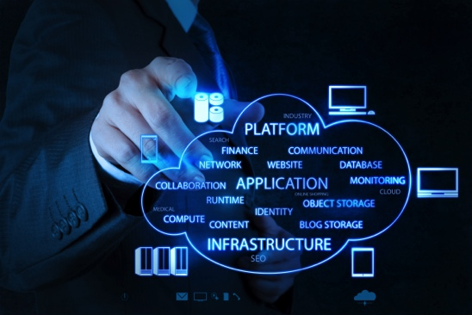
Cloud Computing
The Future of Cloud Computing:
Low cost, highly functional compute and storage available anywhere. Tiers of Clouds
Trends To The Future:
Efficiencies of this architecture are driving compute costs down
Agility of this model is helping innovators innovate and developers develop
New forms of Cloud Computing include ultra-small datacenters which can function as internal clouds
Most versatile small form-factor data centers can be bought in shipping containers and put anywhere
Open Questions:
Will the big cloud providers be monopolies?
Will the future Internet be “walled gardens?
How will nations settle data retention disputes?
How we think.

Slide 7
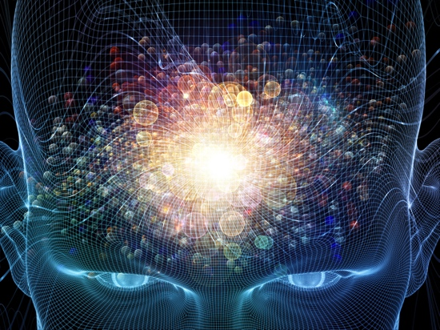
Artificial Intelligence
The Future of Artificial Intelligence:
Computer software assists people in every function and totally displaces many human jobs, across all industries and disciplines.
Trends To The Future:
With business models returning profit now, all indications are AI is here to stay
AI and Machine Learning are being coupled with incredibly low cost cloud computing
No accepted protocol for security in AI. Creators use a “generate and test” approach to creating functionality.
Open Questions:
Will job displacement be a crisis?
Will companies use AI for good?
Will there ever be a widely-accepted security framework for AI?
Can behavioral analytics enhance security?
How we think.

Slide 8
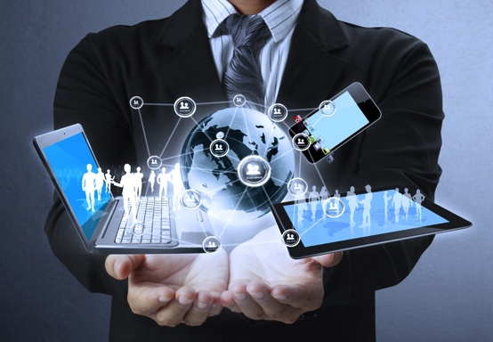
Mobility
The Future of Mobility:
All humans connected anywhere on the planet. Irreversible change to all cultures.
Trends To The Future
A connected supercomputer
With 100's of sensors and millions of applications which can fuel and support use cases we have yet to begin to imagine
User location and its history becomes the ultimate biometric
Enterprises must serve mobile users and mobile employees, and watch for mobile threats
Open Questions:
Will the eyes and ears be the most used senses for mobile devices?
How will dictatorships react?
What is the impact on privacy?
What use cases will dominate?
How will enterprises shift?
How we think.

Slide 9
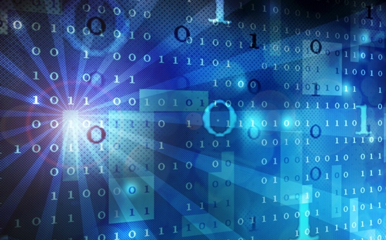
Big Data
The Future of Big Data:
We will always create more data than we can deal with. Will need to be analyzed everywhere.
Trends To The Future:
Estimates of 1 Trillion sensors by 2020
Breakthrough methodologies and new scalable data approaches based around Hadoop hold great promise in sensemaking over large data sets.
Sensemaking is key to success in most all other technology advancements.
Ethical considerations around privacy and security over data will only grow.
Open Questions:
Can there be widely accepted ethical frameworks for data and its use?
Who will individual citizens trust to analyze their personal, home, auto data?
Can behavioral analytics enhance service and security?
How we think.

Slide 10
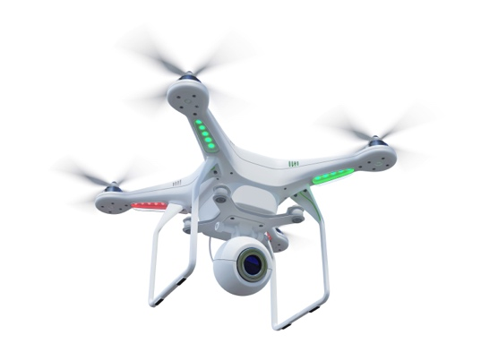
Robotics
The Future of Robotics:
We have seen the future, with robotic cars, boats, subs, workers, companions here now.
Trends To The Future:
They save lives in hospitals, are taking the place of humans in dangerous jobs, improve our oil exploration and farming, endure the hazards of outer space and now fight our wars. Soon they will make driving safe.
Like AI, Robotics hold great potential to displace large portions of the global workforce.
Robotic factories are already causing a large shift of manufacturing back from China to the US and we expect that trend to continue (but the bad news is that new robotic plants employ far fewer people).
Open Questions:
Will job displacement be a crisis?
How hard will it be to deceive robots? Will that make hacking even easier?
What is the role of behavioral analytics in detecting normalcy in robots?
How we think.

Slide 11
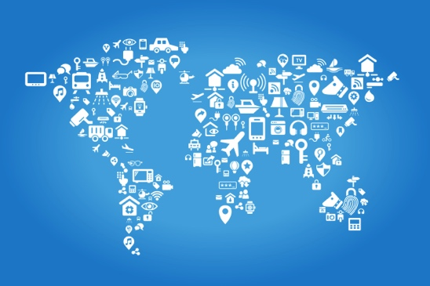
Internet of Things
The Future of the Internet of Things:
The benefits of having everything connected and generating and processing data will touch every aspect of our work and lives. But it will also bring criminals into contact with everything dear to us.
Trends To The Future:
Largely enabled by embedded computing devices and ubiquitous communications
IoT reaches to vehicles, robots, homes, towns and cities, commerce, manufacturing and every aspect of industry.
Use cases are expected to include enhancements to education, training, safety, security, healthcare, transportation and optimized manufacturing.
Open Questions:
Do you believe this will be any more secure than our current systems?
How can we optimize distributed processors when they are idle?
What transmission protocols will rule?
What will normal be? What is role of behavioral analytics?
How we think.

Slide 12
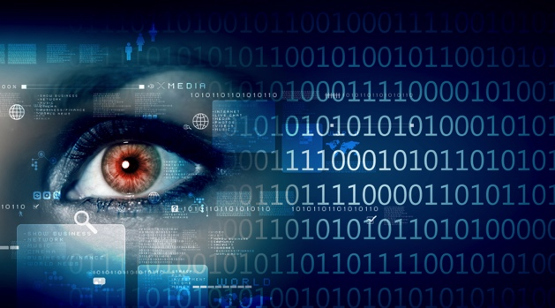
CyberSecurity
The Future of Cybersecurity:
In the future, cybersecurity will be like watching a rodeo. Sometimes the rider will ride and sometimes the rider will be thrown.
Trends To The Future:
Some of humanity's greatest thinkers, business leaders and computer scientists have struggled to enhance cyber security. Their approaches are not working.
Cybersecurity will have to advance or none of these other technologies will be optimized.
Cybersecurity is especially important because of the newfound complexity arising in our systems.
Behavioral analytics is seen as a promising approach to enhancing our response
Open Questions:
Are we sleepwalking into a preventable catastrophe?
Will it be easier to trick future systems?
Will any organization be able to defend itself without help?
What is the role of behavioral analytics?
How we think.

Slide 13
The Impact of These Trends
We use acronym CAMBRIC as a mnemonic to help make these seven technology disciplines easier to think through together. When you think of one of them think of them all, and consider the potential impacts of these technologies when used together.
  Cloud Computing | Artificial Intelligence | Mobility | Big Data | Robotics | Internet of Things | CyberSecurity
How we think.

Slide 14
Some Benefits To Look Forward To
Better enabling mass collaboration on problems to generate solutions
Make the highest quality education a right accessible by all
Enhancing the ability to leverage data to solve issues of poverty, healthcare, the economy and issues of war and peace
Enable new business models across every industry
Improve safety in our everyday lives and in the workforce
Enable knowledge capture, which will enhance the continued advancement of humanity
Enhance the ability of law enforcement to fight violent crime
Improve healthcare and extend meaningful life
Enhanced security through behavioral analytics at multiple levels
How we think.

Slide 15
Some Risks To Avoid
Increase risks to individual privacy
Open up new methods for criminals to steal information
Increase risk of job displacement
Increase wealth inequality
Potentially new national security risks
Threat of out of control technology?
How we think.

Slide 16
Recommendations For You At Work
Organizational leaders should consider the impact of these on how you operate. Odds are very high that old processes will fail under the pressure of change. Anticipate how you will adjust.
Work in your organization to collectively address questions like:
  How might these technologies impact your business or organizational mission?
  How can you build an agile data management framework that enables you to make use of all data at your disposal, including new formats and sources you have never anticipated?
  How can you mitigate risks to your mission in a world where there will never be perfect security?
  Can you leverage new behavioral analytics approaches to enhance security?
How we think.

Slide 17
Recommendations For You At Home
We should all also work to anticipate how we will need to adjust our personal and career goals and strategies.
For example, ask yourself:
  How might these technologies work together in other ways to impact your personal life and the life of your family?
  What should you do now to improve your career or mentor others to better prepare themselves for the future?
The most important thing we can do as individuals is to understand we have a personal responsibility to learn and to continually educate ourselves. Those of us with technical training have a special responsibility to learn and to help others understand.
Technologists should also help society think through the many ethical dimensions of how these new technologies will be applied. Intelligent discussion on an ethical framework around these technologies is clearly needed.
How we think.

Slide 18
Contact Us
Bob Gourley bob.gourley@cognitiocorp.com
              Twitter: @bobgourley
              Twitter: @CognitioCorp
              On-line: ThreatBrief.com
              On-line: CTOVision.com
Cognitio Corp
1750 Tysons Blvd, Ste 1500
McLean, VA 22102
(703)738-0068
How we think.

Slide 19
How we think.

