Slide 1
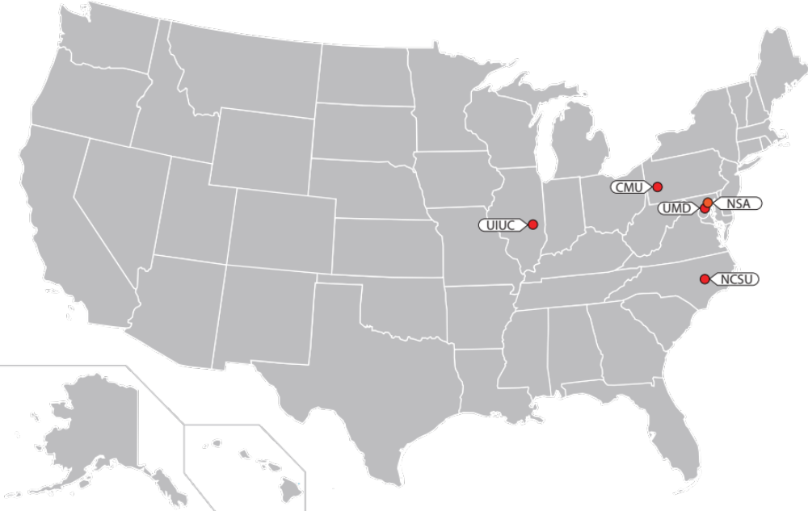
Science of Security Lablets

Slide 2


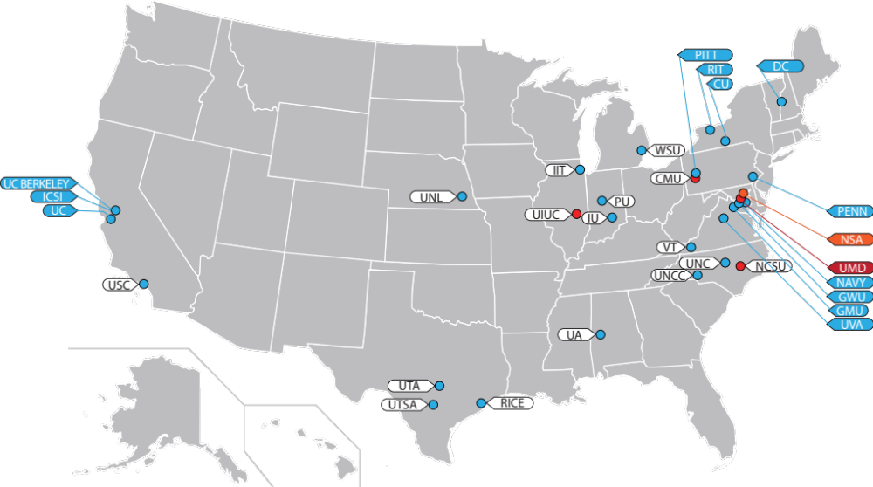
Science of Security Lablets & Sub-Lablets

Slide 3
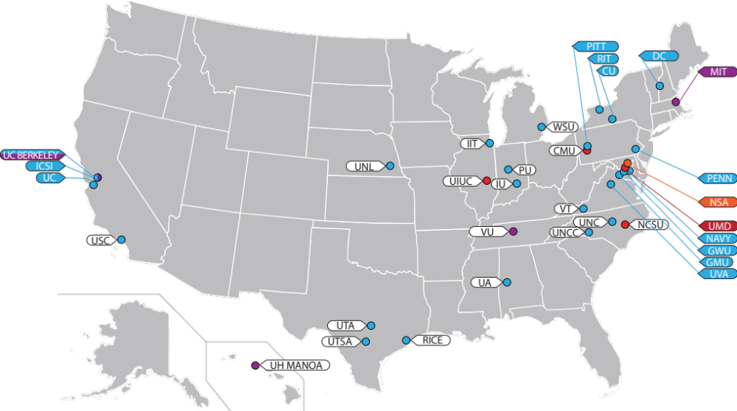
Science of Security Lablets, Sub-Lablets and SURE

Slide 4
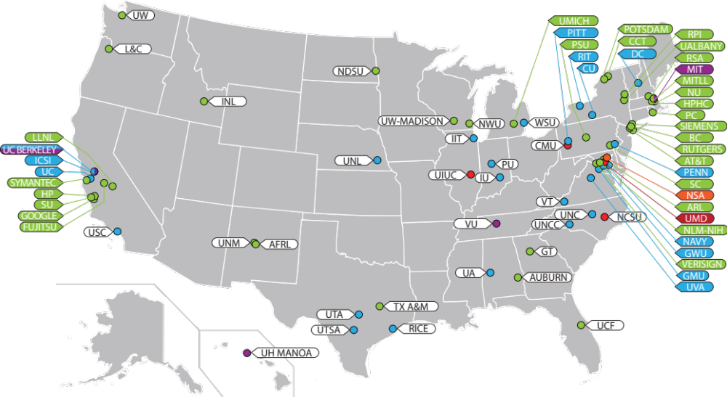
Science of Security Lablets, Sub-Lablets, SURE and Collaborators

Slide 5
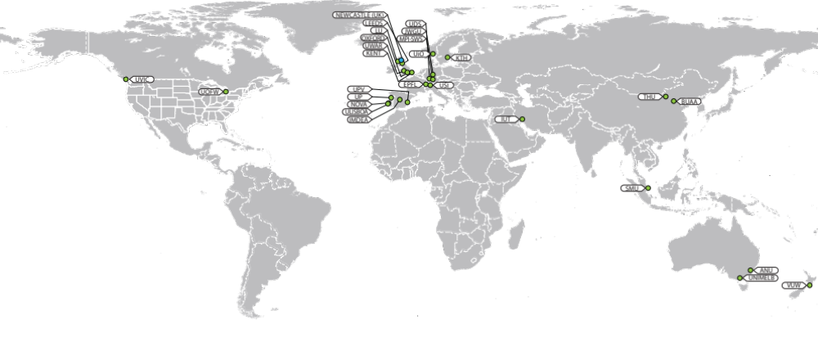
Science of Security International Sub-Lablets and Collaborators

Slide 6
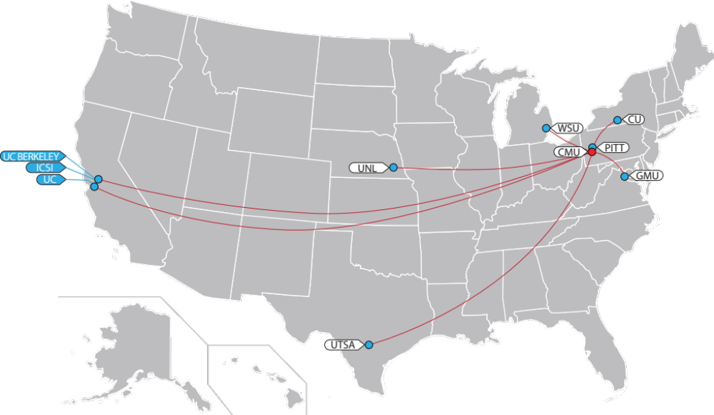
Carnegie Melon University Lablet & Sub-Lablets

Slide 7
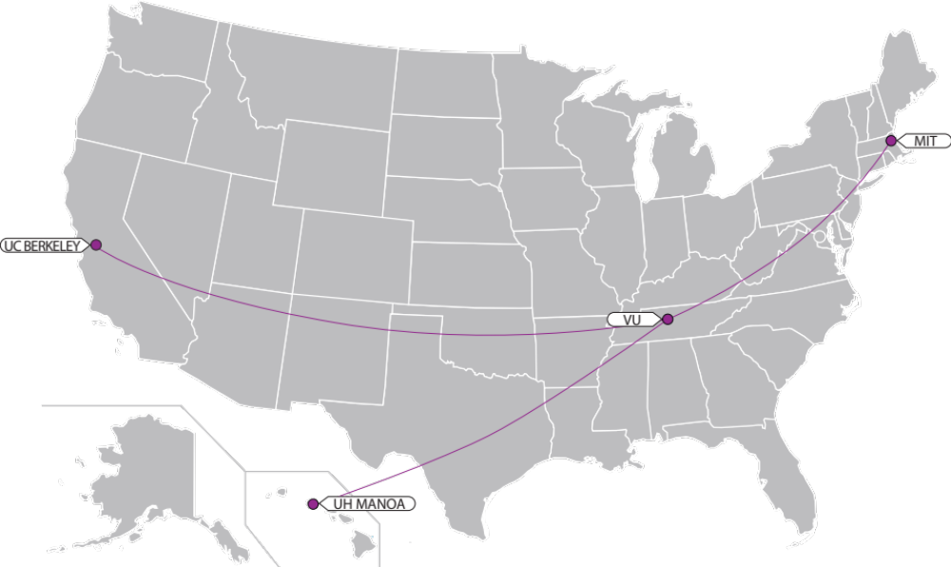

Science of SecUre and REsilient CPS Project Locations

Slide 8
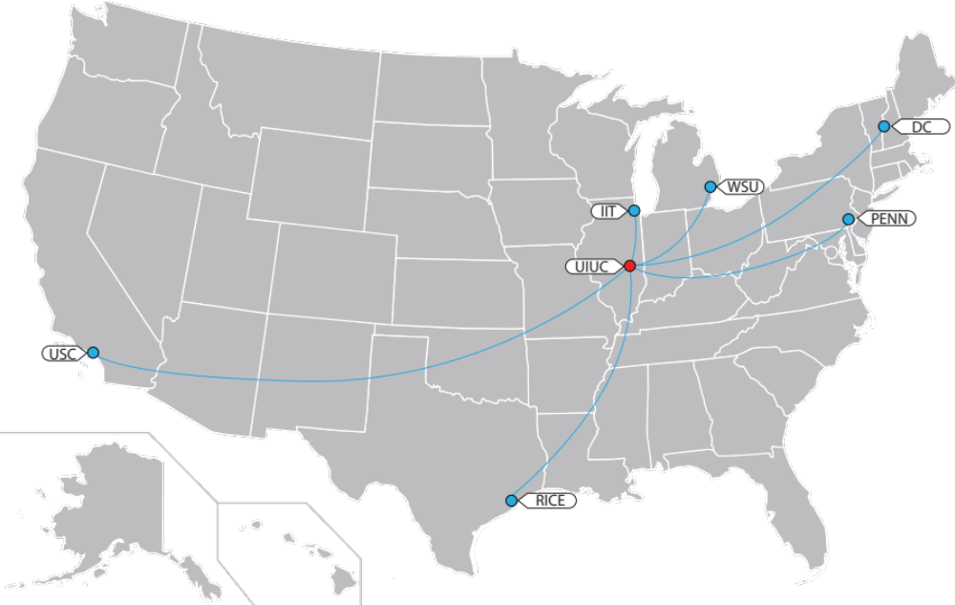
University of Illinois at Urbana-Champaign Lablet & Sub-Lablets

Slide 9
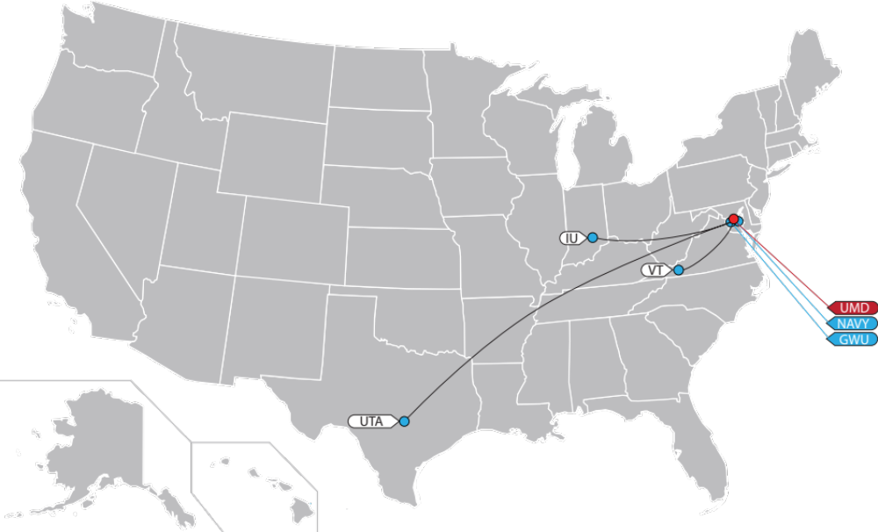
University of Maryland Lablet & Sub-Lablets

Slide 10
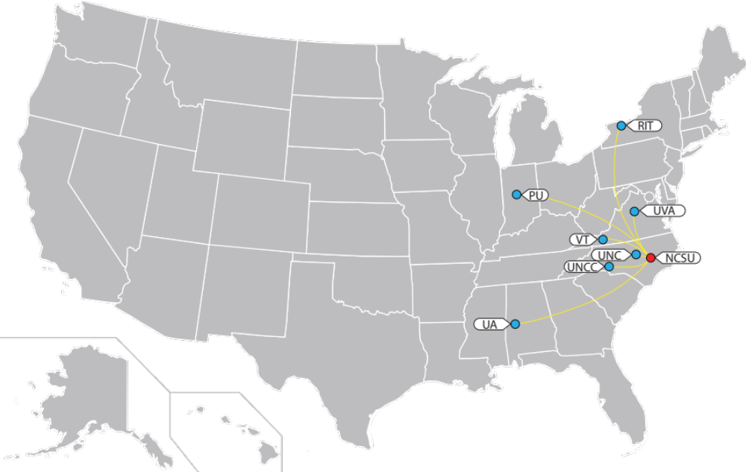
North Carolina State University Lablet & Sub-Lablets

Slide 11
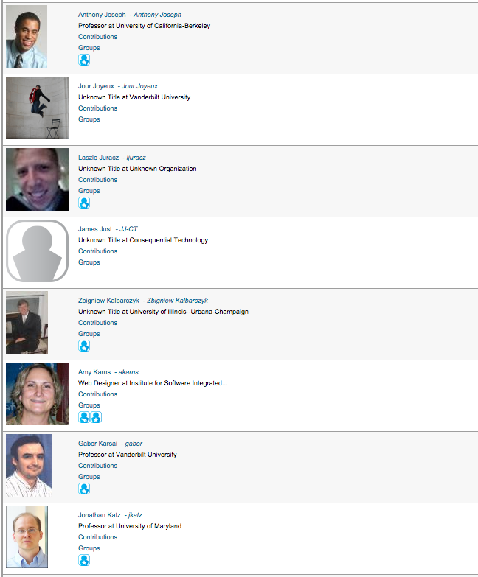
Get Your Profile Picture Taken Here!

