Slide 1
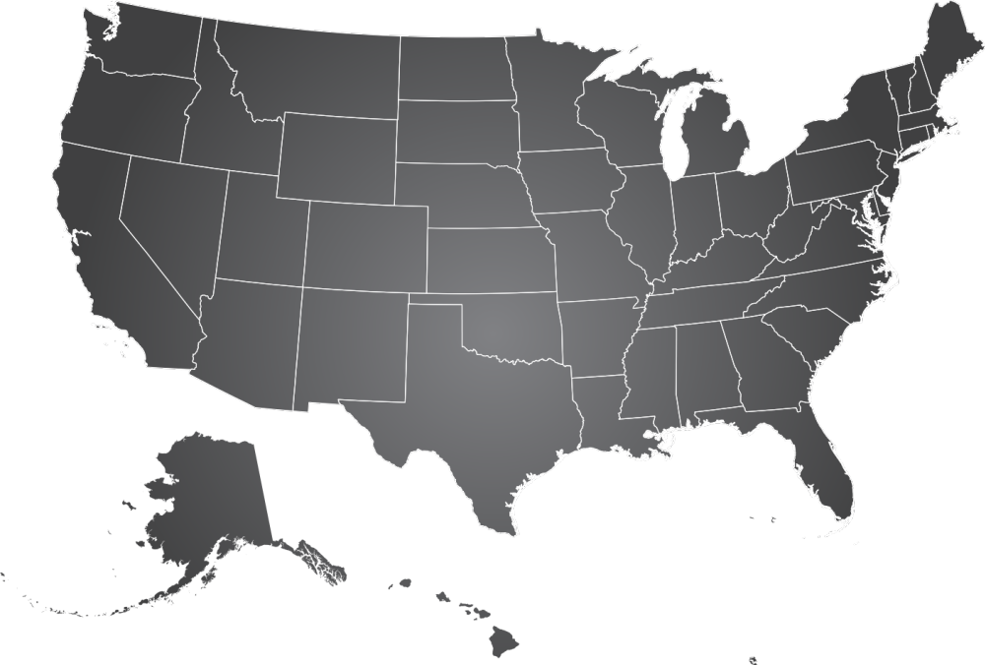

Science of Security Research Locations
CMU
UMD
UIUC
NCSU
LABLET (4)

Slide 2

Science of Security Research Locations
UK
UoN
DC
RIT
WSU
CU
IIT
PENN
PITT
CMU
UNL
PU
UMD
UC
BERKELEY
UC
UIUC
IU
GMU
UVA
NAVY
VT
UNC
NCSU
GWU
USC
UNCC
UA
UTA
UTSA
RICE
LABLET (4)
SUB-LABLET (25)

Slide 3

Science of Security Research Locations
UK
UoN
DC
RIT
MIT
WSU
CU
IIT
PENN
PITT
CMU
UNL
PU
UMD
UC
BERKELEY
UC
UIUC
IU
GMU
UVA
NAVY
VT
UNC
NCSU
GWU
VU
UNCC
USC
UA
UTA
UTSA
RICE
LABLET (4)
UH Manoa
SUB-LABLET (25)
SURE (4)

Slide 4

Science of Security Research Locations
UK
UoN
POTSDAM
CU
DC
RSA
RIT
MIT
UW
NWU
WSU
CU
MITLL
IIT
PENN
BC
AT&T
SIEMENS
RUTGERS
PITT
CMU
UNL
PU
UMD
UC
BERKELEY
UC
UIUC
IU
GMU
UVA
NAVY
VT
ARL
UNC
NCSU
GWU
VU
UNCC
USC
UNM
AFRL
UA
AUBURN
TEXAS A&M
UTA
UTSA
RICE
UCF
LABLET (4)
SUB-LABLET (25)
UH Manoa
SURE (4)
COLLABORATORS (49)

Slide 5
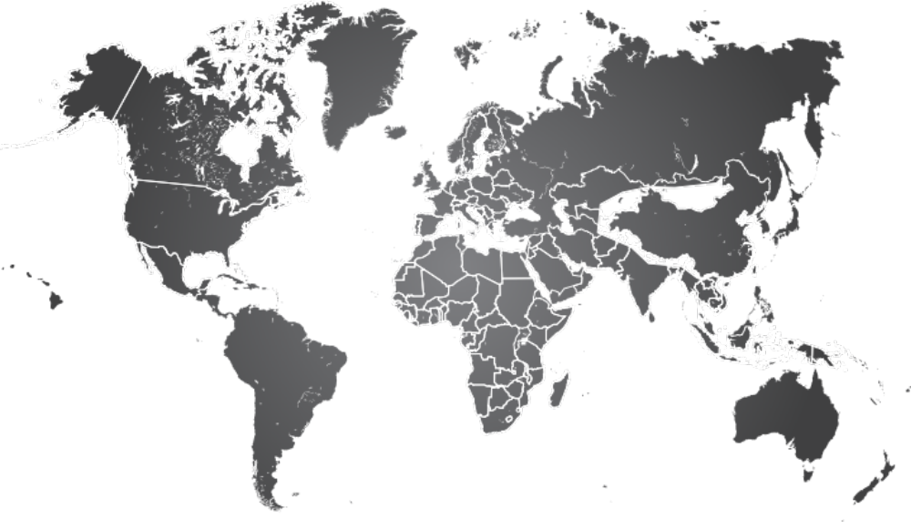
International Science of Security Research Locations
UWAR
UL
OXFORD
KENT
LU
UNDA
UiO
UVic
IMDEA
UOFW
UDS
EPFL
THU
UP
UNL
UPV
???
IUT
UH Manoa
SMU
LABLET (4)
UNIMELB
SUB-LABLET (25)
VUW
SURE (4)
COLLABORATORS (49)

