Slide 1
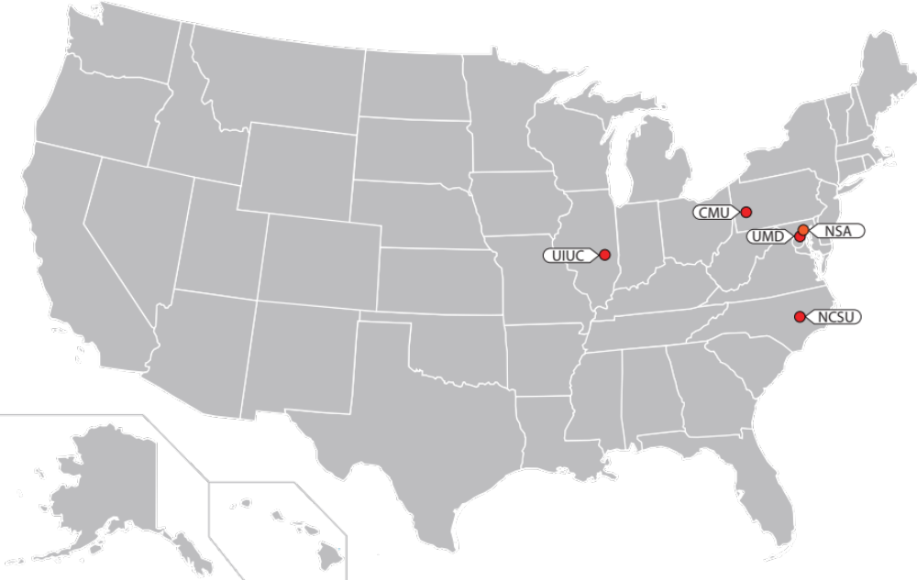
Science of Security Lablets
CARNEGIE MELLON UNIVERSITY
Lead PIs:
Bill Scherlis
Jonathan Aldrich
NORTH CAROLINA STATE UNIVERSITY
Lead PIs:
Laurie Williams
Munindar Singh
UNIVERSITY OF ILLINOIS URBANA-CHAMPAIGN
Lead PI:
David Nicol
UNIVERSITY OF MARYLAND
Lead PI:
Jonathan Katz
http://sos-vo.org/map

Slide 2
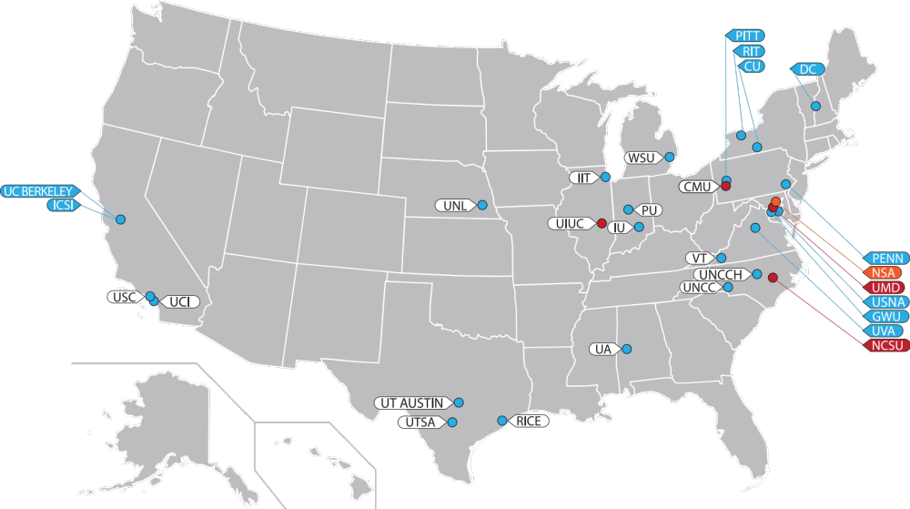
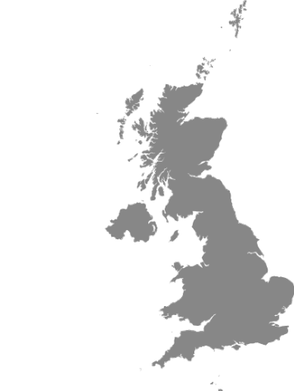
Science of Security Lablets and Sub-Lablets
CARNEGIE MELLON UNIVERSITY
Lead PIs:
Bill Scherlis
Jonathan Aldrich
Sub-lablets:
Cornell University
George Mason University
International Computer Science Inst. at Berkeley
University of Pittsburgh
University of California – Berkeley
University of Texas – San Antonio
University of Nebraska Lincoln
NORTH CAROLINA STATE UNIVERSITY
Lead PIs:
Laurie Williams
Munindar Singh
Sub-lablets:
Purdue University
Rochester Institute of Technology
University of Alabama
University of North Carolina
University of North Carolina – Charlotte
University of Virginia
UNIVERSITY OF ILLINOIS URBANA-CHAMPAIGN
Lead PI:
David Nicol
Sub-lablets:
Dartmouth College
Illinois Institute of Technology
Newcastle University
Rice University
University of Pennsylvania
University of Southern California
Wayne State University
UNIVERSITY OF MARYLAND
Lead PI:
Jonathan Katz
Sub-lablets:
George Washington University
Indiana University
United States Naval Academy
University of Texas – Arlington
Virginia Polytechnic Institute and State University
http://sos-vo.org/map

Slide 3
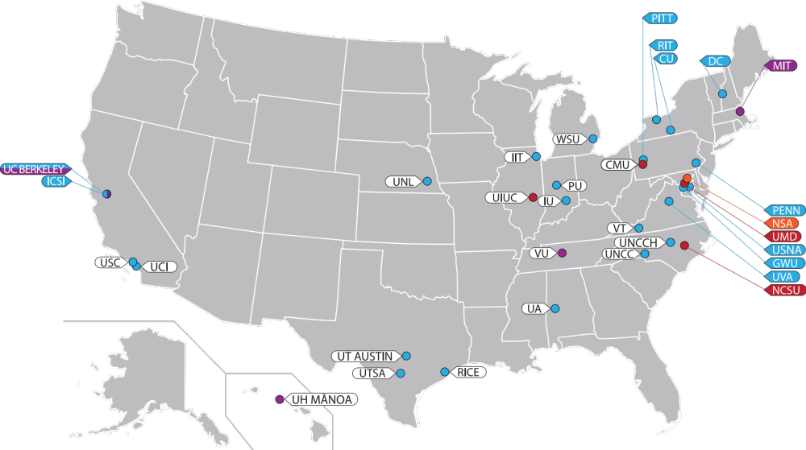
Science of Security Lablets, Sub-Lablets, and SURE
CARNEGIE MELLON UNIVERSITY
Lead PIs:
Bill Scherlis
Jonathan Aldrich
Sub-lablets:
Cornell University
George Mason University
International Computer Science Inst. at Berkeley
University of Pittsburgh
University of California – Berkeley
University of Texas – San Antonio
University of Nebraska Lincoln
NORTH CAROLINA STATE UNIVERSITY
Lead PIs:
Laurie Williams
Munindar Singh
Sub-lablets:
Purdue University
Rochester Institute of Technology
University of Alabama
University of North Carolina
University of North Carolina – Charlotte
University of Virginia
UNIVERSITY OF ILLINOIS URBANA-CHAMPAIGN
Lead PI:
David Nicol
Sub-lablets:
Dartmouth College
Illinois Institute of Technology
Newcastle University
Rice University
University of Pennsylvania
University of Southern California
Wayne State University
UNIVERSITY OF MARYLAND
Lead PI:
Jonathan Katz
Sub-lablets:
George Washington University
Indiana University
United States Naval Academy
University of Texas – Arlington
Virginia Polytechnic Institute and State University
SURE
Lead PI:
Xenofon Koutsoukos
Sub-lablets:
Massachusetts Institute of Technology
Vanderbilt University
University of California – Berkeley
University of Hawaii – Manoa
http://sos-vo.org/map

Slide 4
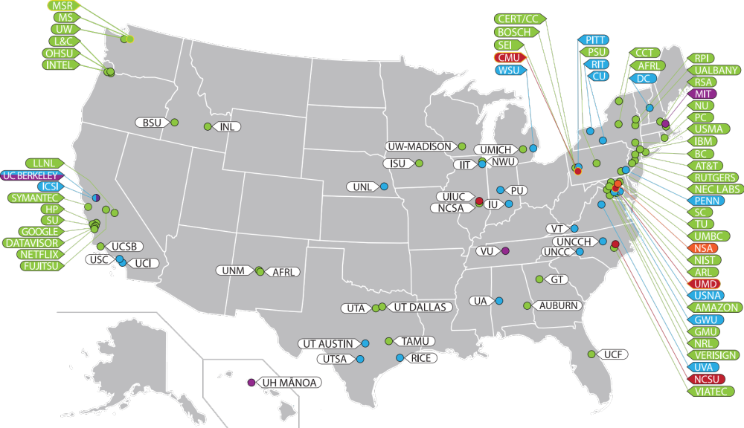
Science of Security Lablets, Sub-Lablets, SURE, and Collaborators
http://sos-vo.org/map

Slide 5
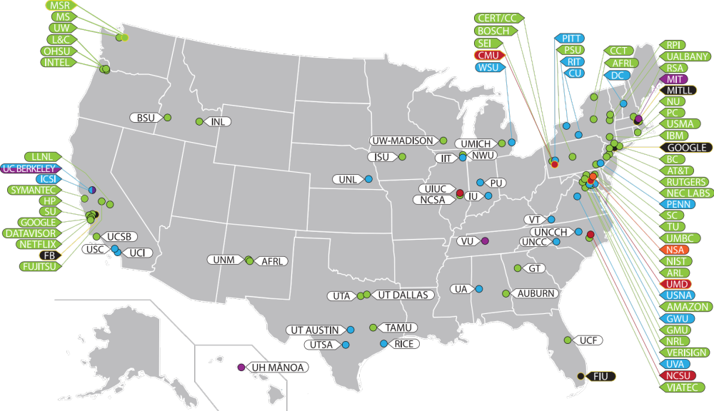
Science of Security Lablets, Sub-Lablets, SURE, Collaborators,
and Paper Competition Winners/Honorable Mentions
http://sos-vo.org/map

Slide 6
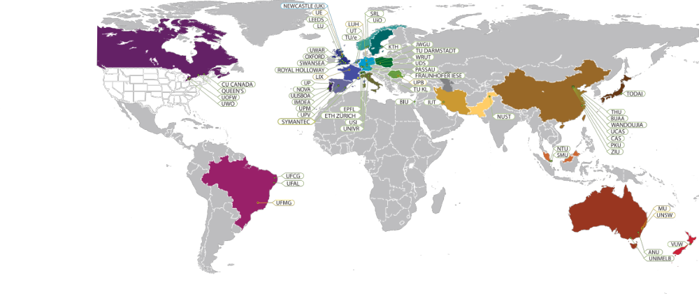
Science of Security International Locations
http://sos-vo.org/map

Slide 7
Science of Security Lablets and Sub-Lablets
CARNEGIE MELLON UNIVERSITY
Lead PIs:
Bill Scherlis
Jonathan Aldrich
Sub-lablets:
Cornell University
George Mason University
International Computer Science Inst. at Berkeley
University of Pittsburgh
University of California – Berkeley
University of Texas – San Antonio
University of Nebraska Lincoln
NORTH CAROLINA STATE UNIVERSITY
Lead PIs:
Laurie Williams
Munindar Singh
Sub-lablets:
Purdue University
Rochester Institute of Technology
University of Alabama
University of North Carolina
University of North Carolina – Charlotte
University of Virginia
UNIVERSITY OF ILLINOIS URBANA-CHAMPAIGN
Lead PI:
David Nicol
Sub-lablets:
Dartmouth College
Illinois Institute of Technology
Newcastle University
Rice University
University of Pennsylvania
University of Southern California
Wayne State University
UNIVERSITY OF MARYLAND
Lead PI:
Jonathan Katz
Sub-lablets:
George Washington University
Indiana University
United States Naval Academy
University of Texas – Arlington
Virginia Polytechnic Institute and State University
http://sos-vo.org/map

Slide 8
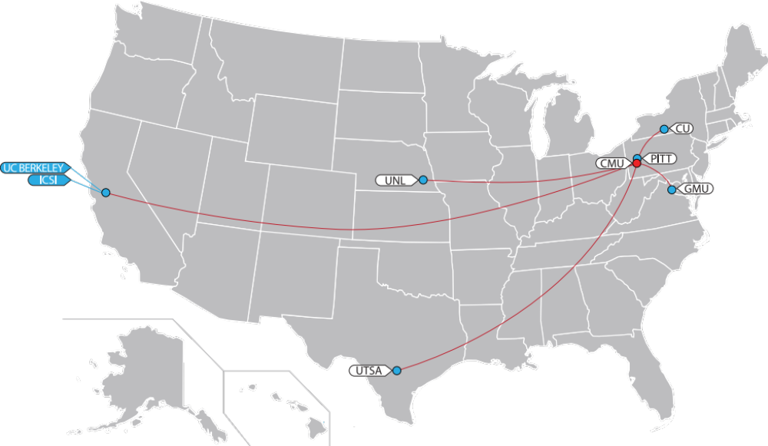
Carnegie Mellon University Lablet & Sub-Lablets
Lead PIs:
Bill Scherlis
Jonathan Aldrich
Sub-lablets:
Cornell University
George Mason University
International Computer Science Inst. at Berkeley
University of Pittsburgh
University of California – Berkeley
University of Texas – San Antonio
University of Nebraska Lincoln
http://sos-vo.org/map

Slide 9
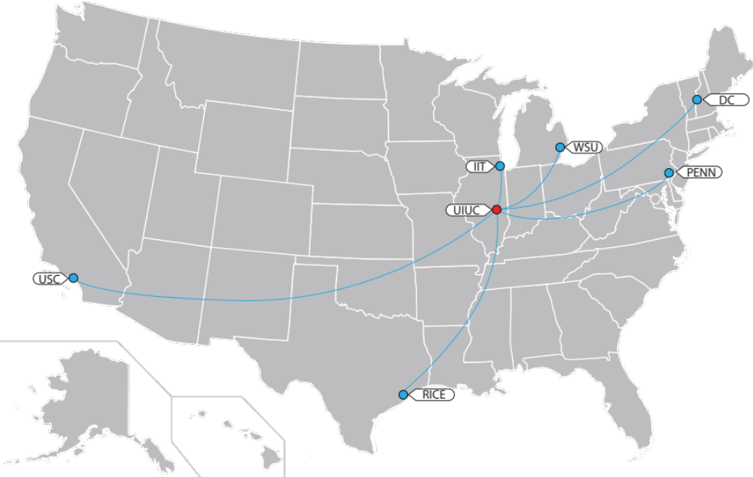

University of Illinois at Urbana-Champaign Lablet & Sub-Lablets
Lead PIs:
David Nicol
Sub-lablets:
Dartmouth College
Illinois Institute of Technology
Newcastle University
Rice University
University of Pennsylvania
University of Southern California
Wayne State University
http://sos-vo.org/map

Slide 10
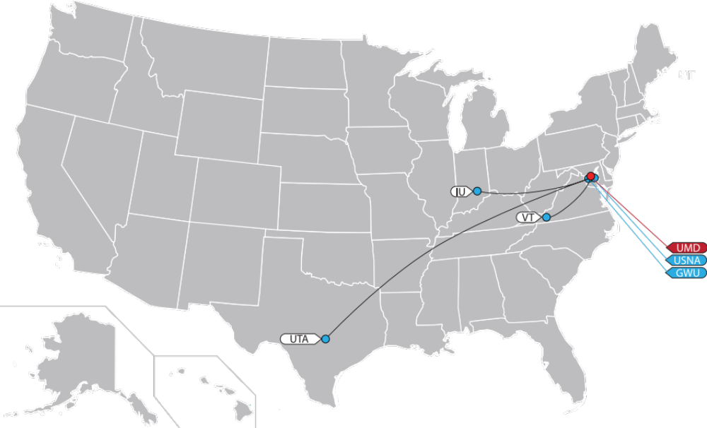
Lead PI:
Jonathan Katz
Sub-lablets:
George Washington University
Indiana University
United States Naval Academy
University of Texas – Arlington
Virginia Polytechnic Institute and State University
University of Maryland Lablet & Sub-Lablets
http://sos-vo.org/map

Slide 11
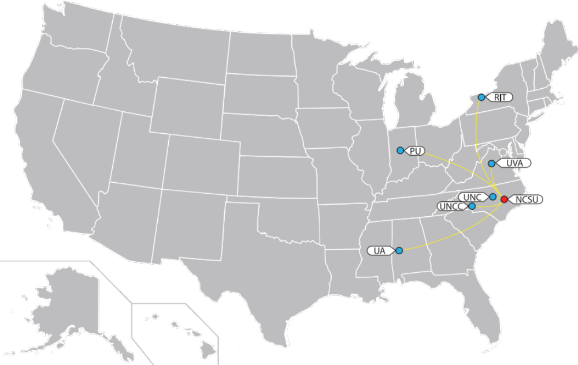
Lead PIs:
Laurie Williams
Munindar Singh
Sub-lablets:
Purdue University
Rochester Institute of Technology
University of Alabama
University of North Carolina
University of North Carolina – Charlotte
University of Virginia
North Carolina State University Lablet & Sub-Lablets
http://sos-vo.org/map

Slide 12
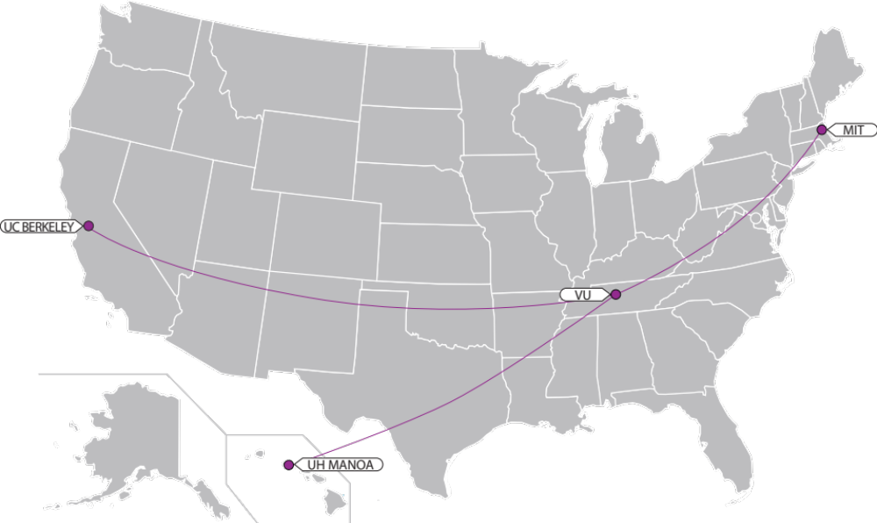
Science of SecUre and REsilient CPS Project Locations
Lead PI:
Xenofon Koutsoukos
Sub-lablets:
Massachusetts Institute of Technology
Vanderbilt University
University of California – Berkeley
University of Hawaii – Manoa
http://sos-vo.org/map

