Slide 1


APT Detection Using Belief Propagation on DNS Data
Alina Oprea and Zhou Li Peter Chin
RSA Laboratories Draper Laboratory
BU University
January 13th 2014

Slide 2





APT “Kill-Chain”
Command-and-Control
Download malware
Social Engineering
Lateral Movement
Data Exfiltration

Slide 3
Suspicious external connections
Command-and-Control
Download malware
Monitor external DNS queries to detect connections to suspicious domains
Command-and-Control
Lateral Movement
Data Exfiltration

Slide 4
Overview
Situational awareness
  Identify internal subnets, end hosts and servers
Data reduction and normalization
  Filter internal queries and queries made by servers
Profile typical host activity
  Domains contacted by each
  host during training month
Detect new, suspicious activity
  Belief propagation on bipartite
  graph with host-to-domain edges
  Start with set of known
  compromised hosts when available
  At each iteration, detect malicious domains
  and augment set of compromised hosts
Hosts
Domains

Slide 5
Situational awareness
No of unique domains (on 02-01): 735,562
No of unique source IPs (on 02-01): 83,472
Most popular domain: webb.bin (internal site)
Domain | No. hosts
hat.webb.bin | 22085
gig.webb.bin | 21560
baas.webb.bin | 17220
cot.webb.bin | 16572
weediest.webb.bin | 14157
ego.webb.bin | 11867
impregnates.webb.bin | 11845
skateboards.webb.bin | 11561
urey.webb.bin | 11376
decamped.webb.bin | 10880

Slide 6
Identify internal servers
Parse MX records to identify internal mail servers
Mail server | No. queries
252.90.88.52 | 30480
252.90.88.53 | 27020
252.90.88.28 | 8758
Identify internal DNS servers
DNS Server | No. queries generated | No. queries received
252.90.88.59 | 263519 | 5259406
252.90.88.58 | 258687 | 5149688
74.92.185.4 | 257164 | 48554974
74.92.185.33 | 54025 | 2550625
252.90.214.1 | 8069 | 5264109
74.92.251.88 | 3492 | 2851958
74.92.168.21 | 1644 | 389541

Slide 7
Data reduction and normalization
02-01
Filter queries to internal resources
Filter queries made by servers
Folding to third-level domain
Normalized representation daily:
For each host and folded domain keep list of query timestamps
For each domain store list of IP addresses to which it resolves
Domain names
Folded domains
r13---sn-p5qlsnel.c.youtube.com
as-api-elb-1971836622.us-west-2.elb.amazonaws.com
scontent-b-lga.xx.fbcdn.net
c.youtube.com
elb.amazonaws.com
xx.fbcdn.net
Notes:
- 400 MB for query_host and 500MB for resp_dom

Slide 8
Profiling external destinations
Profile domains visited by each host during training month
New domains: domains never visited before by any host
Unpopular domains: domains visited by a small number of hosts

Slide 9
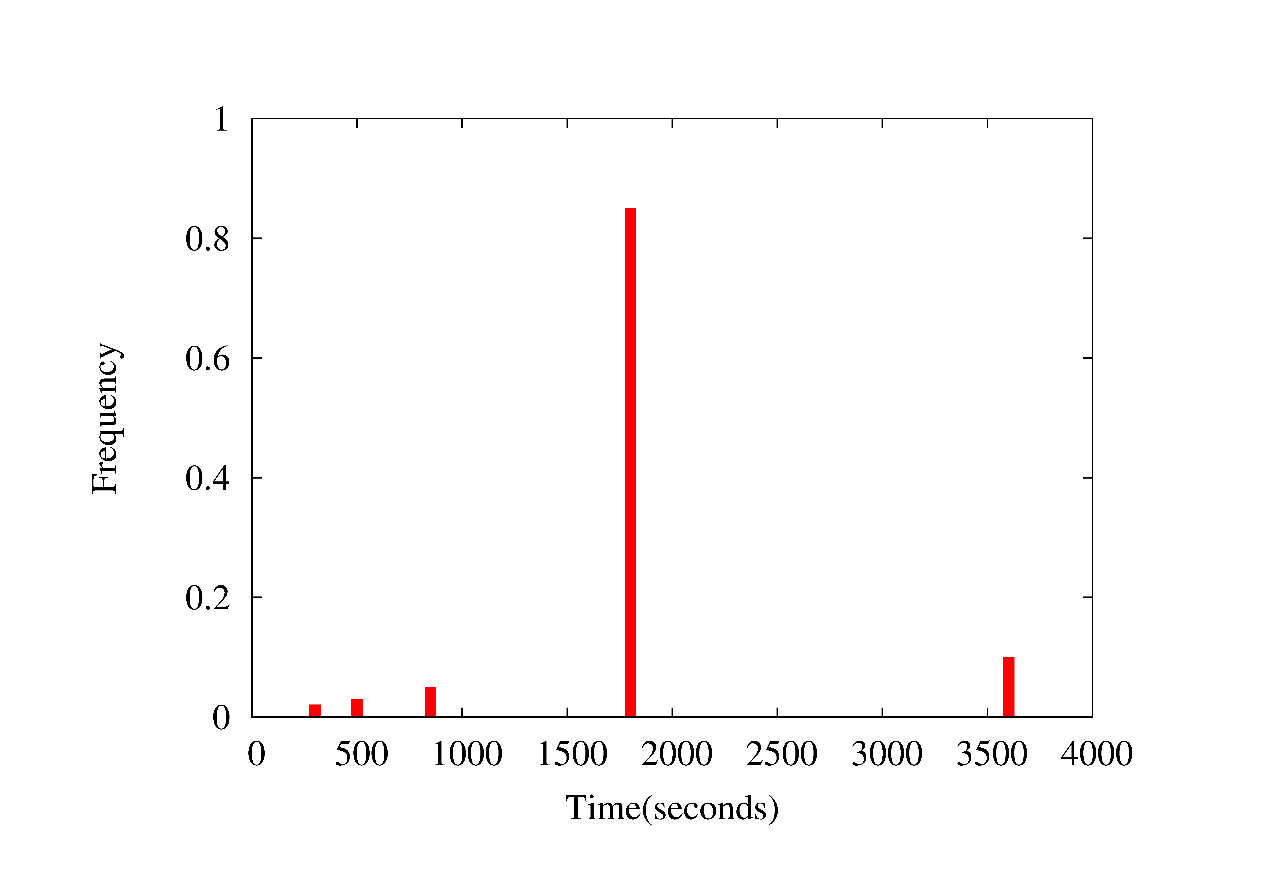
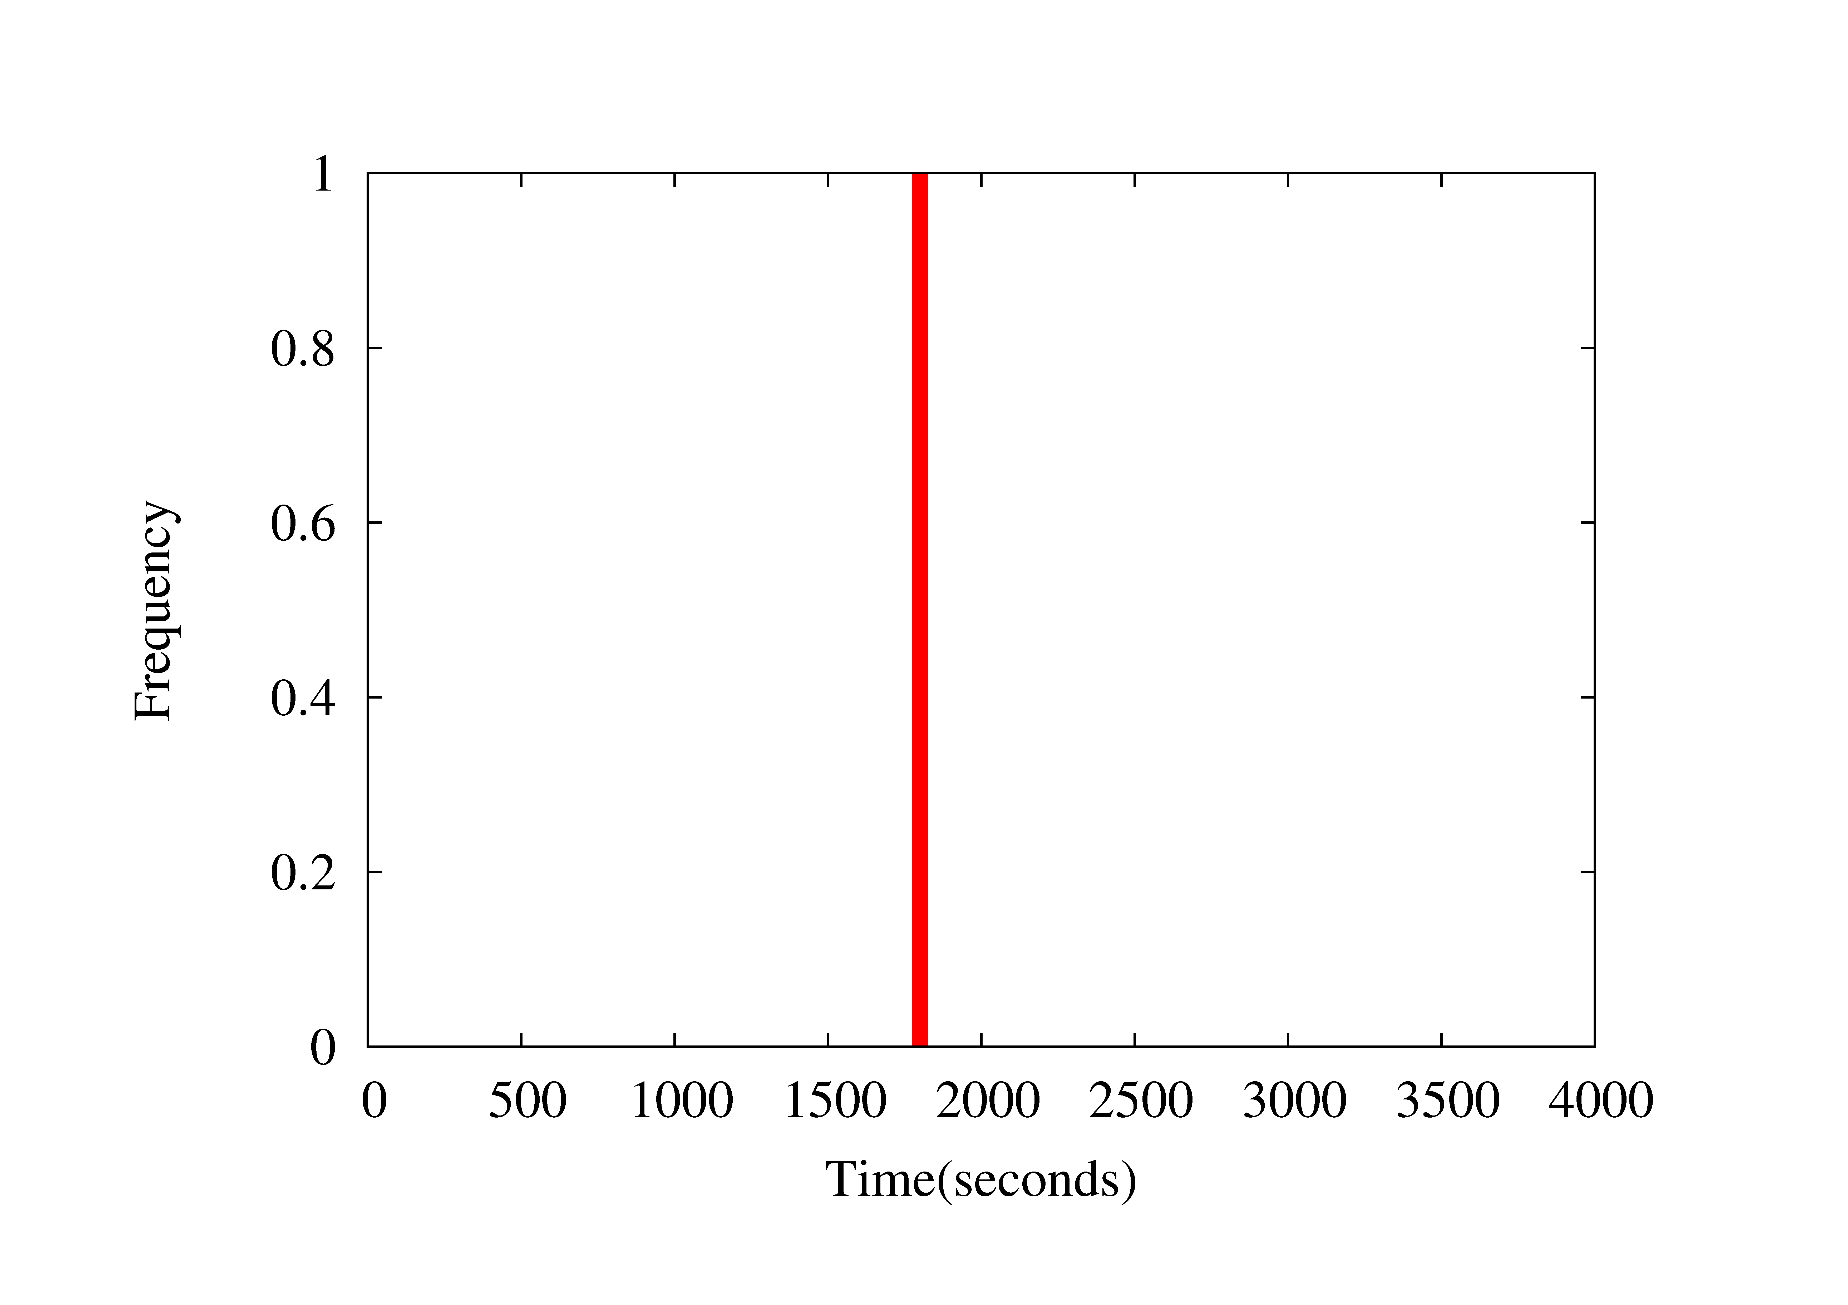

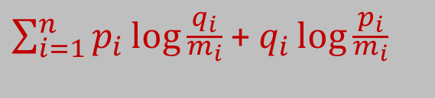
Detect suspicious domains
Consider new and unpopular domains
Identify automated activity (not human generated)
DNS query times from a host to a domain
7:30
8:00
8:30
9:30
9:59
10:05
10:35
11:05
11:35
Time
p_{i}
Inter-connection histogram
q_{i}
Periodic histogram
Jeffrey divergence:
$\sum_{i=1}^{n}{p_{i}\log{\frac{q_{i}}{\begin{aligned}m_{i} \\ \end{aligned}}}}$ + $q_{i}\log{\frac{p_{i}}{\begin{aligned}m_{i} \\ \end{aligned}}}$
$$m_{i}=(p_{i}+q_{i})/2$$

Slide 10
Case 1
New and unpopular domains contacted by compromised host
03-04
cot.ai65-x0kvt61ck0wh9.wad
aa8n-1tan7-289-9ts90*.wad
aqryo6cefn3.sharif.wad
ag3rramh8xygf2xs-8p.wad
atrvqg-8v.fiberglas.wad
aev4ewfd2.fifths.wad
seasick.adx0w0.don
shrdhost.mungled.wad
aqryo6cefn3.wad
viagra.adx0w0.don
glazes.mrsifor.in
grandfenagle.in
tut.adx0w0.don
cot.abtir.wad
7:26
10:24
10:56
11:07
11:21
15:04
16:24
Time
1. Beaconing at 19 minutes
2. Expand to domains contacted close in time

Slide 11
Case 2
New and unpopular domains with automated activities contacted by at least one compromised host
03-05
Hosts
Domains
74.92.98.236
bniely.rd
cot.abu2i.wad
andean.asebfray.wad
74.92.150.196
ajk3llkryfp0q-xuzz.wad
ar8tzyhw.fatality.wad
l8h.us
74.92.169.145
…
105 domains

Slide 12
Case 2
New and unpopular domains contacted by at least two compromised hosts
03-05
Hosts
Domains
74.92.98.236
bniely.rd
Beaconing at 59 minutes
74.92.150.196
austerfold.rd
74.92.169.145
pucker.a5sk3.rd

Slide 13
Case 2
But malicious domains could be contacted by only one host!
03-12
Hosts
Domains
74.92.56.31
flashforward.narc.dw
74.119.145.200
74.92.12.12
groverly.action.don
74.146.246.44
No beaconing!
74.92.32.119
westeros.action.don
74.92.32.72
74.146.246.44
Label malicious all domains in same /24 subnet with known malicious domain

Slide 14
Case 3 - Belief Propagation
03-19
Iteration 1
Hosts
Domains
rainbow-.c3
Beaconing at 10 minutes
74.92.144.170
191.146.166.145
fluttershy.c3
/24 subnet
252.90.88.2
191.146.166.31
74.92.144.27
74.92.144.31
Identify one or several malicious domains (beaconing)
Augment set of compromised hosts
Expand set of domains (new and unpopular domains)

Slide 15
Case 3 - Belief Propagation
03-19
Iteration 2
Hosts
Domains
Beaconing at 10 minutes
74.92.144.170
rainbow-.c3
fluttershy.c3
/24 subnet
252.90.88.2
pinkiepie.c3
Max score
74.92.144.27
74.92.144.31
Identify one or several malicious domains (max score)
Augment set of compromised hosts
Expand set of domains (new and unpopular domains)

Slide 16
Case 3 - Belief Propagation
03-19
Iteration 3
Hosts
Domains
Beaconing at 10 minutes
74.92.144.170
rainbow-.c3
fluttershy.c3
/24 subnet
252.90.88.2
pinkiepie.c3
74.92.144.27
applejack.c3
Max score
74.92.144.31
74.92.144.137
Identify one or several malicious domains (max score)
Augment set of compromised hosts
Expand set of domains (new and unpopular domains)
74.92.144.186

Slide 17
Computing domain score
Score is function of:
Similar /16 subnet with malicious domain
Timing correlation with known malicious domain
Overlap with set of malicious hosts
Timing correlation across hosts
2
No
Yes
Yes
Iteration 2
Hosts
Domains
16:16
74.92.144.170
rainbow-.c3
16:16
191.146.166.145
252.90.88.2
16:15
fluttershy.c3
74.92.144.27
191.146.166.31
16:15
74.92.144.31
pinkiepie.c3
93.31.34.158

Slide 18
Case 4
Start with new and unpopular domains with automated activities
Contacted by at least 2 hosts with similar inter-connection patterns
03-22
Hosts
Domains
otyugh.muck.don
Beaconing at 30 minutes
74.92.25.58
74.125.138.45
nalfeshnee.muck.don
Beaconing at 30 minutes
252.90.88.2
74.125.32.78
74.92.56.28
delver.h0
Overlap 4 hosts
Timing correlations
222.76.9.36
74.92.137.28
derrick.formian.h0
/24 subnet
222.76.9.42
74.92.171.7
phasm.rd
Overlap 3 hosts
Timing correlations
New and unpopular
Automated
453 domains
220.236.25.18
New and unpopular
40 domains
New and unpopular
39 domains
74.92.92.140

Slide 19
Challenge Summary
Case 1
  New and unpopular domains with beaconing activity contacted by compromised host
  Expand with other new and unpopular domains contacted close in time
Case 2
  New and unpopular domains contacted by at least 2 compromised hosts
  Consider new domains per host, in addition to globally new
  Other domains with IP address in same /24 subnet as a malicious domain

Slide 20
Challenge Summary
Case 3
  Belief propagation algorithm, start with compromised host
  Label malicious either beaconing domain or domain of maximum score among all new and unpopular domains contacted by set of compromised hosts
  Score is function of 4 features:
    Overlap with set of compromised hosts
    IP address with similar /16 subnet as malicious domain
    Timing correlation across hosts
    Timing correlation with malicious domain
  Augment set of compromised hosts with those contacting newly labeled malicious domains and iterate
Case 4
  Start with new and unpopular beaconing domains contacted by at least 2 hosts with similar distribution
  Apply belief propagation algorithm from case 3

Slide 21
Results
Case | True Positives | False Positives | False Negatives
Case 1 | 12 | 2 | 0
Case 2 | 21 | 1 | 1
Case 3 | 24 | 0 | 0
Case 4 | 5 | 0 | 0
Total | 62 | 3 | 1

