Slide 1



UNCLASSIFIED // Distribution Unlimited
ARL Science of CyberSecurity: Needs and Approach
Dr. Robert F. Erbacher
Network Security Branch
U.S. Army Research Laboratory
UNCLASSIFIED // Distribution Unlimited

Slide 2
Data Scale
50+ TB of data
  Goal is 500+ TB
  50+ CNDSP customers
300+ sensors
Millions of IPs

Slide 3
Advanced Persistent Threat
Main research goal:
Support analysis of advanced persistent threat
Automate analysis of other threats
  Automated alert fusion and correlation
Novel techniques to support this process
  Intrusion detection
Visualization
  Longer term goal
  Improve display and interpretation of alerts

Slide 4

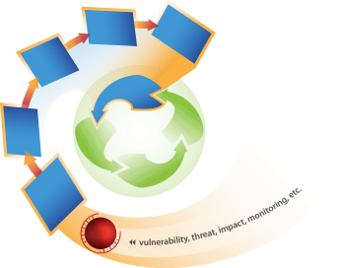
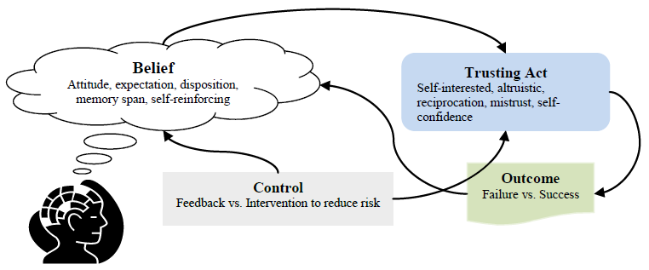
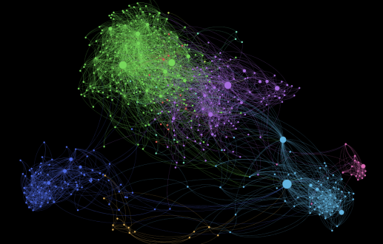

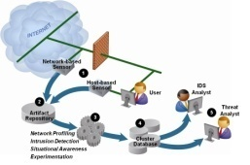
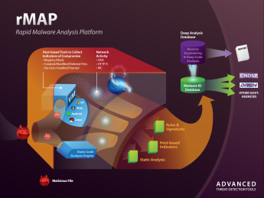
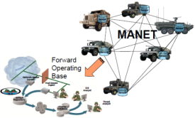
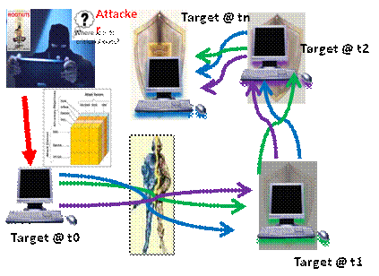
ARL Cyber Research Portfolio
Network Metrics
Trust in Networks
Network Sensing
Intrusion Understanding
Adversarial Dynamics
Advanced Detection
Defense of Complex Networks
Cyber
Maneuver

Slide 5
Characteristic Problems in Science of Cyber
The science of (cyber)security is a study
of relations between policy, attacker, and defender
Policy P: a set of assertions about what event
should and should not happen. To simplify, focus
on incidents I: events that should not happen.
Defender D: a model / description of defender’s defensive tools and techniques Td, and operational assets, networks and systems Nd
Attacker A: a model / description of attacker’s
tools and techniques Ta

Slide 6
Characteristic Problems in Science of Cyber (2)
Then, science of cyber is to seek models
of relations between I, Td, Nd, Ta:
    (I, Td, Nd, Ta) = 0
Note: The above does not mean I expect to see a fundamental equation of this form. It is merely a shorthand for models that relate I, Td, Nd, Ta
Similar perspective in:
Schneider, F. B., “Blueprint for a Science of Cybersecurity,” The Next Wave, Vol. 19, No.2, 2012
Bau, J., and Mitchell, J.C., “Security Modeling and Analysis ,” Security & Privacy, IEEE, May-June 2011

Slide 7
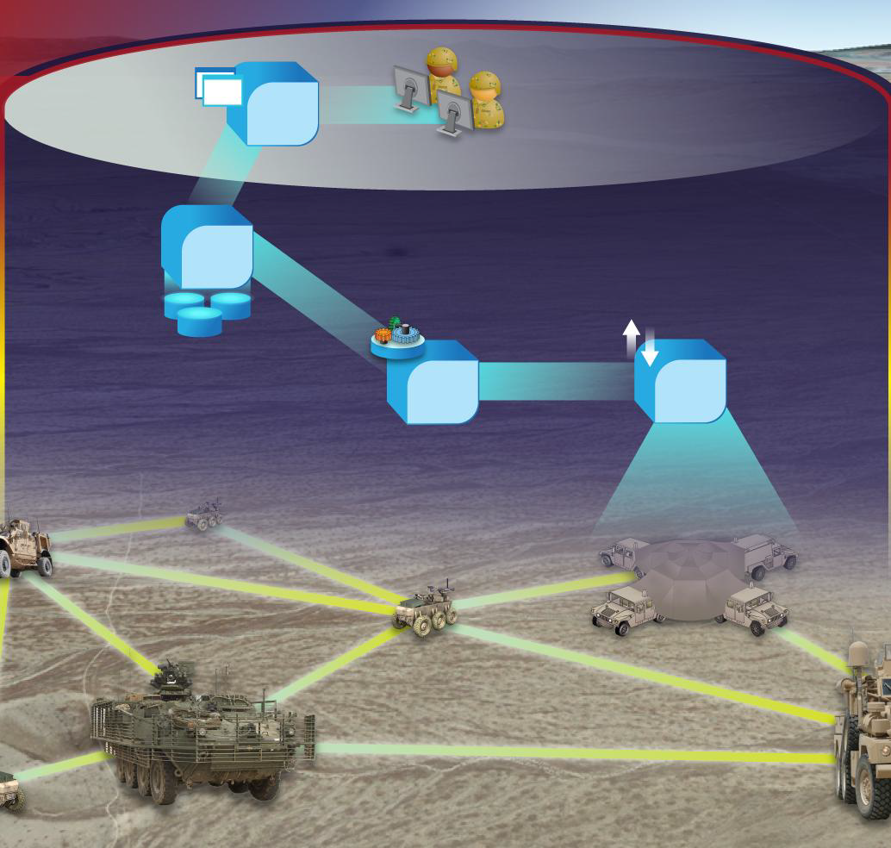
Example: Intrusion Detection for Converged & Mobile Tactical Networks
Research Issues:
How to utilize minimum resources to transmit intrusion data and achieve high detection rate?
How to accelerate filtering and pattern matching while preserving detection rates?
Are there suitable sampling and
in-network aggregation techniques?
Can we perform an information theoretic evaluation of detection accuracy in bandwidth-restricted environments?
How to empirically characterize loss of detection accuracy in bandwidth-restricted environments?
Analysis
Data
Computation
Ingest
Sensor
Sensor
Sensor
Sensor
Sensor

Slide 8
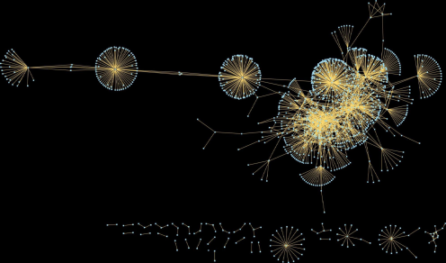
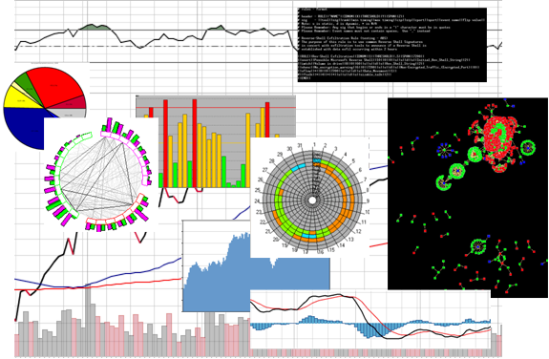
Example: Aggregation &
Visualization for Anticipation of Attacks
Research Issues:
Why are attempts to develop effective visualizations for cyber defense so unsuccessful?
Is there a better way to do quantitative user-independent evaluation of cyber defense visualization techniques?
Does the cyber analyst need a broader network context, and what could it be?
Can we leverage neuroscience?
  Are there better way to aggregate information for better anomaly detection by human analyst?
Notes:
8

Slide 9
Aggregation & Visualization for Intrusion Analyst
Technical Objectives:
Approaches to aggregation of alerts that are consistent with cognitive needs of the analysts
Discovery of barriers to adoption of visual aids via quantitative objective evaluation
of cyber analysis visualization techniques
Technical Approaches:
Adapt neuroscience based saliency
( with Itti, USC)
  Investigation of effects of alert aggregation
  Explore the paradigm of fine-grain characterization to improve detection accuracy (with Arbaugh, UMD)
  Prior Accomplishments:
  Prototyped innovative network visualizations to support anomaly detection
  Developed Interrogator Alert Correlation tool
Notes:
9

Slide 10
Intrusion
Detection
Nd, Ta, I → Td
Synthesis & characterization of tools
& techniques for incident detection
& prevention
Including
  Synthesis of IDS & IPS
  Techniques of intrusion analysis
  & defense

Slide 11
Cyber Maneuver
If Td = {STd, BTd(t)}, where BTd(t) is defender’s behavior & actions,
Then Nd, Ta, I → BTd(t) is the problem
of synthesis & control of defenders course of action
Including
  Network operations
  Damage control
  Cyber maneuver
  Moving target defense

Slide 12
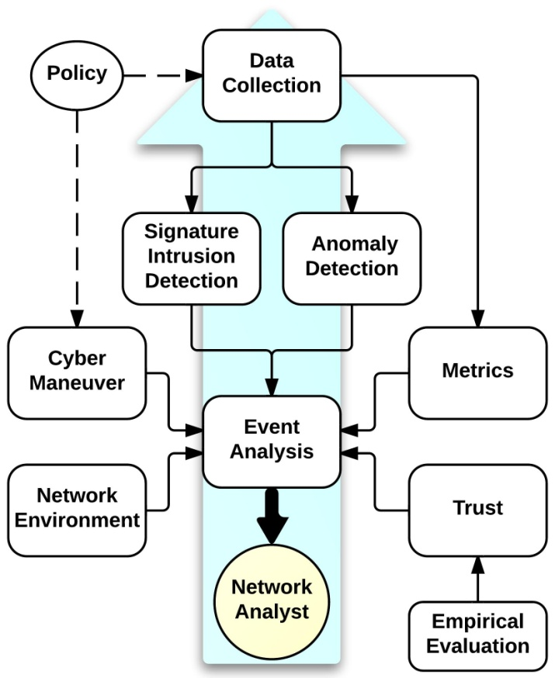
Unified Intra-CyberSecurity Theory

Slide 13
Conclusions
As a research area, Cyber Science can be defined by a coherent,
linked set of characteristic problem classes
These classes inform the needs for general models that would
comprise Cyber Science
Priorities of US national science & technology leadership focus
on important subset of these classes
Much of the current research in Cyber Science are in early
“observation” phase of scientific method:
  Exploratory point solutions serve accumulation of observations
  Leading to formulation of rigorous hypothesis & models
Maturation of Cyber Science will see emergence of models that:
  Are informed by observations gained in practice of cyber defense
  Address significantly general subsets of the characteristic problem classes
  Are at least partially theoretically grounded
  Are empirically validated

Slide 14
Joint Research
Collaboration with universities
  Cooperative agreements
  Expand research capabilities
Post-docs, Summer Faculty, Senior Researchers
  Research area: Science of Cyber Security
  ORAU:
  http://www.orau.org/arlpostdocfellowship/applicants/cisd/cisd-science_cyber_security.html
  NRC: http://nrc58.nas.edu/RAPLab10/Opportunity/Opportunity.aspx?LabCode=76&ROPCD=763602&RONum=B7556
Interns, coops
US Citizens
Email me: Robert.F.Erbacher@us.army.mil
Robert.F.Erbacher.civ@mail.mil

