Slide 1
Access Control Policy Evolution: An Empirical Study
Access
Control
Policy
Application
Access Request
Policy
Evaluation
Engine
Response
JeeHyun Hwang, Laurie Williams, and Mladen Vouk
Notes:
Good morning, everybody. Thank you for attending to my final oral examination. My dissertation title is “Improving the Quality of Security Polices”

Slide 2
Access Control Policy Evolution
Policy change is inevitable
Permissions (“what” actions) change over time are the driver for access control policy evolution.
Policy Change
New security requirements emerge
The business environment changes
New computers and resources are added
Repair policy faults
Other
Notes:
Evolution
The stage in a software system’s life cycle where it is in operational use and is evolving as new requirements are proposed and implemented in the system.

Slide 3
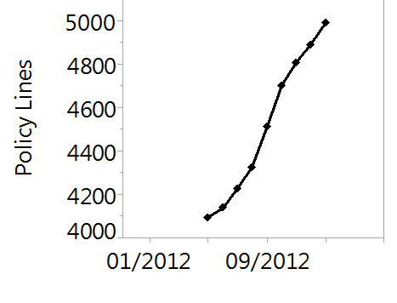
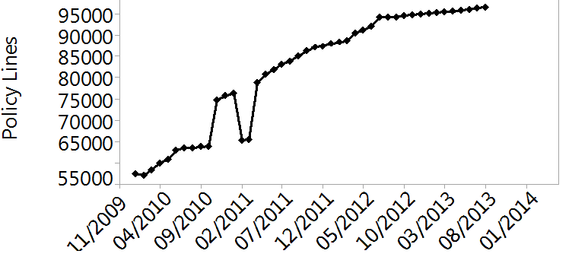
Empirical Observations
Open Source
Private Cloud
NCSU Virtual Computing Lab (VCL) operation policy
SELinux reference policy
  Growth vs Change
    Growth along policy evolution appears to be more or less linear
    Policy changes frequently
      # policy revisions: 5,489 (SELinux) and 896 (VCL)
      # permission changes: 2,714 (SELinux) and 7 (VCL)
Notes:
My hypothesis is that there is still a lot of room for growth: new drivers, file systems, architectures.
Also, the bandwagon is very popular right now. IBM, Dell and other heavyweights are strongly committed to Linux (including support).

Slide 4
Empirical Observations
Open Source
Private Cloud
NCSU Virtual Computing Lab (VCL) operation policy
SELinux reference policy
  Growth vs Change
    Growth along policy evolution appears to be more or less linear
    Policy changes frequently
      # policy revisions: 5,489 (SELinux) and 896 (VCL)
      # permission changes: 2,714 (SELinux) and 7 (VCL)
Notes:
My hypothesis is that there is still a lot of room for growth: new drivers, file systems, architectures.
Also, the bandwagon is very popular right now. IBM, Dell and other heavyweights are strongly committed to Linux (including support).

Slide 5
Policy Change Patterns
Policy | # Permission Changes | # Frequent Patterns | %Coverage
SELinux (Folder Permission) | 1222 | 5 | 86
VCL | 7 | 1 | 100
Some of permissions are related and assigned together
  read, Ioctl, lock to read a folder
Some of the evolution patterns appear to occur more frequently
  Five evolution patterns covered 86% (SELinux) and one evolution pattern covered 100% (VCL)
  For example, in SELinux, one pattern happened 568 times (46%) out of the total number of folder permission changes
Notes:
We next present our pattern mining research project.
Mining is the process for extracting previously unknown patterns from large data. What we did was this.
We used an existing mining approach to find common patterns in specifying and maintaining security policies. I will explain our approach and mined patterns at the next slide.
Some may have a question - why patterns are related to the quality of security policies?
Previous research work showed that patterns help identify suspicious behaviors such as attacks, credit card suspicious transactions . Like this research work, we find patterns to identify violations of patterns as candidates for inspection.

Slide 6
Conclusion and Future Work
An empirical study of the evolution of access control policies of the two systems: SELinux and VCL
  Frequently policy changes
  # policy lines of policies increased more or less linearly over time
  Some of evolution patterns occured more frequently
Our future work
  Mine patterns of policy changes
  Study why policies evolve
  Develop tools that help correctly change policies

