Slide 1
Assurance Cases
Software Engineering Institute
Carnegie Mellon University
Pittsburgh, PA 15213
Charles B. Weinstock
January 26, 2015
Notes:
Title Slide
Title and Subtitle text blocks should not be moved from their position if at all possible.

Slide 2
Copyright 2015 Carnegie Mellon University
This material is based upon work funded and supported by the Department of Defense under Contract No. FA8721-05-C-0003 with Carnegie Mellon University for the operation of the Software Engineering Institute, a federally funded research and development center.
NO WARRANTY. THIS CARNEGIE MELLON UNIVERSITY AND SOFTWARE ENGINEERING INSTITUTE MATERIAL IS FURNISHED ON AN “AS-IS” BASIS. CARNEGIE MELLON UNIVERSITY MAKES NO WARRANTIES OF ANY KIND, EITHER EXPRESSED OR IMPLIED, AS TO ANY MATTER INCLUDING, BUT NOT LIMITED TO, WARRANTY OF FITNESS FOR PURPOSE OR MERCHANTABILITY, EXCLUSIVITY, OR RESULTS OBTAINED FROM USE OF THE MATERIAL. CARNEGIE MELLON UNIVERSITY DOES NOT MAKE ANY WARRANTY OF ANY KIND WITH RESPECT TO FREEDOM FROM PATENT, TRADEMARK, OR COPYRIGHT INFRINGEMENT.
This material has been approved for public release and unlimited distribution.
This material may be reproduced in its entirety, without modification, and freely distributed in written or electronic form without requesting formal permission. Permission is required for any other use. Requests for permission should be directed to the Software Engineering Institute at permission@sei.cmu.edu.
DM-0002075

Slide 3
Overview
Maturity of Assurance Cases
ISO 15026-2 Assurance Case Standard
Goal Structured Notation
Example from Industry
Confidence Work at the SEI
Other Current Work on Assurance Cases
Closing Thoughts

Slide 4
Maturity of Assurance Case Technology
Developed in late 90s in Europe
Used for safety cases in Europe for over 20 years
The UK Ministry of Defence requires generation of a compelling case to support claims that specific safety requirements are met:
  “The safety case shall consist of a structured argument, supported by a
  body of evidence, that provides a compelling, comprehensible and valid case that a system is safe for a given application in a given operating environment.” [DEFSTAN 00-56 (Part 1)/4]
ISO standard under development (ISO 15026-2)
NRC Report: “Software for Dependable Systems: Sufficient Evidence?”

Slide 5
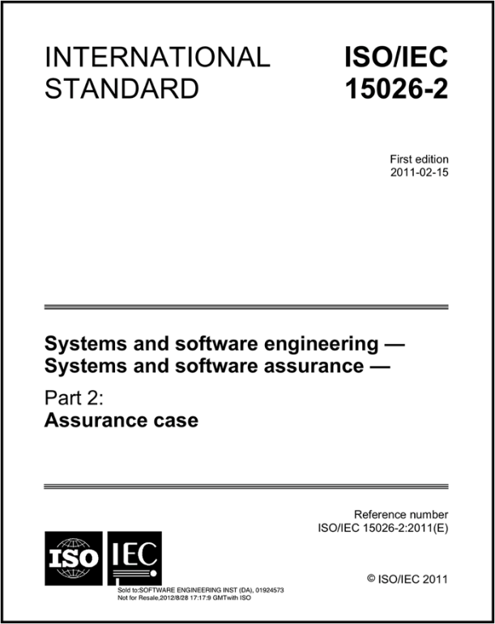
ISO/IEC 15026-2: Assurance Case
Claim: A proposition to be assured (e.g., “The system is safe”)
Evidence: A fact, datum, object, claim, or other assurance case
Argument: A reason why the set of evidence shows that the claim is true
Justification: A reason why a claim has been chosen
Assumption: A claim that appears as evidence
An Assurance Case is a quadruple a=(c,j,es,g) where c is a claim, j is a justification, es is a set of evidence, and g is an argument which assures c using es.
The assurance case is to be delivered and maintained with the system
This definition is recursive

Slide 6
Goal Structuring Notation (GSN) – Kelly 1998
A specific notation for an assurance case consistent with 15026-2.
Developed to help organize and structure safety cases in a readily reviewable form
Used successfully for over a decade to document safety cases for aircraft avionics, rail signaling, air traffic control, and nuclear reactor shutdown
Shows how claims are broken down into sub-claims,
and eventually supported by evidence or
while making clear the argumentation strategies adopted,
the rationale for the approach (assumptions, justifications)
and the context in which claims are stated
A/J

Slide 7
Example: Battery Exhaustion – Part One

Slide 8
Example: Battery Exhaustion – Part Two

Slide 9
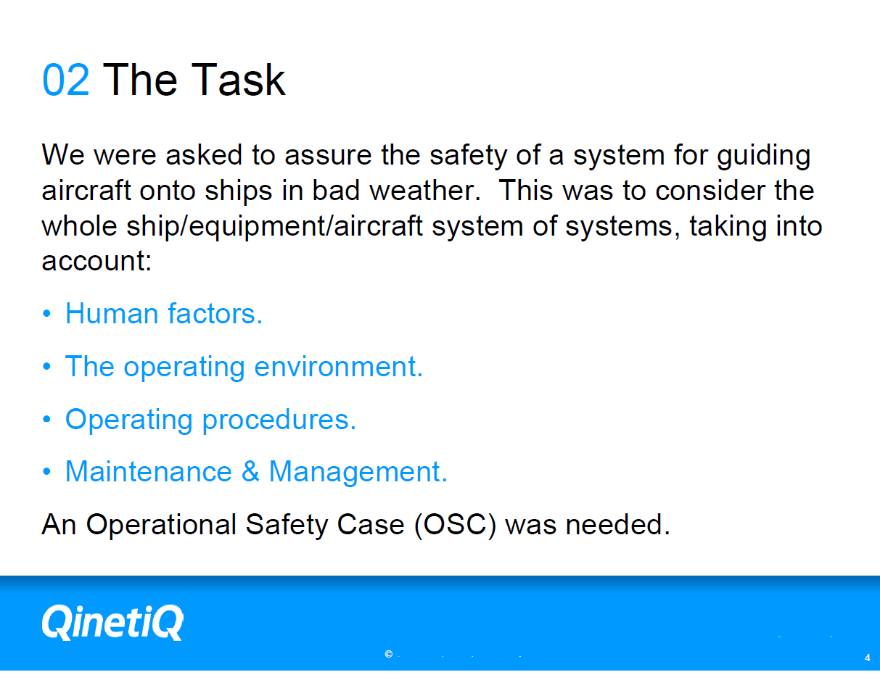
Extracted from “Assuring Operational Systems — A Safety Case Study” by Simon Di Nucci, Systems and Software Technology Conference, 2008

Slide 10
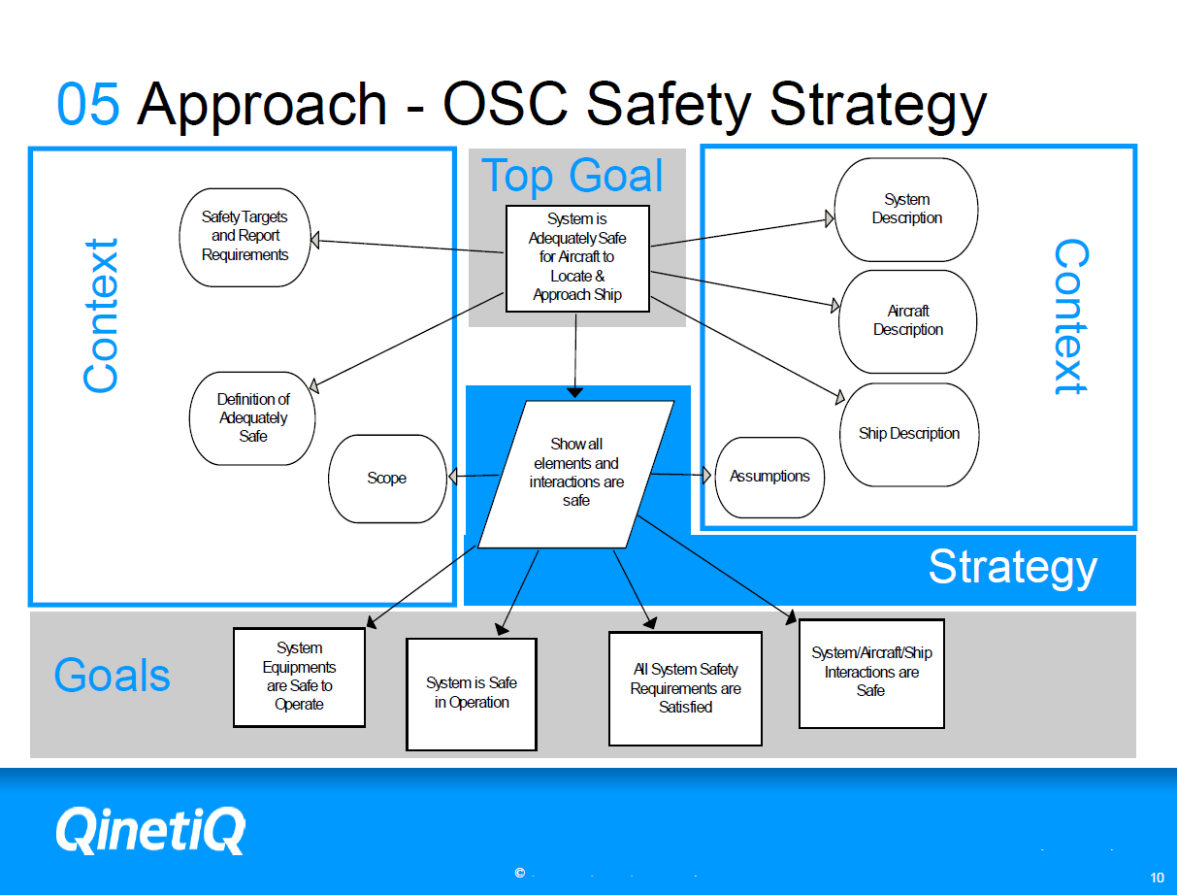
Extracted from “Assuring Operational Systems — A Safety Case Study” by Simon Di Nucci, Systems and Software Technology Conference, 2008

Slide 11
What confidence should be placed on an AC?
Given the evidence, how confident should we be in the claim C1? Why?
What does it mean to have confidence in the claim?
What could be done to improve confidence? Why?

Slide 12

The Basis for Confidence in a Claim
A classic philosophical problem:
  Justify belief in a hypothesis
Use Induction
  Enumerative: Support increases as confirming instances are found
?
Using past experience as the basis for predicting future behavior
Notes:
Justifying belief in a hypothesis is a classical philosophical problem of induction. One form of induction commonly used for this purpose is enumerative induction. In enumerative induction, …

Slide 13
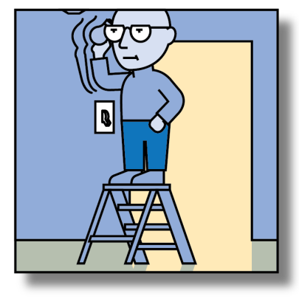
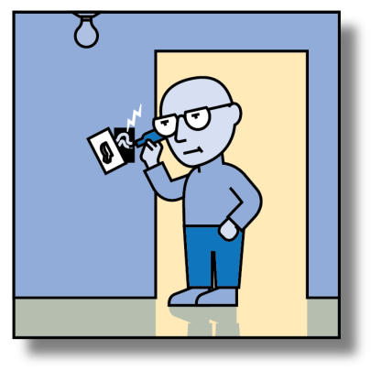
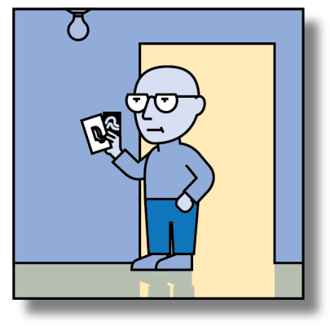
Eliminative Induction
Support for a claim increases as reasons for doubt are eliminated
CLAIM: The light turns on (when the switch is flicked).
Bulb OK?
Power?
Wired?
✓
✓
?
✓
Confidence increases as doubts are eliminated

Slide 14
What confidence should be placed on an AC?
How confident in C1? Why? (Number of uneliminated doubts)
What does it mean to have confidence? (Lack of doubt)
What could be done to improve confidence? Why? (Elim. more doubts)

Slide 15
A Small Example
Rebutting defeaters (R) attack claim validity
Inference rule (IR) for validating a claim
Undercutting defeaters (UC) attack rule sufficiency
Undermining defeaters (UM) attack evidence validity

Slide 16
Key Ideas
Confidence grows as doubts are identified and eliminated
  Doubts about a claim (rebutting defeater)
    Why claim may be invalid
  Doubts about evidence (undermining defeater)
    Why evidence may be invalid
  Doubts about reasoning (undercutting defeater)
    Premise ok; conclusion uncertain
Notes:
These are the only kinds of doubts needed in an eliminative argument

Slide 17
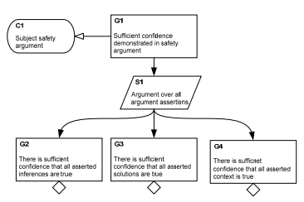
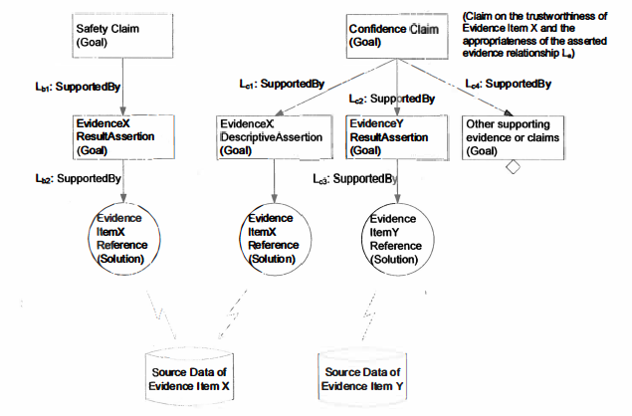
Other State of the Art
John Knight – University of Virginia
  Confidence cases: a confidence argument created in parallel to the safety argument that documents the confidence in the structure and basis of the safety argument.
Tim Kelly – University of York
  Evidence elaboration: modeling evidence to better understand it and its evaluation for the purpose of explicit integration of the source data of evidence and the safety case argument.

Slide 18
Concluding Thoughts
This has been a quick overview of assurance cases and confidence and an introduction to the concept eliminative argumentation as developed by the SEI.
  It is not a comprehensive review of all that is happening in the area.
  The SEI has been applying Baconian probabilities to confidence maps to show how much different portions of the argument contribute to overall confidence – something that may prove useful for incremental certification.
Assurance cases have been proven effective in the safety domain.
  The effectiveness of confidence cases and eliminative induction have yet to be demonstrated in practice.

Slide 19
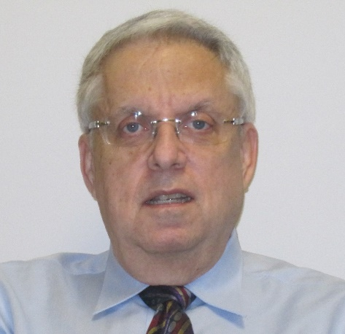
Contact Information
Charles B. Weinstock Principal Researcher Software Solutions Division Telephone: +1 412-268-7719 Email: weinstock@sei.cmu.edu | U.S. Mail Software Engineering Institute 4500 Fifth Avenue Pittsburgh, PA 15213-2612 USA

