Slide 1
Formal Methods and Certification
High Confidence Systems and Software
May 1, 2019
Lucas Wagner

Slide 2
Outline
DO-178B overview
DO-178C revisions and technology supplements
Product applications
  Synoptics
  Crew Alerting Systems
  Flight Controls
Questions

Slide 3
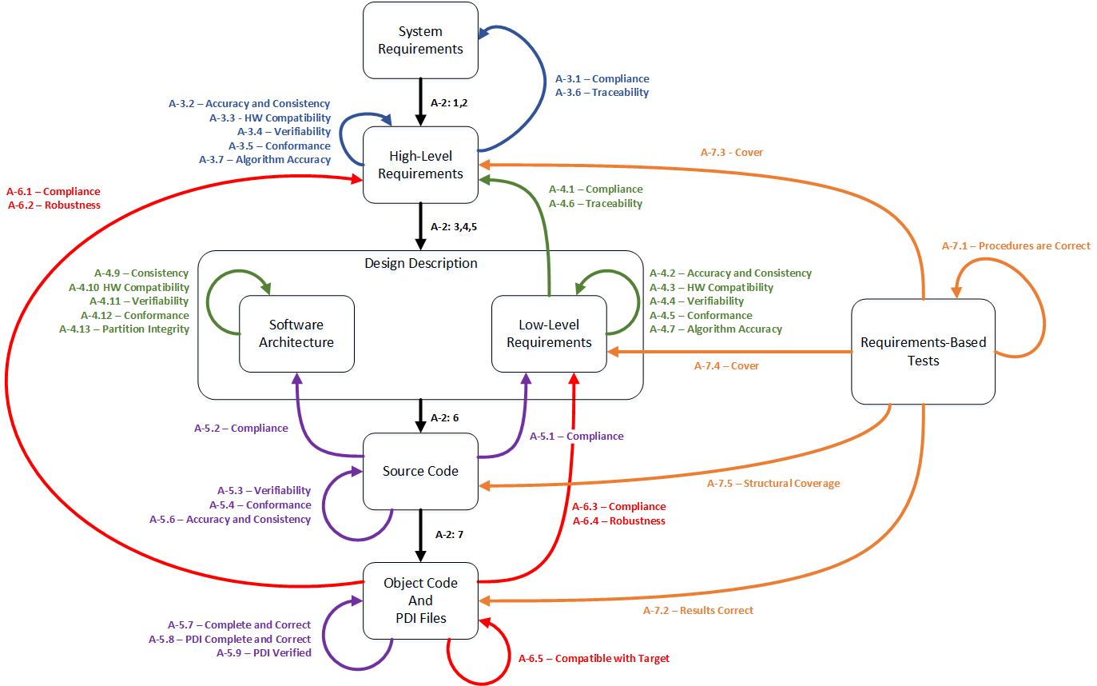
DO-178B: PROCESS-Based Certification
Flight critical software must be developed according to a pre-ordained process.
Developers must:
Develop artifacts (system requirements to object code)
Perform activities to ensure each artifact is correct
Test, test, test the object code
Analysis by formal methods was considered “alternative means of compliance”.
Notes:
DO-178C processes developed by Lucas Wagner

Slide 4


DO-178C: A revision ENABLING Formal methods
DO-178B
Airborne
DO-278
Ground
DO-178C
Airborne
DO-278A
Ground
DO-248B
Support
DO-248C
Support
DO-330
Tool Qualification
DO-331
Model-Based Development
DO-332
Object Oriented
DO-333
Formal Methods

Slide 5

Collins FM Applications
Our avionics products often use specialized languages/representations to specify DO-178 artifacts. Our work has focused on:
Identifying processes that require manual effort for verifying these artifacts.
Building tools to use FM to automate peer review and testing processes.
Integrating those tools into existing workflows.
Notes:
Main idea: When looking at machine learning and neural nets being used in autonomous systems, traditional methods don’t apply or don’t provide the same assurance as for logical, branchy code.
Unsolved: Can people tell you the requirements other than “The plane flies” or “It distinguishes planes from birds.”? No answers yet.
What is being worked:
(Stanford) Combine SMT with linear programing to check properties on NN. Robustness of requirements (small change in reqts → small or big change?)
(RC) Architectural approaches (e.g., simplex)
(U of MN) Better tests (new TCG). Matrix multiplication (NN) has no branching. MC/DC → one test. How do we get more meaningful tests?
(RC) Dynamic assurance cases. A run time version of Resolute. How much confidence do we have in the system at run-time? As it learns, do the assurance cases still hold?

Slide 6
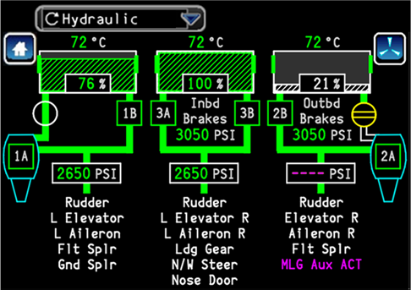
Synoptics: Overview
The Synoptics application captures and displays real-time information about the electro-mechanical systems of the aircraft.
Process raw sensor inputs.
Perform logical computations to intuitively display critical information on-screen.

Slide 7
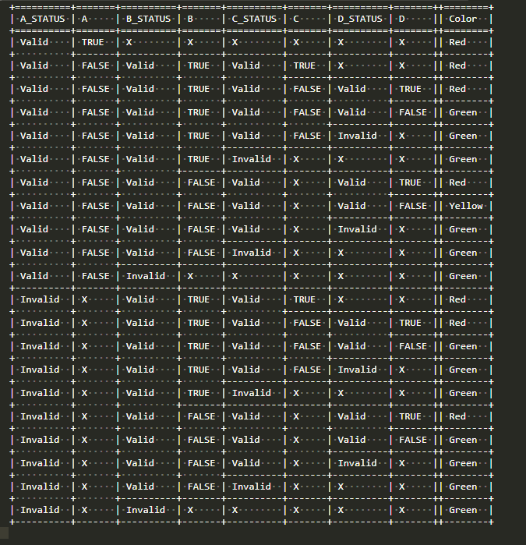
Synoptics: Problem
Software requirements about the logical behavior are captured in a tabular notation. Manually verifying that the software correctly implements these tables is time-consuming and error-prone.
Peer review requires a tedious evaluation of the nested if-then-else structure in source code to confirm compliance with tabular requirements.
Testing alone can miss mistakes.

Slide 8
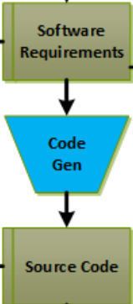
Synoptics: approach
The Synoptics team does two things that enable FM to work in this environment:
Software requirements are in structured English and easily formalizable
Source code is generated, making its structure predictable
Solution: Use a source code model checker to determine compliance between requirements and generated code automatically
Verification
“Harness”
Source
Code
C Bounded Model Checker (CBMC)

Slide 9
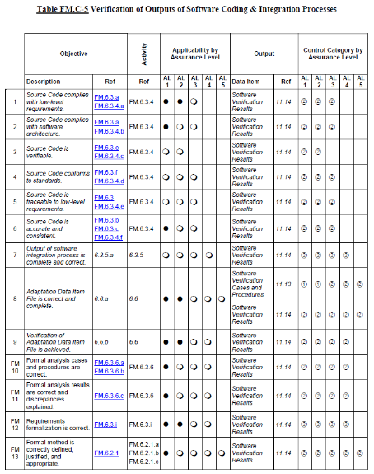
Synoptics: Impact
Addresses certification objectives related to source code with limitations.
  CBMC cannot verify, for example, that the source code does not implement extra functionality
  CBMC cannot adequately verify arithmetic, due to tool limitations
Improves quality
  Partially replaces manual peer review with automated, exhaustive analysis
Saves weeks (10-15) of engineering labor per program

Slide 10
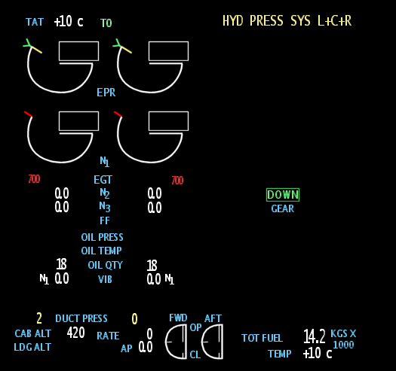
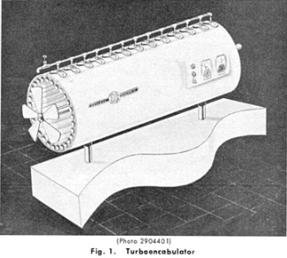
Crew Alerting System: Overview
The Crew Alerting System (CAS) is part of the EICAS application that alerts the pilot to situational changes of aircraft systems using on-screen messaging and auditory cues
Example:
  Notional requirement: Notify the pilot when the turboencabulator’s spurving bearing #1 oil pressure is out of safe operating range.
The CAS system would present a message to the pilot like this
Engine Indication Flight Display
TENC_OIL_PRESS_SB1

Slide 11
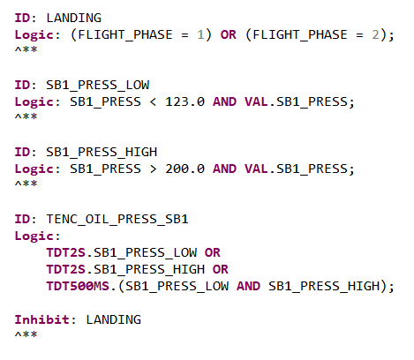
Crew Alerting System: Approach
The logic for displaying a CAS message is driven by complex Boolean equations.
Roughly 1000 equations per program
Test cases need to obtain coverage:
  decision – turn each equation on/off
  mcdc – show each condition influences the equation’s evaluation
Solution: Create a logical model of the equation and use SMT-based model checking property refutation to generate test cases.

Slide 12
Crew alerting system: value Proposition
Equations are complex often interacting with other equations through several layers of nesting.
TECN_OIL_PRESS_SB1 depends on:
SB1_PRESS_LOW
  SB1_PRESS
SB1_PRESS_HIGH
  SB1_PRESS
LANDING
  FLIGHT_PHASE
Manual test generation is tedious for humans but a non-factor for the model checker.

Slide 13
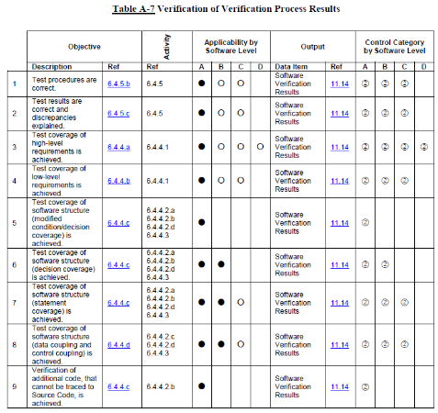
Crew Alerting System: Impact
This work is still in progress, but we have demonstrated the following:
Approach scales to programs of record for *both* coverage metrics.
Each program using the tool eliminates years of tedious engineering labor associated with manual test generation.
Next step:
Mature (document, qualify) test generator and use it as standard work on every program.

Slide 14
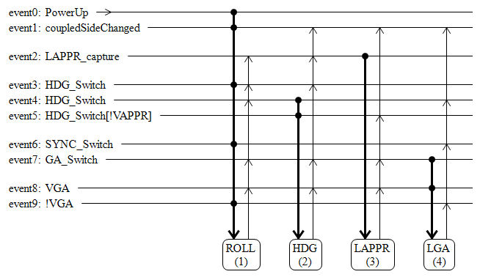
Flight controls
Vision: Build a custom development environment based on “Dot Arrow” notation for engineers to automate development, verification, and certification activities. Specifically:
An environment designed for the customer to build state machines.
Static analyses of requirements, property verification, and test generation to support peer review.
Domain specific property generation and verification for quality improvement.
Test generation and test execution on the object code.

Slide 15
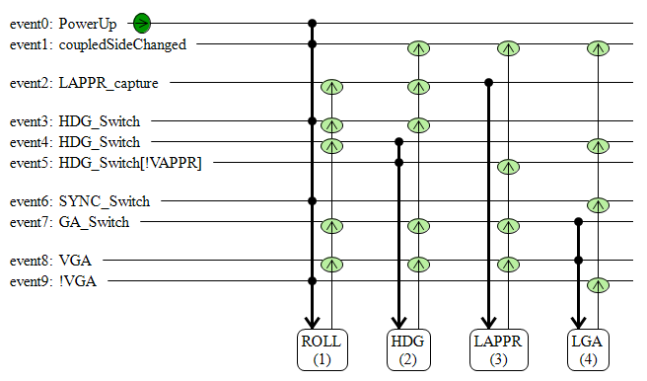
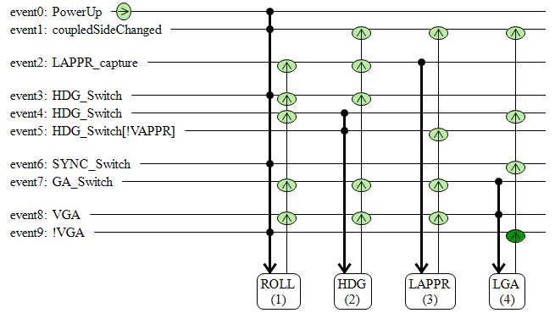
Flight controls: Analysis
The notation is translated to a formal representation and model checking can be used to show requirements compliance via property proving.
R0: The system shall start in the ROLL mode.
R1: The system shall switch out of Lateral Go Around mode when Vertical Go Around is deselected.

Slide 16
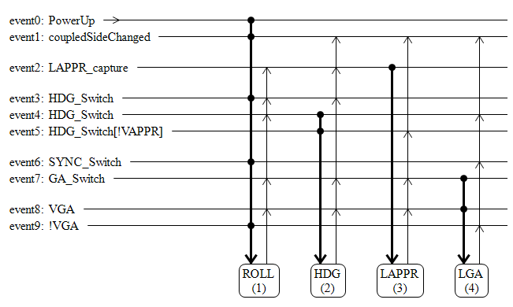
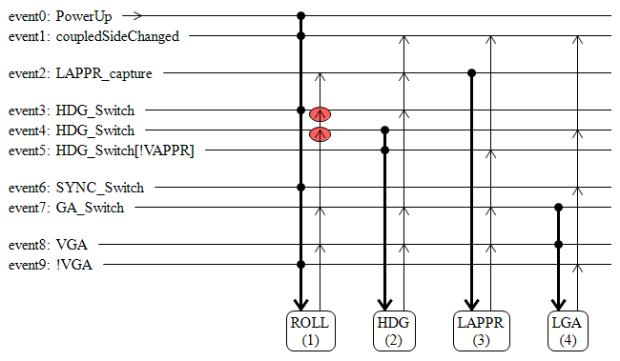
Flight Controls: Generating tests
Like the CAS work, we use the formal model and SMT-based model checking property refutation to generate tests.
Test condition:
  not (pre_mode == ROLL &
event3_fired &
mode == ROLL)
This transition is untestable; event 4 will always fire and take priority over event 3.

Slide 17
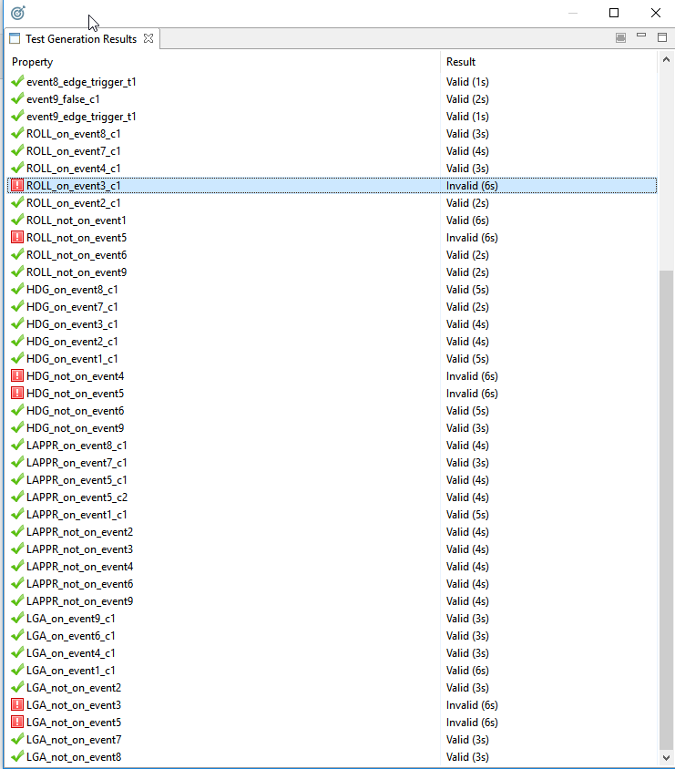
Flight Controls: Test coverage
The tool walks over the model and emits test procedures for all relevant tests:
Machine initializes into the correct state.
Transitions can occur with mcdc condition coverage and result in the correct end state.
Transitions do not occur where not specified.

Slide 18
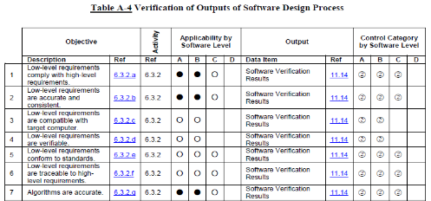
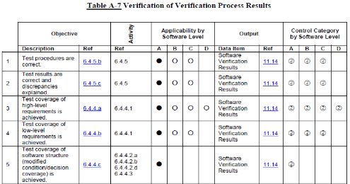
Flight controls: Expected Impact
Expected quality improvements:
Static analysis, property proving, and test generation can identify logical issues early.
Anticipated cost improvements:
Peer review of requirements artifact can be automated.
Test generation, and regeneration, can be automated.

Slide 19
QUESTIONS
?

