Slide 1
A Quorum Detection Algorithm for Tracking APT Infections
C3E January 13 2014
Shalini Ghosh, Patrick Lincoln, Phil Porras, Vinod Yegneswaran
Computer Science Lab
SRI International

Slide 2
Challenge
Given DNS logs for a site, identify infected internal and external hosts
Hypothetical APT Timeline
Phishing email with an enticing link to a malicious site (terrible.au) is sent to staff at some site (lanl).
2. (Minutes to hours later) The recipients see the emails and some click the link. The loaded page detects their browser and OS version, and redirects them to a new host (zaphod.be) with an exploit payload.
3. (Moments later) On some systems the exploit payload is successful. Compromised browser then downloads and executes the second stage.
4. (Twenty minutes later) The second stage begins beaconing home to a third host (gig.bacon.ca).
5. (Several hours later) A malicious actor sends a command to hosts that beacon to establish a control tunnel to the beaconing host over http. Optionally installs backdoors and perniciously persistent presence on compromised machines.
6. (Over the next several hours) The malicious actor gathers documents from that host, and sends them out over https to an external staging area (gord.third.clam).
7. (Over the next few weeks) The malicious actor moves laterally. Infects different hosts in the local network near the newly infected machine, proxying through the initially infected host. Documents gathered are sent to the staging area directly (gord.third.clam).
8. (Indefinitely) Backdoors are established on additional hosts (not all are utilized for document exfiltration and infection spreading).

Slide 3
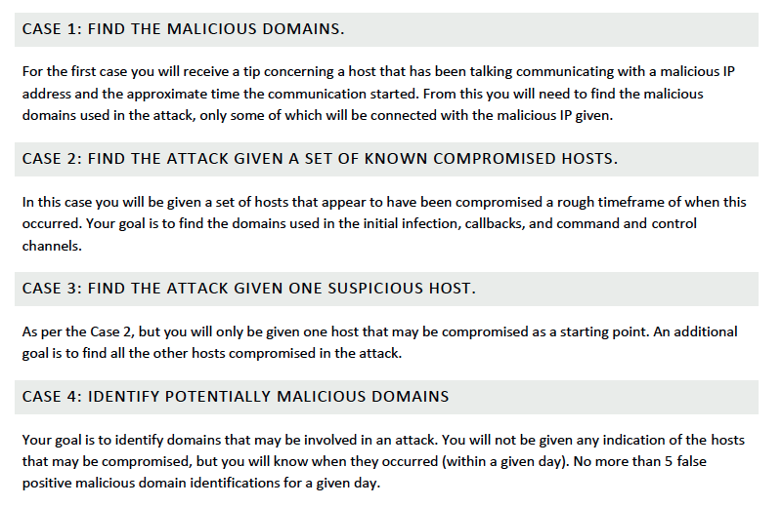
Challenge Problem: Cases

Slide 4
Given: Infected IP, Initial list of malicious DNS, no timeframe
Challenge: Derive a criteria to locate other APT-related domains
Our Focus: “Case 1”
For the first case you will receive a tip concerning a host that has been talking communicating with a malicious IP address and the approximate time the communication started. From this you will need to find the malicious domains used in the attack, only some of which will be connected with the malicious IP given.

Slide 5
Sample Hints in Data
2013-03-04
CASE 1
2013-03-02
As per 2013-03-02, except:
host - 74.92.103.13
email received - 2:47 PM
There are three domains involved:
glazes.mrsifor.in (Stage 1 fetch)
grandfenagle.in (Stage 2 fetch)
shrdhost.mungled.wad (Callback)
Host (74.92.226.44) received a potentially malicious email at 12:30 PM.
Timeline:
2:30:20 - User at (74.92.226.44) receives email containing malicious PDF.
2:31:35 - User has opened attachment, which exploits vulnerable adobe acrobat (stage 1)
2:31:36 - Stage 1 contacts malicious domain (zarflugal.noe) over http, and downloads second stage.
2:31:42 - Stage 2 starts periodic http callbacks to second malicious domain (askerpat1sk8nd2.aa9kz-j.ho.ari.do).
CASE 1
2013-03-03
As per 2013-03-02, except:
host - 74.92.150.57.
email received - 11 AM
There are three domains involved:
telamundo.in (Stage 1 fetch)
ethereal.in (Stage 2 fetch)
conventional.noe (Callback)
CASE 1

Slide 6
Algorithm: Multi-Host APT Outbreak Detection
Filtering:
  Detect potential APT domains from the massive background domain lookups by benign applications
    Use overlapping filters
Detection:
  Identify APT beacons using unique behavioral patterns, e.g.,
    Quorum of IP linksets querying the beacon also query a common newbie domain preceding the beacon

Slide 7
Algorithm Schematic
Original
data
Pre-processing : Set of domains that exhibit beacon behavior
Filtering: Generates filtered set of beacons via successive filters
Detection: Identifies APT beacons using novel algorithm

Slide 8
Before we get into details:
Some definitions
Newbie: A domain that has not been seen prior to the current (eg. day of) analysis
Beacon: A domain that
  Occurs at least minimum number of times
  Occurs with long repeat cycle
  Occurs with limited jitter of repeat cycle
  Etc.

Slide 9
Algorithm Details
Key Steps:
  Successive, overlapping filtering of beacons
  Identify linksets (groups of IPs that query a beacon)
  Identify APT beacons as ones for which a quorum of linkset IPs queried a common preceding newbie domain
Results:
  Can isolate the four multihost APT outbreaks found within the LANL APT dataset on March 5-8

Slide 10
Example: Pattern of APT on March 6
Queries to newbie aejqxgsy.e2 temporally precede queries to beacon provayder.cc
Quorum of 3 IPs also query a newbie domain aejqxgsy.e2
74.92.44.97,74.92.185.4,aejqxgsy.e2,1,0,0,0,252.153.165.50,aejqxgsy.e2,2013-03-06, 13:42:05
74.92.150.220,74.92.185.4,aejqxgsy.e2,1,0,0,0,252.153.165.50,aejqxgsy.e2,2013-03-06, 13:53:02
74.92.227.1,74.92.185.4,aejqxgsy.e2,1,0,0,0,252.153.165.50,aejqxgsy.e2,2013-03-06, 14:04:37
74.92.44.97,74.92.185.4,augerhost.e2,1,0,0,0,252.153.165.75,augerhost.e2,2013-03-06, 13:42:05
74.92.150.220,74.92.185.4,augerhost.e2,1,0,0,0,252.153.165.75,augerhost.e2,2013-03-06, 13:53:02
74.92.227.1,74.92.185.4,augerhost.e2,1,0,0,0,252.153.165.75,augerhost.e2,2013-03-06, 14:04:37
74.92.44.97,74.92.185.4,provayder.cc,20,1137,0,1,55.3.197.114,provayder.cc,2013-03-06, 16:42:08
74.92.150.220,74.92.185.4,provayder.cc,19,1134,0,1,55.3.197.114,provayder.cc,2013-03-06, 16:53:14
74.92.227.1,74.92.185.4,provayder.cc,19,1138,0,1,55.3.197.114,provayder.cc,2013-03-06, 17:04:37
provayder.cc is detected as an APT beacon
(verified by hint)
And time interval of repeating > 1000
These 3 IPs are part of the linkset for provayder.cc
provayder.cc is a beacon
As it occurs more than 9 times

Slide 11
Future Work: Algorithm Extension
We are designing an extension of this algorithm that can identify more complex APT patterns
Main idea:
  Relax the beacon filters and do additional post-processing to identifying the APTs present
Current Issue:
  Filter relaxation is leading to data explosion on a single machine, may require a more scalable bigdata analysis framework.

Slide 12
Questions?

Slide 13
Some Questions
Where is the rest of March? We just have up to March 6th
Hints for case 2 do not provide rough time frame … whereas challenge description indicates you are provided with rough timeframe. Will you provide a timeframe?
Hint file 1 is inconsistent. It initially says the infected emails arrives around 12:30, and then in the bullets it says the infected email arrives around around 2:30.
There are signficant numbers of cases where either the Query is seen but there is no corresponding Reply … or vice versa … or my code is buggy.
During APT propagation, will the infected host be expected to make DNS queries to find other victim hosts in the network. (Typically, we’d expect them to perform direct IP lookups and bypass DNS. Other thoughts?).

Slide 14
Details of Algorithm Extension
We make the following modification to the current APT detection code, to get more recall
  If we see that two or more IPs (instead of >= 3 in the original algorithm) that issue a newbie beacon also issued at least 2 other newbie beacons earlier in the same day, then we mark the IPs as part of a "strong quorum".
  For each IP of the strong quorum, we list all the newbie beacons issued by them as potential APT domains.
This increases the recall of APT domain detection, at the cost of reducing precision.

