Slide 1
Cognitive Security
Oppositional Human Factors
Presented by: Kimberly Ferguson-Walter
NSA, Laboratory for Advanced Cybersecurity Research
R.S. Gutzwiller, K.J. Ferguson-Walter, S.J. Fugate, A.V. Rogers, “Oh, look, a butterfly!” Distracting Attackers To Improve Cyber Defense, Human Factors and Ergonomics Society, October 2018.

Slide 2
Malicious actions in cyberspace
Very large range of potential targets
Results in everything from loss of privacy, loss of productivity to loss of operational security and potentially loss of life.
By disrupting the attacker.
Aurora Test (2007) @ Idaho National Labs –
$1M generator destroyed by remote hack
https://pixabay.com/en/anonymous-hacker-network-mask-2821433/
How can we stop or disrupt cyber attacks?
Approved for public release
Notes:
There are an incredible range of computer systems put at risk by malicious cyber activity.
The activity ranges from targeted to indiscriminate, and the perpetrators do not always get identified and stopped.
Proliferation of electronics - IoT

Slide 3
Cyberspace is a human-system environment.
Defenders keep attackers at bay…but….
  Asymmetrical disadvantage
  Difficult job, never-ending, no feedback
  Limited by software (no windows in cyberspace!)
  Few trained operators
  Less flashy vs offense!
  Confidence in results maybe impossible
  Human Factors for cyber defense is not fully realized (Gutzwiller, Fugate, Sawyer & Hancock, 2015).
Notes:
What do cyber defenders do?
Human Factors science is not fully realized (Gutzwiller, Fugate, Sawyer & Hancock, 2015).
Note that it *HAS* grown since the 2015 paper we wrote.

Slide 4


Attacker Cognition
How we disrupt attackers today has cognitive implications, though they are indirect.
Cyber deception shows the importance of attacker cognition:
  Distract attackers from real assets and content (slows even persistent attacker)
  Provide incorrect understanding of network topology (waste attacker resources)
  Creates confusion and frustration (increase human error, fatigue)
Suggests attacker cognition matters:
  Why not shift that usability landscape directly?
Notes:
Less studied, but an opportunity for this community to help cyber defenders in another way.

Slide 5

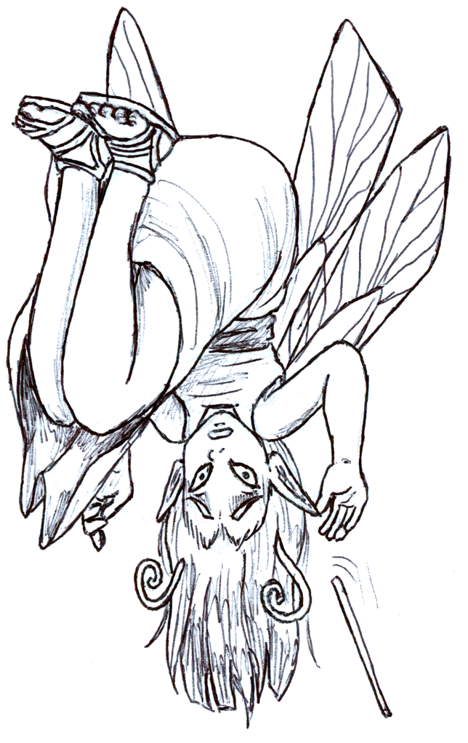
Oppositional Human Factors
Use of human factors theory, technique and practice to disrupt usability, understanding and improvement of interaction with systems for malicious actors.
Attackers should not expect or receive good usability
Andrew Rogers
R.S. Gutzwiller, K.J. Ferguson-Walter, S.J. Fugate, A.V. Rogers, “Oh, look, a butterfly!” Distracting Attackers To Improve Cyber Defense, Human Factors and Ergonomics Society (HFES), Oct 2018.
R. S. Gutzwiller, K. J. Ferguson-Walter, and S. J. Fugate. Are cyber attackers thinking fast and slow? Evidence for cognitive biases in red teamers reveals a method for disruption. Proceedings of the Human Factors and Ergonomics Society Annual Meeting (HFES), Oct 2019.
Andrew Rogers

Slide 6
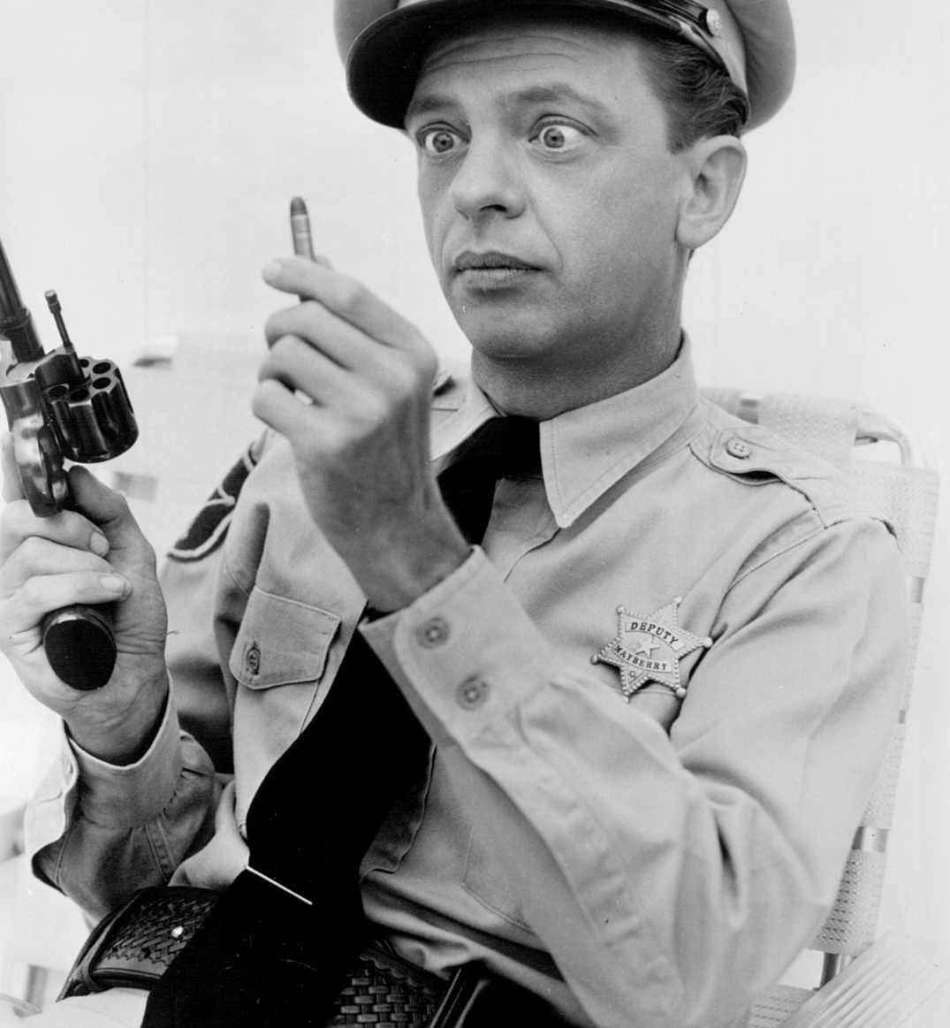
Oppositional Human Factors for Cyber
  Information altered to disrupt and influence attacker perception, cognition & action based on HFE theory
Attention
      Interruptions
      Distraction
      Cognitive tunneling
Decision-making
      Heuristics & Biases
Team Cognition
      Communication
      Shared mental models
      Trust
Turn capable attackers into….
… incompetent TV comedians?
This can be a general strategy that doesn’t disrupt end-users.
Notes:
What we WANT is to turn capable attackers into the TV character, Barney Fife, who has trouble putting bullets in his gun and is either constantly questioning his own capabilities and actions, OR, incredibly, over-confidently incorrect in his theories/actions).
Disrupting attacker cognition can take many forms, and we have begun to explore them.
****Attention – main focus of this paper
- Each of these areas has a wealth of literature, some robust findings that can be tested for their oppositional value, and some direct applications to cybersecurity domains.

Slide 7
Experimental evidence for attacker behaviors
Background:
Same three participants performing adversary emulation (red teaming) in deception experiment
Phase 1
Phase 2
Decoys are present
Red team is told there is deception
Decoys present
Phase 3
No decoys
Red team infers deception from Phase 2
No one is told deception is present.
Ferguson-Walter, K. J., LaFon, D. S., & Shade, T. B. (2017). Friend or faux: Deception for cyber defense. Journal of Information Warfare (JIW), 16(2), 28–42.
Notes:
Study was not designed to examine cognitive bias or research OHF…. But they were still apparent.
After the results were published, we were able to examine the transcripts for evidence.
Infers INCORRECTLY

Slide 8
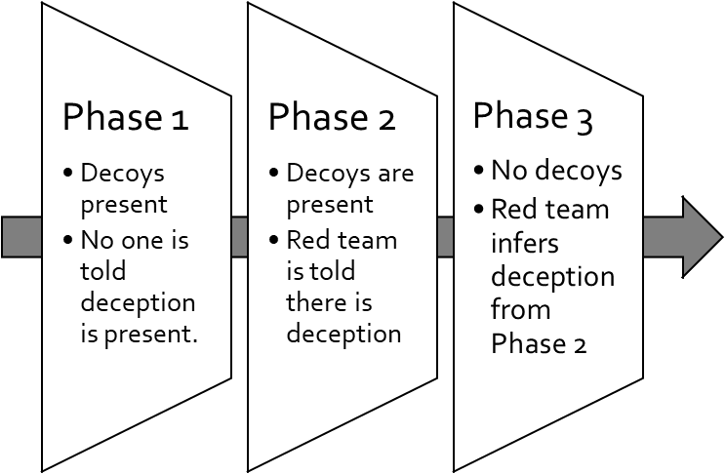
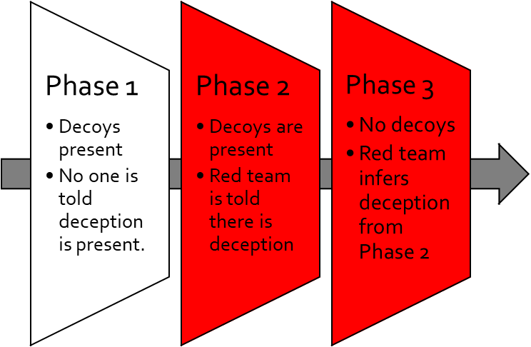
Example 1
Attackers showed:
  Framing Effect
  Tunneling
Told there was deception
Red team made very different assessments from nearly identical behavior of systems
  Font size
  Differential locking behavior
  Different RDP connection times
Spent significantly more time attempting to find indicators that systems are fake, (A secondary task)…… INSTEAD OF data exfiltration (A PRIMARY TASK)
“…instead of just targeting the most interesting assets, we actually spent time comparing them.”
- Participant
Notes:
This suggests a framing effect which then appears to lead to attentional tunneling.
**Natural messiness of the network. Plausible deniability**

Slide 9
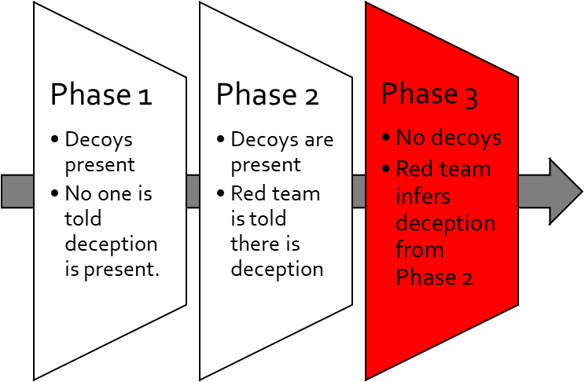
Example 2
Attackers showed:
  Anchoring
  Tunneling
Red team anchoring on “deception present” information
One operator continued to insist a machine was an impressive fake, and, continued to work with it
“…let me finish poking and prodding at these servers
- Participant
that I know are fake
.”
There were no fake systems!
Notes:
- anchoring: fixation on information that biases future responses; can happen with numbers especially. Here we think of it in terms of anchoring on the fact that deception may be present.
However, the machine is real and the user name is actual valid. This is an example of the anchoring bias, where the participant is relying too heavily on the information given at the start of the study that deception might be present, and continues to insist the machine is a really impressive fake instead of real. We also observed many instances where red team confidence in a system being fake increased throughout the day even when no additional evidence was available. This is a clear example of irrational escalation, gradually increasing their estimation of the correctness of a judgement based on incomplete and insufficient evidence.
“So, with that knowledge I know that they're out there, so I'm trying to find which ones are fake and I'm very impressed with this one because the, I know for a fact that that SID is not valid because it does not show up in the infrastructure. So I use that a, that script to automate the process of validating all my User names and so I know it's fake, and so I connected to the machine and I'm greeted with what looks correct.”…“Let me, let me finish poking and prodding at these servers that I know are fake.

Slide 10
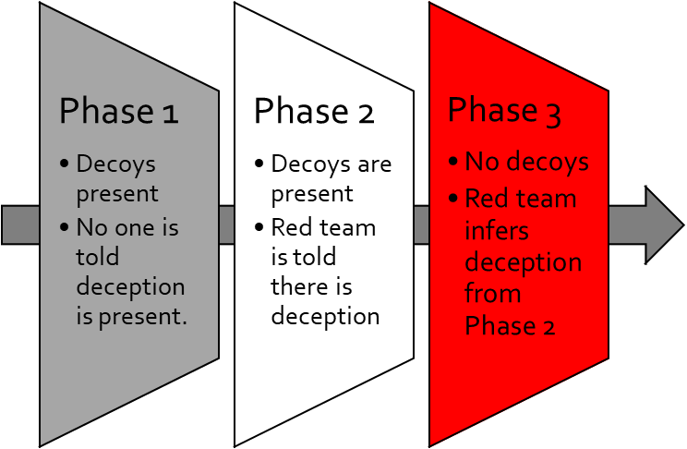
Example 3
Attackers showed:
Framing Effects
Attackers in Phase 1 sought out printers to attack and were successful.
But when informed (thus, framed), the possibility of deception --- not its existence --- made the participant attackers suspicious of printers, and led them to speculate printers were intentionally presented as vulnerable targets in order to seduce them.
Deception information functioned as framing effect
“And I have a printer here. Do we care about printers? I remember the day when we used to... (laughter)” - Participant
Notes:
- framing effect: all about how people view information. Printers (originally would be framed as gain, as they are vulnerable) now being framed as potential loss (if printers are fake and reveal or disrupt red team actions)

Slide 11
Support for Oppositional Human Factors Approach for Cyber Defense
Observational data are supportive of using oppositional human factors in design to disrupt attackers.
  In further analysis of Ferguson-Walter et al. (2017), we found
    * Confirmation bias || Anchoring || Illusion of control
    * Sunk-cost-fallacy || Belief revision || Mere exposure
    * Irrational escalation || Hindsight bias
Analysis of new cyber deception study:
  Data from 130+ professional red teamers
  Ferguson-Walter, K. J., Shade, T. B., Rogers, A. V., Niedbala, E. M., Trumbo, M. C., Nauer, K., Divis, K. M., Jones, A. P., Combs, A., and Abbott, R. G. (2019). The Tularosa Study: An Experimental Design and Implementation to Quantify the Effectiveness of Cyber Deception. In Hawaii International Conference on System Sciences (HICSS), Maui, Hawaii, January 2019.
Design of OHF Studies
Attackers cannot easily overcome oppositional human factors design, and the approach should scale without impacting end-users.
Approved for public release
Notes:
**Future Work**
In conclusion, we believe oppositional human factors provides a new direction for how the human factors community can help cyber defenders to protect and defend against cyber attacks. Focusing on ATTENTION allocation is a great place to start.

