Slide 1
Human-Machine Teaming:
Theme and Variations
David Burke
C3E 2019

Slide 2
Spectrum of Themes
Replacement
Tool
Partnership
Augmentation
Symbiosis
Loosely Coupled
Tightly Coupled

Slide 3

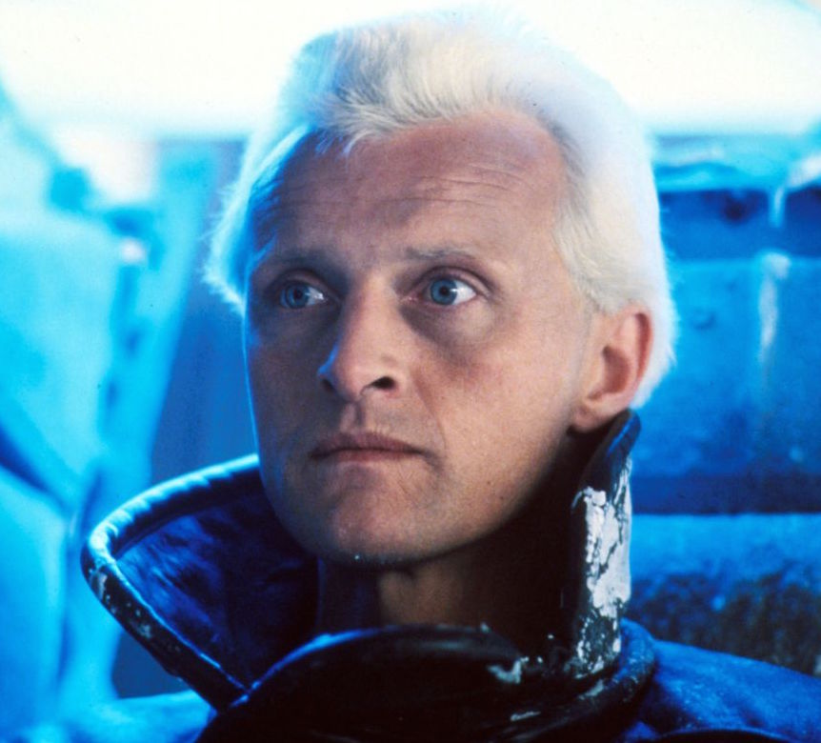
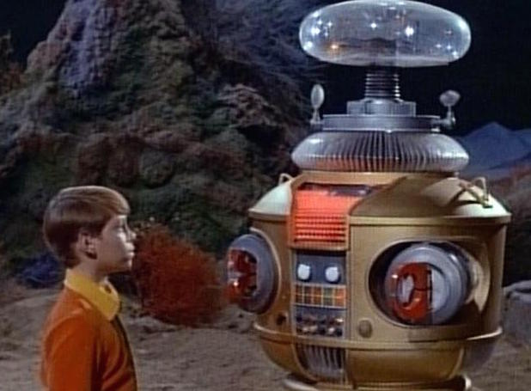
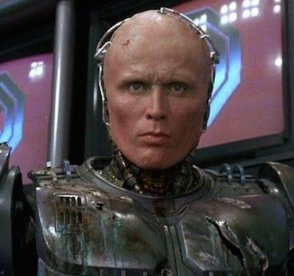

Spectrum of Themes
Replacement
Tool
Partnership
Augmentation
Symbiosis
Loosely Coupled
Tightly Coupled

Slide 4
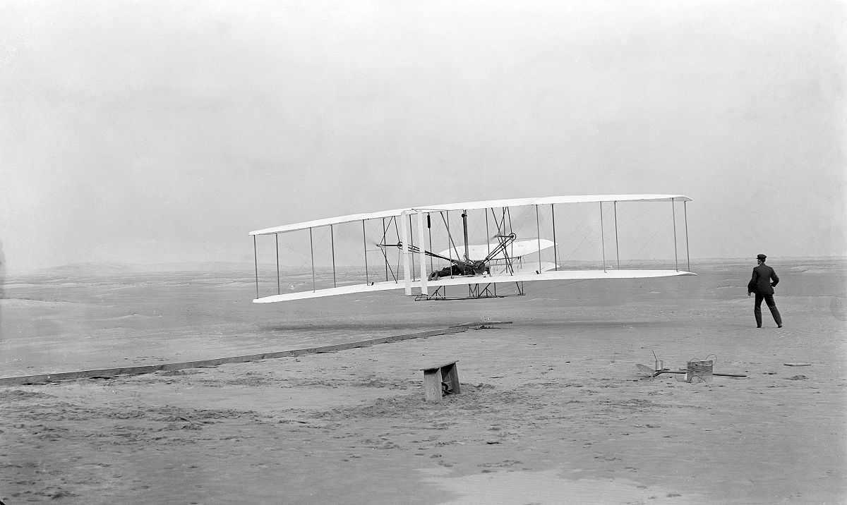

Slide 5
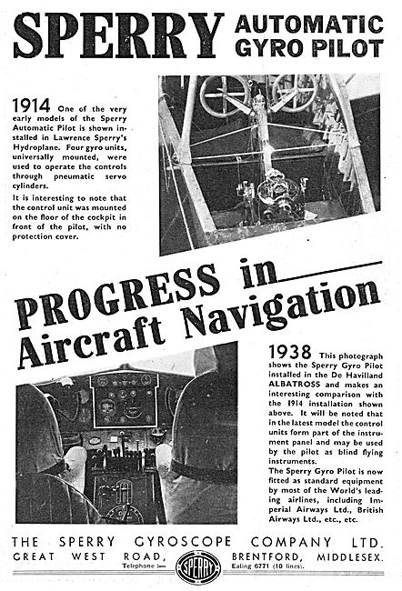
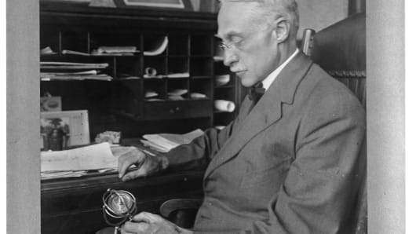
Elmer Sperry and Early Control Systems

Slide 6
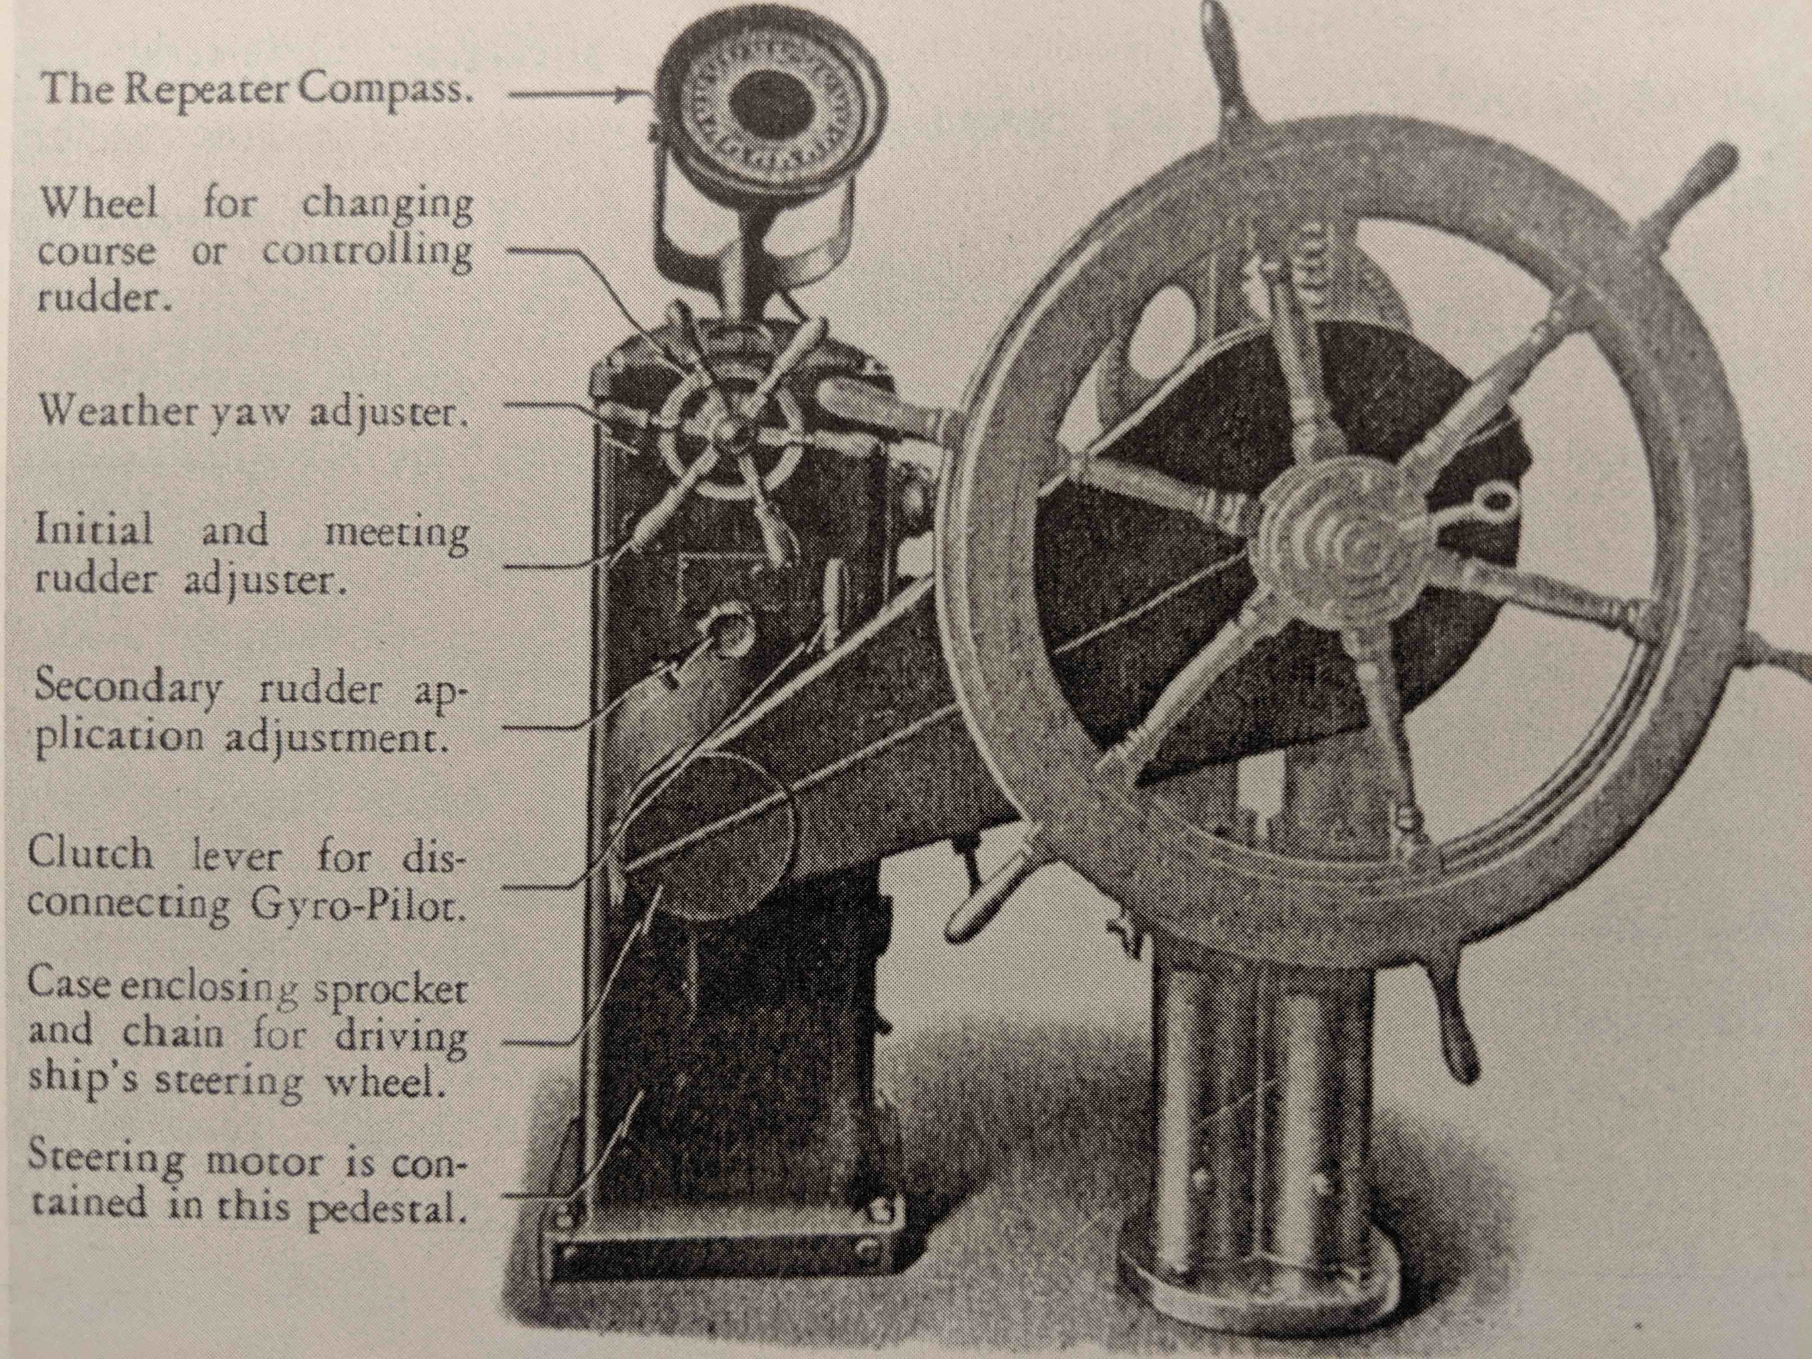
Sperry Gyro-Pilot - “Metal Mike”
“Wanted – a permanent position on board ship as a wheelsman. Have had experience in steering every type of merchant ship, can steer courses more accurately than others and use less rudder. Am sober, intelligent, strictly attentive to business, never ask for time off, do not talk back, am not affected by … poor cooking, in fact do not eat at all. Wages wanted, only 54 cents per day for 24 hours service.”
[signed]
Sperry Gyro Pilot
Sperry Advertisement

Slide 7
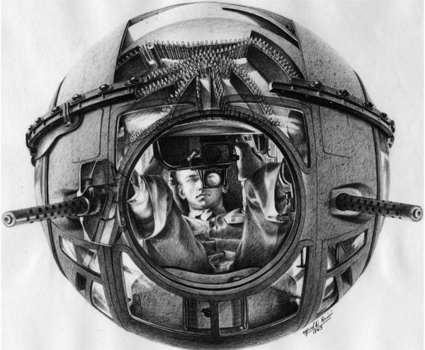
Human-Machine Interface: WWII B-17 Bomber

Slide 8
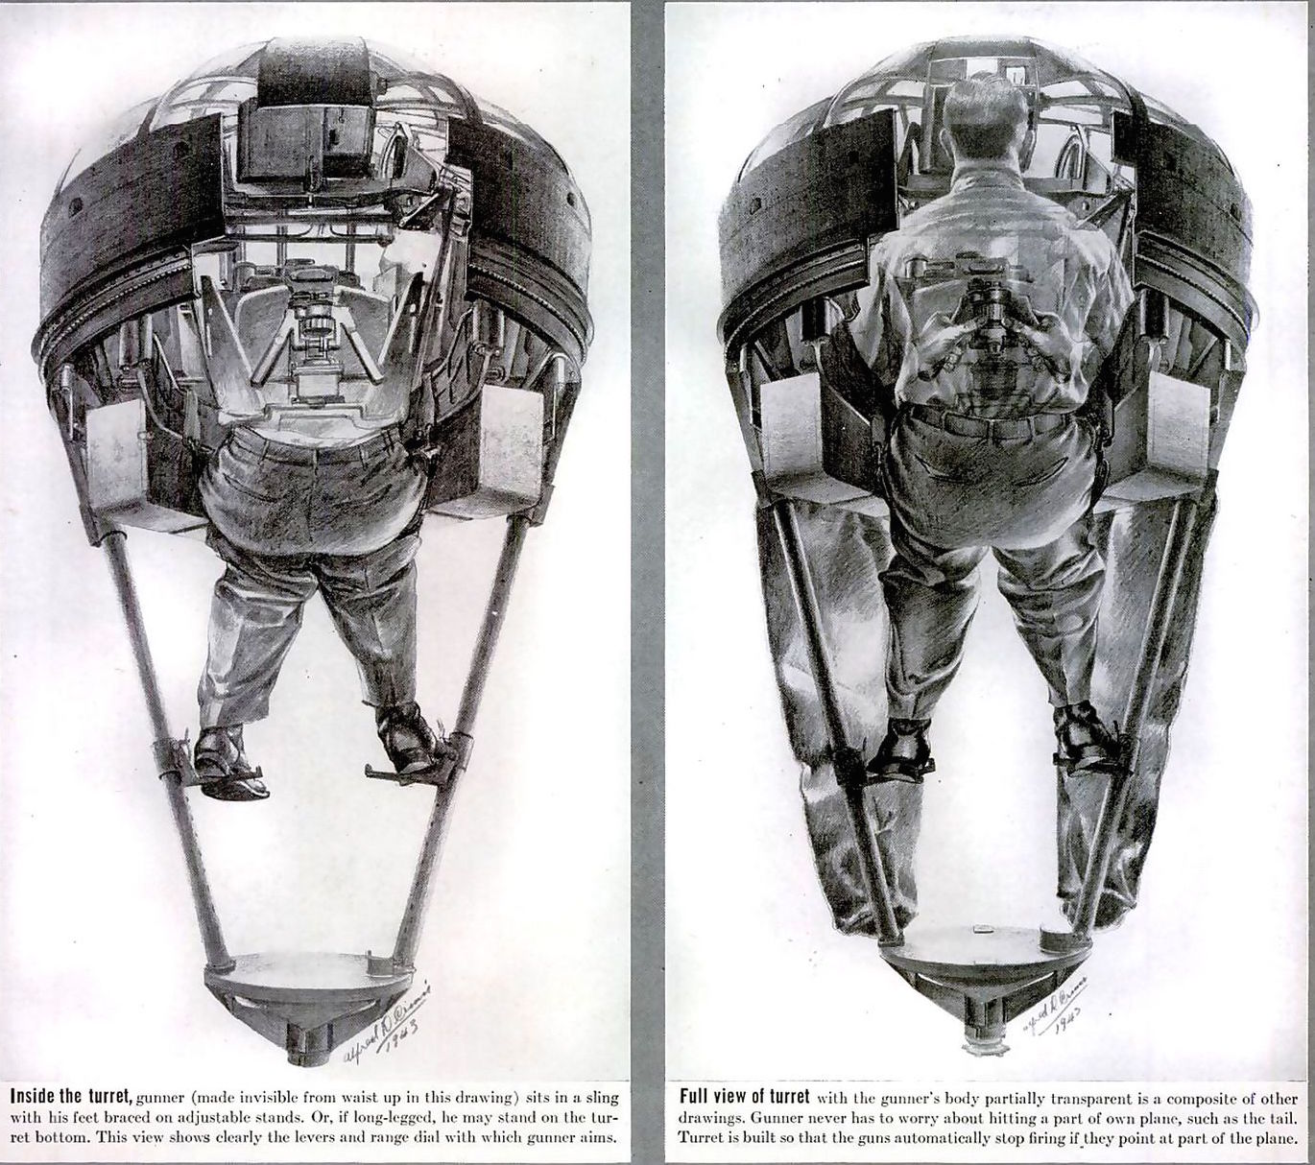

Slide 9
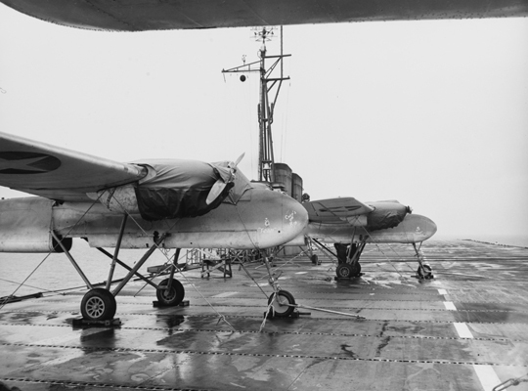
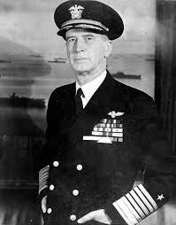
Project Option
Fleet Admiral Ernest King
TDN-1 Drones on the USS Sable

Slide 10
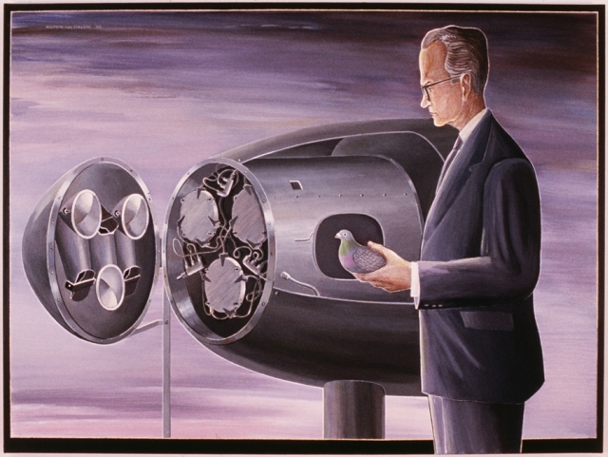
B.F. Skinner and Project Pigeon

Slide 11
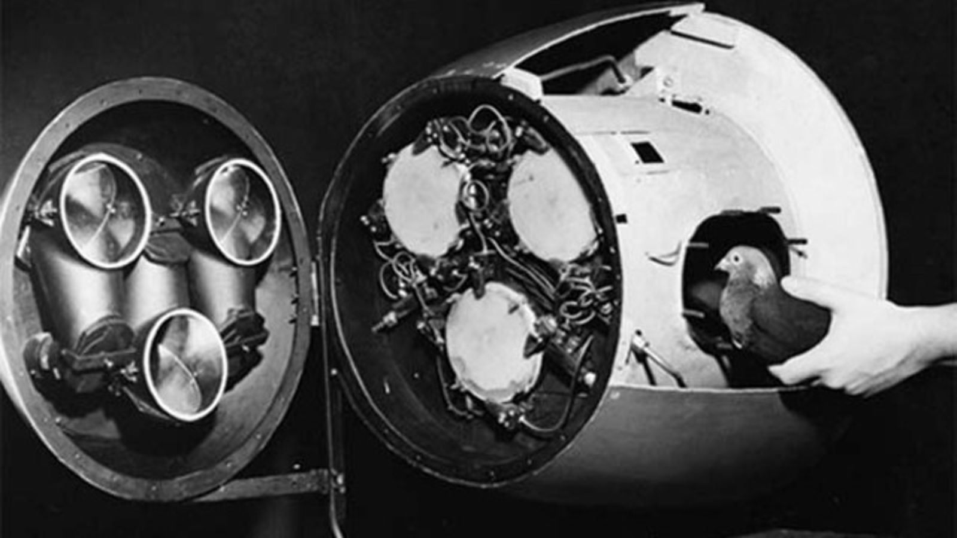
Project Pigeon Prototype
Notes:
Pg 387 of “Unmanned Systems” of WWII

Slide 12
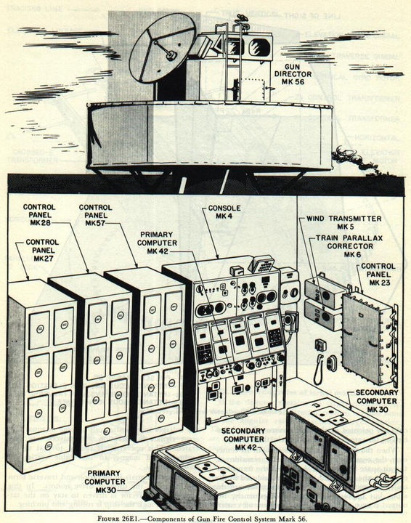
Mark 56 Gun Fire
Control System
Notes:
See page 76 of “Cybernetic Moment” to get description of this moth/bedbug machine.

Slide 13
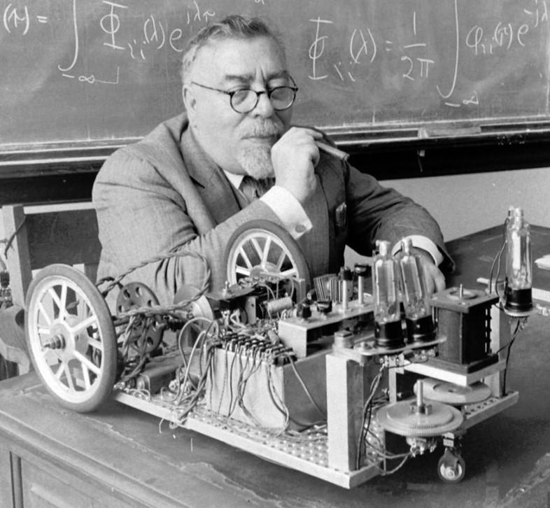
Norbert Weiner and Cybernetics
Notes:
See page 76 of “Cybernetic Moment” to get description of this moth/bedbug machine.

Slide 14
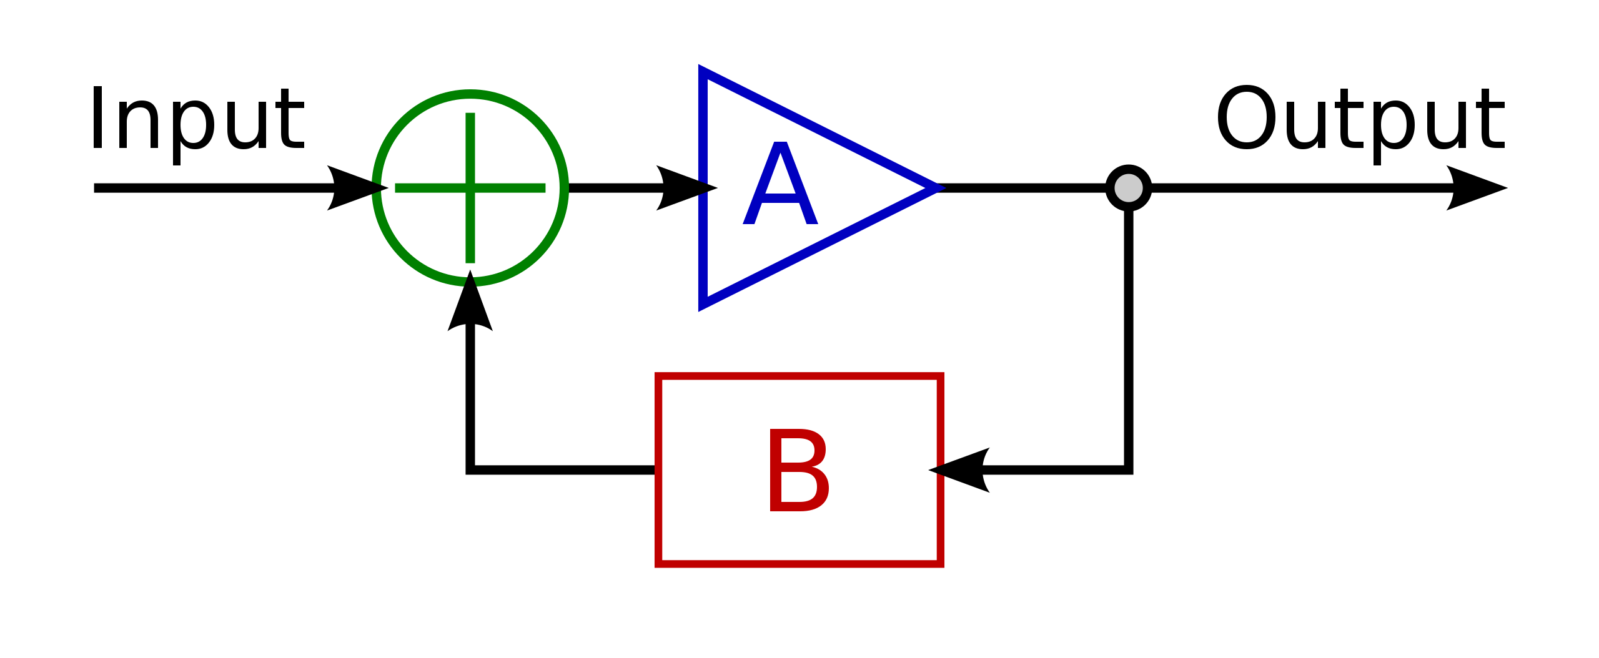
Cybernetics and Feedback Loops
Notes:
Comments here about insufficient feedback being a problem for pilots – you become untrained in emergency settings.

Slide 15
2nd Order Cybernetics
In 2nd Order Cybernetics, observers are part of the system under study.
Notes:
See page 76 of “Cybernetic Moment” to get description of this moth/bedbug machine.

Slide 16


HABA-MABA (Fitts, 1951)
Humans are better at
Machines are better at
HABA
Detecting small amounts of visual and auditory energy.
Perceiving patterns of light and sound.
Improvising/using flexible procedures.
Storing large amounts of information and performing selective recall.
Reasoning inductively.
Exercising judgment.
MABA
Responding quickly and applying great force smoothly and precisely.
Performing repetitive, routine tasks.
Storing information briefly, then erasing it completely.
Reasoning deductively.
Multitasking.

Slide 17
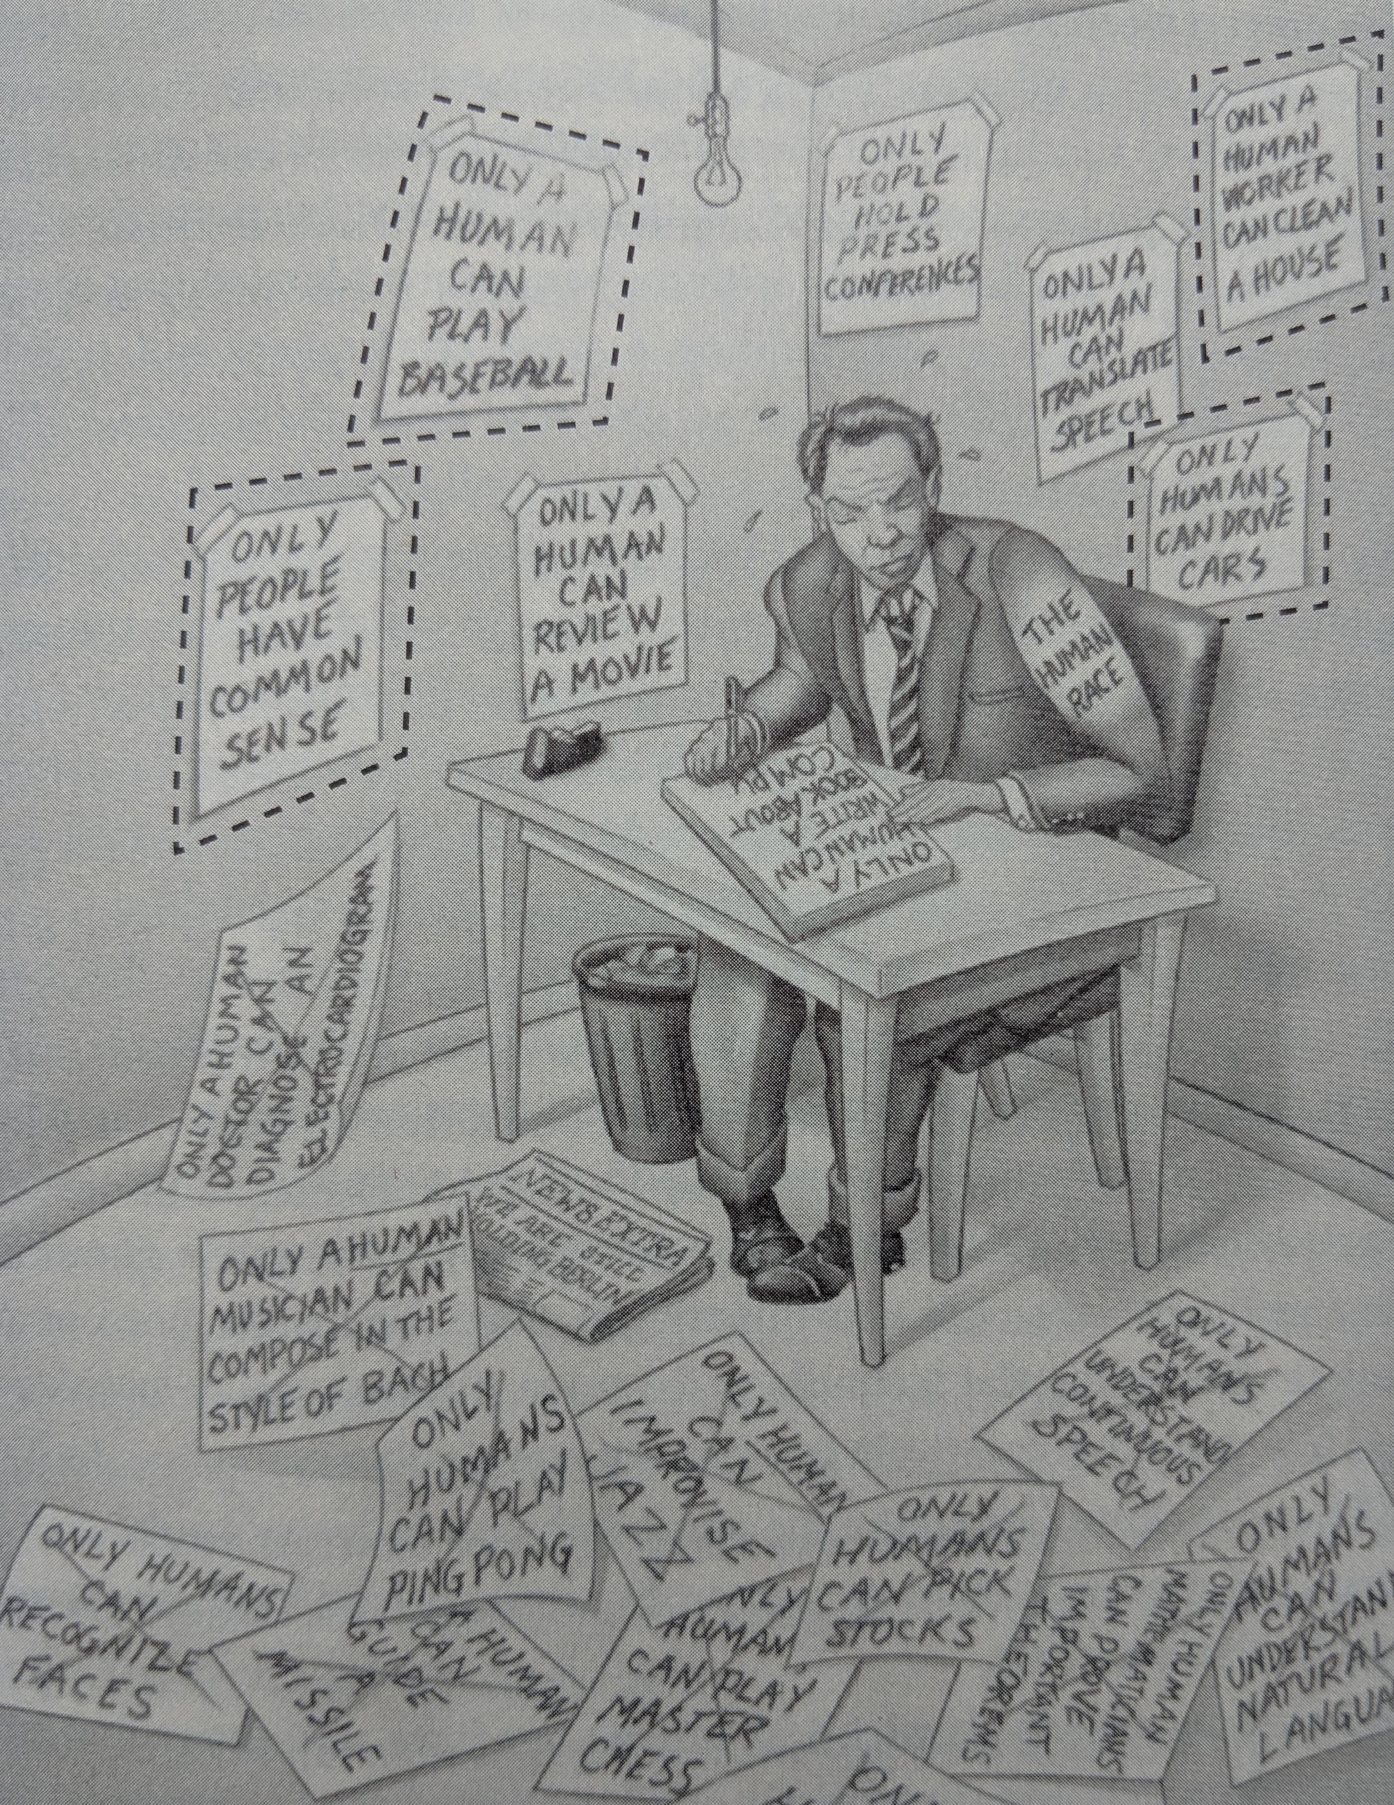
HABA-MABA as a moving target
Source: “The Singularity is Near”
by Ray Kurzweil

Slide 18
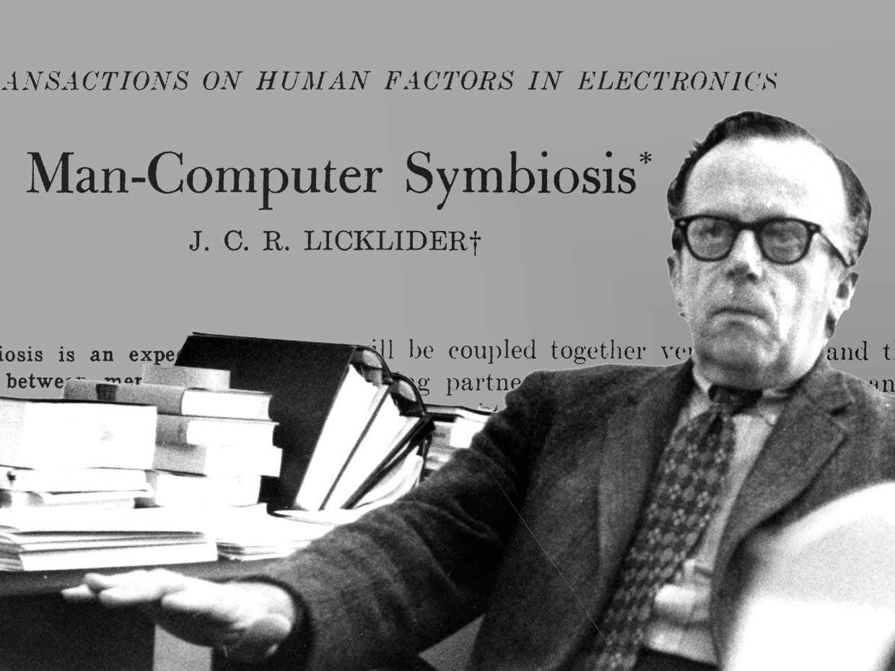
J.C.R. Licklider and Human-Computer Symbiosis
“The hope is that in not too many years, human brains and computing machines will be coupled together very tightly, and that the resulting partnership will think as no human brain has ever thought and process data in a way not approached by the information-handling machines we know today.”
“Men will set the goals, formulate the hypotheses, determine the criteria, and perform the evaluations. Computing machines will do the routinizable work that must be done to prepare the way for insights and decisions in technical and scientific thinking"

Slide 19
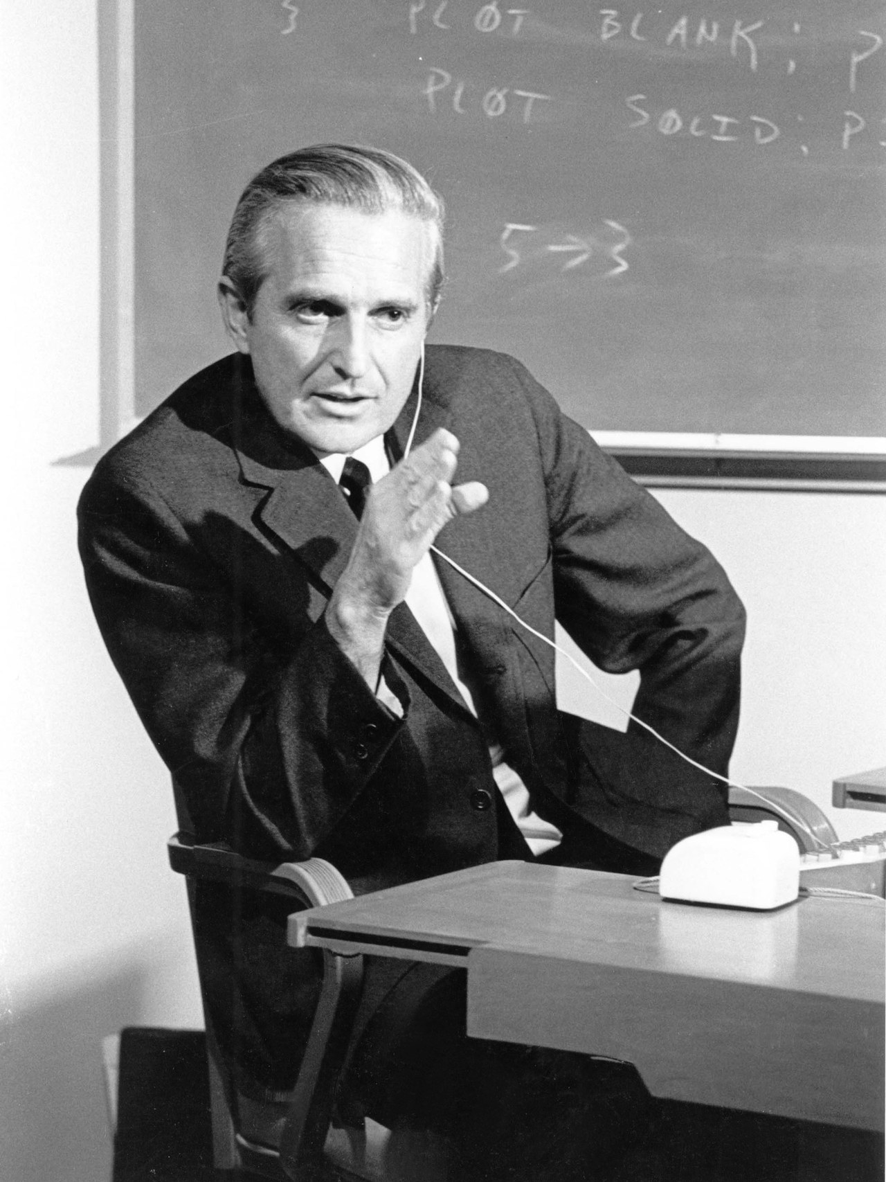
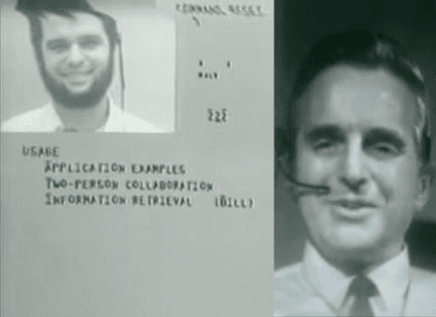
Dec 9th, 1968 – The “Mother of All Demos”
mouse
interactive real-time computing;
the graphical user interface;
hypertext linking;
cut-copy-paste editing;
collaborative document sharing by multiple users
modern teleconferencing

Slide 20
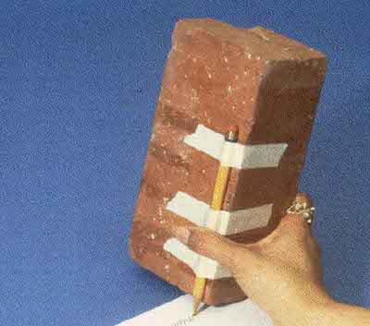
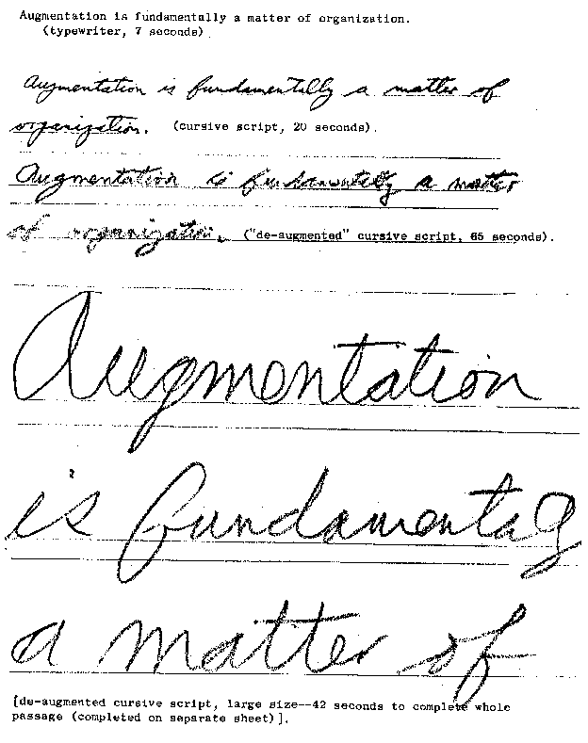
“Augmentation is fundamentally a matter of organization.”
Notes:
See page 76 of “Cybernetic Moment” to get description of this moth/bedbug machine.

Slide 21
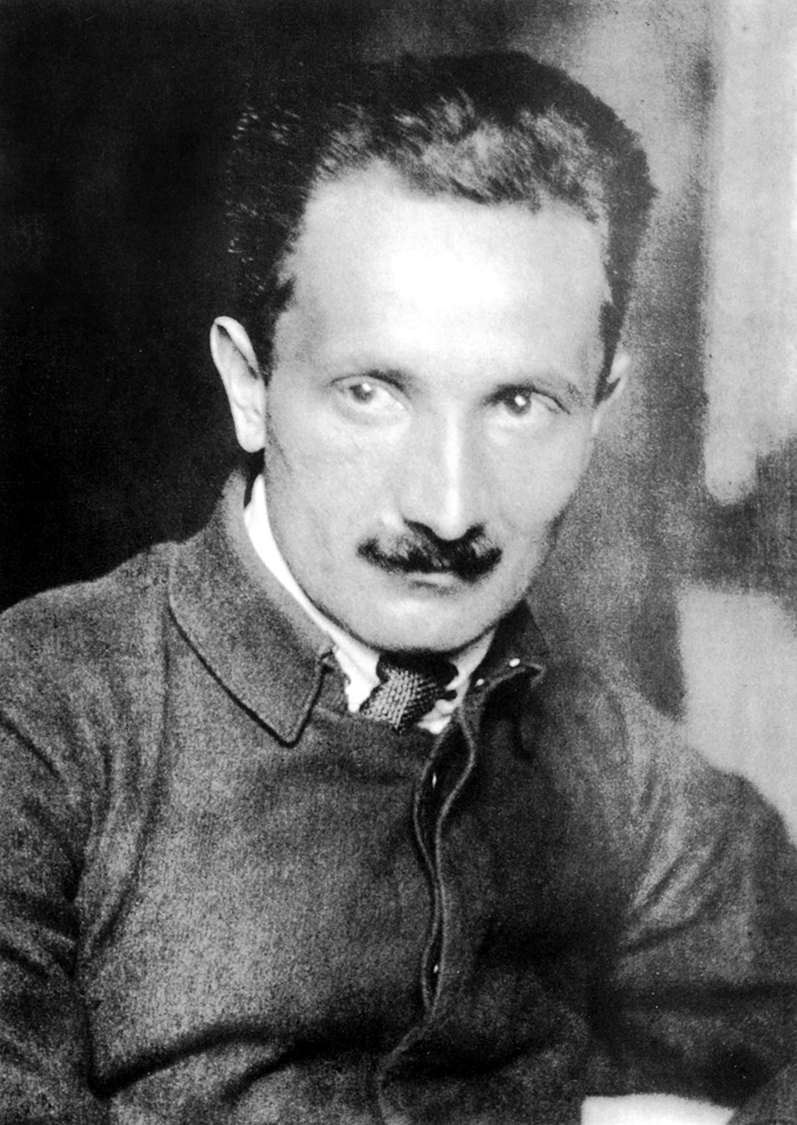
Heidegger and Representations

Slide 22
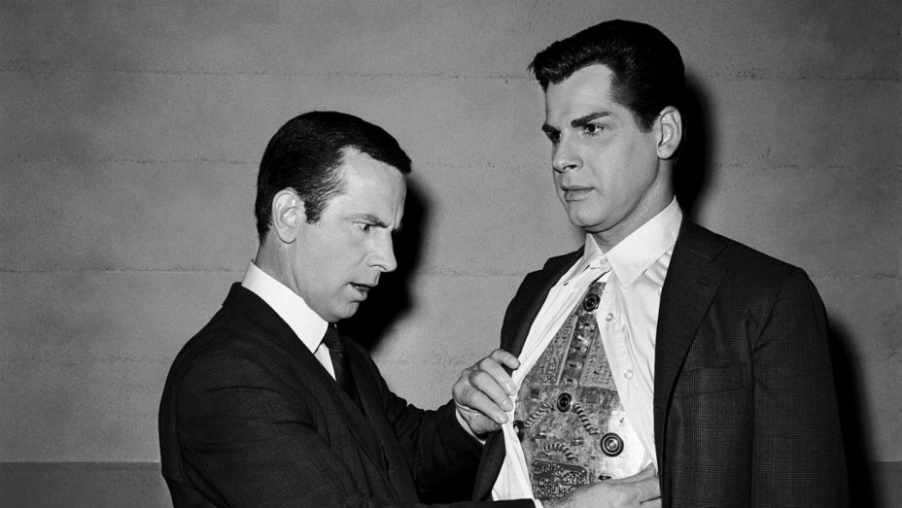
Maxwell Smart and Robot Colleague

Slide 23


Edwin Hutchins and “Cognition in the Wild”

Slide 24
Naturally Situated Cognition
Big idea: Cognition is socially distributed. Systems of activity have cognitive properties of their own than are different than the cognitive properties of individuals.
Hutchkins found “too much emphasis on finding knowledge structures inside an individual instead of knowledge being situated in a complex sociocultural world”
Distributed cognitive systems are hybrid systems where cognition is distributed among humans and material/computational artifacts.
“Humans create their cognitive powers by creating the environments in which they exercise those powers”
Notes:
The term “distributed” comes from the fact that cognitive process is distributed among humans and material artifacts. Distributed cognitive systems are hybrid systems. (The related term “collective cognition” refers to all-human ensembles)
A key feature of a distributed cognitive system is that it contains external representations, which are representations of the world that don’t exist solely in a person’s brain or in a computer. These external representations are created and manipulated by the humans in the distributed cognitive system.
Humans are the only cognitively active agents in a distributed cognitive system. There is no need to endow the system as a whole with other attributes of human cognitive agents such as intention, belief, knowledge, responsibility and consciousness.

Slide 25
Paradoxes of Judgment Aggregation
 | p | p -> q | q
Judge 1 | True | True | True
Judge 2 | True | False | False
Judge 3 | False | True | False
Majority | True | True | False
Each of three judges uses their judgments of the premises p, p->q and propositional logic to draw conclusions about q (first three lines of the table)
However, if we simply aggregate each column by taking the majority vote, we have both p and p-> q both being true, and q as false.
Notes:
Here’s an example of an inconsistency showing up using a simple majority rule as an aggregation procedure.

Slide 26
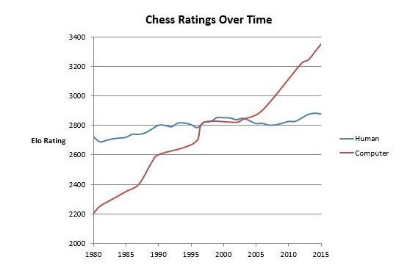
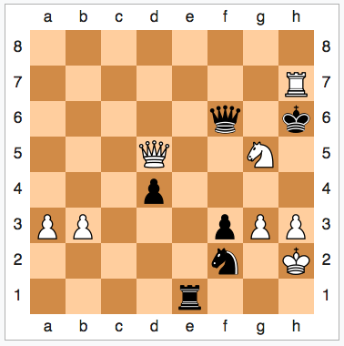
Progress in Computer Chess
Source: Erik Brynjolfsson
Deep Blue (white) vs. Kasparov (black):
Game 1 final position (black resigns)

Slide 27
Freestyle Chess
Garry Kasparov introduced the idea of “centaur chess” or “cyborg chess” as a way to further increase the level of chess play – a player can use a chess program as a consultant.
Freestyle Chess is an “anything goes” variant: any number of humans and machines play chess under time controls.
The first Freestyle Chess tournament took place in 2005, with 48 entrants, including several Grandmasters (ratings 2500 or above).

Slide 28
Freestyle Chess
Garry Kasparov introduced the idea of “centaur chess” or “cyborg chess” as a way to further increase the level of chess play – a player can use a chess program as a consultant.
Freestyle Chess is an “anything goes” variant: any number of humans and machines play chess under time controls.
The first Freestyle Chess tournament took place in 2005, with 48 entrants, including several Grandmasters (ratings 2500 or above).
The winning team:
Steven Cramton (1685 USCF) and Zackary Stephen (1398 USCF) with 3 computers running chess engines.
“We had really good methodology for when to use the computer and when to use our human judgment, that elevated our advantage,”

Slide 29
Kasparov on Freestyle
“[A] weak human plus machine plus better process was superior to a strong computer alone and, more remarkably, superior to a strong human plus machine plus inferior process.”
Garry Kasparov

Slide 30
Kasparov on Freestyle
“[A] weak human plus machine plus better process was superior to a strong computer alone and, more remarkably, superior to a strong human plus machine plus inferior process.”
Garry Kasparov
Excerpt from a recent interview with Kasparov:
Interviewer: Today, 2017, do you still think it’s the case that a human paired with a set of programs is better than playing against just the single strongest computer program in chess?
KASPAROV: There’s no doubt about it.

Slide 31
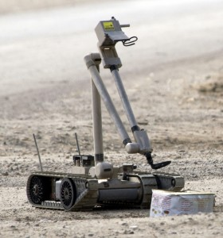
Credit: U.S. Navy photo by Journalist 1st Class Jeremy L. Wood.
Notes:
When Boomer was lost on the battlefield in Taji, Iraq, his brothers in arms gave him a funeral. The tribute involved a 21-gun salute, and the awarding of both a Purple Heart and a Bronze Star Medal. All in recognition, according to a soldier who has worked with Boomer's comrades, of Boomer's heroism and of the many lives he had saved on the battlefield.

Slide 32
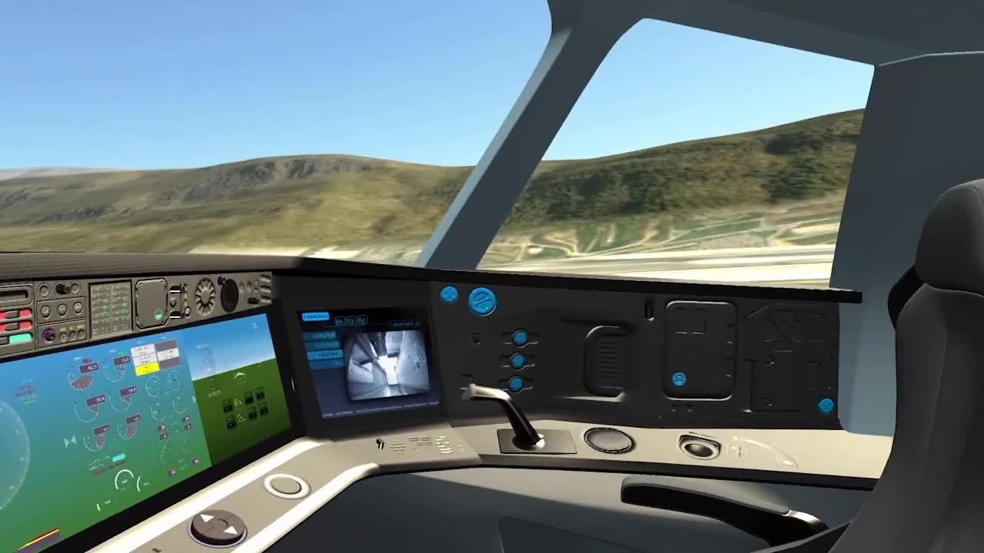
Cockpit of the Future

Slide 33
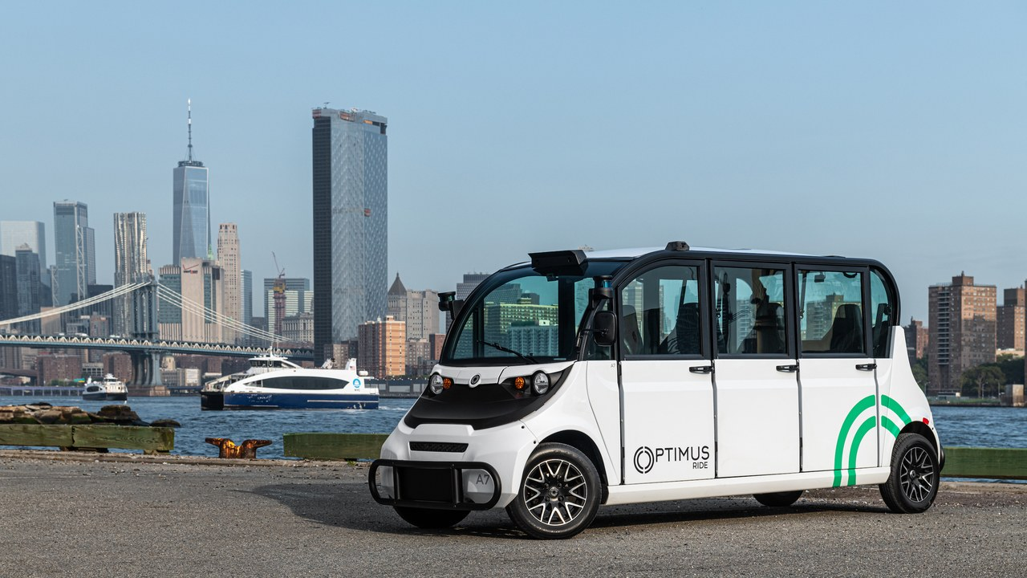
“Finally, Driverless Vehicles Have Arrived in New York City”
(says Architectural Digest Magazine)
Source: Optimus Ride

Slide 34
“Aoccdrnig to a rsceareh at Cmabrigde Uinervtisy, it dseno’t mtaetr in waht oerdr the ltteres in a wrod are, the olny iproamtnt tihng is taht the frsit and lsat ltteer be in the rghit pclae.”

Slide 35
Repair, Attribution, and all That (RAT)
“Human users constantly ‘repair’ the inadequacy of computer behavior, then attribute the results to intelligence on the part of the machine, while discounting the actual intelligence that was supplied in the process of repair.”
From Collins and Kusch (1999)
“The Shape of Actions: What Humans and Machines Can Do”

Slide 36
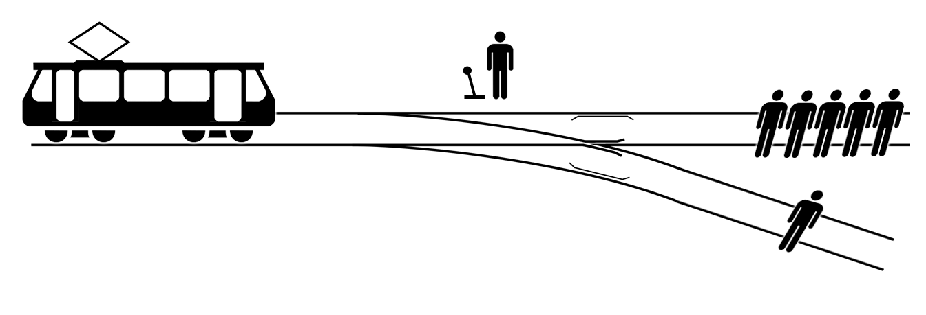
Trolley Problem

Slide 37
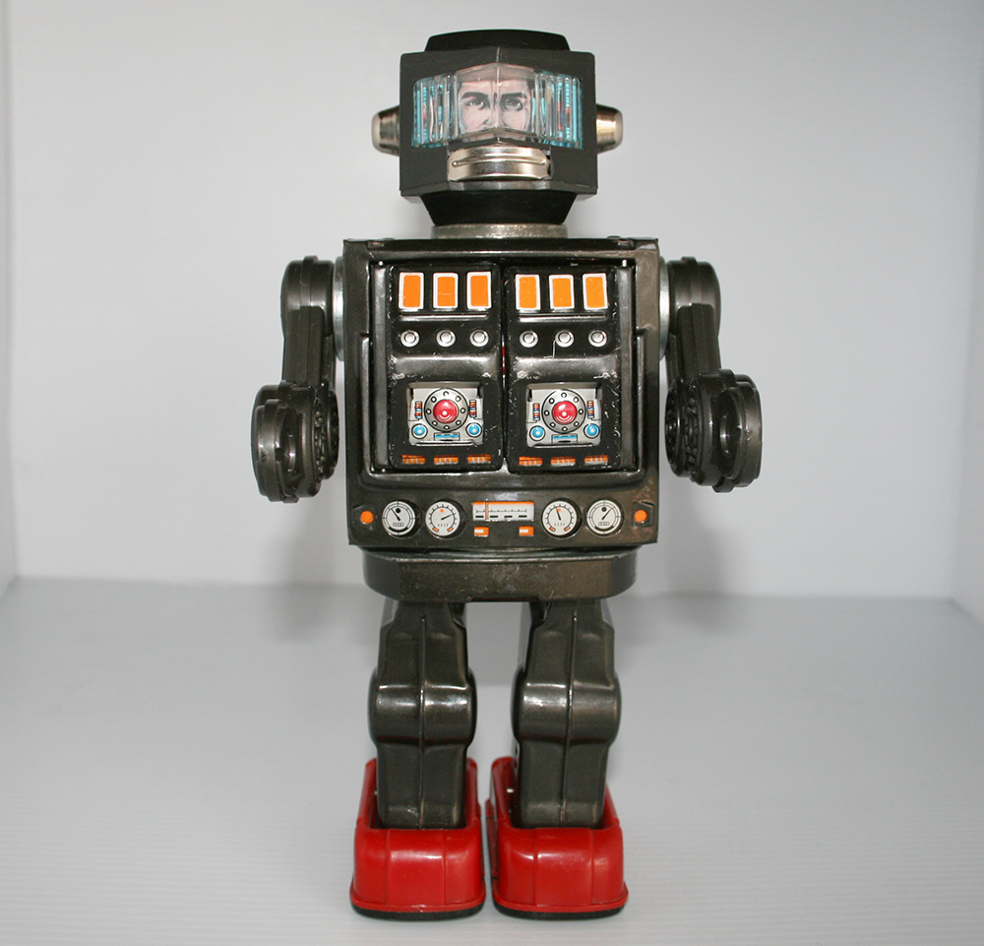

Two Scenarios
Trusted robot, whom you’ve known for many years.
Intelligent, dependable, and wise.
“Pull the switch!”
Trusted human, whom you’ve known for many years.
Intelligent, dependable, and wise.
“Pull the switch!”

Slide 38
Denouement

Slide 39
Empirical Findings
Almost half the participants didn’t want to pull the switch:
“people shouldn’t take decisions like this upon themselves”
“saving five people doesn’t warrant the death of an innocent person”

Slide 40
Empirical Findings
Almost half the participants didn’t want to pull the switch:
“people shouldn’t take decisions like this upon themselves”
“saving five people doesn’t warrant the death of an innocent person”
When the switch was pulled, who is to blame for the death of the
innocent bystander?
1. In the case of the human advisor:
The majority of respondents wanted to share blame equally between the
advisor and the switch puller.
2. In the case of the robot advisor:

Slide 41
Empirical Findings
Almost half the participants didn’t want to pull the switch:
“people shouldn’t take decisions like this upon themselves”
“saving five people doesn’t warrant the death of an innocent person”
When the switch was pulled, who is to blame for the death of the
innocent bystander?
1. In the case of the human advisor:
The majority of respondents wanted to share blame equally between the
advisor and the switch puller.
2. In the case of the robot advisor:
None of the respondents blamed the robot!

Slide 42
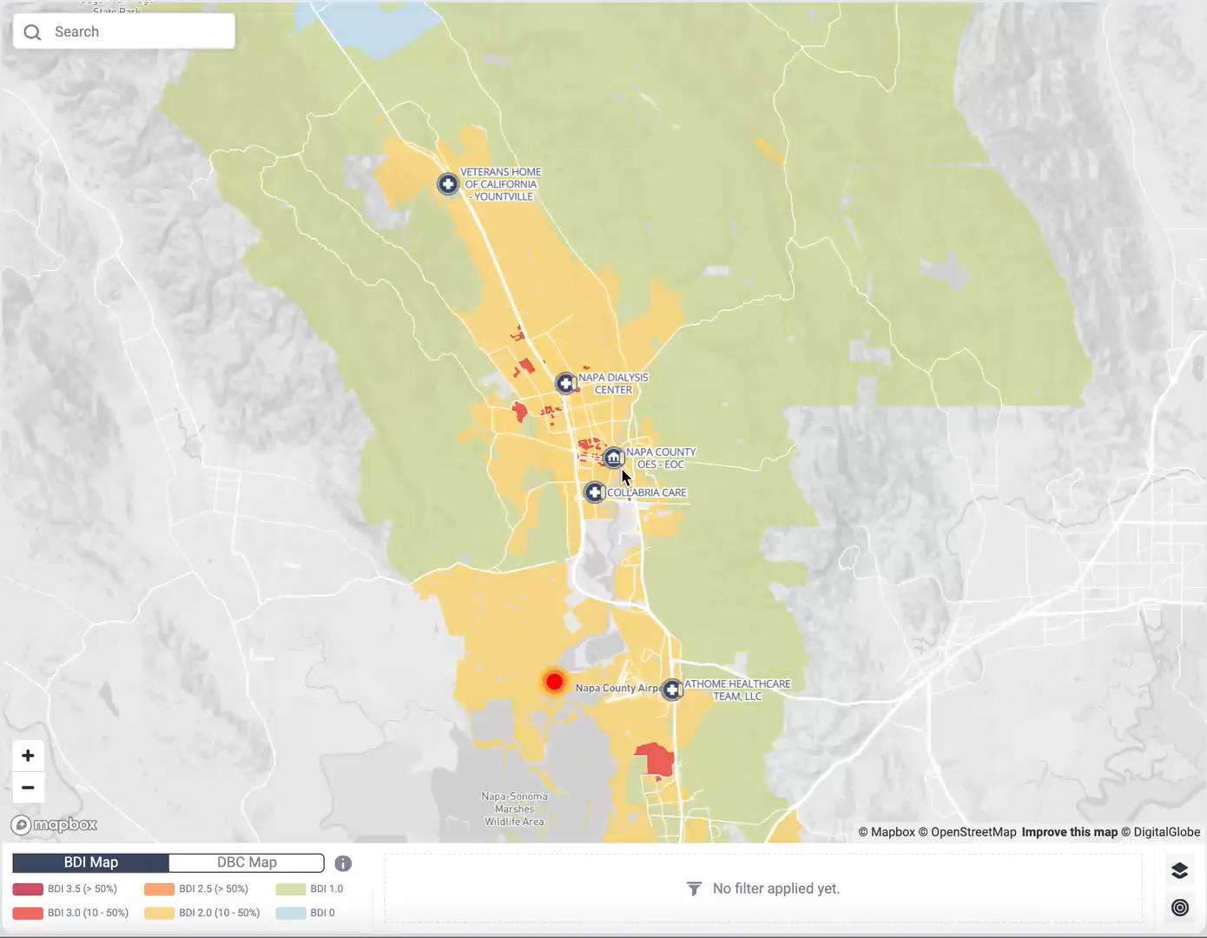
One Concern – Emergency Responder Tools

Slide 43
Caveats
“We are in no way ever telling these first responders that we are replacing your decision-making judgment or capability.”
As the reach of artificial intelligence expands, “… it remains difficult to convey concepts of uncertainty to officials who often
do not have technical backgrounds and who want clear-cut answers.”
Source: https://www.nytimes.com/2019/08/09/us/emergency-response-disaster-technology.html

Slide 44
How Machines Learn
Machines can share their knowledge at extremely high speeds compared to humans, who must do knowledge sharing via language.
Machines will have access via the Internet to all of the knowledge of our human-machine civilization, and will master all of this knowledge.
Nonbiological intelligence will be able to download skills and knowledge from other machines, as well as absorbing all knowledge from humans.
Adapted from Ray Kurzweil’s “How to Create a Mind:
The Secret of Human Thought Revealed” (2012)

Slide 45
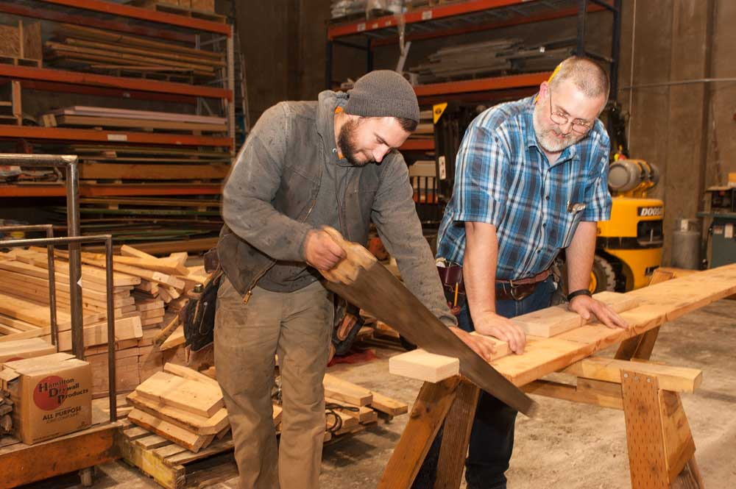

How Humans Learn

Slide 46
Myths of Autonomy
Myth 4: Autonomous systems are autonomous.
Myth 5: Once achieved, full autonomy obviates the need for human-machine collaboration.
Myth 7: “Full autonomy” is not only possible, but is always desirable.
Source: The Seven Deadly Myths of “Autonomous Systems” Bradshaw, Hoffman, Johnson and Woods (2013)

Slide 47
Takeaways
Identification of Interaction Dimensions
Attention and Cognitive Loading
Autonomy isn’t one-dimensional
Observability & Predictability
Feedback & Causality
Augmentation/Symbiosis as organizational design
Explicitness of Representations
Context
Distributed Cognition
Resource Allocation
Repair and Skill Attribution
Explainability
Trust
Learning
Good online resource:
MITRE’s “Human-Machine Teaming Systems Engineering Guide” (2018)
Notes:
May only be apparent through experience and/or breakdowns and tradeoffs

Slide 48
To continue the discussion…
David Burke
davidb@galois.com
503-330-9512

Slide 49
Backups

Slide 50
Human-Machine Difficulty Matrix
Notes:
This diagram is adapted from a paper in Pietro Michelucci’s Handbook of Human Computation, making the argument about complimentary capabilities between humans and machines.

