Slide 1


C3E 2019 Workshop Summary
Computational Cybersecurity in
Compromised Environments (C3E)
December 6, 2019

Slide 2
Agenda
Workshop Introduction
  Brad Martin & Dan Wolf
2019 C3E Workshop Overview
  Dan Wolf
Track Outcomes
  Kimberly Ferguson-Walter
  Danko Nebesh
Challenge Problem
  Dan Wolf
2020 Workshop Proposed Topics

Slide 3
Evolution of C3E
C3E has become a community of interest focused on novel approaches and solutions needed, drawn from multiple areas
  Identify ideas for strategic and near-term research
Recent workshops placed more emphasis on diversity of disciplines from the astronomy, behavioral sciences, biomedical informatics, financial assessment, and other areas.
1st Challenge problem involving epidemiological intelligence reaffirmed the value of analytic diversity for emerging problems
  C3E 2013/4/5/6/7/8 Challenge Problems focused more directly on cyber security

Slide 4
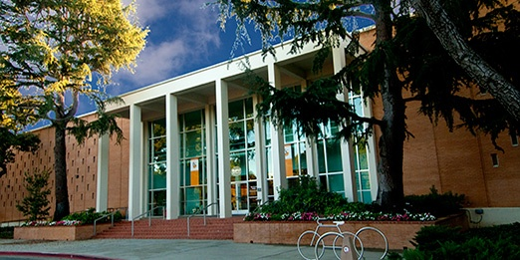
2019 C3E Workshop
SRI – Menlo Park CA

Slide 5
Workshop Overview
Examine key elements explored during 2018 Workshop
  Cognitive Security & Human-Machine Teaming
Secure and support cognitive activities (e.g. decision-making, analytic judgements) that may be vulnerable to incorrect, incomplete, or misinformation in cyber contexts
Consider the role of AI, human, and cyber context in decision-making and its influence; the accuracy of human behavior modelling; the role of humans and machines as advisors of each other

Slide 6
C3E 2019 Workshop
2019 Theme: Role of Humans in Cyber Environment
Cognitive Security
  Decision–making and analytic judgements
  Purposeful misinformation
  Cognitive biases
  Explicit adversarial manipulation
Human Behavior
  Role of AI, human, and cyber context in decision–making
  Accuracy of human behavior modeling
  Leveraging of human biases to the defender's advantage
Location: SRI International, Menlo Park, CA
Attendees: 72+ registered (23/Gov 28/Academic 9/Industry 3/Other plus support)
Co-Chairs: Celeste Paul & Dan Wolf
Dates : 16-18 September 2019

Slide 7
Monday | September 16, 2019
8:45 AM | Welcome - Brad Martin, Celeste Paul, Dan Wolf - Pat Lincoln, SRI International, Director, Computer Science Lab
9:15 AM | 2019 C3E Challenge Problem - Dan Wolf
10 AM | Invited Talk – David Burke, Galois Inc.
11 AM | Plenary Introduction of Human Machine Teaming – Danko Nebesh, Bill Streilein
11:30 AM | Lunch Speaker – Col Benjamin Ring, USCYBERCOM
1 PM | Invited Talk – Rebecca Goolsby , Office of Naval Intelligence
2 PM | Plenary Introduction of Cognitive Security – Kimberly Ferguson-Walter, Adam Hill
2:20 PM | -------- Initial Track Sessions --------
4:15 PM | ------- Plenary Discussion: Track Ideas Incubation Panel -------
5 PM | Agenda Review

Slide 8
Tuesday | September 17, 2019
8:40 AM | Call to Order SRI Auditorium – Celeste Paul, Dan Wolf, C3E Co-Chairs
8:45 AM | Invited Talk – Coty Gonzalez, Carnegie Mellon University
9:45 AM | ------------ Morning Track Sessions ------------ Cognitive Security Human Machine Teaming
11:45 AM | Lunch Speaker – C3E Workshop Exercise
1 PM | Invited Talk – William W. Streilein, MIT Lincoln Laboratories
2 PM | ------------ Afternoon Track Sessions ------------- Cognitive Security Human Machine Teaming
4:15 PM | ------- Plenary Discussion: Track Ideas Incubation Panel -------
5 PM | Agenda Review
5:05 PM | C3E Poster Session
6 PM | No Host Dinner at Mama Coco Cocina Mexicana. Optional.

Slide 9
Wednesday | September 18, 2019
8:15 AM | Call to Order SRI Auditorium – Celeste Paul, Dan Wolf, C3E Co-Chairs
8:30 AM | Invited Talk – Patrick Lincoln, SRI International
9:45 AM | ------------ Final Track Sessions ------------ Cognitive Security Human Machine Teaming
11:00 AM | Plenary Review of Track Efforts
11:45 PM | Summary and Closing Remarks – Brad Martin, Celeste Paul, Dan Wolf
12 PM | Workshop Adjourns
1 PM | Post Workshop – Government Only Session – Review of Outcomes
2:30 PM | Post Workshop Discussions Adjourn

Slide 10
Invited Talks
David Burke – Human-Machine Teaming: Theme and Variations
Col Benjamin Ring – Data Driven Decisions
Coty Gonzalez – Role of Deception in Attack Decisions Using Cybersecurity Scenarios
William W Streilein – Role of Cognitive Fatigue and Overload in Facilitating Cognitive Compromise
Rebecca Goolsby – Human, Bots and Cyborgs: Social Cyber Behavior and the Challenge of Online Influence
Patrick Lincoln – Engineering Teams of Humans and Machines

Slide 11
Track Outcomes

Slide 12
Cognitive Security Track Results
Kimberly Ferguson-Walter (NSA R2)
Adam Hill (UC Berkeley)
Palvi Aggarwal (CMU)

Slide 13
Cognitive Security Track
Humans are subject to cognitive limitations and bias, which leads to lower quality decision making and bad decisions.
Cyber attackers take advantage "cognitive biases" to launch various attacks.
Improved understanding of cognitive biases in cyber domain could be used to strengthen cybersecurity.
Network owners & defenders can use the “home-field advantage” to present information to attackers to exacerbate innate human biases in order to delay, disrupt, or deter the attack.
Improve the cognitive security of a relevant population by detecting and mitigating individual and group-level biases.
Explore means to detect and mitigate biases; decision-making processes at risk; and methods for exploit biases in attackers
Track leads: Adam Hill, Kim Ferguson-Walter, Palvi Agarwall

Slide 14
Methodology
Four Track Sessions
Guiding Questions
  How to take advantage of the attacker’s cognitive biases for adaptive and personalized defense?
  How to detect and mitigate biases to ensure security?
Focus on Developing Research Proposal and Challenge Problem Ideas

Slide 15

Track Sessions
Session 1
  General Discussions on Guiding Questions
  Develop Focus Questions
  Assign and Split Into Subgroups
Session 2
  Subgroup Discussions
Session 3
  Subgroup Discussions
  Identify Research Proposal & Challenge Problems
Session 4
  Subgroups Develop Write-Ups

Slide 16
Resulting Focus Areas
White Paper/Challenge Problem/Proposal
Identifying Data
Bias Differences
Identifying Biases
Understanding Attackers
Technology

Slide 17

Research Proposals
Hacking Sunk Costs
Human Cognition
Cognitive Security Data Mining
Defense Through Transparency
Attacker Taxonomy
Bias Questions

Slide 18
Hacking Sunk Cost
Induce and exacerbate biases in cyber attackers to increase attacker cost
Develop scenarios in HackIT to induce and exacerbate sunk cost bias
Conduct experiments with human subject experiments to test hypotheses
Formal proposal developed: Arizona State University (lead); Carnegie Mellon University; University of Texas El Paso; NSA Research advisor
Builds on existing work across collaborators; New collaboration opportunity due to C3E

Slide 19
Human Cognition
Computational Cognition
Define a cyber security modeling framework built on the theory of human cognition in a similar fashion that the theory of computational complexity played in modern cryptography.
Resolve the runaway engineering practices of cyber deceit by scientific theories of cyber security
Re-cast the theory of cyber security as a theory of cyber-social security

Slide 20
Cognitive Security Data Mining
Identify existing data sets suitable for use in modeling cognitive bias in cybersecurity, simulating cyber-attack behaviors, training artificial intelligence models, and developing human-computer teaming for cyber defense.
Locating Existing Data Sets
Data Standards
Data Access And Sharing
Data Requirements For Modeling

Slide 21
Defense Through Transparency
Develop methods and mechanisms that give people more understanding of an influence campaign and thus are able to make better decisions
  National Public Social Media
Disinformation is constructed carefully – identify the tactics, techniques and procedures
Empowering the individual would raise the cost of the Disinformer
Invert costs of misinformation and reality-based information

Slide 22
Attacker Taxonomy
Formulate An Attacker Taxonomy
  Not An Attack Taxonomy
  Cognitive Attributes
Goal: Better understand attackers to improve defenses
Develop and validate an attacker taxonomy
Investigate techniques for measuring cognitive and socio-cultural dimensions of cyber attackers
Conduct experiments to evaluate the use of the taxonomy and associated measurements
Exploit these measures to inform effective defensive strategy

Slide 23
Bias Questions
How do biases differ depending on culture, identities, skills, and generations?
How do cyber attackers different from the general population?
Are there individual differences such as personality and decision making style, that tend to make a cyber operator more or less vulnerable to a bias?
Can we identify key cues or signals about what hackers use to determine to avoid or attack a victim?
Which mathematical models can be used to express known cognitive biases?
Are there tests out there already, that measures personality traits of hackers? If so what types of results came out?
What existing research results directly applies to cyber and which do not and why?

Slide 24
Human Machine Teaming Results
Danko Nebesh (NSA R6)
Sarah Joseph (NSA R6)
Bill Streilein (MIT LL)
Marco Carvalho (FIT)

Slide 25
Human Machine Teaming
J.C.R. Licklider’s vision as described in his 1960 paper titled “Man-Computer Symbiosis.”
  To combine human and computer capabilities so that “human brains and computing machines will be coupled together very tightly, and that the resulting partnership will think as no human brain has ever thought and process data in a way not approached by the information-handling machines we know today.”

Slide 26
What is a team?
A team is a group of people who come together to accomplish a common goal.
Team members leverage their individual strengths as they coordinate activities and solve problems together.

Slide 27
HMT Tradeoffs
Strengths
Increased trust in and use of automation
Allows people to contribute when work proceeds at machine speeds
Ability to offload some cognitive work onto machine teammate
Integrated provenance information across disparate tools & data
Increased efficiency, completeness, correctness, and volume of work.
Take advantage of natural assets of humans and machines
  Human: Creativity, context-sensitivity, real-work knowledge
  Machine: speed, memory, capacity, indefatigability, computational rigor
Weaknesses
Loss of control by user
Wasted compute on dead ends
Difficult for person to specify needs (person may not know needs)
Privacy concerns (machine monitoring user, storing knowledge about user)
Increased communications cost
Greater burden on user to keep track of computer-assisted work.
Attentional costs for human
Potential over-reliance on automation

Slide 28
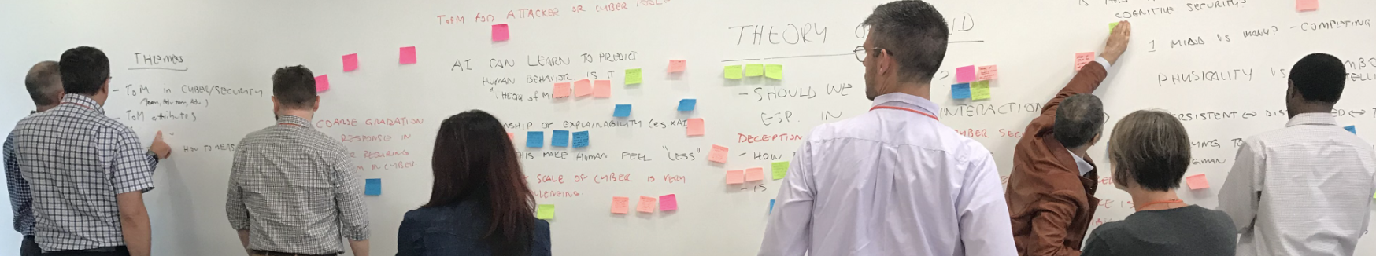
Methodology
Four Track Questions
  How do humans and automation properly share internal mental states (beliefs, intentions, etc.) with one another?
  How to create and maintain a shared context between humans and machine/automation?
  What are the most appropriate modes of interaction between humans and automation/intelligent systems in cyber operations?
  How do we quantify the performance or effectiveness of human-machine teams?
Focus on Developing Research Agenda and Challenge Problem Ideas

Slide 29
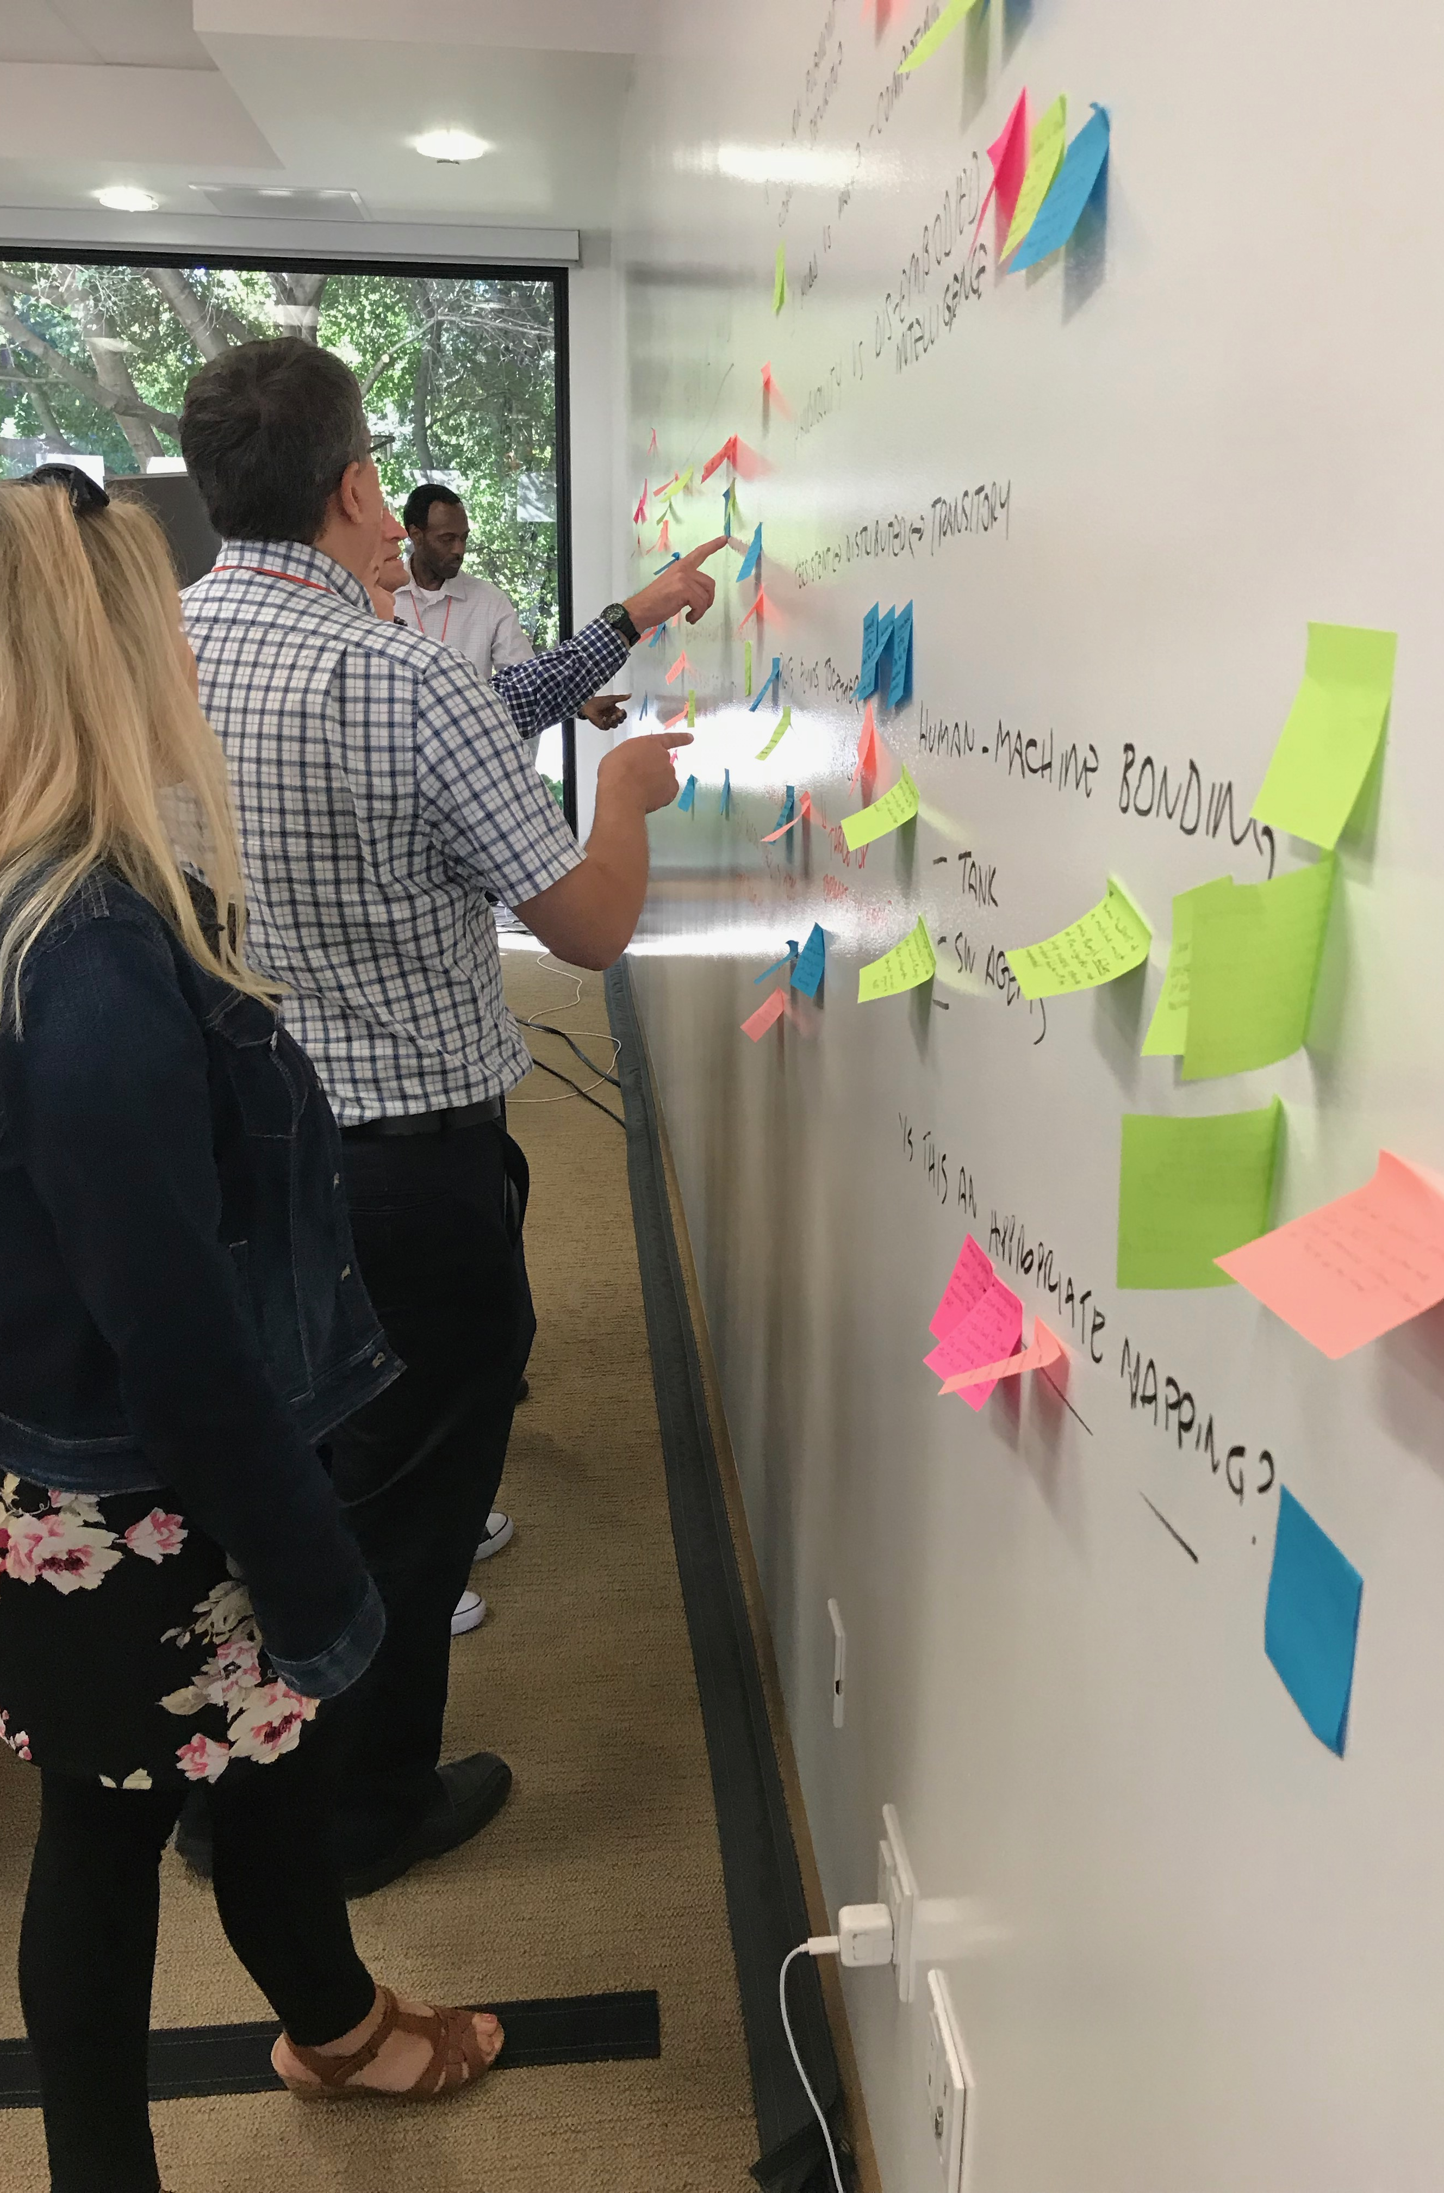

Track
Sessions
Session 1 - Theory of Mind
Brief: HMT: Theme and Variations
Brainstorming
Session 2 - Context
Brief: HMT: The Importance of
Common Ground
Brainstorming
Session 3 - Interactions
Brief: What to Talk About in Cyberspace:
Interacting with a Machine Teammate
Brainstorming
Session 4 – Wrap-up
Summarize discussions
Propose research ideas
Develop outbrief

Slide 30

Research Questions
What carries over from HHT to HMT?
What role does inter-predictability play?
How are human and machine teammates to maintain common ground?
What should a non-physical MT look like?
How is the domain to be depicted?
What internal metrics of teamwork are useful for HMT in Cyber?
How are roles determined within cyber HMT?
How will HMT in Cyber fit into organizational and social contexts?

Slide 31
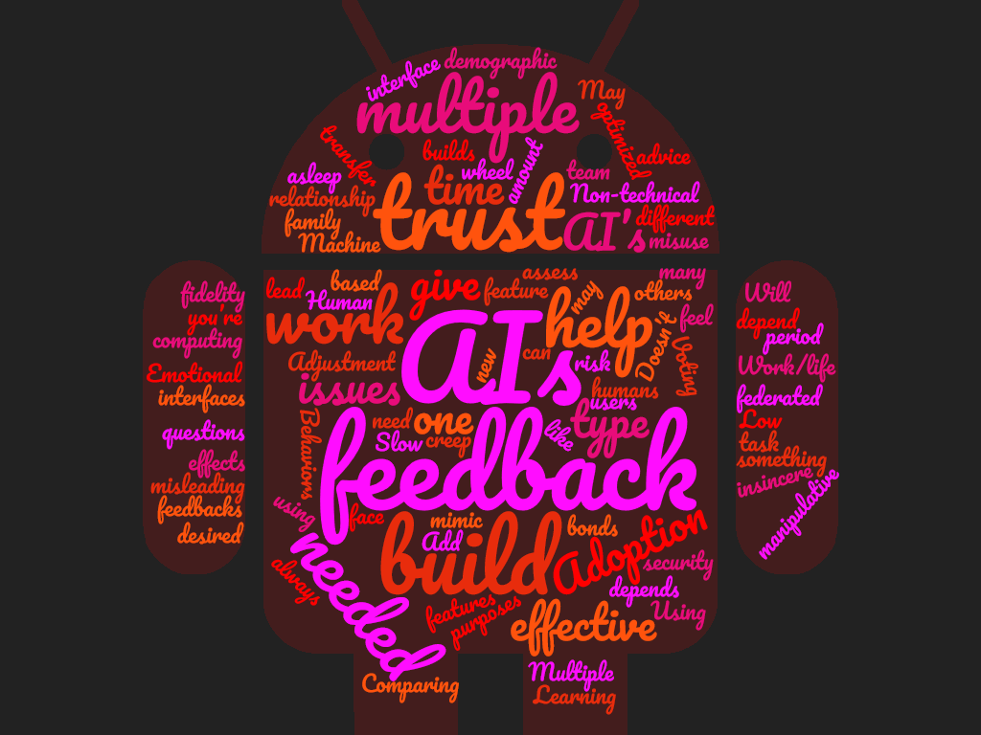
What carries over from HHT to HMT?
What’s different in teaming with non-physical machines in general and in cyber in particular?
Are there differences in the content and maintenance of common ground in cyber HMT?
What elements of cyber context need to be considered and represented for enabling effective teamwork in cyber?
What is the mechanism for trust calibration in cyber HMT?

Slide 32
What role does inter-predictability play?
Can a deep neural network serve to predict human behavior for a machine?
Does the machine need an explicit representation of human beliefs and tendencies?
What are the equivalent knowledge requirements for people about their machine teammates?
  Especially in a cyber environment running at machine speed.
What role does explanation play?
How can humans communicate change in mental availability (migraine)?

Slide 33
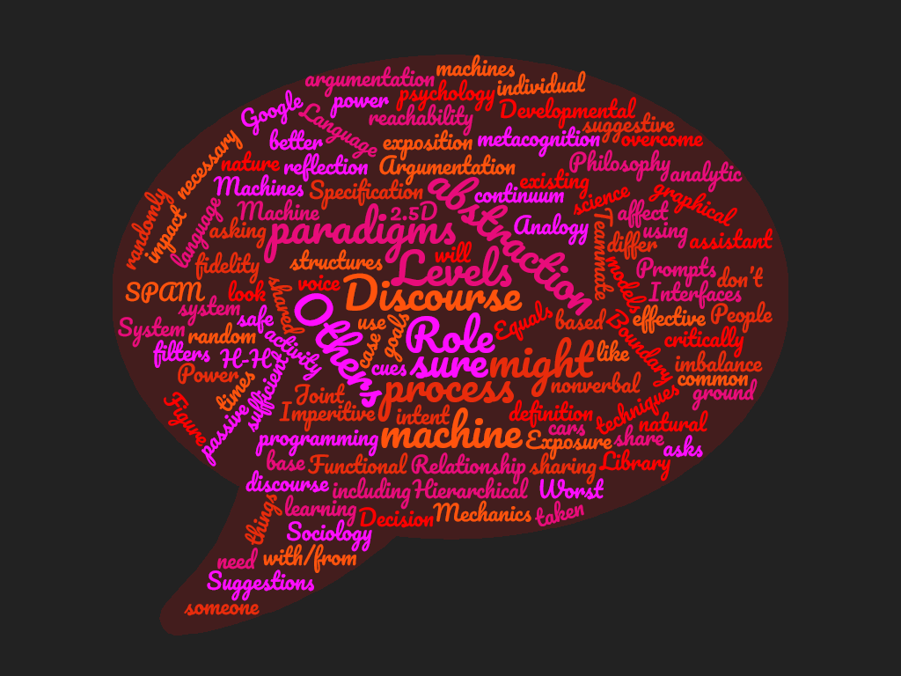
How do HT and MT maintain common ground?
What is the nature of their interaction in doing this? Dialogue?
  Interaction dialogue will be embodied in various modalities: visual interaction, text and speech, perhaps VR/AR.
  What is the content of that dialogue?
  How will dialogue repair be conducted when misunderstandings or incomplete information transfer happen?

Slide 34

What should a non-physical HMT look like?
How should a non-physical teammate present itself?
What effect will the presentation have on cyber teamwork?
Is anthropomorphism to be embraced or countered in particular contexts (Cyber)?
What is the goal of anthropomorphic design?
  Improve communication?
  Improve performance?
  Increase trust?
  Build relationship?

Slide 35

How is the domain to be depicted?
How are levels of abstraction to be represented and navigated?
What interaction metaphors and modalities are appropriate for HMT in cyber?
How are elements of common ground and other elements of teamwork to be represented for cyber HMT?

Slide 36
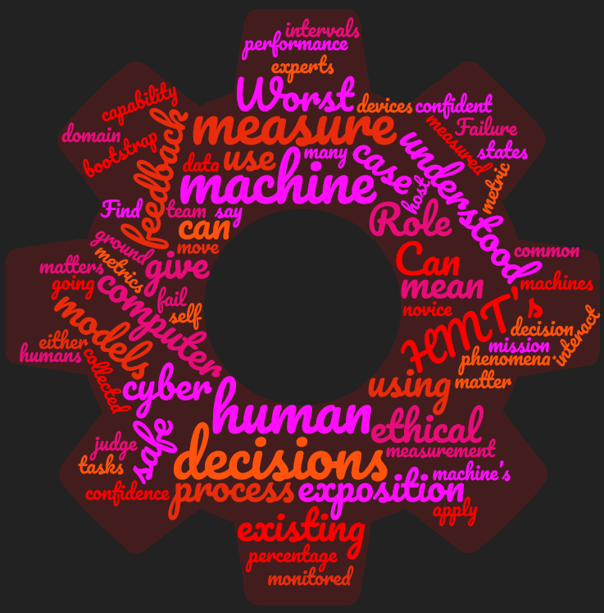
What metrics are useful for HMT in Cyber?
Interpredictability?
Common ground agreement?
Congruence of teammates’ models of context?
Accuracy and completeness of teammates’ models of each other?
Calibration of trust within the team?
Comparison with H-H teams?

Slide 37

How are roles determined within cyber HMT?
Dynamic role allocation is important to team effectiveness and resilience.
  How much authority/autonomy does the machine teammate have to allocate roles?
  What roles in which contexts are better accomplished by people and by machines?

Slide 38

How will HMT in Cyber fit into organizational and social contexts?
What organizational and social factors are relevant to HMT in cyber?
What factors will affect adoption of HMT in cyber?
How can HMT be introduced to gain trust?
What is the role of privacy in HMT?
How do non-digital artifacts come into the HMT context?

Slide 39
HMT: TURNSTONE2
Overall Goal: To define what the analyst work environment looks like in 10 years in an AI/ML-enabled future and provide guidance and requirements to NSA AI/ML investments
Activities:
  Design thinking workshops: Work with analysts to elicit ideas of a future human/machine teaming environment
  Design socials: Engage with the wider NSA analytic workforce to socialize, discuss, and iterate on early use cases of AI/ML work environments
  Design requirements: Develop a set of notional use case scenarios and program requirements to inspire, inform, and direct existing and new investments in AI/ML technologies
Findings
  Initial findings expected January/February 2020.

