Slide 1
C3E Malicious Cyber Discovery
Doug Carson
August 7, 2014
EMG material rebranded to Keysight

Slide 2
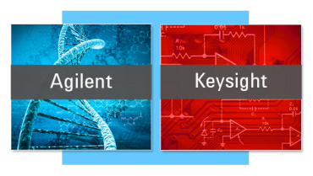
Background
Life Sciences
Measurement
Electronic
Measurement

Slide 3
Analysis Technique - Similarity Networks
Similarity networks are used to visually identify proteins with similar biological functions using a metric based on DNA sequence similarity.
Force directed display to identify clusters
Atkinson, Holly J., et al. "Using sequence similarity networks for visualization of relationships across diverse protein superfamilies." PloS one 4.2 (2009): e4345.

Slide 4
Deriving a Similarity Metric

Slide 5
Distance Metric
F
A
S
T
-
C
A
-
T
S
Mismatch
+1
Match
+0
Delete
+1
Match
+0
Insert
+1
= 3

Slide 6
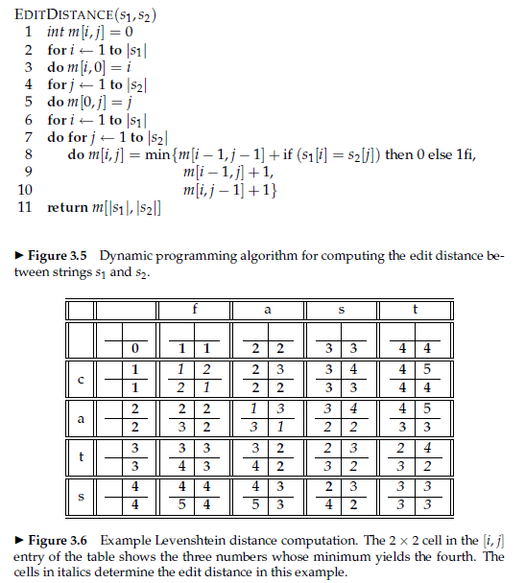
Dynamic Programming Algorithm
Levenshtein Metric
At least 1M cell updates per pair of samples

Slide 7
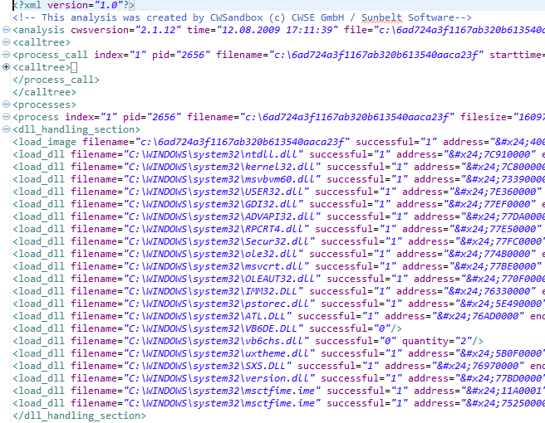
Similarity Networks Applied to Cyber Discovery
PC/Server
GET /
Sandbox
Bare metal
Response Header
Ignored
Machine metadata
In-band network metadata

Slide 8
Machine Metadata Heatmap
~20x20
25 hours to compute on 4 core / 2 hyperthread Westmere

Slide 9
Machine Metadata Malware Similarity Network

Slide 10
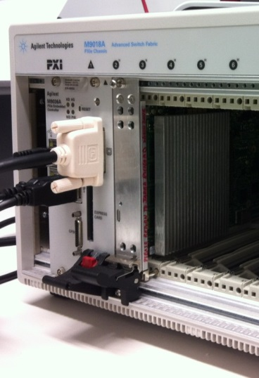
Accelerated Processing
PE
5
Systolic Array
PE
4
PE
3
PE
2
PE
1

Slide 11
Why No PREDICT Data?
No PREDICT access to UK researchers…yet.
Strong support from HMG and DHS S&T to build partnerships
Contagio used a data source
Gh0st
Taidoor
IXESHE
Enfal-Lurid

Slide 12
Experiment 1
Is there correlation between network malware samples?

Slide 13
Heatmap

Slide 14
Classification Results

Slide 15
Network Metadata Similarity Network

Slide 16
Experiment 2
Is there correlation at a client / server level?

Slide 17
Client Server View

Slide 18
Strong Correlation

Slide 19
Conclusions
Simple underlying technique
Well established in bioinformatics
Can be accelerated for low SWaP
Machine metadata is useful complement to discovery task
Good performance in identifying malware strains
Provides additional features to classify against OSINT
Similarity networks on network metadata insufficient for discovery. Additional features required
Connection / flow metrics
Endpoint metadata
Sequencing can be used to derive signatures / fingerprints

