Slide 1
Recognizing the Adversary:
Track Report
C3E 2015

Slide 2
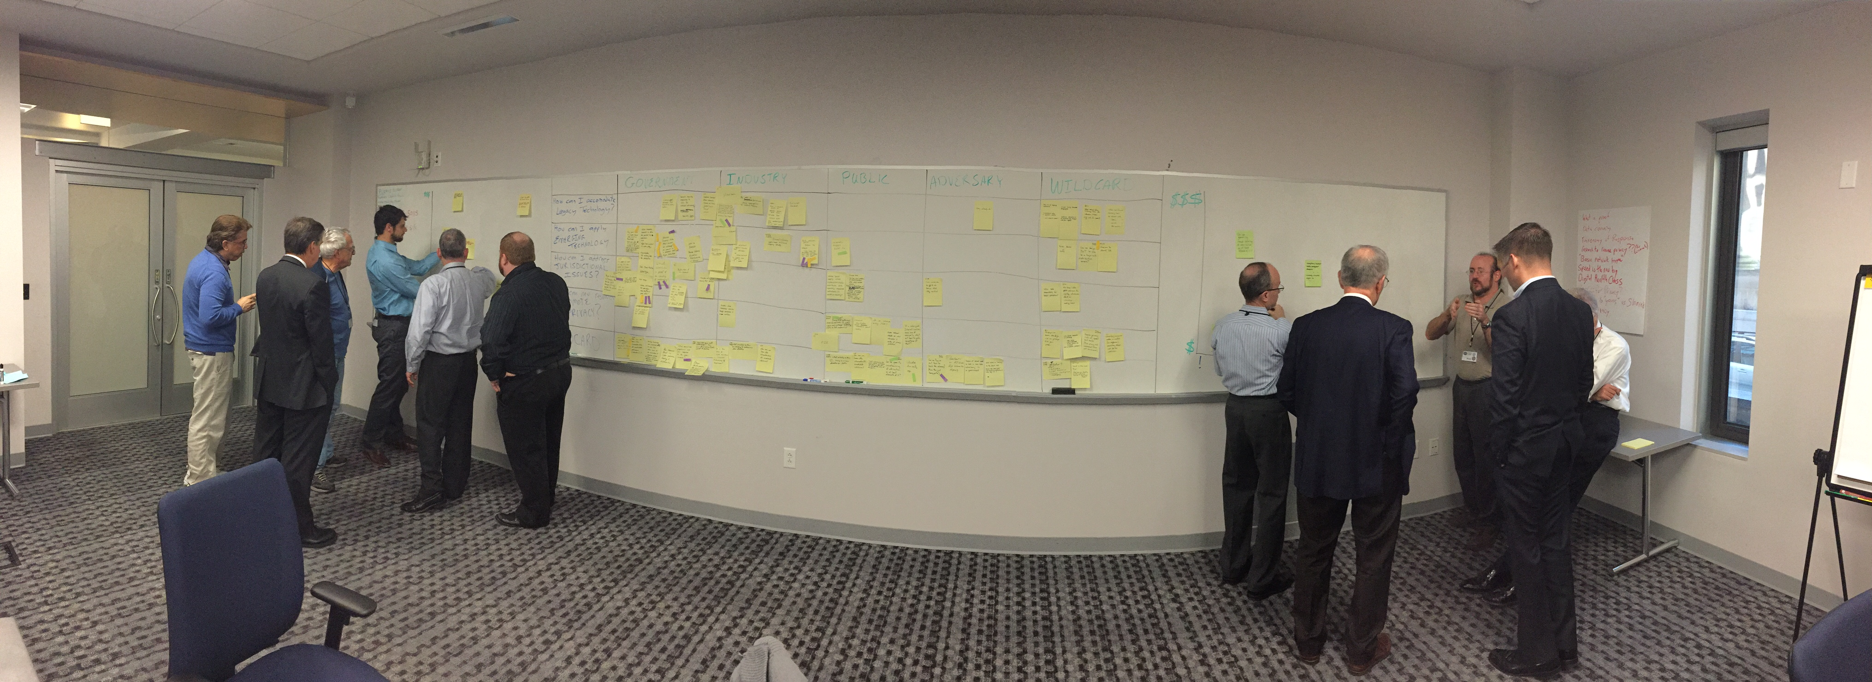
Work in Progress – organizing ideas

Slide 3
Recognizing the Adversary – Work Groups
IOT Sensors for Shared Situational Awareness
Building Attribution Profiles & Self-tracking Data
Recognize the Adversary through Smart Data & Hoop Jumping
Herding the Adversary

Slide 4
IOT Sensors for Shared Situational Awareness

Slide 5

IoT Sensors for Shared Situational Awareness
Big Network
&
Recognizing the Adversary

Slide 6
New Ideas
  Deploy IoT sensors and for Monitoring (e.g., Sprint, Quest)
  Situational analytics applications
  based on classifier and property
  at ISP infrastructure
    Monitor cybersecurity
    Smart City

Slide 7
Objectives
Obtaining data we did not have before
  Physical data
  Environmental data
More timely
  Allows faster response (& mitigation) to surprising (adversarial?) patterns
Data from the physical and technical edge

Slide 8
Schedule and Budget
Align with OSTP smart city initiative
  Seeding with NSA IOT Lab
Obviously, < $500k

Slide 9
Building Attribution Profiles & Self-tracking Data

Slide 11
Recognize the Adversary through
Smart Data and Hoop Jumping

Slide 12
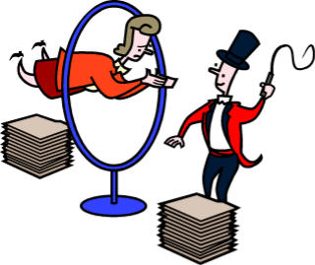

Recognize the Adversary through Smart Data and Hoop Jumping
You steal my cycles to steal my data.
You give me your cycles to enable you to do what I want with my data

Slide 13
The big idea
Redesign the concept of “data” from flat, static ones and zeros and turn “data” into an active “smart” living element
  If you want the information in the data you must engage with the data via some kind protocol. This protocol then gives the defender a set options.
  If you want the information without using the protocol the expense is high on a per data element basis
Build a set of layered defenses around this smart data that acts like a cyber maze, make the adversary jump through hoops
  The way the maze is run increases the amount of information leaked
  The details of the maze run provides information to the smart data for inform how it should interact with the environment outside its normal operating environment

Slide 14
Impacts
Cultural shift in infrastructure and data storage
  Increased cost to the adversary & defender
  Increased risk of exposure of the adversary
  Increased positive control of ones own data
  Increased options for action
Defender shift in shaping the cyber terrain
  Reduced misattribution
  Shorter attribution lifecycle
  Increased diversity of response options

Slide 15
Consequences of Attribution
Why be able to recognize the adversary?
  Attribution enables directed measured response
  That response enables deterrence
Higher fidelity attribution enables a wider range of response options
There is a potential difference between who took the data and who currently has the data
  We can enable non-repudiation for “where is Waldo now”

Slide 16
Herding the Adversary

Slide 17
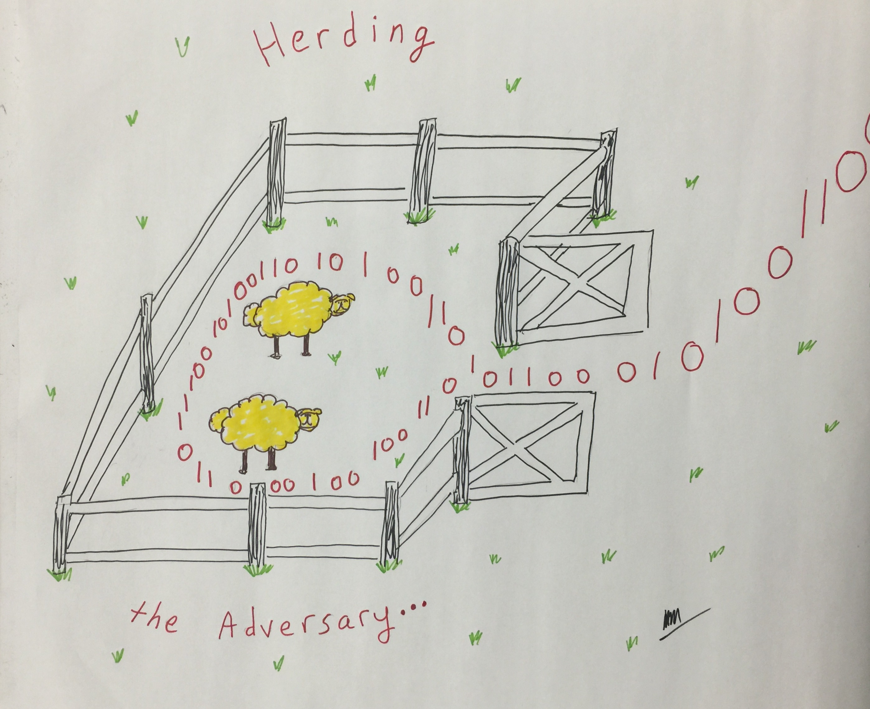

Slide 18
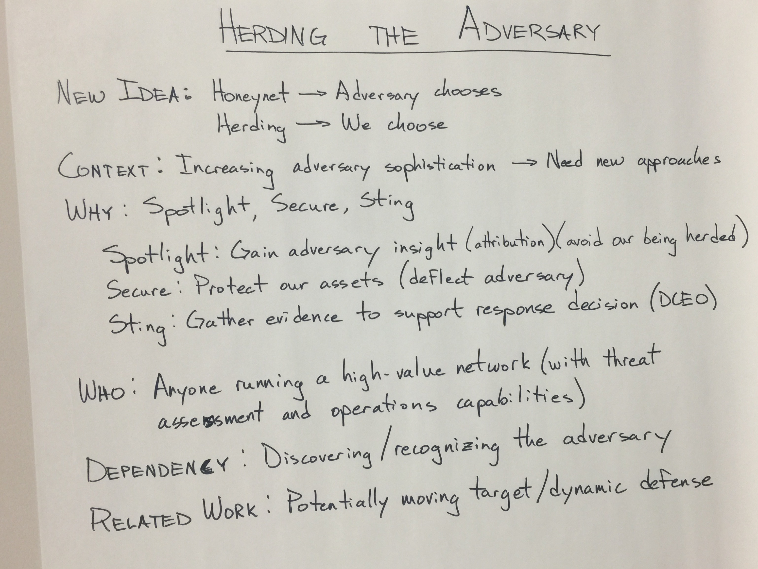

Slide 19
