Slide 1
Checked C: Safe C, Incrementally
Michael Hicks (UMD & Correct Computation, Inc.)
Joint work with Andrew Ruef (UMD, IDA/CCS), Leonidas Lampropoulos (UMD, Upenn), Ian Sweet (UMD), David Tarditi (MSR)
High Confidence Software and Systems (HCSS) 2019

Slide 2
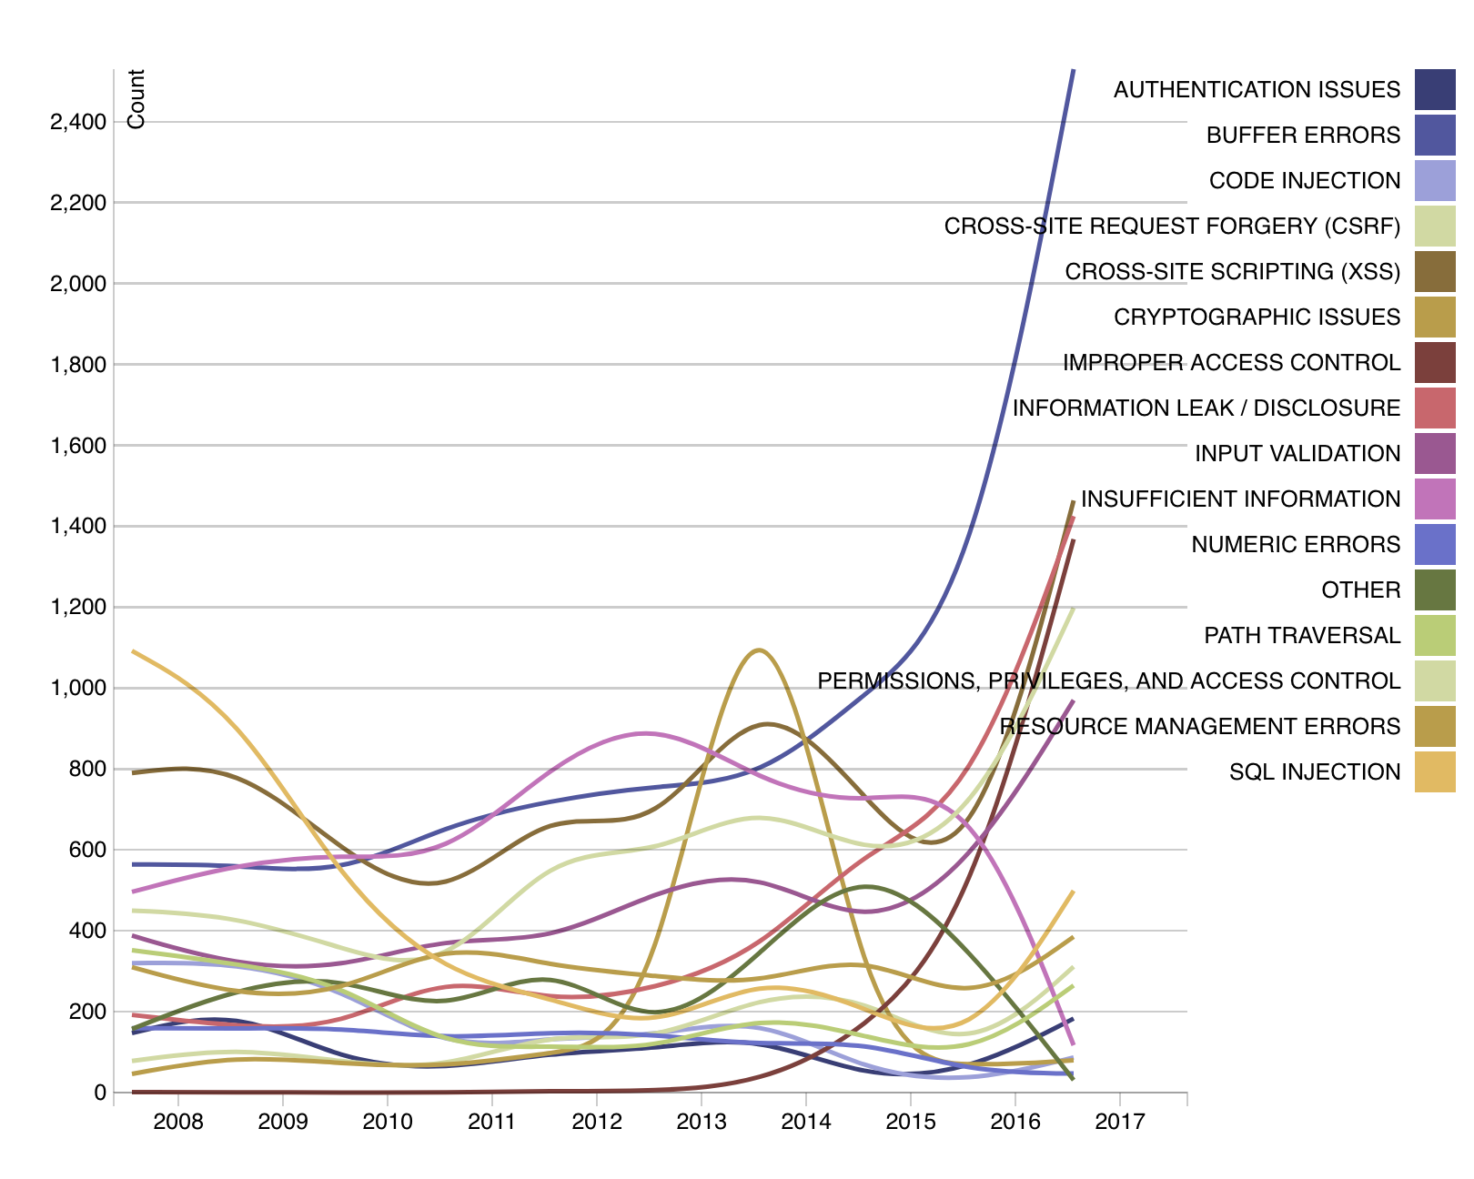
I get older, the problems stay the same
Buffer errors
https://nvd.nist.gov/general/visualizations/vulnerability-visualizations/cwe-over-time#vuln-type-total-by-year-title

Slide 3
Motivation
Lots of existing C code out there
  One estimate – 8.5 billion lines of C code
  How much of it is safe?
  How much of it do we have to trust?
Paths to trusting this code:
  Find and fix the bugs (fuzzing, static analysis)
  Mitigate the bugs (CET, MPX, ASLR)
  Rewrite the code
    A new language, Java, Rust, etc.
    A new dialect of C, Cyclone, CCured, Deputy

Slide 4

Checked C
A different take at making C more reliable and secure
Extension to C with new types that can express spatial memory safety
Language supports incremental conversion
  Mix checked and unchecked types
  Checked regions enforce safety within those regions
Automated conversion tool to add annotations for more safety
Implemented on top of clang/LLVM: https://github.com/Microsoft/checkedc

Slide 5
This Talk
Overview of Checked C’s safe pointers
Supporting incremental porting: Checked regions
  Checked regions cannot be blamed for run-time error
  Property formalized and proved in an idealized core calculus
Implementation and Evaluation
  Code changes small, run-time overhead small, too
Automated porting tool
  Converts C program to one with Checked C annotations
  Takes advantage of Checked C’s incremental nature to avoid over-conservatism

Slide 6
Checked C: Design
Making code spatially safe: checked types with declared bounds
  Dynamic bounds checking with opportunistic static elimination
  Safe initialization
  No temporal safety yet
Backward compatibility
  Strict extension to C
  No pointer representation change
  Unchecked and checked types can co-exist within the same function
  Checked regions: full spatial safety
    Can prove a “blame” property that characterizes isolation

Slide 7
Example: Pointers
int a;
int *b = &a;
becomes
_Ptr<int> b = &a;
Singleton pointers (_Ptr<T>) can be dereferenced safely

Slide 8
Example: Arrays and Pointers to Arrays
int vals[50] = { 0 };
int *pvals = calloc(n, sizeof(int));
becomes
int vals checked[50] = { 0 };
_Array_ptr<int> pvals : count(n) = calloc(n, sizeof(int));
Declarations of pointers to arrays are decorated with their bounds
Also a variant for NUL-terminated arrays

Slide 9
Example: NUL Terminated Pointers
char *str = calloc(n, sizeof(char));
char str2[N] = { … };
becomes
_Nt_array_ptr<char> str : count(n-1) =
calloc(n, sizeof(char))
char str checked[N+1] = { …, ‘\0’};

Slide 10
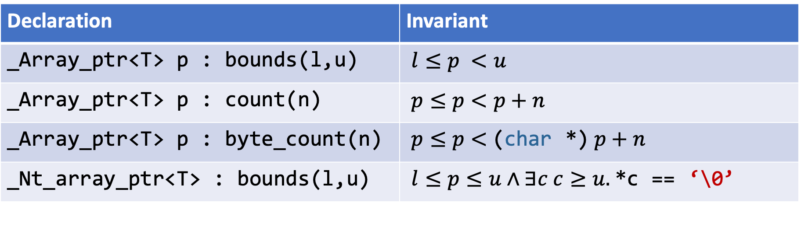
Bounds Declarations Summary
Declaration | Invariant
_Array_ptr<T> p : bounds(l,u) | $l≤p <u$
_Array_ptr<T> p : count(n) | $p≤p<p+n$
_Array_ptr<T> p : byte_count(n) | $p≤p<$(char *) $p+n$
_Nt_array_ptr<T> : bounds(l,u) | $l≤p≤u∧∃c c≥u.$ *c == ‘\0’
Expressions in bounds(l,u) must be non-modifying
  No mutations
  No calls
_Nt_array_ptr: Can read *u or write ‘\0’ to it

Slide 11
Bounds expansion
size_t my_strlcpy(_Nt_array_ptr<char> dst : count(dst_sz-1),
_Nt_array_ptr<char> src, size_t dst_sz) {
size_t i = 0;
_Nt_array_ptr<char> s : count(i) = src;
while(s[i] != ‘\0’ && i < dst_sz – 1) {
// bounds on s may expand by 1
dst[i] = s[i];
++i;
}
dst[i] = ‘\0’; // OK to write to upper bound
return I;
}

Slide 12
Bounds and Checks
Bounds declarations are program invariants
  Verified at compile time
Accesses dynamically checked against bounds at run time
  Unless proved safe at compile time
Checks inserted at
  Pointer dereference: int i = *p;
  Assignment: *p = 0;
  Compound assignment: *p += 1;
  Increment/Decrement (*p)++;

Slide 13
Partially Converted Code
We may not want to, or be able to, port all the code at once
We can use checked types piecemeal
  Reduces, but does not eliminate, risk of spatial problems
  Allows some hard-to-prove-safe idioms
The piecemeal approach has dangers

Slide 14
Unsafe Code
void more(int *b, int idx, ptr<int *> r) {
int oldidx = idx, c;
do {
c = readvalue();
b[idx++] = c; //could overflow b to corrupt r?
} while (c != 0);
*r = b+idx-oldidx; //bad if r now bogus
}

Slide 15
Checked Regions
Checked regions are scopes (or functions or files) that are internally safe. Within a checked region, we disallow
  uses of unchecked pointers/array types
  most pointer casts
  varargs

Slide 16
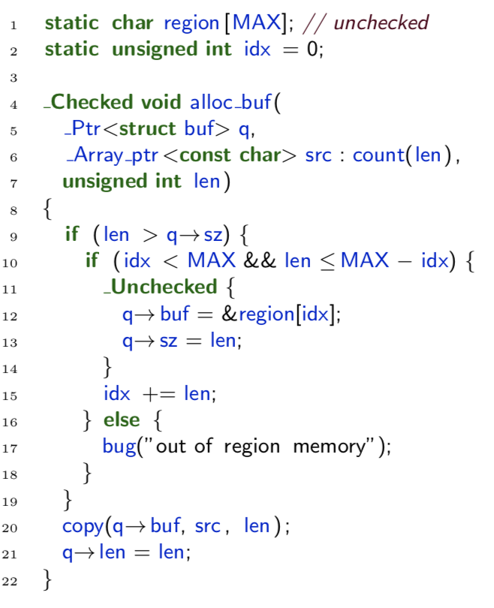
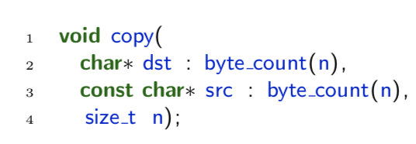
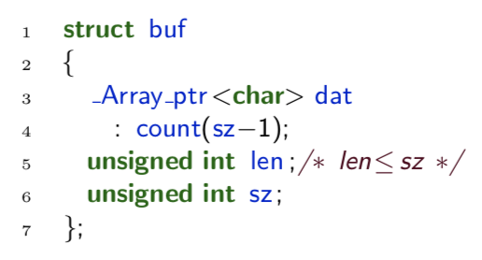
Example

Slide 17
Blame
What assurance do checked regions give us?
  If checked pointers reachable from checked regions are well formed, then pointer accesses by checked regions are safe
  Checked regions preserve well-formedness of pointers
  Hence: Checked code cannot be blamed for faults
We proved this property in a simple formalization of Checked C
  Called CoreChkC
  Development mechanized in Coq (see POST’19 paper)

Slide 18
Checked Interfaces
How do we use existing libraries (or system calls) that are not checked?
Annotate unchecked pointers with bounds at declaration sites
size_t fwrite(void *p : byte_count(s*n),
size_t s,
size_t n,
FILE *st : itype(_Ptr<FILE>));
Code of fwrite unchanged (must be proved safe via other means)

Slide 19
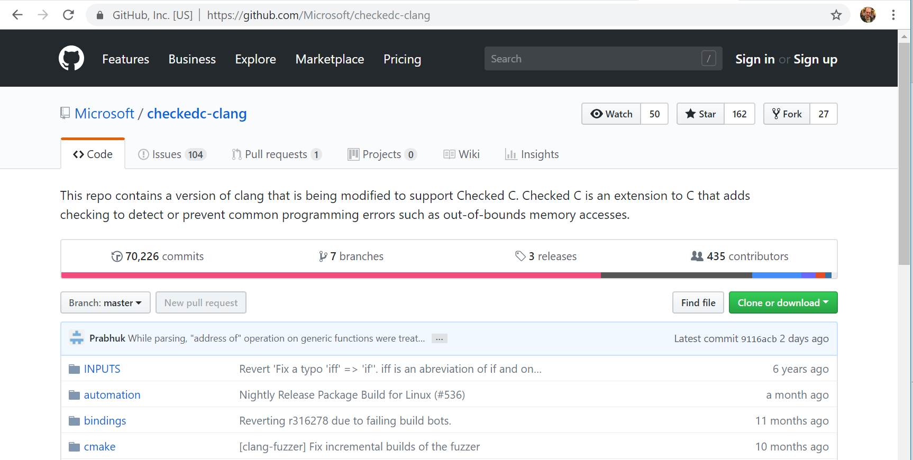
Implementation

Slide 20
Implementation
Extended C grammar implemented in clang
Extended clang type checker and code generator

Slide 21
Evaluation
How much code must be changed to port some C code to Checked C?
How hard are those changes?
Once changed, what is the overhead added:
  Running time
  Compilation time
  Executable size

Slide 22
Setup
Two benchmark suites, total of 15 programs:
  Olden
  Ptrdist
Benchmarks used by prior work on “safer C” (CCured, Deputy)
Converted by hand
12 Core Intel Xeon, 32GB RAM

Slide 23
Benchmarks
Benchmark | LoC | Description
bh | 1162 | Barnes & Hut N-body force computation
bisort | 263 | Forward & Backward Bitonic Sort
em3d | 478 | 3D Electromagnetic Wave Propagation
health | 389 | Colombian Health Care Simulation
mst | 328 | Minimum Spanning Tree
perimeter | 399 | Perimeters of Regions on Images
power | 458 | Power Pricing Optimization Solver
treeadd | 180 | Recursive Sum Over Tree
tsp | 420 | Traveling Salesman Problem
voronoi | 814 | Computes Voronoi diagram of a set of points
anagram | 362 | Finding Anagrams from a Dictionary
bc | 5194 | Arbitrary Precision Calculator
ft | 893 | Minimum Spanning Tree uing Fibonacci Heaps
ks | 552 | Schweikert-Kernighan Graph Partitioning
yacr2 | 2529 | VSLI Channel Router

Slide 24
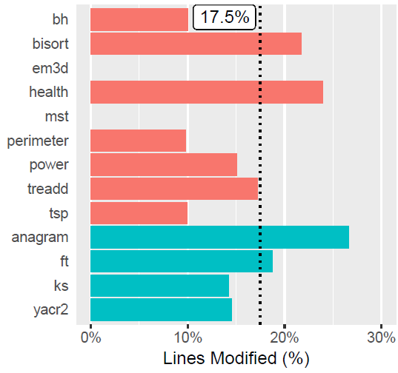
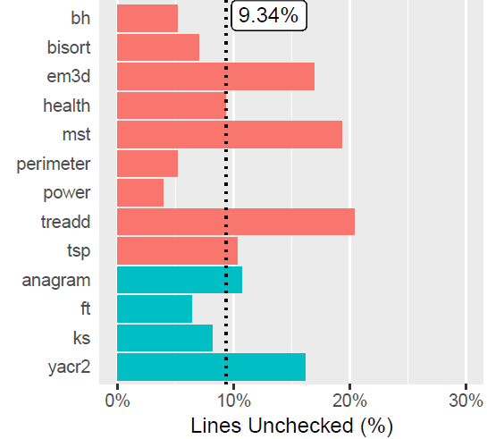
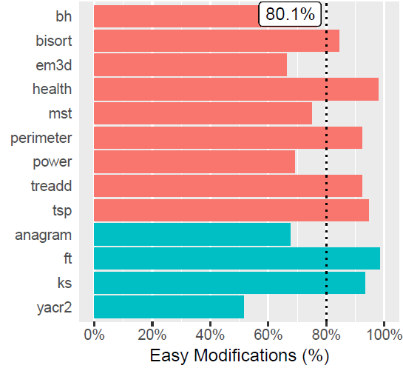
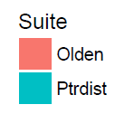
Code modifications
“easy”

Slide 25
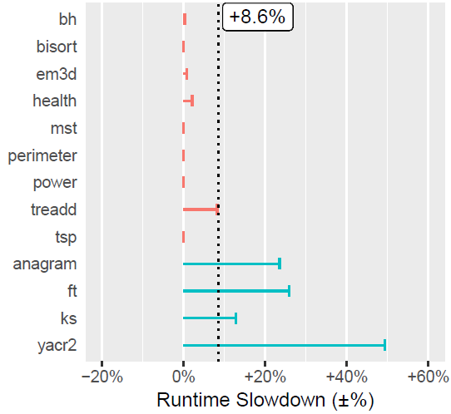
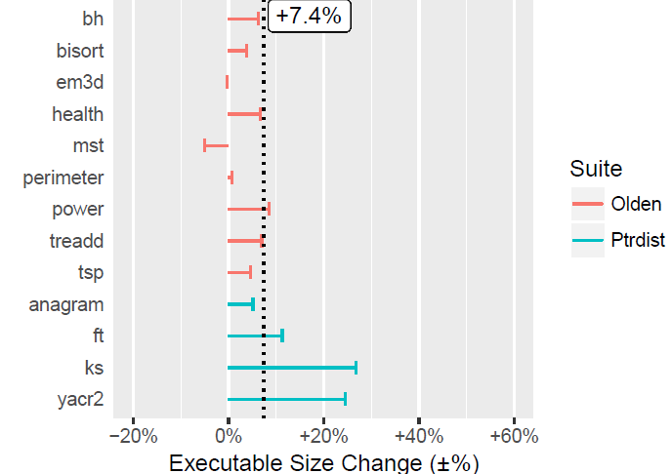
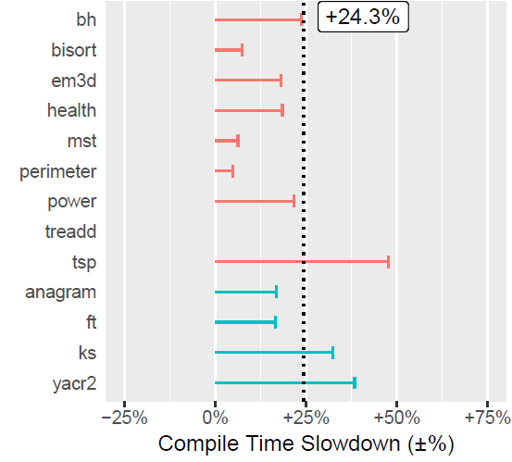
Performance overhead
+8.6% running time slowdown
+7.4% executable size change
+24.3% compile time slowdown
More details in SecDev’18 paper

Slide 26
Switching Gears: Automated Porting
clang tool identifies when pointers can be converted to safe pointers
Outputs partially annotated source code
  Works on whole programs or parts of programs
  Complicated analysis done just once, not each time you make a small change and recompile
  Developers can modify it later

Slide 27
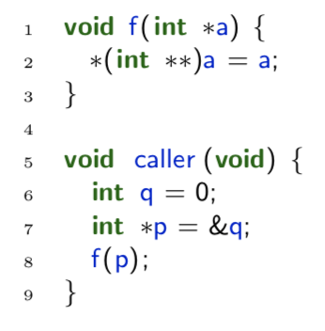
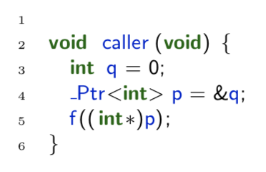
Flexibility in Constraint Resolution
Rather than force p to be unchecked, we can insert a cast at the call to f
  Better than whole-program, unification based algorithm

Slide 28
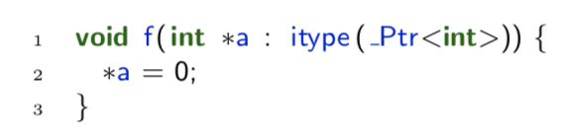
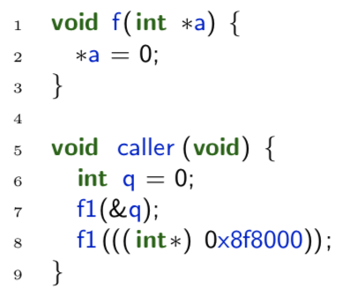
Flexibility in Constraint Resolution
Rather than force a to be unchecked, we give it an interface type
  Treats it internally as if a _Ptr<int>, but callers can pass in unchecked pointers

Slide 29
Experience with Automated Porting
Program | # of * | %/# Ptr | %/# Arr | %/# Unk | # Casts(Calls) | # itype (Functions) | LOC
zlib | 4514 | 46%/2076 | 5%/222 | 49%/2216 | 8 (300) | 464 (1188) | 17388
sqlite | 34230 | 38%/11348 | 3%/910 | 59%/20172 | 2096 (29462) | 9132 (23305) | 106806
parson | 1132 | 35%/392 | 1%/14 | 64%/726 | 3 (378) | 340 (454) | 2320
lua | 15114 | 23%/3464 | 1%/103 | 76%/11547 | 175 (1443) | 784 (2708) | 13577
libtiff | 34518 | 26%/8940 | 1%/424 | 73%/25154 | 495 (1986) | 1916 (5812) | 62439
34% of pointers can be changed to “safer” pointers automatically

Slide 30
Related: Migratory Typing
Moving from dynamically typed to statically typed/annotated code
Typical theorems:
  Prove fully statically typed program safe
  Prove that use of run-time checks blames dynamic code
But: What about “erasure semantics” with no checks?
  No theorem when something goes wrong
  Our work fills that gap

Slide 31
Related: Rust
Like Checked C, aims to be memory/type safe
Like Checked C, has designated unchecked regions
Unlike Checked C, much harder to port to
  But also includes temporal safety
RustBelt project: Semantic typing, plus verification conditions for unsafe code
  Heavyweight
  Our approach to blame is syntactic; can view as a first step

Slide 32
Future work
Expanding automatic conversion of C code
  Working on inferring bounds expressions via abstract interpretation
  Automatically inferring checked regions
Support for C++
Support for temporal safety
More experience writing code in Checked C

Slide 33
Summary
Checked C is a new effort to make C safer
  Binary compatible with C – pointer representation unchanged
  Built on top of LLVM – production quality C compiler with robust optimizations and frontend support
  Good performance
  Extension, not replacement – incremental conversion a first class concept.
  Theorem: Checked Code Cannot be Blamed
  Flexibility with porting – not all pointers need to be converted
https://github.com/Microsoft/checkedc

Slide 34
EXTRA

Slide 35
Bounds expansion
size_t my_strlcpy(_Nt_array_ptr<char> dst : count(dst_sz-1),
_Nt_array_ptr<char> src, size_t dst_sz) {
size_t i = 0;
_Nt_array_ptr<char> s : count(i) = src;
while(s[i] != ‘\0’ && i < dst_sz – 1) {
// bounds on s may expand by 1
dst[i] = s[i];
++i;
}
dst[i] = ‘\0’; // OK to write to upper bound
return I;
}

Slide 36
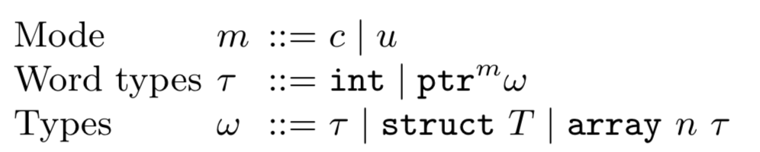
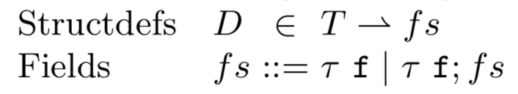
Syntax: Types, Defs
Pointers annotated with mode
c = checked (e.g., _Ptr<T>), u = unchecked (e.g., T*)
Array types carry their (constant) size

Slide 37
Syntax: Expressions
Numbers n annotated with intended type τ
Either int or ptr (can cast between them)
Simplified to focus on the essence of safe/unsafe pointer use, and blame
No functions, control operators
Arrays are constant sized (but dynamically indexed)

Slide 38

Operational Semantics
H is the heap, a partial function from unsigned ints to values
  Values are type-annotated numbers, n^{τ}
m is the execution mode – either within a checked block or an unchecked one
r is a result, which is either
  value n^{τ}
  Null pointer exception, Null
  Array out-of-bounds exception, Bounds
Failure occurs if program ends in stuck state (i.e., non-result)

Slide 39
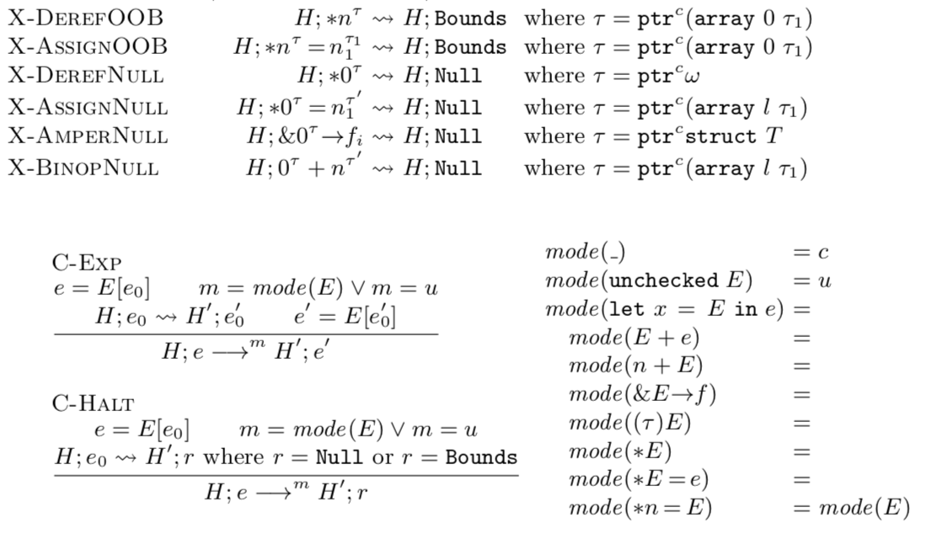
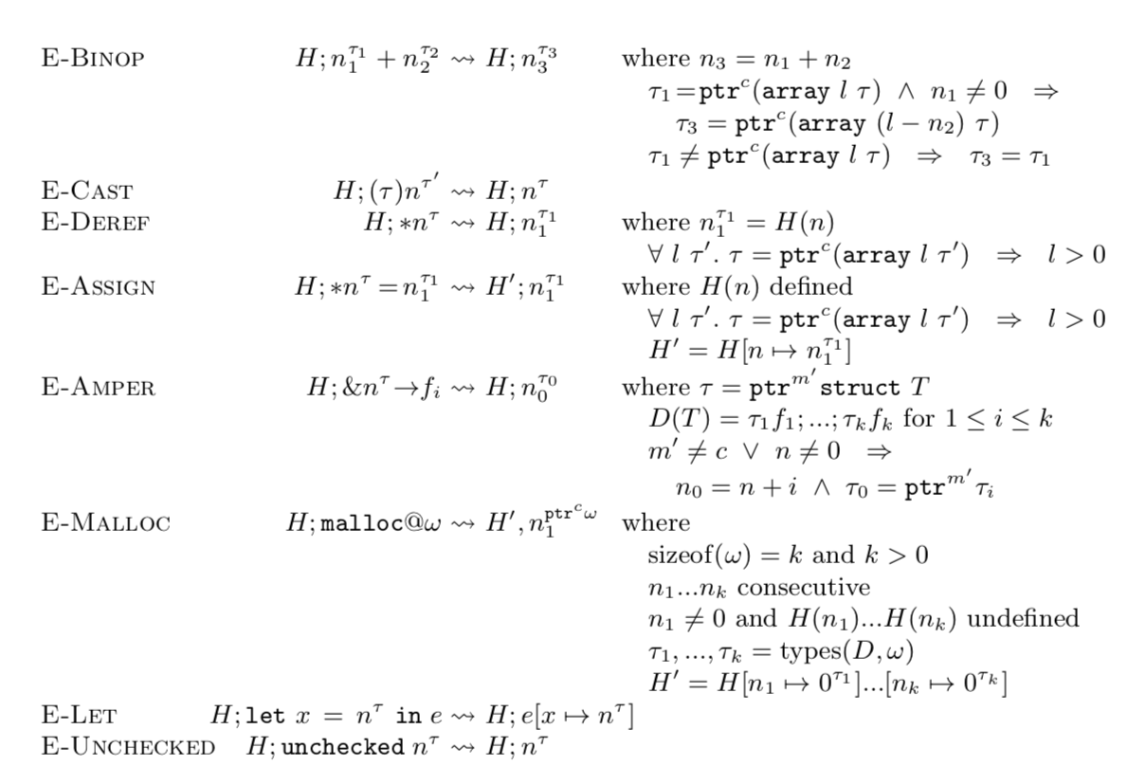
Operational Semantics
Type annotations on nums support run-time checks, pointer arithmetic
  Annotation ignored if it’s not a checked pointer type
Execution mode determined by syntactic structure; or unchecked

Slide 40

Typing
Γ is the environment, a partial function from variables to types τ
σ is the scope
  Set of values previously seen during typing, to handle cycles in heap
m is the execution mode
  Rules differ if in checked blocks or unchecked ones

Slide 41
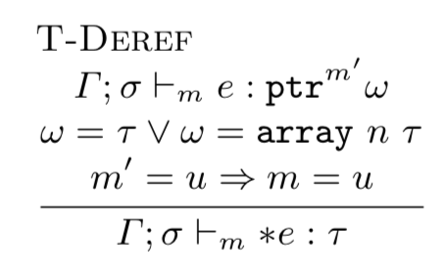
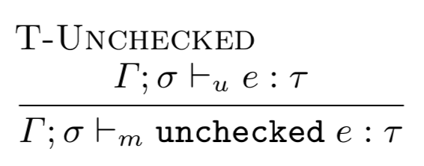
Typing: Dereferencing Pointers
May only dereference unchecked pointers in unchecked blocks

Slide 42
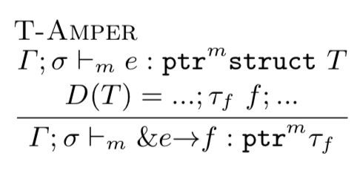
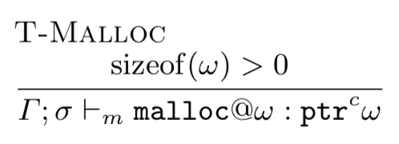
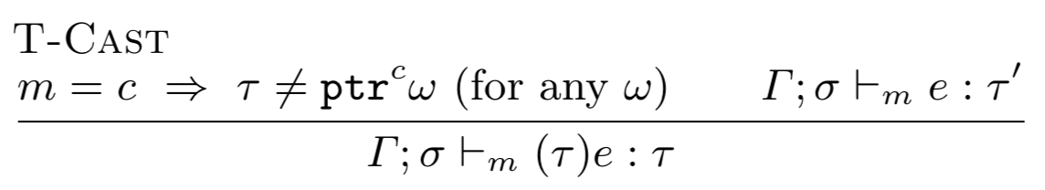
Typing: Making Checked Pointers
Checked pointers safely constructed from malloc
In a checked block:
  Can take addr of checked pointer field
  Cannot cast to a checked pointer

Slide 43
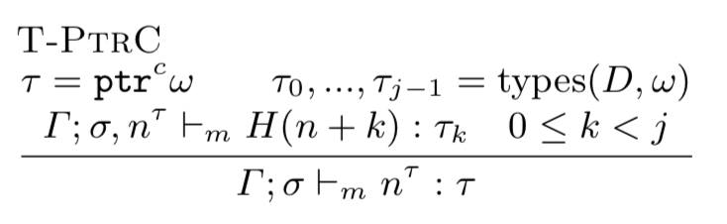
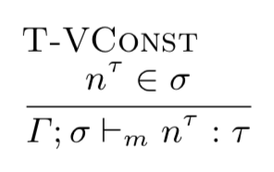
Typing: Checked Pointers WF in Heap
Checked pointers in main expression point to heap
Confirm that declared type of pointer matches that of heap, recursively
Scope σ keeps track of previously (or now-being) checked pointers to heap blocks
  Same pointer may appear with multiple types

Slide 44
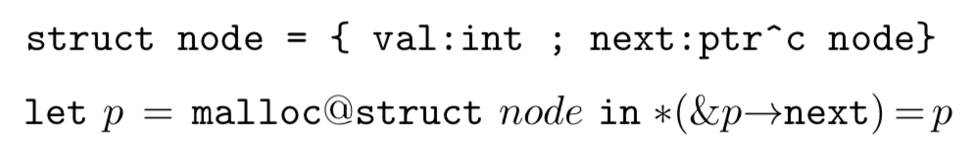
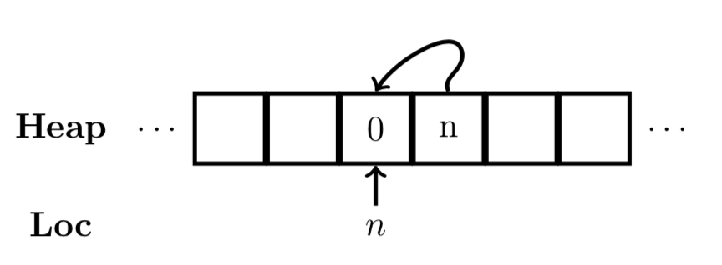
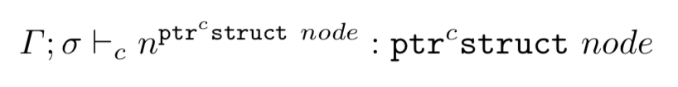
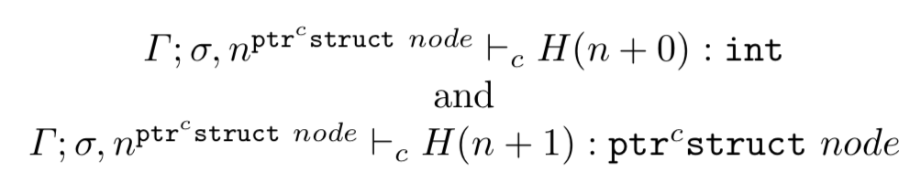
Example
Running this code
Yields the following heap
Type checking the returned pointer:
Holds because of the following two facts:

Slide 45
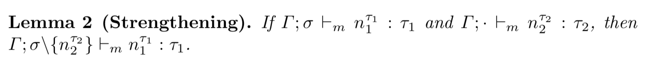
Useful Lemma: Strengthening
Informally: We can remove n₂^{τ2} from the scope s because if that fact is used in the proof of n₁^{τ1}, then we can just use the fact that n₂^{τ2} holds in the empty scope instead
  This is, in essence, a coinductive argument

Slide 46
Checked Code Cannot Be Blamed
Theorem: Suppose we start with a well-typed term. Then if the term ever gets stuck, then the source of the issue is unchecked code
Proof by Progress and Preservation. These are mode-specific:
  Progress: If a program is well-typed but stuck, then its redex must be in unchecked mode
  Preservation: Well-typed programs in checked mode step to well-typed programs in checked mode
    Hence, if the program becomes stuck, at some point the term must not have been well typed, but that could only be the fault of taking a step in unchecked code

