Slide 1
Content Moderation and the Problem of Meshed Cognition
Adam Hill (presenter) and Deirdre K. Mulligan
Fall 2019 Computational Cybersecurity in Compromised Environments (C3E) Workshop
Morning Speaker
Annapolis, Maryland
May 6, 2019

Slide 2
What does optimal cognitive performance look like?
Beliefs match the world
World matches our desires
Direction of fit
Expected utility theory
State of world
Preferences
Outcomes
Notes:
(1) Beliefs aim at being true
What is it for a belief to be true? It fits the world
(2) Desires aim at being realizing
(3) Direction of fit necessary for EUT
For EUT to work, knowledge about STATE must be true; PREFERENCES must reflect desires
***EXTRA***
EUT Informally:
Want to know the STATE of the world
What ACTS lead to best OUTCOMES as you define them
EUT example:
The concept of expected utility is best illustrated by example. Suppose I am planning a long walk, and need to decide whether to bring my umbrella. I would rather not tote the umbrella on a sunny day, but I would rather face rain with the umbrella than without it. There are two acts available to me: taking my umbrella, and leaving it at home. Which of these acts should I choose?

Slide 3
Global Social Information Environment (GSIE) is …
Biases in reasoning
Diminishing critical thinking and analysis
Exposing individuals to covert exploitation
Eroding Cognitive Performance
Net effect
Slack in DoF
Bad decision-making, bad outcomes
Notes:
(1) GSIE - social media sites - is reducing quality of cognitive performance
(2) BIAS
Even in best case, our rationality is “bounded,” because individuals have predictable biases that interfere with it.
Our rationality is constrained by ignorance, inertia, akrasia, queasiness, and so forth.
These biases typically come in the form of judgment errors or deviations from expected utility theory.
The first category includes availability biases, optimism bias, hindsight bias, and leads to systematic errors in making assessments about the world.
The second category includes loss aversion, the endowment effect, and prospect theory, and lead individuals to act suboptimally even when they are processing information accurately (that is, when the first category of biases are not present).
Both of these biases result in direction-of-fit errors.
Sense that the GSIE is making these WORSE
***See also slide A4***

Slide 4
Human-centric cyber vulnerabilities resulting...
from decreased cognitive performance
Too much or too little trust
Confusion around identity
Too much or too little deference to authority and expertise
from violations of norms (ethical, social)
Degradation of norms of confidentiality, integrity, and access (CIA)
Notes:
When slack emerges in a DoF, other dominos start to fall
What info can you trust?
Can you trust your own perceptions of authority?
When deference to elites depends on membership in group, what happens?
What does it mean for informational integrity when the source of information is disputed?
Many of these norms are dependent on strong DoF

Slide 5
Where are these dynamics playing out?
Social Networking Sites (SNS)
“Shape human experience on a global scale”
Key attributes of SNS
User profiles
Public lists of “friends” (viewable)
Most or all actions public by default
Facebook
YouTube
Reddit
All social media platforms moderate
“Platform politics”
Notes:
Platform politics: “the assemblage of design, policies, and norms that encourage certain kinds of cultures and behaviors to coalesce on platforms while implicitly discouraging others.” (Gillespie 2010).

Slide 6
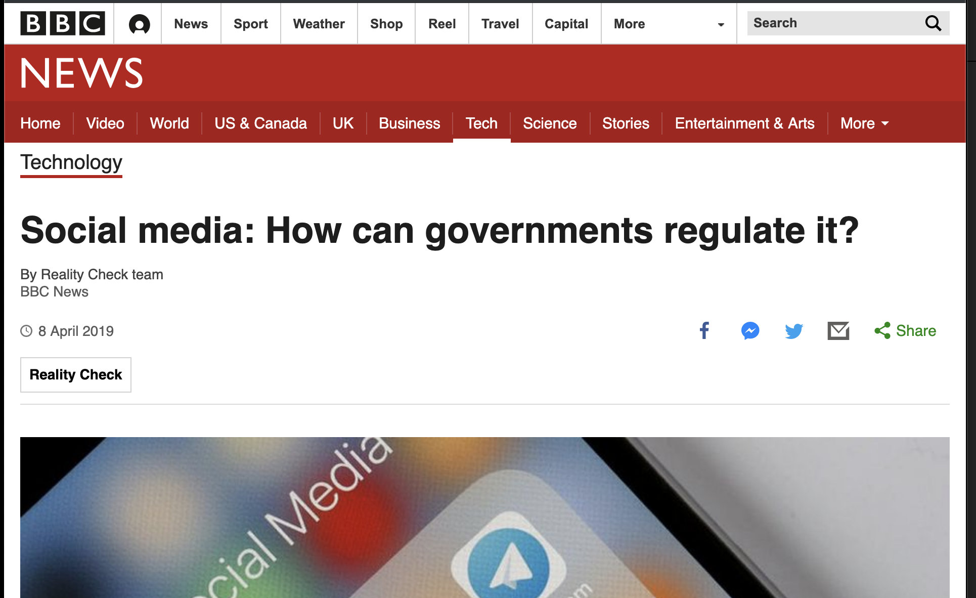
SNS platform moderation as our point of leverage
Widespread dissatisfaction with SNS
  Awareness of the political, social, and economic costs of harassment, fake news, and otherwise anti-social content and behavior
  Platforms are under pressure to limit the creation, spread, and influence of “toxic” content
Notes:
Self-governance
YouTube has defended its record on removing inappropriate content.
The video-sharing site said that 7.8m videos were taken down between July and September 2018, with 81% of them automatically removed by machines, and three-quarters of those clips never receiving a single view.
Globally, YouTube employs 10,000 people in monitoring and removing content, as well as policy development.
Facebook, which owns Instagram, told the BBC that it has 30,000 people around the world working on safety and security. It said that it removed 15.4m pieces of violent content between October and December, up from 7.9m in the previous three months.
Germany
Germany's NetzDG law came into effect at the beginning of 2018, applying to companies with more than two million registered users in the country.
They were forced to set up procedures to review complaints about content they are hosting and remove anything that is clearly illegal within 24 hours.
European Union
The EU is considering a clampdown, specifically on terror videos.
Social media platforms would face fines if they did not delete extremist content within an hour.
The EU also introduced the General Data Protection Regulation (GDPR) which set rules on how companies, including social media platforms, store and use people's data.
But it is another proposed directive that has worried internet companies.
Article 13 of the copyright directive would put the responsibility on platforms to make sure that copyright infringing content is not hosted on their sites.
Previous legislation has only required the platforms to take down such content if it is pointed out to them. Shifting the responsibility would be a big deal for social media companies.
Australia
Australia passed the Sharing of Abhorrent Violent Material Act on 5 April, introducing criminal penalties for social media companies, possible jail sentences for tech executives for up to three years and financial penalties worth up to 10% of a company's global turnover.
It followed the live-streaming of the New Zealand shootings on Facebook.
In 2015, the Enhancing Online Safety Act created an eSafety Commissioner with the power to demand that social media companies take down harassing or abusive posts. Last year, the powers were expanded to include revenge porn.
Russia
Under Russia's data laws from 2015, social media companies are required to store any data about Russians on servers within the country.
Its communications watchdog is taking action against Facebook and Twitter for not being clear about how they planned to comply with this.
Russia is also considering two laws similar to Germany's example, requiring platforms to take down offensive material within 24 hours of being alerted to it and imposing fines on companies that fail to do so.
China
Sites such as Twitter, Google and WhatsApp are blocked in China. Their services are provided instead by Chinese applications such as Weibo, Baidu and WeChat.
Chinese authorities have also had some success in restricting access to the virtual private networks that some users have employed to bypass the blocks on sites.
The Cyberspace Administration of China announced at the end of January that in the previous six months it had closed 733 websites and "cleaned up" 9,382 mobile apps, although those are more likely to be illegal gambling apps or copies of existing apps being used for illegal purposes than social media.
China has hundreds of thousands of cyber-police, who monitor social media platforms and screen messages that are deemed to be politically sensitive.
Some keywords are automatically censored outright, such as references to the 1989 Tiananmen Square incident.
New words that are seen as being sensitive are added to a long list of censored words and are either temporarily banned, or are filtered out from social platforms.

Slide 7
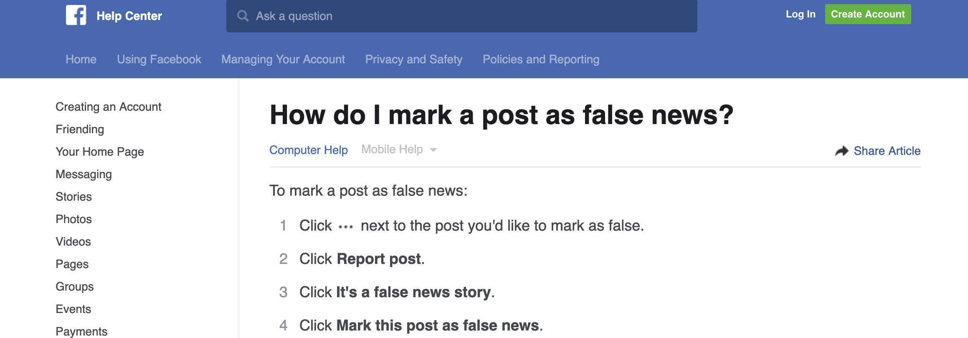
Conventional Approach to SNS Moderation
Designed around individual-level interventions.
    Goal: improve individual cognition by reducing biases and improving decision-making
Actions: Flagging, rating, muting, blocking
Current, ongoing practice at SNS

Slide 8
Conventional Approach to SNS Moderation
Two categories of intervention
Informational nudges
Exposure control
Proprietary combinations of background behavioral signals (e.g., repeated sign ups from the same IP address) and human moderation to reduce exposure
Give users the info they need to succeed
Notes:
informational nudges possess three advantages
First, they have a track record of improving choices for a wide array of serious problems, including those involving finances, energy, and health.
Second, informational nudges are consistent with platforms’ broad anti-interventionist stance on regulating content.
Third, informational nudges are broadly normative appealing, in particular because of their connection to free speech. For the same reasons nudges appeal to government regulators wary of overly paternalistic policies, proponents of informational nudges argue that they are merely more complex ways of fostering user autonomy.

Slide 9
Three Types of Individual-Level Nudges
Nudge type | Example | Cognitive effect | Normative contestability
Informational | Google Maps | Adds info about which individual reasons | Low
Salience-exploiting | Thermostat that shows energy usage | Forces individual to grapple with salient fact E.g., that they are using a ton of energy | Medium
Bias-exploiting | Graphic warnings on cigarette packs | Covertly motivates action or reasoning | High
Notes:
Three types of approaches SNS can use to improve individual cognition
Each of these can be deployed via SNS affordances

Slide 10
The Problem with the Conventional Approach
Wrong unit of analysis
Conceive of the problem as one of individual cognition
Thus, doomed to fail
These approaches have ignored group cognition
Powerfully impacts individual cognition
Individual cognition often subordinate to group cognition
Operates at scale

Slide 11
Our proposal: Moderate Meshed Cognition
SNS should turn their attention to Meshed Cognition
MC must be successfully managed before individual-level interventions will work

Slide 12
Is MC new?
Prior to advent of SNS, MC arose in limited set of conditions
Teams, exercise groups, families, close friendships
These groups cooperated through norms that were typically non-dominant in social life
Norms of responsiveness, commitment, and support to group members

Slide 13
Meshed Cognition
SNS affordances lead to MC dominance
People end up in loosely organized non-hierarchical groups without really intending to
These norms make individual-level interventions ineffective, because they subordinate individual interests to group interests from the start
Need new interventions that reflects this new SNS-driven cognitive framework
Become saddled with these new norms that govern their behavior
Notes:
Because of the affordances of the SNS infrastructure, these three norms these become much more DOMINANT

Slide 14
How do these group “think”?
Corporation: hierarchical
rules
MC: just-in-time flexibility
Mob: uncoordinated aggregation
Notes:
Between the mob and the corporate hierarchy
Mob: stock market
Uncoordinated individual decisions
Corporation:
Rules and procedures create structured cognition
On the spectrum of collective action, MC sits in the space between frenzied crowds, which operate on the basis of emotional contagion, and well-organized corporate entities, which operate on the basis of hierarchical governance rules.
Meshed cognition allows users to mob a target — trolling, harassing, and confusing — with more organization than contagion-based mobs, yet with more speed than top-down hierarchical governance. Because meshed cognition emerges as an effective way for users to reason together, it is common not only among users creating and sharing toxic content, but among user bases at large.

Slide 15
Analog to Meshed Wireless Networks
When MC emerges, individual cognition operates like nodes in a mesh wireless network
  Individual nodes’ utility functions maximize the group’s connectivity over their own
Nodes sacrifice in order to offer (R, S, C) to the group in order to achieve a larger end
  Where meshed wireless networks push spectrum across a group of nodes, individuals push a bundled set of beliefs and desires about the world across a network.
Where meshed wireless networks use certain protocols to communicate, individuals push these bundled sets of beliefs and desires through meshing norms.
  They are, in a sense, the communication protocols of meshed cognition

Slide 16
Hypothesis: Meshed Cognition
MC is driving the crisis in cognition more than failures of individual reasoning
SNS accelerate the creation and scale of MC
In turn, MC accelerates the types of cognitive failures that lead to cyber vulnerabilities
Direction of the bias is uniform across groups
As opposed to individual-level bias, in which errors aren’t always correlated
Individual cognitive errors "wash out"

Slide 17
How MC Flourishes on SNS
Individuals use SNS to assemble publics
They are platforms of association, not just communication
SNS drive users to see their own social agency in terms of collective goals, which can best be realized through technical affordances provided by SNS
Unlike other communication technologies, such as email or phone calls, which are primarily used as 1-to-1 or one-to-many modes of communication, SNS are default to group communication
Creates an active ongoing relationship between the user and the community.
Default posture is one of support for a user’s network.
Exit can occur, but typically requires something akin to a permanent withdrawal from the network.

Slide 18
How MC Flourishes on SNS
New SNS users must decide where to channel own preexisting beliefs and preferences.
Almost by necessity, it will be toward high status personas who represent groups with collective goals.
Users convey passive support for their (now) shared goal.
Collective goals reinforced relentlessly by algorithms that move high controversy posts to the top of users timelines.
Shared goals and discourses become largely stable and persistent across a user’s platform experience.
Notes:
SNS lead groups to adopt meshing norms more quickly and more robustly than they otherwise would.
Offline, collective goals established ratherly slowly
Takes time and energy
SNS structurally mediate relationships among users in ways that encourage the emergence and flourishing of meshing norms
Showing commitment to a shared goal on SNS is the default action, even if users do nothing. Merely following a high status persona is enough to show basic commitment to the goal. Actions as simple as retweeting or forwarding posts show even higher commitment. None of this requires the same effort, discipline or hard choices about how to use scarce resources.

Slide 19
MC Defeats Current Moderation Strategies
Premise of informational nudges is that they engage a user’s System 2 cognition, which involves the slow, deliberate processing of information.
Assumption: the educating information helps the subject “get where she wants to go.”
If the educative nudge is designed to hinder the success of a shared project supported by MC norms, however, the individual’s investment in the shared goal will blunt the impact of the nudge.
Individual has already decided where they want to go

Slide 20
Research Opportunities and Questions
We offer a simple yet robust causal structure that links the social meaning of groups’ projects with individual decision-making biases.
While we illustrate our theoretical account here with examples, our theory is ripe for experimental testing
Future work
  Experimental
    Testing how quickly groups establish MC in the lab
    Testing what affordances contribute to malicious or benign MC
  Network analysis
    Can we use techniques of network analysis to identify MC groups before they form?

Slide 21
Research Opportunities and Questions
Pressing questions
  What strategies can SNS use to stop formation of malicious MC?
  How do we distinguish malicious MC from benign MC ex ante?
  In what ways does influencing MC through SNS affordances raise normative concerns, such as coercion or paternalism?

Slide 22
This work is supported by the following grants
NSF INSPIRE: Value-Function Handoffs in Human-Machine Compositions SES 1650589
UC-Berkeley Center for Long-Term Cybersecurity: Ride Free or Die: Overcoming Collective Action Problems in Autonomous Driving Governance, CY2018, #42

Slide 23
Appendix

Slide 24
A1: The three norms of MC (Meshing Norms)
A distinctive set of norms emerge when individuals coordinate behavior non-hierarchically
  Three key norms for MC
    Responsiveness
      Willingness to be flexible in response to co-coordinators
    Support
      Willingness to lend material support (time, money, energy) where it will help achieve the group goal
    Commitment
      Willingness to subordinate other important ends to the group’s goal(s)
These norms tend to produces biases in individuals’ reasoning and decision-making. The resulting reasoning is what we refer to as MC

Slide 25
A2: More on the analogy to meshed networks
The way in which meshing norms are instantiated among a group of individuals can strongly shape the meaning of information shared among and processed by the network.
As network protocols can shape and re-shape the information that passes through a network, so too can meshing norms shape the information that passes among users in a social network.

Slide 26
A3: Cyber vulnerabilities created by MC
Asset Management
  The data, personnel, devices …” (NIST cybersecurity framework)
To the extent cyber vulnerabilities can be generated through cognitive degradation, risk exists
Mitigation strategies
  Strengthening culture within organization to help combat association with hostile groups

Slide 27
A4: Two types of human cognitive bias
These apply even in the best circumstances
  Probably irreducible feature of human life
    We can make improvements on the margin
Judgment errors
  Errors that cause there to be a reduction in the fit between belief and world.
    Confirmation bias: regard evidence that matches world view more favorably than evidence which does not match their world view, even when the latter is stronger.
Preference errors
  Prospect theory: individuals have inconsistent desires about how the world should be. In this case, the bias leads individuals to fail to intend to make the world fit their desires.

