Slide 1
Why can’t I put down my phone?
The paradox of computing in modern work environments
Jennifer Cowley
Why can’t I put down my phone?
Feb. 1, 2017
© 2017 Carnegie Mellon University.
Notes:
At my organization, I’m forced to review a broad array of corpuses of research to provide clues about hard problems; some drilling down in the weeds is necessary. This presentation is intended to start a discussion. Over the past five years, I started wondering why I couldn’t concentrate on challenging books like I used to read. What was wrong with me? Why was I so distracted?

Slide 2
Copyright 2017 Carnegie Mellon University
This material is based upon work funded and supported by the Department of Defense under Contract No. FA8721-05-C-0003 with Carnegie Mellon University for the operation of the Software Engineering Institute, a federally funded research and development center.
NO WARRANTY. THIS CARNEGIE MELLON UNIVERSITY AND SOFTWARE ENGINEERING INSTITUTE MATERIAL IS FURNISHED ON AN “AS-IS” BASIS. CARNEGIE MELLON UNIVERSITY MAKES NO WARRANTIES OF ANY KIND, EITHER EXPRESSED OR IMPLIED, AS TO ANY MATTER INCLUDING, BUT NOT LIMITED TO, WARRANTY OF FITNESS FOR PURPOSE OR MERCHANTABILITY, EXCLUSIVITY, OR RESULTS OBTAINED FROM USE OF THE MATERIAL. CARNEGIE MELLON UNIVERSITY DOES NOT MAKE ANY WARRANTY OF ANY KIND WITH RESPECT TO FREEDOM FROM PATENT, TRADEMARK, OR COPYRIGHT INFRINGEMENT.
[Distribution Statement A] This material has been approved for public release and unlimited distribution. Please see Copyright notice for non-US Government use and distribution.
This material may be reproduced in its entirety, without modification, and freely distributed in written or electronic form without requesting formal permission. Permission is required for any other use. Requests for permission should be directed to the Software Engineering Institute at permission@sei.cmu.edu.
Carnegie Mellon® and CERT® are registered marks of Carnegie Mellon University.
DM-0004432
Why can’t I put down my phone?
Feb. 1, 2017
© 2017 Carnegie Mellon University.
Notes:
Anecdotally, when I find blocks of time to think, I can’t. Why? I turn to my mobile device. Why? Can I put it down? No. why”

Slide 3

Do I feel satisfaction when I’m not able to concentrate?
Problem: Deep technical work seems an impossibility in modern computing work environments. Why?
Consequences: Work dissatisfaction
Is it the job?
Am I unhappy?
Afterwards, do I feel better?
Am I genetically pre-dispositioned?
Why can’t I put down my phone?
Feb. 1, 2017
© 2017 Carnegie Mellon University.
Notes:
Anecdotally, when I find blocks of time to think, I can’t. Why? I turn to my mobile device. Why? Can I put it down? No. why”

Slide 4
Possible antecedents of the problem
Underlying digital addictions
Increase in quantity of workplace distractions
Increased surveillance
Why can’t I put down my phone?
Feb. 1, 2017
© 2017 Carnegie Mellon University.
[Distribution Statement A] This material has been approved for public release and unlimited distribution. Please see Copyright notice for non-US Government use and distribution.
Notes:
In this presentation, I’m going to use terms interchangeably so forgive me if I confuse you. For example, the term internet addictive disorder, gaming disorder, internet use disorder…digital addictions. I also don’t always define my terms so bear with me.
It’s not just surveillance, we’ve produced tools that are addictive to give more avenues of surveillance.
Talk about the terminology problem

Slide 5
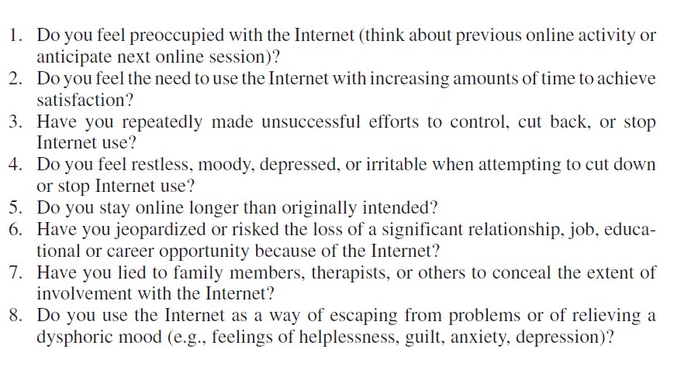
Underlying digital addictions
Why can’t I put down my phone?
Feb. 1, 2017
© 2017 Carnegie Mellon University.
[Distribution Statement A] This material has been approved for public release and unlimited distribution. Please see Copyright notice for non-US Government use and distribution.

Slide 6
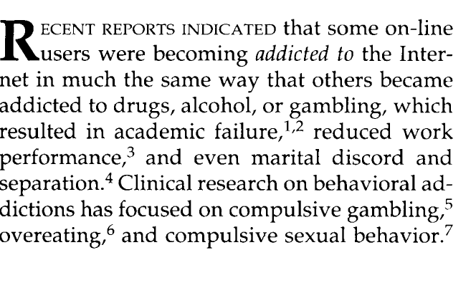
Young, 1998
Why can’t I put down my phone?
Feb. 1, 2017
© 2017 Carnegie Mellon University.

Slide 7
Timeline of Onset of Digital Age and Respective Effects

Slide 8
1960-1980
1962, the first game Spacewars. (Friedman, 1995)
Late 1950s, minicomputers allow for games to be played on computers (Friedman, 1995)
1973 Xerox’s Personal computer is born followed by Apple (1976 Apple II) and IBM PC. Xerox’s first personal computer commercially available in 1979 (Smith & Alexander, 1999)
Game design became a field of study???
1969, birth of the internet (Flisher, 2010)
1960s chess and other digital games developed; educational and military training gaming also developed (Smith 2009)
1970
1970s, Reports of the first gaming addictions surfacing in clinical (Kiraly et al., 2014.)
1960
Early 1970s, Birth of the home video arcade (Friedman, 1995)
1980
Why can’t I put down my phone?
Feb. 1, 2017
© 2017 Carnegie Mellon University.
[Distribution Statement A] This material has been approved for public release and unlimited distribution. Please see Copyright notice for non-US Government use and distribution.
Notes:
Australian Mobile Telecommunications Association. AMTA 2003 Annual Report. Canberra, Australian Capital Territory: Australian Mobile Telecommunications Association; 2003.
Smith, D. K., & Alexander, R. C. (1999). Fumbling the future: How Xerox invented, then ignored, the first personal computer. iUniverse.
Friedman, T. (1995). Making sense of software: Computer games and interactive textuality. Cybersociety; Computer-Mediated Communication and Community. Thousand Oaks, Calif.: Sage Publications.
Wilson, 1992
Friedman, T. (1995). Making sense of software: Computer games and interactive textuality. Cybersociety; Computer-Mediated Communication and Community. Thousand Oaks, Calif.: Sage Publications.
Smith, R. (2009). The long history of gaming in military training. Simulation & Gaming.
Shaw, M., & Black, D. W. (2008). Internet addiction. CNS drugs, 22(5), 353-365.
Petry, N. M., & O'brien, C. P. (2013). Internet gaming disorder and the DSM‐5. Addiction, 108(7), 1186-1187.
Flisher, C. (2010). Getting plugged in: an overview of internet addiction. Journal of paediatrics and child health, 46(10), 557-559.
The internet in the 1970s was a giant bulletin board system

Slide 9
1980s
1982, PacMan is named the biggest arcade game in US history.
1985; Psychological Power of Games is Acknowledged in Manifesto for Cyborgs. (Friedman, 1995)
1980s, Gaming production software became a commercial industry
1982 and 1983 , First digital addictions reported in clinical pysch research papers
(Griffith, 2013)
1983- Mobile phones introduced (AMTA, 2003)
1990
1980
Why can’t I put down my phone?
Feb. 1, 2017
© 2017 Carnegie Mellon University.
[Distribution Statement A] This material has been approved for public release and unlimited distribution. Please see Copyright notice for non-US Government use and distribution.
Notes:
Australian Mobile Telecommunications Association. AMTA 2003 Annual Report. Canberra, Australian Capital Territory: Australian Mobile Telecommunications Association; 2003.
Smith, D. K., & Alexander, R. C. (1999). Fumbling the future: How Xerox invented, then ignored, the first personal computer. iUniverse.
Friedman, T. (1995). Making sense of software: Computer games and interactive textuality. Cybersociety; Computer-Mediated Communication and Community. Thousand Oaks, Calif.: Sage Publications.
Young, K. S. (2004). Internet addiction: A new clinical phenomenon and its consequences. American behavioral scientist, 48(4), 402-415.
Young, K. (2010). Internet addiction over the decade: a personal look back. World Psychiatry, 9(2), 91-91.
Griffiths, M. D. (2013). 16 An Overview of Online Gaming Addiction. Multiplayer: The Social Aspects of Digital Gaming, 3, 195.
1985; Psychological Power of Games is Acknowledged in Manifesto for Cyborgs.
“Flowing through a continuous series of decisions made almost automatically, hardly aware of the passage of time, the player forms a symbiotic circuit with the computer, a version of the cyborgian consciousness described by Donna Harraway in her influential "Manifesto for Cyborgs" (1985).” “The computer comes to feel like an organic extension of one's consciousness, and the player may feel like an extension of the computer itself. (Friedman, 1995, pp. 8 )”

Slide 10
1990s Major Events
1998 Negative effects of team monitoring published. (Sewell, 1998)
1995. First mass study with 500 heavy gamers and compared to DSM IV.
(Flisher 2010)
1998 ”Caught in the Net” published. The the first book to identify Internet addiction. (Young, 2010)
1991; Encomium published in manuscript explaining that gaming is "an aesthetic of cognitive mapping.”(Jameson, 1991, p. 54)
1995 Rehab clinics are born in USA (Flisher, 2010)
1993; gaming critics stated that games could allow gamers to misidentify them as reality
1995. The term Internet addiction (IA) was first coined by
psychiatrist Dr. Ivan Goldberg.
1996, Annual Meeting of the
American Psychological Association (Young, 1996) convened to discuss internet addictions
2000
1990
1993; game design was engineered and plotted to entice (Laurel 1993)
Why can’t I put down my phone?
Feb. 1, 2017
© 2017 Carnegie Mellon University.
[Distribution Statement A] This material has been approved for public release and unlimited distribution. Please see Copyright notice for non-US Government use and distribution.
Notes:
Australian Mobile Telecommunications Association. AMTA 2003 Annual Report. Canberra, Australian Capital Territory: Australian Mobile Telecommunications Association; 2003.
Smith, D. K., & Alexander, R. C. (1999). Fumbling the future: How Xerox invented, then ignored, the first personal computer. iUniverse.
Friedman, T. (1995). Making sense of software: Computer games and interactive textuality. Cybersociety; Computer-Mediated Communication and Community. Thousand Oaks, Calif.: Sage Publications.
Young, K. S. (2004). Internet addiction: A new clinical phenomenon and its consequences. American behavioral scientist, 48(4), 402-415.
Young, K. (2010). Internet addiction over the decade: a personal look back. World Psychiatry, 9(2), 91-91.
Griffiths, M. D. (2013). 16 An Overview of Online Gaming Addiction. Multiplayer: The Social Aspects of Digital Gaming, 3, 195.
1991; Simulations may be our best opportunity to create what Fredric Jameson calls "an aesthetic of
cognitive mapping: a pedagogical political culture which seeks to endow the individual subject with
some new heightened sense of its place in the global system" (Jameson, 1991, p. 54) Playing a
simulation means becoming engrossed in a systemic logic which connects a myriad array of causes
and effects. The simulation acts as a kind of map-in-time, visually and viscerally (as the player
internalizes the game's logic) demonstrating the repercussions and interrelatedness of many different
social decisions.
1995 Dr. Kimberly Young conducted a study of 500 heavy users of the Internet or ‘internet addicts’, and compared their behavior to the Diagnostic and Statistical Manual of Mental Disorders (DSM IV) criteria for pathological gambling.
Young gaming study results. Subjects reported
significant impacts on ‘academic achievement, social life, rela-
tionships, occupation and finances’. Young likened these to the
effects of pathological gambling and alcoholism. Although her
study raised the profile of IA among health-care professionals, it
was later criticized for its method of recruiting subjects.
1995: Rehab clinics are born in US. In 1995, Dr Kimberly Young founded the first US private IA clinic, ‘The Centre for Online Addiction Recovery’
offered a psychological treatment program and telephone
counselling services.
(In Flisher article)
1995. The term Internet addiction (IA) was first used by
psychiatrist Dr Ivan Goldberg, who coined the term ‘Internet
Addiction Disorder’ along with a list of symptoms
1998, n 1998, I wrote Caught in the Net, the first book to identify Internet addiction 1. Publishing the book changed my life. Once published, the publicity around the book took on a life of its own. I joked that I had become the Ann Landers of cyberspace, as letters and email from across the globe poured in. I heard from parents, spouses, and addicts themselves struggling to deal with an addiction that they could not understand. Yet, after reading Caught in the Net, they found validation and understanding to a disorder that they knew they were experiencing but had not been recognized by many professionals when they tried to seek help.
After Caught in the Net was published, many journalists and scholars did not believe that people could become addicted to the Internet. At that point, many laughed and scoffed at the idea. How could a tool so useful for information and communication be considered addictive? (5)

Slide 11
2000s Baseline level of computing in the absence of work
November 2008, Psychologists in China called for internet addictions to be officially recognized as a clinical disorder and petitioned the disorder to be registered with the World Health Organization.
(Flisher, 2010)
2008. Fastest social media and internet use growth on record across all cohorts (Edosomwan et al. 2011)
Early 2000, papers started to escalate on internet gaming addiction (Griffiths, 2013)
2007, smart phones introduced (Edosomwan et al. 2011)
1999, Web 2.0 coined but popular in 2004 (Wikipedia)
January 2009, Facebook registered more than 175 million active user (Kaplan Haenlein 2010)
2000, LunarStorm launched (Edosomwan et al. 2011) but in 1998 we had “6 degrees of freedom.”
Feb, 2004, Facebook launched (Edosomwan et al. 2011)
2005, Youtube founded (Edosomwan et al. 2011)
2010
2000, Cyber Addiction Information Center established, Korea (Hur, 2006)
2002, Center for Internet Addiction Prevention and Counseling established (Hur, 2006)
2008 . CBS News publishes “Social Networking: An Internet Addiction?”
2000
Why can’t I put down my phone?
Feb. 1, 2017
© 2017 Carnegie Mellon University.
[Distribution Statement A] This material has been approved for public release and unlimited distribution. Please see Copyright notice for non-US Government use and distribution.
Notes:
Australian Mobile Telecommunications Association. AMTA 2003 Annual Report. Canberra, Australian Capital Territory: Australian Mobile Telecommunications Association; 2003.
Smith, D. K., & Alexander, R. C. (1999). Fumbling the future: How Xerox invented, then ignored, the first personal computer. iUniverse.
Friedman, T. (1995). Making sense of software: Computer games and interactive textuality. Cybersociety; Computer-Mediated Communication and Community. Thousand Oaks, Calif.: Sage Publications.
Young, K. S. (2004). Internet addiction: A new clinical phenomenon and its consequences. American behavioral scientist, 48(4), 402-415.
Edosomwan, S., Prakasan, S. K., Kouame, D., Watson, J., & Seymour, T. (2011). The history of social media and its impact on business. Journal of Applied Management and entrepreneurship, 16(3), 79.
Young, K. (2010). Internet addiction over the decade: a personal look back. World Psychiatry, 9(2), 91-91.
Griffiths, M. D. (2013). 16 An Overview of Online Gaming Addiction. Multiplayer: The Social Aspects of Digital Gaming, 3, 195.
Kaplan, A. M., & Haenlein, M. (2010). Users of the world, unite! The challenges and opportunities of Social Media. Business horizons, 53(1), 59-68.
2008. According to Forrester Research, 75% of Internet surfers used “Social Media” in the second quarter of 2008 by joining social networks, reading blogs, or contributing reviews to shopping sites; this represents a significant rise from 56% in 2007. The growth is not limited to teenagers, either; members of Generation X, now 35–44 years old, increasingly populate the ranks of joiners, spectators, and critics. It is therefore reasonable to say that Social Media represent a revolutionary new trend that should be of interest to companies operating in online space—or any space, for that matter.

Slide 12
2010s Baseline level of computing in the absence of work
May 18, 2013, Internet gaming addiction is named in Section 3 of DSM-V. (Cho et al., 2014)
2014 . CBS News publishes “How real a risk is social media addiction?”
2013; 250 pubs on internet gaming addictions (called internet use disorder, gaming or internet addiction, gaming or internet dependence, pathological or problematic gaming, internet gaming disorders, etc. (DSM V)
2020
2010
Why can’t I put down my phone?
Feb. 1, 2017
© 2017 Carnegie Mellon University.
[Distribution Statement A] This material has been approved for public release and unlimited distribution. Please see Copyright notice for non-US Government use and distribution.
Notes:
Australian Mobile Telecommunications Association. AMTA 2003 Annual Report. Canberra, Australian Capital Territory: Australian Mobile Telecommunications Association; 2003.
Smith, D. K., & Alexander, R. C. (1999). Fumbling the future: How Xerox invented, then ignored, the first personal computer. iUniverse.
Friedman, T. (1995). Making sense of software: Computer games and interactive textuality. Cybersociety; Computer-Mediated Communication and Community. Thousand Oaks, Calif.: Sage Publications.
Young, K. S. (2004). Internet addiction: A new clinical phenomenon and its consequences. American behavioral scientist, 48(4), 402-415.
Young, K. (2010). Internet addiction over the decade: a personal look back. World Psychiatry, 9(2), 91-91.
Griffiths, M. D. (2013). 16 An Overview of Online Gaming Addiction. Multiplayer: The Social Aspects of Digital Gaming, 3, 195.
Cho, H., Kwon, M., Choi, J. H., Lee, S. K., Choi, J. S., Choi, S. W., & Kim, D. J. (2014). Development of the Internet addiction scale based on the Internet Gaming Disorder criteria suggested in DSM-5. Addictive Behaviors, 39(9), 1361-1366.

Slide 13
Human characteristics that exacerbate addiction
Gambling and impulse control (Griffiths & Woods, 2000)
Perceptions of “just around the corner” rewards (Griffiths & Woods, 2000; Kiraly et al., 2014)
Comorbidities like ADD/ADHD, aggression, narcissistic personality disorders, decreased psycho-social well-being, lower life satisfaction, loneliness, depressions, low self esteem (Starcevic et al., 2011)
Feelings of need to escape real-life problems and difficulties (Kuss et. Al, 2012; Kwon, Chung & Lee, 2011; Yee, 2006)
Orientation towards achievement, competition, advancement (Kwon, Chung & Lee, 2011)
Poor life achievements (Kiraly et. al., 2015)
Why can’t I put down my phone?
Feb. 1, 2017
© 2017 Carnegie Mellon University.

Slide 14
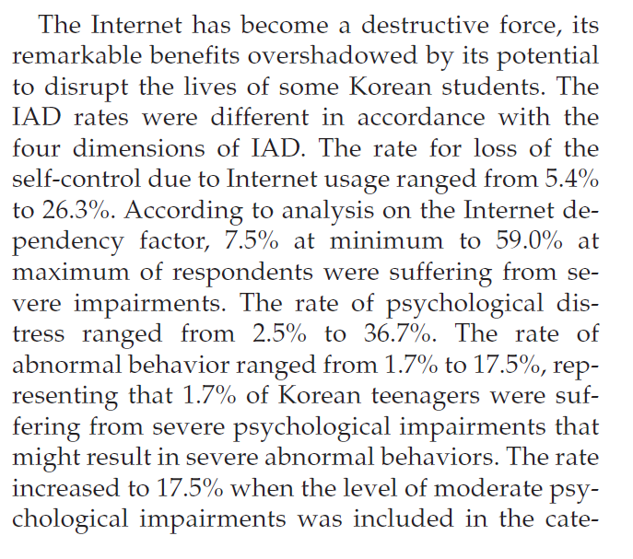
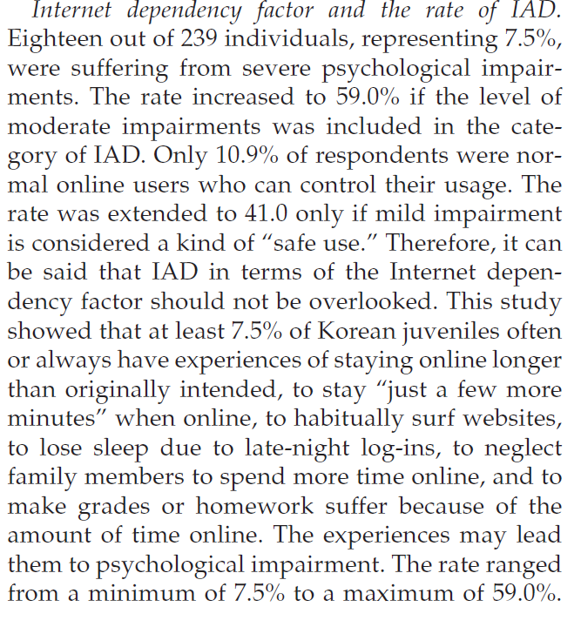
How pervasive is internet addiction?
Hur, 2006; n=240 teens
Why can’t I put down my phone?
Feb. 1, 2017
© 2017 Carnegie Mellon University.
[Distribution Statement A] This material has been approved for public release and unlimited distribution. Please see Copyright notice for non-US Government use and distribution.
Notes:
Does that mean that the other 90% have psychopathologies?

Slide 15
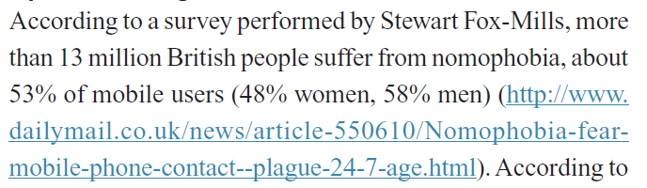
How pervasive is internet addiction?
~6% are addicted (Greenfield, 1999)
~50% of mobile phone users have nomophobia (Bragazzi & Puente, 2014)
Why can’t I put down my phone?
Feb. 1, 2017
© 2017 Carnegie Mellon University.
[Distribution Statement A] This material has been approved for public release and unlimited distribution. Please see Copyright notice for non-US Government use and distribution.

Slide 16
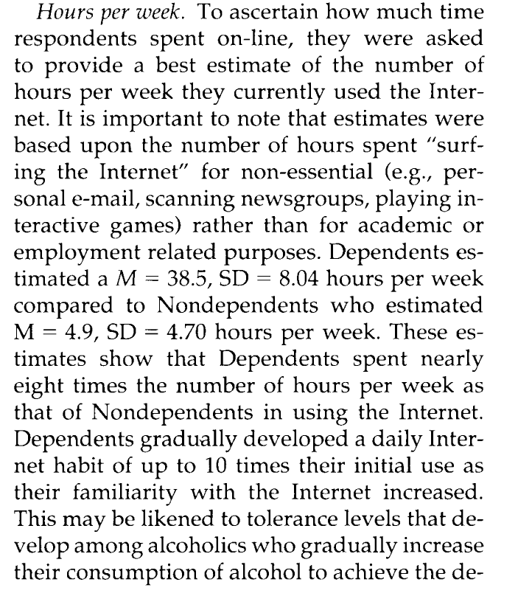
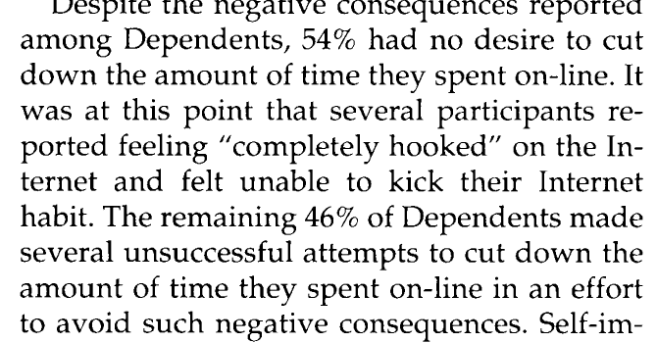
How pervasive is internet addiction?
Young 1998; n=396 mean age ~25
Why can’t I put down my phone?
Feb. 1, 2017
© 2017 Carnegie Mellon University.
[Distribution Statement A] This material has been approved for public release and unlimited distribution. Please see Copyright notice for non-US Government use and distribution.

Slide 17
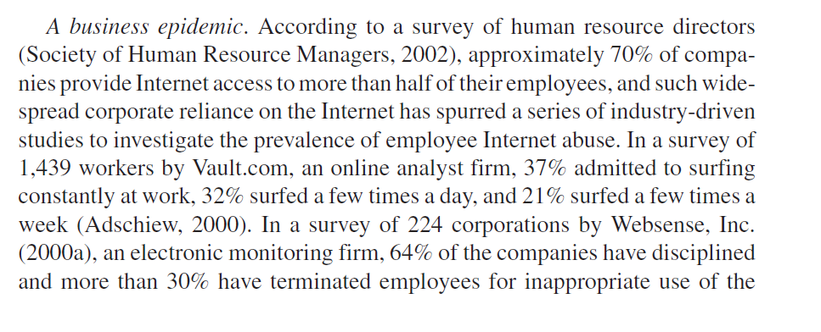
How pervasive is internet addiction?
Young, 2004
Why can’t I put down my phone?
Feb. 1, 2017
© 2017 Carnegie Mellon University.
[Distribution Statement A] This material has been approved for public release and unlimited distribution. Please see Copyright notice for non-US Government use and distribution.

Slide 18
In sum
Digital addictions grew with advancing technology
It doesn’t seem like psychopathology is required to be addicted
The more a person is forced to use the internet at work, the higher the risk of digital addiction.
Digital addictions come with a list of psycho-biological withdrawal symptoms
Digital addictions are correlated with low grades, low esteem, low work performance, loneliness, poor relationships, etc.
Why can’t I put down my phone?
Feb. 1, 2017
© 2017 Carnegie Mellon University.

Slide 19
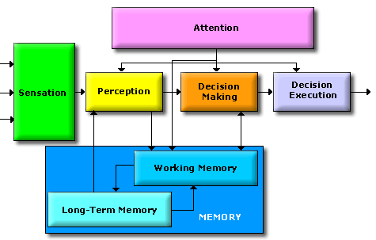
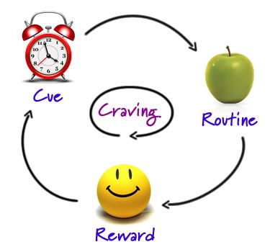
How does this relate to work?
Why can’t I put down my phone?
Feb. 1, 2017
© 2017 Carnegie Mellon University.
Notes:
So they come in the door already caught up in the cycle, even if they are ‘addicted.’ Then, they must switch to this mode at work. However, what is missing in my knowledge and not discoverable in the research world is how the two meld together. A sensation could be that craving. Causing you to miss percpeptual cues.

Slide 20
Increase in quantity of workplace distraction?
What makes people attracted to cyber job roles?
What percentage are distraction tasks?
What do we know from the distraction research?
Why can’t I put down my phone?
Feb. 1, 2017
© 2017 Carnegie Mellon University.
[Distribution Statement A] This material has been approved for public release and unlimited distribution. Please see Copyright notice for non-US Government use and distribution.
Notes:
So, do we have a change in the amount of work tasking (e.g., communicatins) that make us more distracted?

Slide 21
What makes people attracted to cyber job roles?
Cowley, J. (2014). Job Analysis Results for Malicious-Code Reverse Engineers: A Case Study (No. CMU/SEI-2014-TR-002). CARNEGIE-MELLON UNIV PITTSBURGH PA SOFTWARE ENGINEERING INST.
Work-life balance
Autonomy
Rewarding work that challenges technical competence
High-quality work that is appreciated by sponsor
Appropriate performance metrics
Allow for expertise development
Minimize time pressure when high quality is required
Desire for large blocks of time to work uninterrupted
Why can’t I put down my phone?
Feb. 1, 2017
© 2017 Carnegie Mellon University.
[Distribution Statement A] This material has been approved for public release and unlimited distribution. Please see Copyright notice for non-US Government use and distribution.

Slide 22

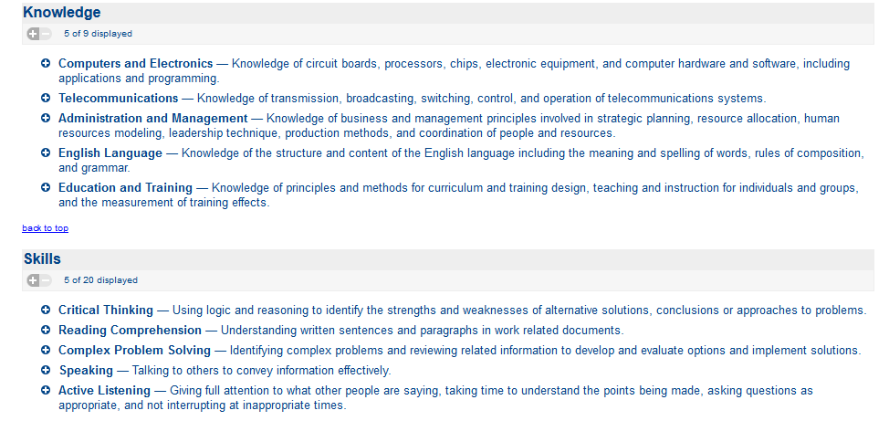
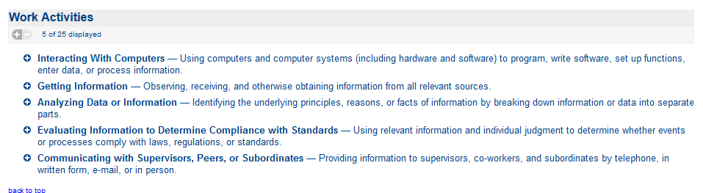
O*Net Job Tasking
https://www.onetonline.org/link/summary/15-1122.00?redir=15-1071.01
Why can’t I put down my phone?
Feb. 1, 2017
© 2017 Carnegie Mellon University.
[Distribution Statement A] This material has been approved for public release and unlimited distribution. Please see Copyright notice for non-US Government use and distribution.

Slide 23

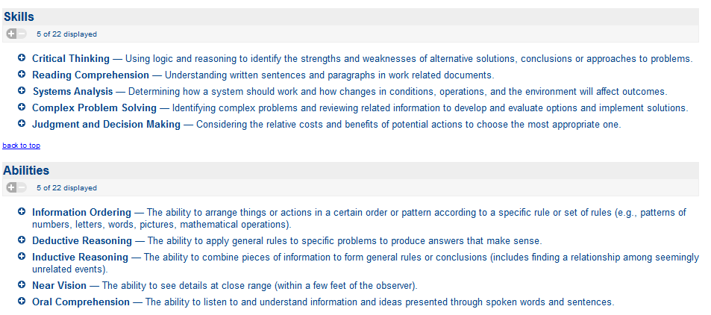
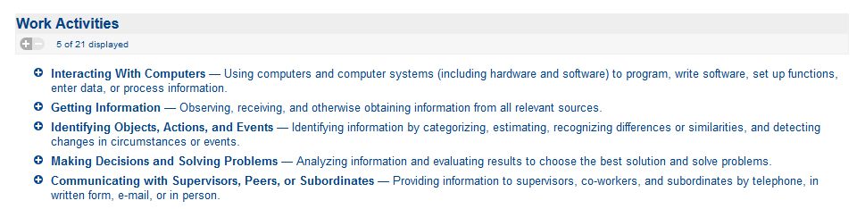
O*Net Job Tasking
https://www.onetonline.org/link/summary/15-1142.00
Why can’t I put down my phone?
Feb. 1, 2017
© 2017 Carnegie Mellon University.
[Distribution Statement A] This material has been approved for public release and unlimited distribution. Please see Copyright notice for non-US Government use and distribution.
Notes:
So we have more deep thinking requirements than distraction…but in my own experience, it was lopsided.

Slide 24
Are we working longer hours and doing more distraction-based work from pre- to post-digital age?
Has it increased?
??? Some publications make these statements without evidence to support it (Twenge & Campbell, 2008)
Rones, Ilg & Gardner (1997) show an increase in length of work week across ‘professionals’ and ‘managers’ between 1985 and 1993.
Has it decreased?
Whaples (1991) claims the work week was shortened since WWII
Why can’t I put down my phone?
Feb. 1, 2017
© 2017 Carnegie Mellon University.
[Distribution Statement A] This material has been approved for public release and unlimited distribution. Please see Copyright notice for non-US Government use and distribution.
Notes:
My premise is that it used to be that technology was going to reduce workload and free up time.
Whaples, R. (1991). The shortening of the American work week: An economic and historical analysis of its context, causes, and consequences. The Journal of Economic History, 51(02), 454-457.
Rones, P. L., Ilg, R. E., & Gardner, J. M. (1997). Trends in hours of work since the mid-1970s. Monthly Lab. Rev., 120, 3.

Slide 25
What does the research say about multi-tasking?
Multi-tasking research
Distraction and mood: (Adamczyk, & Bailey, 2004; Broderick, 2005; Rusting & Nolen-Hoeksema, 1998; Van Dillen & Koole, 2007; Moore et al., 2013)
Performance and distraction: (Leiva, et al., 2012; Adamczyk, & Bailey, 2004; Speier et al., 1999)
Social media and performance
  Why we distract: (Loukopoulos, Dismukes & Barshi, 2009; Wang & Tcherney, 2012; Crenshaw, 2008; Rose, 2010; Wang & Tcherney, 2012)
  Social media and performance: (Gikas & Grant, 2013; David et al., 2015)
  Cost of re-engagement: (Cartwright & Holmes; 2006; Sheppes & Meiran, 2008; Healey et al., 2008; Turrill et al, 2012; Witmer & Gotlib, 2012; Carter et al., 2015 and 10 other references)
Why can’t I put down my phone?
Feb. 1, 2017
© 2017 Carnegie Mellon University.
[Distribution Statement A] This material has been approved for public release and unlimited distribution. Please see Copyright notice for non-US Government use and distribution.
Notes:
In order to understand how people are surviving their workplace, we looked at specific lines of research. Keep in mind that it’s not just a topic like multitasking. It’s the cause of, the natural propentity to, the way people feel when, the way people feel afterwards, and the performance outcomes.
Smartphone users might be interrupted while interacting with
an application, either by intended or unintended circum-
stances. In this paper, we report on a large-scale observa-
tional study that investigated mobile application interruptions
in two scenarios: (1) intended back and forth switching be-
tween applications and (2) unintended interruptions caused
by incoming phone calls. Our findings reveal that these inter-
ruptions rarely happen (at most 10% of the daily application
usage), but when they do, they may introduce a significant
overhead (can delay completion of a task by up to 4 times).
We conclude with a discussion of the results, their limitations,
and a series of implications for the design of mobile phones

Slide 26
Let’s do the math
How many times do we self-distract?
On average between 17 and 27 times an hour (Marci, 2012).
Information workers switch tasks on average 3 times per hour (González and Mark, 2004),
Computation for time lost due to distraction:
Information workers switch 1 time/3 minutes
1 minute to complete the distraction and re-engage
~120 interruptions in 8 hour period
~ 2 hours in switching costs per day
Why can’t I put down my phone?
Feb. 1, 2017
© 2017 Carnegie Mellon University.
Notes:
So if information workers switch every three minutes and on average it takes 1 minute to switch back and re-engage with the work, that’s ~160 interruptions in an 8-hour period. This in turn costs the employee 160 minutes or 2.67 hours each day just in switching costs. And yet, organizations blindly provide and/or require employees to use social media work collaboration tools, productivity tools, instant messenging, emails and other task interrupting tools that the employee must shoulder the costs of.

Slide 27
Organizations then expect employees to use enterprise social media applications. Why?
Why can’t I put down my phone?
Feb. 1, 2017
© 2017 Carnegie Mellon University.

Slide 28
What do we know about social media in the workplace?
Why do employees use enterprise-level social media
  Establish ones credibility as a thought leader (Jackson, Yates, & Orlikowski, 2007)
  Used for career advancement and image management (DiMicco et al., 2008)
Social media outcomes
  High distraction creates habitual distraction patterns that encumber learning, poor subjective inhibition, poor focus, reduce cognitive functioning and poor socio-emotional stability but research is mixed (for review, see Schuur et al., 2015)
  Initially high non-work socialization and then reduced (DiMicco et al., 2008) (Van Dijck, 2013; Becker et al, 2013; Gikas & Grant, 2013)
  Less socializing and more information seeking in the workplace (Hasan & Pfaff, 2006; Jackson, Yates & Orlikowski, 2007; Kim, Lee & Hwang, 2008; Millen, Feinberg & Kerr, 2006)
Why can’t I put down my phone?
Feb. 1, 2017
© 2017 Carnegie Mellon University.
[Distribution Statement A] This material has been approved for public release and unlimited distribution. Please see Copyright notice for non-US Government use and distribution.

Slide 29
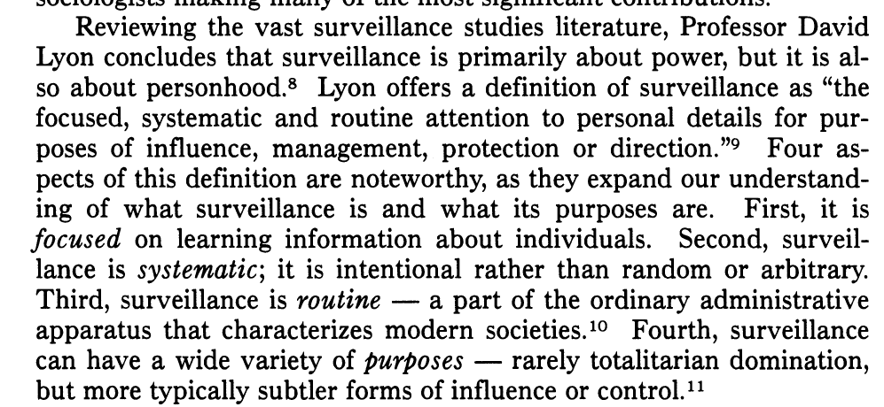
Increase surveillance
Why can’t I put down my phone?
Feb. 1, 2017
© 2017 Carnegie Mellon University.
[Distribution Statement A] This material has been approved for public release and unlimited distribution. Please see Copyright notice for non-US Government use and distribution.

Slide 30
Uses of Surveillance
Insider Threat Network Monitoring
Executive Order 13587 -- Structural Reforms to Improve the Security of Classified Networks and the Responsible Sharing and Safeguarding of Classified Information
Job Performance (EPM, DPM)
“Objective” assessment of job performance
[Distribution Statement A] This material has been approved for public release and unlimited distribution. Please see Copyright notice for non-US Government use and distribution.

Slide 31
How surveillance impacts the employee
Reduced quality and frequency of social engagements with peers and supervisors (Marx & Sherizen, 1986)
More loneliness, depression, anxiety, stress, irritability (Aiello,1993) & fear (Greenwald, 2014; Nau, 2014)
Distrust in management and leadership (Greenwald, 2014)
Belief that management over emphasizes quantity, not quality of the work outputs (Iving, Higgins, & Safayeni, 1986)
Demotivation (Lee & Kleiner, 2003)
Increase in intention to resign (Chalykoff & Kochan, 1989)
Invasion of privacy (Marx & Sherizen, 1986)
Physiological stress indicators increase: headaches, musculoskeletal discomfort, increased blood pressure and eye strain (Aiello, 1993; Aiello & Kolb, 1995; Henderson, Mahar, Saliba, Deane, & Napier, 1998).
Unintended human errors rise (Driskell & Salas, 2013; Reason, 1990).
Why can’t I put down my phone?
Feb. 1, 2017
© 2017 Carnegie Mellon University.

Slide 32
Behavioral Responses to Surveillance
Employee Behavioral Responses
Temporarily increase performance (Ariello, 1993; Lee & Kleiner, 2003)
Self-censoring and “chilling effect” (Marder et al., 2016; Priks, 2015; Richards, 2013)
Social conformity and reduced autonomy (Greenwald, 2014)
Implications for Research
Restriction of range problem with censoring and “chilling effect”
False-positive baselining with social conformity and “chilling effect”
Why can’t I put down my phone?
Feb. 1, 2017
© 2017 Carnegie Mellon University.
[Distribution Statement A] This material has been approved for public release and unlimited distribution. Please see Copyright notice for non-US Government use and distribution.
Notes:
-
Now at Centre for Applied Psychology, University of Canberra, ACT 2616, Australia.
‡ Now at School of Social Science, Queensland University of Technology, Beams Road, Carseldine,
Queensland 4018, Australia.
∞
Now at DSTO Aeronautical and Maritime Research Laboratory, Air Operations Division, Human
Factors, PO Box 4331, Melbourne, Vic. 3001, Australia.
±
Visiting Researcher, from the Department of Psychology, Massey University, New Zealand.
E
The research was conducted on behalf of the Harry Trigubo§ AM Syndicate.
Int. J. Human
–
Computer Studies
(1998)
48,
143
–
157
Electronic monitoring systems: an examination of
physiological activity and task performance within
a simulated keystroke security and electronic
performance monitoring system
R
ON
H
ENDERSON
,
-
D
OUG
M
AHAR
,‡ A
NTHONY
S
ALIBA
,
∞
F
RANK
D
EANE
,
±
R
ENEE
N
APIER
The Trust Project,
E
RSISE, Australian National Uni
v
ersity, ACT 0200, Australia,
e-mail: ron
@
science.canberra.edu.au
(Recei
v
ed 11 March 1996 and accepted in re
v
ised form 12 September 1997)
Electronic monitoring systems are becoming a prominent feature of the modern o¶ce.
The aims of the present study were three-fold. First, to assess the e§ects electronic
security monitoring systems (ESM) have on the user’s physiological state. Second, the
researches aimed to examine the e§ects explicit security challenges have on both user
behaviour and physiological state when using an ESM system. Finally, the research
aimed to examine the e§ects one form of electronic performance monitoring system may
have on the user’s physiological state. To this e§ect, the present study examined the
physiological and performance e§ects of two simulated electronic monitoring systems
(security/performance). The computer task required 32 subjects to enter mock clinical
case notes under various conditions. In the first session subjects were only required to
enter the case notes while keystroke data were collected. The second session was divided
into three discrete stages. In the ‘‘security baseline’’ condition, subjects were informed
that a keystroke security monitoring system had been instituted, but no security chal-
lenges occurred. In the ‘‘security challenge’’ condition, however, a number of explicit
security challenges occurred. In the final ‘‘performance monitoring’’ condition, subjects
were informed that their data entry speed was monitored and they were placed on
a response-cost schedule for poor performance. Blood pressure and continuous inter-
heartbeat latency were recorded for the security and performance conditions. Results
indicated that monitoring systems have the potential to evoke altered arousal states in
the form of increased heart rate and blood pressure. Contrary to expectations, the
hypothesized improvement in task performance within the performance monitoring
condition was not observed. The implications of these results for the design and imple-
mentation of electronically based behavioural-based security and performance monitor-
ing systems are discussed

Slide 33
Are we creating our own workplace threats?
Why can’t I put down my phone?
Feb. 1, 2017
© 2017 Carnegie Mellon University.
[Distribution Statement A] This material has been approved for public release and unlimited distribution. Please see Copyright notice for non-US Government use and distribution.

Slide 34
What are the leading antecedents in workplace violence, crime, etc.?
Low levels of work engagement (Saks, 2006 and 2 other references)
Lack of worker autonomy (Baard, Deci & Ryan, 2004; Gagne & Deci, 2005)
Distrust in management (Konovsky & Pugh, 1994)
Perceptions of injustice (Aquino, Trip & Bies, 2001; Greenberg & Alge, 1998; and 14 other references)
Lack of perceived organizational support (Abas, Omar, Halim & Hafidz, 2015 and ~10 other references)
Emotional exhaustion (Krischer, Penney & Hunter, 2010)
Negative mood generally (Bushman, Baumeister & Phillips, 2001 and 3 other references)
Stress (Vermunt & Steensma, 2005)
Abusive leadership (Restubog et al., 2011; Shoss et al., 2013)
[Distribution Statement A] This material has been approved for public release and unlimited distribution. Please see Copyright notice for non-US Government use and distribution.

Slide 35
The Workplace Paradox
What draws employees to the work? | What’s it like in the workplace environment? | Antecedents to workplace threat
Work-life balance Autonomy Rewarding work that challenges technical competence High-quality work that is appreciated by sponsor Appropriate performance metrics Allow for expertise development Minimize time pressure when high quality is required Desire for large blocks of time to work uninterrupted | Isolation and reduced socialization Reality/virtual reality conflation Poor work performance Little time for deep thinking Time lost due to task re-engagement Depression, anxiety, loneliness, etc. Lack of autonomy Fear Distrust in management Perceived injustice Censorship Rigid work schedule Management stresses quantity over quality | Low levels of work engagement Lack of worker autonomy Distrust in management Perceptions of injustice Lack of perceived organizational support Emotional exhaustion Negative mood generally Stress Abusive leadership
Why can’t I put down my phone?
Feb. 1, 2017
© 2017 Carnegie Mellon University.

Slide 36
Are we creating our own workplace threats?
Thank you!
Why can’t I put down my phone?
Feb. 1, 2017
© 2017 Carnegie Mellon University.
[Distribution Statement A] This material has been approved for public release and unlimited distribution. Please see Copyright notice for non-US Government use and distribution.

Slide 37
[Distribution Statement A] This material has been approved for public release and unlimited distribution. Please see Copyright notice for non-US Government use and distribution.

Slide 38
What does the research say about work tasking
Team collaboration uses and outcomes
  Video conferencing -in person is better at planning and info exchange (DeMeyer, 1991; Galegher & Kraut, 1994)
  Virtual teams are stymied by virtual meetings in trust, cohesion and job satisfaction but this can be remedied with team training.
  Face to face has more social relationsh and team satisfaction (Warkentin et al., 1997) but in some studies, this wasn’t the case and often offset by heterogeneous gender composition (dePillis & Furumo, 2006)
[Distribution Statement A] This material has been approved for public release and unlimited distribution. Please see Copyright notice for non-US Government use and distribution.

