Slide 1
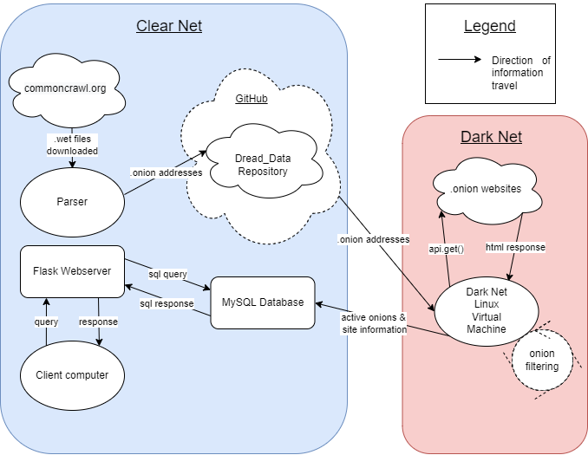
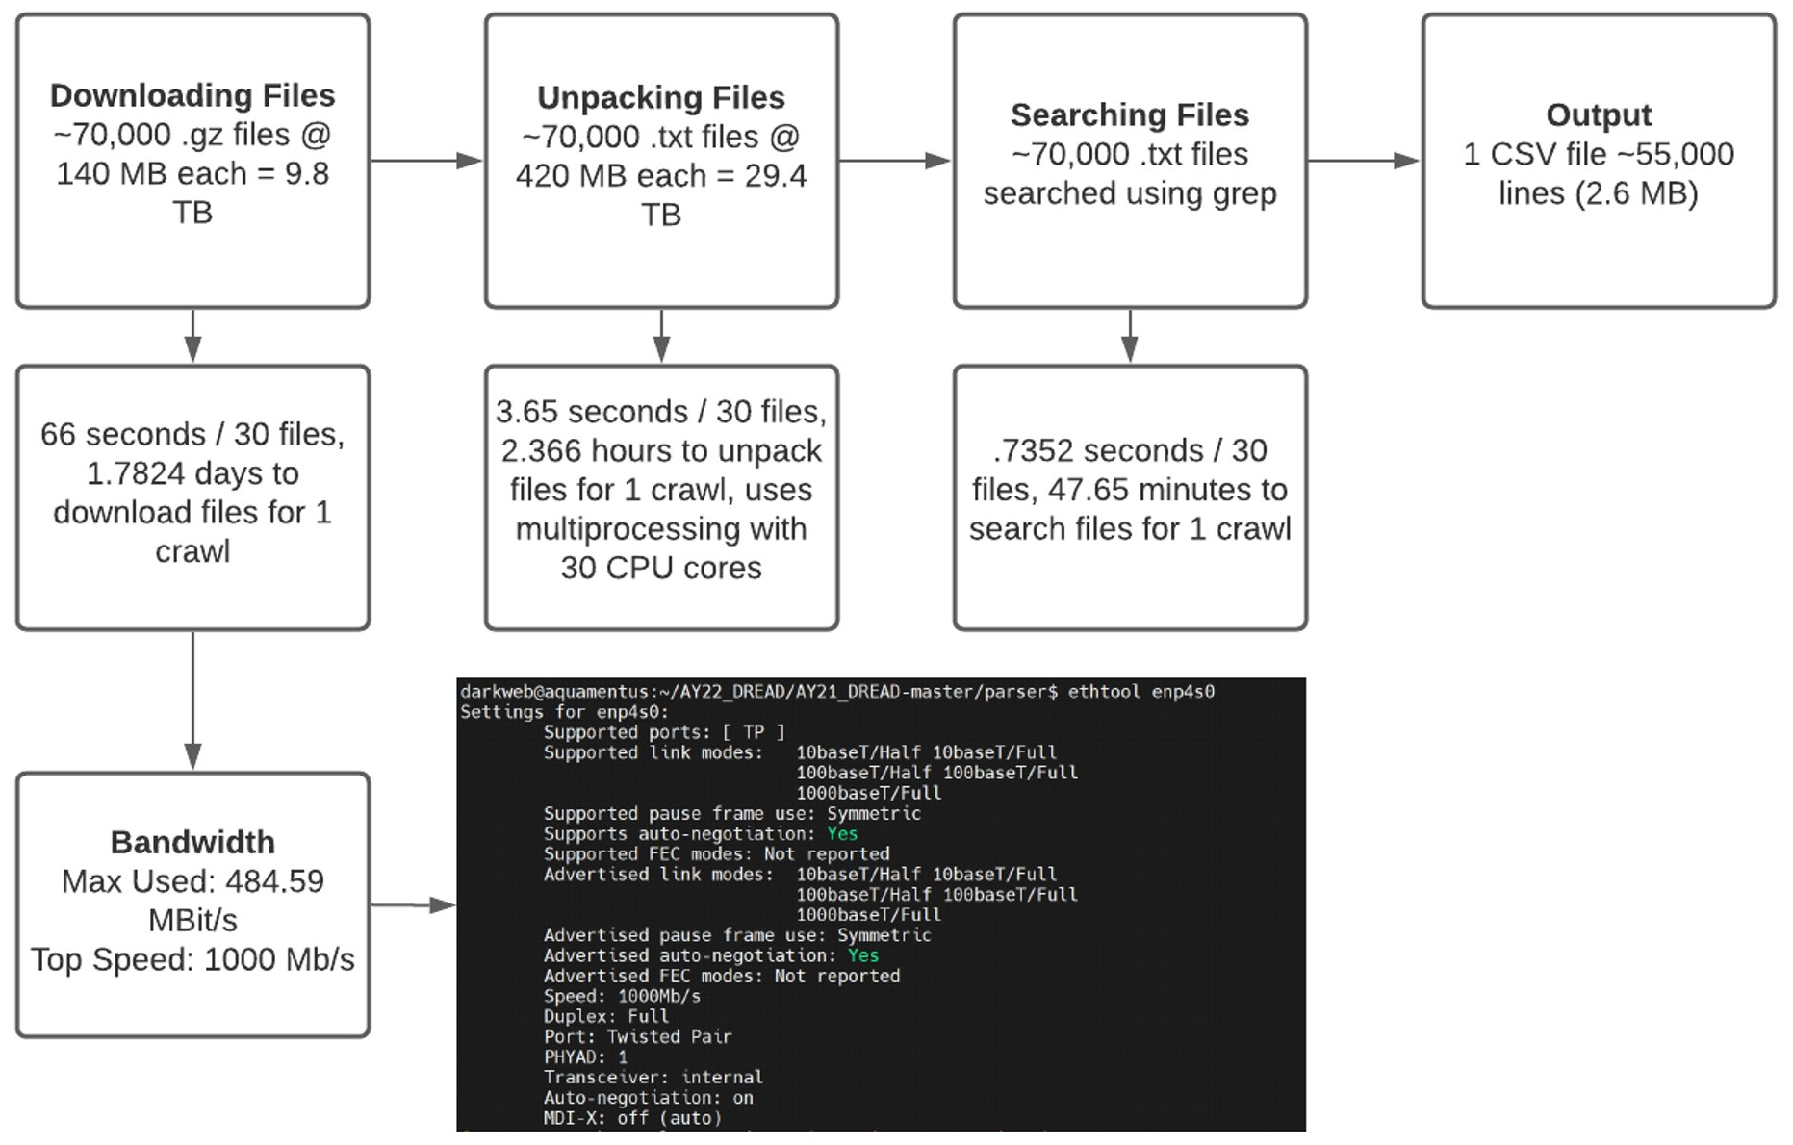
DREAD: Dark web Retrieval, Examination, And Detection
Kyle Krage, Nicholas Schultz, Ryan Hogan, Stonewall Sisk, Luke Whitman, David Ryan, Michael Kapralos, and Raymond Blaine
United States Military Academy
Takeaway
DREAD provides a website interface designed to reduce the time spent manually searching for illicit dark web activity
Design
New Common Crawl data released monthly
Parser automatically downloads the new Crawl and searches for .onion addresses
The resulting CSV of .onion addresses is pushed to our GitHub repository titled “Dread_Data”
The CSV of .onion addresses is pulled onto the Dark Net Linux Virtual Machine
Connection testing of each .onion address initiates using api.get() requests
If a successful connection is established, the website’s complete HTML code is returned as text
Active .onion files are searched for keywords, and subsequently inserted into the corresponding table of the MySQL database
Responses to queries by the Flask webserver are displayed for the user on the website
Related Work
DREAD expands on two years of previous work, with a proof of concept demonstrated by Dargle
Mörch et al. employed nine dark web search engines to analyze suicide-related information identified from keyword searches
DARPA developed a deep and dark web search engine, known as Memex, to combat human trafficking
Most search engines on the dark web are not designed to investigate illicit activities
Results
Automatic parsing of monthly Common Crawl data
70,000 .gz files downloaded, unpacked, and searched in 2 days with 50,000 unique .onion addresses found
Dark web address (.onion) filtering
10% success rate connecting to the addresses, with failed connections attempted a second time, over the span of 5 days
Multi-table MySQL database
Whole category or specific keyword querying through the Flask website interface
Additional Research
Repository of current and past data
Keyword search statistics and site trend analysis

