Slide 1
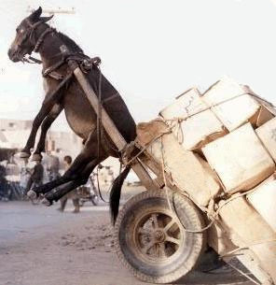
DATA

Slide 2
Data Issues
What is the optimal data?
  “The unreasonable effectiveness of data”
  Need both detail and broader context
    Hierarchical data and hierarchical models
Adaptive approach / moving target
  Soon most data streaming only
  System needs to learn and adapt
  Continuous need for new data
Detecting outliers and inliers
  “Inliers”: need to change the representation
Passive “sniffing” vs targeted sensor design

Slide 3
Models and Data
Take computation/analysis to the data
Data ⬄ Models, two sides of the same
Massive sets of models are data
  Use data to build/populate models
Detect signature of good actor goes bad
  Need some historic trends as well
  Longitudinal data

Slide 4
Central vs Distributed Data
Central: advantages in decision making
Distributed: tied to sensors/organizations
Technical aspects, geo-location
Can you do on demand sharing?
How much analysis at the sensor?
  Data reduction/Latency
  Only simple models at the sensor
  Is the relevant propagated?

Slide 5
Harvest Novel Data Sources
Crowd source, games
Internet telemetry
  Trace routes, router tables
Simulations
  Red-team, blue team: insert synthetic events into real data stream and test recovery rate
Correlations between data sources from multiple sensors/views of environment

Slide 6


Book Citations
Ted Senator, one of Poindexter’s colleagues used a metaphor to describe the difficult task ahead in creating TIA. “Our task is akin to finding dangerous groups of needles hidden in stacks of needle pieces,” he said. “This is much harder than simply finding needles in haystack: we have to search through many stacks of needles, not just one; we do not have a contrast between shiny, hard needles and dull, fragile hay; we have many ways of putting the pieces together into individual needles and and the needles into group of needles; and we cannot tell if a needle or group is dangerous until it is at least partially assembled.” (from DARPATech 2002 speech, available on DARPA web site, and quoted on p. 102)

