Slide 1




Developing Security Metrics
Andy Meneely, Rochester Institute of Technology
Laurie Williams, Mladen Vouk, Huaiyu Dai
North Carolina State University
Science of Security
Lablet

Slide 2
NCSU Metrics Group
Software engineering backgrounds
Vision: better allocation of resources for engineering secure software
Contributing evidence-based knowledge
  Systematizing research on Intrusion Detection Systems
  Analyze vulnerability-proneness and resilience of an overall system
  Measuring the attack surface to assess risk

Slide 3
Intrusion Detection Systems
The security world is saturated with IDS research
  YAIDS papers
  (Yet Another Intrusion Detection System Paper)
  “An IDS with X Algorithm and Y Data”
  Focus is on how, not the what
Our approach: systematize the knowledge
  By metrics of IDS evaluation
  Use of metrics internally too

Slide 4
Systematizing IDS Knowledge
Classification by evaluation
  Methods of evaluation
  Benchmark performances
  Inherent limitations
Status: systematic literature review
  Collected over 300 papers
  Classifying papers
  Narrowing venues

Slide 5

Oct-14/v6
Vulnerability and Resilience
Prediction Metrics and Models
Mladen A. Vouk, Laurie Williams
Anoosha Vangaveeti, Da Young Lee, Shweta Subramani
NC State University

Slide 6
Scope
Goal. To develop a science-based understanding of which security metrics can be used to accurately predict its field resilience and vulnerability-proneness.
Open Question: What is resilience? (see discussion tomorrow – Ravi Iyer) – for example: the number of new (critical) vulnerabilities discovered in the field per week?
Hypotheses:
  H2.3.1: Measurable properties of a system and associated software development processes are indicative of the presence of vulnerabilities in released software.
  H2.3.2: Statistical models based upon current (classical) reliability and availability prediction models and attack profiles can accurately predict the resilience of a system.

Slide 7
Some Results
“Steady-state” security problem discovery rate in the field for Fedora and Windows are in the range of a few per week (rate is in the 10e-5 to 10e-7 per inservice-week).
A large fraction (in the 30+% range) of problems reported weekly for STABLE field versions of Fedora and Windows are security problems.

Slide 8
Some More Results
A very large fraction (65% and above) of security problems detected in the field for open-source Fedora (many different releases) belong to epistemic category (flawed process, knowledge, model, ..).
Classical reliability models appear to describe and predict well field discovery of security problems for open-source Fedora.

Slide 9
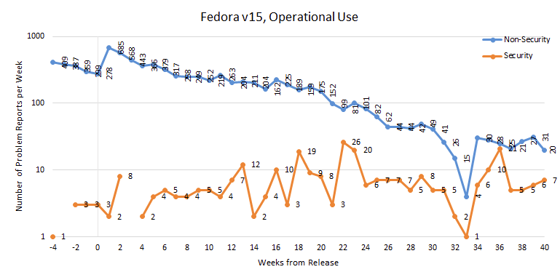
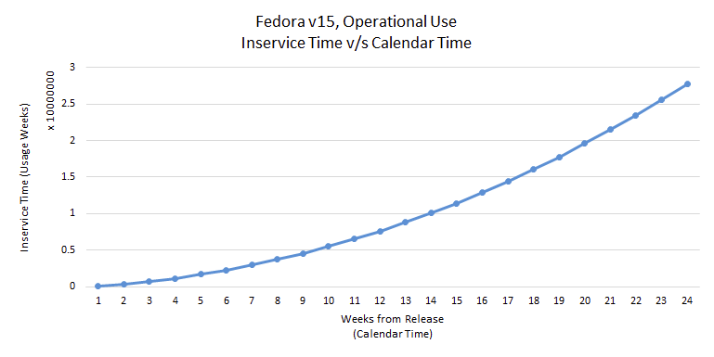
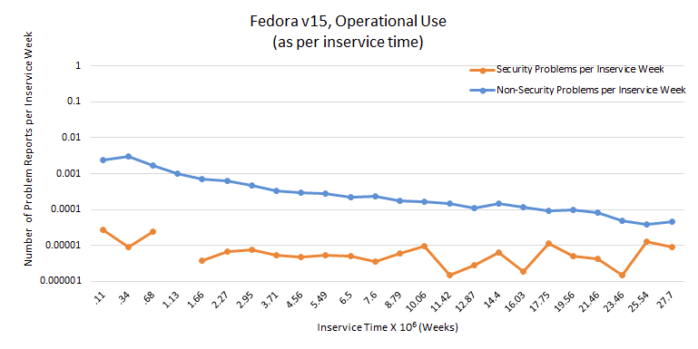
Implication (1) – Open Source, Ramp-up
Once software and its operational profile stabilize in the anomalies the result of sampling low to very low probability input vectors. If “white list” filter “closes” at that point, software may now be “immune” to further attacks (at the expense of some functional loss).

Slide 10
Implication (2) - Windows
10e-5 to 10e-7 security problems per inservice week may be the best we can do given current OTS software development processes and usage patterns.
Windows 7 | 22-Oct-09
Windows 8 | 26-Oct-12
Windows RT | 26-Oct-12
Win Vista | 30-Jan-07

Slide 11
White List Defense Model
Beyond this point there is ~94% chance that any
new URL requests are attacks.
.

Slide 12
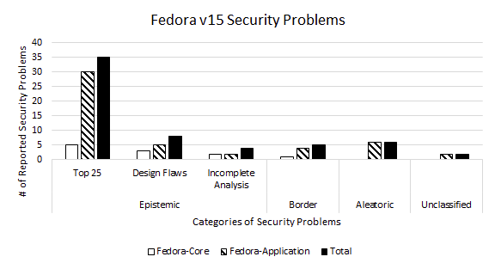
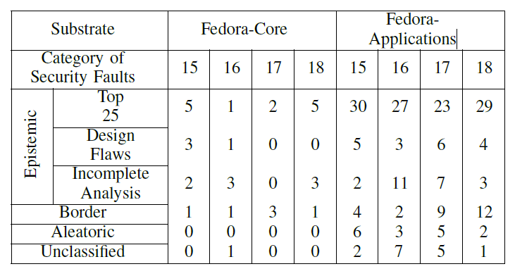
Fedora - Distribution of Security Problems
Improved (agile) development processes may eliminate, and improved epistemic field-defenses may reduce field vulnerabilities by 60-80% (in the next release?).
Safe way of handling aleatory problems (including 0-days) is via dynamic “oracle” –based anomaly detection.

Slide 13
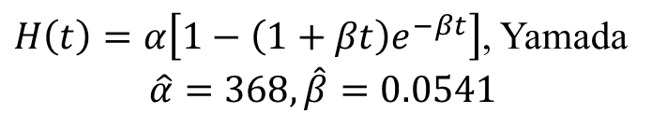
Modeling Cumulative Profile
(Fedora 15, Security Problems)
$H\left(t\right)=α\left[1−\left(1+βt\right)e^{−βt}\right]$, Yamada
$$\hat{α}=\text{368}, \hat{β}=0.0541$$
Notes:
This figure shows the fit obtained for security problems reported for fedora 15 release using the delayed S-shaped SRGM by Yamada. The fit was obtained using the CASRE tool. Note that the vertical axis is logarithmic. Input data were unique problem reports for fedora 15 through 18. By unique we mean that only problems whose status were “closed” and resolution was either ”current or next” release or errata were considered as they satisfy the independent failures assumption of the model.
The tool uses the first 22 weeks failure or problem information to estimate the unknown parameters of the model and projects the most likely total problems with 95% confidence for the 40th week. At week 20 the actual cumulative number of security problems reported are 123. The model estimates there to be anywhere between 123 to 656 problems at the end of week 40. The total number of problems that were reported were 275.
This gives us an upper bound on the number of residual problems at the end of 40 weeks which is 656-123=533.
This estimate of the residual or “yet to be found” security problems could be used to estimate the order of magnitude of additional attack cases that one may need to find the remaining security problems and subsequently improve the security reliability growth in the current or next release of fedora.

Slide 14
Assumptions of SRE models are satisfied in Security Context?
Satisfying Poisson process
    Homogenous or non-homogenous
    Times between failures are independent
Faults are perfectly fixed after their discovery
Fall 2014 Community Forum
October 24, 2014

Slide 15
Verification of Poisson Process
To qualify SRE models for use in security context, verification of Poisson process is conducted
  Poisson distribution test with the number of events in inter-arrival time
  Exponential distribution test with inter-arrival times between two independent consecutive events

Slide 16
Conclusions
Making Progress. Towards a good science-based understanding of which security metrics of a system can be used to (accurately) predict its field resilience and vulnerability-proneness (in this case resilience is defined in terms of new vulnerabilities discovered in the field).
Hypotheses:
  H2.3.1: Measurable properties of a system and associated software development processes are indicative of the presence of vulnerabilities in released software.
  H2.3.2: Statistical models based upon current (classical) reliability and availability prediction models and attack profiles can accurately predict the resilience of a system.

Slide 17
Oct-14/v6
Attack Surface Metrics
Laurie Williams, Andy Meneely
Christopher Theisen, Nuthan Munaiah
NC State University

Slide 18
The Attack Surface
Goal: assess risk of a software system by way of its input and output space
Measure evolution over time:
  More inputs ➔ More entry points ➔ More risk
  More outputs ➔More exit points ➔ More risk
  Early alert system for developers
Approaches thus far (see Manadhatta, Wing, & Howard)
  Enumerate entry/exit points as functions that call input/output functions
  Measure ease of attack based on configurations

Slide 19
Beyond the Surface
Idea: analyze the function call graph
Compute reachability
30%
Entry points
50%
80%
open_socket()
40%
A Software System
http()
read()
save_to_db()
log_warn()
Exit points

Slide 20
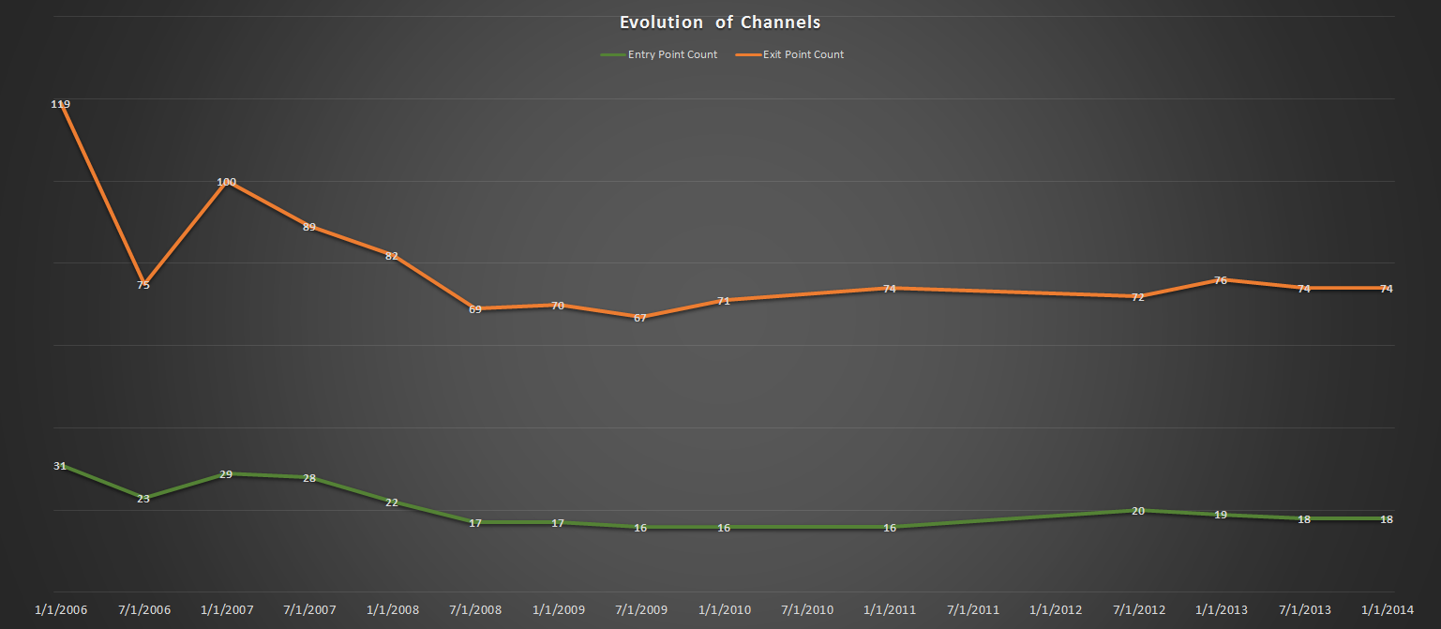
Entry/Exit Evolution in FFMpeg
#Entry Points, #Exit points 2005-2014
#Entry and #Exit points don’t change much over time!

Slide 21
…but what about reachability?
Entry and exit point reachability do change, and can vary wildly over time

Slide 22
Current Research Questions
RQ1: Do vulnerabilities reside near the attack surface historically?
RQ2: Do severe vulnerabilities appear in areas of high reachability?
RQ3: Do applying asset weights and designed defenses improve our measurements?

Slide 23
Oct-14/v6
Attack Surface Approximation
via Stacktraces
Laurie Williams
Christopher Theisen
NC State University

Slide 24
Scope
Goal. The goal of this research is to aid software engineers in prioritizing security efforts by approximating the attack surface of a system via stack trace analysis.
Research Questions:
  RQ1: How effectively can stack traces to be used to approximate the attack surface of a system?
  RQ2: Can the performance of vulnerability prediction be improved by limiting the prediction space to the approximated attack surface?

Slide 26
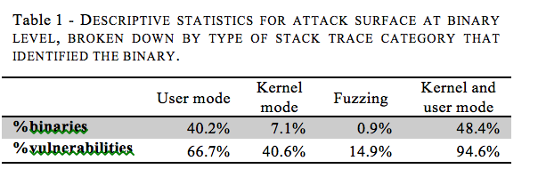
Attack Surface Approximation

Slide 27
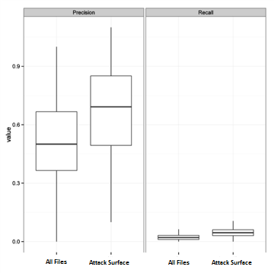
Vulnerability Prediction

Slide 28
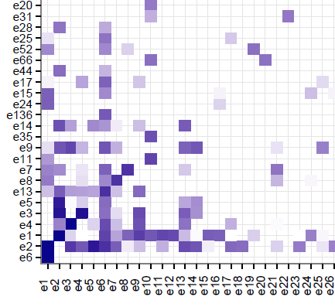
Future Work

