Slide 1

V1/4-Apr-2014
Diversity Based Detection
of Security Anomalies
Roopak Venkatakrishnan
Dr.Mladen A. Vouk

Slide 2
Motivation
Attacks on web services up 30%
Acceptance testing requires prior knowledge & External checking has limited applicability
Diversity – pro-active, expensive but helps identify difficult to detect attacks
Fall 2013 Community Forum
October 22, 2013
Notes:
There are different ways one can detect anomalies in software of which (….) are the most common
Acceptance testing and w
The first 3 can perform checking in real time. Consistency checking is usually offline.

Slide 3
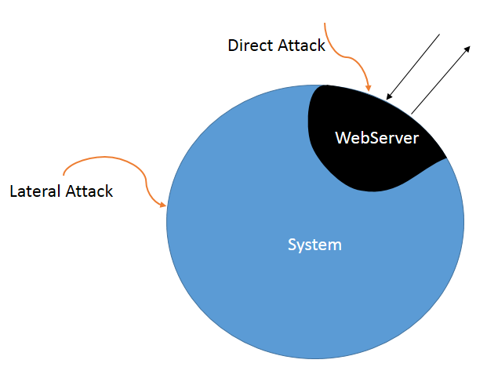
Types of Attacks
Direct Attacks -
Vulnerability in
  Web server core
  3rd party add-ons
Lateral Attacks
Fall 2013 Community Forum
October 22, 2013
Notes:
There are different ways one can detect anomalies in software of which (….) are the most common
Acceptance testing and w
The first 3 can perform checking in real time. Consistency checking is usually offline.

Slide 4



Lateral Compromise – Linux/Cdorked.A
Plugin sends iframe redirect based on conditions including random factor.
Avoids redirect for admins
In-memory operation
~80%
Fall 2013 Community Forum
October 22, 2013

Slide 5
Nginx Zero Day Exploit
Allowed Access to restricted content
Caused due to improper parsing of request
Detected easily using Diversity due to difference in status codes.
Fall 2013 Community Forum
October 22, 2013

Slide 6
Diversity based Detection
Can help detect attacks which are not detected otherwise.
Use of cloud based resources make it cost effective
Fall 2013 Community Forum
October 22, 2013
Notes:
Color one red
Two green
Disagree (red)

