Slide 1
Frontier: Beyond Technical Security:
Developing an Empirical Basis for Socio-Economic Perspectives
Presented by
Jeremy Epstein
National Science Foundation
Research by
Stefan Savage, Geoffrey M. Voelker, James Fowler, Alex Snoeren,
Lawrence Saul, Kirill Levchenko, Erin Kenneally
University of California, San Diego
Vern Paxson, Mark Allman, Chris Grier, Chris Hoofnagle, Dan Klein,
Christian Kreibich, Deirdre Mulligan, Nicholas Weaver
International Computer Sciences Institute
Damon McCoy
George Mason University
Notes:
Mention coauthors

Slide 2
Stefan’s comment
From a security of science standpoint, I think our contribution is to point out that while there is a very strong attraction to looking for an axiomatic solution to the security problem, that it is unlikely to ever be foolproof simply because conflict is a human endeavor and we can no more formalize all the modes of potential unwanted human interaction via computers than we can do with physical weapons. We're proponents for also investing in trying to understand the social and economic components driving both attack and defense, and to place the evaluation of these on an empirical footing.

Slide 3
Stefan’s Comment (cont)
This isn't satisfying in the way that a proof of correctness is, because its not guaranteed, but in our experience this level of understanding has both broad applicability and allows one to be much more effective in thinking about defense (and offense for that matter). Our work on abuse-advertised counterfeit goods (e.g., e-mail spam, search engine abuse, social network abuse, etc) is probably the best success story in that it showed how identifying the full value chain revealed a bottleneck in payment processing that is now being used to extremely potent effect.

Slide 4
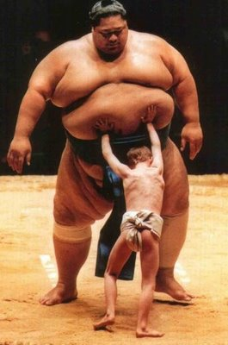
A decade of computer security research
We didn’t stop worms
or malware,
or e-crime…
nor did anyone else.
One key mistake:
looking at security as a
purely technical problem

Slide 5
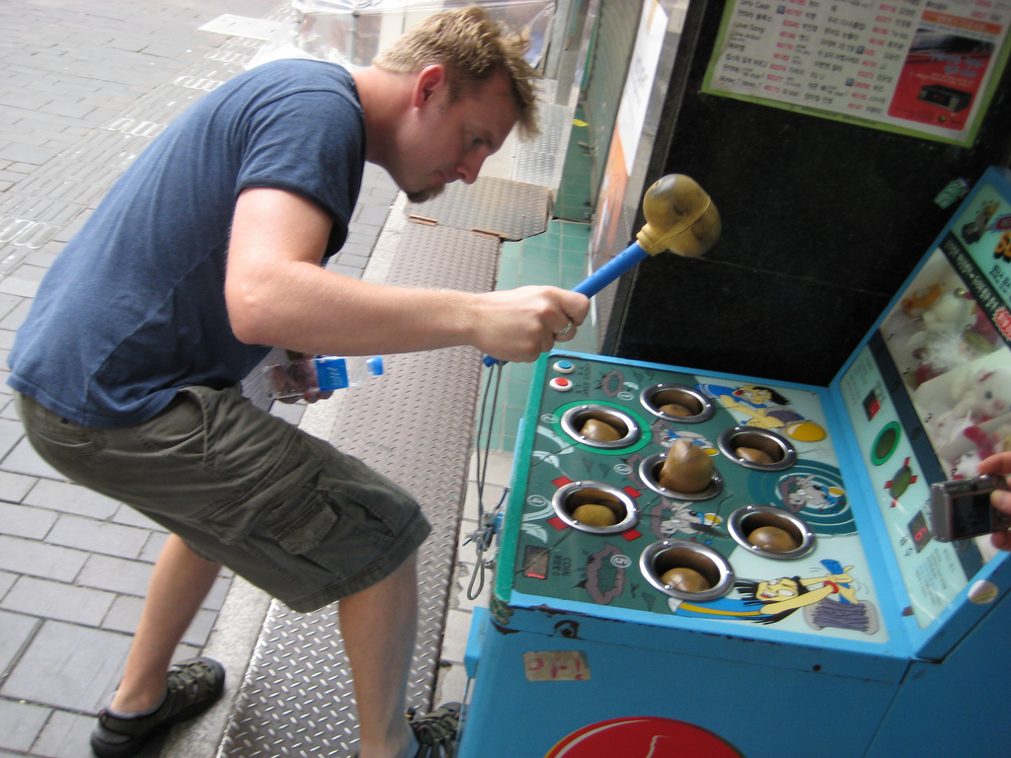
State of the practice in security

Slide 6
Why? structural asymmetries
Initiative: Defenders reactive, attackers proactive
  Defenses public, attacker develops/tests in private
  Arms race where best case for defender is to “catch up”
Innovation: New defenses expensive, new attacks cheap
  Defenses sunk costs/business model
  Attacker agile and not tied to particular technology
Incentives: Low risk to attack, low reward to defend
  Minimal deterrence; functional anonymity on Internet
  Security is rarely a key competitive feature (why? see next)
Evaluation: Defenses hard to measure, attacks easy
  Few security metrics (no “evidence-based” security)
  Attackers measure monetization which drives attack quality

Slide 7

What to do?
Popular refrain: “We need a Science of Security”

Slide 8
What to do?
Popular refrain: “We need a Science of Security”
But, what kind of science?

Slide 9
What to do?
Popular refrain: “We need a Science of Security”
Like math:
  Security has an axiomatic basis, once you derive principals and implement them, everything will be secure (e.g., crypto, type theory)
Like a physical science (e.g., experimental physics)
  There is real Platonic truth of security and we can discover it by generalizing from experimental evidence (e.g., biometrics)
Like a social science (e.g., economics, sociology)
  There are contextual truths that we can discover experimentally and through field work and some of them might be generalizable

Slide 10
Claim: we need to also consider non-technical issues
Security is about people
  Adversaries: motivations, capabilities, organization
  Victims: behaviors, limitations
  Defenders: incentives
Conflict may be mediated by computers, but driven by social, political and economic issues
To make good security decisions we need to understand these socio-economic issues too

Slide 11
Why? Economic transformation
Since ~2004, emergence of profit-making malware
  Anti-spam efforts force spammers to launder e-mail through compromised machines (SoBig.F, MyDoom)
  “Virtuous” economic cycle transforms nature of threat
Commoditization of compromised hosts
  Fluid third-party exchange market (millions of hosts)
    Raw bots (range from pennies to dollars)
    Value added tiers: e.g., SPAM proxying, hosting, etc
Innovation in both host substrate, in uses and in market
  Sophisticated infection and command/control networks: platform
  SPAM, piracy, phishing, identity theft, DDoS are all applications
  Market for goods, services, enablers, etc…

Slide 12
Elements of the Internet
“underground economy”
Acquisition of illicit digital goods
  Tier-1 goods (e.g. credit card dumps, on-line bank accounts)
    Directly valued in “real world”; single step liquidity
  Tier-2 goods (e.g. bots, exploits, malware, accounts, VPNs, hosting and other support services)
    Valued only in UE, rented for service, or used to produce value in scam
  Hybrid goods (e.g., MMPORG accounts/items – for laundering in Asia, bitcoin)
Trade/Sale in such goods
  On-line markets and market enablers
Scams (capital investment to extract new value)
  Combine digital goods with value creation strategy
  SPAM, phishing, DDoS, credential stealers, etc
Liquidation of goods (cash out)
  Indirect: SPAM/SEO (potentially legal), Click fraud, pump/dump
  Direct: white plastic cashout, re-shipping, ACH transfer money mules

Slide 13

Motivation
There is a broader socio-economic view
Key hypothesis:
  These extrinsic factors will provide a more effective basis for designing security interventions
  Actors
    Adversaries
    Victims
    Defenders
  Incentives/Costs
  Capabilities
  Relationships

Slide 14
Why an empirical focus?
Security is poised to become a big data field
  But defenses/policies need good models; good models need to be informed by good data
  Very poor ground truth data in security field today
For validating hypotheses
  e.g., monetary payments are a structural bottleneck in all advertising-based e-crime
For deriving hypotheses
  e.g., how important is trust establishment for online criminals?

Slide 15
The Work Plan
(1) Pursue in-depth empirical analyses of a range of online criminal activities, including the broad range of enabling infrastructure activities that involve “sale to the trade”.
(2) Map out the evolving attacker ecosystem that preys on online social networks; the extent to which unsafe online behavior is itself learned and transmitted via this same platform; and the use of social networks by adversaries beyond monetary gain: to manipulate public opinion and effect censorship.

Slide 16
The Work Plan (2)
(3) Study the nature of “trust amongst thieves” and how relationships among these criminals are established, maintained, and evolve over time within this medium.
(4) Undertake large-scale studies to measure the efficacy of today’s security interventions, both in the large and at the level of individual users.

Slide 17
Summary
Our work is driven by two beliefs
  Effective intervention will require reasoning about the economic/social structure of our adversaries
  This reasoning should be informed by empirical measurement data and fieldwork
This research agenda is both achievable and has the opportunity for major impact
(both for research and the real world)

