Slide 1
It Takes Data To Protect Data

Slide 2
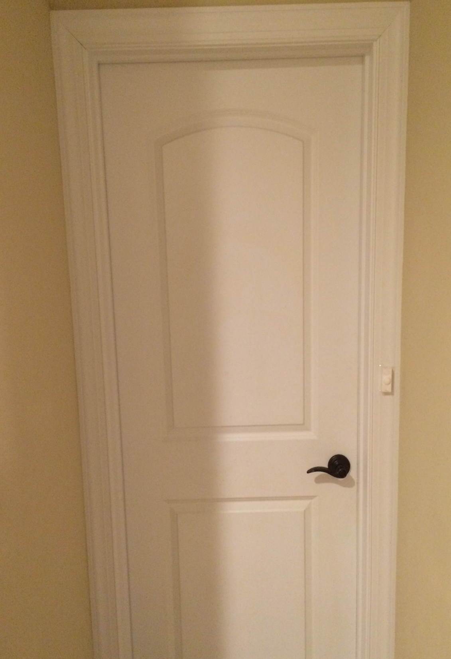
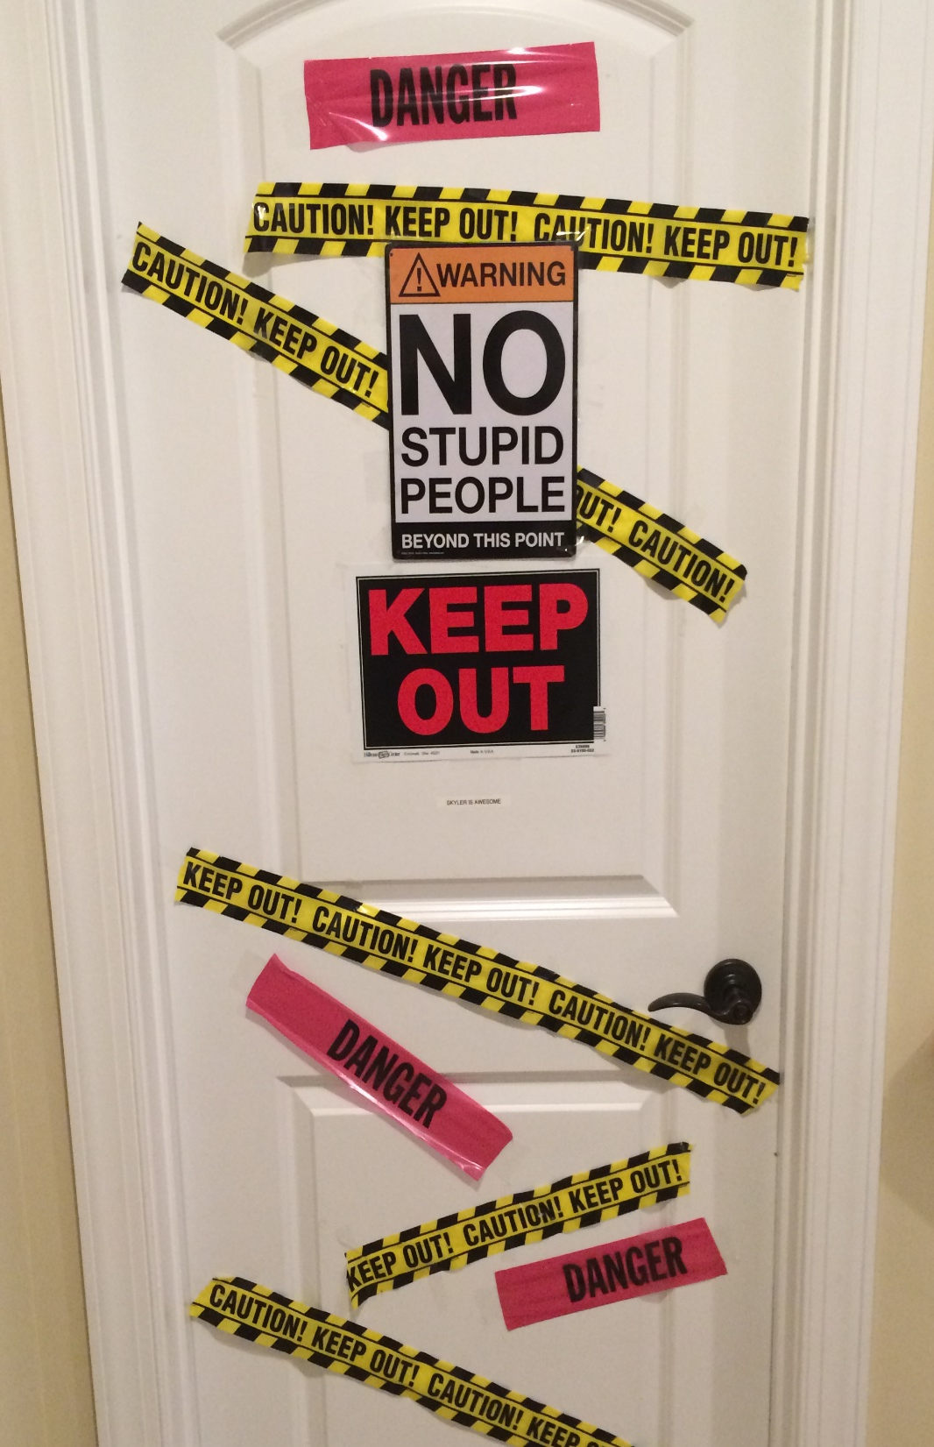

Slide 3
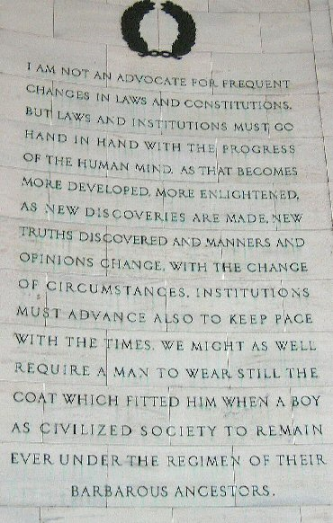

Slide 4
Surveillance Law Theme
      Legislative Compromises
+
Changed Politics
New Technology
=
      Conflict

Slide 5
Compromise Examples
  1947 – National Security Act
    Foreign vs. Domestic
  1978 – Foreign Intelligence Surveillance Act
    National Security vs. Law Enforcement
  2001 – PATRIOT Act
    Increased domestic surveillance vs. increased oversight

Slide 6
US Const.
Art. II
4th Amend.
1789
PPD
28
2014
FISA
1978
PAA
2007
National
Security
Act
1947
EO
12,333
1981
Patriot
Act
2001
FAA
2008
USA
Freedom
Act
2015

Slide 7
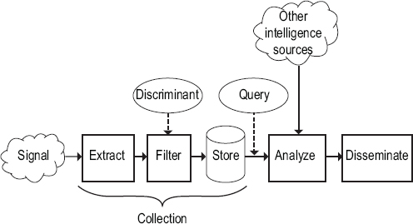

Slide 8
Some Distinctions
Identifiable Data vs. De-Identified Data
Content vs. Meta Data
Collecting Data vs. Storing Data vs. Accessing Data vs. Querying Data
US Persons vs. Non-US Persons
What is Legal vs. What is Good Policy

Slide 9
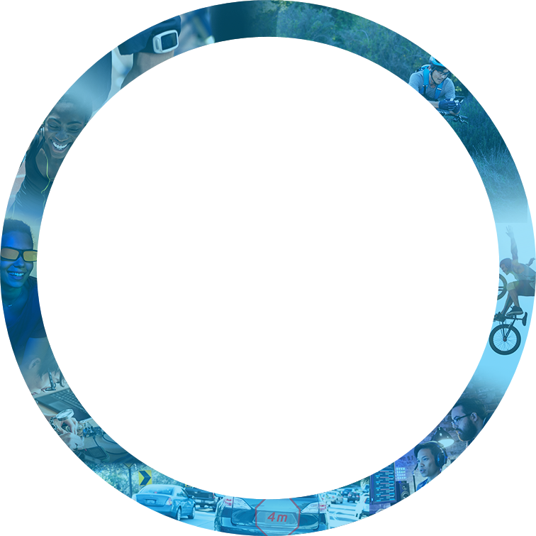

Virtuous Cycle of Growth
Experiences
connectivity
Cloud &
DATA Center
connectivity
MEMORY
FPGA
Experiences
Things &
Devices
Notes:
Intel is the ONLY company that powers every segment of the smart, connected world – from the cloud, to the network, to the device – and everything in between. We alone have the assets to power the next generation of technologies for the world.
Our Strategy – A Virtuous Cycle
We call it a virtuous cycle – the cloud and the data center, the Internet of Things, memory and FPGAs -- all bound together by connectivity and enhanced by the economics of Moore’s Law.
Our strategy builds upon itself. These assets are all connected, and together, they fuel our business. With each new device that comes online and connects to the cloud – we have the tremendous opportunity to reinforce our company’s growth.
The Cloud and Data Center
The cloud is the most important trend shaping the future of the smart, connected world – and thus Intel’s future.
Intel architecture defines the infrastructure of the cloud, and we will continue to drive more and more of the footprint of the data center globally. The cloud and analytics from the data center are the greatest value drivers in technology today.
This digitization of everything will disrupt entire industries and open up new cycles of growth.
At Intel, we’ll accelerate the power and value of this data and its analytics by continuing to innovate in high-performance computing, big data and machine learning capabilities.
Internet of Things
The Internet of Things encompasses all smart devices – every PC, device, sensor, console and any other edge device – that are connected to the cloud.
The PC is foundational to our compute strategy and to our business. It’s an engine that creates critical shared IP that drives innovation across our entire product portfolio. Intel will continue to deliver an annual cadence of leadership performance and innovation in our PC and broader computing roadmap, with a focus on key growth opportunities in 2 in 1s, gaming and home gateways. We are imaging and inventing a PC that is truly immersive, assistive, with an incredibly natural interface tailored for your individual needs.
Intel is also inventing a future that is more informed, collaborative, and meaningful given the widespread interconnectedness of everyday objects. As the Internet of Things evolves, we see three distinct phases emerging.
Make everyday objects smart – this is well underway with everything from smart toothbrushes to smart car seats now available.
Connect the unconnected, with new devices connecting to the cloud and enabling new revenue, services and savings. New devices like cars and watches are being designed with connectivity and intelligence built into the device.
Deliver constant connectivity for devices that will need the intelligence to make real-time decisions based on their surroundings.
At Intel, we will focus on autonomous vehicles, industrial and retail as our primary growth drivers of the Internet of Things.
Memory and Programmable Solutions
Memory and programmable solutions such as FPGAs will deliver entirely new classes of products for the data center and the Internet of Things.
Rack Scale Design, 3D XPoint™ memory, FPGAs and silicon photonics are technologies that have been in development for several years at Intel and that we will bring to production soon.
FPGAs are now at the heart of a diverse compute model that spans the Internet of Things (IoT), communications infrastructure, to the cloud and data center, and automotive markets. Intel FPGAs are used by over 10,000 customers in applications ranging from machine learning, to Advanced Driver Assist Systems (ADAS), from the core to edge, and in factory automation and smart energy systems among many others.
Intel is driving innovations – using our deep understanding of materials science as well as computer architecture – to grow memory and storage at a much faster rate to virtually eliminate latency for data from storage.
Bigger memory and faster storage benefits many new devices by enabling more immersive experiences with natural interaction and also provides significant value to the cloud by allowing businesses to run more efficiently.
The availability of faster storage and bigger memory also unlocks more value in the cloud as we learn to automate and efficiently analyze increasing quantities of data.
Connectivity
Threading this virtuous cycle together is connectivity – the fact that providing computing power to a device and connecting it to the cloud makes it more valuable.
In the future, we will add more than 50 billion smart and connected devices, machines, autonomous vehicles, buildings and cities. These devices will be always on and connected — with a demand for lower-latency where dynamic, split-second analytics, decisions and action on the data is required.
At Intel, we recognize that 5G is more than an evolutionary step forward for our industry. As the world moves to 5G, Intel will lead because of our technological strength to deliver end-to-end 5G systems. This is why Intel is focusing on three key areas: industry partnerships, end-to-end 5G-related hardware and software development, and supporting 5G standards-setting.
Intel will continue to develop technologies such as Mobile Edge Computing, millimeter wave and NarrowBand IOT (NB-IOT). These are all important steps to bring connectivity to a variety of new IoT devices globally. We’ll also continue to forge industry partnerships to develop and transform network infrastructure technologies.
Moore’s Law
Moore’s Law will continue to progress and Intel will confidently continue to harness its value. Intel’s leadership in Moore’s Law has driven the products delivering massive computing power growth and increasingly better economics and pricing.
As we progress from 14 nanometer technology to 10 nanometer and plan for 7 nanometer and 5 nanometer and even beyond, our plans are proof that Moore’s Law is alive and well.
Amazing Experiences
Understanding this virtuous cycle, imagine a world where everything is smart and connected.
Where your wedding ring monitors your blood sugar, your coffee pot automatically orders a refill of your favorite bean, or where your work station eliminates distractions to keep you productive - soon everything will seamlessly improve and support day-to-day tasks, both simple and complex.
Where smart devices are embedded in all types of sports equipment, from jerseys, to balls, to protective gear. And these devices are generating vast amounts of data that are revolutionizing how players train, coaches teach, and scouts evaluate talent. The technologies we invent will also radically improve player safety, and transform the viewing experience. Audiences will be more engaged than ever, tracking the precise activity of their favorite athletes, from warm ups, to celebrating the victory.
Where autonomous vehicles will soon be part of an integrated transportation network where cars will communicate with each other about traffic patterns, collisions, or even let you know when walking or taking mass transit is faster. Cars are becoming intelligent in a way that will save time and save lives.
Intel transforms the technology we invent into amazing experiences.

Slide 10
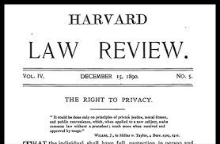
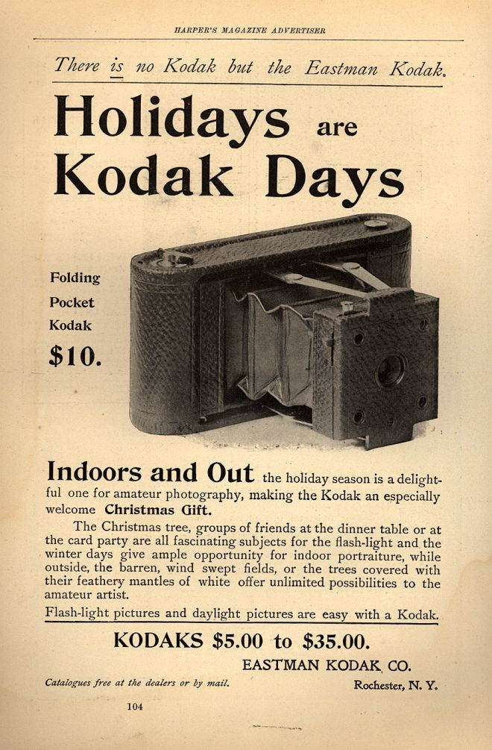

Slide 11



Slide 12
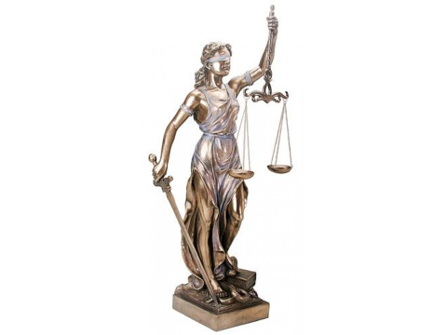

Slide 13

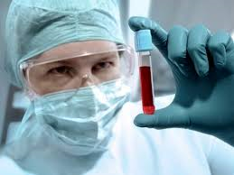

Slide 14
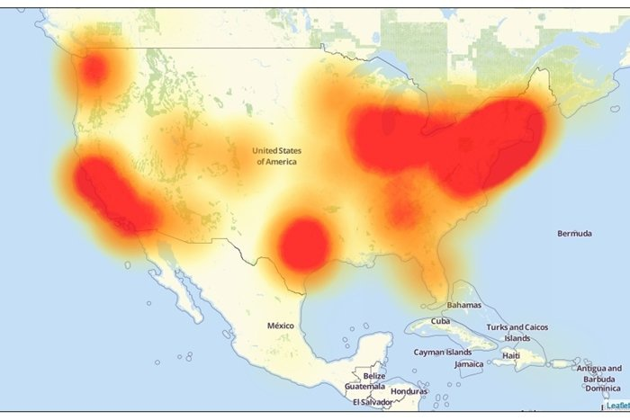

Slide 15
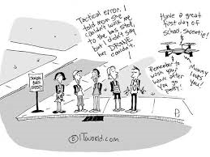

Slide 16
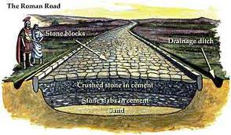

Slide 17
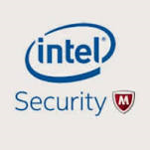






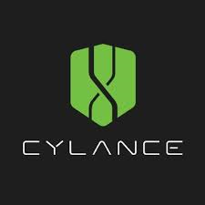

Slide 18
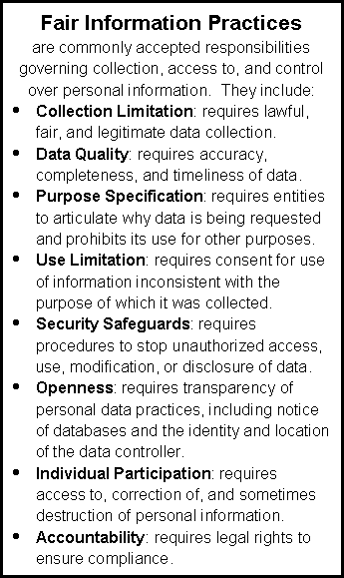

Slide 19
Thank You

