Slide 1
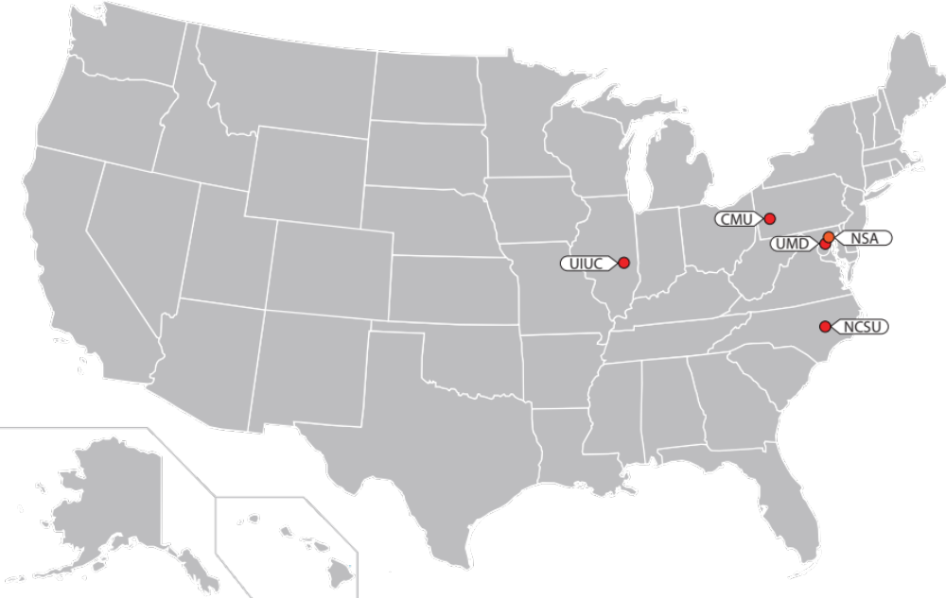
Science of Security Lablets

Slide 2

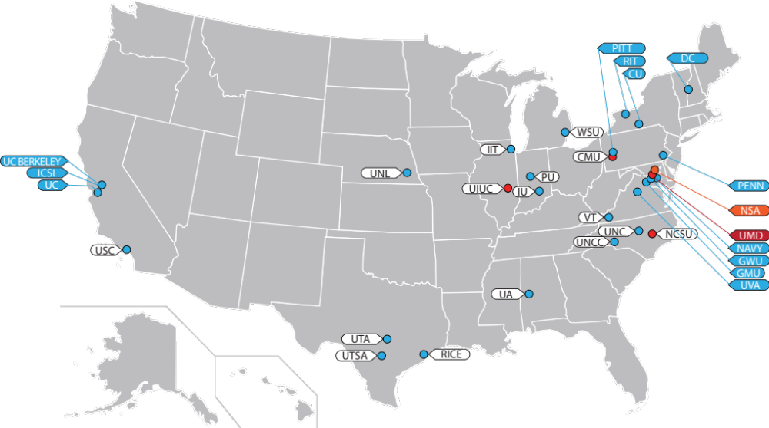
Science of Security Lablets & Sub-Lablets

Slide 3
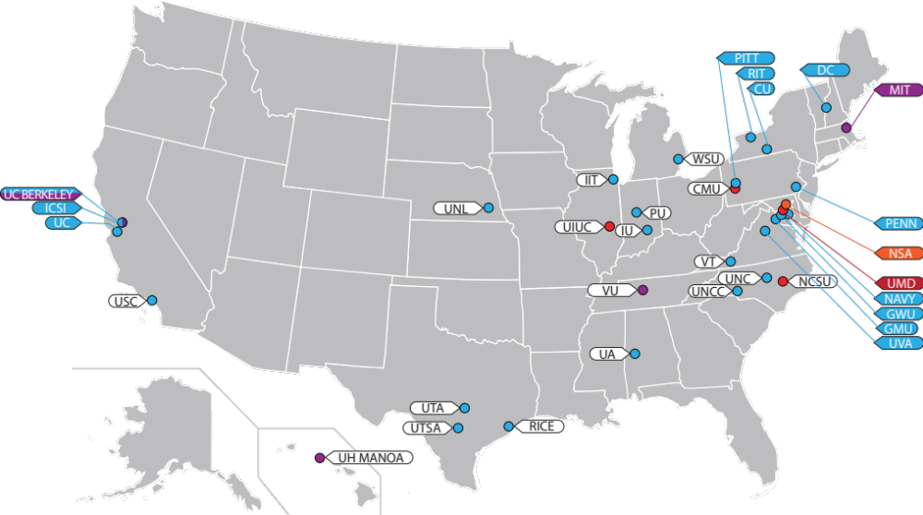
Science of Security Lablets, Sub-Lablets and SURE

Slide 4
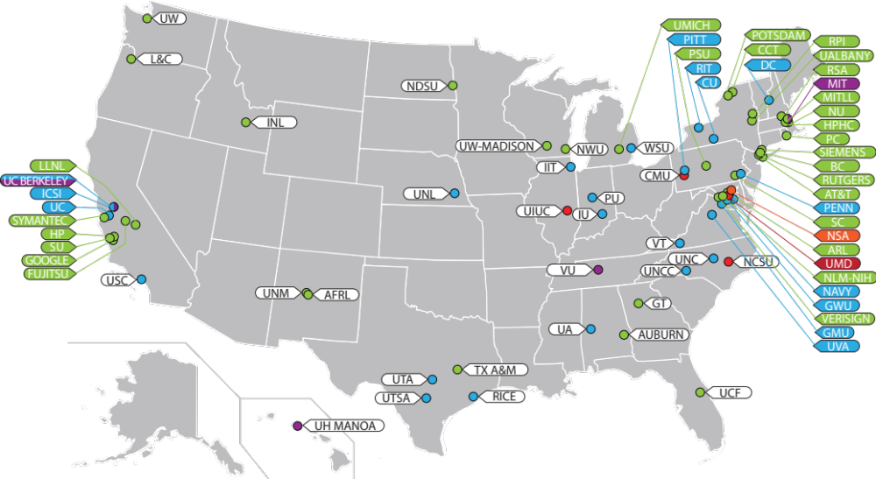
Science of Security Lablets, Sub-Lablets, SURE and Collaborators

Slide 5
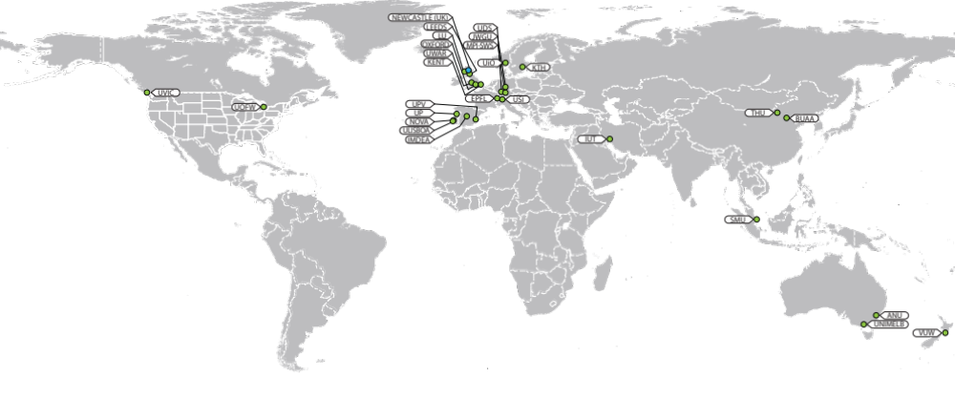
Science of Security International Sub-Lablets and Collaborators

Slide 6
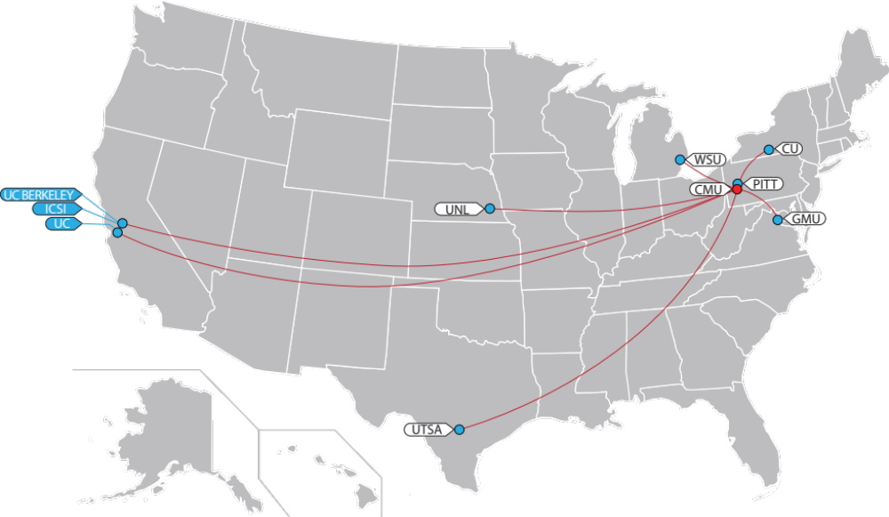
Carnegie Melon University Lablet & Sub-Lablets

Slide 7
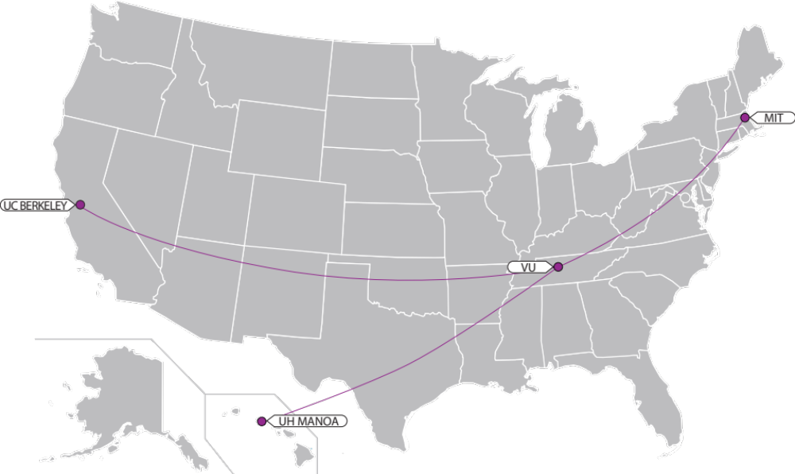
Science of SecUre and REsilient CPS Project Locations

Slide 8
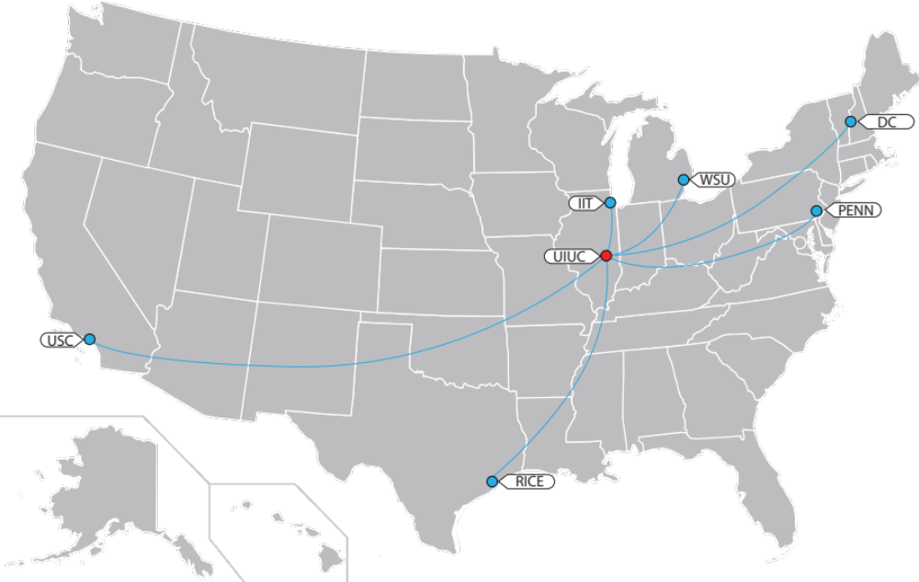
University of Illinois at Urbana-Champaign Lablet & Sub-Lablets

Slide 9
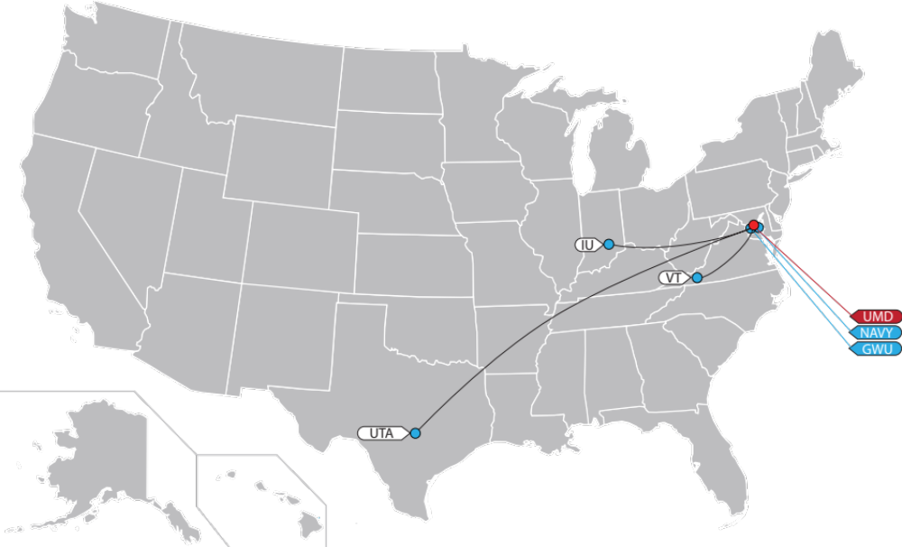
University of Maryland Lablet & Sub-Lablets

Slide 10
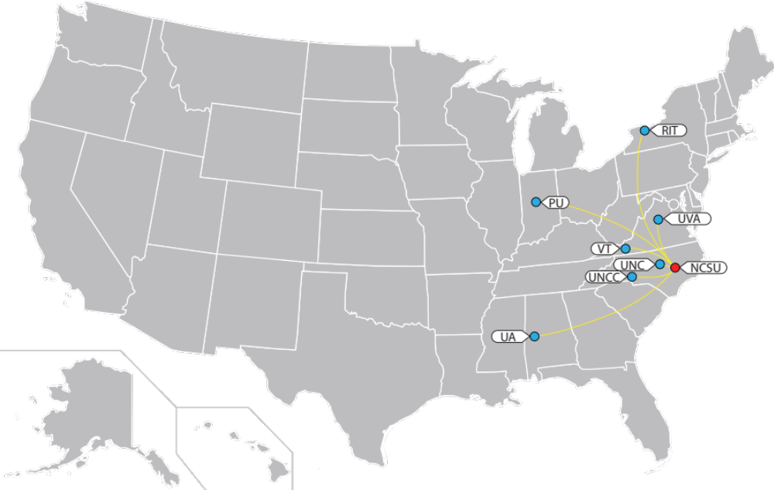
North Carolina State University Lablet & Sub-Lablets

Slide 11
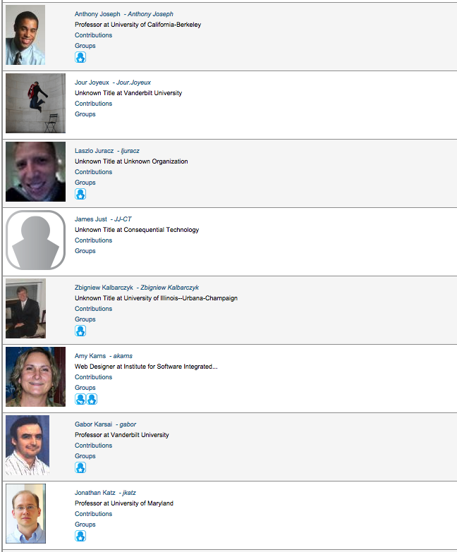
Get Your Profile Picture Taken Here!

Slide 12
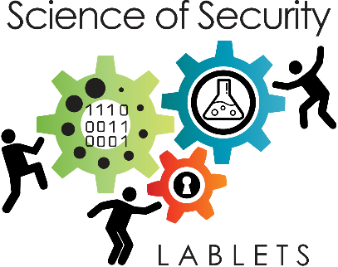


Dr. Laurie Williams, PI, focuses on software security, healthcare IT, agile software development practices and processes, software reliability, software testing and analysis and open source software development.

Slide 13


Dr. Jonathan Katz, PI, studies cryptography, computer and network security, science of cybersecurity, and other subjects.

Slide 14


Dr. William Scherlis, PI, studies software assurance, software analysis, and assured safe concurrency.

Slide 15


Dr. David Nicol, PI, researches high performance computing, simulation modeling and analysis, and security`

Slide 16


Dr. Xenofon Koutsoukos is the PI for the System Science of SecUrity and REsilience (SURE) for the project, developing foundations and tools for cyber-physical systems (CPS) to maintain essential system properties in the presence of adversaries.

Slide 17

Hot SoS is the premier Science of Security Community event. Co-sponsored by ACM, HotSoS aims to address the fundamental problems of security in a principled manner. The annual event brings together a diverse community of researchers, government, and industry participants who seek a comprehensive and methodical approach to identifying removing threats to security.

Slide 18
5 “Hard Problems” in SoS
Scalability and Composability: Constructing secure systems with known security properties from components with known security properties
Policy-Governed Secure Collaboration: Methods for handling data with differing usage needs and among users in different domains
Security-Metrics-Driven Evaluation, Design, Development, and Deployment: Security metrics and models able to predict or confirm if a system preserves its security properties
Resilient Architectures: System architectures that deliver required service despite compromised components
Understanding and Accounting for Human Behavior: Models to design, model, and analyze behavioral security properties

Slide 19
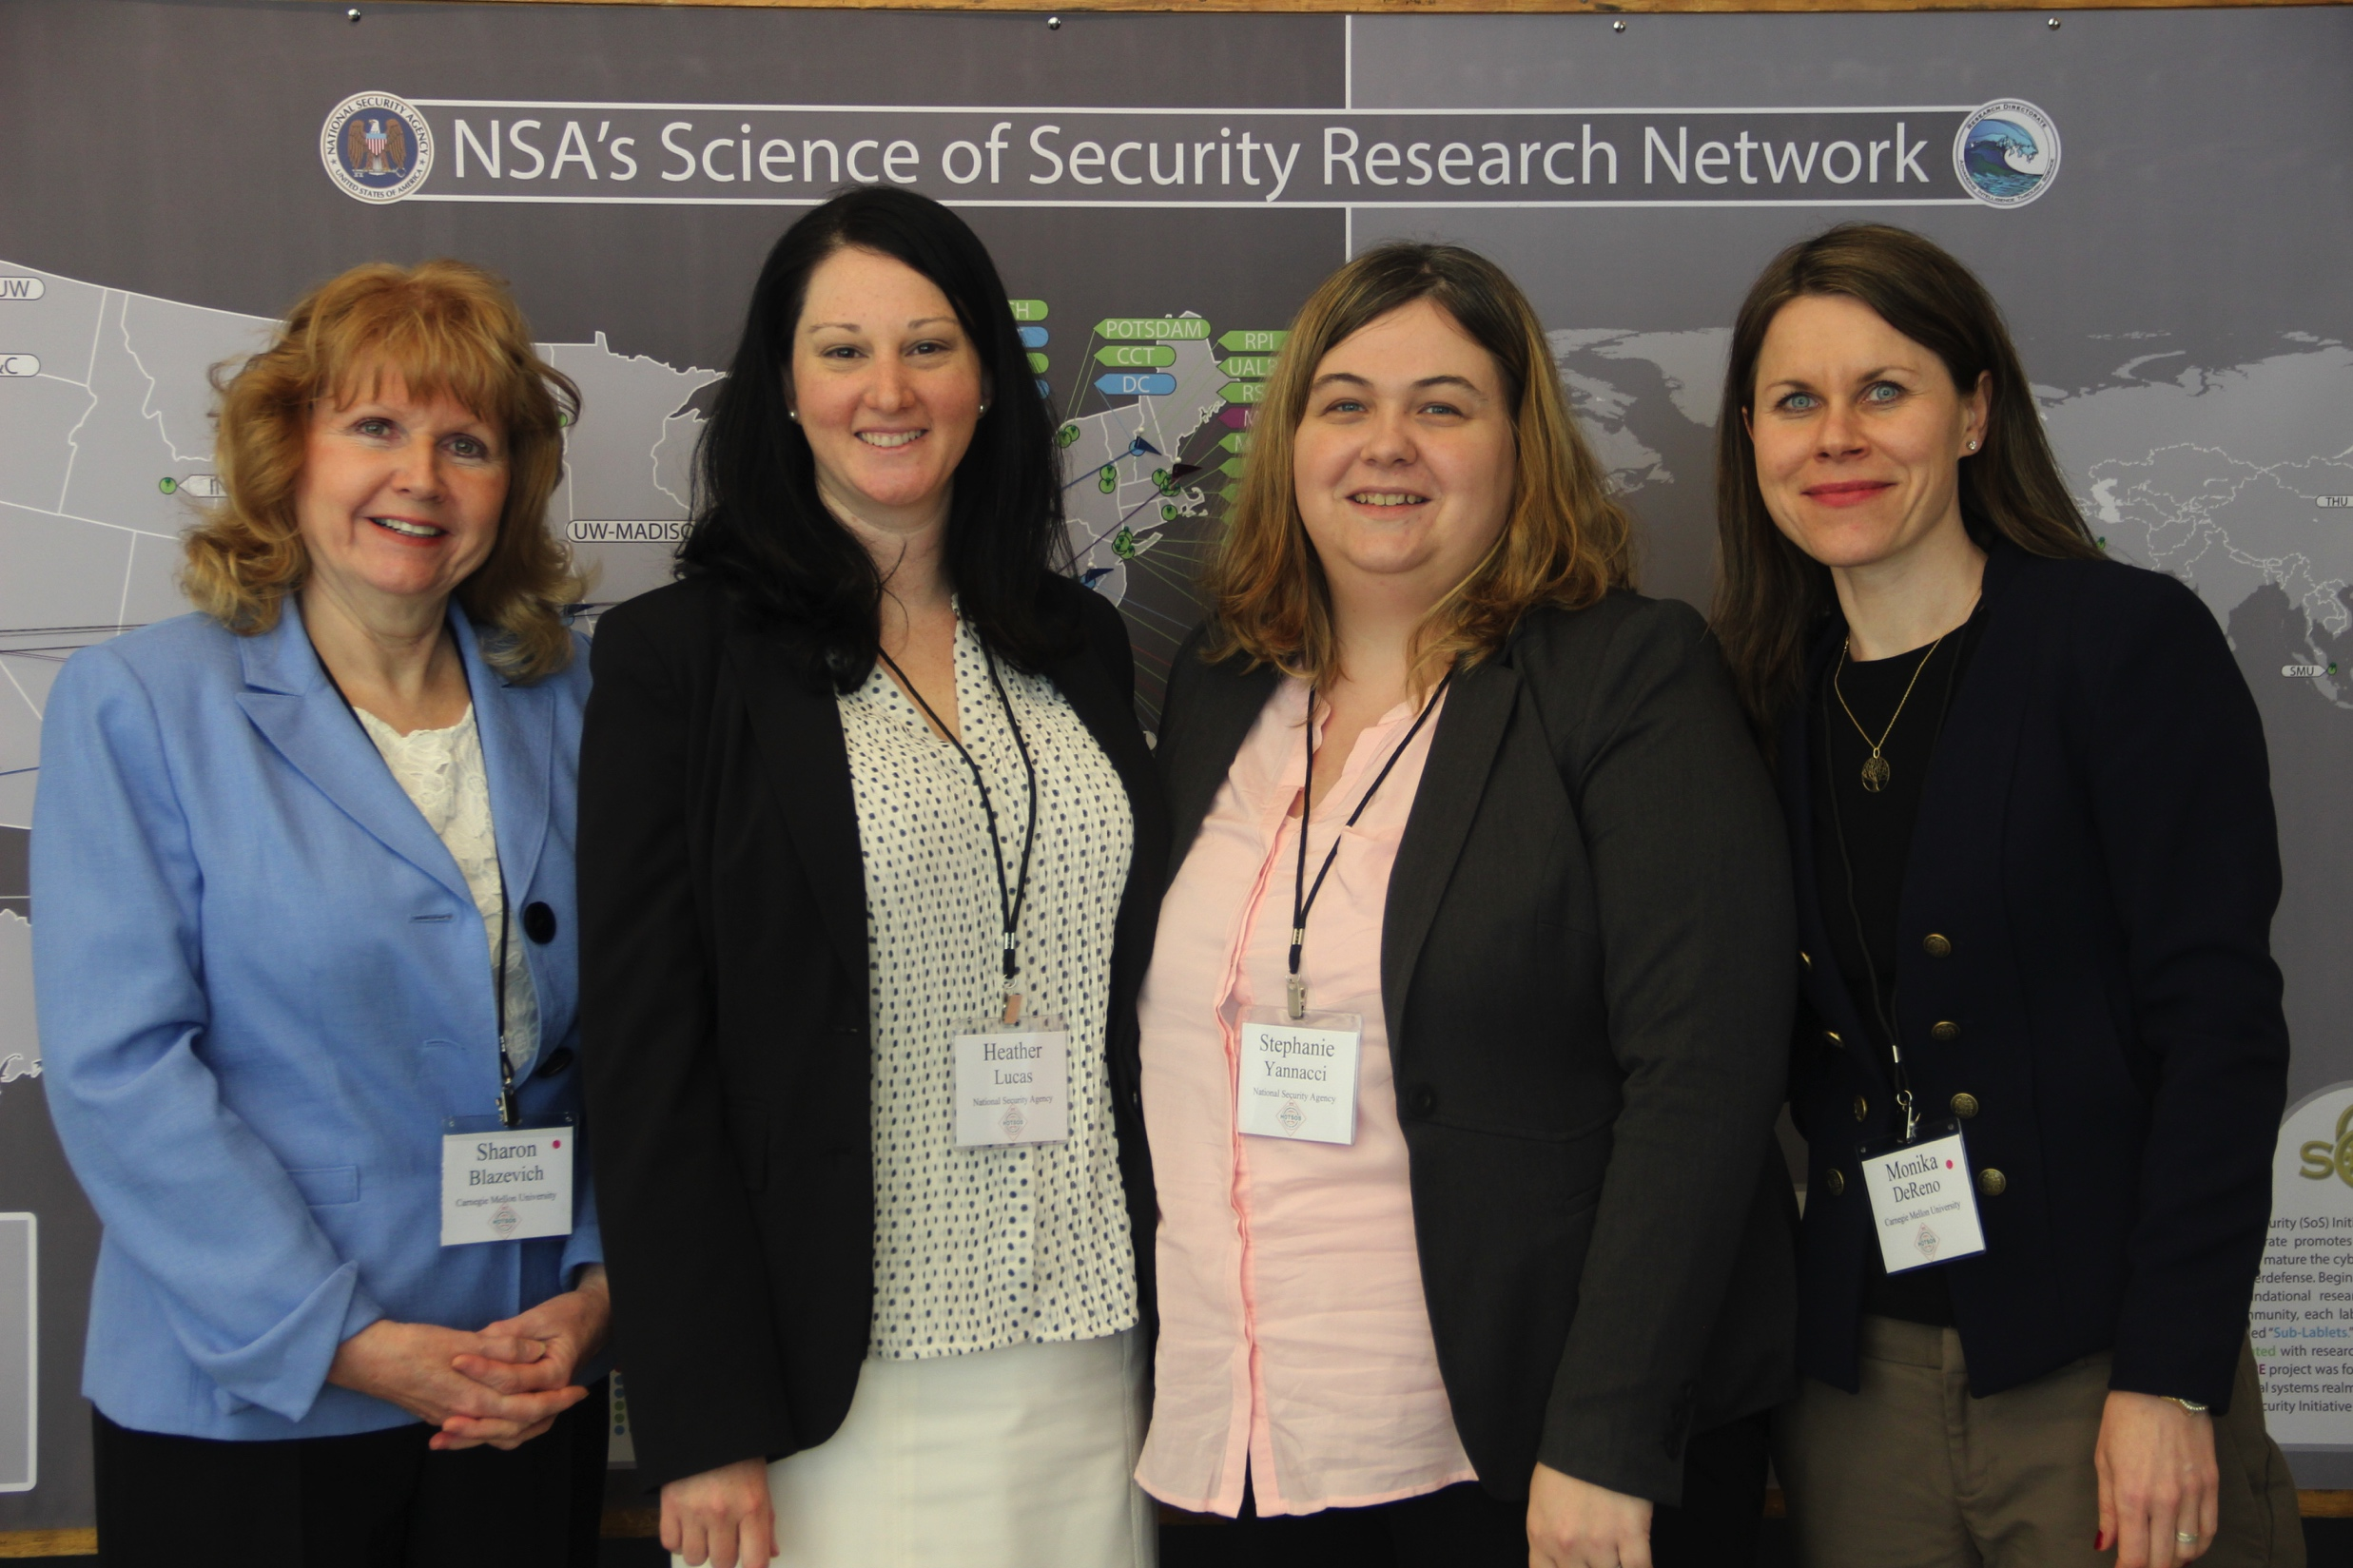

Slide 20
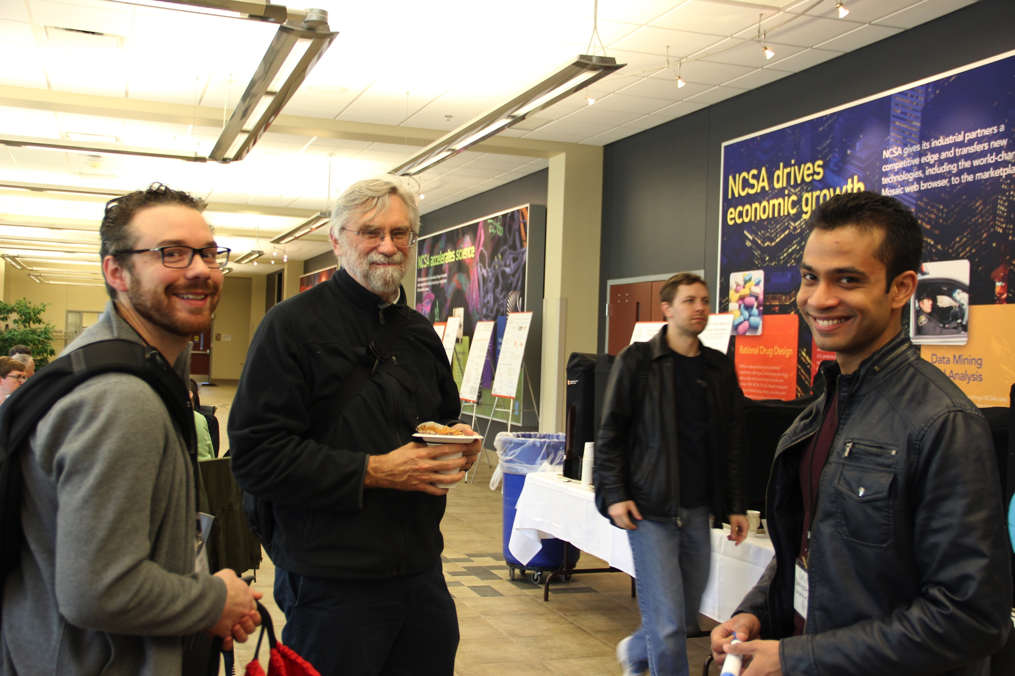

Slide 21
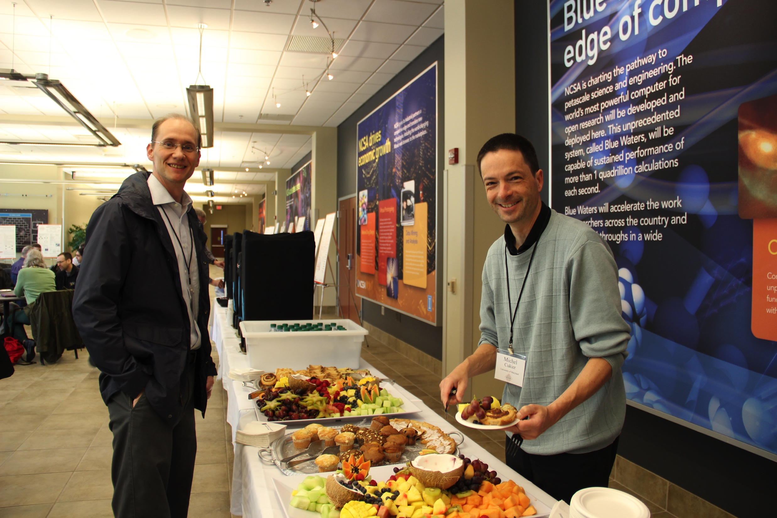

Slide 22
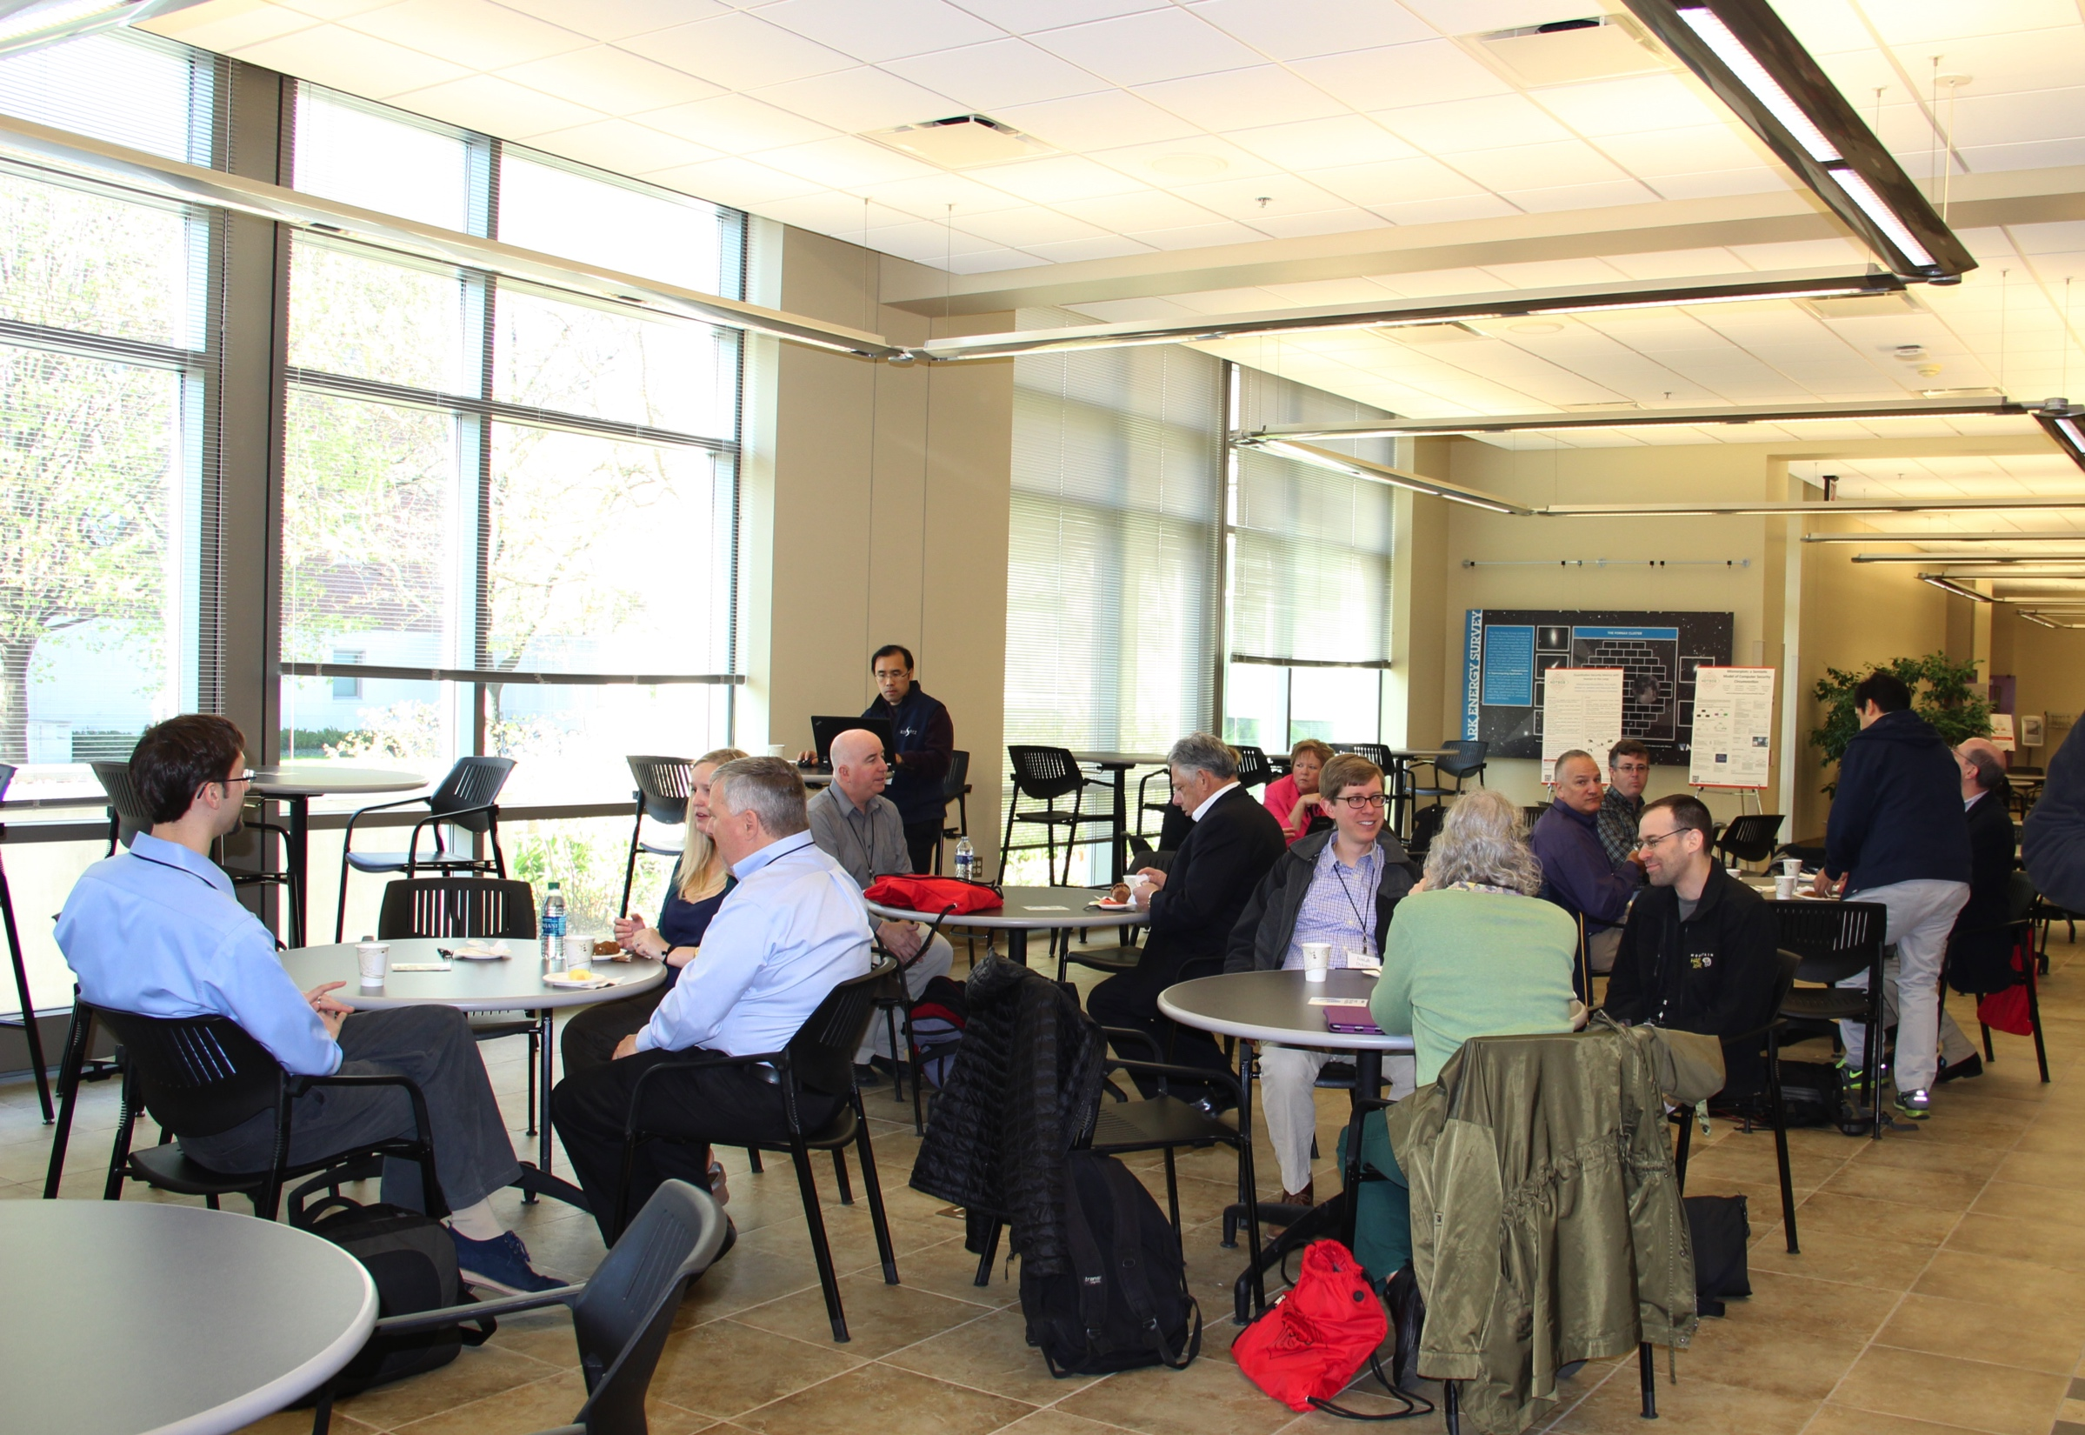

Slide 23
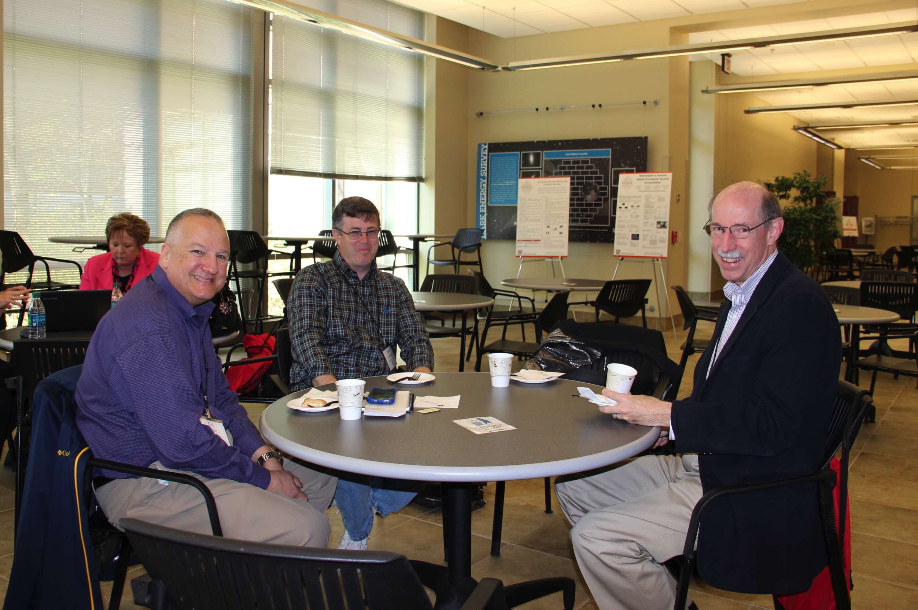

Slide 24
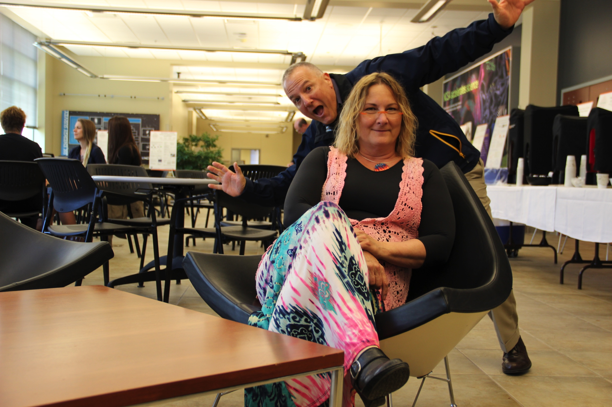

Slide 25
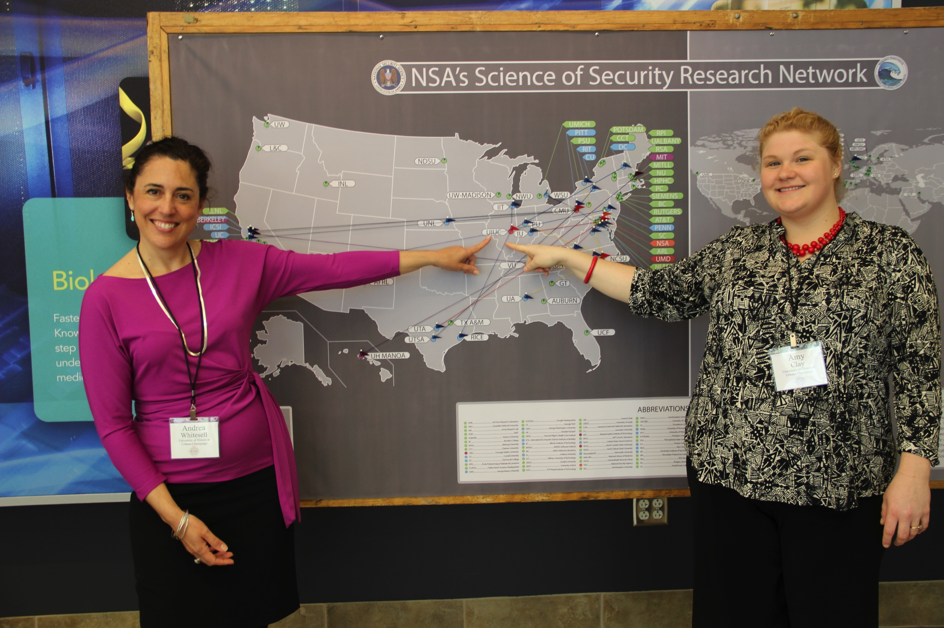

Slide 26
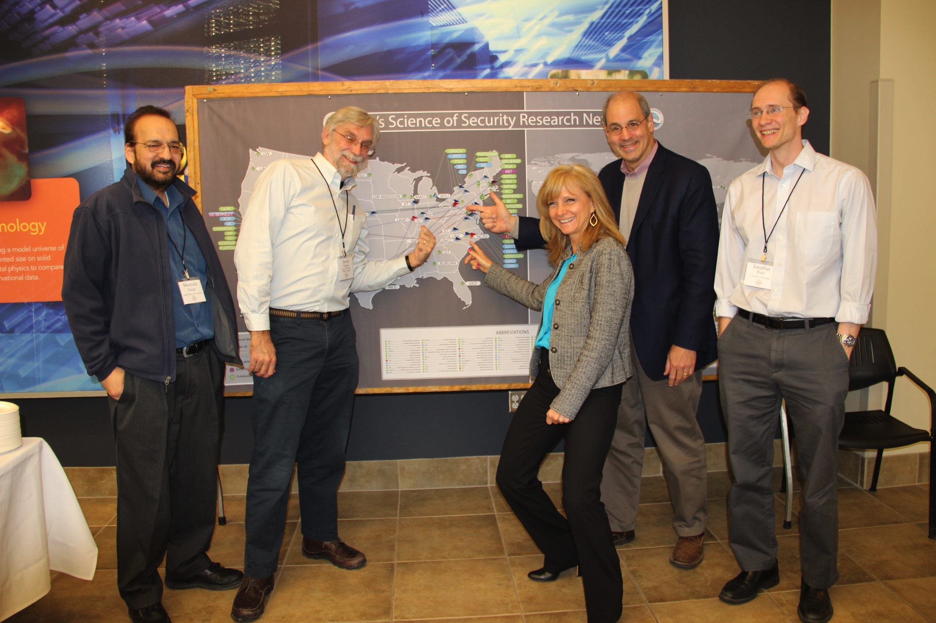

Slide 27
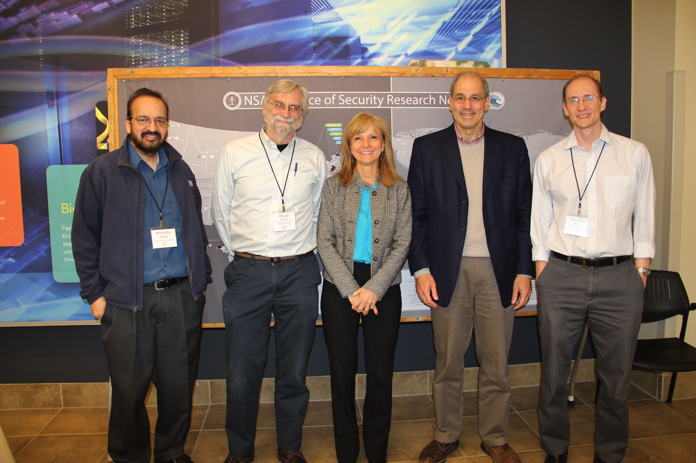

Slide 28
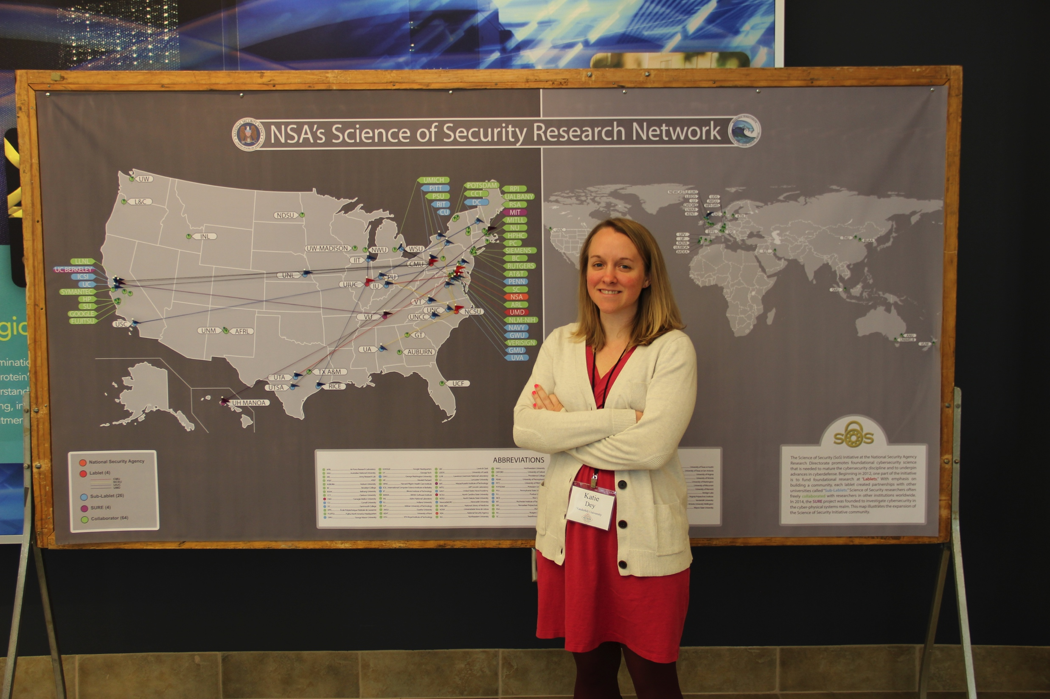

Slide 29
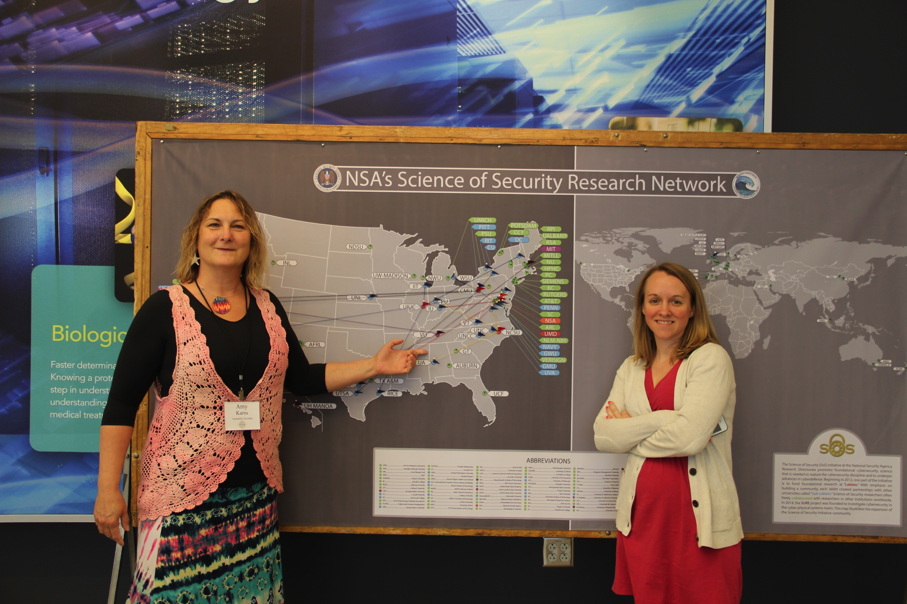

Slide 30
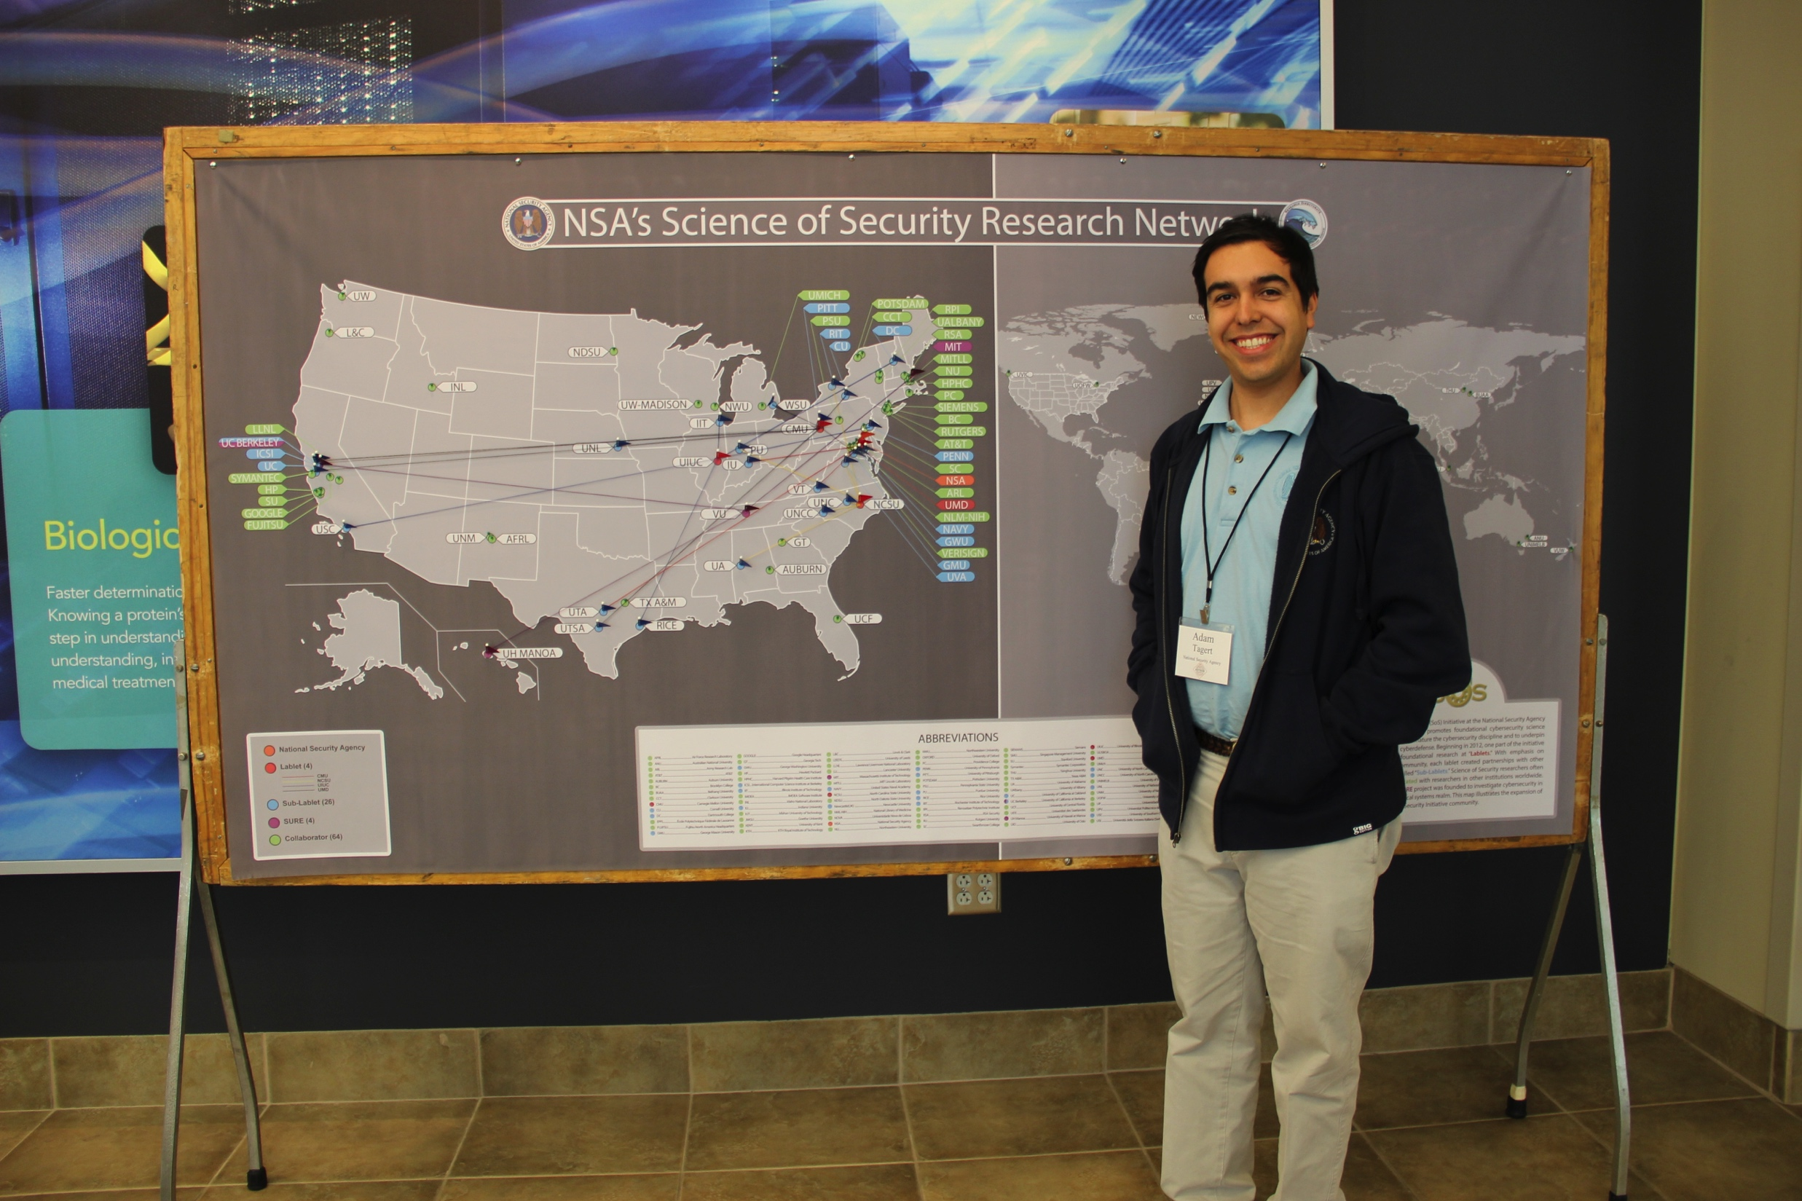

Slide 31
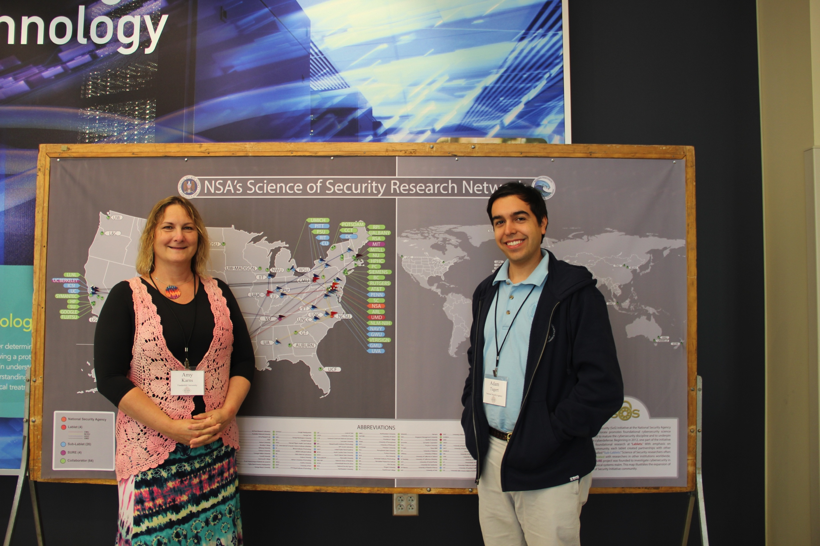

Slide 32
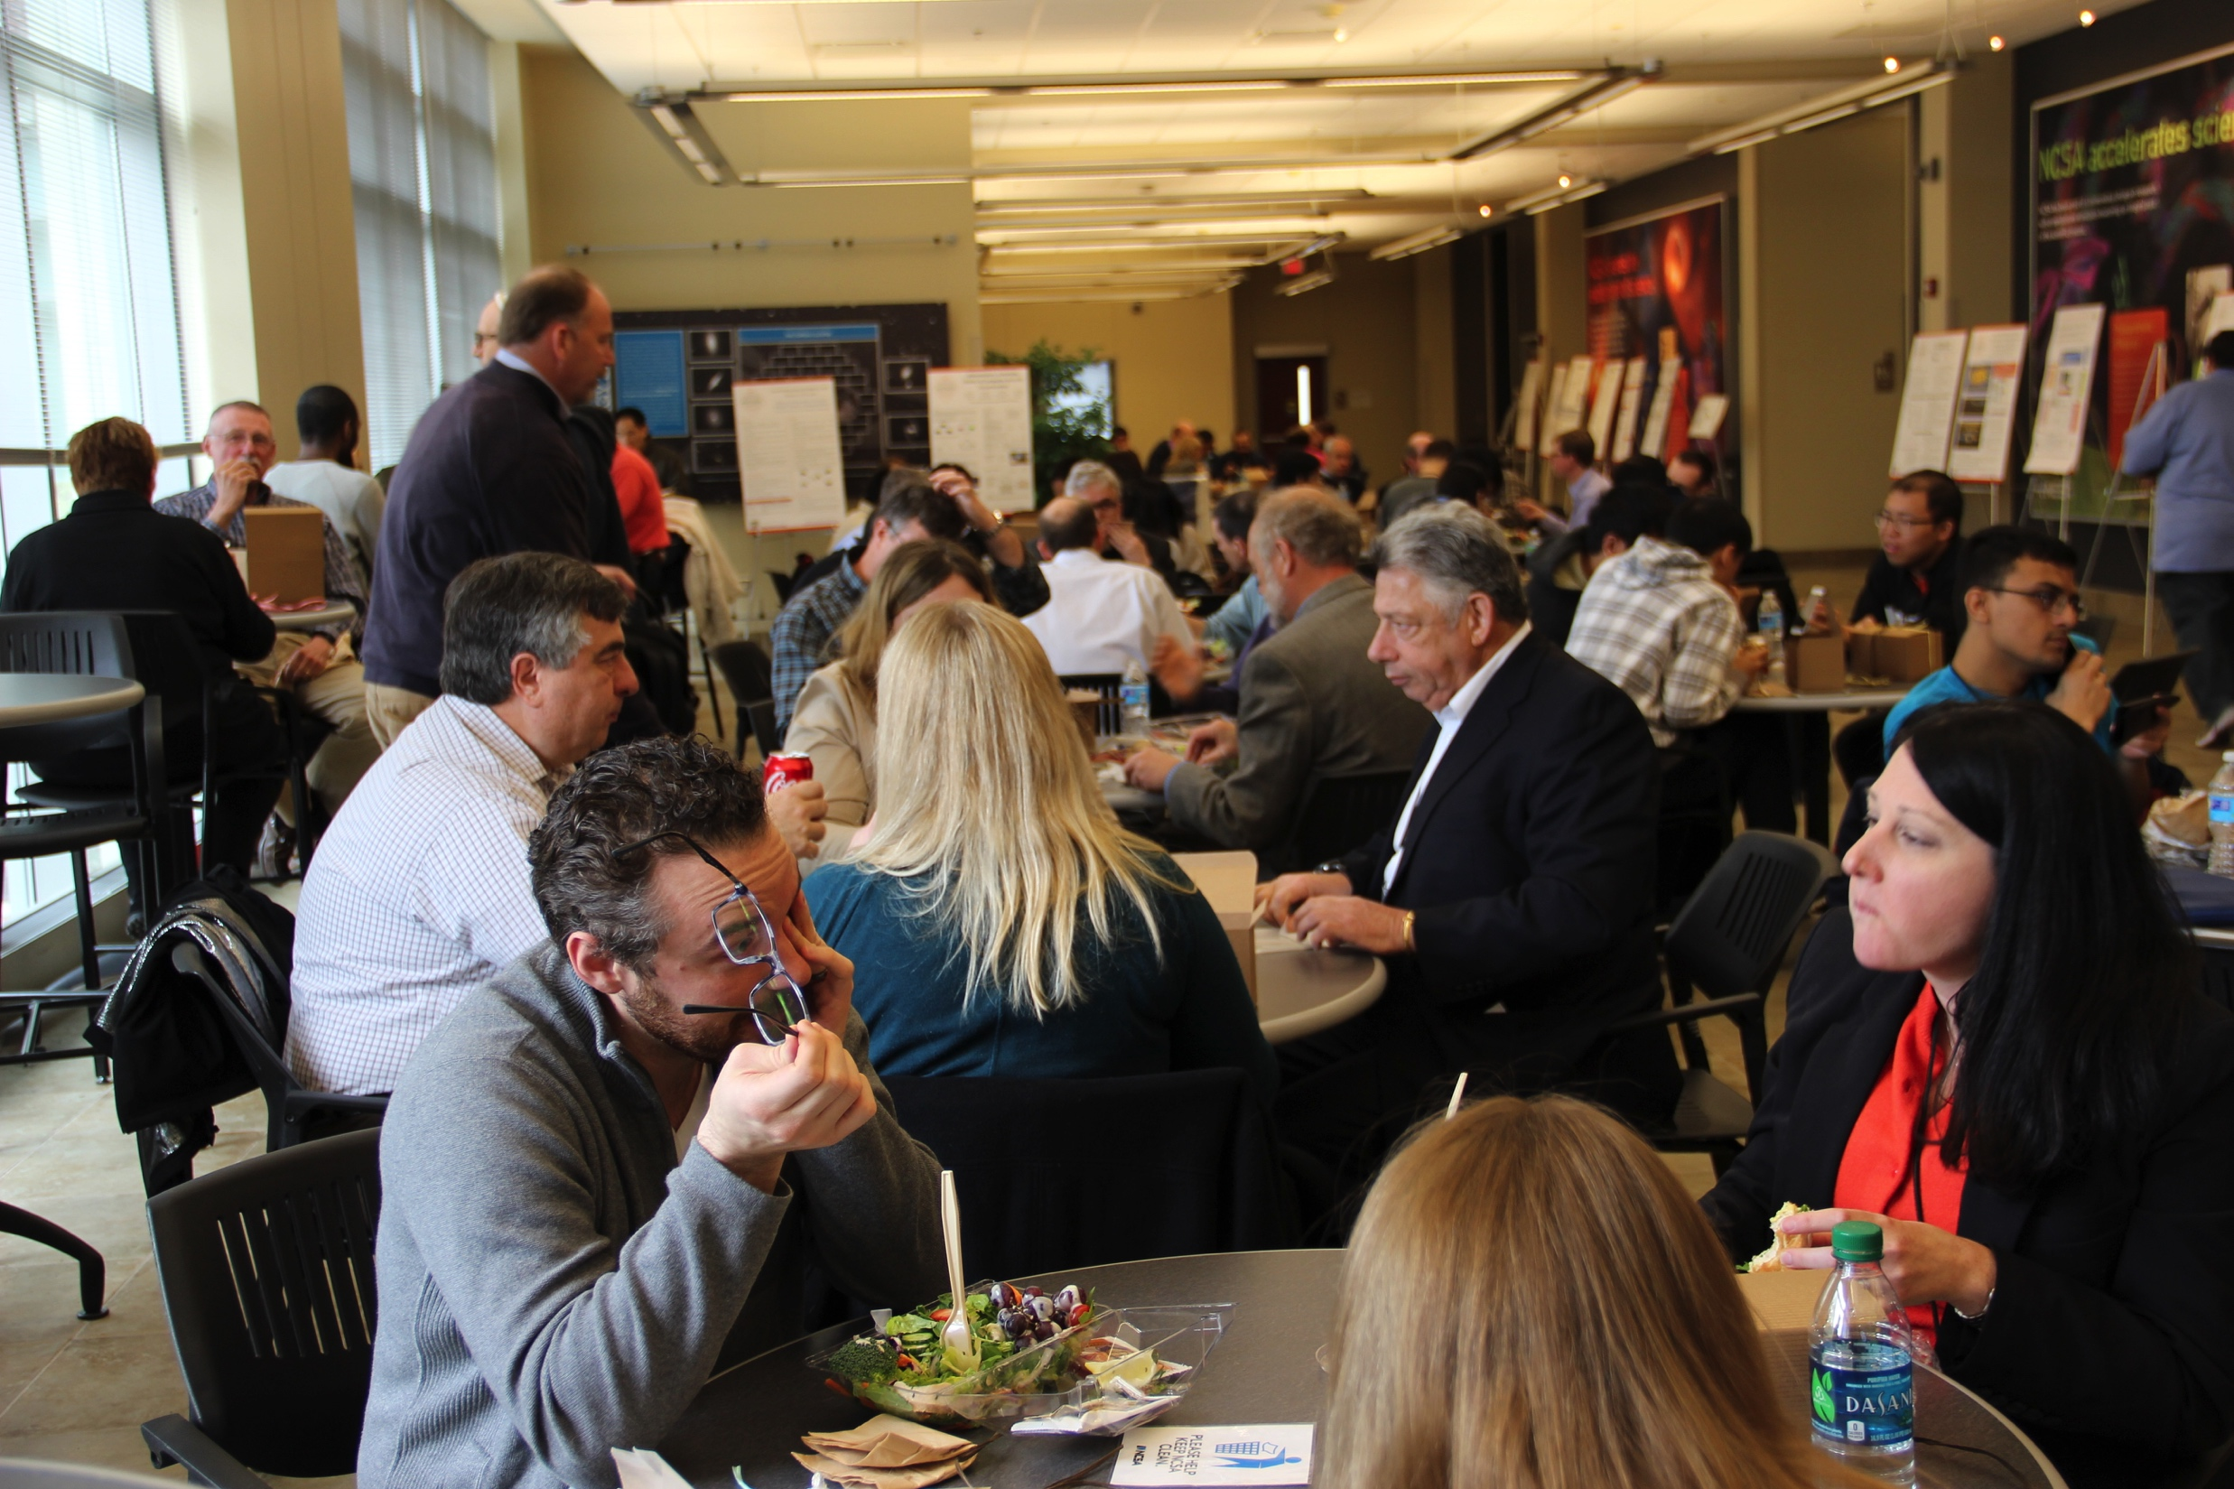

Slide 33
