Slide 1

Engaging the Academic Community to Build a
Science of Security
Adam Tagert, Ph.D.
National Security Agency
Research Directorate
Science of Security
Adam.c.tagert.civ@mail.mil

Slide 2
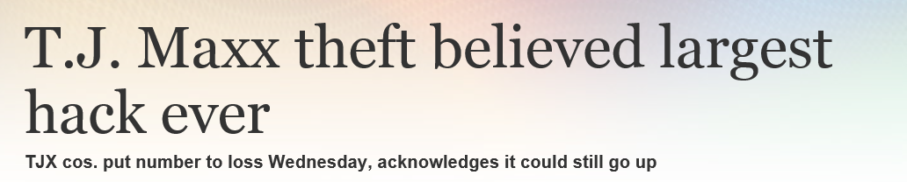
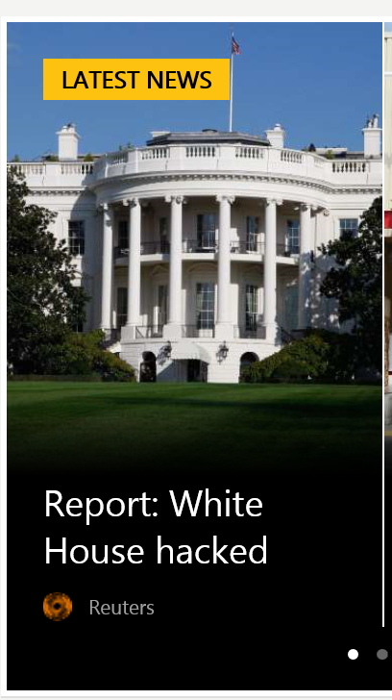
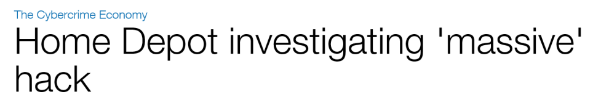

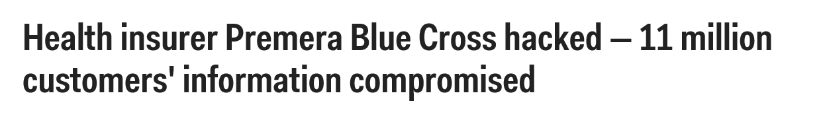

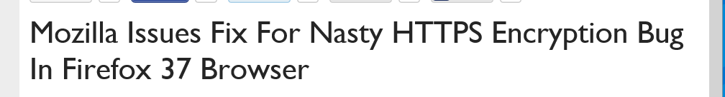
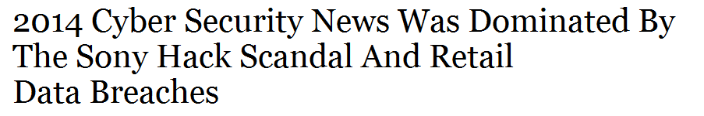
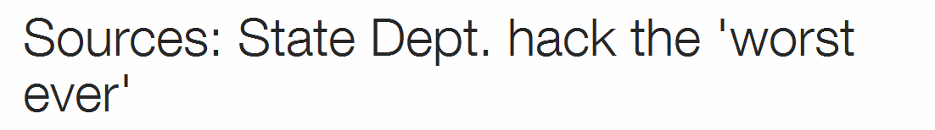
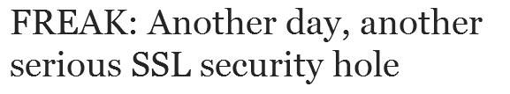
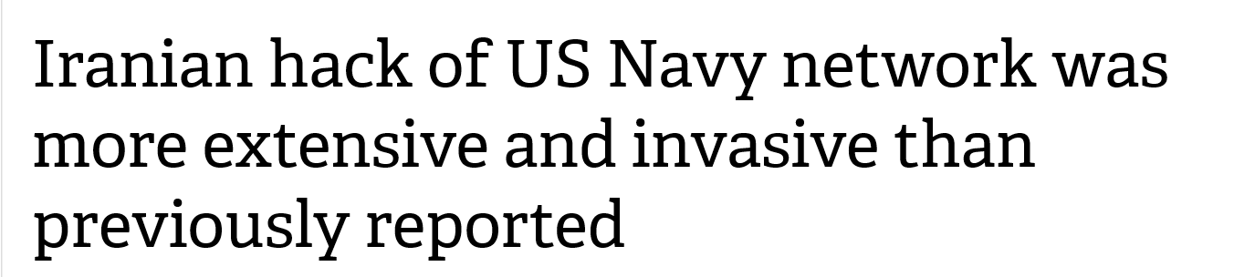
Cybersecurity, not a success story, yet….

Slide 3
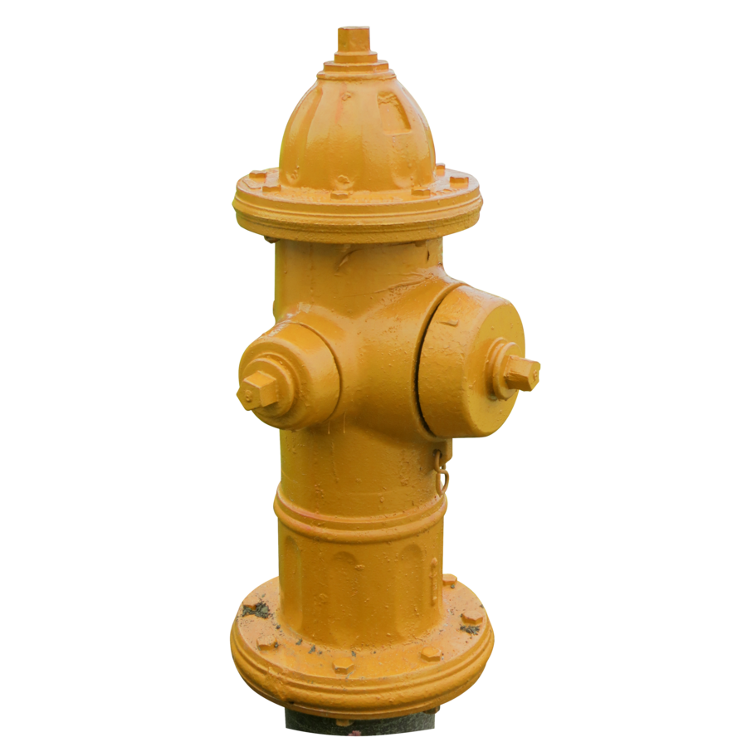
A Fundamental Challenge
Mid 2000s, a focus effort need to move from Art to Science
Doing it twice, two results
Lack of scientific reasons for taking an approach
  Fundamentals in other disaplines
Many Compare to need for building and fire codes
Notes:
In the mid to late 2000s, cybersecurity experts were having discussions and workshops on moving the practices of cybersecurity from art to a scientific discipline. This was needed to parlay the ever increasing cy

Slide 4
What is science?
Rigorous
Repeatable
Predictable
Long lasting impact
Not completely there yet.

Slide 5
Establishment of Science of Security (SoS)
How to nudge the creation of a science?
Lots of meetings, workshop at Berkeley. Greater than NSA
2012 NSA starts a Science of Security Initiative in Research Directorate
  Completely Open and Unclassified
  Foundational
Goal of self sustaining field

Slide 6
Parts of Building a Science
Foundational Research
Rigorous Research Methods
Growing a SoS Community

Slide 7
Foundational Research

Slide 8





Lablets
Lablet – a small lab
Competitive Selection
Began 2012 with an ARL grant to 3 universities
2014 – NSA contract with 4 Universities
  From a BAA
  About $8 million per year total
  20% of funding to other institutions (29 other Universities)
  For Research and to build a science
Over 230 Published Documents

Slide 9
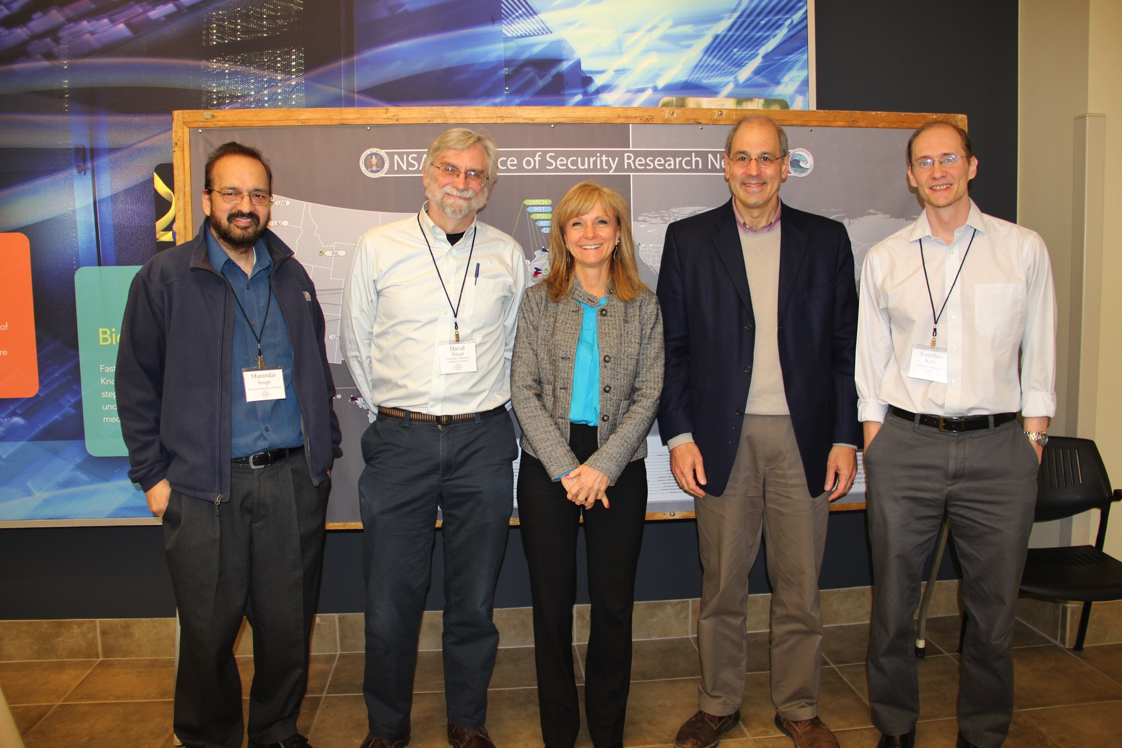
Lablet Funding Supports
Research
Salaries and/or Tuition of Professors, Researchers, Post-Docs, Ph.D. Students, Masters Students, and undergraduate research
Outreach activities for making a science

Slide 10
Science of SecUre and REsilient Cyber-Physical Systems (SURE)
Additional Research
Foundational Research on Cyber Physical Systems – Internet of Things
About $1 million / year

Slide 11
5 Hard Problems
A Measure for Progress
Developed by lablet PIs
Not all inclusive
Needed for improving cybersecurity situation
Resilient Architectures; Scalability and Composability; Secure Collaboration; Metrics; Human Behavior

Slide 12
Research Highlights 1
Resilient Architectures
  Power Grid (UIUC)
Scalability and Composability
  WYVERN (CMU)
Human Behavior
  Model of Human Circumvention (UIUC)

Slide 13
Research Highlights 2
Secure Collaboration
  E-voting Protocol (UMD)
Metrics
  Attack Surface and Defense-in-Depth Metrics (NCSU)
CPS
  Cube Sat Command & Control (Vanderbilt)

Slide 14
Rigorous Research Methods

Slide 15
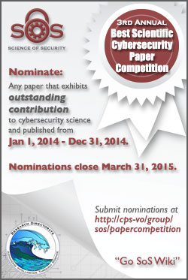
Best Scientific Cybersecurity Paper Competition
Identify and Recognize the best cybersecurity paper
Purpose: to hold up the best example of scientific work as an example
Papers are Reviewed by Panel of Distinguished Experts
  Findings sent to RD Director for Selection
Current Status – Papers under review
  3rd Annual, 50 nominations
Notes:
Committee:
Dr. Whitfield Diffie, Cybersecurity Advisor
Dr. Dan Geer, In-Q-Tel
Dr. John McLean, Naval Research Laboratory
Prof. Angela Sasse, University College London
Prof. Fred Schneider, Cornell University
Mr. Phil Venables, Goldman Sachs
Prof. David Wagner, University California at Berkeley
Dr. Jeannette Wing, Microsoft Research

Slide 16
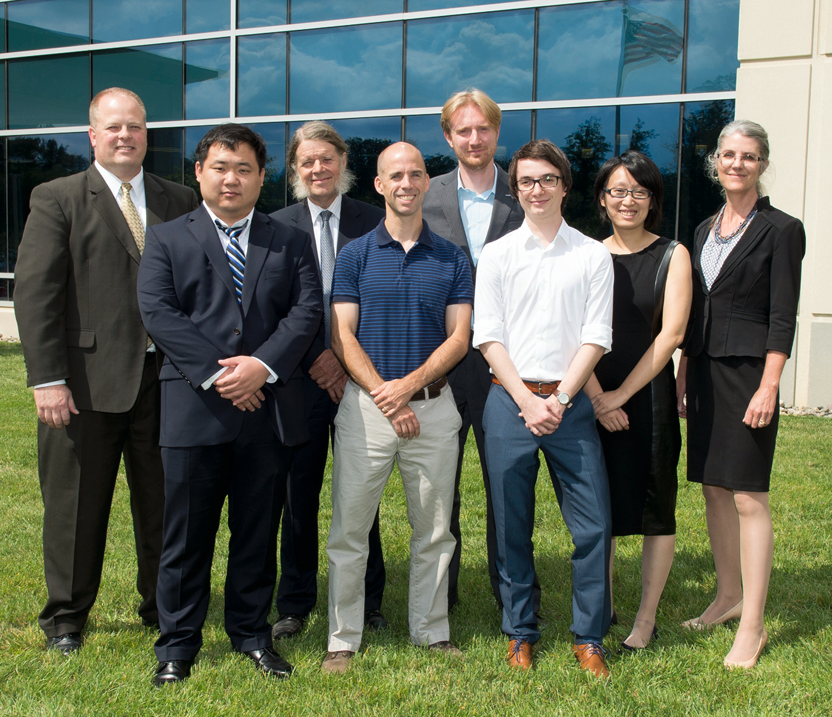
Winners
2nd Winners: Memory Trace Oblivious Program Execution (University of Maryland)
2nd Honorable Mention: Rethinking SSL Development in an Appified World (Leibniz University in Hannover, Germany)

Slide 17
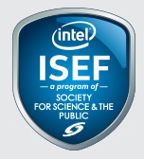
Intel Science and Engineering Fair Award
Sponsor of Intel science fair
  Intel as CPU manufacture rather than intelligence
Recognize top high school cyber security projects
Encourage students to enter cyber security research

Slide 18
Lablets Adding Science
Security Science Classes
Revising curriculum to include security

Slide 19
Growing a Community

Slide 20
Lablets for Grwoth
Intra and inter institutional collaboration
New doctors become professors, other field, carrying SoS

Slide 21
Science of Security Lablets

Slide 22
Science of Security Lablets & Sub-Lablets

Slide 23
Science of Security Lablets, Sub-Lablets and SURE

Slide 24
Science of Security Lablets, Sub-Lablets, SURE and Collaborators

Slide 25
Science of Security International Sub-Lablets and Collaborators

Slide 26


HOT-SOS – Hot Topics in Science of Security: Symposium and Bootcamp on the Science of Security
Annual Public Meeting for the Science of Security Community
Goal of becoming a premier conference of SoS
Academic Gathering, partial sponsorship by ACM
2015 Meeting in Pittsburgh. See VO for updates
http://www.hot-sos.org

Slide 27
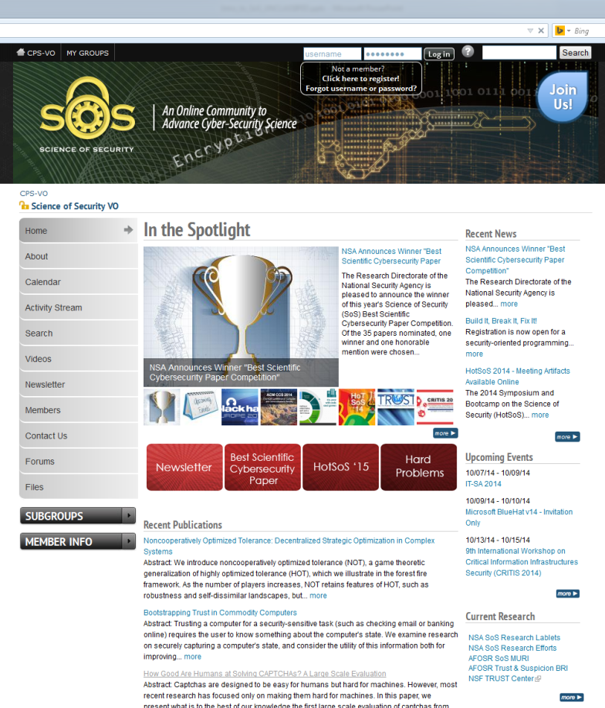
Science of Security Virtual Organization (SoS-VO)
A website built on NSF collaboration platform
Building a place to enable a geographically disperse community to engage and collaborate
Find News, SoS Projects, Papers, Events, Funding Opportunities, News Letter
Over 650 members
URL: http://www.sos.-vo.org

Slide 28
=Sum(Slides)
Summing UP

Slide 29
Happen to be on JWICS?
Go SoS-Wiki
Go Testflight

Slide 30
Using the Results
Results are Publically Published.
Digestion challenge.
  Still an unsolved question of how to have others use it.
  Mostly foundational Research, not products

Slide 31
Participating in the Science of Security
Join the SoS VO – http://www.sos-vo.org
  Contribute to the Discussion and engage with Researchers
  Find the papers published by SoS Researchers
  Other Relevant Materials for SoS
Nominate Papers for the Paper Competition
Attend HOT-SoS 16
Read The Next Wave
Apply Scientific Principles to Your Cybersecurity Issues

Slide 32
Thank You / Questions

