Slide 1
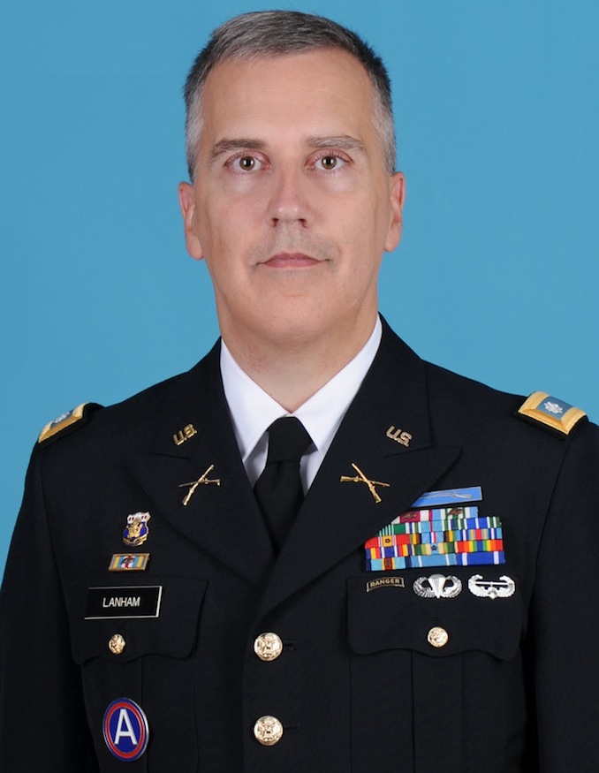
Thesis Defense Institute for Software Research (ISR) Computation, Organization, and Society (COS)
Rapid Mission Assurance Assessment via Socio-Technical Modeling and Simulation
Michael J. Lanham
Thursday, May 7, 10 am -1 pm
Gates-Hillman Center Room 6505
The thesis of this dissertation is: Organizations can design themselves to increase their assurance of continued mission(s) execution in contested cyber environments.
How do organizations assess command-level effects of cyber attacks? Leaders need a way of assuring themselves that their organization, people, and information technology (IT) can continue their missions in a contested cyber environment. To do this, leaders should: 1) require assessments be more than analogical or anecdotal; 2) should demand the ability to rapidly model their organizations; 3) identify their organization’s structural vulnerabilities; and 4) have the ability to forecast mission assurance scenarios.
I present a rapid data-to-modeling and assessment approach for organizations to develop and analyze complex models of their people, resources, tasks, knowledge, beliefs, and other characteristics that impact the ability of the organization to continue its mission(s). I integrate graph-theoretic analysis techniques used in the social network analysis research as well as meta-network analysis and research—supporting objective analysis across multiple dimensions rather than simple compliance with risk management frameworks. I demonstrate the migration of these models into agent-based dynamic simulations and examine the impacts of the three most common effects of contested cyber environments—loss of confidentiality, integrity, and availability. I find that most attacks are in the nuisance range and that only multi-prong targeted or severe stochastic attacks cause meaningful failure.
Though performance along multiple measures of performance often decreases during attacks, organizations can put structural and procedural mitigations in place to improve their resilience to these events. Through simulations, I show that structural and functional mitigations are feasible and effective at reducing the impacts of contested cyber environments on the organizations’ performance. I find that organizations can design for resiliency and provide guidelines in how to do so.
Dr. Kathleen M. Carley (chair), Dr. Virgil Gligor,
Dr. Jüergen Pfeffer, Dr. Robert Elder (Lt. Gen. USAF Ret),
Dr. John Graham (COL, USA, USMA)

