Slide 1
Navigating Cyberspace

Slide 2
Presentations
Alex Szalay: Electronic Astronomy Visualization and Navigation
Jason Hong: Visualization and Lessons Learned
Max Planck: Navigating Control Structures

Slide 3
Our Process: Brainstorming
Identify challenges, current solutions, ideas
Group items into affinity groups
Discuss affinity groups
Produce Creative Matrix
Techniques versus Concerns
Place “solutions” into those areas
Identify top 3 techniques.
Place into cost versus values context
Develop 4 projects

Slide 4
Outputs
Top Affinities
Data Science (data prep, analytics, visualization)
Most “stickies”
Information Sharing
Detection
Context
Most challenges
Physical Mapping
Least “stickies”

Slide 5
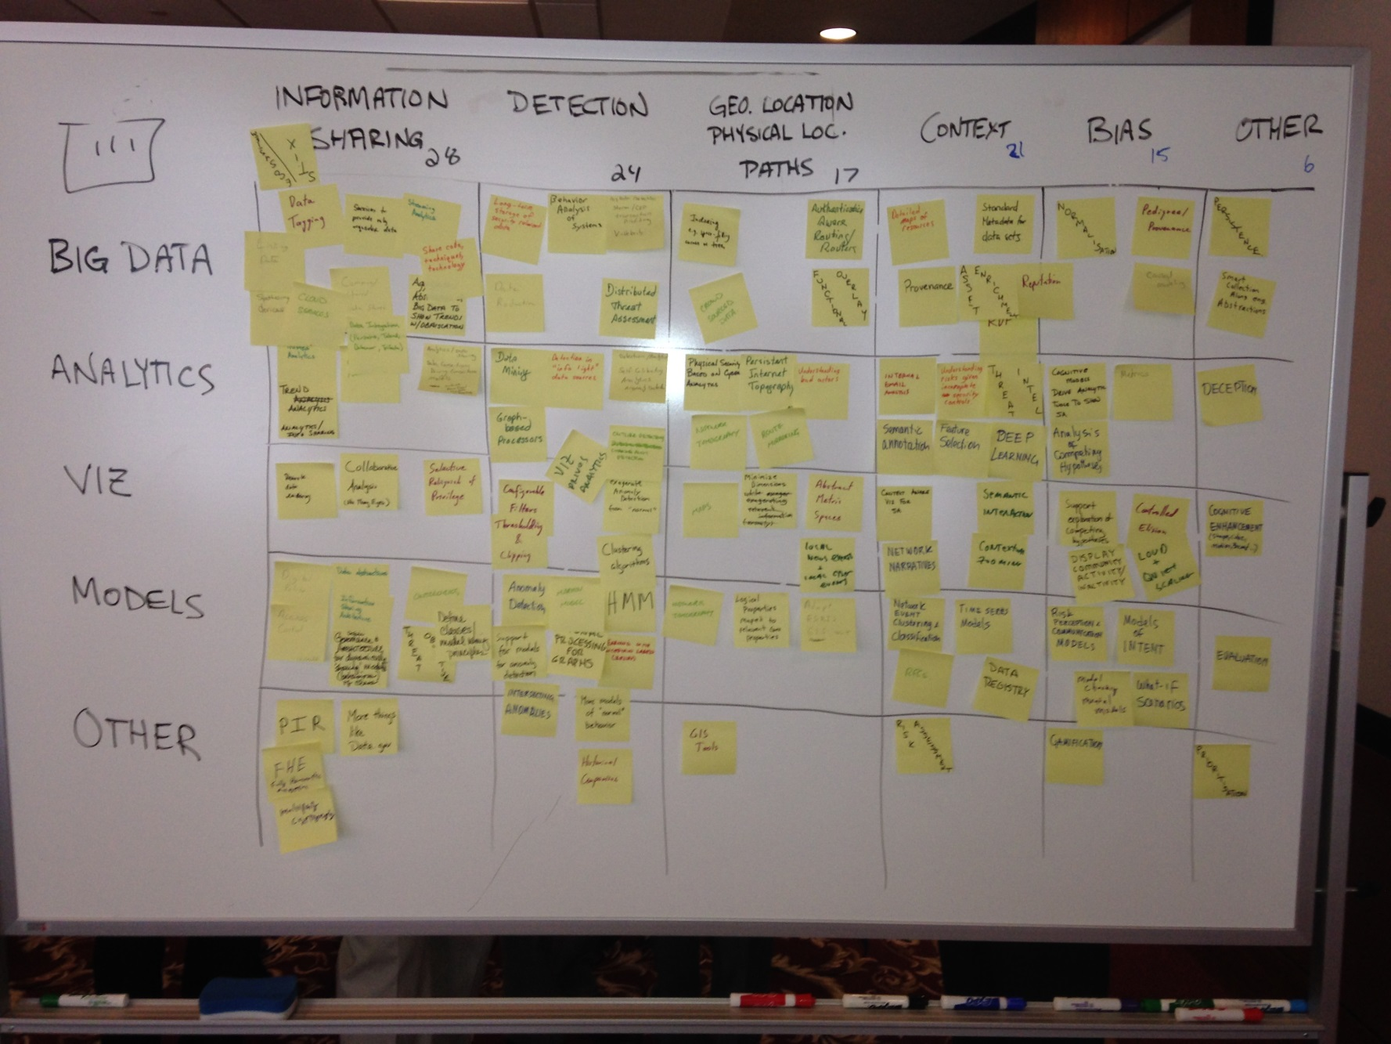
Outputs: Creative Matrix

Slide 6
Outputs: Cost – Value Matrix
Strategic
Luxuries
50 cards
Total
Clusters:
Network narratives
Data sharing
Must have
Low-hanging fruit

Slide 7
Outputs: Projects

Slide 8
Key Take-Aways
Affinity Group Discussion
Context
Cost-Value Matrix
People -> don’t forget about them
Behavioral models
Clusters
Network narrative
Semantic Gap
Compromised Environment
Does it change anything?

Slide 9
Backup Slides

Slide 10
Affinity Diagram - Challenges, Solutions, and Ideas
Category | Challenges | Solutions | Ideas
Data Science (data, analytics, visualization) | 30 | 29 | 19
Information Sharing | 11 | 3 | 4
Detection | 4 | 4 | 1
Context | 19 | 5
Physical Mapping | 2 |  | 2
Others | 70 | 29 | 29

