Slide 1
Online Container Vulnerability Exploit Detection and Security Patching
PI: Helen Gu
Email: gu@csc.ncsu.edu
Professor
Department of Computer Science
North Carolina State University
Notes:
Coordinated Machine Learning-Based Vulnerability Discovery for Containerized Infrastructures
Coordinated Machine Learning-Based Vulnerability Discovery and Security Patching for Resilient Virtual Computing Infrastructures
Hello, everyone, my name is
Today I am going to be presenting research that we have been working on in my DANCE lab group
And this work is on detecting security vulnerability exploits in containers

Slide 2
Container Security
Attack Surfaces
  Vulnerabilities in Linux Kernel, e.g., Dirty COW that enables container escaping
  Vulnerabilities in Docker Engine, e.g., enabling privilege escalation and information leakage
  Vulnerabilities in Container applications, e.g., Heartbleed that enables information disclosure

Slide 3
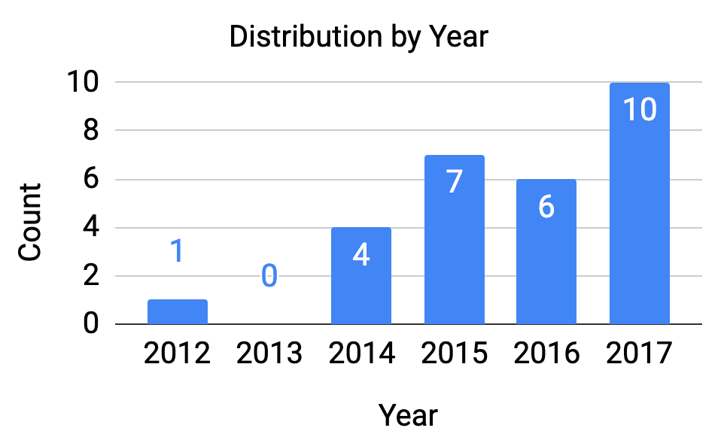
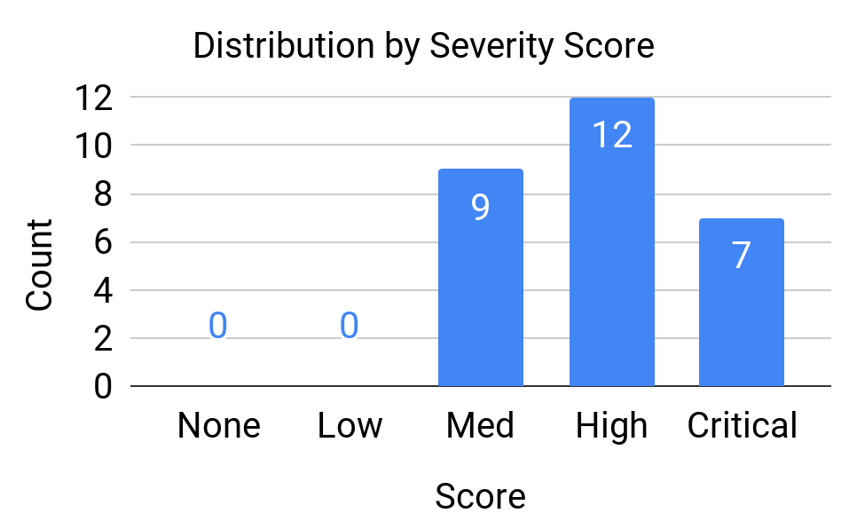
Studied Vulnerabilities
28 recent vulnerabilities of moderate to high severity
  24 containerized applications
Notes:
But first some details about the vulnerabilities we studied
We studied 28 vulnerabilities most of which were reported within 5 years now 7 years
We also studied serious vulnerabilities as shown by scores here (assigned by the National Vulnerability Database)
Refresh knowledge about some examples
Top vulnerability categories identified by previous work, NVD & CVE details
Severity: 0-None 0.1-Low 4-Med 7-High
HTTP, DNS, NTP, FTP, SMB, SSH, applications

Slide 4
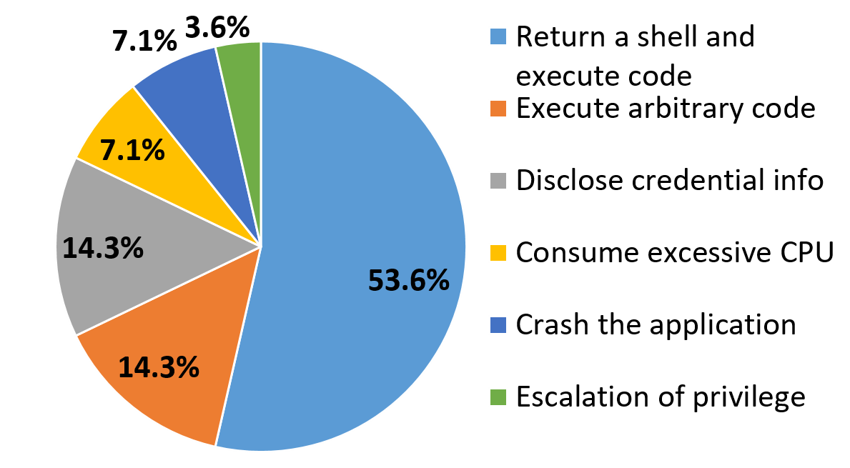
Studied Vulnerabilities
Vulnerability categories
Notes:
Vulnerabilities fall into the following categories which reflect the top categories identified by previous work.
In previous work where we looked a different detection model, we highlighted the return shell category, these class are major group that allow the return of a shell to the attacker. So we performed a separate analysis of these vulnerabilities
by looked into the lead time.
For these attacks there is a window from when the attack command is entered until it is completed.
The time from when the system detects the attack until when it is completed.
=================================================================================
We actually have an ongoing project that is exploring improving the detector so lead time is still in progress
============
Some 2014 CVEs = within 5 years
Refresh knowledge about some examples
Top vulnerability categories identified by previous work, NVD & CVE details
HTTP, DNS, NTP, FTP, SMB, SSH, applications

Slide 5
Studied Vulnerabilities
Threat Impact | CVE ID | CVSS Score | Application
Return a shell and execute arbitrary code | CVE-2012-1823 | 7.5 | PHP
 | CVE-2014-3120 | 6.8 | Elasticsearch
 | CVE-2015-1427 | 7.5 | Elasticsearch
 | CVE-2015-2208 | 7.5 | phpMoAdmin
 | CVE-2015-3306 | 10.0 | ProFTPd
 | CVE-2015-8103 | 7.5 | JBoss
 | CVE-2016-10033 | 7.5 | PhpMailer
 | CVE-2016-3088 | 7.5 | Apache ActiveMQ
 | CVE-2016-9920 | 6.0 | Roundcube
 | CVE-2017-11610 | 9.0 | Supervisor
 | CVE-2017-12149 | 7.5 | JBoss
 | CVE-2017-12615 | 6.8 | Apache Tomcat
 | CVE-2017-7494 | 10.0 | Samba
 | CVE-2017-8291 | 6.8 | Ghostscript
Notes:
But first some details about the vulnerabilities we studied
We studied 28 vulnerabilities most of which were reported within 5 years
We also studied serious vulnerabilities as shown by scores here (assigned by the National Vulnerability Database)
Refresh knowledge about some examples
Top vulnerability categories identified by previous work, NVD & CVE details
Severity: 0-None 0.1-Low 4-Med 7-High
HTTP, DNS, NTP, FTP, SMB, SSH, applications

Slide 6
Studied Vulnerabilities
Threat Impact | CVE ID | CVSS Score | Application
Execute arbitrary code | CVE-2014-6271 | 10.0 | Bash
 | CVE-2015-8562 | 7.5 | Joomla
 | CVE-2016-3714 | 10.0 | ImageMagick
 | CVE-2017-12794 | 4.3 | Django
 | CVE-2017-5638 | 10.0 | Struts
Disclose credential information | CVE-2014-0160 | 5.0 | OpenSSL
 | CVE-2015-5531 | 5.0 | Elasticsearch
 | CVE-2017-7529 | 5.0 | Nginx
 | CVE-2017-8917 | 7.5 | Joomla
 | CVE-2018-15473 | 5.0 | OpenSSH
Consume excessive CPU | CVE-2014-0050 | 7.5 | Apache Tomcat
 | CVE-2016-6515 | 7.8 | OpenSSH
Crash the application | CVE-2015-5477 | 7.8 | BIND
 | CVE-2016-7434 | 5.0 | NTP
Escalate privilege level | CVE-2017-12635 | 10.0 | Couchdb
Notes:
But first some details about the vulnerabilities we studied
We studied 28 vulnerabilities most of which were reported within 5 years
We also studied serious vulnerabilities as shown by scores here (assigned by the National Vulnerability Database)
Refresh knowledge about some examples
Top vulnerability categories identified by previous work, NVD & CVE details
Severity: 0-None 0.1-Low 4-Med 7-High
HTTP, DNS, NTP, FTP, SMB, SSH, applications

Slide 7

Static Vulnerability Detection
Container image scanning
Container image scanning
Depends on
  Packages and versions
  Vulnerability records
Limitations
High false positive rate
Low detection rate
Notes:
First we looked into clair, a popular static detection tool (open source)
Clair is helpful because you get a report of vulnerabilities and how one might update to avoid them
It does this by scanning the container image for details about packages and associated vulnerabilities
Unfortunately, Didn’t show good results, plagued by false alarms and did not detect many of our studied vulnerabilities

Slide 8
Dynamic Detection Challenges
Containers are often short-lived
Containers typically operate under dynamic computing environments and workloads
Notes:
Moved on to dynamic, but what dynamic detection approaches do we use?
Interested in real time online
1. In practice - there is a service abstraction over containers - app might use any container providing that service - Flexible nature - low training data
In practice groups of containers are orchestrated together so a single container might not last very long - low training data
2. Adjustable resources - algorithm needs detailed info on the actual workload at any point in time
3. They only contain the Needed libraries to run - so our algorithm should also have low overhead in order to not defeat this benefit.
2018 Sysdig, 74% less than an hour
85% less than a day

Slide 9
Anomaly Detection Over System Calls
Unsupervised machine learning methods
  k-Nearest Neighbors (k-NN)
  Principal Component Analysis (PCA) + k-Nearest Neighbors (k-NN)
  k-Means
  Auto-encoder neuron network
Notes:
This led to the following algorithms
We have familiar Classical unsupervised algorithm
Interested in unsupervised algorithms because without labeled data, more likely to be robust to unknown attacks
I would like to point out that our algorithms used the system calls made by container as input data
With that said, we can move on to a closer look at our experiment

Slide 10
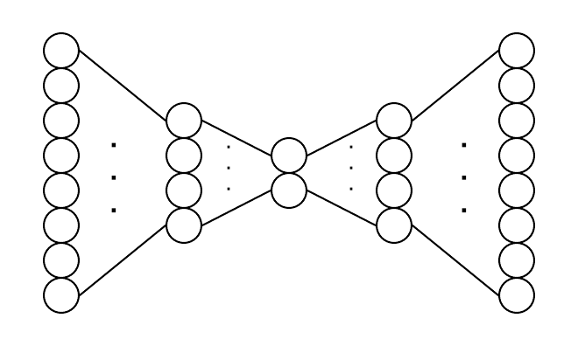
Autoencoder Network
Model represents normal training data in a lower dimensional space
Testing data is reconstructed with the trained model
Anomalies manifest as high reconstruction error samples
encode
decode
input layer
(555 dimensions)
output layer
(input reconstruction, 555 dimensions)
32 16 32
hidden layers
Notes:
0.1s samples

Slide 11
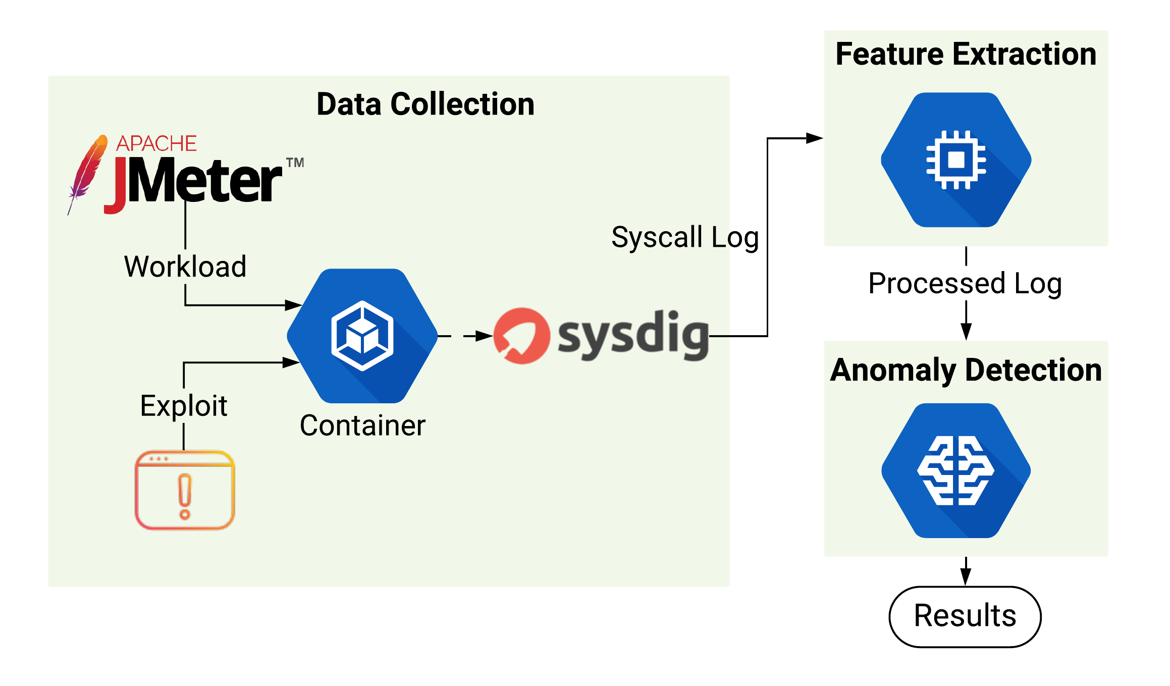
Experiment
Setup
Notes:
There are main 3 pieces to our experiment here
The area on the left describes how we collect system call data
The feature extraction prepares our syscall data for the final anomaly detection step.
So let’s start by zooming into the data collection step

Slide 12
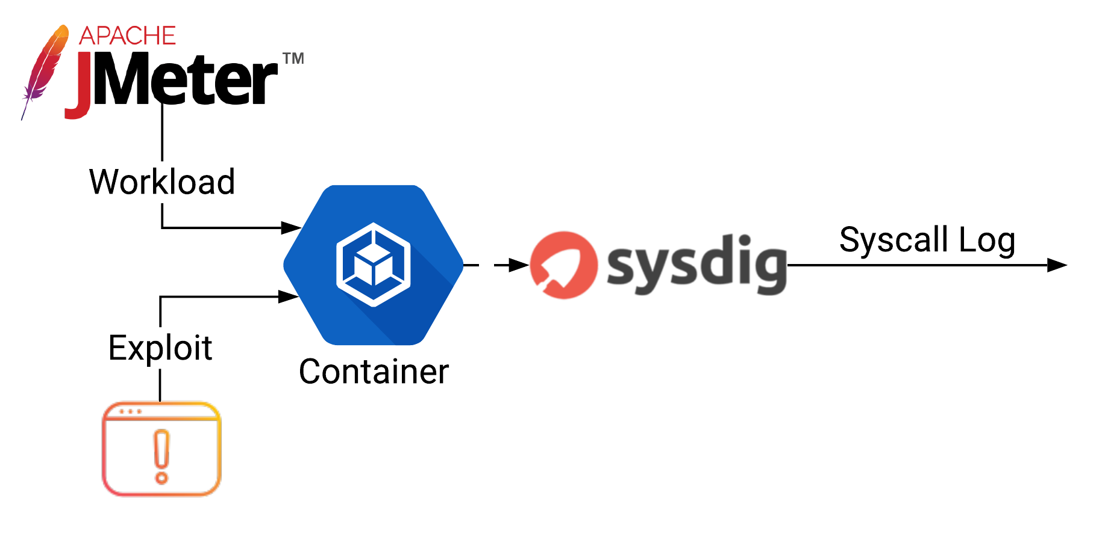
Data Collection
Deliver workload for a particular application
Trigger the exploit at appropriate time
Collect a detailed log of the system call information
Notes:
Highlight a few components here
JMeter sends all kinds of requests - request for application
Exploits sent at the appropriate time
Sysdig monitors the kernel to get syscalls made by the application for normal and abnormal periods
Output is this log that the next step utilizes
These systems are outside the container

Slide 13
System Call Processing
Frequency vector
  System call occurences per sampling interval
Timestamp | System Calls
 | write | read | futex | epoll_wait
1516544689186 | 100 | 256 | 430 | 78
1516544689286 | 300 | 759 | 726 | 356
Notes:
How do we process the raw logs for our detection algorithms?
First approach is count the number of occurrences made by a syscall in a sample
Here the write syscall is made 100 times between the first and second timestamps
Another approach is time vector. This counts the execution time of the syscall.
Intuition is that attacks will be reflected by an increase in the amount of system calls than normal,
Or longer execution

Slide 14
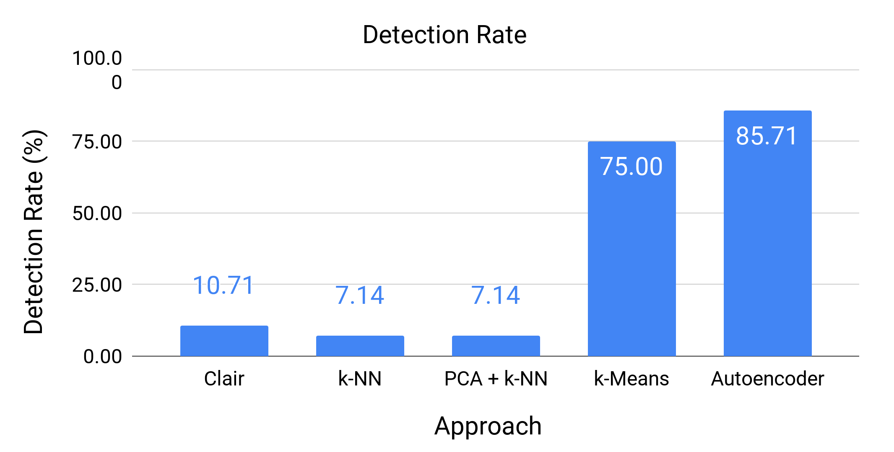
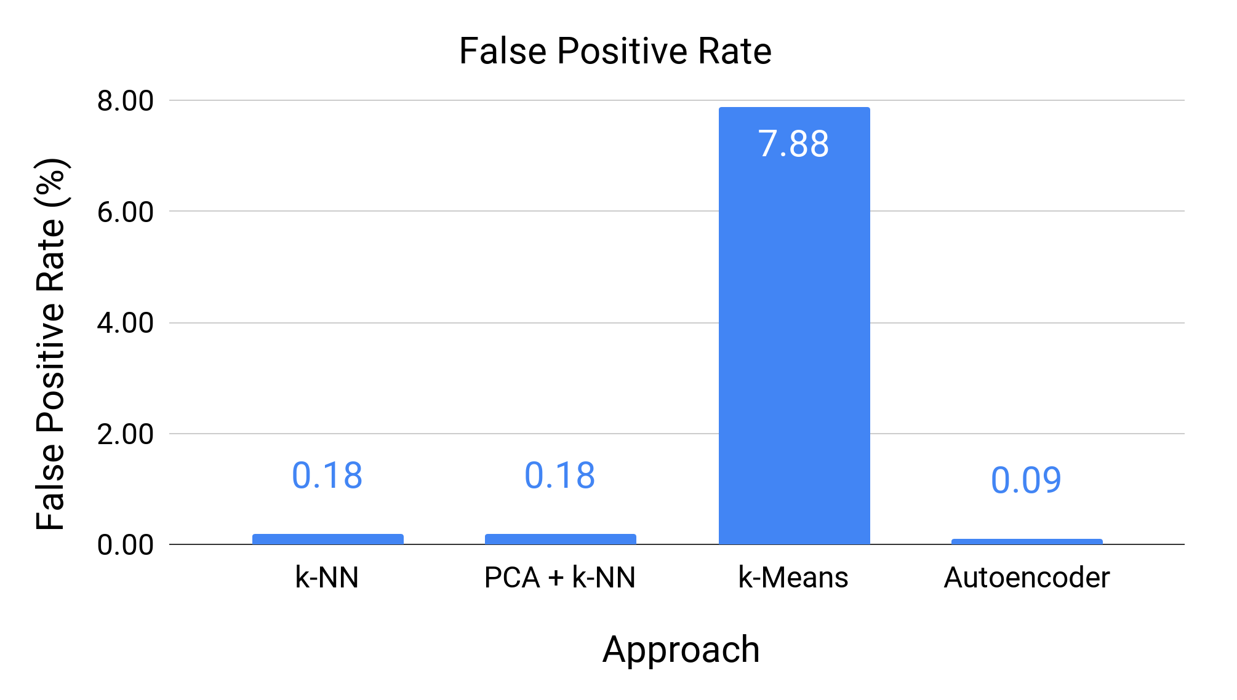
Detection Accuracy
Notes:
Of our 28 vulnerabilities, what percentage was there an alarm?
In this chart we show the results of using frequency vector but include results of using time vector for SOM.
Clair has a rate of only about 10%
k-NN performs better and we can see an improvement if we use Principal Component Analysis
K-Means is next best with about 67%
SOM performs best with about 78%
We also ran the detection with time vector processed trace but that slightly reduced our percentage

Slide 15
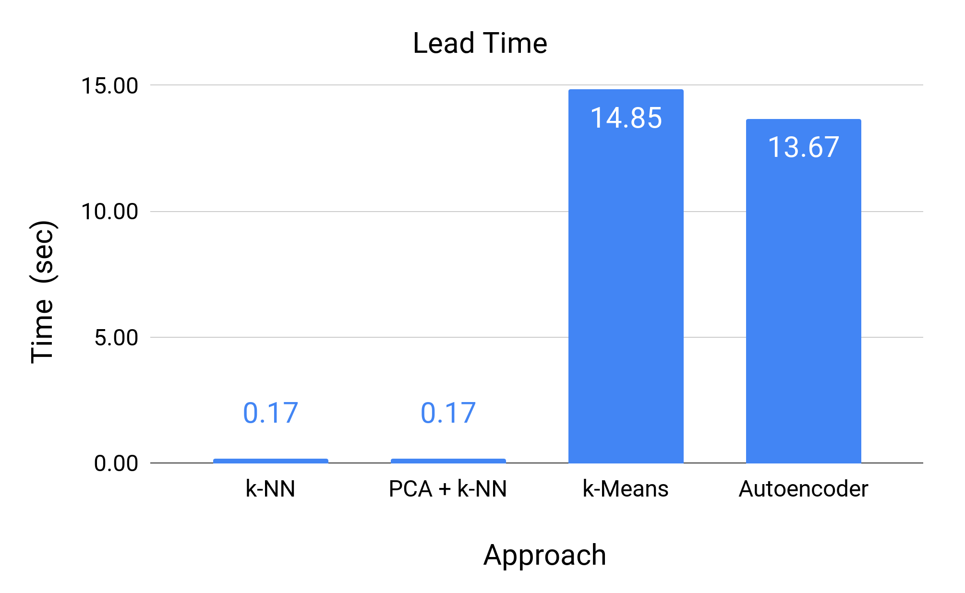
Detection Lead Time
Time between the alarm notice and attack success
For the category of exploits that return a shell
Notes:
For those attacks that return a shell we explore lead time analysis
In these attacks there is a time between when the attack command is entered and when a shell is returned
so the lead time is how much before the attack is completed we get an alarm
We don’t see much lead time with k-NN and k-Means but SOM provides a lot more substantial lead time.

Slide 16
On-demand Security Patching
Identifying Exposures
Updating Applications
Detect the anomaly
Recognize the culprit CVE
Understand the patch overhead
Apply the patch
Validate the patch
Notes:
Here are our goals for exploring such a system
The talk today will touch on areas highlighted in blue,
About our detection system and how it leads into patching
However, the focus will be on topics under exploit detection

Slide 17
Attack Signature
Characterize the attack with the top system calls present during the exploit
Vulnerability | System Calls
PHPMailer (CVE-2016-10033) | stat | lstat | setitimer | switch | read
RoundCube (CVE-2016-9920) | stat | lstat | read | close | switch
ProFTPD (CVE-2015-3306) | read | switch | stat | close | poll

Slide 18
Attack Signature
Get the attack start time from the anomaly detector
For each system call:
  Compute its average frequency during this abnormal period
  Compile the top 5 calls
  Concatenate the top system call name strings
  The signature is the SHA hash value result
Notes:
As mentioned, the input to this system is the alarm times so we use this to establish the attack period
During this period we can extract the frequency of each system call.
With this we can determine a simple rank by taking the average.
After sorting we can obtain the top 5 calls
To build the signature, we make a string out of the names and then run a Secure Hash Algorithm on it.
The hash value is the signature

Slide 19
Signature Results
CVE ID | Unique | System Calls
CVE-2012-1823 | ✓ | read | mmap | close | writev | lstat
CVE-2014-3120 | ✓ | futex | switch | epoll_wait | read | sched_yield
CVE-2015-1427 | ✓ | switch | futex | epoll_wait | read | stat
CVE-2015-2208 | ✓ | switch | select | nanosleep | read | stat
CVE-2015-3306 | ✓ | read | switch | stat | close | poll
CVE-2015-8103 | ✓ | futex | switch | stat | read | lseek
CVE-2016-10033 | ✓ | stat | lstat | setitimer | switch | read
CVE-2016-3088 | ✓ | futex | switch | epoll_wait | write | read
CVE-2016-9920 | ✓ | stat | lstat | read | close | switch
CVE-2017-11610 | ✓ | mmap | close | open | fstat | switch
CVE-2017-12149 | ✓ | futex | switch | stat | sched_yield | close
CVE-2017-12615 | ✓ | futex | switch | stat | close | epoll_wait
CVE-2017-7494 | ✓ | write | fcntl | geteuid | getegid | switch
CVE-2017-8291 | ✓ | futex | switch | sendto | madvise | close
Notes:
But first some details about the vulnerabilities we studied
We studied 28 vulnerabilities most of which were reported within 5 years
We also studied serious vulnerabilities as shown by scores here (assigned by the National Vulnerability Database)
Refresh knowledge about some examples
Top vulnerability categories identified by previous work, NVD & CVE details
Severity: 0-None 0.1-Low 4-Med 7-High
HTTP, DNS, NTP, FTP, SMB, SSH, applications

Slide 20
Signature Results
CVE ID | Unique | System Calls
CVE-2014-6271 | ✓ | switch | read | stat | close | mmap
CVE-2015-8562 | ✓ | lstat | fstat | access | close | open
CVE-2016-3714 | ✓ | lstat | stat | setitimer | fcntl | read
CVE-2017-12794 | ✓ | stat | switch | poll | sendto | futex
CVE-2017-5638 | ✓ | read | lseek | open | switch | futex
CVE-2014-0160 | ✓ | switch | poll | stat | writev | read
CVE-2015-5531 | ✓ | switch | futex | epoll_wait | read | mprotect
CVE-2017-7529 | ✓ | epoll_wait | switch | close | writev | write
CVE-2017-8917 | ✓ | fstat | lstat | access | close | open
CVE-2018-15473 | ✓ | read | close | fstat | mmap | open
CVE-2014-0050 | ✓ | read | lseek | open | switch | stat
CVE-2016-6515 | ✓ | close | mmap | read | open | fstat
CVE-2015-5477 | ✓ | xtensa | ioctl_console | ioctl_iflags | ioctl_getfsmap | ioctl_fideduperang
CVE-2016-7434 | ✓ | rt_sigprocmask | gettid | write | read | clock_gettime
CVE-2017-12635 | ✓ | epoll_wait | sched_yield | close | switch | futex
Notes:
But first some details about the vulnerabilities we studied
We studied 28 vulnerabilities most of which were reported within 5 years
We also studied serious vulnerabilities as shown by scores here (assigned by the National Vulnerability Database)
Refresh knowledge about some examples
Top vulnerability categories identified by previous work, NVD & CVE details
Severity: 0-None 0.1-Low 4-Med 7-High
HTTP, DNS, NTP, FTP, SMB, SSH, applications

Slide 21
Dynamic Detection Challenges
Containers are often short-lived
Containers typically operate under dynamic computing environments and workloads
Notes:
Moved on to dynamic, but what dynamic detection approaches do we use?
Interested in real time online
1. In practice - there is a service abstraction over containers - app might use any container providing that service - Flexible nature - low training data
In practice groups of containers are orchestrated together so a single container might not last very long - low training data
2. Adjustable resources - algorithm needs detailed info on the actual workload at any point in time
3. They only contain the Needed libraries to run - so our algorithm should also have low overhead in order to not defeat this benefit.
2018 Sysdig, 74% less than an hour
85% less than a day

Slide 22
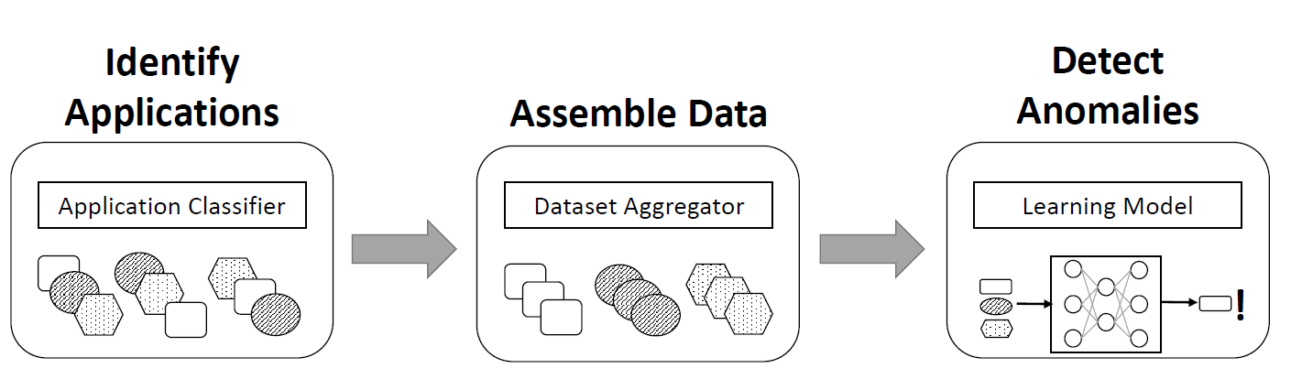
Aggregated Learning

Slide 23
Application Classification
Expanded each trace to 555 dimensions of known system calls
Used sliding window with window size of 30 seconds and sliding step of 1 second
Classification methods
  Extremely Randomized Trees
  Random Forest

Slide 24
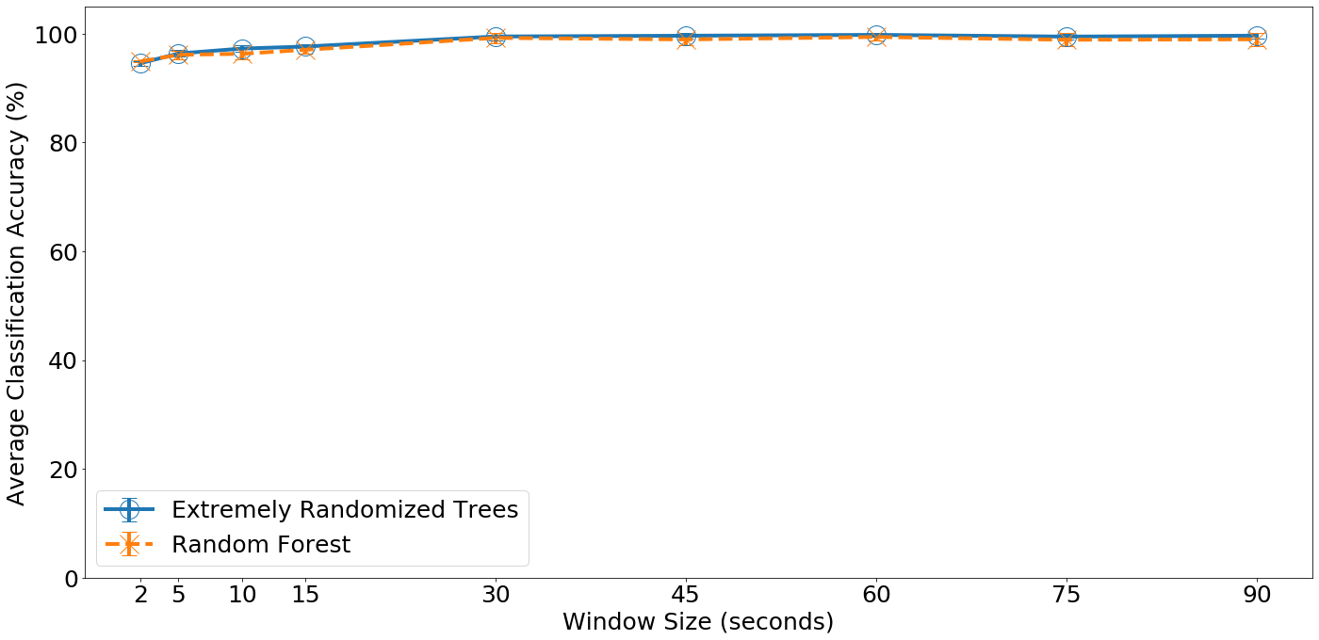
Application Classification Accuracy
Notes:
The larger the window is, the better accuracy will be. But if the window is too large, then the first detection time will be affected. We decided to pick 30 seconds as our window size. Extremely randomized trees show slight improvement over random forest, so we chose the former algorithm.

Slide 25
Conclusion
Studied 28 real world vulnerabilities in 24 common containerized applications
Dynamic detection and attack type recognition using unsupervised machine learning methods
Attack signature creation using top ranked system calls
Automatic application classification using extremely randomized trees
Notes:
To recap, we explored 28 real world vulnerabilities in 24 common applications
And by combining static and dynamic approaches we were able to detect 24 out of 28 application
which was better than each approach alone

Slide 26
Future Work
Aggregated Training
  Integrating application classification with dynamic attack detection
Online Security Patching
  Investigating online security patching system using dynamic attack detection and signature recognition
Thank you!

