Slide 1
PEASOUP: Preventing Exploits Against Software Of Uncertain Provenance
Presented by:
David Melski

Slide 2
PEASOUP Programmatics
Team
  GrammaTech: (Prime) David Melski (PI), David Cok, Denis Gopan, Tim Teitelbaum, Tom Reps, Duc Nguyen, John Phillips …
  University of Virginia: Jack Davidson (PI), John Knight (PI), Jason Hiser, Anh Nguyen-Tuong, Michele Co, Ben Rodes …
  Georgia Institute of Technology: Wenke Lee (PI), Chengyu Song, Tielei Wang, …
  Raytheon: David Hyde (PI), Brian Mastropietro, Billy Ella …
Sponsored by Air Force Research Laboratories
  Contract #FA8650-10-C-7025

Slide 3
PEASOUP Vision
Software
Executable
SOUP: Software Of
Uncertain Provenace
Not malicious, but …
Not safe from attack!
Includes:
  Doc, PDF viewers
  Media players
  Utilities (zip, etc.)
  Web browsers

Slide 4
PEASOUP Vision
PEASOUP Analyzer
Recovers:
    Structure
    Vulnerabilities
Generates prog. variants:
    Alters attack surface
    Confines or repairs vulnerabilities
Checks correctness, strength
Software
Executable
SOUP: Software Of
Uncertain Provenace
Not malicious, but …
Not safe from attack!
Includes:
  Doc, PDF viewers
  Media players
  Utilities (zip, etc.)
  Web browsers

Slide 5
PEASOUP Vision
PEASOUP Analyzer
Recovers:
    Structure
    Vulnerabilities
Generates prog. variants:
    Alters attack surface
    Confines or repairs vulnerabilities
Checks correctness, strength
Software
Executable
Hardened
Executable
SOUP: Software Of
Uncertain Provenace
Not malicious, but …
Not safe from attack!
Includes:
  Doc, PDF viewers
  Media players
  Utilities (zip, etc.)
  Web browsers
Immune to many attacks
On malicious input:
  Corrected execution
  Controlled exit
  Uncontrolled exit
  Stops exploits!

Slide 6
PEASOUP Vision
PEASOUP Analyzer
Recovers:
    Structure
    Vulnerabilities
Generates prog. variants:
    Alters attack surface
    Confines or repairs vulnerabilities
Checks correctness, strength
Software
Executable
Hardened
Executable
Notice: no specification is provided
SOUP: Software Of
Uncertain Provenace
Not malicious, but …
Not safe from attack!
Includes:
  Doc, PDF viewers
  Media players
  Utilities (zip, etc.)
  Web browsers
Immune to many attacks
On malicious input:
  Corrected execution
  Controlled exit
  Uncontrolled exit
  Stops exploits!

Slide 7
Targeted Weaknesses (Phase I)
 | CWE(s) | Description
Numeric Errors | 128, 190-1 | Integer over/under flow
 | 194-6 | Signedness Errors
 | 197 | Numeric Truncation Error
 | 198 | Use of Incorrect Byte Ordering
 | 369 | Divide by Zero
 | 839 | Numeric Range Comparison without Minimum Check
Memory Errors | 120-2, 124, 126-7 | Buffer over/under read/write
 | 129, 805-6 | Improper Buffer Access
 | 134 | Uncontrolled Format String
 | 170 | Improper Null Termination
 | 415-6, 590, 761-2 | Heap Management Error (Use After Free, …)
 | 785 | Use of Path Manipulation Fn. with Under-sized Buffer

Slide 8
PEASOUP (offline) Analyzer
SOUP
Concolic Execution
(high-coverage test suite)
Improve precision of detectors
Inputs
Safety Detectors
(MEDS, others)
Sorted
Inputs
Generate detectable errors
IR Constructor (learns
from good/bad runs)
Intermediate
Representation
Correct for IR mistakes
Variant Generator &
Remediation Strategist
SOUP
Variants
BED (compares behavior of
each variant with original)
Valid
Variants
TSET (tests inputs, BED)

Slide 9
PEASOUP Execution Monitor
Valid
Variants
Intermediate
Representation
Execution Manager
Known vulnerabilities patched;
Static diversification
SIM
Strata Dynamic
Translator
Selected
Variant
Stops code injection, other attacks.
Run-time diversification: ILR …
Memory protection for Strata.
(kernel-level protection)

Slide 10
PEASOUP Rewriting
SOUP
Offline Runtime
Inputs
Sorted
Inputs
IR DB
SIM
Strata Dynamic
Translator
Intermediate
Representation
SOUP
Variants
Valid
Variants

Slide 11
PEASOUP Analysis and Transformation Core Technologies
Binary
STARS
(Static Analysis for Reliability and Security
Other Analyses
IRDB
PEASOUP Analysis & Transformation Phase
Strata
Context
Capture
Fragment Cache
Cached?
New
Fragment
No
New
PC
Reassembly Engine
Fetch
No
Yes
Decode
Finished?
Translate
Context
Switch
SPRI
Next PC
Yes

Slide 12
Virtualization Approaches
Application₁
Application_{n}
Applications
Operating System
Virtualizing Software
(e.g. Strata)
Virtualizing Software
(e.g. Strata)
Virtualizing Software
(e.g. Xen)
Virtualizing Software
(e.g. Xen)
Operating System
Hardware
Hardware
Process-level VM
+
System-level VM
System-level VM
Process-level VM

Slide 13
Strata
Application Binary
Context
Capture
Portable
Retargetable
Flexible
Small
Fast!!
Fragment Cache
Dynamic Translator
Cached?
New
PC
New
Fragment
Fetch
Finished?
Decode
Context
Switch
Translate
Next PC

Slide 14

PEASOUP Analysis and Transformation Core Technologies
Binary
STARS
(Static Analysis for Reliability and Security
Other Analyses
IRDB
PEASOUP Analysis & Transformation Phase
Strata
Context
Capture
Fragment Cache
Cached?
New
Fragment
No
New
PC
Reassembly Engine
Fetch
No
Yes
Decode
Finished?
Translate
Context
Switch
Next PC
Yes

Slide 15
SPRI: Strata Program Rewriting Interface
Simple language for dynamically rewriting instructions as they are translated by Strata
Sufficient to perform arbitrary transformations of a binary
Two types of rules:
  addr ‘-’ ‘>’ addr and
  addr ‘*’ ‘*’ count byte_sequence
Where
  addr is an address, count is a byte count, and byte_sequence is a sequence of count bytes
  All numbers are hexadecimal
Allows arbitrary changes to a binary

Slide 16
SPRI: Strata Program Rewriting Interface
Example
080481f0 <main>: 55 push %ebp
08481f10 89 e5 mov %esp,%ebp
080481f3 83 ec 18 sub $0x18,%esp
080481f6 8e e4 f0 and $0xfffffff0,%esp
080481f9 c7 44 24 09 23 00 00 movl $0x23,0x8(%esp)
. . . .
The following SPRI “sprocket”
080481f3 -> f0000000
f0000000 ** 03 83 ec 24
f0000003 -> 080481f6
Rewrites main’s prologue code so that its stack frame has 0x24 bytes instead of 0x18 bytes.
Notes:
No cost!!

Slide 17
PEASOUP Defenses
Memory Error Protections
  Stack Layout Randomizations
  Heap Protections
Numeric Error Protections
General Protections
  PC Confinement
  Instruction Set Randomization (ISR)
  Instruction Layout Randomization (ILR)
    Diversification technique developed at UVA
    Effective defense against ROP attacks

Slide 18
Stack-Layout Randomization
Unchecked buffer boundaries may allow attackers write/read beyond the boundary.
Consequences
  Arbitrary code execution
  Privilege escalation
  Denial of service
  Loss of confidential data
  Data corruption
  …
Param B
Incoming
Arguments
Param A
Return Addr
Frame Pointer
Stack Growth
EBX
Saved Registers
Var X
Var Y
Var Z
Local
Variables
Out Arguments
Example of a
Function Stack Frame

Slide 19
Stack-Layout Randomization
Param B
Variable Relationships
Have Changed!
Padding
Param A
Return Addr
Frame Pointer
EBX
Var X
Var X
Var Y
Var Y
Var Z
Var Z
Padding
No Longer
Accessible!
Padding
Out Arguments
Padding

Slide 20
Heap Protection: Offline Analysis
Heap Protection
Arbitrary Binary
IRDB
Heap Transforms
(Policies)
Functions
Annotations
Reassembly Engine
SPRI
Dynamic rewrite of calls to memory allocation /de-allocation routines
  Pad heap allocated objects
  Prevent allocations that are ‘too large’
  Delay frees
  Prevent frees of non-heap memory
  Prevent double frees
Addresses many memory corruption weaknesses
  Use after free (CWE 416), Double free (CWE 415, 590), Heap overrun (CWE 122, 124, 805)
Page 20

Slide 21
Numeric Error Protection
Instrument every integer operation
Combination of static and dynamic analyses
  Infer signedness from static usage (where possible)
  Analyze for potentially dangerous and definitely benign errors
  Incorporate evidence from dynamic analysis on “good” inputs
Protection policy selected for every integer operation
  Issue warning
  Controlled exit
  Change semantics to saturating arithmetic
Overall policy can be tuned
  E.g., what type of policy to use for a given CWE

Slide 22
PC Confinement aka Program Shepherding
Keep the program counter in valid ranges
  Defeats code injection attacks
Previously described in the literature
Reserved
.text
.data
Heap
libc
libm
libX11
Stack
Reserved

Slide 23
PC Confinement + ISR
Encrypt the code
  Prevents (meaningful) code modification
  Prevents code exfiltration
First published by UVA in ’06
  Solved efficiency hurdles (1%)
  AES encryption
  Detected injection w/o crash
PEASOUP makes it practical for deployment
    Dynamic libraries, threading, etc.
  Skipping details
Reserved
.text
.data
Heap
libc
libm
libX11
Stack
Reserved

Slide 24
ILR
Create new address space for instructions
Randomize location of every instruction
Reserved
Changes the attack surface for arc injection and ROP attacks
  Unlike ASLR
  Unlike SDT
.text
.data
Heap
libc
libm
libX11
Stack
Reserved

Slide 25
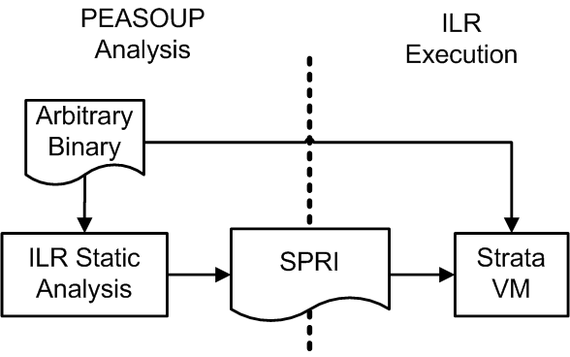
How ILR Works: 30,000 ft.

Slide 26
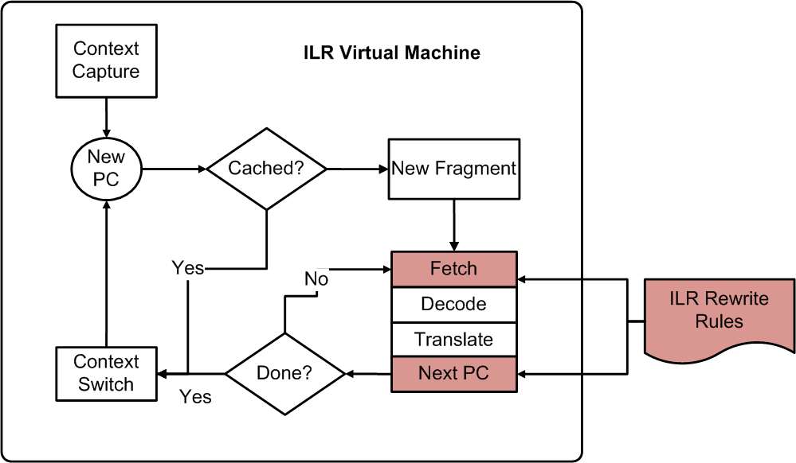
ILR VM

Slide 27
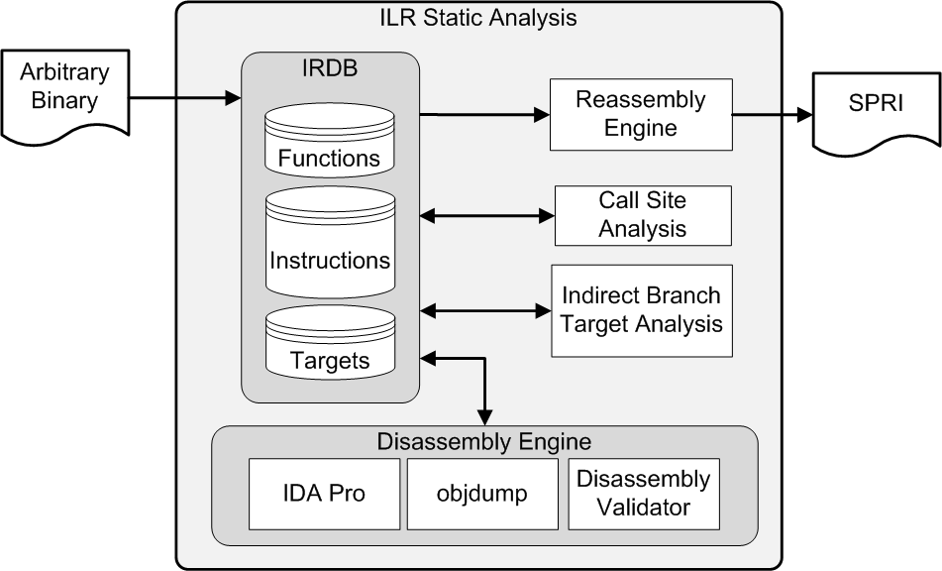
ILR Static Analysis

Slide 28
ILR Results
Evaluated on real-world programs
  SPEC CPU2006 programs exceed 400KLOC with over 1M insns
  Defeated ROP exploits in acroread and xpdf
  No false positives
Result: 99% reduction in Arc injection attack surface
Result: 99.96% reduction in ROP attack surface
  1-3 ROP gadget left; no feasible ROP attacks found
Result: Low runtime overheads
  7% for Strata, 6% more for ILR
Practical, principled, efficient, effective ROP defense
  To appear in IEEE S&P 2012. ILR: Where’d my gadgets go? Hiser, et al.
  UVA patent pending

Slide 29
Overall D-I-D Results
ISR+PC Confinement
  Code injection completely eliminated
  No additional overhead
ILR
  ROP attacks not viable
  Arc injection infeasible
Combined: 13% runtime overhead on real-world benchmarks (SPEC CPU2006) with over 400KLOC and over 1 million instructions

Slide 30
General Defenses (only)
PEASOUP advances many defense-in-depth approaches
  7% runtime overhead for Strata SDT
  Zero-overhead ISR
  Zero-overhead PC Confinement
  6% for ILR
PEASOUP advances state of the art for ROP defenses
  First practical, principled, ROP defense provides 3.5 (99.96%) orders of magnitude reduction in attack space
Provides these defenses on program binaries, no language, recompilation or toolchain support needed
  Tested on binaries from C, C++, Fortran using GCC, CLANG compilers with a variety of compilation flags

Slide 31
PEASOUP Phase I Summary
Applied research program
  Explicit focus on deployable & reliable tools
Core technologies in place
  Grace, BED/TSET, SIM, Strata, Analysis Engine, IRDB, Evaluation Testbed
State-of-the-art advances
  High-entropy diversity
    Order magnitudes in attack surface reduction
  Defeats sophisticated ROP attacks
  Novel use of concolic execution
    Benign weakness detection
    Validation of transformations (BED+TSET)
  Binary repair & remediation
  Automatic generation and composition of security protection
  Secure Dynamic Translation
Flexible extensible architecture
Plug ‘n’ Play Analysis
Plug ‘n’ Play Transformations
Notes:
Plug’N’Play: not just our own tools, but other third-party tool as well

Slide 32
PEASOUP: Preventing Exploits Against Software Of Uncertain Provenance
Presented by:
David Melski

