Slide 1
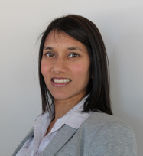


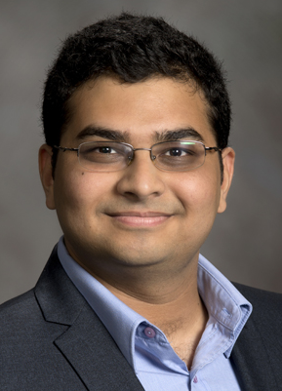

Remind me tomorrow:
Human Behaviors and Cybervulnerabilities
Marshini Chetty, Tudor Dumitras,
VS Subrahmanian (UMD)
Aditya Prakash (Virginia Tech)

Slide 2
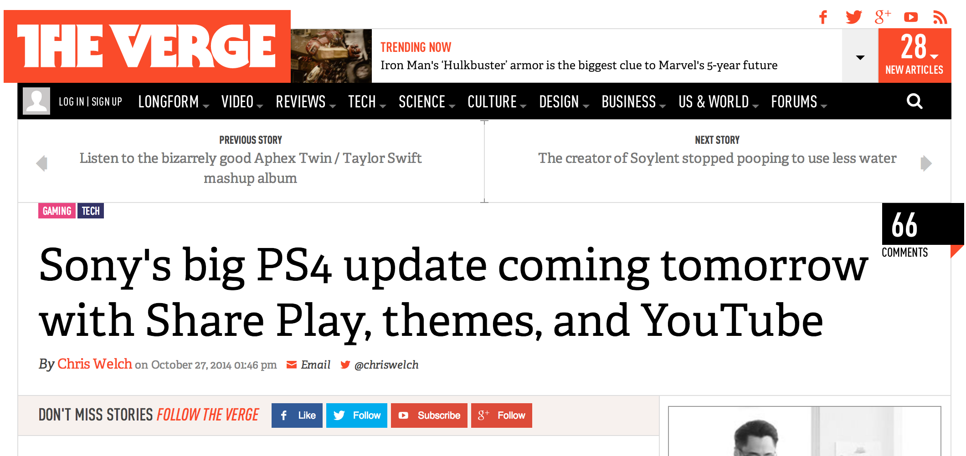
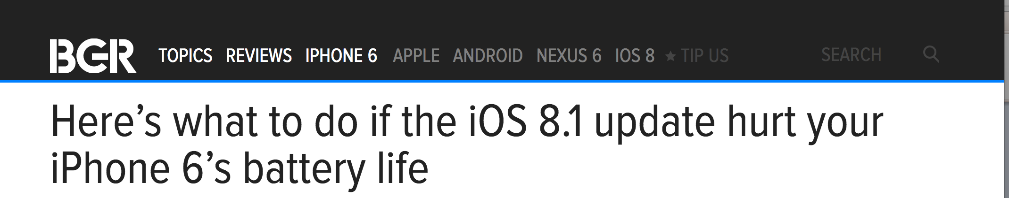
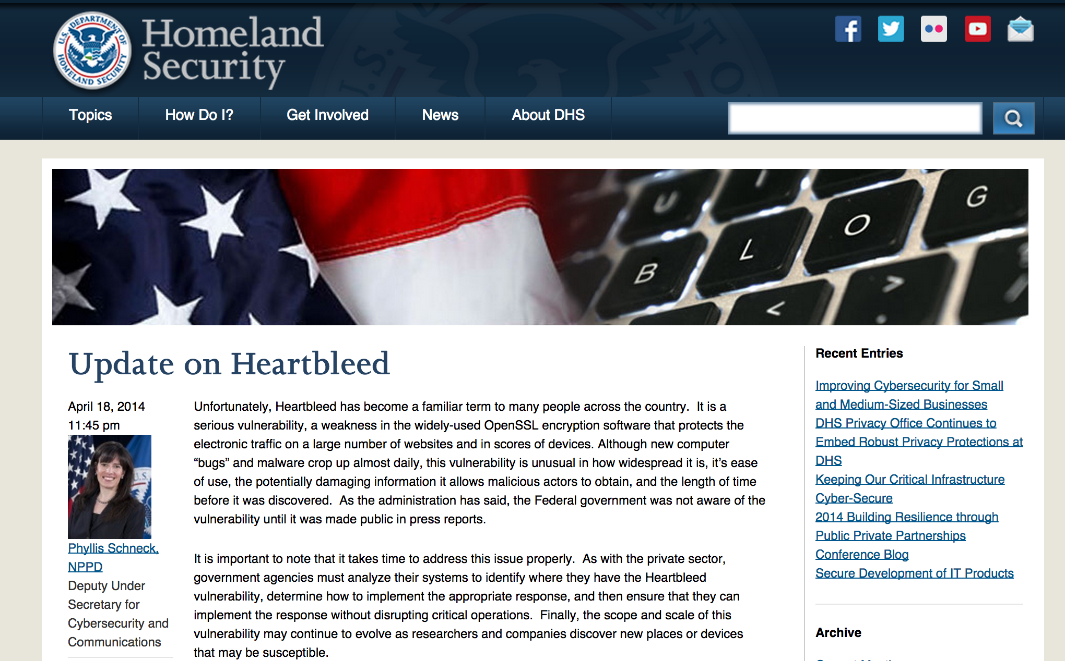

Slide 3
Majority of computers compromised using vulnerability that has an update that has not been applied
-Symantec Internet Threat Report 2013

Slide 4
Zero-Day Vulnerabilities After Disclosure
[CCS’12]
Before disclosure:
Targeted attacks
After disclosure:
Large-scale attacks
Bilge and Dumitras

Slide 5
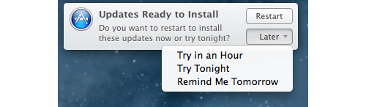

Slide 6
How do users update their software?
What are the barriers and facilitators to updates from the user perspective?
Can we compare what users say they do with what they actually do?

Slide 7
What are the implications for improving updating mechanisms and updating interfaces?

Slide 8
Methodology
Analyze Symantec’s Worldwide Intelligence Network Environment (WINE) data
  Field data collected from hosts around the world
    e.g., binary executables downloaded by users who opt into Symantec data sharing program
User studies of patching behaviors
Comparing and contrasting results of these studies

Slide 9
Results from Work in Progress

Slide 10

What are users’ actual patching behaviors?
(Dumitras and Johnson)

Slide 11
Vulnerability Patching After Disclosure
Analyzed 1,593 vulnerabilities in 10 side applications on Windows from 8.4 million hosts over 5 years
  Not visible to network vulnerability scanners
  Often targeted in spear-phishing
  Applications selected
    Chrome, Firefox, Opera, Safari (browsers)
    Flash Player, Quicktime (multimedia)
    Thunderbird (email)
    Adobe Reader (document reader)
    Microsoft Word (editor)
    Wireshark (networking)
Goal: measure patch deployment milestones
  Start of patching
  Time to patch 50%, 90%, 95% of vulnerable hosts
  Factors influencing the rate of patching

Slide 12
Data Analysis Pipeline
Popular
executables
WINE
Vulnerable & patched host counts
File sets
VT
Certificate info
Vulnerable versions
NVD
NSRL
Installers
Vulnerable versions
OSVDB
Version–File Mapping
Vulnerable File Sets
Survival Analysis
Determine vulnerable and patched files
Cluster CVEs with same vulnerable version ranges
Analyze patch deployment
Application
version released
Vulnerability
disclosed
Patched
version released
Patch deployment
completed

Slide 13
Analysis for Patch Deployment
Can detect global decay of vulnerable host population for each vulnerability cluster as updates are deployed
Can estimate:
  Delay to issue a patch
  Rate of patching
  Vulnerable population
  Estimate dates exploits are available and percentage of host population that is vulnerable when exploits are released

Slide 14
Patching Release Delay
Start of patching is strongly correlated with the disclosure date
  Correlation coefficient r = 0.994
77% vulnerabilities start patching within 7 days
92% vulnerabilities start patching within 30 days
1000
Number of CVE
600
200
0
-1000
-500
0
500
1000
Start of Patching Offset in Days

Slide 15
Upgrade Mechanisms and Median Time-to-Patch
Program | t_{m} (% reach) | % Versions
Manual Update
Wireshark | N/A (0%) | 100%
Prompt Download
Flash | 271 (55%) | 85.1%
Reader | 171.5 (87%) | 87.7%
Prompt Install
Firefox | 38 (91%) | 97.3%
Quicktime | 131 (98%) | 100%
Safari
Silent Update
Chrome | 15 (100%) | 100%
Firefox | 14 (100%) | 2.7%
Flash | 20.5 (100%) | 14.9%
Reader | 36 (80%) | 12.3%
Median time to patch (t_{m}):
  #days needed to deploy the patch on 50% of the vulnerable hosts

Slide 16
Reaching High Levels of Patch Completion
Time to patch 90% of vulnerable hosts
Time to patch 95% of vulnerable hosts
200 days
300 days
Patching slows down over time

Slide 17
Implications
Software vendors generally respond promptly to disclosures
  However, patch deployment exhibits a long tail
  Exploits are generally effective even if not zero-day
Considerable difference among updating mechanisms
  Prompt for download: marginally more effective than manual updates
  Auto-download and prompt for install:
    Nearly as effective as silent updates for patching 50% of vulnerable hosts
    Less effective for reaching 95% patch completion

Slide 18

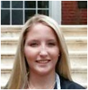
What do users say they do?
Chetty, Sobti, and Engel

Slide 19
User study of patching behaviors
Conducted online survey + interviews in summer 2014
  118 complete responses from US users over age of 18
  30 interviews over Skype/telephone
  Even gender split + fairly educated users
Interviews transcribed and analyzed using inductive coding
Surveys statistically analyzed

Slide 20
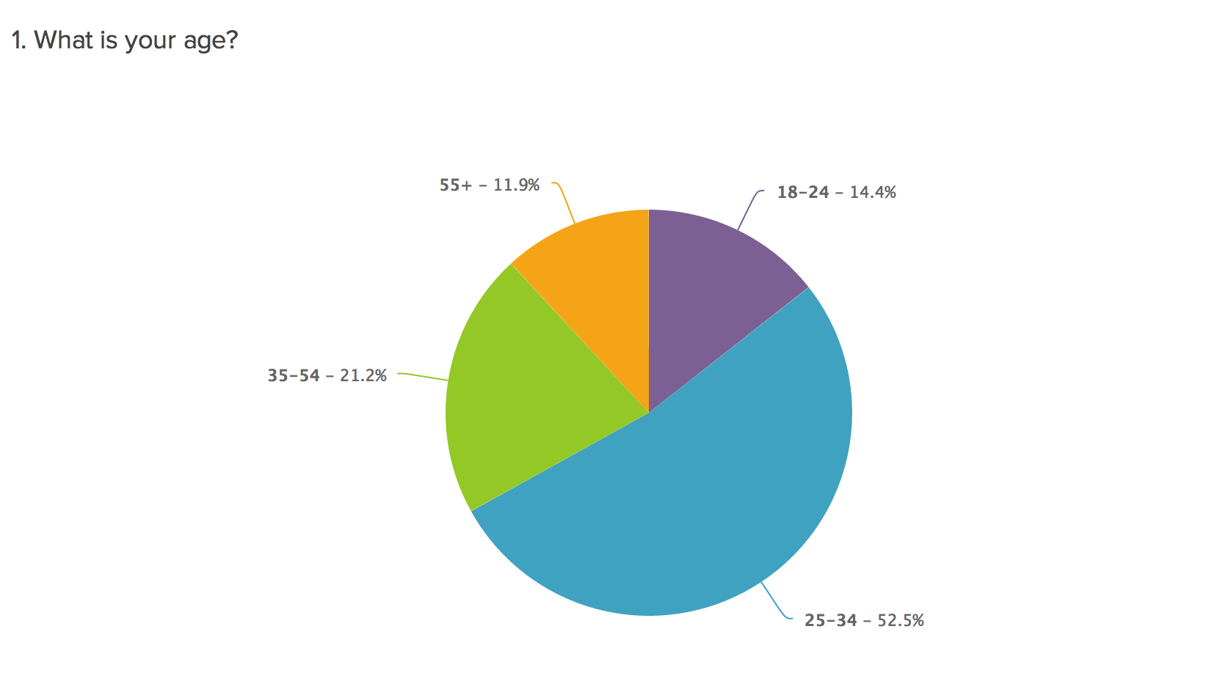

Slide 21
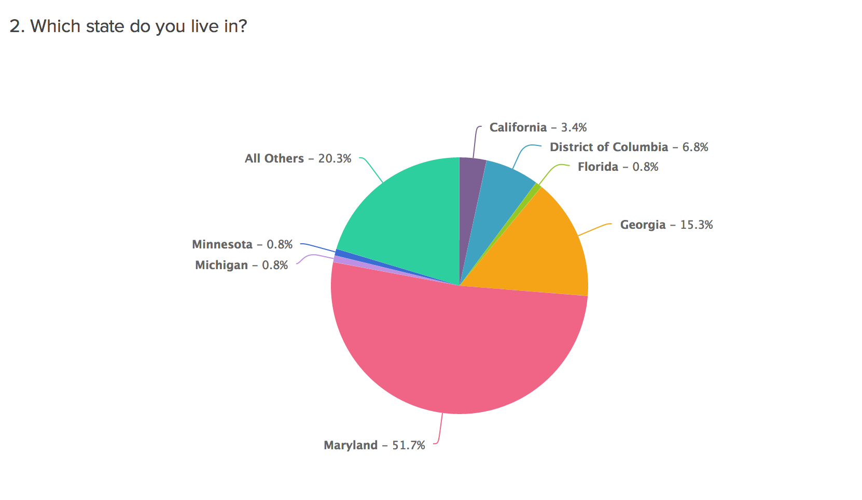

Slide 22


Why update?
Keep system up to date for new features + functions and security
  70.3% of survey respondents felt it is critical to keep software up to date
  Nearly half of survey respondents updated for security or to fix bugs/enhance performance

Slide 23
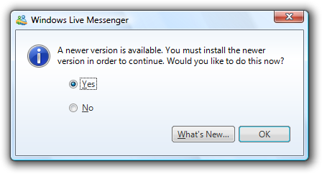
Bundled updates and missing versions
Some cases forced to update to continue using software

Slide 24
Information about update changes clear
“If its security then I will say, “Ok you can go ahead and install that.”. If it doesn’t say security, I will look at the patch and go through the notes and see what does this do and if it’s not something I need, I generally won’t install it.” – P9

Slide 25
Frequency of use
“I pretty much don’t update unless it’s the feature I really need” – P13

Slide 26
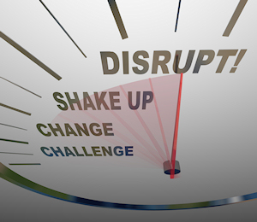
Why Avoid Updates?
Disruptive (61% of respondents)
  40% survey respondents said updating takes up too much time
  2/3 avoid updates when busy
  “Update day”

Slide 27
  “Timing issues are the biggest concern. The interruption of my workflow, the interruption of my user experience is the chief reason why I would delay an update. It is the chief reason why I would ignore an offer to update because I don’t want to be interrupted or I am short on time at that particular moment.” P9

Slide 28
Information about updates unclear
“If I am given information to be persuaded that it is critical, just being told that it is critical does not really make me feel like it is critical. I need to feel the urgency and feel like there could be a consequence if I don’t update it” – P20

Slide 29
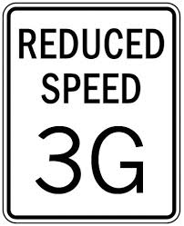

Internet costs and performance

Slide 30

Update fatigue
  Over 1/3 survey respondents felt there were too many updates

Slide 31
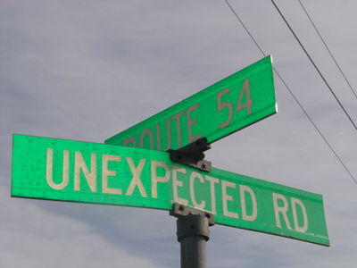
Patching Expectations
Do not like unexpected changes, especially to the user interface (UI)
Want to know what has been changed
Fear of destabilization and incompatibility
  2 versions common
Expectations
  Visible change
  Change in performance
  (better or worse)

Slide 32
Preferences for patching mechanisms
42% of survey respondents preferred automatic downloads
72% of survey respondents preferred manual installation
Automatic updates for infrequently used programs and devices
Manual for frequently used to see changes
Did not like the concept of silent updates and not knowing what has been changed

Slide 33
Implications
Information about updates can be improved
  Nuanced rating of security update
  Expected changes and possible pitfalls
  Size of update/Expected time to update
  Ratings by other users who’ve applied it (may be –ve)
Patching settings and mechanisms
  Silent or not?

Slide 34
Comparing what users do with what they say they do
Dumitras and Chetty

Slide 35
Comparing what users say and do
Patching mechanisms and no of applications to update
Consistency of patching behaviors over time and across applications
Fear of destabilization
Update Fatigue
Geographical Factors
Deployment Specific Factors

Slide 36

How do patching mechanisms affect users?
Users didn’t like silent updates
But silent updates one of the most effective patching mechanisms in terms of time to patch
What does that mean for patching?

Slide 37
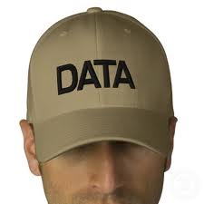
Geographic factors
Look at hosts in different geographical regions
Data caps?
What should count towards the cap?

Slide 38
How do users update their software?
What are the barriers and facilitators to updates from the user perspective?
Can we compare what users say they do with what they actually do?

Slide 39
Next Steps
Complete collaborative work
Continued empirical analysis of WINE
User studies extend to system administrators and developers + design of improved UI for information about updates
Modeling attacker and defender behavior using game theory + WINE data

Slide 40
Get in touch.
http://marshini.net
marshini@umd.edu
http://www.umiacs.umd.edu/~tdumitra/
tdumitra@umiacs.umd.edu

