Slide 1
Resolute: An Assurance Case Language for Architecture Models
High Assurance Cyber Military Systems (HACMS)
DARPA I2O
Andrew Gacek, John Backes, Darren Cofer, Konrad Slind (Rockwell Collins)
Mike Whalen (University of Minnesota)
Software Certification Consortium
26 January 2015

Slide 2
Ideas
1. Your presentation is scheduled for Jan 26 in the second morning session; it is the first technical session of the workshop.
2. Duration of this session is 2 – 2.25 hours. Your segment has a rough budget of half an hour.
3. This session focuses on the sub-theme of an assurance case framework based on a fundamental reasoning structure.
4. The two presentations preceding you (Prof. Maibaum and Chuck Weinstock) lay the theoretical foundation for the audience and provide general information.
5. Your presentation demonstrates the example of using an assurance case structure on a quad-copter case – the theory put to practice.
5.1. A video of the flying machine (if you have one) could show the audience how real it is.
5.2. The demo is also the time to stimulate and address questions.
6. It would be motivational to the audience to hear how you leverage your investment in the architectural design to build your assurance case efficiently – the intrinsic economics.
7. In your presentation, it would also be appropriate to mention the availability of tools you developed and what an adopter can do with them.
8. If further R&D is in the works, close out with mentioning your goal state.
9. Following your presentation, there is a small group breakout discussion session of 30-45 minutes duration. Stimulated by your demonstration, people in the audience will internalize what they heard/saw and think about its implications in their respective application domains.

Slide 3
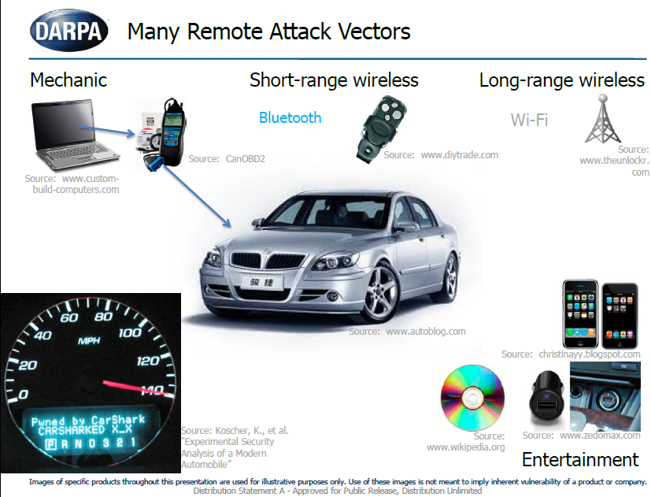
HACMS motivation…

Slide 4
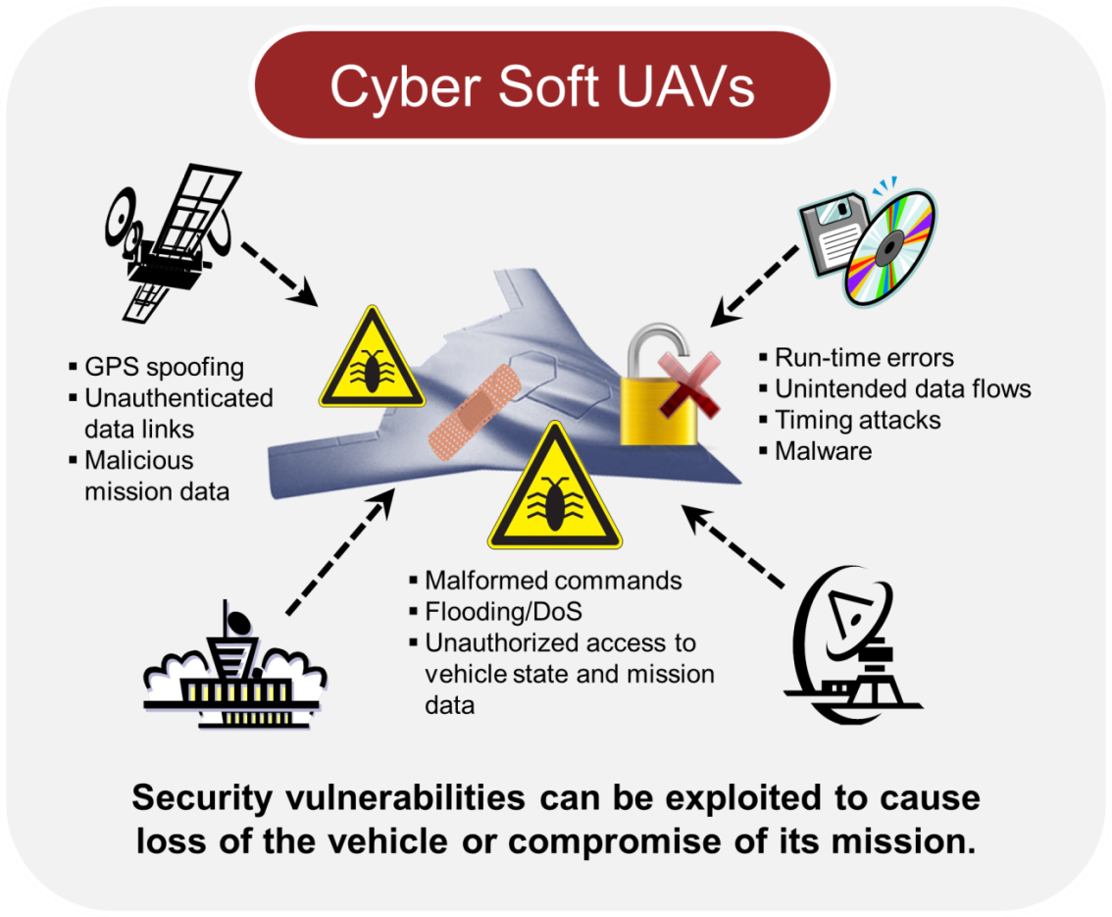

Aircraft may be susceptible to cyber attack
Security vulnerabilities
that can lead to
safety hazards
Growing awareness among customers, regulators, and public
FAA close to issuing new guidance

Slide 5
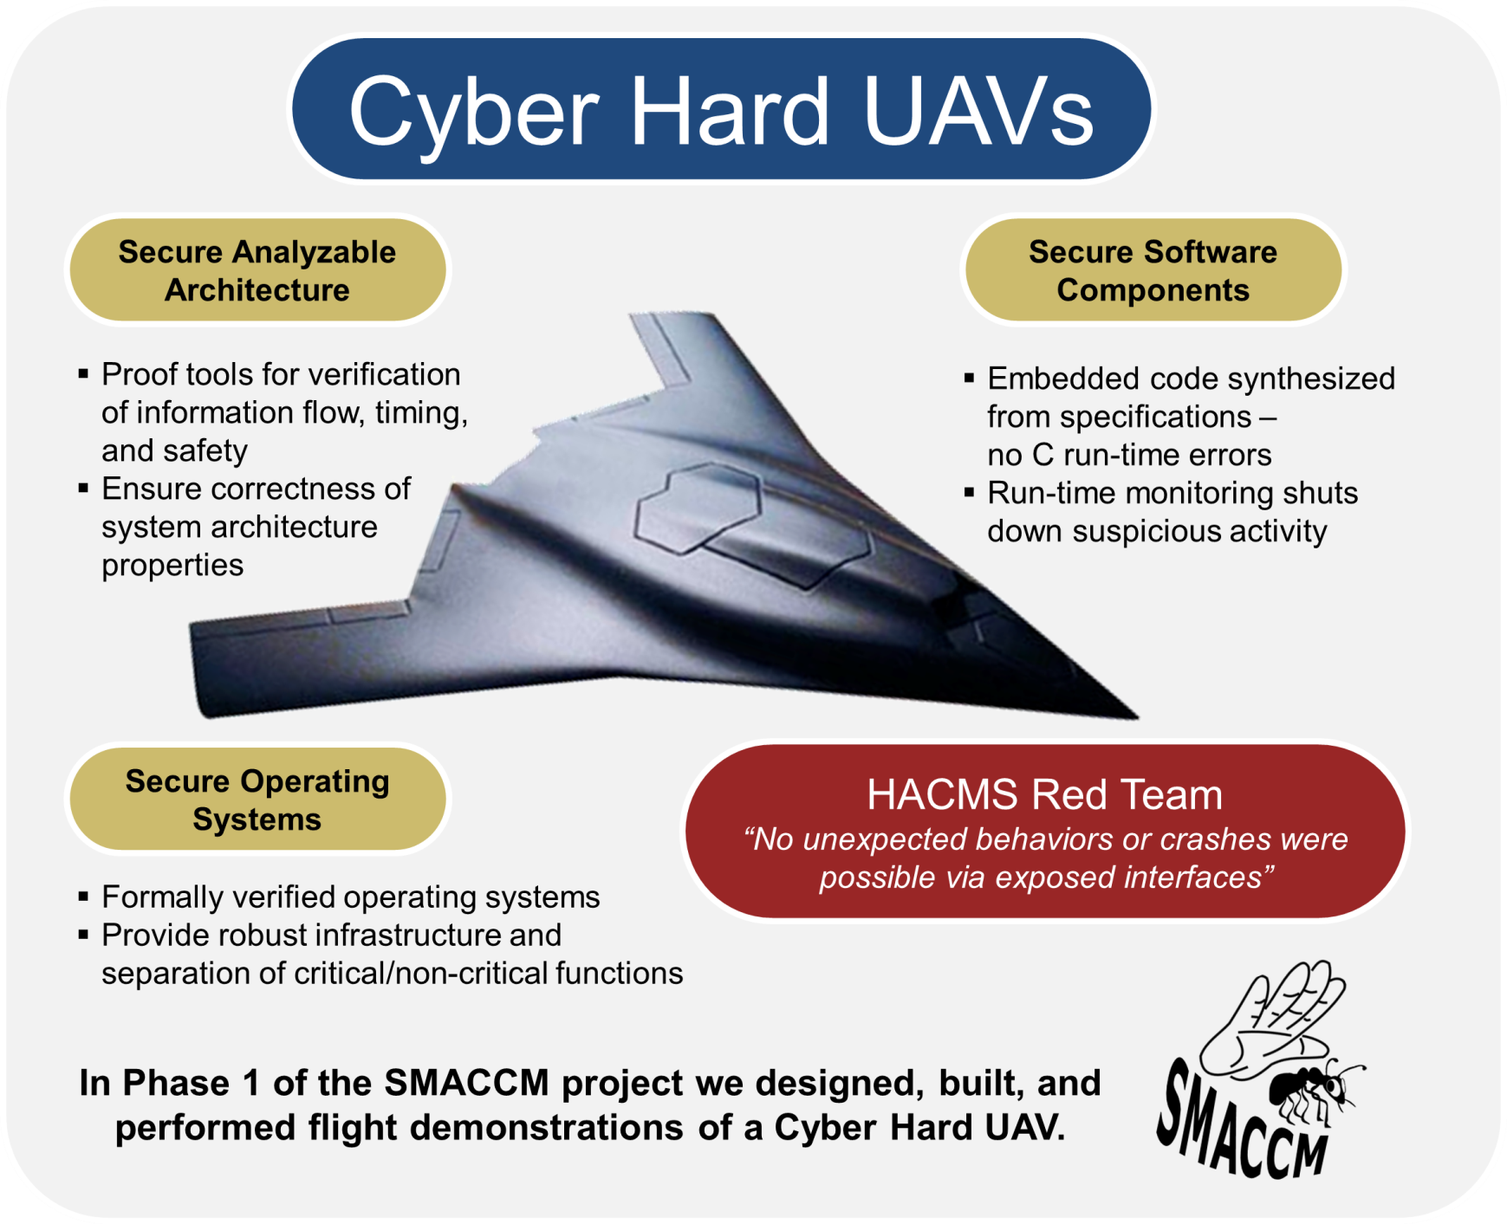
Secure Mathematically Assured Composition of Control Models (SMACCM)

Slide 6
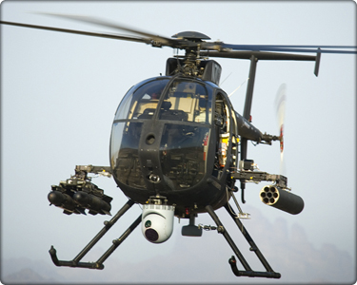
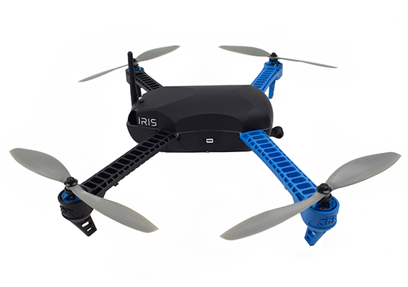
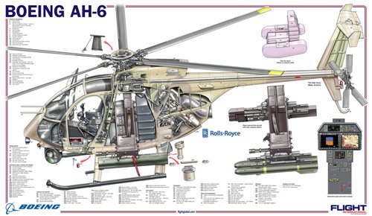
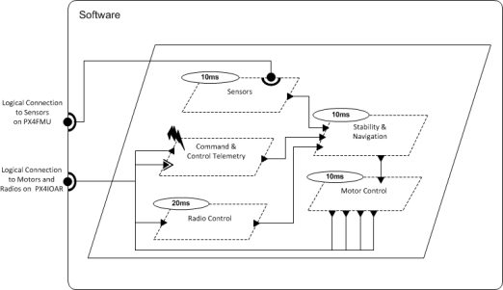
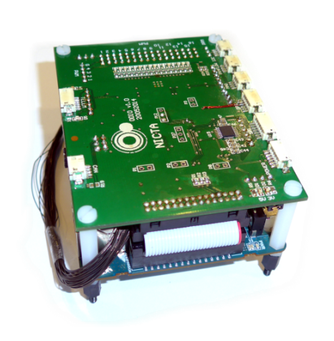
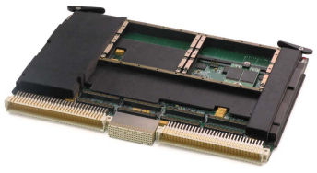
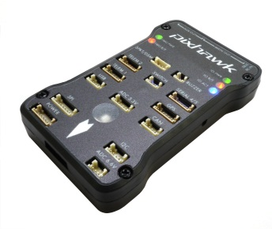
Air Team Platforms
Boeing Unmanned Little Bird (ULB)
AH-6 derivative
3DR IRIS quadcopter
(SMACCMcopter)
/* The STM32F405 has 1024Kb of FLASH beginning at address 0x0800:0000 and
* 192Kb of SRAM. SRAM is split up into three blocks:
*
* 1) 112Kb of SRAM beginning at address 0x2000:0000
* 2) 16Kb of SRAM beginning at address 0x2001:c000
* 3) 64Kb of TCM SRAM beginning at address 0x1000:0000
*
* When booting from FLASH, FLASH memory is aliased to address 0x0000:0000
* where the code expects to begin execution by jumping to the entry point in
* the 0x0800:0000 address range.
*
* HWF4: In the original linker script, the first 0x4000 of flash was
* reserved for the bootloader. For now, we'll place the application
* at the start of flash until we start using a boot loader again.
*/
MEMORY
{
/* flash (rx) : ORIGIN = 0x08004000, LENGTH = 1008K */
flash (rx) : ORIGIN = 0x08000000, LENGTH = 1024K
sram (rwx) : ORIGIN = 0x20000000, LENGTH = 128K
ccsram (rwx) : ORIGIN = 0x10000000, LENGTH = 64K
}
/* Top of the user mode stack. */
_estack = 0x20020000; /* top of 128KiB of SRAM */
/* Error in the linker if heap and stack don't fit. */
_min_heap_size = 0;
_min_stack_size = 0x400;
OUTPUT_ARCH(arm)
ENTRY(Reset_Handler)
/*
* Ensure that abort() is present in the final object. The exception handling
* code pulled in by libgcc.a requires it (and that code cannot be easily avoided).
*/
/* EXTERN(abort) */
New electronics to host provably secure software
Notes:
Discuss HW & SW changes in each vehicle

Slide 7
SMACCM Project Objectives
Develop a complete, formally proven architecture and components for UAVs (and other embedded systems) that provides robustness against cyber attack
Develop compositional verification tools driven from the architecture model for combining formal evidence from multiple sources, components, and subsystems
Prototype these technologies on an open research platform and transition them to a military platform to demonstrate their practicality and effectiveness
Key Problem
Many vulnerabilities occur at component interfaces.
How can we use formal methods to detect these vulnerabilities and build provably secure systems?
Verifiable Security
Not just providing security,
but confidence in and evidence of security
Notes:
The point is not just to build something secure, but to have confidence in and evidence of its security.

Slide 8
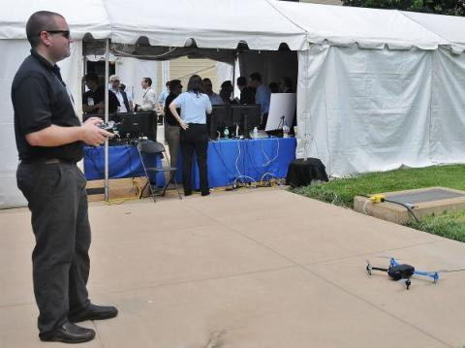
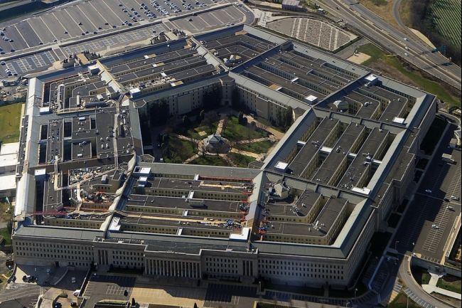
Featured at DARPA I2O Demo Day at Pentagon
100+ Cyber Security and Big Data projects (22 May 2014)
HACMS was one of 4 projects highlighted by DARPA
Flew the SMACCMcopter in the Pentagon courtyard

Slide 9
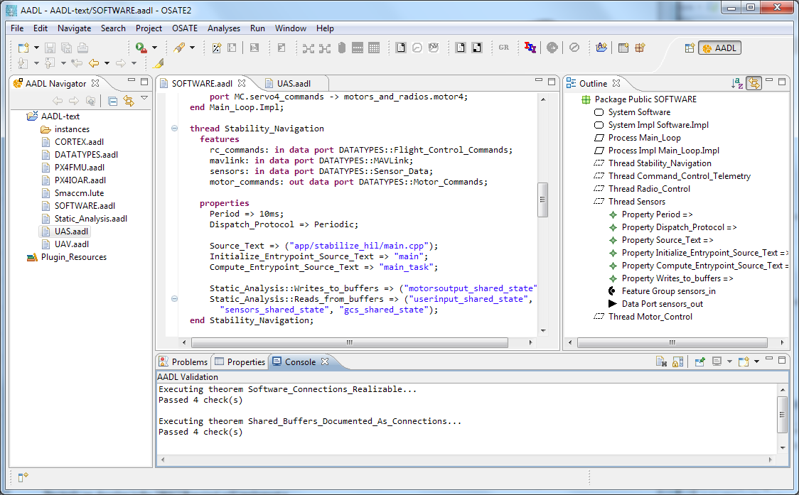

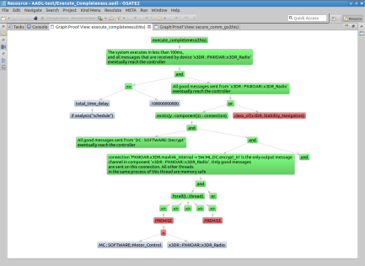
AADL Tools: Formal Methods Workbench
Resolute
OSATE
Assurance Case
AGREE
Trusted
Build
Behavioral Analysis
Lute
Structural
Analysis
Architecture Models
Architecture Translation
Architecture Analysis
A
C
Assumption: Input < 20
Guarantee: Output < 2*Input
Assumption: none
Guarantee: Output = Input1 + Input2
B
seL4
Assumption: Input < 20
Guarantee: Output < Input + 15
Assumption: Input < 10
Guarantee: Output < 50
eChronos
Kind/JKind

Slide 10
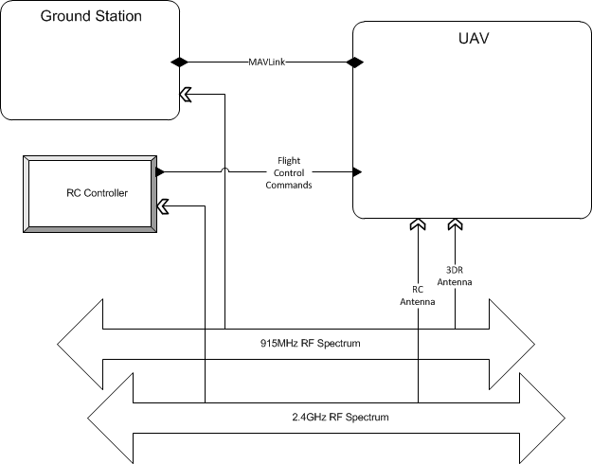
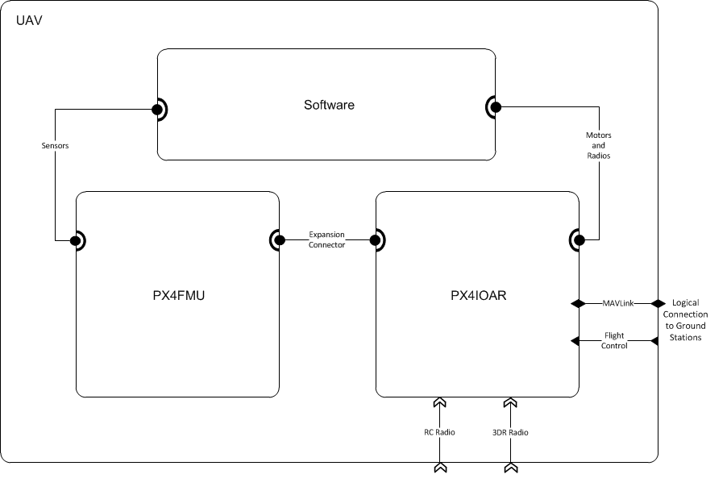

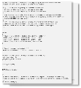
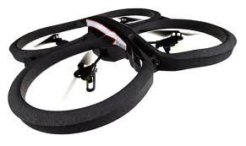
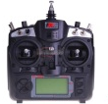
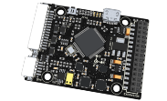
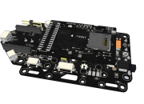
SMACCMcopter Architecture

Slide 11

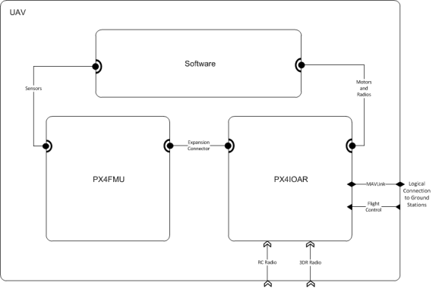
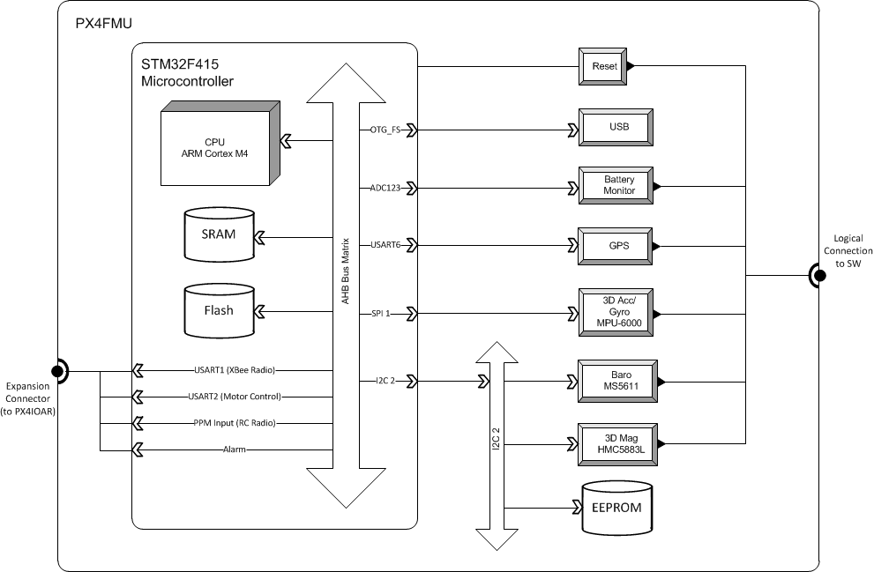
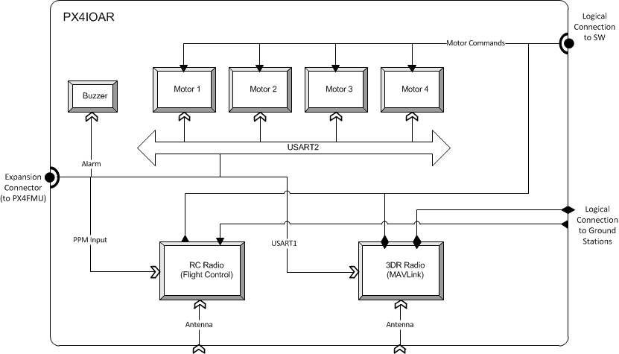
AADL model

Slide 12
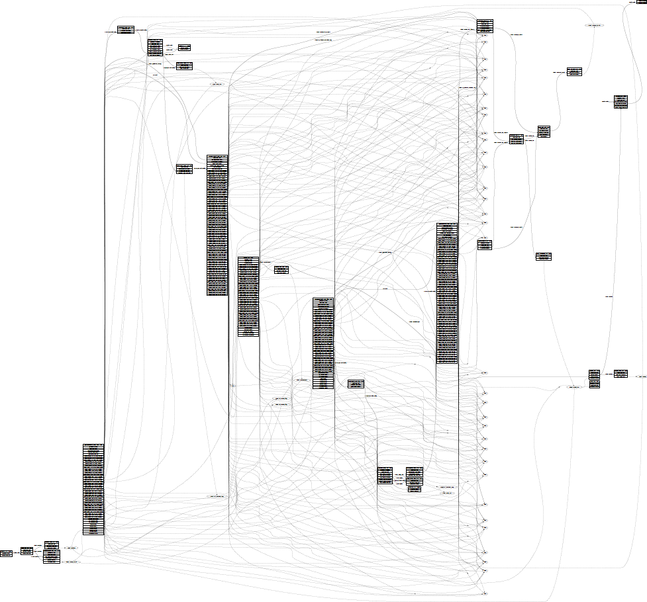
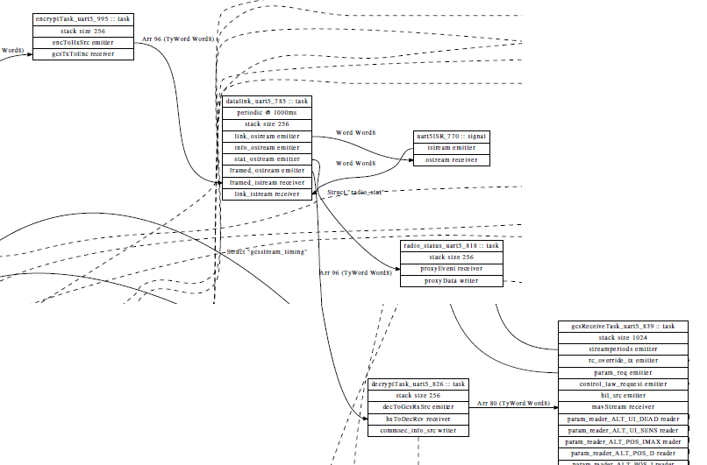
Datalink
Radio UART
GCS Receive
Decrypt

Slide 13
System Analysis Goals
How can we make high-level claims about correctness of the system design?
Can we combine heterogeneous evidence from multiple sources?
  Characteristics of system architecture
  Properties of hardware/software components, operating system
  Analysis results
  Test results
  Development processes

Slide 14
Assurance Case
A reasoned and compelling argument, supported by a body of evidence, that a system, service or organization will operate as intended for a defined application in a defined environment
  GSN community standard V1
A graphical representation of an argument supported by evidence
May address different system aspects
  Safety
  Security
  Correctness

Slide 15
Assurance Cases
Goal Structuring Notation (GSN) is used in several tools
  Goals: claims about the system
  Strategy: argues why a goal is true
  Assumptions
  Solution: leaf level evidence

Slide 16
Assurance Cases
Pro
  Informal
  Can include many different sources of evidence
  Understandable by domain experts
  Captures structure of argument
Con
  Informal
  Not strongly tied to the system design
  Semantics are loose (English is ambiguous)

Slide 17
Assurance Cases
Con
  Informal
  Not strongly tied to the system design
  Semantics are loose (English is ambiguous)
Resolute: An Assurance Case Language for Architecture Models
  Use a logic to generate an assurance case
  Make the structure of the system architecture dictate the structure of the assurance case
  Use an architectural design language with defined semantics (AADL)

Slide 18
Resolute: A Computational Logic for Assurance Cases
Resolute is a logic and implementation for constructing assurance cases
Make the structure of the system architecture dictate the structure of the assurance case
Rules describe possible ways of providing evidence to satisfy a given claim
Resolute constructs an assurance case from the successful claims
Claims may include computations over elements in the AADL model
Resolute annex is an extension of AADL syntax

Slide 19
Resolute Language
Claims and rules for satisfying those claims
Rules and claims parameterized by AADL types
Assurance cases instantiated with elements from AADL model
memory_protected(p : process) <=
** "The memory of process " p " is protected from alterations by other processes" **
property(p, SMACCM::OS) = "SeL4" or
(property(p, SMACCM::OS) = "eChronos" and
forall (mem : memory). bound(p, mem) =>
forall (q : process). bound(q, mem) => memory_safe_process(q))

Slide 20
Resolute Logic
Rules are sufficient but not complete
  No closed world assumption (similar to other logic programing languages)
This means a claim can never be used in a negative context
  “The absence of evidence is not evidence of absence”
Resolute supports computations which can be used in a negative context
memory_protected(p : process) <=
** "The memory of process " p " is protected from alterations by other processes" **
property(p, SMACCM::OS) = "SeL4" or
(property(p, SMACCM::OS) = "eChronos" and
forall (mem : memory). bound(p, mem) =>
forall (q : process). bound(q, mem) => memory_safe_process(q))

Slide 21
Tool Environment
Implemented as an annex in AADL
Uses Xtext to work fluidly in OSATE
process implementation Main_Loop.Impl
subcomponents
SS: thread Sensors;
CCT: thread Command_Control_Telemetry;
RC: thread Radio_Control;
SN: thread Stability_Navigation;
MC: thread Motor_Control;
DC: thread Decrypt;
annex resolute {**
prove only_receive_gs(this.MC)
prove schedulable(this)
**};
end Main_Loop.Impl;

Slide 22
memory_protected(p : process) <=
** "The memory of process " p " is protected
from alterations by other processes" **
property(p, SMACCM::OS) = "SeL4" or
(property(p, SMACCM::OS) = "eChronos" and
forall (mem : memory). bound(p, mem) =>
forall (q : process). bound(q, mem) => memory_safe_process(q))
memory_safe_process(p : process) <=
** "The process " p " only writes to its own memory space" **
forall (t : thread). contained(t, p) => memory_safe_thread(t)
memory_safe_thread(t : thread) <=
** "The thread " t " only writes to its own memory space" **
ivory_thread(t)
ivory_thread(t : thread) <=
** "The thread " t " is generated from Ivory" **
property(t, SMACCM::Language) = "Ivory"

Slide 23
Process “System.Proc1” protected from other processes
memory_protected(p : process) <=
** "The memory of process " p " is protected
from alterations by other processes" **
property(p, SMACCM::OS) = "SeL4" or
(property(p, SMACCM::OS) = "eChronos" and
forall (mem : memory). bound(p, mem) =>
forall (q : process). bound(q, mem) => memory_safe_process(q))
memory_safe_process(p : process) <=
** "The process " p " only writes to its own memory space" **
forall (t : thread). contained(t, p) => memory_safe_thread(t)
memory_safe_thread(t : thread) <=
** "The thread " t " only writes to its own memory space" **
ivory_thread(t)
ivory_thread(t : thread) <=
** "The thread " t " is generated from Ivory" **
property(t, SMACCM::Language) = "Ivory"

Slide 24
Process “System.Proc1” protected from other processes
Process “System.Proc1” Writes to own memory
memory_protected(p : process) <=
** "The memory of process " p " is protected
from alterations by other processes" **
property(p, SMACCM::OS) = "SeL4" or
(property(p, SMACCM::OS) = "eChronos" and
forall (mem : memory). bound(p, mem) =>
forall (q : process). bound(q, mem) => memory_safe_process(q))
memory_safe_process(p : process) <=
** "The process " p " only writes to its own memory space" **
forall (t : thread). contained(t, p) => memory_safe_thread(t)
memory_safe_thread(t : thread) <=
** "The thread " t " only writes to its own memory space" **
ivory_thread(t)
ivory_thread(t : thread) <=
** "The thread " t " is generated from Ivory" **
property(t, SMACCM::Language) = "Ivory"

Slide 25
Process “System.Proc1” protected from other processes
Process “System.Proc1” Writes to own memory
“System.Proc1.Thread1” Writes to own memory
memory_protected(p : process) <=
** "The memory of process " p " is protected
from alterations by other processes" **
property(p, SMACCM::OS) = "SeL4" or
(property(p, SMACCM::OS) = "eChronos" and
forall (mem : memory). bound(p, mem) =>
forall (q : process). bound(q, mem) => memory_safe_process(q))
memory_safe_process(p : process) <=
** "The process " p " only writes to its own memory space" **
forall (t : thread). contained(t, p) => memory_safe_thread(t)
memory_safe_thread(t : thread) <=
** "The thread " t " only writes to its own memory space" **
ivory_thread(t)
ivory_thread(t : thread) <=
** "The thread " t " is generated from Ivory" **
property(t, SMACCM::Language) = "Ivory"

Slide 26
Process “System.Proc1” protected from other processes
Process “System.Proc1” Writes to own memory
“System.Proc1.Thread1” Writes to own memory
“System.Proc1.Thread1” Written in Ivory
memory_protected(p : process) <=
** "The memory of process " p " is protected
from alterations by other processes" **
property(p, SMACCM::OS) = "SeL4" or
(property(p, SMACCM::OS) = "eChronos" and
forall (mem : memory). bound(p, mem) =>
forall (q : process). bound(q, mem) => memory_safe_process(q))
memory_safe_process(p : process) <=
** "The process " p " only writes to its own memory space" **
forall (t : thread). contained(t, p) => memory_safe_thread(t)
memory_safe_thread(t : thread) <=
** "The thread " t " only writes to its own memory space" **
ivory_thread(t)
ivory_thread(t : thread) <=
** "The thread " t " is generated from Ivory" **
property(t, SMACCM::Language) = "Ivory"

Slide 27
Process “System.Proc1” protected from other processes
Process “System.Proc1” Writes to own memory
“System.Proc1.Thread1” Writes to own memory
“System.Proc1.Thread2” Writes to own memory
“System.Proc1.Thread1” Written in Ivory
memory_protected(p : process) <=
** "The memory of process " p " is protected
from alterations by other processes" **
property(p, SMACCM::OS) = "SeL4" or
(property(p, SMACCM::OS) = "eChronos" and
forall (mem : memory). bound(p, mem) =>
forall (q : process). bound(q, mem) => memory_safe_process(q))
memory_safe_process(p : process) <=
** "The process " p " only writes to its own memory space" **
forall (t : thread). contained(t, p) => memory_safe_thread(t)
memory_safe_thread(t : thread) <=
** "The thread " t " only writes to its own memory space" **
ivory_thread(t)
ivory_thread(t : thread) <=
** "The thread " t " is generated from Ivory" **
property(t, SMACCM::Language) = "Ivory"

Slide 28
Process “System.Proc1” protected from other processes
Process “System.Proc1” Writes to own memory
“System.Proc1.Thread1” Writes to own memory
“System.Proc1.Thread2” Writes to own memory
“System.Proc1.Thread1” Written in Ivory
“System.Proc1.Thread2” Written in Ivory
memory_protected(p : process) <=
** "The memory of process " p " is protected
from alterations by other processes" **
property(p, SMACCM::OS) = "SeL4" or
(property(p, SMACCM::OS) = "eChronos" and
forall (mem : memory). bound(p, mem) =>
forall (q : process). bound(q, mem) => memory_safe_process(q))
memory_safe_process(p : process) <=
** "The process " p " only writes to its own memory space" **
forall (t : thread). contained(t, p) => memory_safe_thread(t)
memory_safe_thread(t : thread) <=
** "The thread " t " only writes to its own memory space" **
ivory_thread(t)
ivory_thread(t : thread) <=
** "The thread " t " is generated from Ivory" **
property(t, SMACCM::Language) = "Ivory"

Slide 29
Process “System.Proc1” protected from other processes
Process “System.Proc1” Writes to own memory
Process “System.Proc2” Writes to own memory
“System.Proc1.Thread1” Writes to own memory
“System.Proc1.Thread2” Writes to own memory
“System.Proc1.Thread1” Written in Ivory
“System.Proc1.Thread2” Written in Ivory
memory_protected(p : process) <=
** "The memory of process " p " is protected
from alterations by other processes" **
property(p, SMACCM::OS) = "SeL4" or
(property(p, SMACCM::OS) = "eChronos" and
forall (mem : memory). bound(p, mem) =>
forall (q : process). bound(q, mem) => memory_safe_process(q))
memory_safe_process(p : process) <=
** "The process " p " only writes to its own memory space" **
forall (t : thread). contained(t, p) => memory_safe_thread(t)
memory_safe_thread(t : thread) <=
** "The thread " t " only writes to its own memory space" **
ivory_thread(t)
ivory_thread(t : thread) <=
** "The thread " t " is generated from Ivory" **
property(t, SMACCM::Language) = "Ivory"

Slide 30
Process “System.Proc1” protected from other processes
Process “System.Proc1” Writes to own memory
Process “System.Proc2” Writes to own memory
“System.Proc1.Thread1” Writes to own memory
“System.Proc1.Thread2” Writes to own memory
“System.Proc1.Thread1” Written in Ivory
“System.Proc1.Thread2” Written in Ivory
memory_protected(p : process) <=
** "The memory of process " p " is protected
from alterations by other processes" **
property(p, SMACCM::OS) = "SeL4" or
(property(p, SMACCM::OS) = "eChronos" and
forall (mem : memory). bound(p, mem) =>
forall (q : process). bound(q, mem) => memory_safe_process(q))
memory_safe_process(p : process) <=
** "The process " p " only writes to its own memory space" **
forall (t : thread). contained(t, p) => memory_safe_thread(t)
memory_safe_thread(t : thread) <=
** "The thread " t " only writes to its own memory space" **
ivory_thread(t)
ivory_thread(t : thread) <=
** "The thread " t " is generated from Ivory" **
property(t, SMACCM::Language) = "Ivory"
“System.Proc2.Thread3” Writes to own memory

Slide 31
Process “System.Proc1” protected from other processes
Process “System.Proc1” Writes to own memory
Process “System.Proc2” Writes to own memory
“System.Proc1.Thread1” Writes to own memory
“System.Proc1.Thread2” Writes to own memory
“System.Proc1.Thread1” Written in Ivory
“System.Proc1.Thread2” Written in Ivory
memory_protected(p : process) <=
** "The memory of process " p " is protected
from alterations by other processes" **
property(p, SMACCM::OS) = "SeL4" or
(property(p, SMACCM::OS) = "eChronos" and
forall (mem : memory). bound(p, mem) =>
forall (q : process). bound(q, mem) => memory_safe_process(q))
memory_safe_process(p : process) <=
** "The process " p " only writes to its own memory space" **
forall (t : thread). contained(t, p) => memory_safe_thread(t)
memory_safe_thread(t : thread) <=
** "The thread " t " only writes to its own memory space" **
ivory_thread(t)
ivory_thread(t : thread) <=
** "The thread " t " is generated from Ivory" **
property(t, SMACCM::Language) = "Ivory"
“System.Proc2.Thread3” Writes to own memory
“System.Proc2.Thread3” Written in Ivory

Slide 32
Failed Assurance Cases
Unlike traditional assurance cases, Resolute can produce a failed assurance case
  Claims that are false are shown in red so the assurance case can be debugged
Failures may occur if the architecture changes, or if external analysis fails

Slide 33
Process “System.Proc1” protected from other processes
Process “System.Proc1” Writes to own memory
Process “System.Proc2” Writes to own memory
“System.Proc1.Thread1” Writes to own memory
“System.Proc1.Thread2” Writes to own memory
“System.Proc1.Thread1” Written in Ivory
“System.Proc1.Thread2” Written in Ivory
memory_protected(p : process) <=
** "The memory of process " p " is protected
from alterations by other processes" **
property(p, SMACCM::OS) = "SeL4" or
(property(p, SMACCM::OS) = "eChronos" and
forall (mem : memory). bound(p, mem) =>
forall (q : process). bound(q, mem) => memory_safe_process(q))
memory_safe_process(p : process) <=
** "The process " p " only writes to its own memory space" **
forall (t : thread). contained(t, p) => memory_safe_thread(t)
memory_safe_thread(t : thread) <=
** "The thread " t " only writes to its own memory space" **
ivory_thread(t)
ivory_thread(t : thread) <=
** "The thread " t " is generated from Ivory" **
property(t, SMACCM::Language) = "Ivory"
“System.Proc2.Thread3” Writes to own memory
“System.Proc2.Thread3” Written in Ivory

Slide 34
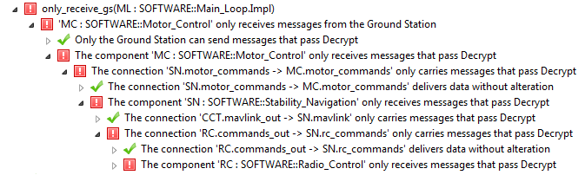
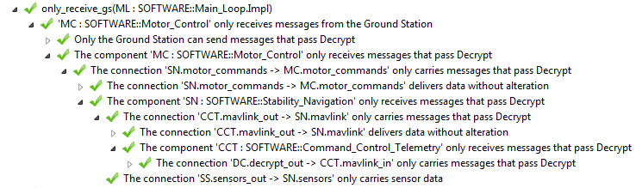
Analysis Results
Failed assurance case
Successful assurance case

Slide 35
Properties from SMACCM Project
Attacker A
Vehicle
Attacker
Comm
Internal bus
command
Unknown credentials
Wireless network
Mission computer
Flight computer
Comm
Decrypt
Validate
Control Laws
Ground Station
Key
User
command
Encrypt
Actuator
Key
The motor controller only receives messages from the trusted ground station.
All messages received by the radio reach the motor controller.
All connections are accurate/non-bypassable.
  Requires memory-safety

Slide 36
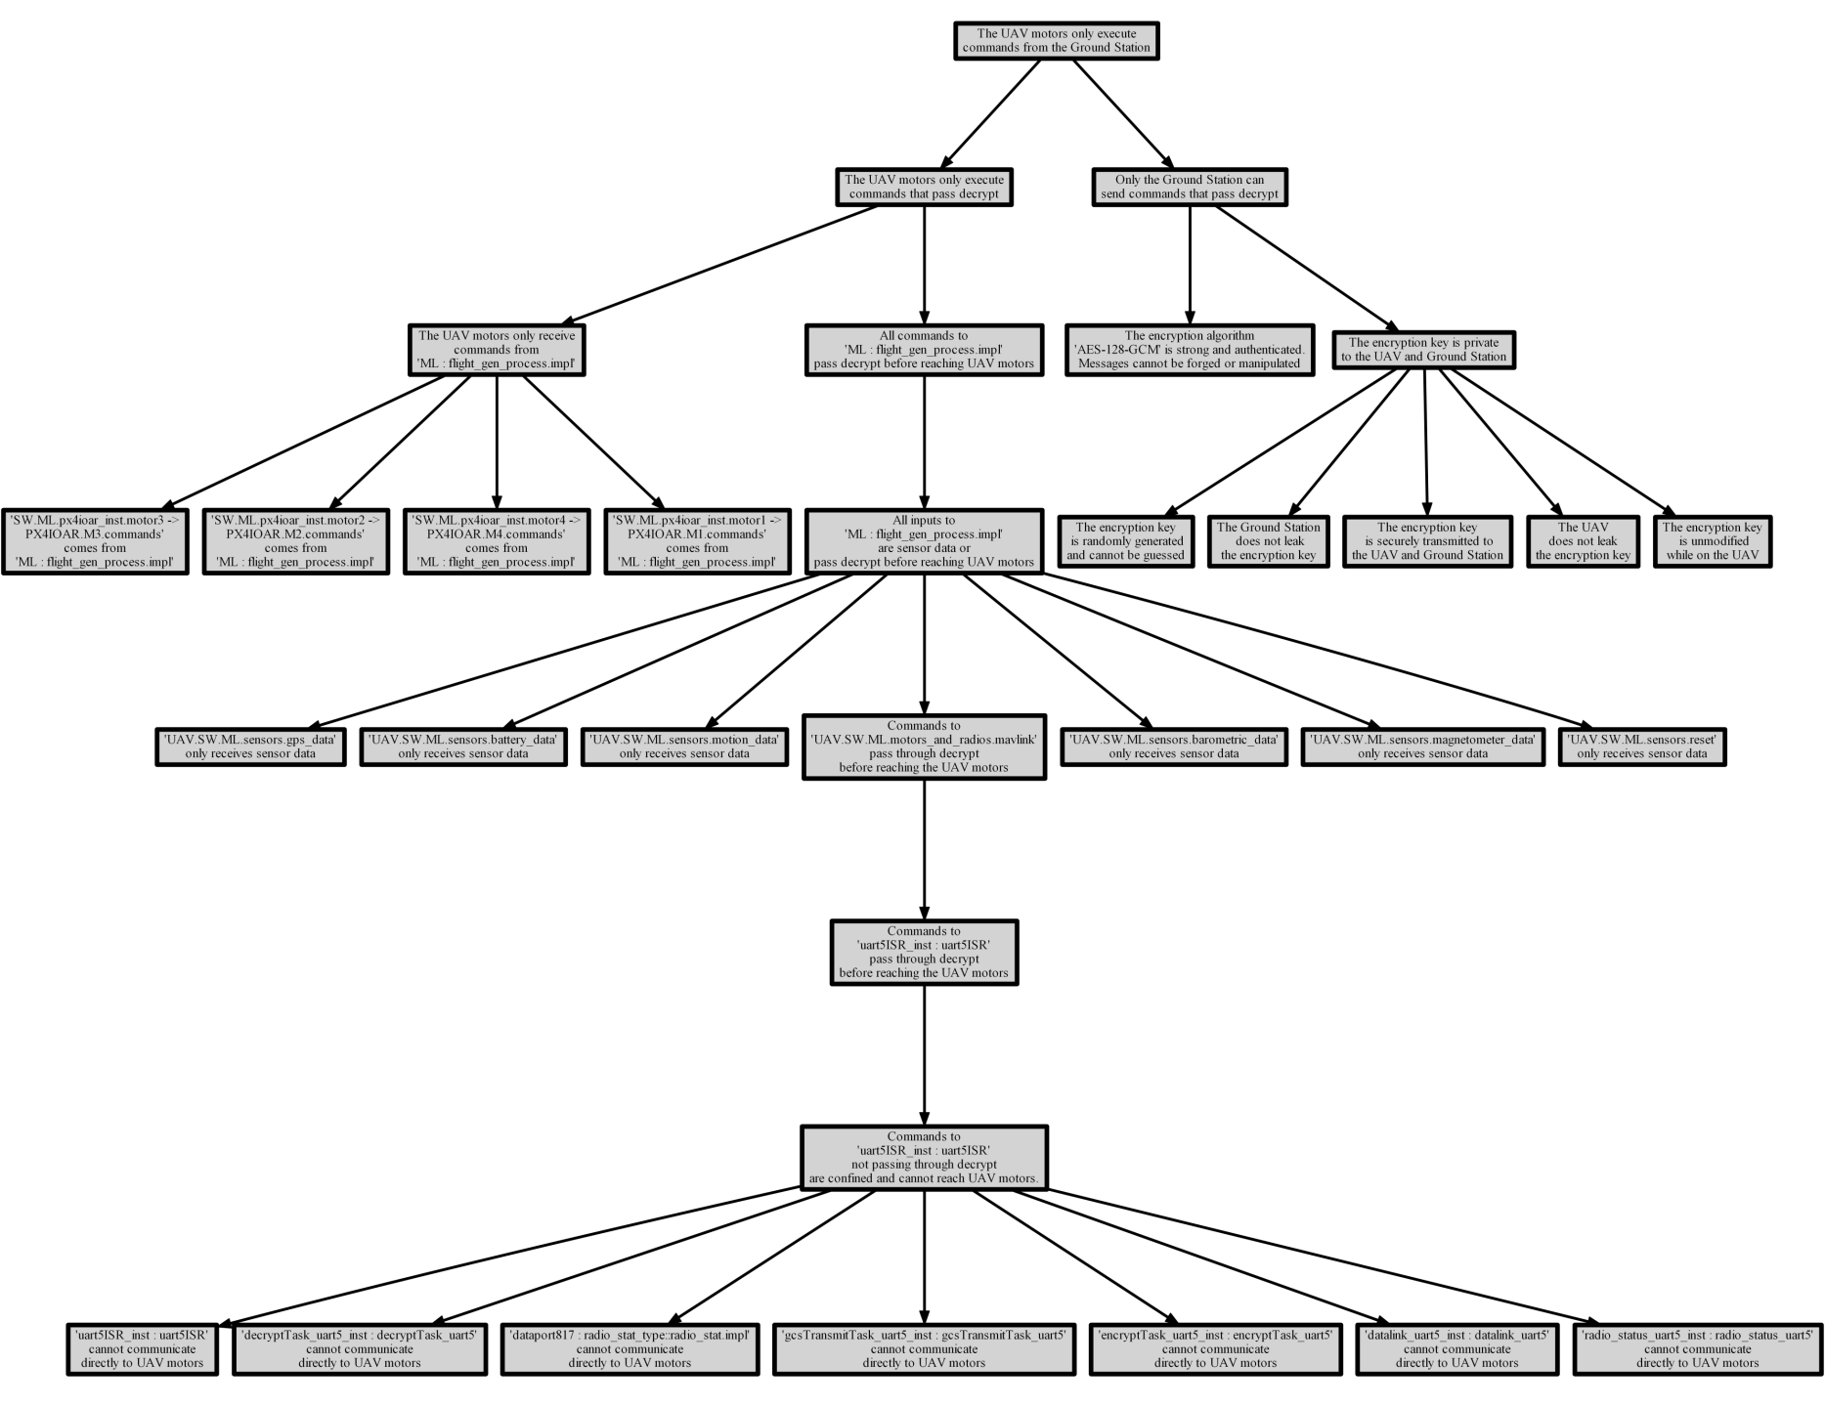
Secure Delivery
UAV motors only execute
commands from the ground station
Proper use of
encryption
Classification of inputs
Threads before
authentication

Slide 37
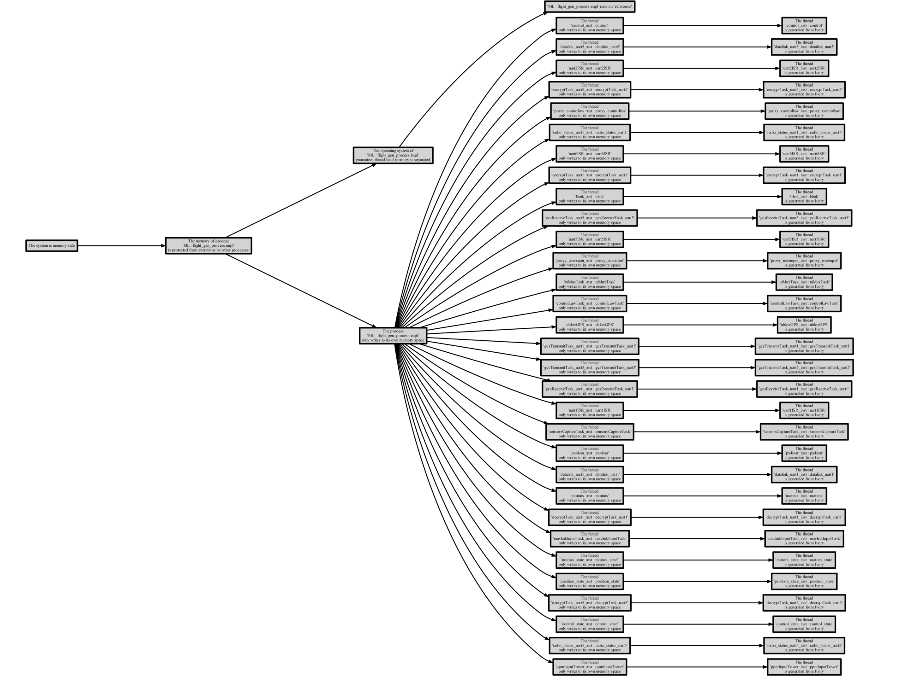
Memory Safety
Thread only writes to to its own memory space
Thread local state protected by
RTOS
Requires guarantees from eChronos RTOS and Ivory-Tower component generation

Slide 38
Future Work
Integration with other assurance case tools
  We currently support CertWare
Support for other GSN types
Integration with other AADL analyses
  Internal: Schedulability, Fault Analysis
  External: HOL, SMT Solvers
Support for other AADL semantics

Slide 39
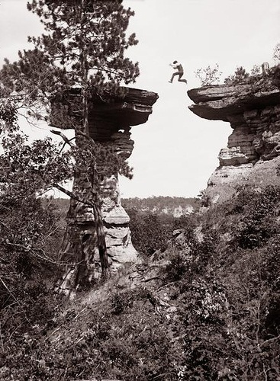
Formal Methods
Case Studies for
DO-333
New certification standards provide guidance for using formal methods to meet certification objectives
But current certification practice and industry experience is based on testing
Provide concrete examples to illustrate how it’s done

Slide 40
Application of Formal Methods in Software Verification Process
Case Study:
Theorem Proving
Case Study:
Model Checking
Case Study:
Abstract Interpretation

Slide 41
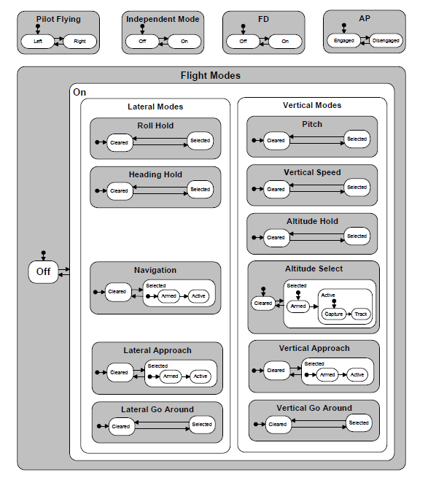
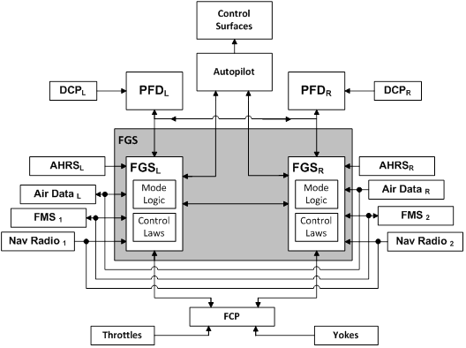
Example: Dual-Channel Flight Guidance System
Mode Logic
Model Checking
Simulink/Stateflow
SLDV and
Gryphon/Kind
Flight Guidance System
Pilot Flying Protocol
Theorem Proving
PVS and HOL4
Heading Control
Abstract Interpretation
C source code
Polyspace and Astrée

Slide 42
Tool Qualification?
REQTS
MODEL CHECKER
REQTS
MODEL CHECKER
PROOF
PROOF CHECKER
MODEL
MODEL
T/F
T/F
OK?
DO-330: “Software Tool Qualification Considerations”
What does this look like for formal methods tools?
NASA project just started…

Slide 43
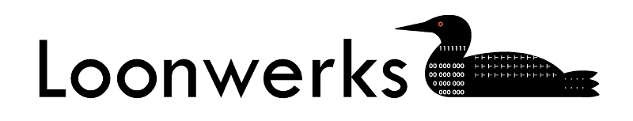
More information, code, papers available at:
Loonwerks.com

