Slide 1

A Control-theoretic View
of AI for Security
David L. Roberts
Acknowledgements to: Rob St. Amant, Ignacio X. Domínguez,
Jayant Dhawan, Alok Goel, Andrew Buff,
Arpan Chakroborty, Brent Harrison

Slide 2

Two Faces of the CIIGAR Lab
Computational Intelligence and Interactive GAmes Research
Canine Instruction with Instrumented Gadgets Administering Rewards

Slide 3
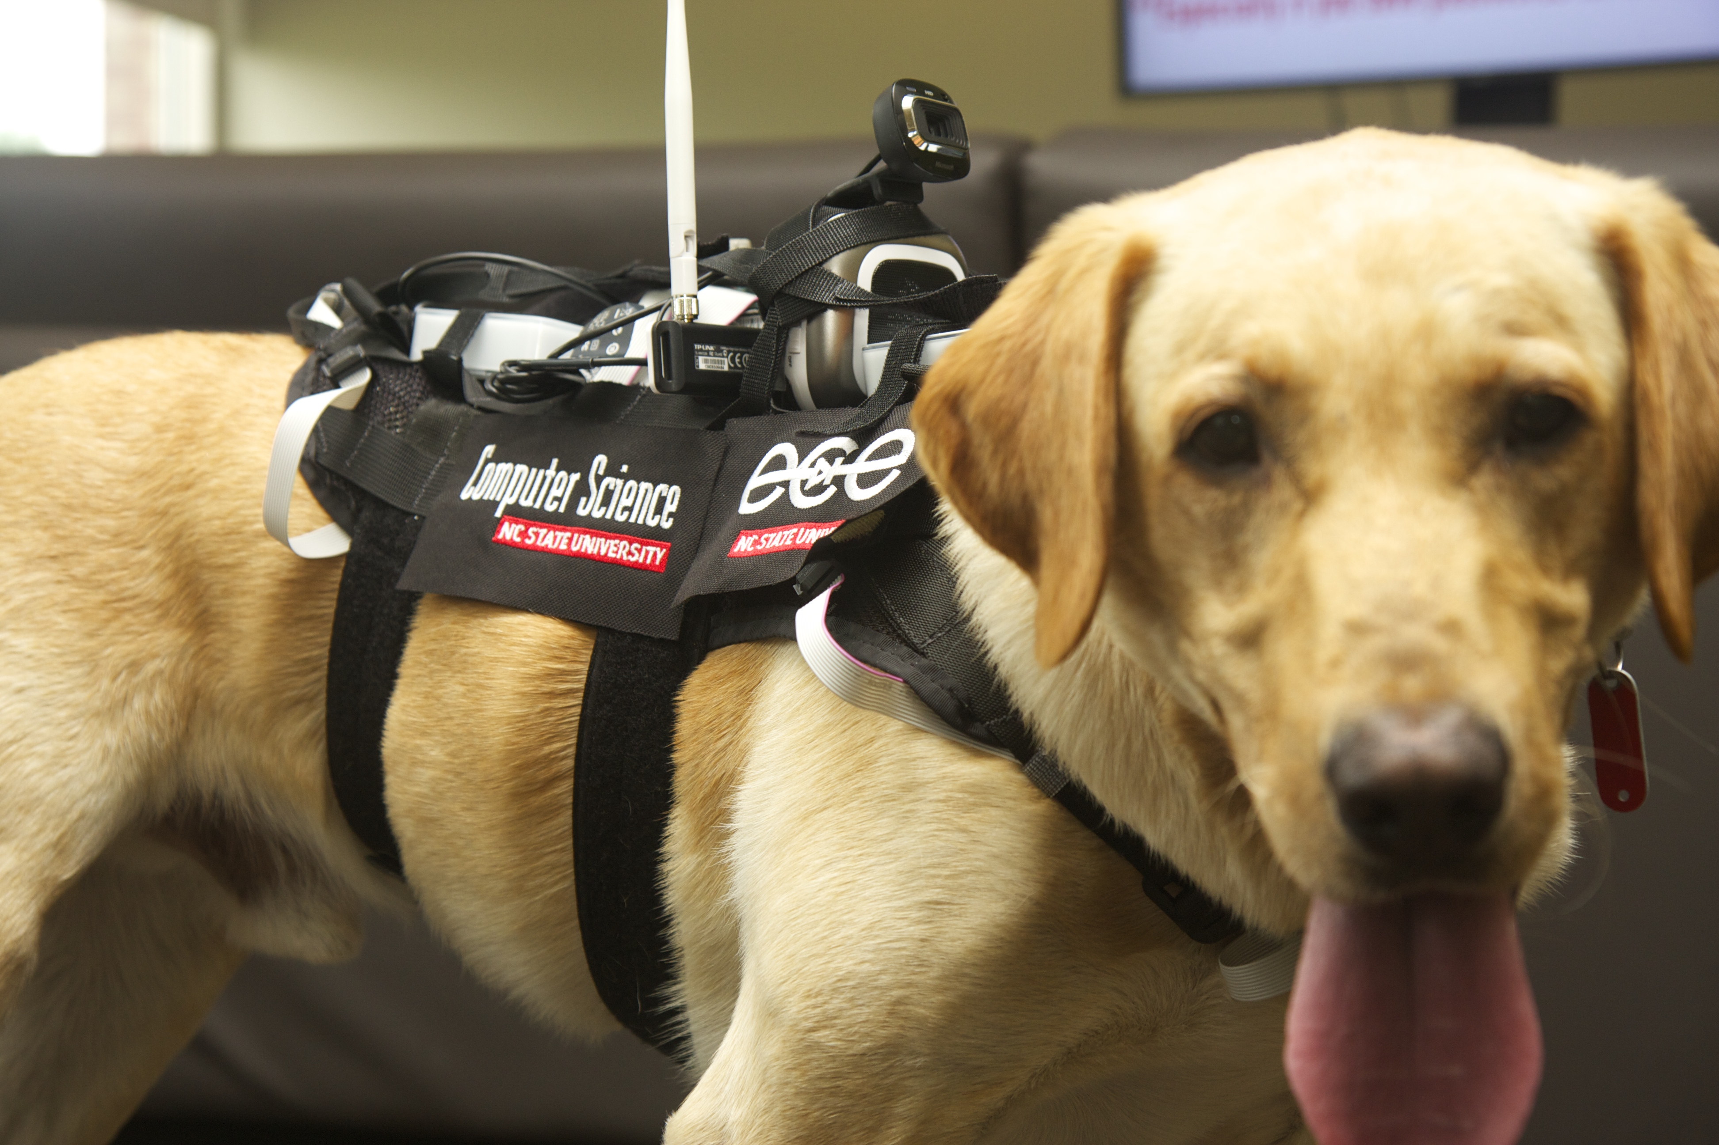
Dogs!

Slide 4
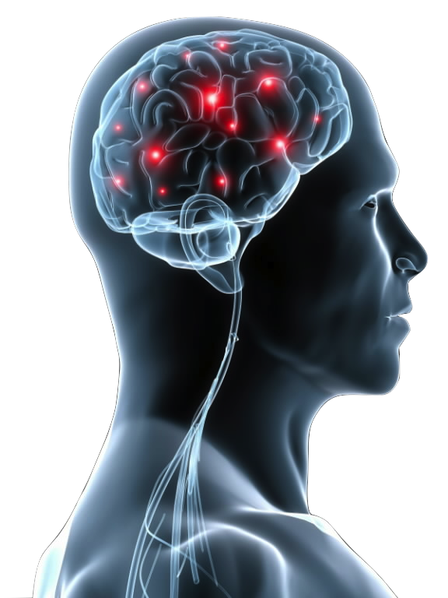
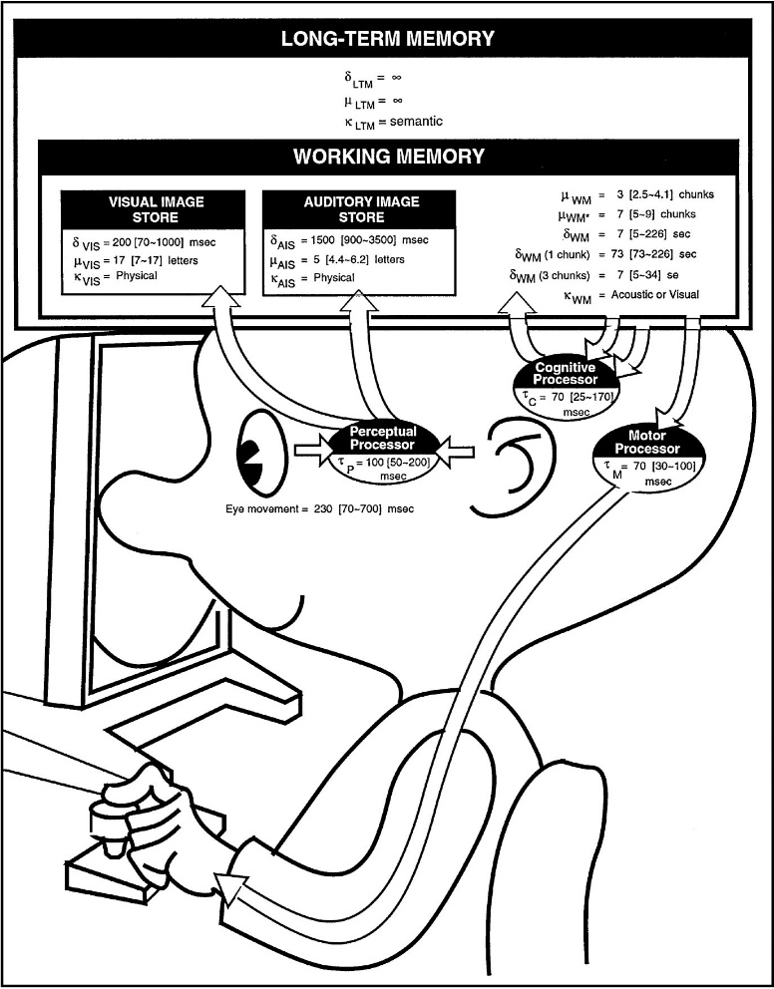
Games
The way we behave and things we do on computers can serve as a window into our personality or our mind.

Slide 5
“Much Can be Learned….”
Personality judgment based on
  Offices and Bedrooms [Gosling et. al.]
  Websites [Vazire & Gosling]
Can we learn about people by observing how they interact virtually?
Gosling, S. D., Ko, S. J., Mannarelli, T., & Morris, M. E. (2002). A room with a cue: personality judgments based on offices and bedrooms. Journal of personality and social psychology, 82(3), 379.
Vazire, S., & Gosling, S. D. (2004). e-Perceptions: personality impressions based on personal websites. Journal of personality and social psychology, 87(1), 123.

Slide 6
What This Talk is About
Securing systems through making careful manipulations that produce predictable and measurable changes in user behavior.

Slide 7
What This Talk is About
A way of describing the use of AI for security proofs
A way of contextualizing the technical challenges to realizing those proofs
A request for feedback

Slide 8
Security Context
Abnormal:¹
  Different from what is normal or average
  Unusual, especially in a way that causes problems
Practical examples of abnormal behavior detection:
  Bots
  Intrusion
  Not proper attention to the task
¹ "abnormal." Merriam-Webster.com. 2015.
http://www.merriam-webster.com (6 Apr 2015).

Slide 9
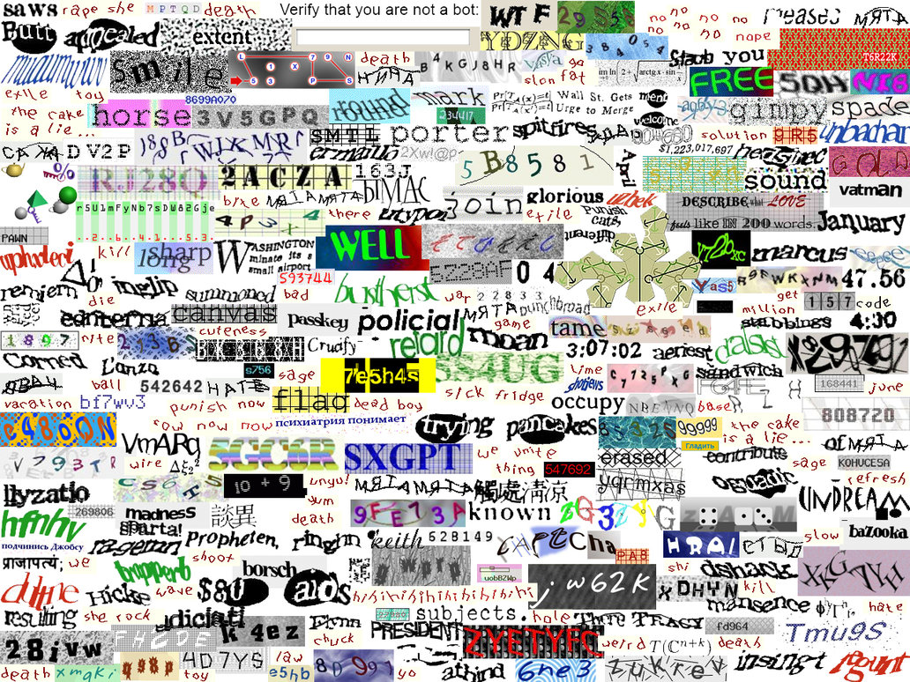
Human Interactive Proofs (HIPs)
Completely Automated Public Turing test to tell Computers and Humans Apart (CAPTCHA)
Disruptive
Adds cognitive burden to the user
Single-point check
Not applicable to every domain

Slide 10
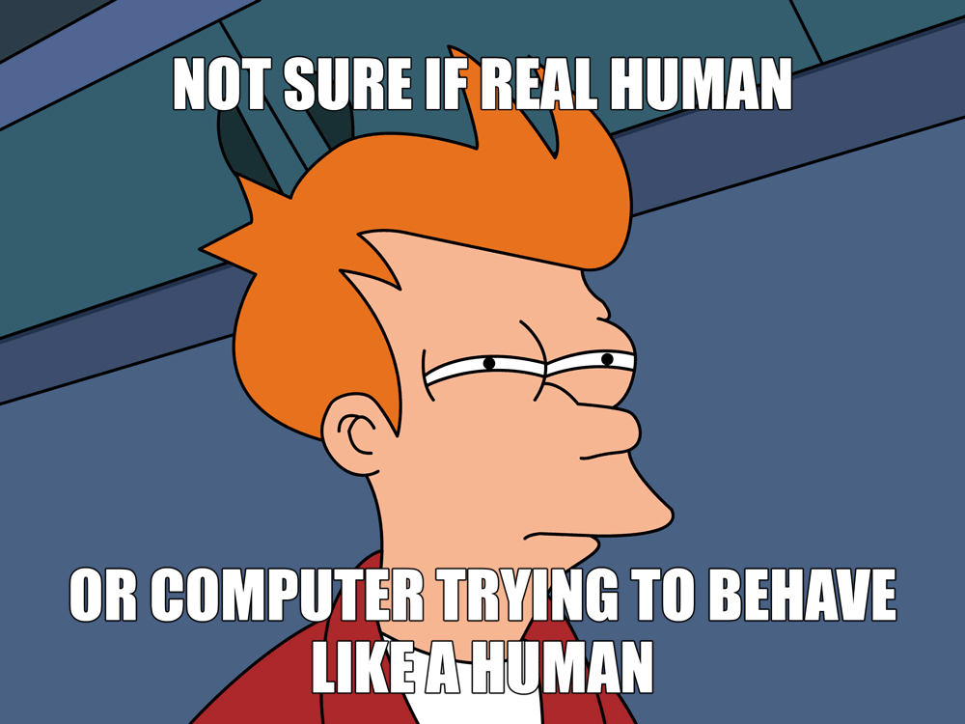
Human Observational Proofs (HOPs)
Observe behavior to make sure it looks like something a human would produce
Problems solved:
  Unobtrusive
  Constant

Slide 11
HOP Architecture
Measured
Error
System
output
Example: Intrusion Detection
  System output: user interactions
  Sensor: security logs
  Detector: compare logs to examples of acceptable use
Reference
Detector
System
Measured State
Sensor

Slide 12
Control-theoretic Architecture
Measured
Error
System
input
System
output
Reference
Controller
System
Measured State
Sensor
Control theory is an engineering method that deals with the
behavior of dynamical systems with inputs, and how their
behavior is modified by feedback.
Source: https://en.wikipedia.org/wiki/Control_theory
Notes:
Examples include: HVAC systems, cruise control, autopilot

Slide 13
Definitions
Controlable: a system can be forced into a state using a control signal
Observable: output measurements characterize the state of the system

Slide 14
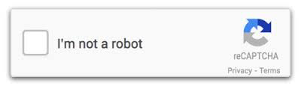
Security Example: HIPs
Passwords
CAPTCHAs
Biometrics
Reference
(known
answer)
Measured
Error
Screen
Prompt
User
Input
Controller
User
Measured State
Interface device

Slide 15
A Subtle Point
Research in psychology, HCI, and related fields tells us that human behavior can be predicted, influenced, and measured; those characteristics provide a security advantage given the right data, analytics, and models.

Slide 16
Control-theoretic Definitions
(for Security)
Controlable: a user can be influenced, using a control signal, to perform a specific task in a specific way
Observable: measurements characterize the state of the user while performing a task

Slide 17
Security Example: Subtlety Proofs
Leverage unique characteristics of human interaction
tendencies to produce changes in task performance
Cognition, decision making, etc.
Reference
(Model)
Measured
Error
Interface
manipulation
User
Input
Model-
Based AI
User
Measured Sate
Interface device

Slide 18
Human Subtlety Proofs (HSPs)
Expand on HIPs and HOPs
Best of both worlds:
  More precise like HIPs
  Un- (or less-)obtrusive like HOPs

Slide 19
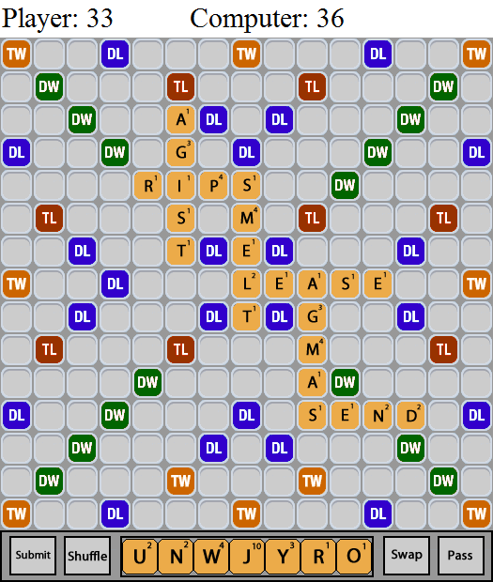
Example: Mouse Click Locations
Click
Unclick
Goal: Bot detection
Data/Analytics:
  Mouse click location
  Mouse unclick location
Manipulations:
  Move button
  Provide data that requires different operation
Reference
(Model)
Measured
Error
Model-
Based AI
Interface
manipulation
User
Input
User
Measured Sate
Interface device

Slide 20
Example: Search vs. Recall
Memory Task
Visual Search Task
Goal: Task attention
Data/Analytics
  Mouse location
  Mouse movement
Manipulations
  Reveal targets
  Hide targets
Reference
(Model)
Measured
Error
Model-
Based AI
Interface
manipulation
User
Input
User
Measured Sate
Interface device

Slide 21
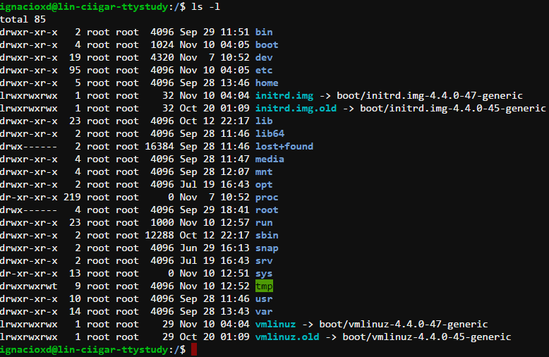
Example: Typing
Goals:
  Promote focus
  Reduce distraction
Data/Analytics:
  Keystroke timings
  Eye tracking
Manipulations:
  Color
  Timing delays
  Character changes
Reference
(Model)
Measured
Error
Model-
Based AI
Interface
manipulation
User
Input
User
Measured Sate
Interface device

Slide 22
Takeaway
One fundamental task in AI for security is to develop control-theoretic methods that enable systems to use analytics to reason about how users complete tasks and identify evidence of departures from normal behavior using control feedback to influence task conditions.

Slide 23
Computational Intelligence and Interactive GAmes Research
Canine Instruction with Instrumented Gadgets Administering Rewards
Dr. David L. Roberts
robertsd@csc.ncsu.edu
http://ciigar.csc.ncsu.edu/

