Slide 1
C3E DNS Challenge Report
Scott McMillan (presenter),
Naomi Anderson, Jonathan Chu, Derrick Karimi, Andrew Mellinger, David Shepard, Eric Werner
Emerging Technology Center
Software Engineering Institute
Carnegie Mellon University
Pittsburgh, PA 15213
January 13, 2013
Notes:
C3E – Computational Cybersecurity in Compromised Environments

Slide 2
Our Team
Emerging Technology Center @ The Software Engineering Institute
  Data-intensive computing (“Big Data”) expertise
  Minimal cybersecurity domain expertise (i.e. not CERT)
  “Do tank”
Goals
  Build stuff! (tools and techniques)
  Demonstrate rapid technology prototyping capability
  Increase domain knowledge
  Increase experience with tools of the trade
  ETC Director’s challenge: “What can you do in 2 weeks?”

Slide 3
Our Approach
pcap
Data reduction
Whitelist generation and filtering
Beacon detection and ranking
Link analysis/graph analytics
dns_parse
DNS Logs (Challenge data)
Data Reduction
Inferred connection records
Whitelist(s)
-
Σ
Candidate records
Beacon Detection
Suspicious callback/host pairs
Link Analysis
Candidate APTs (prioritized)

Slide 4
Data Reduction
Find connections inferred by “A” records:
computer.foo.com
my_dns.foo.com
top_dns.foo.com
google.com?
google.com?
google.com?
dns.isp.net
74.12.131.104
74.12.131.104
74.12.131.104
google.com
74.12.131.104
Notes:
Stated assumption: name lookup occurs prior to any transmission of data between internal and external hosts.
Could go through many layers of name servers before it gets to one that can respond to the request
Have access only to DNS records (requests and responses) that occur within the network boundary (left of vertical line)
Real names are anonymized (e.g. www.google.com might appear as cot.amazed.wad)
Real IP addresses also anonymized.

Slide 5

Whitelist
Filtering
Resolved IPv4 Address Range
All March resolved DNS request IP addresses.
Time
Notes:
Rasterizer again…to visualize the effect of aggressive whitelist filters.
red = number of DNS hops, green = number of IP addresses returned, blue = name was resolved.

Slide 6
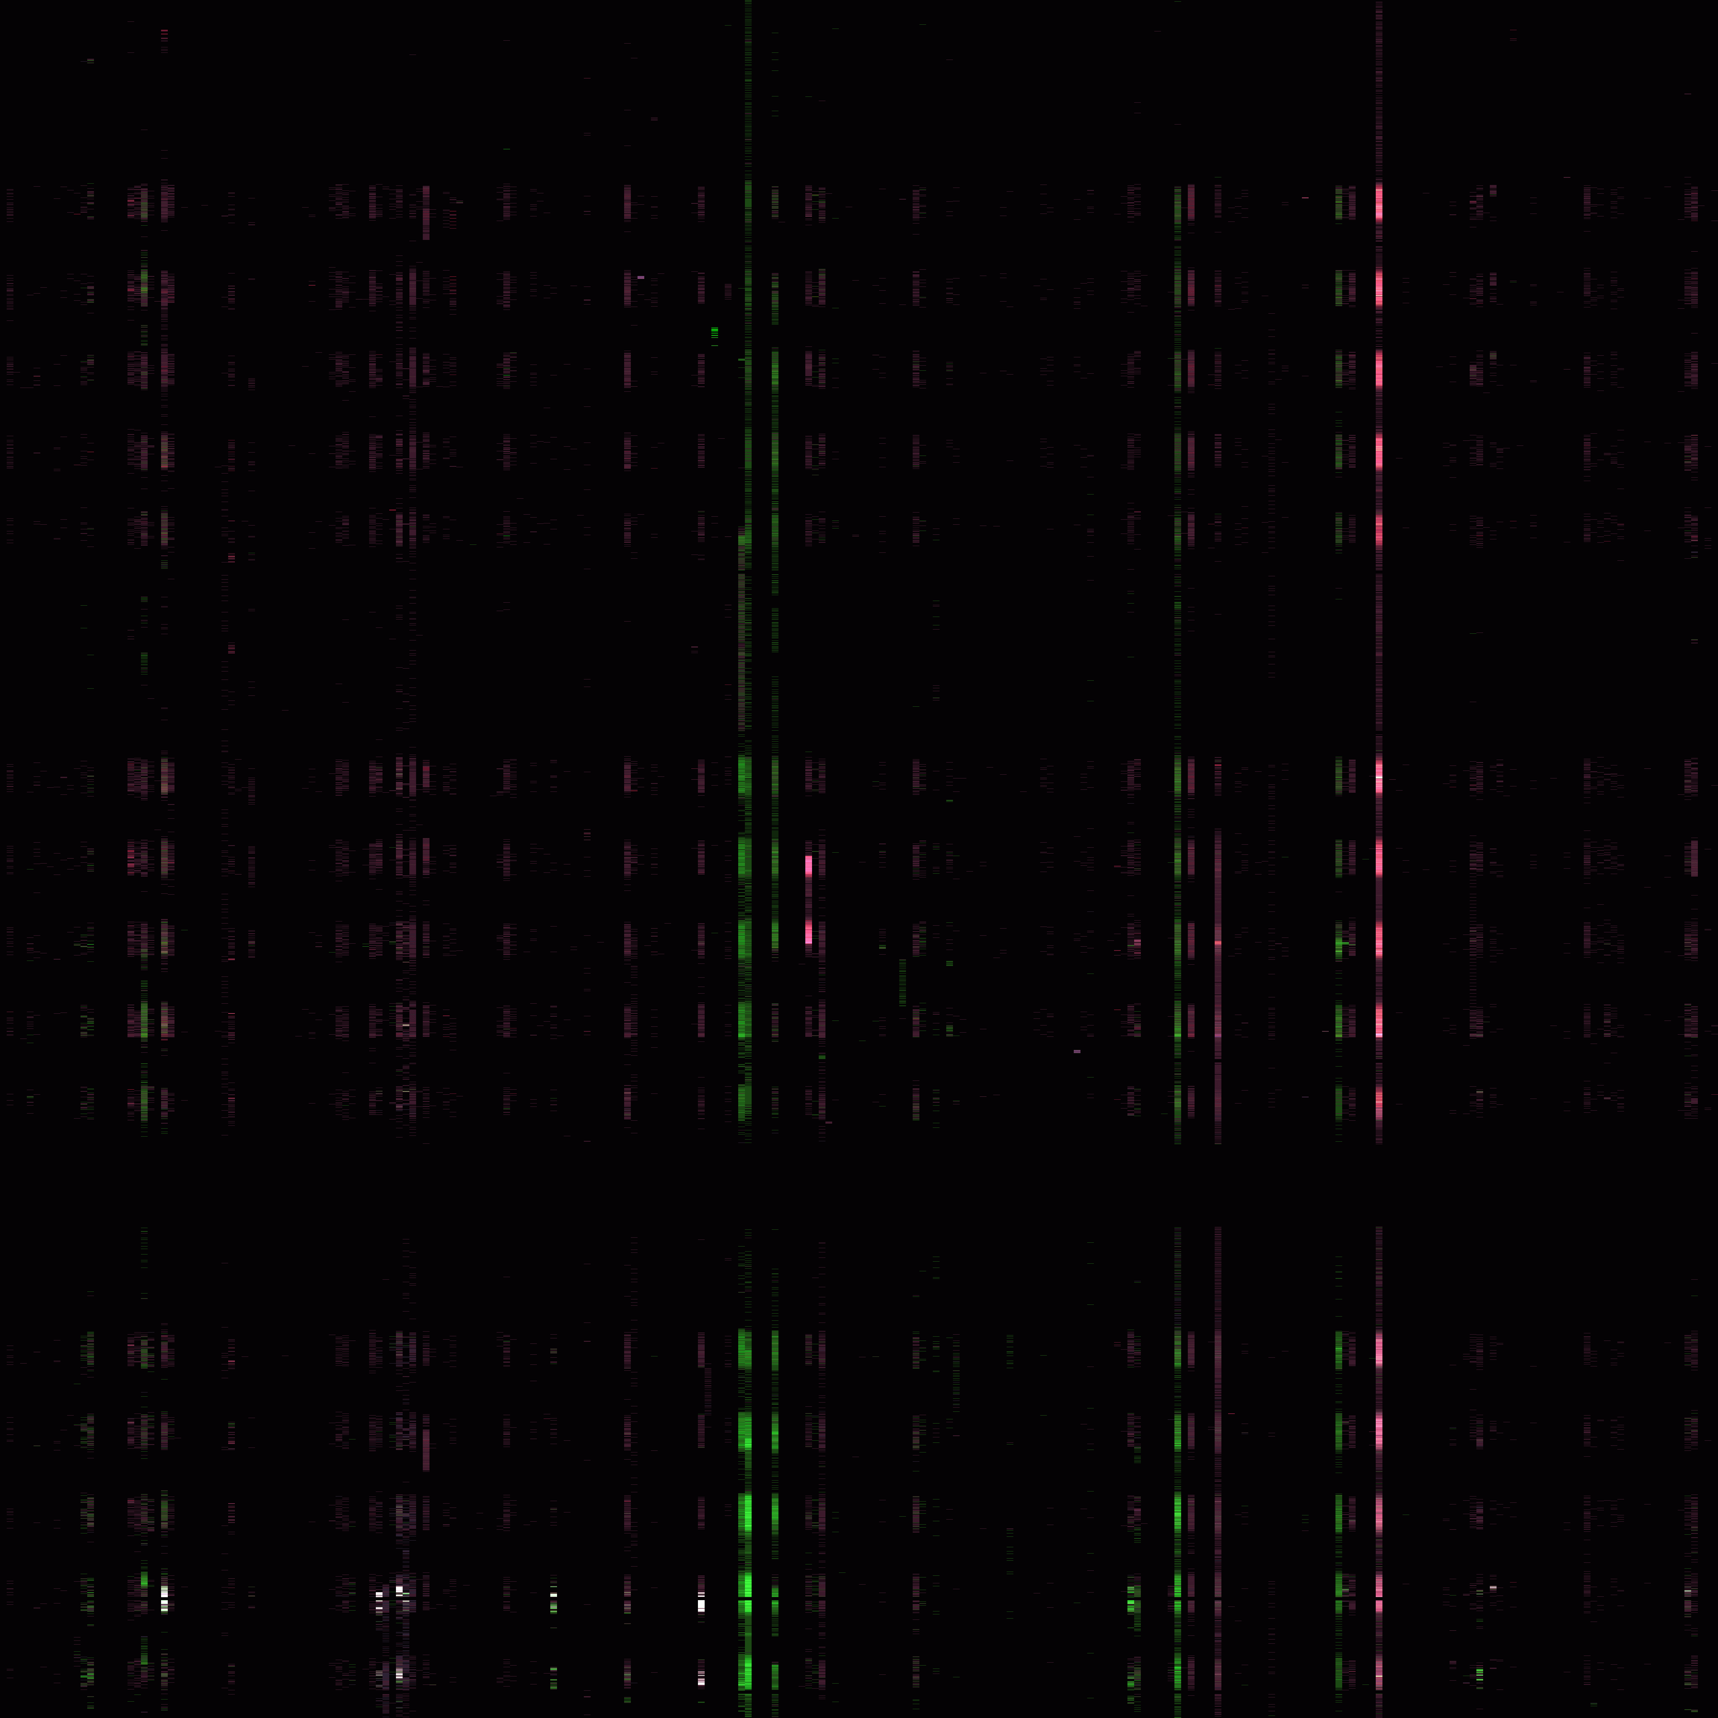
Whitelist
Filtering
Resolved IPv4 Address Range
March resolved DNS request IP addresses after aggressive whitelist filtering:
  Remove webb.bin
  Remove hostnames resolved in February
Data reduction: 100 : 1
Time
Notes:
After…
red = number of DNS hops,
green = number of IP addresses returned,
blue = name was resolved.

Slide 7
What do these attacks look like? (from Case 1, 3/10/2013)
2013-03-10 16:29:20.383769: 74.92.83.97 --> woolliest.mopping.wad
2013-03-10 16:29:20.446735: 74.92.83.97 --> i.fatality.wad
2013-03-10 16:29:22.216041: 74.92.83.97 --> sarto.6.deice.noe
2013-03-10 16:29:27.000020: 74.92.83.97 --> vanishing.inkly.k3
2013-03-10 16:29:27.481496: 74.92.83.97 --> gel.tad.wad
2013-03-10 16:29:29.642661: 74.92.83.97 --> aeg.deice.noe
2013-03-10 16:29:29.719437: 74.92.83.97 --> quid.vanishing.wad
2013-03-10 16:29:29.797566: 74.92.83.97 --> ulna.emulsions.noe
2013-03-10 16:29:29.844296: 74.92.83.97 --> legitimizing.warrens.glazes.wad
2013-03-10 16:29:29.937753: 74.92.83.97 --> disproportionately.glazes.wad
2013-03-10 16:29:32.000022: 74.92.83.97 --> glazes.inkly.k3
2013-03-10 16:32:13.953268: 74.92.83.97 --> ulna.emulsions.noe
2013-03-10 16:32:26.452304: 74.92.83.97 --> cot.vet.wad
2013-03-10 16:32:26.553868: 74.92.83.97 --> foam.vet.wad
2013-03-10 16:36:24.836345: 74.92.83.97 --> cot.jeans.tad.wad
2013-03-10 16:36:25.152466: 74.92.83.97 --> men.speccing.wad
2013-03-10 16:36:25.385679: 74.92.83.97 --> cot.exemplifications.wad
...
2013-03-10 16:40:32.435668: 74.92.83.97 --> ph.eulogy.noe
2013-03-10 16:40:32.888850: 74.92.83.97 --> cot.exemplifications.wad
2013-03-10 16:40:33.003165: 74.92.83.97 --> cot.fashions.wad
2013-03-10 16:40:33.114696: 74.92.83.97 --> cot.circumnavigations.wad
2013-03-10 16:40:33.227833: 74.92.83.97 --> shrimp.mo.inapt.noe
2013-03-10 16:42:26.463691: 74.92.83.97 --> cot.vet.wad
2013-03-10 16:42:26.648195: 74.92.83.97 --> foam.vet.wad
2013-03-10 16:47:05.660914: 74.92.83.97 --> ulna.emulsions.noe
2013-03-10 16:47:26.479085: 74.92.83.97 --> cot.vet.wad
2013-03-10 16:48:49.231853: 74.92.83.97 --> foam.vet.wad
2013-03-10 16:52:26.484706: 74.92.83.97 --> cot.vet.wad
2013-03-10 16:52:26.673943: 74.92.83.97 --> foam.vet.wad
2013-03-10 16:53:05.945733: 74.92.83.97 --> ulna.emulsions.noe
2013-03-10 16:54:32.000020: 74.92.83.97 --> glazes.inkly.k3
2013-03-10 16:55:18.006245: 74.92.83.97 --> cot.suavest.wad
2013-03-10 16:56:01.326800: 74.92.83.97 --> ac3ak6imsj62a.bernard.crusaders.maze.wad
2013-03-10 16:57:26.487928: 74.92.83.97 --> cot.vet.wad
2013-03-10 16:57:26.669508: 74.92.83.97 --> foam.vet.wad
2013-03-10 16:57:26.981415: 74.92.83.97 --> 0.rev.tester.wad
2013-03-10 16:57:26.992271: 74.92.83.97 --> rev.evidencing.wad
2013-03-10 16:57:27.049704: 74.92.83.97 --> uh.rev.tester.wad
2013-03-10 16:57:27.276964: 74.92.83.97 --> riviera.tepees.wad
...
2013-03-10 17:02:29.319477: 74.92.83.97 --> foam.vet.wad
2013-03-10 17:11:05.040318: 74.92.83.97 --> ulna.emulsions.noe
2013-03-10 17:12:07.717979: 74.92.83.97 --> jeans.all.les.noe
2013-03-10 17:12:11.847581: 74.92.83.97 --> men.speccing.wad
2013-03-10 17:12:11.870045: 74.92.83.97 --> byzantine.romanticizes.wad
2013-03-10 17:12:12.105164: 74.92.83.97 --> cot.exemplifications.wad
2013-03-10 17:12:12.146992: 74.92.83.97 --> b.superconductivity.wad
2013-03-10 17:12:12.107799: 74.92.83.97 --> rev.puke.noe
2013-03-10 17:12:29.241149: 74.92.83.97 --> cot.vet.wad
2013-03-10 17:12:29.431466: 74.92.83.97 --> foam.vet.wad
2013-03-10 17:17:12.013278: 74.92.83.97 --> ulna.emulsions.noe
2013-03-10 17:17:29.247362: 74.92.83.97 --> cot.vet.wad
2013-03-10 17:17:29.391525: 74.92.83.97 --> foam.vet.wad
2013-03-10 17:18:28.086983: 74.92.83.97 --> men.speccing.wad
2013-03-10 17:18:28.513200: 74.92.83.97 --> cot.exemplifications.wad
2013-03-10 17:18:28.515345: 74.92.83.97 --> rev.puke.noe
2013-03-10 17:19:31.999968: 74.92.83.97 --> glazes.inkly.k3
2013-03-10 17:26:28.858640: 74.92.83.97 --> aaaqsiothhkjlqn.whiskered.maze.wad
2013-03-10 17:27:20.394695: 74.92.83.97 --> legitimizing.warrens.glazes.wad
2013-03-10 17:27:20.488755: 74.92.83.97 --> disproportionately.glazes.wad
2013-03-10 17:44:32.000018: 74.92.83.97 --> glazes.inkly.k3
2013-03-10 17:55:18.097422: 74.92.83.97 --> cot.suavest.wad
2013-03-10 17:56:19.295996: 74.92.83.97 --> ac3ak6imsj62a.bernard.crusaders.maze.wad
2013-03-10 17:58:52.742510: 74.92.83.97 --> legitimizing.warrens.glazes.wad
2013-03-10 17:58:52.837624: 74.92.83.97 --> disproportionately.glazes.wad
Notes:
DNS logs for ONE computer already with MANY records already filtered…
Data from Challenge Case 1, 3/10/13.

Slide 8
What do these attacks look like?
2013-03-10 16:29:20.383769: 74.92.83.97 --> woolliest.mopping.wad
2013-03-10 16:29:20.446735: 74.92.83.97 --> i.fatality.wad
2013-03-10 16:29:22.216041: 74.92.83.97 --> sarto.6.deice.noe
2013-03-10 16:29:27.000020: 74.92.83.97 --> vanishing.inkly.k3
2013-03-10 16:29:27.481496: 74.92.83.97 --> gel.tad.wad
2013-03-10 16:29:29.642661: 74.92.83.97 --> aeg.deice.noe
2013-03-10 16:29:29.719437: 74.92.83.97 --> quid.vanishing.wad
2013-03-10 16:29:29.797566: 74.92.83.97 --> ulna.emulsions.noe
2013-03-10 16:29:29.844296: 74.92.83.97 --> legitimizing.warrens.glazes.wad
2013-03-10 16:29:29.937753: 74.92.83.97 --> disproportionately.glazes.wad
2013-03-10 16:29:32.000022: 74.92.83.97 --> glazes.inkly.k3
2013-03-10 16:32:13.953268: 74.92.83.97 --> ulna.emulsions.noe
2013-03-10 16:32:26.452304: 74.92.83.97 --> cot.vet.wad
2013-03-10 16:32:26.553868: 74.92.83.97 --> foam.vet.wad
2013-03-10 16:36:24.836345: 74.92.83.97 --> cot.jeans.tad.wad
2013-03-10 16:36:25.152466: 74.92.83.97 --> men.speccing.wad
2013-03-10 16:36:25.385679: 74.92.83.97 --> cot.exemplifications.wad
...
2013-03-10 16:40:32.435668: 74.92.83.97 --> ph.eulogy.noe
2013-03-10 16:40:32.888850: 74.92.83.97 --> cot.exemplifications.wad
2013-03-10 16:40:33.003165: 74.92.83.97 --> cot.fashions.wad
2013-03-10 16:40:33.114696: 74.92.83.97 --> cot.circumnavigations.wad
2013-03-10 16:40:33.227833: 74.92.83.97 --> shrimp.mo.inapt.noe
2013-03-10 16:42:26.463691: 74.92.83.97 --> cot.vet.wad
2013-03-10 16:42:26.648195: 74.92.83.97 --> foam.vet.wad
2013-03-10 16:47:05.660914: 74.92.83.97 --> ulna.emulsions.noe
2013-03-10 16:47:26.479085: 74.92.83.97 --> cot.vet.wad
2013-03-10 16:48:49.231853: 74.92.83.97 --> foam.vet.wad
2013-03-10 16:52:26.484706: 74.92.83.97 --> cot.vet.wad
2013-03-10 16:52:26.673943: 74.92.83.97 --> foam.vet.wad
2013-03-10 16:53:05.945733: 74.92.83.97 --> ulna.emulsions.noe
2013-03-10 16:54:32.000020: 74.92.83.97 --> glazes.inkly.k3
2013-03-10 16:55:18.006245: 74.92.83.97 --> cot.suavest.wad
2013-03-10 16:56:01.326800: 74.92.83.97 --> ac3ak6imsj62a.bernard.crusaders.maze.wad
2013-03-10 16:57:26.487928: 74.92.83.97 --> cot.vet.wad
2013-03-10 16:57:26.669508: 74.92.83.97 --> foam.vet.wad
2013-03-10 16:57:26.981415: 74.92.83.97 --> 0.rev.tester.wad
2013-03-10 16:57:26.992271: 74.92.83.97 --> rev.evidencing.wad
2013-03-10 16:57:27.049704: 74.92.83.97 --> uh.rev.tester.wad
2013-03-10 16:57:27.276964: 74.92.83.97 --> riviera.tepees.wad
...
2013-03-10 17:02:29.319477: 74.92.83.97 --> foam.vet.wad
2013-03-10 17:11:05.040318: 74.92.83.97 --> ulna.emulsions.noe
2013-03-10 17:12:07.717979: 74.92.83.97 --> jeans.all.les.noe
2013-03-10 17:12:11.847581: 74.92.83.97 --> men.speccing.wad
2013-03-10 17:12:11.870045: 74.92.83.97 --> byzantine.romanticizes.wad
2013-03-10 17:12:12.105164: 74.92.83.97 --> cot.exemplifications.wad
2013-03-10 17:12:12.146992: 74.92.83.97 --> b.superconductivity.wad
2013-03-10 17:12:12.107799: 74.92.83.97 --> rev.puke.noe
2013-03-10 17:12:29.241149: 74.92.83.97 --> cot.vet.wad
2013-03-10 17:12:29.431466: 74.92.83.97 --> foam.vet.wad
2013-03-10 17:17:12.013278: 74.92.83.97 --> ulna.emulsions.noe
2013-03-10 17:17:29.247362: 74.92.83.97 --> cot.vet.wad
2013-03-10 17:17:29.391525: 74.92.83.97 --> foam.vet.wad
2013-03-10 17:18:28.086983: 74.92.83.97 --> men.speccing.wad
2013-03-10 17:18:28.513200: 74.92.83.97 --> cot.exemplifications.wad
2013-03-10 17:18:28.515345: 74.92.83.97 --> rev.puke.noe
2013-03-10 17:19:31.999968: 74.92.83.97 --> glazes.inkly.k3
2013-03-10 17:26:28.858640: 74.92.83.97 --> aaaqsiothhkjlqn.whiskered.maze.wad
2013-03-10 17:27:20.394695: 74.92.83.97 --> legitimizing.warrens.glazes.wad
2013-03-10 17:27:20.488755: 74.92.83.97 --> disproportionately.glazes.wad
2013-03-10 17:44:32.000018: 74.92.83.97 --> glazes.inkly.k3
2013-03-10 17:55:18.097422: 74.92.83.97 --> cot.suavest.wad
2013-03-10 17:56:19.295996: 74.92.83.97 --> ac3ak6imsj62a.bernard.crusaders.maze.wad
2013-03-10 17:58:52.742510: 74.92.83.97 --> legitimizing.warrens.glazes.wad
2013-03-10 17:58:52.837624: 74.92.83.97 --> disproportionately.glazes.wad
Notes:
Hint provided for initial analysis.

Slide 9
What do these attacks look like?
2013-03-10 16:29:20.383769: 74.92.83.97 --> woolliest.mopping.wad
2013-03-10 16:29:20.446735: 74.92.83.97 --> i.fatality.wad
2013-03-10 16:29:22.216041: 74.92.83.97 --> sarto.6.deice.noe
2013-03-10 16:29:27.000020: 74.92.83.97 --> vanishing.inkly.k3
2013-03-10 16:29:27.481496: 74.92.83.97 --> gel.tad.wad
2013-03-10 16:29:29.642661: 74.92.83.97 --> aeg.deice.noe
2013-03-10 16:29:29.719437: 74.92.83.97 --> quid.vanishing.wad
2013-03-10 16:29:29.797566: 74.92.83.97 --> ulna.emulsions.noe
2013-03-10 16:29:29.844296: 74.92.83.97 --> legitimizing.warrens.glazes.wad
2013-03-10 16:29:29.937753: 74.92.83.97 --> disproportionately.glazes.wad
2013-03-10 16:29:32.000022: 74.92.83.97 --> glazes.inkly.k3
2013-03-10 16:32:13.953268: 74.92.83.97 --> ulna.emulsions.noe
2013-03-10 16:32:26.452304: 74.92.83.97 --> cot.vet.wad
2013-03-10 16:32:26.553868: 74.92.83.97 --> foam.vet.wad
2013-03-10 16:36:24.836345: 74.92.83.97 --> cot.jeans.tad.wad
2013-03-10 16:36:25.152466: 74.92.83.97 --> men.speccing.wad
2013-03-10 16:36:25.385679: 74.92.83.97 --> cot.exemplifications.wad
...
2013-03-10 16:40:32.435668: 74.92.83.97 --> ph.eulogy.noe
2013-03-10 16:40:32.888850: 74.92.83.97 --> cot.exemplifications.wad
2013-03-10 16:40:33.003165: 74.92.83.97 --> cot.fashions.wad
2013-03-10 16:40:33.114696: 74.92.83.97 --> cot.circumnavigations.wad
2013-03-10 16:40:33.227833: 74.92.83.97 --> shrimp.mo.inapt.noe
2013-03-10 16:42:26.463691: 74.92.83.97 --> cot.vet.wad
2013-03-10 16:42:26.648195: 74.92.83.97 --> foam.vet.wad
2013-03-10 16:47:05.660914: 74.92.83.97 --> ulna.emulsions.noe
2013-03-10 16:47:26.479085: 74.92.83.97 --> cot.vet.wad
2013-03-10 16:48:49.231853: 74.92.83.97 --> foam.vet.wad
2013-03-10 16:52:26.484706: 74.92.83.97 --> cot.vet.wad
2013-03-10 16:52:26.673943: 74.92.83.97 --> foam.vet.wad
2013-03-10 16:53:05.945733: 74.92.83.97 --> ulna.emulsions.noe
2013-03-10 16:54:32.000020: 74.92.83.97 --> glazes.inkly.k3
2013-03-10 16:55:18.006245: 74.92.83.97 --> cot.suavest.wad
2013-03-10 16:56:01.326800: 74.92.83.97 --> ac3ak6imsj62a.bernard.crusaders.maze.wad
2013-03-10 16:57:26.487928: 74.92.83.97 --> cot.vet.wad
2013-03-10 16:57:26.669508: 74.92.83.97 --> foam.vet.wad
2013-03-10 16:57:26.981415: 74.92.83.97 --> 0.rev.tester.wad
2013-03-10 16:57:26.992271: 74.92.83.97 --> rev.evidencing.wad
2013-03-10 16:57:27.049704: 74.92.83.97 --> uh.rev.tester.wad
2013-03-10 16:57:27.276964: 74.92.83.97 --> riviera.tepees.wad
...
2013-03-10 17:02:29.319477: 74.92.83.97 --> foam.vet.wad
2013-03-10 17:11:05.040318: 74.92.83.97 --> ulna.emulsions.noe
2013-03-10 17:12:07.717979: 74.92.83.97 --> jeans.all.les.noe
2013-03-10 17:12:11.847581: 74.92.83.97 --> men.speccing.wad
2013-03-10 17:12:11.870045: 74.92.83.97 --> byzantine.romanticizes.wad
2013-03-10 17:12:12.105164: 74.92.83.97 --> cot.exemplifications.wad
2013-03-10 17:12:12.146992: 74.92.83.97 --> b.superconductivity.wad
2013-03-10 17:12:12.107799: 74.92.83.97 --> rev.puke.noe
2013-03-10 17:12:29.241149: 74.92.83.97 --> cot.vet.wad
2013-03-10 17:12:29.431466: 74.92.83.97 --> foam.vet.wad
2013-03-10 17:17:12.013278: 74.92.83.97 --> ulna.emulsions.noe
2013-03-10 17:17:29.247362: 74.92.83.97 --> cot.vet.wad
2013-03-10 17:17:29.391525: 74.92.83.97 --> foam.vet.wad
2013-03-10 17:18:28.086983: 74.92.83.97 --> men.speccing.wad
2013-03-10 17:18:28.513200: 74.92.83.97 --> cot.exemplifications.wad
2013-03-10 17:18:28.515345: 74.92.83.97 --> rev.puke.noe
2013-03-10 17:19:31.999968: 74.92.83.97 --> glazes.inkly.k3
2013-03-10 17:26:28.858640: 74.92.83.97 --> aaaqsiothhkjlqn.whiskered.maze.wad
2013-03-10 17:27:20.394695: 74.92.83.97 --> legitimizing.warrens.glazes.wad
2013-03-10 17:27:20.488755: 74.92.83.97 --> disproportionately.glazes.wad
2013-03-10 17:44:32.000018: 74.92.83.97 --> glazes.inkly.k3
2013-03-10 17:55:18.097422: 74.92.83.97 --> cot.suavest.wad
2013-03-10 17:56:19.295996: 74.92.83.97 --> ac3ak6imsj62a.bernard.crusaders.maze.wad
2013-03-10 17:58:52.742510: 74.92.83.97 --> legitimizing.warrens.glazes.wad
2013-03-10 17:58:52.837624: 74.92.83.97 --> disproportionately.glazes.wad
2013-03-10 16:29:27.000020: 74.92.83.97 --> vanishing.inkly.k3
2013-03-10 16:29:32.000022: 74.92.83.97 --> glazes.inkly.k3
2013-03-10 16:54:32.000020: 74.92.83.97 --> glazes.inkly.k3
2013-03-10 17:19:31.999968: 74.92.83.97 --> glazes.inkly.k3
2013-03-10 17:44:32.000018: 74.92.83.97 --> glazes.inkly.k3
Notes:
DNS logs for ONE computer already with MANY records already filtered…
Data from Challenge Case 1.
Hints (red) provided for initial analysis
The periodic callback is VERY regular – this is our strong indicator.
Look “backwards” for initial infection candidates.
With the large dataset, this is a SNR problem
Lots of other traffic creates “noise”
Beaconing is common (even when all noise can be removed).
It is also a LARGE graph analytics problem
New malicious hosts/domains are set up long before they are characterized as malicious (looking for “new” behaviour).
Stretch goal: Near real-time responses needed (i.e. in-stream processing).

Slide 10
Beacon Detection
Output of signal processing (data from Case 3, 3/15/2013):
stddev mean num internal_IP external_domain whitelist
(usec) (usec) recs domain status
428.50, 14415819965, 3, 74.92.86.53, cot.au45ufhz2jq.wad, UNKNOWN
8672.39, 70016863, 4, 74.92.42.94, foam.1.quadruplicates.wad, COMMON
8812.19, 7200038761, 6, 74.92.175.4, orfitals.ok, UNKNOWN
9451.00, 14415811274, 3, 74.92.125.45, cot.a06d0z3b4irta.noe, UNKNOWN
22893.55, 3599878415, 24, 74.92.111.222, defecate.abxgzuuihtw3.val, COMMON
23872.00, 14414983370, 3, 184.202.133.26, cot.as2e15pr14i0ra5v.wad, UNKNOWN
25602.00, 3600030438, 3, 252.90.88.58, nvz.val, UNKNOWN
26810.66, 7200031307, 7, 74.92.244.3, orfitals.ok, UNKNOWN
27035.00, 541558668, 3, 74.92.2.102, 1.instrumentals.wad, UNKNOWN
27755.50, 3615024542, 3, 74.92.115.69, i1l.ktl.m.avab85et2md1.wad, UNKNOWN
29728.50, 7200045678, 3, 74.92.120.47, orfitals.ok, UNKNOWN
33075.50, 14415663130, 3, 74.92.32.252, cot.awdi4mbp.val, UNKNOWN
33747.50, 14415665470, 3, 74.92.32.252, cot.au7rcnenxm3.val, UNKNOWN
36327.50, 14415666637, 3, 74.92.32.252, cot.afju5c0jq6g2iu.wad, COMMON
42044.50, 10814890626, 3, 74.92.169.49, cot.ab7cc.curt, UNKNOWN
43604.50, 1803233179, 3, 252.90.88.58, plot.g6m.wad.jm, UNKNOWN
Notes:
Mean/stddev approach also done on ALL src/dest pairs (best result of all combinations leave-one-out)
This example has 2 hour periodicity.
Strong Indicators for ranking (but not requirements):
lower stddev
larger number of samples
Multiple entries for same callback host in later Cases (multiple infections) is a stronger indicator
an “UNKNOWN” domain
Internal hosts and external domains selected form set of “seed” nodes for link analysis.

Slide 11
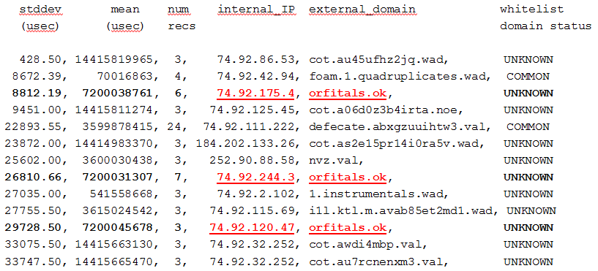
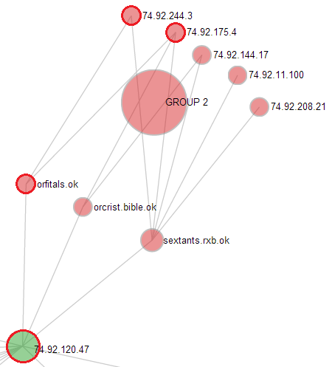
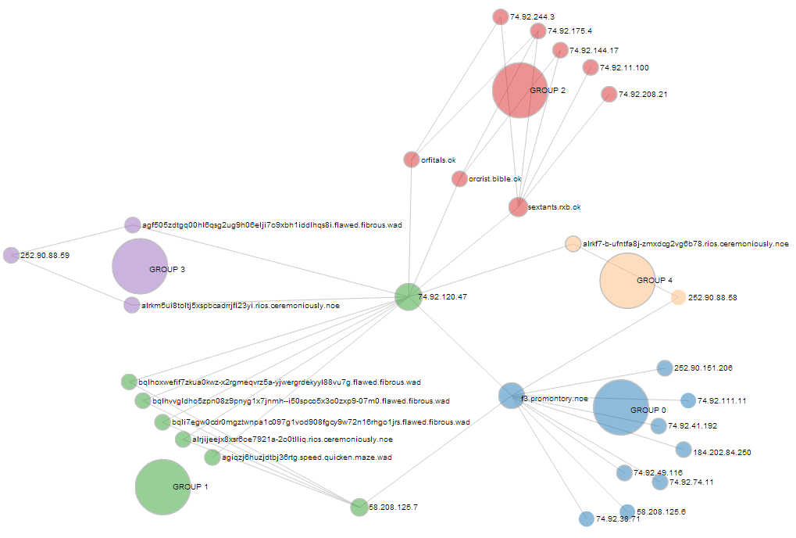
Link Analysis
Candidates from beacon detector are seeds for link analysis
Find the “neighborhood”:
  2nd level query
  Degree filtering
Identify the APT:
  Community detection (Louvain)
  Clique analysis
Notes:
Tools
Automated “beacon” detection
Prioritization techniques
Link analysis queries
Graph visualization/manipulation

Slide 12
Results
Case | APTs Detected | Malicious Domains Identified | Results with 5 or fewer False Positives
1 | 5 of 5 (100%) | 12 of 12 (100%) | 5 of 5 (100%)
2 | 7 of 7 (100%) (3 of 7 used hints) | 20 of 22 (91%) | 6 of 7 (86%)
3 | 7 of 7 (100%) (1 of 7 used hints) | 19 of 24 (79%) | 5 of 7 (71%)
4 | 16 of 20 (80%) (no hints allowed) | 44 of 55 (80%) when beacon detected. (32 of 63 overall) | 9 of 16 (56%) when beacon detected. (9 of 20 overall).
(http://acorn.etc.sei.cmu.edu/ebwerner/socialviz/)
Notes:
Results for cases 1 through 3 were allowed to use hints
Results for case 4 rerun the first three without hints plus one additional attack.
Our original goal: solve Case 1 (5 attacks):
All beacons/callbacks automatically detected
All malicious domains identified
Less than five false positives for all attacks (challenge specified goal)
The team went above and beyond…and the approach shows general applicability to more complex cases.
Cases 2 and 3: 14 attacks
When APT not automatically detected we used hints for link analysis step (4 attacks total).
Starting to miss some malicious domains and false positive rate is going up…but better domain whitelists will drastically improve both.
Case 4: rerun Cases 1,2 and 3 plus one new attack WITHOUT using hints
4 attacks in Cases 2 and 3 drop out completely (need further analysis to determine cause).
Extra attack characterized perfectly.

Slide 13
Future Work
Incorporate other data sources
  WHOIS
  Google Safe Browsing
Incorporate Machine Learning (ML)
  Automate more of the process
Develop a real-time streaming analytics framework
  Achieve earlier detection (even before beacon detected/confirmed?)
Build new situational awareness tools:
  Real-time prioritization, escalation displays
  Integrated query, exploration, and visualization components
  Real-time remediation

Slide 14
Thank you, Los Alamos

Slide 15
Contact Information
Presenter / Point of Contact Scott McMillan, Ph.D. Emerging Technology Center CMU/SEI Telephone: +1 412-268-5800 Email: info@sei.cmu.edu | U.S. Mail Software Engineering Institute Customer Relations 4500 Fifth Avenue Pittsburgh, PA 15213-2612 USA
Web www.sei.cmu.edu www.sei.cmu.edu/contact.cfm | Customer Relations Email: info@sei.cmu.edu Telephone: +1 412-268-5800 SEI Phone: +1 412-268-5800 SEI Fax: +1 412-268-6257

Slide 16
Copyright 2014 Carnegie Mellon University
This material is based upon work funded and supported by the Department of Defense under Contract No. FA8721-05-C-0003 with Carnegie Mellon University for the operation of the Software Engineering Institute, a federally funded research and development center.
Any opinions, findings and conclusions or recommendations expressed in this material are those of the author(s) and do not necessarily reflect the views of the United States Department of Defense.
NO WARRANTY. THIS CARNEGIE MELLON UNIVERSITY AND SOFTWARE ENGINEERING INSTITUTE MATERIAL IS FURNISHED ON AN “AS-IS” BASIS. CARNEGIE MELLON UNIVERSITY MAKES NO WARRANTIES OF ANY KIND, EITHER EXPRESSED OR IMPLIED, AS TO ANY MATTER INCLUDING, BUT NOT LIMITED TO, WARRANTY OF FITNESS FOR PURPOSE OR MERCHANTABILITY, EXCLUSIVITY, OR RESULTS OBTAINED FROM USE OF THE MATERIAL. CARNEGIE MELLON UNIVERSITY DOES NOT MAKE ANY WARRANTY OF ANY KIND WITH RESPECT TO FREEDOM FROM PATENT, TRADEMARK, OR COPYRIGHT INFRINGEMENT.
This material has been approved for public release and unlimited distribution except as restricted below.
This material may be reproduced in its entirety, without modification, and freely distributed in written or electronic form without requesting formal permission. Permission is required for any other use. Requests for permission should be directed to the Software Engineering Institute at permission@sei.cmu.edu.
DM-0000825

Slide 17
Backups

Slide 18
The Challenge
“Develop techniques for detecting malicious hosts given the DNS logs for a site, and to identify potentially infected hosts in the process.”
  7.7 billion records from DNS logs of a large government network
  “Sanitized” dataset publicly released
  20 simulated attacks from advanced persistent threats (APTs)
    10-20 records/attack → “needle-in-the-haystack” problem
    Hints provided
  Grouped into 3 classes of problems (each progressively more complex)
    Identify all malicious external hosts
    Identify all infected internal computers
    Few false positives (under 5).
  Final challenge: Identify all the APTs without hints
Notes:
DNS “logs”: actually parsed, anonymized, redacted to allow for public released by LANL/DOE
Hostname lengths preserved and “word” replacements consistent
February data released July 12, 2013 (missing about 36 hours on 2/8 and 2/9): 27 days
March data released Aug 20/21, Sep 26/30, Oct 10/15/16: 20 days

Slide 19
C3E DNS Challenge Report
Naomi Anderson, Jonathan Chu, Derrick Karimi, Scott McMillan, Andrew Mellinger, David Shepard, Eric Werner
Emerging Technology Center
Software Engineering Institute
Carnegie Mellon University
Pittsburgh, PA 15213

Slide 20
Outline
Problem Statement
Data Exploration
Our Approach
Results
Open Questions

Slide 21
Problem Statement
“Develop techniques for detecting malicious hosts given the DNS logs for a site, and to identify potentially infected hosts in the process.”
Data: seven weeks of “sanitized” DNS logs (7.7B raw records)
  Hostnames anonymized (e.g. lanl.gov → webb.bin)
  IP addresses anonymized (e.g. 192.168.10.44 → 74.92.227.1)
  Many fields redacted including TTL’s
  February is baseline data
  March contains simulated attacks
Hints: provided for each calendar day in March containing an attack.
  Each simulated attack is constrained to only one calendar day
  Multiple attacks and hints for each of three cases provided
  Logs/hints for fourth case withheld until the C3E Conference (January)
Notes:
Not given complete DNS logs…parsed, anonymized, redacted.
Hostname lengths preserved.
Replacements consistent
February data released July 12, 2013 (missing about 36 hours on 2/8 and 2/9)
March data released Aug 20/21, Sep 26/30, Oct 10/15/16
Missing 3/1, 3/14 (hint missing), 3/16, 3/22 (hint missing), 3/23 -3/31

Slide 22
Problem Statement
Example Hint 2013-03-02:
Host (74.92.226.44) received a potentially malicious email at 12:30 PM.
Timeline:
12:30:20 - User at (74.92.226.44) receives email containing malicious PDF.
12:31:35 - User has opened attachment, which exploits vulnerable adobe acrobat (stage 1)
12:31:36 - Stage 1 contacts malicious domain (zarflugal.noe) over http, and downloads second stage.
12:31:42 - Stage 2 starts periodic http callbacks to second malicious domain (askerpat1sk8nd2.aa9kz-j.ho.ari.do).
Issues (partial list):
  Times approximate
  Sometimes missing samples of regular callbacks (beacon)
  Injected IPs sometimes in error

Slide 23
Sample Data
74.92.226.44
2013-03-02 12:57:22.124443,74.92.226.44,74.92.185.4,X,u,q,NA
? zarflugal.noe A
<SEP>
74.92.185.4
Example Hint 2013-03-02:
Host (74.92.226.44) received a potentially malicious email at 12:30 PM.
Timeline:
12:30:20 - User at (74.92.226.44) receives email containing malicious PDF.
12:31:35 - User has opened attachment, which exploits vulnerable adobe acrobat (stage 1)
12:31:36 - Stage 1 contacts malicious domain (zarflugal.noe) over http, and downloads second stage.
12:31:42 - Stage 2 starts periodic http callbacks to second malicious domain (askerpat1sk8nd2.aa9kz-j.ho.ari.do).
zarflugal.noe
Notes:
Corresponding data found with fgrep: A record, q=query
Not timestamps off about 27 minutes from hint (this is common).

Slide 24
Sample Data
74.92.226.44
2013-03-02 12:57:22.124443,74.92.226.44,74.92.185.4,X,u,q,NA
? zarflugal.noe A
<SEP>
2013-03-02 12:57:22.124791,74.92.185.4,252.90.88.2,X,u,q,NA
? zarflugal.noe A
<SEP>
74.92.185.4
252.90.88.2
zarflugal.noe

Slide 25
Sample Data
74.92.226.44
2013-03-02 12:57:22.124443,74.92.226.44,74.92.185.4,X,u,q,NA
? zarflugal.noe A
<SEP>
2013-03-02 12:57:22.124791,74.92.185.4,252.90.88.2,X,u,q,NA
? zarflugal.noe A
<SEP>
2013-03-02 12:57:22.125634,252.90.88.2,123.13.113.150,X,u,q,NA
? zarflugal.noe A
<SEP>
74.92.185.4
252.90.88.2
123.13.113.150
zarflugal.noe

Slide 26
Sample Data
74.92.226.44
2013-03-02 12:57:22.124443,74.92.226.44,74.92.185.4,X,u,q,NA
? zarflugal.noe A
<SEP>
2013-03-02 12:57:22.124791,74.92.185.4,252.90.88.2,X,u,q,NA
? zarflugal.noe A
<SEP>
2013-03-02 12:57:22.125634,252.90.88.2,123.13.113.150,X,u,q,NA
? zarflugal.noe A
<SEP>
74.92.185.4
252.90.88.2
123.13.113.150
zarflugal.noe
182.247.222.31
zarflugal.noe

Slide 27
Sample Data
74.92.226.44
2013-03-02 12:57:22.124443,74.92.226.44,74.92.185.4,X,u,q,NA
? zarflugal.noe A
<SEP>
2013-03-02 12:57:22.124791,74.92.185.4,252.90.88.2,X,u,q,NA
? zarflugal.noe A
<SEP>
2013-03-02 12:57:22.125634,252.90.88.2,123.13.113.150,X,u,q,NA
? zarflugal.noe A
<SEP>
2013-03-02 12:57:22.279882,123.13.113.150,252.90.88.2,X,u,r,NA
? zarflugal.noe A
! zarflugal.noe A 182.247.222.31
<SEP>
74.92.185.4
252.90.88.2
123.13.113.150
zarflugal.noe
182.247.222.31

Slide 28
Sample Data
74.92.226.44
2013-03-02 12:57:22.124443,74.92.226.44,74.92.185.4,X,u,q,NA
? zarflugal.noe A
<SEP>
2013-03-02 12:57:22.124791,74.92.185.4,252.90.88.2,X,u,q,NA
? zarflugal.noe A
<SEP>
2013-03-02 12:57:22.125634,252.90.88.2,123.13.113.150,X,u,q,NA
? zarflugal.noe A
<SEP>
2013-03-02 12:57:22.279882,123.13.113.150,252.90.88.2,X,u,r,NA
? zarflugal.noe A
! zarflugal.noe A 182.247.222.31
<SEP>
2013-03-02 12:57:22.280127,252.90.88.2,74.92.185.4,X,u,r,NA
? zarflugal.noe A
! zarflugal.noe A 182.247.222.31
<SEP>
74.92.185.4
252.90.88.2
123.13.113.150
zarflugal.noe
182.247.222.31

Slide 29
Sample Data
74.92.226.44
2013-03-02 12:57:22.124443,74.92.226.44,74.92.185.4,X,u,q,NA
? zarflugal.noe A
<SEP>
2013-03-02 12:57:22.124791,74.92.185.4,252.90.88.2,X,u,q,NA
? zarflugal.noe A
<SEP>
2013-03-02 12:57:22.125634,252.90.88.2,123.13.113.150,X,u,q,NA
? zarflugal.noe A
<SEP>
2013-03-02 12:57:22.279882,123.13.113.150,252.90.88.2,X,u,r,NA
? zarflugal.noe A
! zarflugal.noe A 182.247.222.31
<SEP>
2013-03-02 12:57:22.280127,252.90.88.2,74.92.185.4,X,u,r,NA
? zarflugal.noe A
! zarflugal.noe A 182.247.222.31
<SEP>
2013-03-02 12:57:22.280761,74.92.185.4,74.92.226.44,X,u,r,NA
? zarflugal.noe A
! zarflugal.noe A 182.247.222.31
<SEP>
74.92.185.4
252.90.88.2
123.13.113.150
zarflugal.noe
182.247.222.31

Slide 30
Sample Data
74.92.226.44
2013-03-02 12:57:22.124443,74.92.226.44,74.92.185.4,X,u,q,NA
? zarflugal.noe A
<SEP>
2013-03-02 12:57:22.124791,74.92.185.4,252.90.88.2,X,u,q,NA
? zarflugal.noe A
<SEP>
2013-03-02 12:57:22.125634,252.90.88.2,123.13.113.150,X,u,q,NA
? zarflugal.noe A
<SEP>
2013-03-02 12:57:22.279882,123.13.113.150,252.90.88.2,X,u,r,NA
? zarflugal.noe A
! zarflugal.noe A 182.247.222.31
<SEP>
2013-03-02 12:57:22.280127,252.90.88.2,74.92.185.4,X,u,r,NA
? zarflugal.noe A
! zarflugal.noe A 182.247.222.31
<SEP>
2013-03-02 12:57:22.280761,74.92.185.4,74.92.226.44,X,u,r,NA
? zarflugal.noe A
! zarflugal.noe A 182.247.222.31
<SEP>
74.92.185.4
252.90.88.2
123.13.113.150
zarflugal.noe
182.247.222.31

Slide 31
Terminology
74.92.226.44
Requestor
“Internal” DNS
74.92.185.4
Top-level “Internal” DNS
252.90.88.2
“External” DNS
123.13.113.150
zarflugal.noe
182.247.222.31
The Interwebs
“Here there be dragons”

Slide 32
Terminology
74.92.226.44
Infected host
“Internal” Network (webb.bin)
74.92.185.4
252.90.88.2
Inferred network boundary
“External” Network
123.13.113.150
zarflugal.noe
182.247.222.31
Malicious external host
Notes:
Note that request can also originate in “external” network.

Slide 33
Terminology
74.92.226.44
74.92.185.4
DNS Request Graph
252.90.88.2
123.13.113.150
zarflugal.noe
182.247.222.31

Slide 34
Terminology
74.92.226.44
74.92.185.4
Inferred Connection Graph
252.90.88.2
123.13.113.150
zarflugal.noe
182.247.222.31
Notes:
Although we don’t see it in the logs, we infer a subsequent connection between requestor and resolved IP address

Slide 35
Outline
Problem Statement
Data Exploration
Our Approach
Results
Open Questions

Slide 36
Data Exploration
Records related to all hints in Case 1 from DNS “A” records only.
DNS Request Graph (February)
585,000 IP addresses
1.5M unique edges
Inferred Connection Graph (February): assume resolution implies connection
360,000 IP addresses of requestors (internal and external)
3.17M hostnames requested
26.1M unique edges
  3.8 requests for webb.bin hostnames (internal and external)
Notes:
Performed an examination of all the hints in Case 1
We decided to look at only A type records: IPv4 Address records
Note: webb.bin is the local (internal) domain…and there were many external requests to resolve names within this domain too.

Slide 37

Data Exploration
Resolved IPv4 Address Range
Weekend
One work week
36 hour outage
Time
President’s Day
February external domain requests (i.e., no webb.bin)
Notes:
One way to visualize it using Derricks rasterizer…Inferred Connections
IP addresses resolved spanned the 32 bit address space.
You can see work days and work hours, Friday loads are about 50% above baseline compared to other week days.

Slide 38
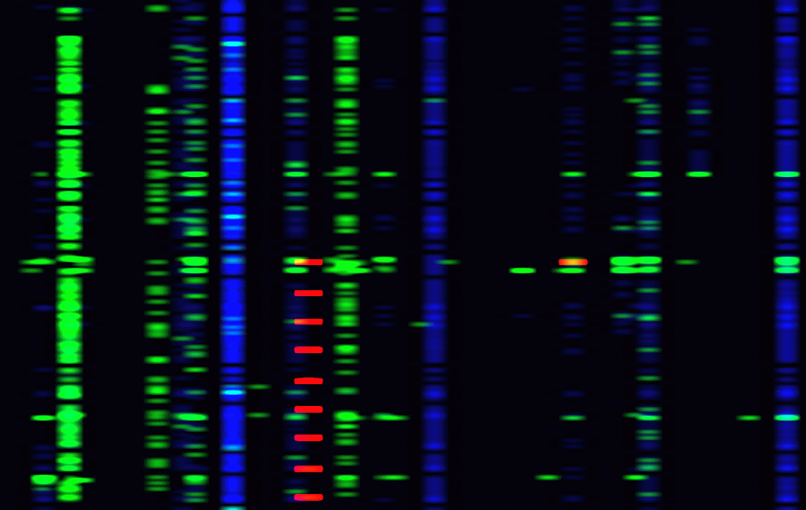
Data Exploration
IPv4 address range of requests
Time
From hint 2013-03-02: 74.92.226.44 DNS requests: blue internal, green external, red malicious.
Notes:
Another Rasterizer image (Inferred Connections) looking at just the infected hosts requests for first hint that we looked at earlier.
One computer’s requests spanning one day.

Slide 39
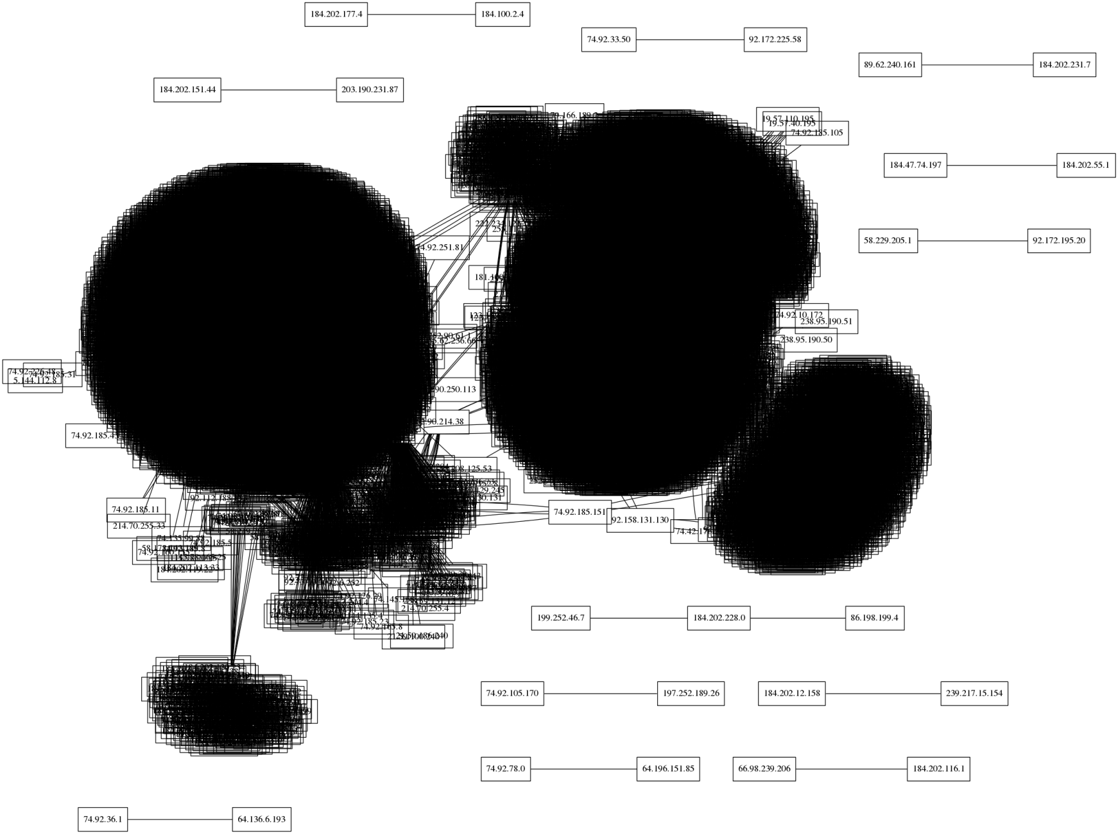
Data Exploration
DNS Request Graph
(1 hour of requests)
Notes:
GraphViz of DNS topology…really can’t handle the amount of data.

Slide 40
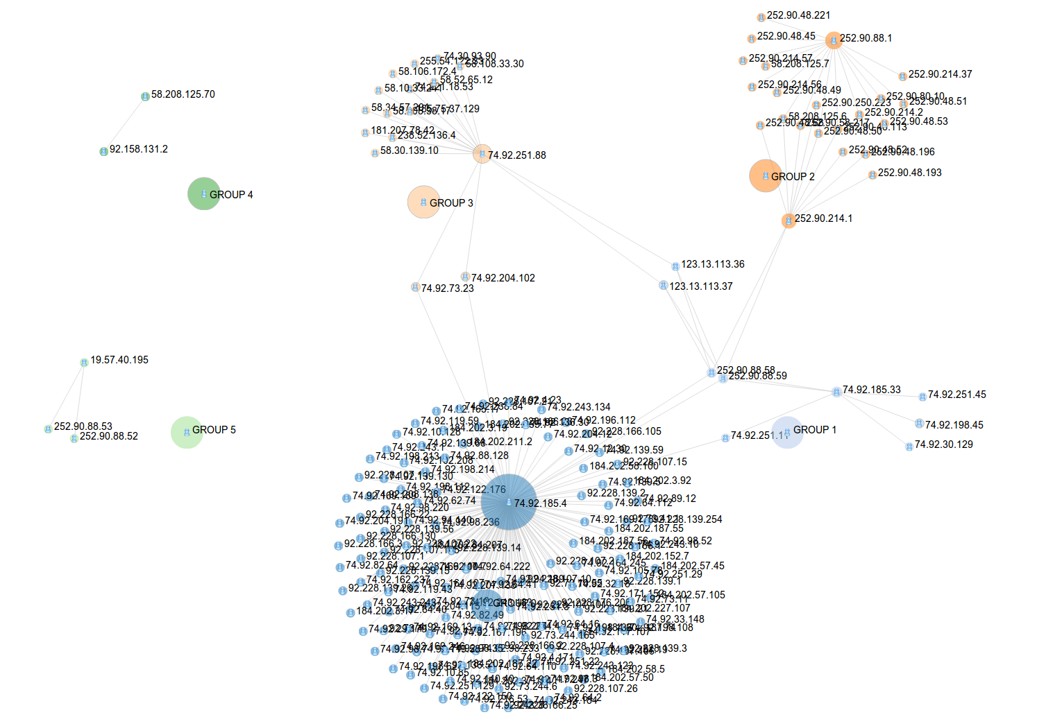
Data Exploration
DNS Request Graph
(1 hour of requests)
Notes:
Same data: D3.js package (d3js.org), rendering JSON format, after community detection algorithm applied.

Slide 41
Data Exploration
External DNS
DNS Request Graph
(1 hour of requests)
Notes:
External DNS servers

Slide 42
Data Exploration
Internal DNS Servers
DNS Request Graph
(1 hour of requests)
Notes:
Multiple levels of internal DNS servers.
Some disconnected components…will likely be connected after processing more data.

Slide 43
Outline
Problem Statement
Data Exploration
Our Approach
Results
Open Questions

Slide 44
Our Approach
pcap
dns_parse
Challenge data (DNS requests, March)
Challenge data
(DNS requests, Feb)
Data Reduction
Minimized “A”-records
Whitelist filter(s)
-
Σ
Candidate “A”-records
Beacon Detection
Callback/internal host pairs
Link Analysis
Candidate malicious hosts (prioritized?)
Notes:
After some discussion this is the processing workflow that took shape:
dns_parse: was performed by Challenge organizers (we did not have access to raw records).
Discuss each one of these in the slides that follow:
Data Reduction – remove data that is (hopefully) clearly not malicious.
Whitelist filters – remove more data that is likely not malicious
Beacon detection – identify the callback portion of the APT
Link Analysis – of internal hosts requesting the callback host to identify the rest of the malicious network

Slide 45
Our Approach: Data Reduction
  Multi-line record format converted to single line:
    100M – 225M records per day.
  Remove all but “A” records (WHY? That’s where the hints are for Case 1)
    60M – 135M records per day (40% reduction)
  Collapse all the DNS “hops” for each request/response sequence:
    23M – 50M records per day (additional 60% reduction)
Overall: 4:1 to 5:1 reduction (without whitelists)
(more reduction on weekends/holidays)
Notes:
Data Reduction:
Only removal of non-A records is a reduction of information
The other two steps reduces space but not really information (i.e. number fields expanded…a few items dropped that maybe should be preserved).

Slide 46
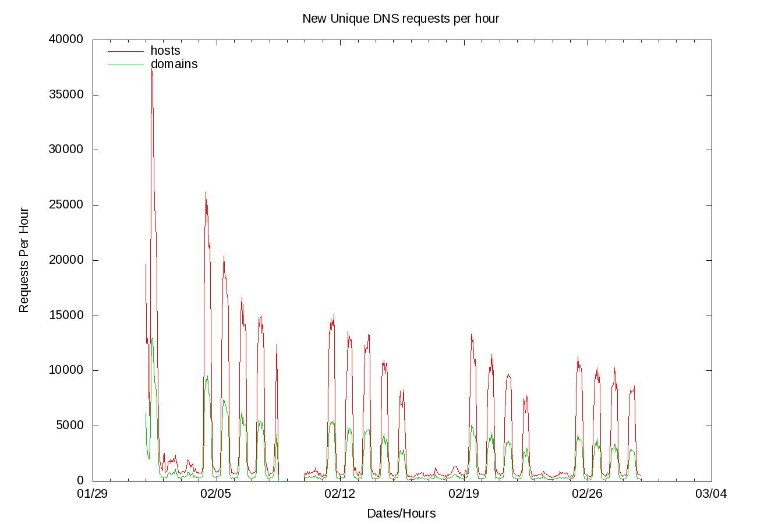
Our Approach: Whitelist Generation
Notes:
Look at all requests (February), see spikes for working hours…new requests leveling off but not tailing to zero…requires further analysis (AV software?)

Slide 47
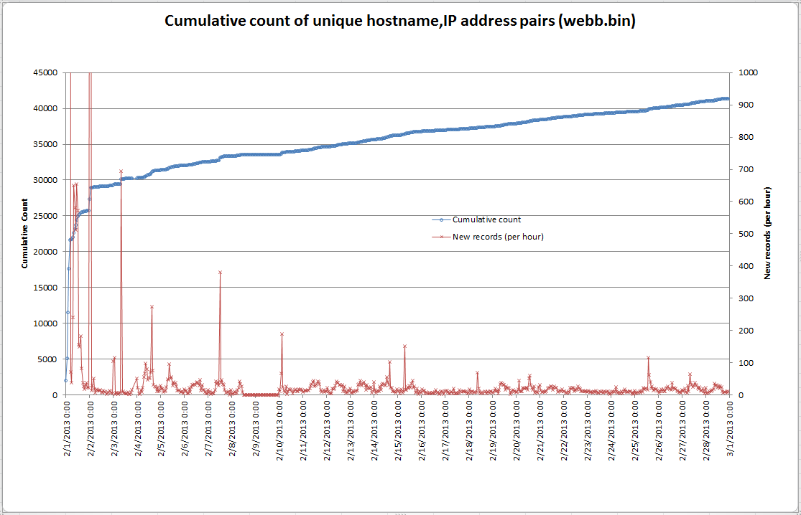
Our Approach: Whitelist Generation
Notes:
Looking at request to resolve internal hosts only does seem to die off more…but still growing after one month.

Slide 48
Our Approach: Whitelist Generation
Multiple approaches:
  Internal (webb.bin) names (assumption: external malicious domains only).
  Conservative: Hosts requested per SRC IP address in February
  Aggressive: All hosts requested in February (regardless of SRC IP)
  Resulting Size of March Datasets:
  Remove all requests to resolve names within webb.bin domain
    317.0M March records (6M – 21M records/day)
  Conservative: Remove all requests for hosts if that particular source node requested it in February
    46.0M March records (262K – 4M records/day)
  Aggressive: Remove all requests for any hosts requested in February
    12.7M March records (380K – 975K records/day)
Aggressive Filter: ~20:1 reduction
Notes:
Remove webb.bin: 60%-75% reduction
AND
Conservative: Additional 80%-95% reduction
OR
Aggressive: Additional 95%
We ended up using the Aggressive whitelists

Slide 49
Our Approach:
Whitelist
Generation
Resolved IPv4 Address Range
All March resolved DNS request IP addresses.
Time
Notes:
Rasterizer again…to visualize the effect of aggressive whitelist filters.
red = number of DNS hops, green = number of IP addresses returned, blue = name was resolved.

Slide 50
Our Approach:
Whitelist
Generation
Resolved IPv4 Address Range
March resolved DNS request IP addresses after aggressive whitelist filtering.
Time
Hmmm…interesting…
Notes:
After…
red = number of DNS hops,
green = number of IP addresses returned,
blue = name was resolved.

Slide 51
Our Approach: Beacon Detection
Detect regular callbacks to command and control (the “beacon”)
  Sort ALL requests by [src IP,hostname] pairs
  Remove all that have less than 3 requests (probably could increase to 4)
  Compute statistics on time deltas between time ordered requests:
    Approach 1: Standard deviations
      Mean/stddev calculations (best of leave-one-out, round-robin)
      Select all with “small” standard deviation
        Mean (beacon interval) between 5-120 minutes
    Approach 2: FFTs
      Look for strong “signal” (more flexible but still requires periodicity)
  Restrict selection between 5 and just above 120 minute periods:
    Below 5 minutes: Assumption: high volume traffic too “loud”
    Above 120 minutes: Too few samples given the calendar day restriction
Notes:
All hints in case 1 involved a periodic callback to an external domain as the last phase of the APT.
It was increased to above 120 minutes because we have at least one case where the beacon is 2 hours + a few milliseconds
We started with mean/stddev approach, went to FFT’s and then back.

Slide 52
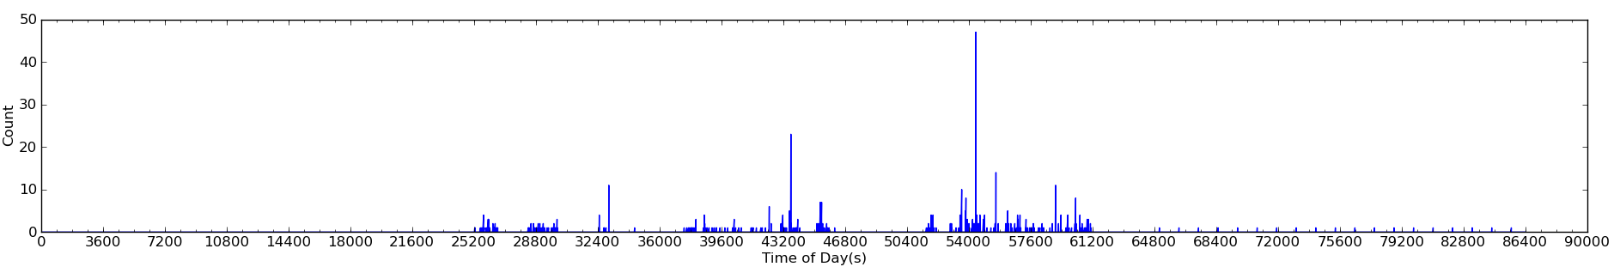
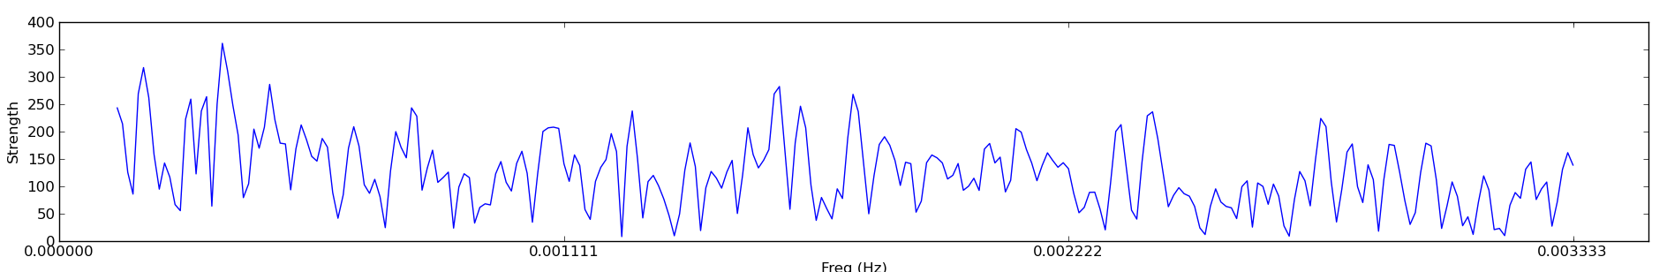
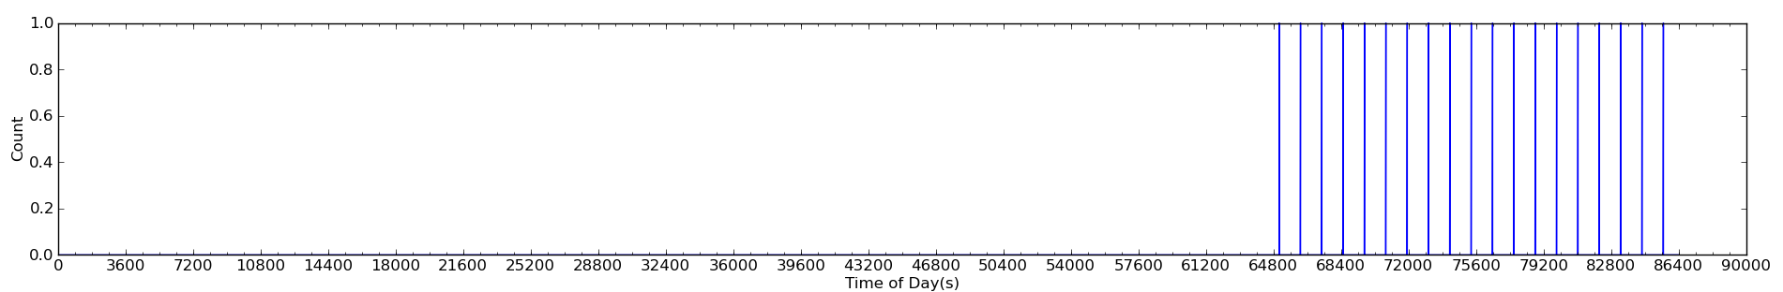
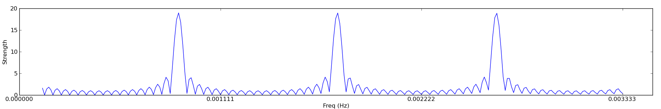
Our Approach: FFT Beacon Detection
Between infected host and all domains (post whitelist filter):
Between infected host and malicious domain:
Notes:
We discovered that you still need to run individual FFT’s on src/dest pairs….can’t do all src requests in one.

Slide 53
Our Approach: Beacon Detection
Output of mean/stddev calculations (Case 3, 3/15/2013):
Stddev mean num internal_IP external_domain whitelist
(usec) (usec) samp domain status
428.50, 14415819965, 3, 74.92.86.53, cot.au45ufhz2jq.wad, UNKNOWN
8672.39, 70016863, 4, 74.92.42.94, foam.1.quadruplicates.wad, COMMON
8812.19, 7200038761, 6, 74.92.175.4, orfitals.ok, UNKNOWN
9451.00, 14415811274, 3, 74.92.125.45, cot.a06d0z3b4irta.noe, UNKNOWN
22893.55, 3599878415, 24, 74.92.111.222, defecate.abxgzuuihtw3.val, COMMON
23872.00, 14414983370, 3, 184.202.133.26, cot.as2e15pr14i0ra5v.wad, UNKNOWN
25602.00, 3600030438, 3, 252.90.88.58, nvz.val, UNKNOWN
26810.66, 7200031307, 7, 74.92.244.3, orfitals.ok, UNKNOWN
27035.00, 541558668, 3, 74.92.2.102, 1.instrumentals.wad, UNKNOWN
27755.50, 3615024542, 3, 74.92.115.69, i1l.ktl.m.avab85et2md1.wad, UNKNOWN
29728.50, 7200045678, 3, 74.92.120.47, orfitals.ok, UNKNOWN
33075.50, 14415663130, 3, 74.92.32.252, cot.awdi4mbp.val, UNKNOWN
33747.50, 14415665470, 3, 74.92.32.252, cot.au7rcnenxm3.val, UNKNOWN
36327.50, 14415666637, 3, 74.92.32.252, cot.afju5c0jq6g2iu.wad, COMMON
42044.50, 10814890626, 3, 74.92.169.49, cot.ab7cc.curt, UNKNOWN
43604.50, 1803233179, 3, 252.90.88.58, plot.g6m.wad.jm, UNKNOWN
Notes:
Mean/stddev approach also done on ALL src/dest pairs.
This is the example that has 2 hour periodicity.
Strong Indicators (but not requirements):
- lower stddev
- larger number of samples
- Multiple entries for same callback host in later Cases (multiple infections) is a stronger indicator
- an “unknown” domain
Internal hosts and external domains selected form set of “seed” nodes for link analysis.

Slide 54
Our Approach: Malicious Domain Finder
Examine DNS requests for infected hosts for the day of the beacon.
Filter requests based on whitelist (again)
  Remove webb.bin (again, assumption is C2 is outside the local network)
  Remove hosts resolved in February
  Examine resulting network “surrounding” infected host(s) and callback domain(s)...
(work in progress)

Slide 55
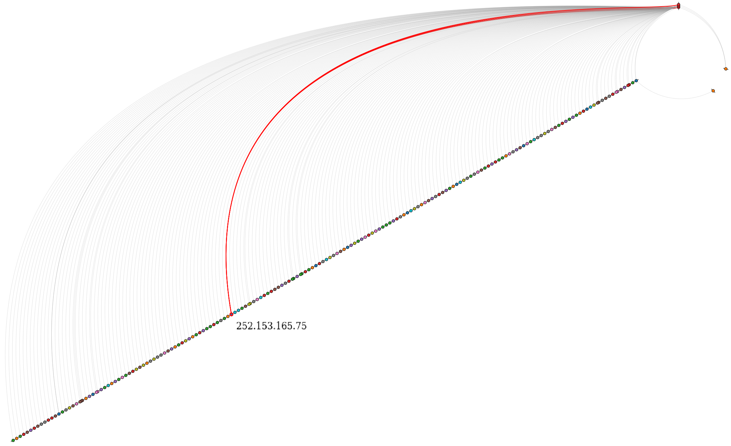
Hive Plots
From Case 2: Shows three hosts (at top) connecting to same malicious domain.
Notes:
Kind hard to see the multiple common connections with the hive plot.

Slide 56
Link Analysis
Are there characteristics of the nodes and links that would indicate a compromised host?
  Perform 2nd level query from known information (seed nodes)
  For all compromised hosts, and known beacon hosts, find all internal and external hosts in that social network up to two levels out
  Filter out non-seed nodes with degree >= 10, as they are likely very common external domains
  Filter out nodes with resulting degree == 0, as they were talking to only the very common domains
  Run community detection algorithm (louvain method) on the remaining graph to try to identify “like nodes” (http://perso.crans.org/aynaud/communities/)
Notes:
Again this is on the inferred connection graph.
Degree as measure by number of unique connections.

Slide 57
Outline
Problem Statement
Data Exploration
Our Approach
Results
Open Questions
Notes:
http://acorn.etc.sei.cmu.edu/ebwerner/socialviz/

Slide 58
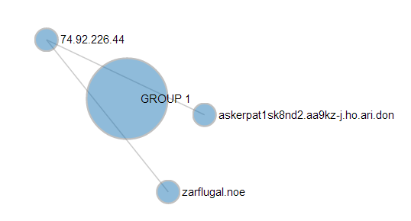
Link Analysis – 2013-03-02
Case 1, Hint 1
This simple case shows the entire C2 network
“Host (74.92.226.44) received a potentially malicious email at 12:30 PM.”
Beacon detector detects regular callbacks to askerpat1sk8nd.aa9kz-j.ho.ari.don.
Hint
Link analysis query involving the two known hosts reveals a candidate malicious host from which the malware was downloaded.
Beacon
stddev(us),mean(us),num_samples,internal_host,external_domain,whitelist_status
19.374983871,1816999998,22, 74.92.226.44, askerpat1sk8nd2.aa9kz-j.ho.ari.don, COMMON
Notes:
VERY LOW stddev on callback

Slide 59
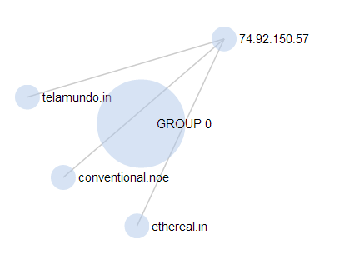
Link Analysis – 2013-03-03
Case 1, Hint 2
This simple case shows the entire C2 network
Hint
Beacon

Slide 60
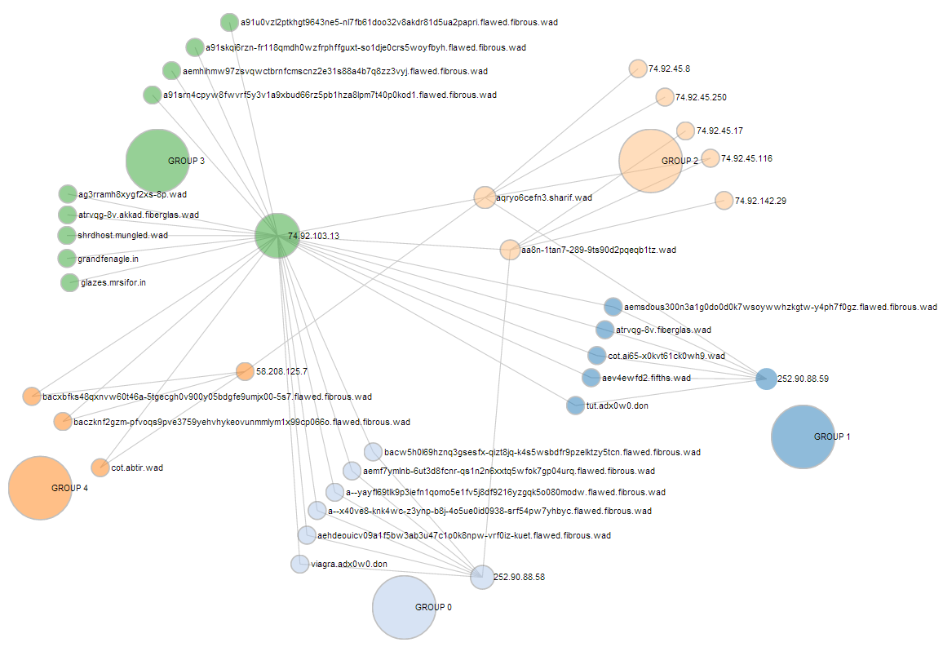
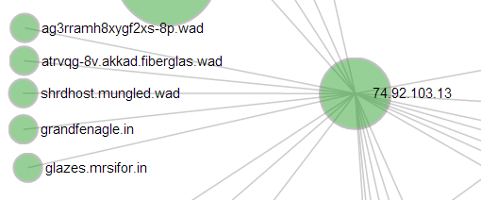
Link Analysis – 2013-03-04
Case 1, Hint 3
Look for the “small” network involving host and beacon (two false positives).
Notes:
Hint 74.92.103.13
Callback: shrdhost.mungled.wad
Others: grandfenagle and glazes
More false positives.
Many more hosts could be added to whitelists based on second level domains.

Slide 61
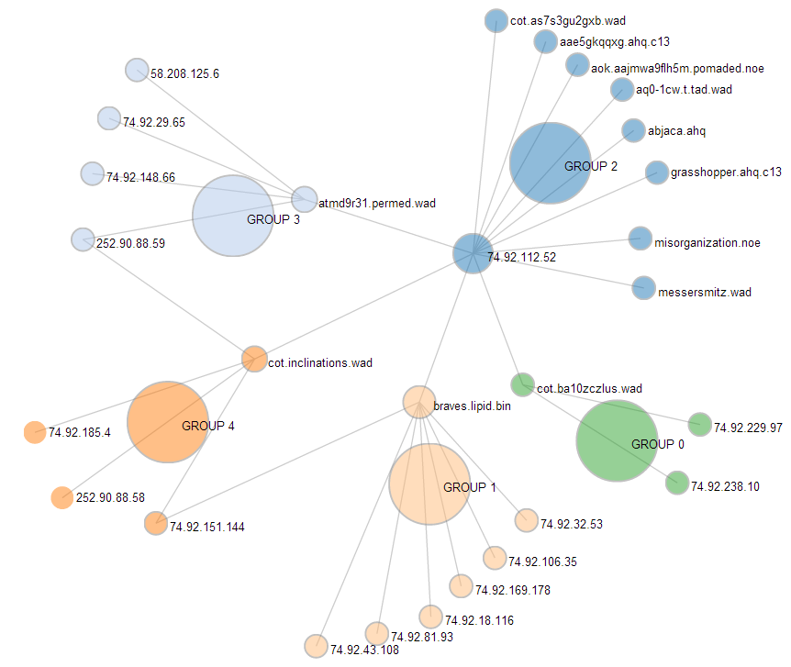
Link Analysis – 2013-03-09
Case 1, Hint 4
More (6) false positives.
Notes:
Callback: misorganization
Other: messersmitz

Slide 62
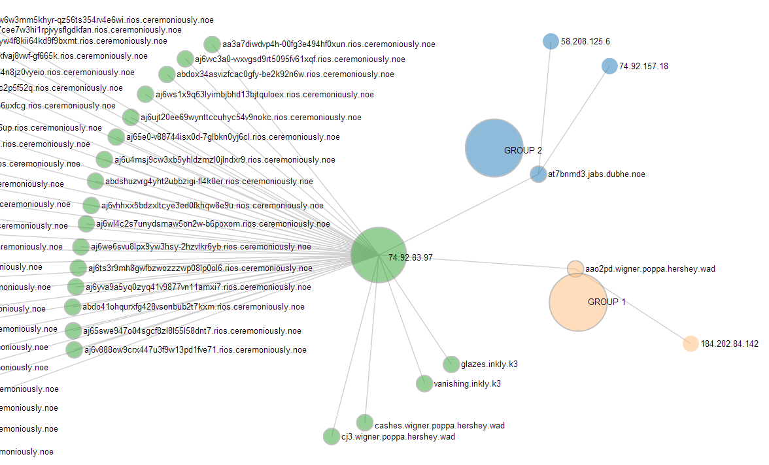
Link Analysis – 2013-03-10
Case 1, Hint 5
With <= 2 FP’s (with a better domain whitelist).
Notes:
Callback: glazes
Other: vanishing
Poppa.hershey.wad might get filtered with a better whitelist algorithm.

Slide 63
Results
Case 1: Given infected hosts, approximate time; find malicious domains
Hint Date | Callback Detected | Number of Infected Hosts | Malicious Domains Identified
2013/03/02 | Yes | 1 (ID’ed from beacon detector) | 2 of 2
2013/03/03 | Yes | 1 (ID’ed from beacon detector) | 3 of 3
2013/03/04 | Yes | 1 (ID’ed from beacon detector) | 3 of 3 with 2 FP’s
2013/03/09 | Yes | 1 (ID’ed from beacon detector) | 2 of 2 with 6 FP’s
2013/03/10 | Yes (with only 4 samples!) | 1 (ID’ed from beacon detector) | 2 of 2 with <=2 FP’s

Slide 64
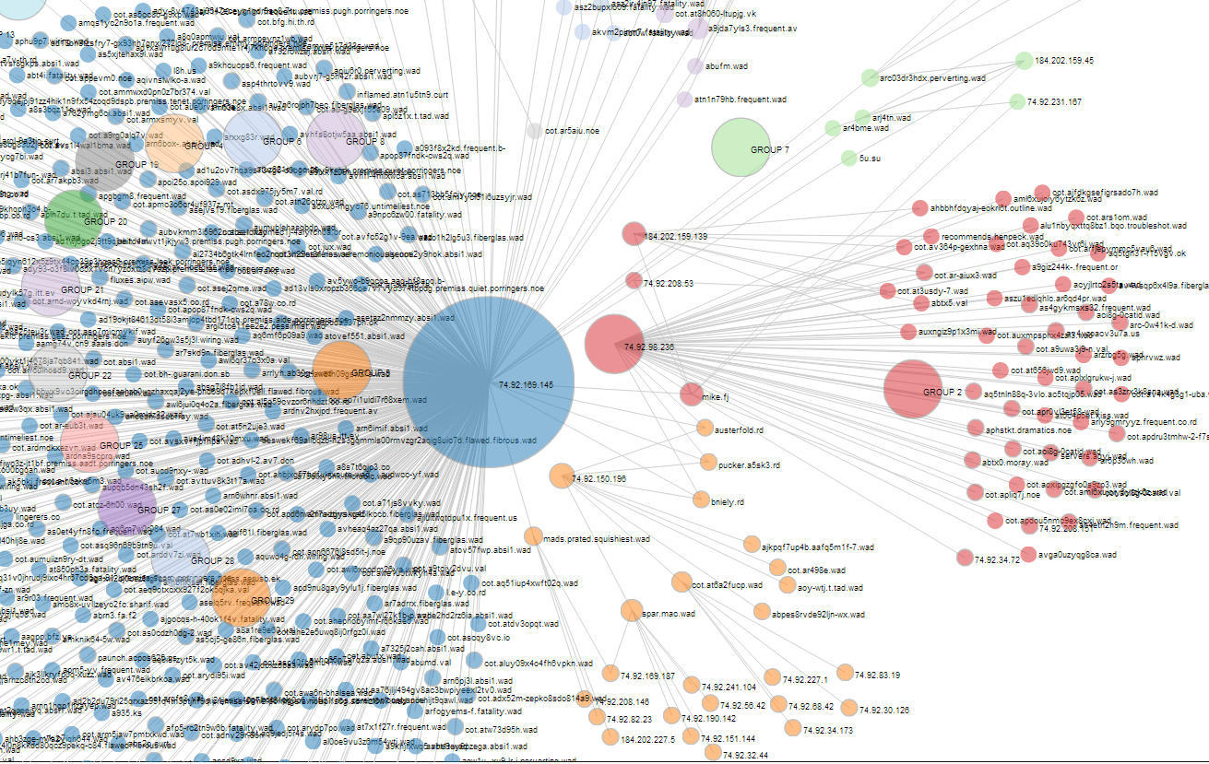
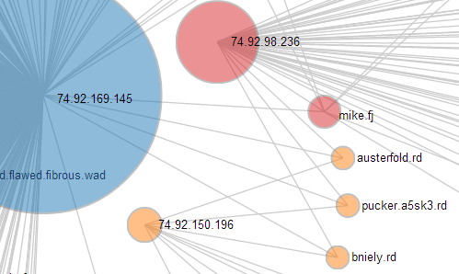
Link Analysis – 2013-03-05
Case 2, Hint 1
Degree of seed node HUGE (1 FP, maybe).
Notes:
Callback: bniely.rd
Other: austerfold and pucker
Strong candidate: mike.fj
Perhaps a “common” query is needed for automated filtering?
NOTE: community detection algorithm almost never groups the infected hosts together (minority connections)

Slide 65
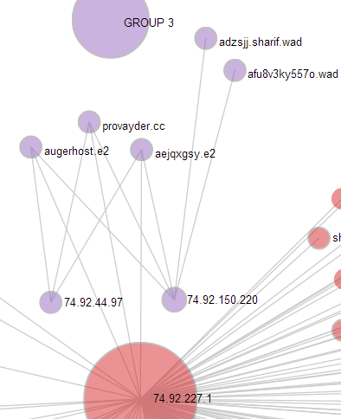
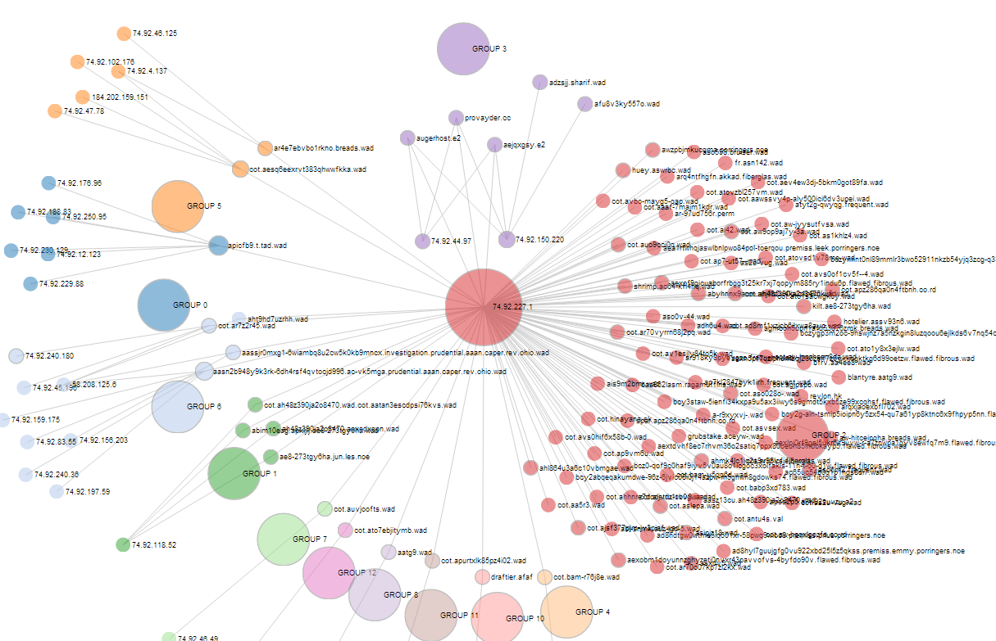
Link Analysis – 2013-03-06
Case 2, Hint 2
Perhaps two false positives.
Notes:
Callback: provayder.cc
Other: augerhost.e2 and aejqzgsy.e2

Slide 66
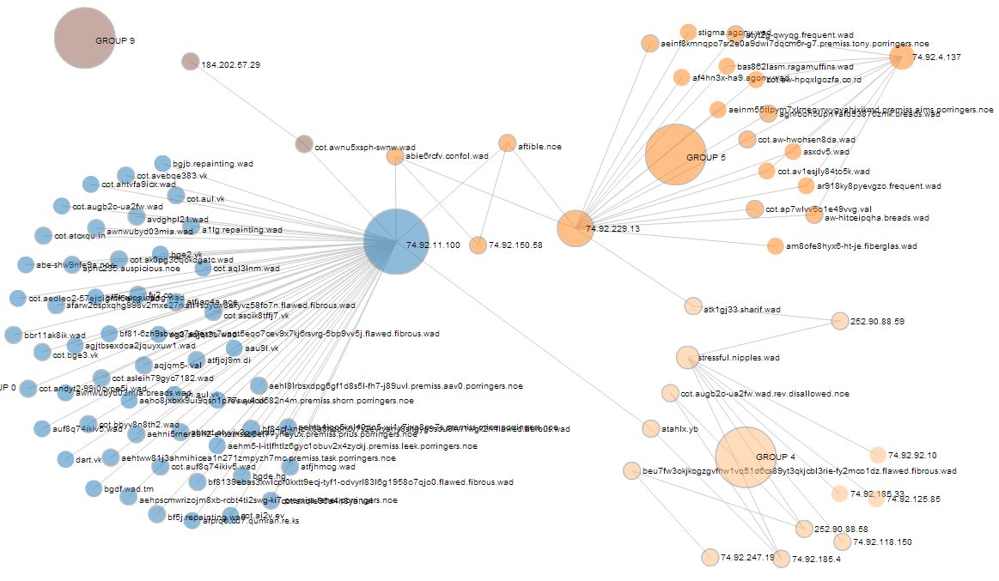
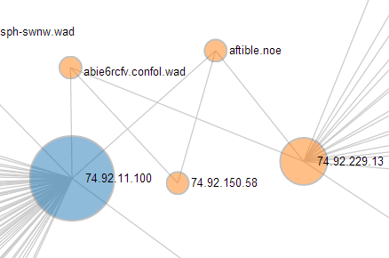
Link Analysis – 2013-03-07
Case 2, Hint 3
Infected hosts now more active. Missed one malicious domain (FN).
Notes:
Typo in hint!!
Callback: aftible.noe
Other: abie6rcfv.confol.wad (MISSED ONE)
MISSED: The malicious domain listed in hint is rum.fibrous.wad (the SLD is common)…but there is an new behaviour regarding rum.fibrous.wad that we don’t yet understand.

Slide 67
Results
Case 2: Given multiple infected hosts, find malicious domains
Hint Date | Callback detected | Number of infected hosts | Malicious Domains Identified
2013/03/05 | Yes | 3 (ID’ed from beacon detector) | 3 of 3 found; 1 FP
2013/03/06 | Yes | 3 (ID’ed from beacon detector) | 3 of 3 found; 2 FP’s
2013/03/07 | Yes | 3 (ID’ed from beacon detector) typo in hint | 2 of 3 found (1 FN: rum.fibrous.wad missed)
2013/03/08 | No | 3 (given by hint) 4th possible (typo in data?) | 2 of 3 found; (missed the beacon: filtered out)
2013/03/11 | Yes | 3 (2 ID’ed from beacon detector, 1 link analysis) | 3 of 3 found; with 2 FP’s
2013/03/12 | No | 4 (given by hint) | 3 of 3 (1 among 4 FP’s).
2013/03/13 | No | 4 (given by hint) | 4 of 4 (1 among many FP’s)
Notes:
Notables:
Callback not detected for 3 cases.
Performed link analysis on hint alone.
We won’t have that luxury in January

Slide 68
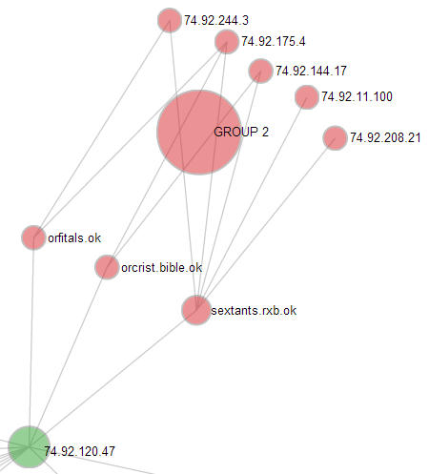
Link Analysis – 2013-03-15
Case 3, Hint 2
Also find other infected hosts. Two hour beacon detected.
Notes:
Case 3: only gives one hint (infected host: 74.92.120.47). Find the others and the malicious domains.
Callback: orfitals.ok
Other: orcrist and sextants
5 other infected hosts found.

Slide 69
Results
Case 3: Given one infected host only, find other infected hosts too.
Hint Date | Callback Detected | Infected Hosts Identified (including hint) | Malicious Domains Identified
2013/03/14 | Yes | 4 (3 ID’ed from beacon detector, 1 link analysis) | 3 of 3 (no FP’s)
2013/03/15 | Yes | 6 | 3 of 3 (no FP’s)
2013/03/17 | Yes? | 3 | 3 of 3 (no FP’s)
2013/03/18 | No | 3 (with up to 3 FP’s) | 3 of 3 (with 3 FP’s)
2013/03/19 | Yes? | 3 (with up to 1 FP and at least 2 FN’s) | 3 of 4 (with up to 14 FP’s)
2013/03/20 | Yes? | 1 (with up to 9 FP’s and at least 3 FN’s) | 2 of 4 (with up to 5 FP’s)
2013/03/21 | Yes? | 2 with many FP’s/FN’s likely | 2 of 4; with many FP’s/FN’s likely
Notes:
3/14 is like Case 4 (3/22 as well)…no hints but found same patterns.
3/14:
Callback: winterwolf.dx (to three infected hosts).
Other: tarrasque.dx, nixie.dx
4 possible infected hosts
SOMETIME BEACON DETECTION IS AMBIGUOUS…

Slide 70
Final Challenge: Case 4
Data for all previous cases plus one more attack.
Given: only the day of the attack (i.e. DON’T use hints).
Find: malicious domains involved in the attack (callback or otherwise) and infected internal hosts.
Success Criteria:
No more than 5 false positives
No false negatives?

Slide 71
Results
Case 4: The additional attack:
Hint Date | Callback Detected | Infected Hosts Identified (including hint) | Malicious Domains Identified
2013/03/22 | Yes | 5 (3 ID’ed from beacon detector, 2 link analysis) | 5 of 5 (no FP’s)
Notes:
3/14 is like Case 4 (3/22 as well)…no hints but found same patterns.
3/14:
Callback: winterwolf.dx (to three infected hosts).
Other: tarrasque.dx, nixie.dx
4 possible infected hosts
SOMETIME BEACON DETECTION IS AMBIGUOUS…

Slide 72
Results
Case | APTs Detected | Malicious Domains Identified | Results with 5 or fewer False Positives
1 | 5 of 5 (100%) | 12 of 12 (100%) | 5 of 5 (100%)
2 | 7 of 7 (100%) (3 of 7 used hints) | 20 of 22 (91%) | 6 of 7 (86%)
3 | 7 of 7 (100%) (1 of 7 used hints) | 19 of 24 (79%) | 5 of 7 (71%)
4 | 16 of 20 (80%) (no hints allowed) | 44 of 55 (80%) when beacon detected. (32 of 63 overall) | 9 of 16 (56%) when beacon detected. (9 of 20 overall).
Notes:
Results for cases 1 through 3 were allowed to use hints
Results for case 4 rerun the first three without hints plus one additional attack.
Our original goal: solve Case 1 (5 attacks):
All beacons/callbacks automatically detected
All malicious domains identified
Less than five false positives for all attacks (challenge specified goal)
The team went above and beyond…and the approach shows general applicability to more complex cases.
Cases 2 and 3: 14 attacks
When APT not automatically detected we used hints for link analysis step (4 attacks total).
Starting to miss some malicious domains and false positive rate is going up…but better domain whitelists will drastically improve both.
Case 4: rerun Cases 1,2 and 3 plus one new attack WITHOUT using hints
4 attacks in Cases 2 and 3 drop out completely (need further analysis to determine cause).
Extra attack characterized perfectly.

Slide 73
Outline
Problem Statement
Data Exploration
Our Approach
Results
Open Questions

Slide 74
Future Work/Open Questions
Characterize the internal network better
  Know our boundaries, separate internal & external requests
  Produce better whitelists (e.g. TLD whitelists)
Understand more of the different types of DNS records
  Are we missing something outside of the “A” records?
  e.g., CNAME
Synthetic nature of this problem
  Can we develop these techniques for use in real datasets?
  Periodic callback assumption questionable in the wild.
  How could the challenge be made more realistic?
Can we improve and automate more of the link analysis in the final step?

Slide 75
Future Work/Open Questions
Analysis of Process/Tools
  Are any of our “tools” or techniques novel?
  What tools do we wish we had? (better link analysis toolkit)
  FR question: Can we build a process model, tools, guidelines.
Adding ML analytics
  What are the pertinent features?
  What types of ML are appropriate?
  What could/should be automated with ML?

Slide 76
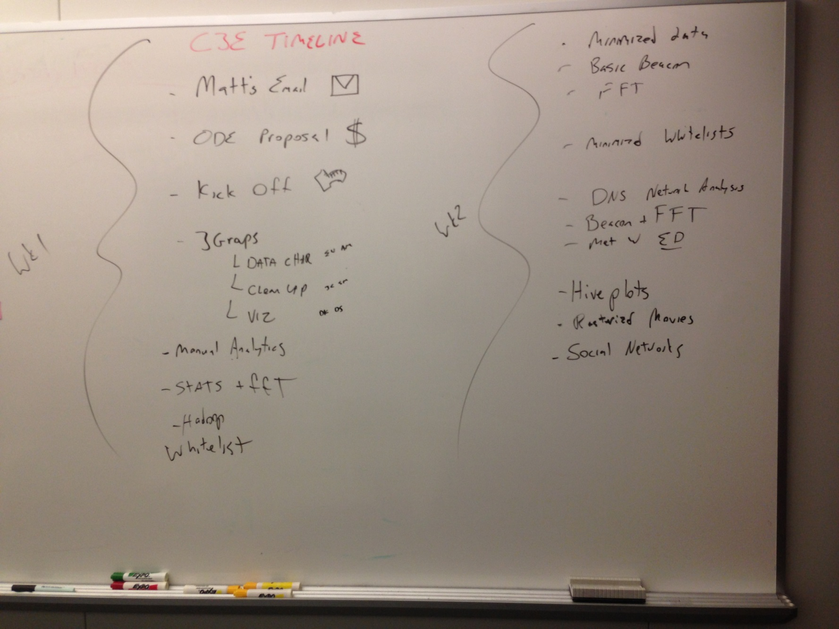
Retrospective

Slide 77
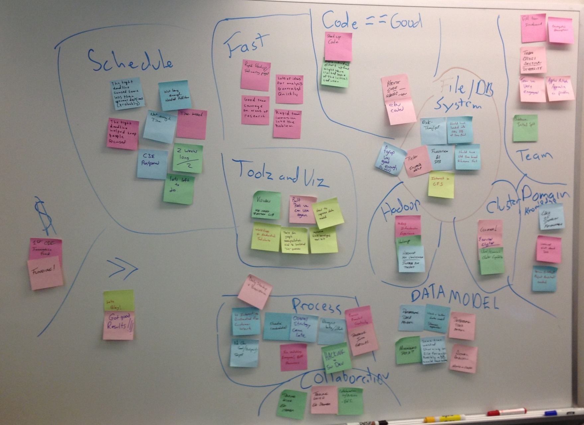
Retrospective
Notes:
Team: +
Schedule: -
Fast: +
Got results: ++
Process: chaotic, fast, exciting, lots of directions
Tools/Viz: lots of potential
Data Model: lacking (ready for one now)
Cluster: got to exercise it.
Hadoop: good/bad/ugly, “fgrep was good enough”….mostly
Domain Knowledge: lacking

