Slide 1
Science of Human Circumvention of Security
Sean Smith, Ph.D., Dartmouth
Jim Blythe, Ph.D., USC
Ross Koppel, Ph.D., Univ. of Penn
David Nicol, Ph.D., Univ of Ill. Uber PI

Slide 2
Project Aims: Human Actions to work with Cyber Access Security Controls
Develop & model metrics so security engineers & other stakeholders can make:
meaningful, quantifiable comparisons, decisions, & evaluations of proposed security controls when these controls are deployed
with busy humans, rather than just rule books or assumed actions.

Slide 3
Science of Human Circumvention of Security
To better understand and to model computer access workarounds—their:
Reasons, Norms, and Justifications
Tasks, Urgency, and Environments
Role in others rule-following behaviors
Methods of discovery
Sensible (responsible & used) controls

Slide 4
Workarounds to Security:
Rigidity and Rules vs. Reality
CMU: September, 2013
Science of Human Circumvention of Security
Ross Koppel, Ph.D., FACMI
University of Pennsylvania and Harvard Medical School
rkoppel@sas.upenn.edu

Slide 5
Ross Koppel, Ph.D., FACMI
University of Pennsylvania: Faculty: Sociology Dept. & PI, School of Medicine
Co-PI: Science of Human Circumvention of Security
Co-I NSF: Safe Cyber Medical Devices info exchange
Harvard Medical School: Internal Evaluator, Project to create a new HIT architecture with substitutable Apps (SMART); FDA study of CPOE and Medication Errors
Co-PI AHRQ’s Guide to Reducing HIT’s Unintended Consequences
>Author: First Do Less Harm: Confronting The Inconvenient Problems Of Patient Safety.
rkoppel@sas.upenn.edu

Slide 6

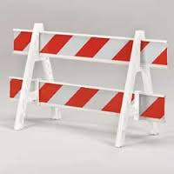
White Hats
People just trying to do their work
Workarounds – especially to cyber access
Good intent: unintended outcomes
Usually unfortunate rules: with lousy outcomes: lost productivity, frustration; more circumvention? Security engineering doesn’t work if we base it on the fantasy that all good users fully comply!

Slide 7

Most Workarounds: symptoms, not the problem
(but can become the problem)
1

Slide 8
Examples of workarounds
Some medical
Some military
Some engineering
Some business
Some intelligence

Slide 9
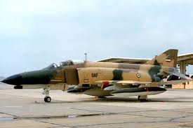
Canopy

Slide 10
Software

Slide 11
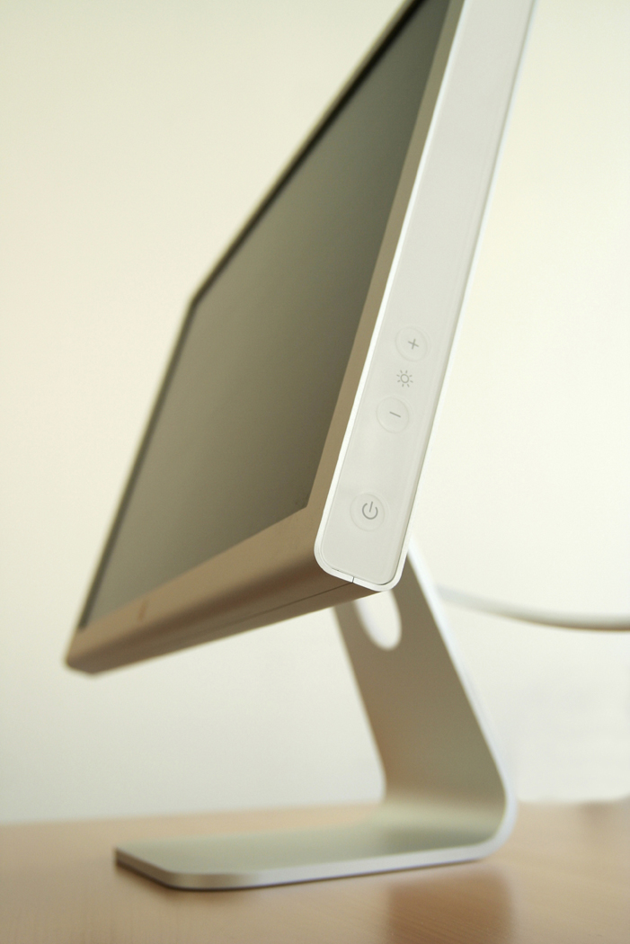
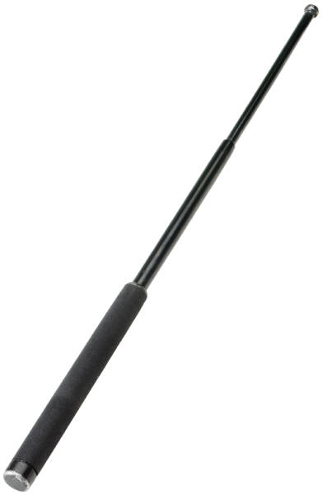
Proximity Indicator
Antenna

Slide 12

Styrofoam Cup

Slide 13
Proximity Indicator: Defeated

Slide 14
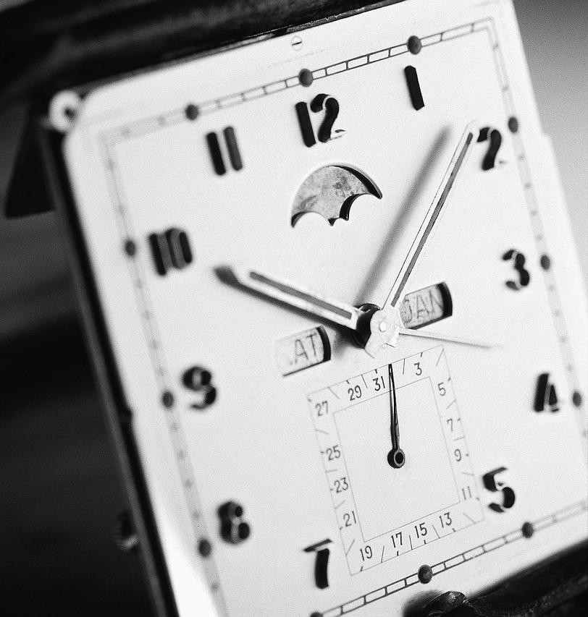
Stealth Dosing
Bug Beeper (Anti Microbial Monitoring Unit)
8 AM to 10 PM
Reasons: cost and patient safety
Workaround: Stealth Dosing

Slide 15
Unnamed US defense agency rules on passwords;
Solution: “Forget” password on day 1 of 90-day change: Get pw reset; and find ALL previous password info lost or ignored. Bingo: You get to keep same password forever
Change every 90 days; and must have 2 caps, 2 #s, 2 lower case characters, 2 special characters.
Can’t reuse for 5 iterations

Slide 16
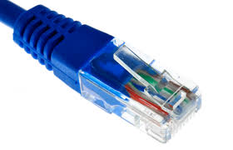
Reach behind (in)security

Slide 18
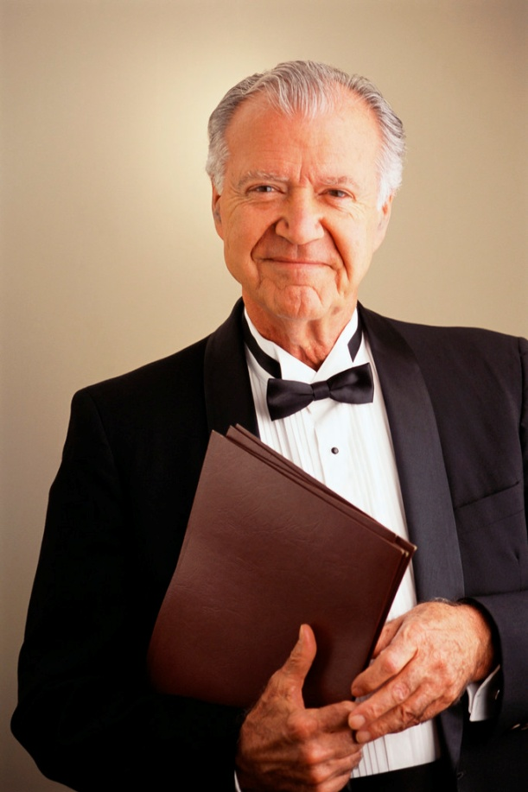
Menus and Workarounds

Slide 19
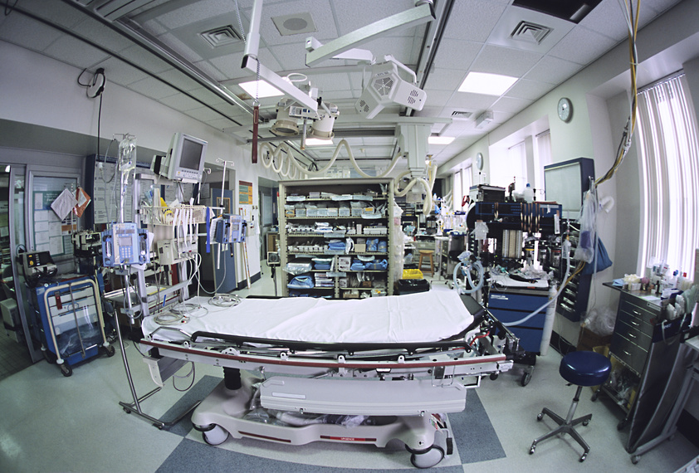
Too Low Blood Pressure in the ER for…
the Computer

Slide 20
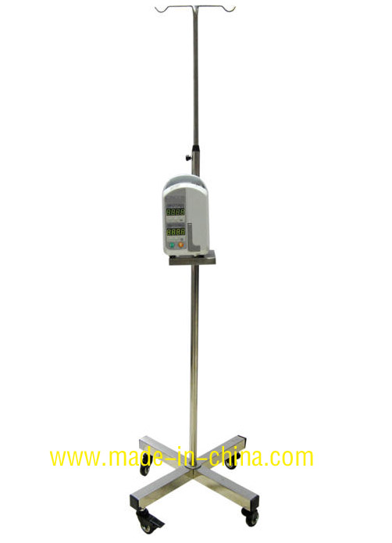
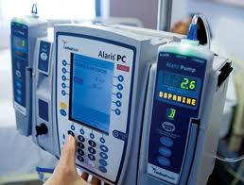
INFUSION PUMP AND LARGE PEOPLE

Slide 21

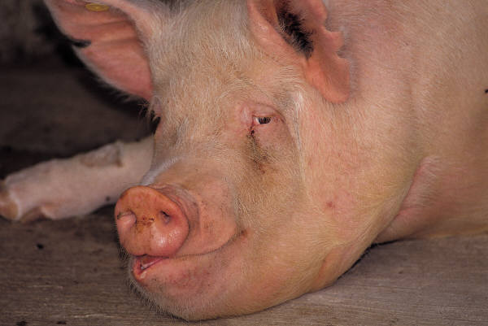
Circumvention & Workarounds Rule (the Rule)

Slide 22
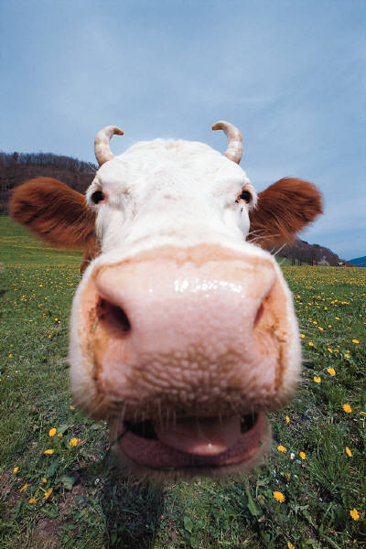

BCMA study Results:
31 CAUSES OF WORKAROUNDS
15 WORKAROUNDS
Notes:
WE”ll TALKED ABOUT THE FAT COW. I’LL EXPLAIN THE BANGLES.

Slide 23
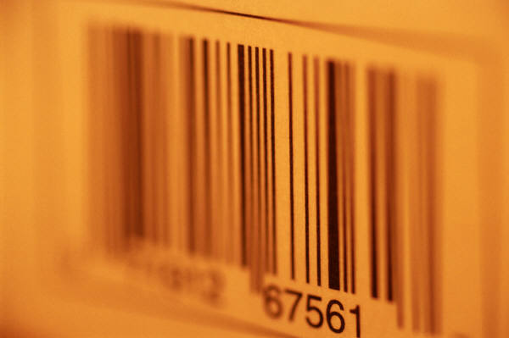
31 Causes of workarounds e.g.,
Unreadable medication-barcodes (crinkled, smudged, torn, missing, covered by another label)
malfunctioning scanners
Don’t forget to scan label!

Slide 24
Causes:
unreadable or missing patient-ID-wristbands (chewed, soaked, wrong, missing)
  Elderly
  Children
  Moving (unit or floor or nursing home)
And: *Covered and *Contact isolation
New: *Intentional (not in paper)

Slide 25

Causes
Uncertain wireless connectivity
Dumb programming
(2 X 10 = 20?)
Notes:
Don’t know if it’s scanner, connection, hospital structure, wrong pt, wrong drug

Slide 26
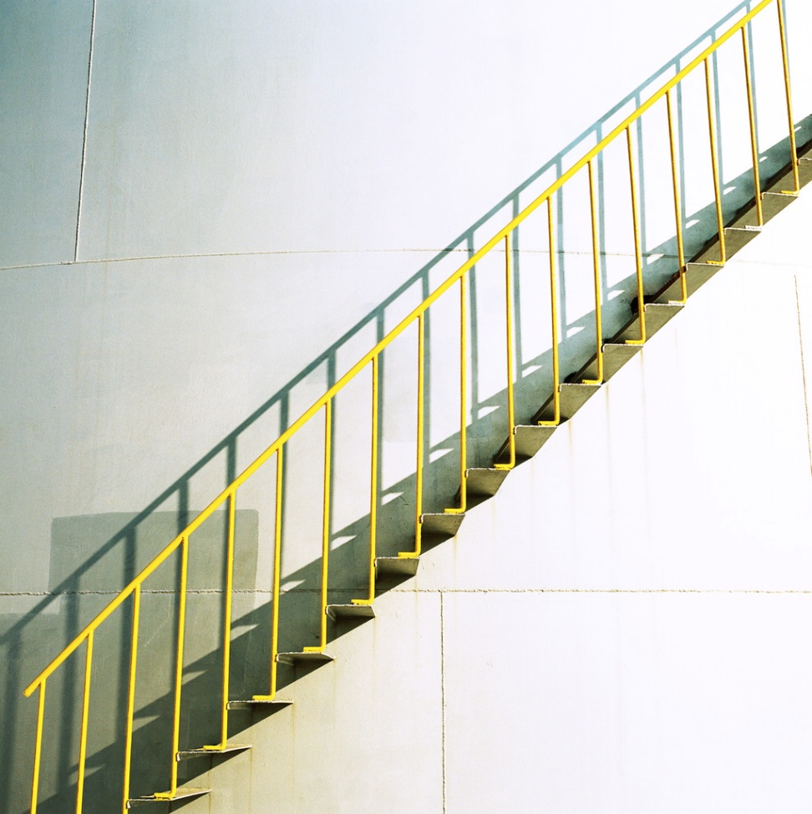
Refrigerated Medicines
Notes:
92 yr old woman. Cut off arm. Wheel pt across hosp floor down stairs. Make extra copy of wrist band. Make other copies.

Slide 27


Now, The fun stuff:
15 identified Workarounds
Barcodes affixed to:
RN clipboard
Scanner itself
In nurses’ pockets,
Belt-rings,
Worn as bangles
Notes:
Click 6ish times

Slide 28
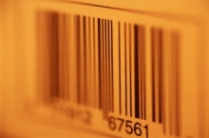
More places we found extra copies of pt. barcodes (1st workaround, continued)
Nurses’ desk
Medication cart
Supply room
Med dispensing machine
Doorjamb
Baby crib
Other places…
Notes:
Click 8 x

Slide 29
And More Workarounds…
BANKS…. and the Ghost Card
You want a deposit?

Slide 30
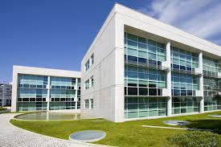
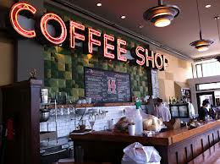
Tight building cyber security and the nearby coffee shop

Slide 31
Why?
Computers don’t know when to look away
Failure to design….
Failure to see work in practice
Failure to Search….Independence helps
Self report/Self examination unreliable. Why?
Every change anywhere means….
A solution: Constant vigilance and an open mind

Slide 32
Our project
Almost a year of field work and interviews
Survey of users, designers, security leaders, etc
Use DASH*software to model human actions, responses to frustration, enterprise rules
Identify and examine hypotheses about:
-Role in others rule-following behaviors
-Tasks, Urgency, and Environments
*Blythe, "A Dual-Process Model for Testing Resilient Control Systems", International Symposium on Resilient Control Systems, 2012

Slide 33
(Our Project 1.1) Publications
J of the Amer Medical Informatics Assoc
Workarounds to Barcode Medication Administration Systems: Their Occurrences, Causes, & Threats to Patient Safety Koppel et al
Healthcare Information Technology’s Relativity Problems: A Typology Of How Patients’ Physical Reality, Clinicians’ Mental Models, And Healthcare Information Technology Differ Sean W. Smith, Ross Koppel
IEEE: Systems Security Circumvention of Security: Good Users Do Bad Things
Jim Blythe, Ross Koppel, Sean W. Smith

Slide 34
Our project (2)
More: Identify and examine hypotheses about:
-Corrosive role of annoying cyber security rules
-Corrosive role of “everyone does it”
-Positive role of responsive cyber security rules --Positive role of aligning security tasks with responsibilities (you break it, you own it &…)

Slide 35
Our project (3)
Parameters of cyber security workarounds:
time constraints
perceived need of the task
professional authority and autonomy of the user
behavior of the bureaucracy in similar settings
laws relevant to the action
regulatory conflicts about computer security vs. requirements to do everything possible to perform the task.

Slide 36
Our project (4)
*Create and test reproducible metrics
*Catalog types and causes of circumvention by well-intentioned users. Data Sources:
Help desk logs, logs of all security-related computer changes, analysis of user behavior in situ, interviews and observations
Simulations and measurement of policy changes and technology decisions
What works in reality & the science behind it

Slide 37
Thank you.
Questions?
Ross Koppel, Ph.D.
Sociology Department, School of Arts & Sciences, &
Center for Clinical Epidemiology & Biostatistics,
School of Medicine, University of Pennsylvania;
rkoppel@sas.upenn.edu

