Slide 1

Science of Security Research Update
Stuart Krohn & Adam Tagert, Ph.D.
National Security Agency
Research Directorate
Science of Security
sakrohn@tycho.ncsc.mil
Adam.c.tagert.civ@mail.mil

Slide 2

A Fundamental Challenge
Mid 2000s, a focus effort need to move from Art to Science
Doing it twice, two results
Lack of scientific reasons for taking an approach
  Fundamentals in other disciplines
Many Compare to need for building and fire codes
Notes:
In the mid to late 2000s, cybersecurity experts were having discussions and workshops on moving the practices of cybersecurity from art to a scientific discipline. This was needed to parlay the ever increasing cy

Slide 3
What is science?
Rigorous
Repeatable
Predictable
Long lasting impact
Not completely there yet.

Slide 4
Establishment of Science of Security (SoS)
How to nudge the creation of a science?
Lots of meetings, workshop at Berkeley. Greater than NSA
2012 NSA starts a Science of Security Initiative in Research Directorate
  Completely Open and Unclassified
  Foundational
Goal of self sustaining field

Slide 5
Parts of Building a Science
Foundational Research
Rigorous Research Methods
Growing a SoS Community

Slide 6
Foundational Research

Slide 7





Lablets
Lablet – a small lab
Competitive Selection
Began 2012 using an ARO grant to 3 universities
2014 – NSA contract with 4 Universities
  From a BAA
  About $8 million per year total
  20% of funding to other institutions (29 other Universities)
  For Research and to build a science
260 Published Papers

Slide 8
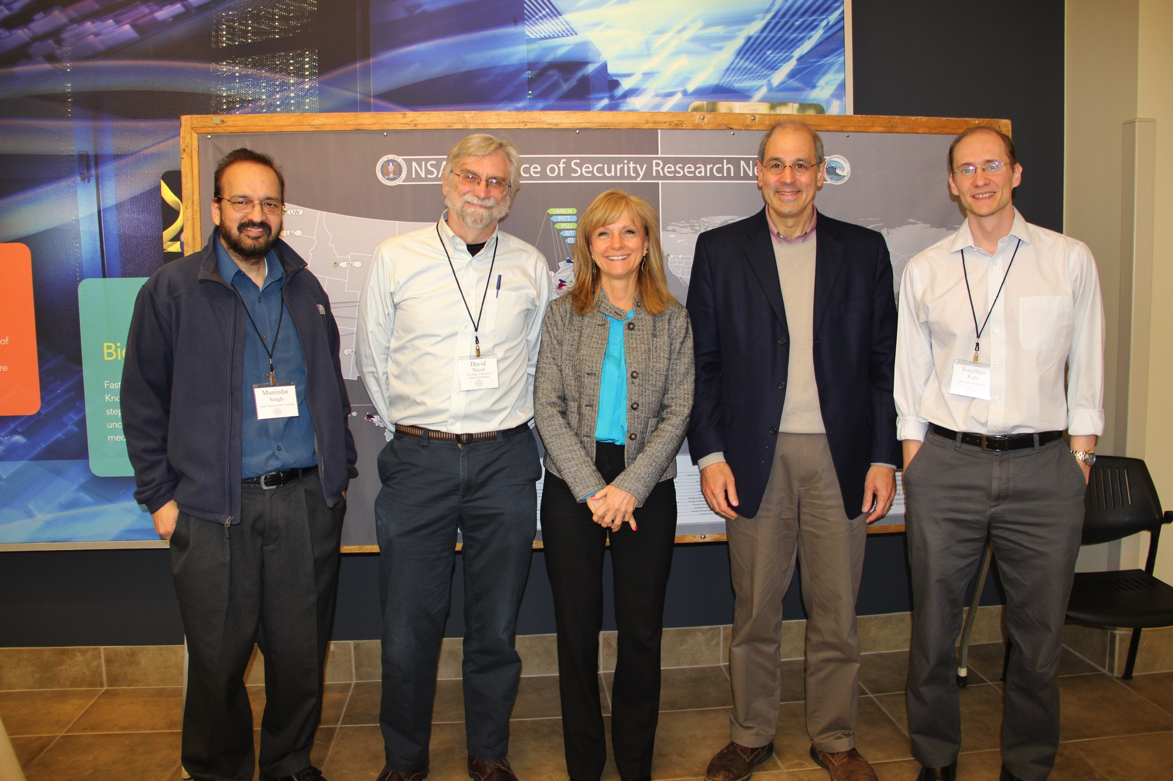
Lablet Funding Supports
Research
Salaries and/or Tuition of Professors, Researchers, Post-Docs, Ph.D. Students, Masters Students, and undergraduate research
Outreach activities for making a science

Slide 9
5 Hard Problems
A Measure for Progress
Developed by lablet PIs
Not all inclusive
Needed for improving cybersecurity situation
Resilient Architectures; Scalability and Composability; Secure Collaboration; Metrics; Human Behavior
Update Paper on Progress; coming soon.

Slide 10
Research Aligned to the Hard Problems
Resilient Architectures |  | Scalability and Composability |  | Policy Governed Secure Collaboration
CMU (2) NCSU (8) UIUC (2) |  | CMU (7) NCSU (4) UIUC (3) UMD (3) |  | CMU (1) NCSU (3) UIUC (2) UMD (1)
Metrics |  | Human Behavior
CMU (5) NCSU (4) UIUC (5) UMD (2) |  | CMU (3) NCSU (5) UIUC (3) UMD (6)

Slide 11
Research Highlights 1
Resilient Architectures
  Power Grid (UIUC)
Scalability and Composability
  WYVERN (CMU)
Human Behavior
  USE: User Security Behavior (CMU)

Slide 12
Research Highlights 2
Secure Collaboration
  E-voting Protocol (UMD)
Metrics
  Attack Surface and Defense-in-Depth Metrics (NCSU)
CPS
  Cube Sat Command & Control (Vanderbilt)

Slide 13
Science of SecUre and REsilient Cyber-Physical Systems (SURE)
Additional Research
Foundational Research on Cyber Physical Systems – Internet of Things
About $1 million / year

Slide 14
Rigorous Research Methods

Slide 15
Lablets Adding Science
Security Science Classes
Revising curriculum to include security
NCSU Industry Day, Summer Workshop
UIUC Summer Internship

Slide 16
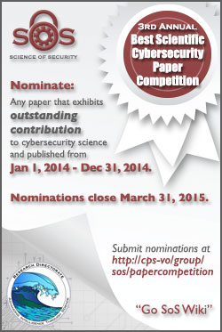
Best Scientific Cybersecurity Paper Competition
Identify and Recognize the best cybersecurity paper
Purpose: to hold up the best example of scientific work as an example
Papers are Reviewed by Panel of Distinguished Experts
  Findings sent to RD Director for Selection
Current Status – Waiting for RD Dir Review
  3rd Annual, 50 nominations
Notes:
Committee:
Dr. Whitfield Diffie, Cybersecurity Advisor
Dr. Dan Geer, In-Q-Tel
Dr. John McLean, Naval Research Laboratory
Prof. Angela Sasse, University College London
Prof. Fred Schneider, Cornell University
Mr. Phil Venables, Goldman Sachs
Prof. David Wagner, University California at Berkeley
Dr. Jeannette Wing, Microsoft Research

Slide 17
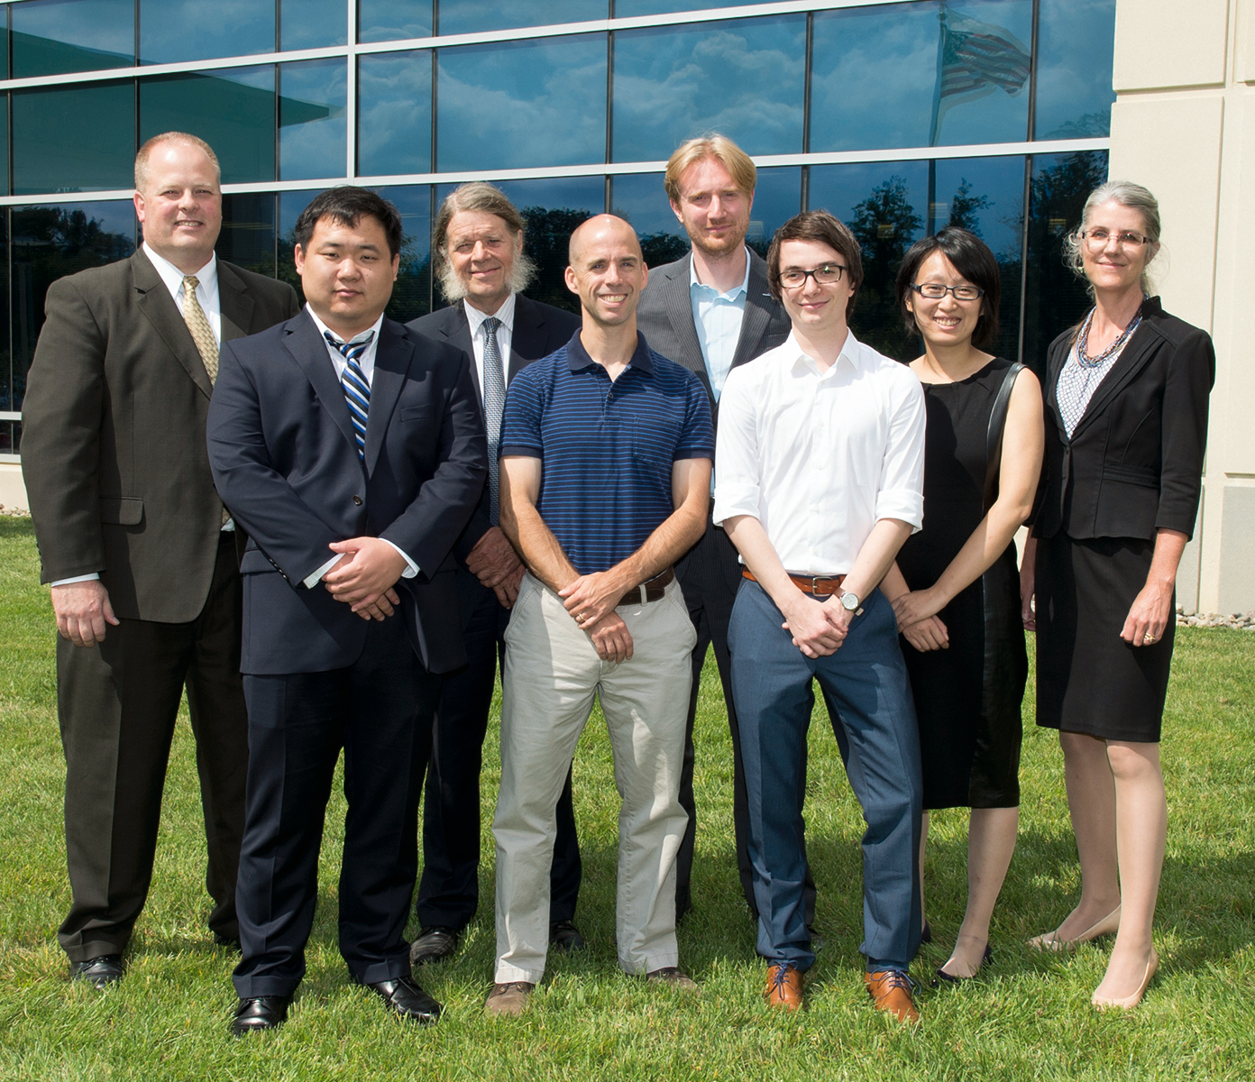
Winners
2nd Winners: Memory Trace Oblivious Program Execution (University of Maryland)
2nd Honorable Mention: Rethinking SSL Development in an Appified World (Leibniz University in Hannover, Germany)

Slide 18
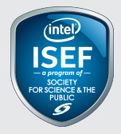
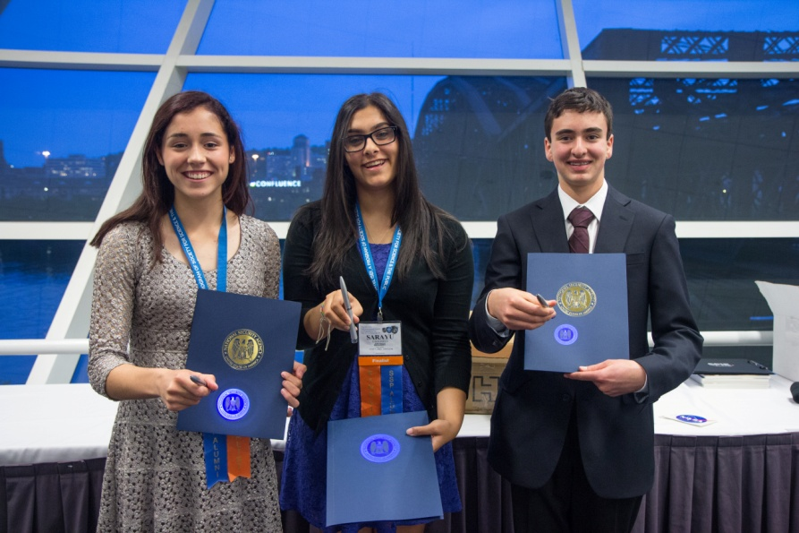
Intel International Science and Engineering Fair Award
Sponsor and Special Award Organization
Recognize top high school cyber security projects
Encourage students to enter cyber security research and careers
Pittsburgh 2015 – 1702 Students, 81 Projects, 18 Interviewed, 3 Winners
First Place ($3,000): A Novel Algorithm for #SAT Using Inclusion-Exclusion Principle and Memorization by Elliot Gorokhovsky, 16 from Fairview High School in Boulder, Colorado

Slide 19
Growing a Community

Slide 20
Lablets for Growth
Intra and inter institutional collaboration
New doctors become professors, other field, carrying SoS

Slide 21
Science of Security Lablets

Slide 22
Science of Security Lablets & Sub-Lablets

Slide 23
Science of Security Lablets, Sub-Lablets, SURE and Collaborators

Slide 24
Science of Security International Sub-Lablets and Collaborators

Slide 25


HOT-SOS – Hot Topics in Science of Security: Symposium and Bootcamp on the Science of Security
Annual Public Meeting for the Science of Security Community
Goal of becoming a premier conference of SoS
Academic Gathering, partial sponsorship by ACM
2015 Meeting in Pittsburgh. See VO for updates
http://www.hot-sos.org

Slide 26
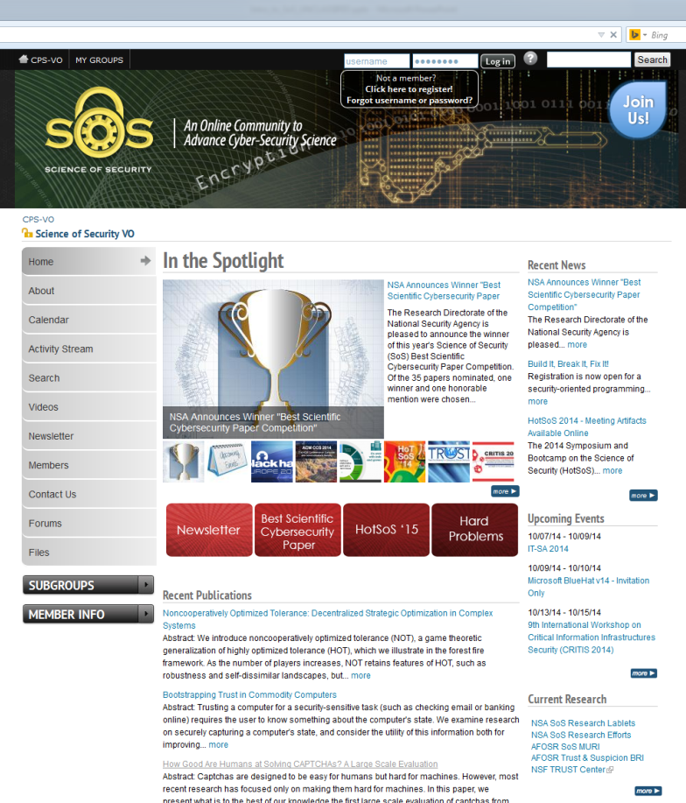
Science of Security Virtual Organization (SoS-VO)
A website built on NSF collaboration platform
Building a place to enable a geographically disperse community to engage and collaborate
Find News, SoS Projects, Papers, Events, Funding Opportunities, News Letter
Over 650 members
URL: http://www.sos.-vo.org

Slide 27
=Sum(Slides)
Summing UP

Slide 28
Participating in the Science of Security
Join the SoS VO – http://www.sos-vo.org
  Contribute to the Discussion and engage with Researchers
  Find the papers published by SoS Researchers
  Other Relevant Materials for SoS
Nominate Papers for the Paper Competition
Attend HOT-SoS 16
Read The Next Wave
Apply Scientific Principles to Your Cybersecurity Issues

Slide 29
Great Alignment with 2011 Strategic Plan
3.2 Developing Scientific Foundations
…A more fruitful way to ground research efforts, and to nurture and sustain progress in the kinds of improved cybersecurity solutions that benefit society, is to develop a science of security. Developing a strong, rigorous scientific foundation to cybersecurity helps the field in the following ways:
••Organizes disparate areas of knowledge – Provides structure and organization to a broad-based body of knowledge in the form of testable models and predictions
••Enables discovery of universal laws – Produces laws that express an understanding of basic, universal dynamics against which to test problems and formulate explanations
••Applies the rigor of the scientific method – Approaches problems using a systematic methodol­ogy and discipline to formulate hypotheses, design and execute repeatable experiments, and collect and analyze data
class of problems; range of scientific methods; common terminology
The government portfolio portion of the science of security to support activities that investigate fundamental laws and enable repeatable experimentation to increase our understanding of the underlying principles of securing complex networked systems

Slide 30
Great Alignment with 2011 Strategic Plan (2)
Research is required to develop:
  ••Methods to model adversaries
  ••Techniques for component, policy, and system composition
  ••A control theory for maintaining security in the presence of partially successful attacks
  ••Sound methods for integrating humans in the system: usability and security
  ••Quantifiable, forward-looking security metrics (using formal and stochastic modeling methods)
  ••Measurement methodologies and testbeds for security properties
  ••Comprehensive, open, and anonymized data repositories
An important effect of this strategic plan is that it provides a basis for discussion among researchers aligned to common objectives
Although our national-level initiatives focus on research activities within the United States, cyber­space—with its vast interaction space of information, markets, and services—knows no borders.

Slide 31
Thoughts on 2015

Slide 32
Thank You / Questions

Slide 33
Project Lists

Slide 34
Resilient Architectures
UIUC 1.2.2 Measurement Driven Security Analytics
UIUC 1.2.3 Hypothesis Testing for Network Security
NCSU 2.1 M1: Attack Surface and Defense-in-Depth Metrics
NCSU 2.2 M2: Systematization of Knowledge from Intrusion Detection Models
NCSU 2.3 M3: Vulnerability and Resilience Prediction Models
NCSU P1: Understanding Effects of Norms and Policies on the Robustness, liveness, and Resilience of Systems
NCSU R1: Resilience Requirements, Design, and Testing
NCSU R2: Redundancy for Network Intrusion Prevention Systems (NIPS)
NCSU R5: Smart Isolation in Large-Scale Production Computing Infrastructures
NCSU R6: Automated Synthesis of Resilient Architectures
CMU Project 1 – Frameworks, APIs, and Composable Security Models
CMU Project 9 – Multi-model run-time security analysis

Slide 35
Scalability and Composability
UMD Task 1: Verifcation of Hyperproperties
UMD Task 2: Trustworthy and Composable Software Systems with Contracts
UMD Task 10: Trust, Recommendation Systems, and Collaboration
UIUC 1.2.1 Security Metrics for Cyber-Physical Systems
UIUC 1.2.3 Hypothesis Testing for Network Security
UIUC 1.2.6 Science of Human Circumvention of Security
NCSU 2.1 M1: Attack Surface and Defense-in-Depth Metrics
NCSU 2.2 M2: Systematization of Knowledge from Intrusion Detection Models
NCSU 2.3 M3: Vulnerability and Resilience Prediction Models
NCSU P2: Formal Specification and Analysis of Security-Critical Norms and Policies
CMU Project 1 – Frameworks, APIs, and Composable Security Models
CMU Project 2 – Limiting Recertification in Highly Configurable Systems: Analyzing Interactions and Isolation among Configuration Options
CMU Project 3 – Security Reasoning for Distributed Systems with Uncertainties
CMU Project 6 – Compositional security
CMU Project 8 – A Language and Framework for Development of Secure Mobile Applications
CMU Project 9 – Multi-model run-time security analysis
CMU Project 10 – Race Vulnerability Study and Hybrid Race Detection

Slide 36
Policy Governed Secure Collaboration
UMD Task 10: Trust, Recommendation Systems, and Collaboration
UIUC 1.2.3 Hypothesis Testing for Network Security
UIUC 1.2.6 Science of Human Circumvention of Security
NCSU P1: Understanding Effects of Norms and Policies on the Robustness, Liveness, and Resilience of Systems
NCSU P2: Formal Specification and Analysis of Security-Critical Norms and Policies
NCSU P3: Scientific Understanding of Policy Complexity
CMU Project 17 – Geo-Temporal Characterization of Security Threats

Slide 37
Metrics
UMD Task 5: Empirical Models for Vulnerability Exploits
UMD Task 8: User-Centered Design for Security
UIUC 1.2.1 Security Metrics for Cyber-Physical Systems
UIUC 1.2.2 Measurement Driven Security Analytics
UIUC 1.2.3 Hypothesis Testing for Network Security
UIUC 1.2.6 Science of Human Circumvention of Security
UIUC 1.2.7 Data-Driven Model-Based Decision-Making
NCSU 2.1 M1: Attack Surface and Defense-in-Depth Metrics
NCSU 2.2 M2: Systematization of Knowledge from Intrusion Detection Models
NCSU 2.3 M3: Vulnerability and Resilience Prediction Models
NCSU R1: Resilience Requirements, Design, and Testing
CMU Project 1 – Frameworks, APIs, and Composable Security Models
CMU Project 2 – Limiting Recertification in Highly Configurable Systems: Analyzing Interactions and Isolation among Configuration Options
CMU Project 9 – Multi-model run-time security analysis
CMU Project 10 – Race Vulnerability Study and Hybrid Race Detection
CMU Project 12 –Usable Formal Methods for the Design and Composition of Security and Privacy Policies

Slide 38
Human Behavior
UMD Task 6: Human Behavior and Cyber Vulnerabilities
UMD Task 7: Does the Presence of Honest Users Affect Intruders' Behavior?
UMD Task 8: User-Centered Design for Security
UMD Task 9: Understanding Developers' Reasoning about Privacy and Security
UMD Task 10: Trust, Recommendation Systems, and Collaboration
UMD Task 11: Reasoning about Protocols with Human Participants
UIUC 1.2.2 Measurement Driven Security Analytics
UIUC 1.2.6 Science of Human Circumvention of Security
UIUC 1.2.7 Data-Driven Model-Based Decision-Making
NCSU 2.2 M2: Systematization of Knowledge from Intrusion Detection Models
NCSU H1: Warning of Phishing Attacks: Supporting Human Information Processing, Identifying Phishing Deception Indicators, and Reducing Vulnerability
NCSU H3: A Human Information-Processing Analysis of Online Deception Detection
NCSU H4: Leveraging the Effects of Cognitive Function on Input Device Analytics to Improve Security
NCSU P3: Scientific Understanding of Policy Complexity
CMU Project 8 – A Language and Framework for Development of Secure Mobile Applications
CMU Project 12 –Usable Formal Methods for the Design and Composition of Security and Privacy Policies
CMU Project 13 – Understanding user behavior when security is a secondary task

