Slide 1
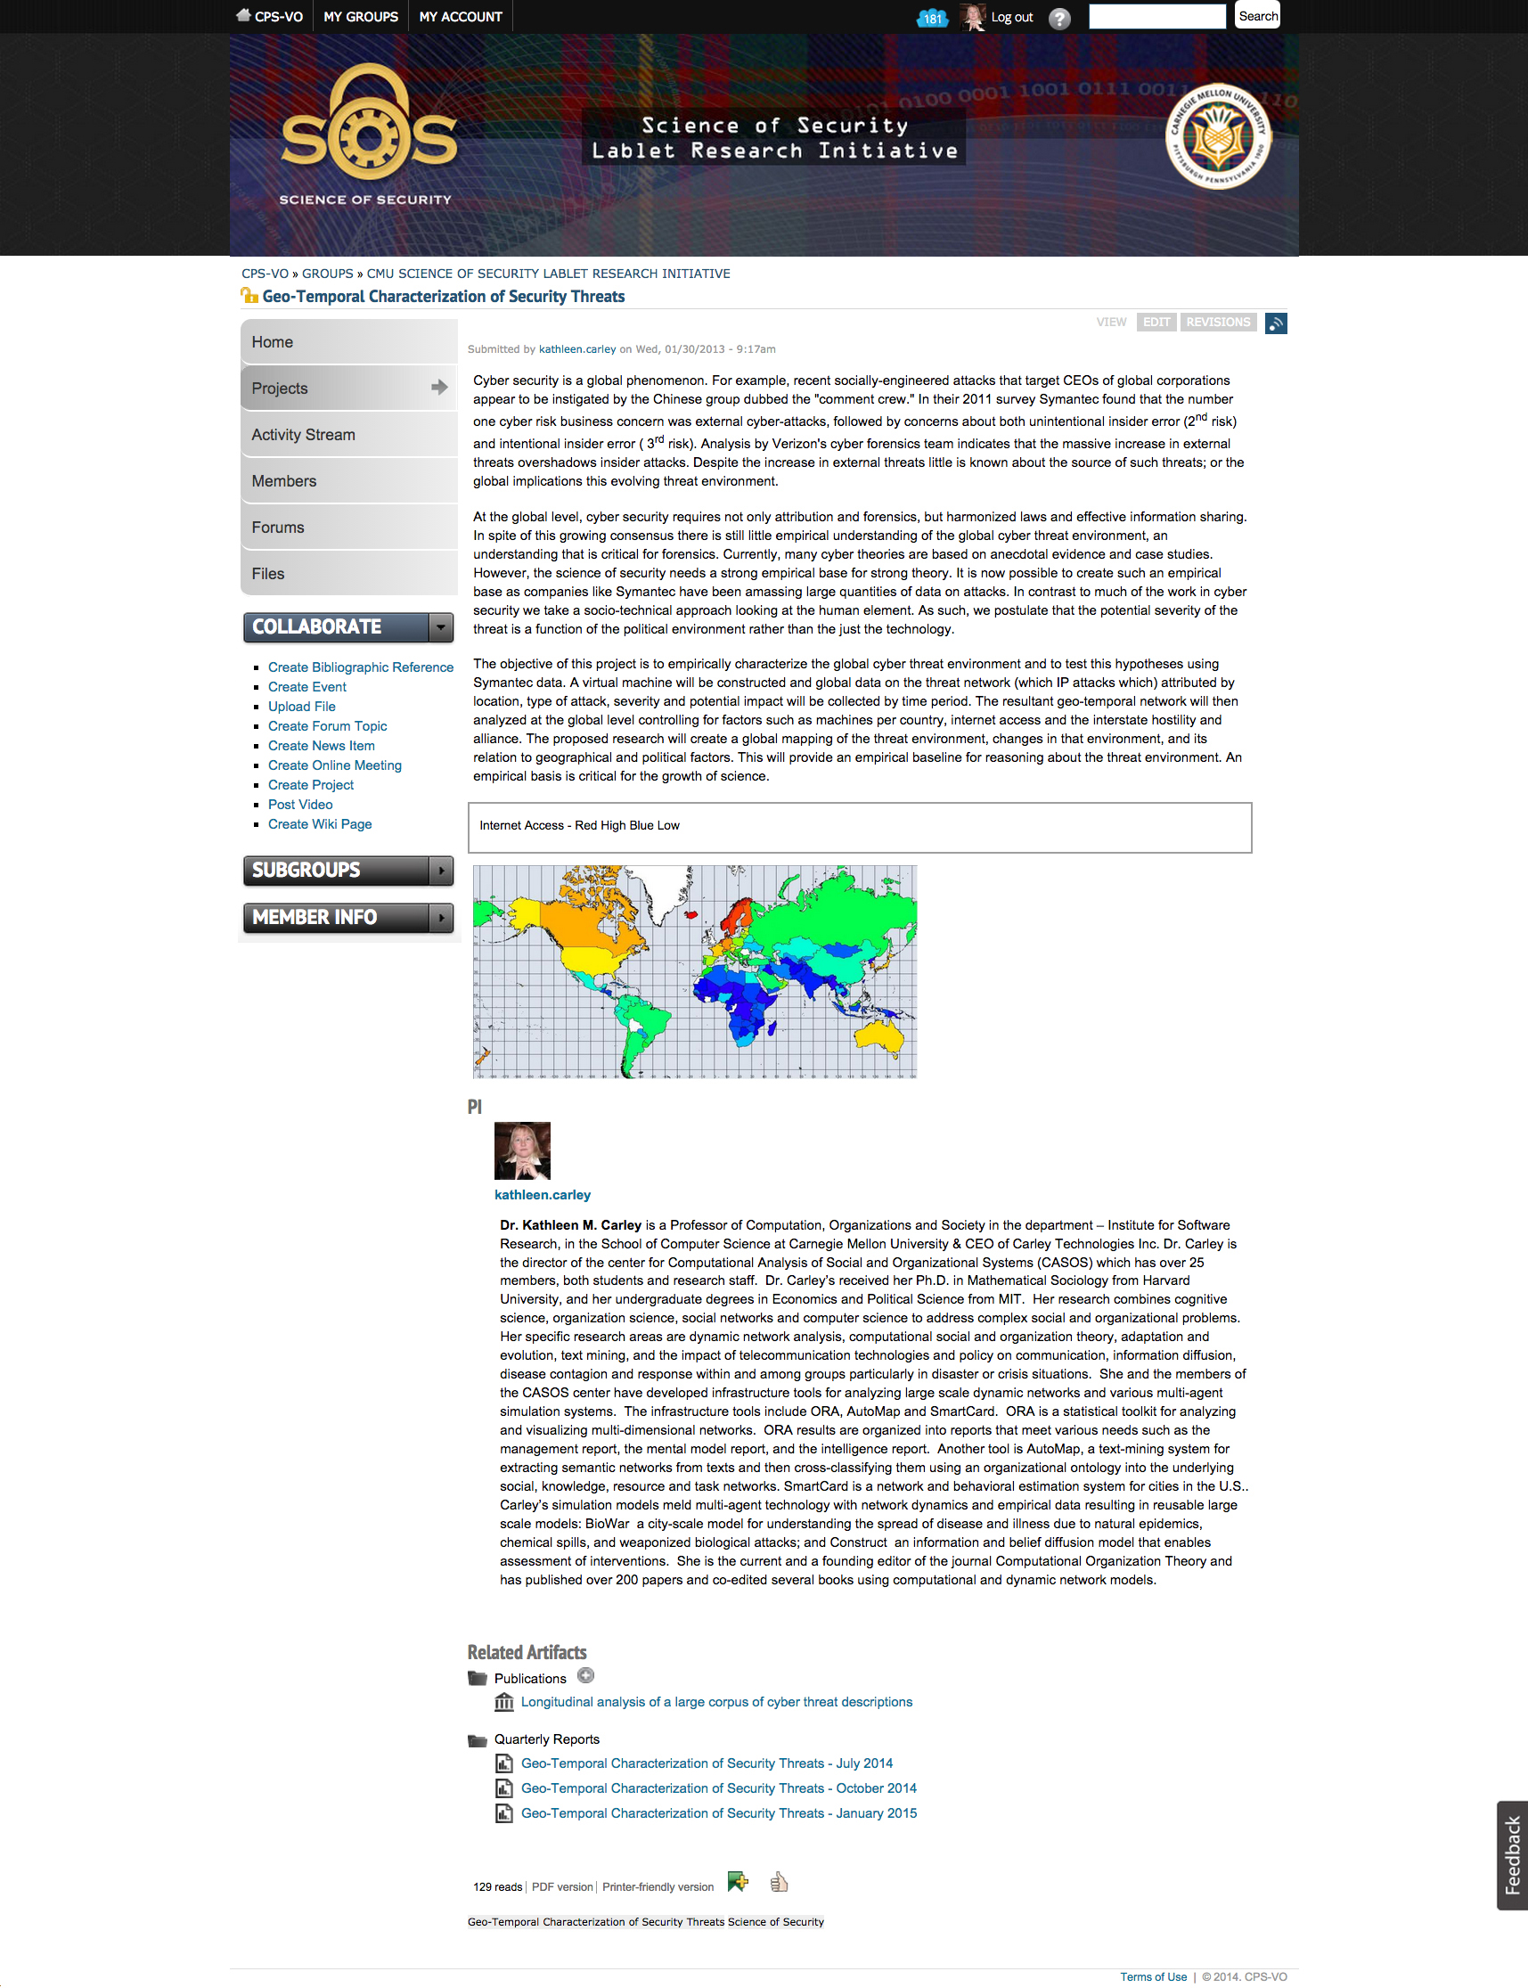
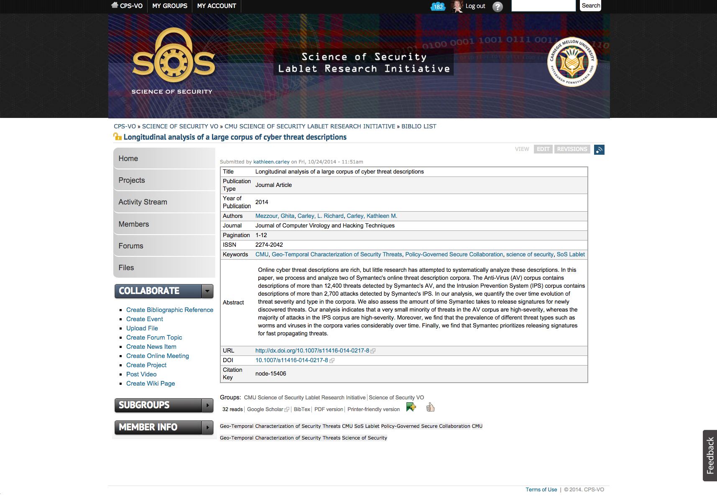
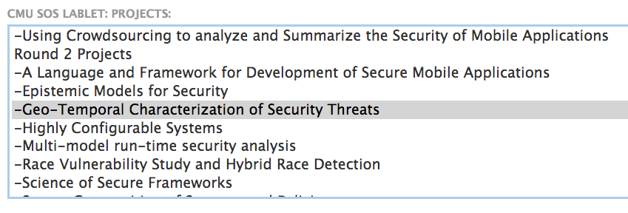
SCIENCE OF SECURITY virtual organization
PROJECTS
Group Project Pages showcase the research and publications related to a project.
There are fields for the project abstract, identification of the relevant Science of Security hard problems, PIs and Project Researchers, and related artifacts.
The related artifacts section lists presentations and quarterly reports related to this project.
CREATE AND MAINTAIN PROJECT PAGES
Projects can be created by clicking on the “Create Project” link in the “Collaborate” toggle menu.
You may later edit your project clicking on the “edit” tab located in the upper right hand corner of the project page.
PUBLICATIONS
Scholarly publications can be listed on the SoS VO by creating a bibliographic reference. Publications can be added by clicking on the “Create Bibliographic Reference” link in the “Collaborate” toggle menu. You may either paste BibTeX code from a digital library or enter the publication details manually by selecting a publication type from the dropdown menu.
Publications tagged with a Group Project will appear in the project’s related artifacts section.
Recent publications will be highlighted on the SoS-VO Home Page, if cross-posted to that group. Click the “more” button there to see the full listing of publications.
http://sos-vo.org

