Slide 1
Privacy incidents, news and News about incidents
Jessica Staddon, NCSU
NSA Quarterly Meeting, NCSU, February 1, 2017
Notes:
Condense user study
Expand and update classifier

Slide 2
Different Articles, Same incident?
“…its privacy policy allows it to periodically scan the [address book contacts] of its users and upload the numbers to its server albeit without names attached to those numbers....”
“...The new [privacy policies] also explain that [company] could start accessing and storing your address book contacts "to facilitate social interactions," such as sending special offers to your friends and family”

Slide 3
Different incidents
“…despite WhatsApp’s lack of ads, its privacy policy allows it to periodically scan the mobile address book of its users and upload the numbers to its server, albeit without names attached to those numbers.” [Forbes, 2/21/14]
“…The new terms of service also explain that Uber could start accessing and storing your address book contacts "to facilitate social interactions," such as sending special offers to your friends and family.” [Refinery29, 6/5/15]

Slide 4
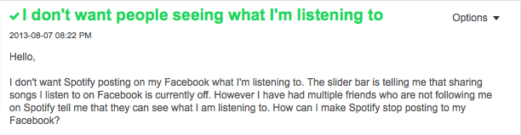
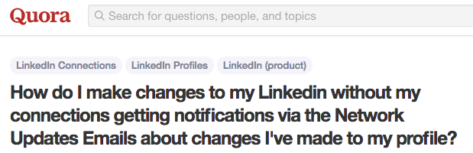
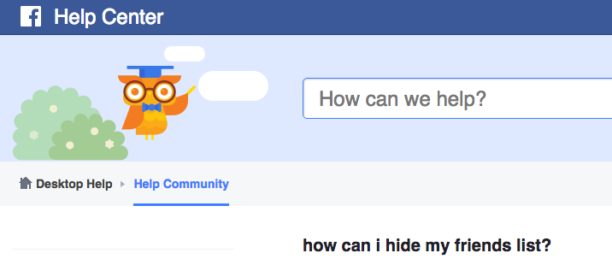
Different problems, Same cause?

Slide 5
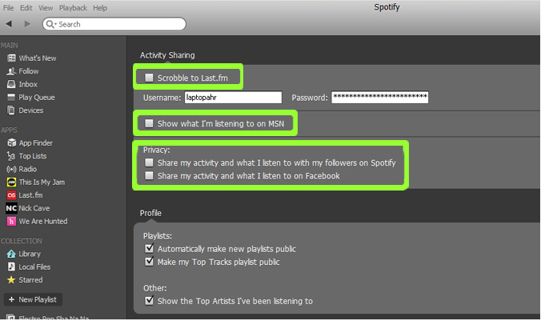
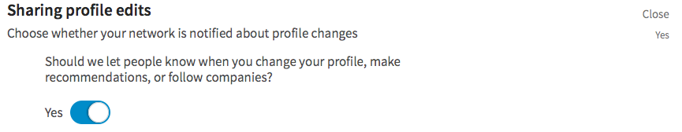
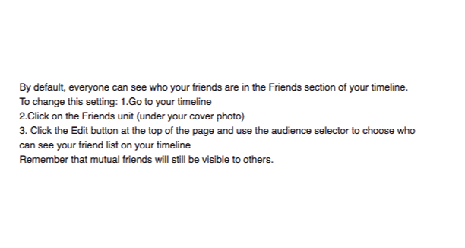
Unexpected defaults

Slide 6
This talk
Privacy Incidents Database
  Vision and status
  Vetting the definition and data
  Partially-automating database maintenance
Privacy News
  Trends in sentiment, entities and keywords

Slide 7
Privacy vs. Security
reidentification
data breaches
security alerts
security updates
malware viruses
social media oversharing
cyberbullying
PII leaks
surveillance
Privacy Incidents
Security Incidents
Notes:
You might wonder if there are already incident databases we can draw from
Security has a lot of incident databases
Data breach incidents are typically both security and privacy incidents, so we can leverage those databases
But there are many areas of privacy that are not represented

Slide 8
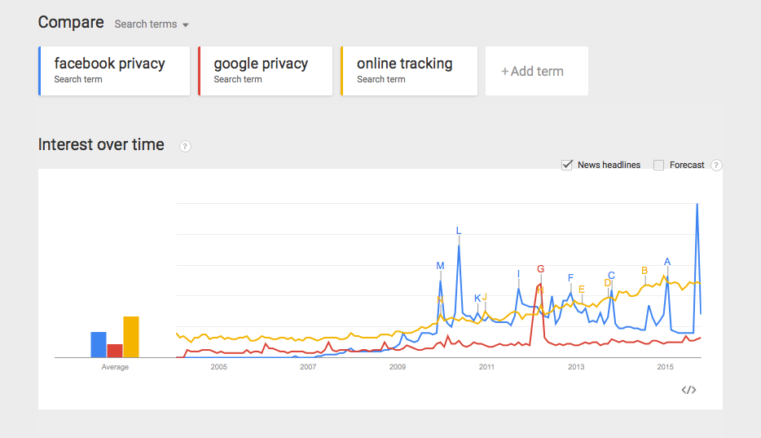
vision
Wikipedia for privacy incidents
  crowd-sourced, but moderated
  Who, what, when, where and why of incidents
Visualizations of incident trends
Downloadable data sets
  Training/education
  Product design
  Policy decisions
Google Trends

Slide 9
What can we learn from a privacy incidents database?
How much cyberbullying happened in 2014?

Slide 10
What can we learn from a privacy incidents database?
How much cyberbullying happened in 2014?
When did awareness of cyberbullying increase?
  How many publicly known incidents were there in 2014?
How many public privacy incidents involving [company] were there last year?
What types of software bugs cause privacy incidents?
What types of privacy incidents are successfully litigated?

Slide 11
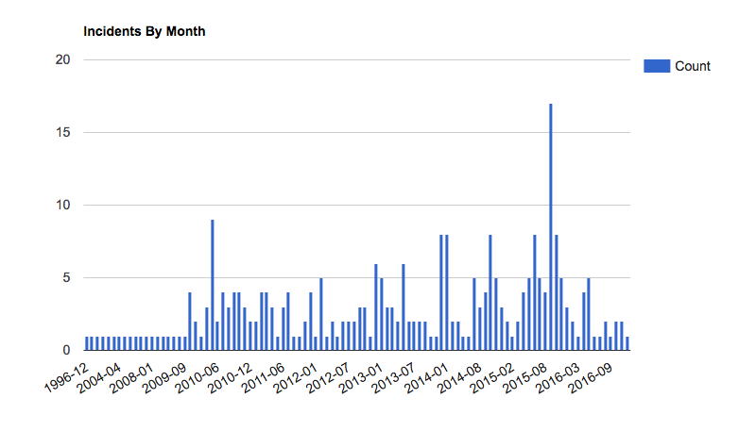
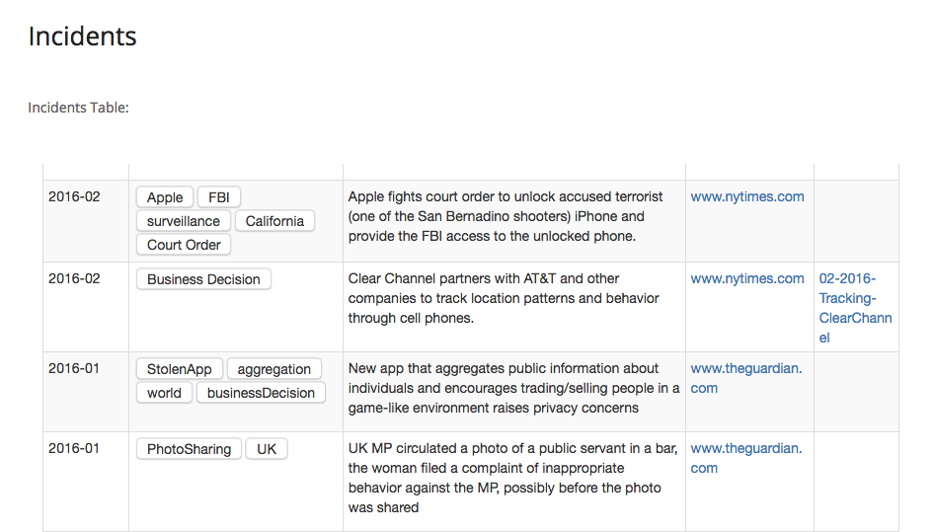
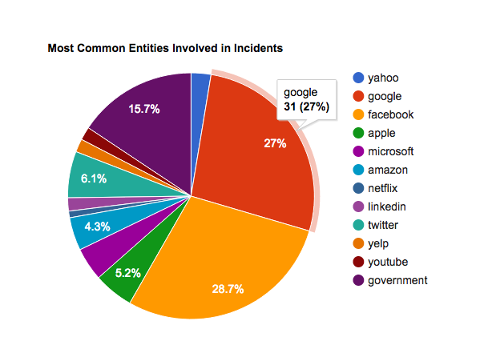
go.ncsu.edu/privacyincidents
Webmasters: Richard Marshall, Esha Sharma
Notes:
----- Meeting Notes (6/6/16 09:06) -----
read the definition of an incident
useful to introduce it before the survey

Slide 12
What is a privacy incident?
Read the news article from the URL below and answer the following questions. ${articleUrl}$
1. In a sentence, please summarize the article:
2. Is the article primarily about a privacy incident?
3. Please explain why it is or is not a privacy incident:
4. Is the article primarily concerned with the collection, use or exposure of sensitive information?
5. Is the article primarily concerned with information that is either being collected, used or shared in digital form?
6. Consider now that for an article to be primarily about a privacy, the answers to the previous questions must be “yes”. Given this, do you still consider the article to be primarily about a privacy incident?
Amazon Mechanical Turk study
268 news articles
  200 positive examples
  68 negative examples
    Regulatory/legal
    Security
    Physical privacy
482 participants
  >=3 participants per article
    3% of positive examples reviewed by >3 participants
w/ Pradeep Murukannaiah, Heather Lipford and Bart Knijnenburg, USEC 2017
Notes:
----- Meeting Notes (6/6/16 09:06) -----
describe AMT
can restrict participants in various -- we restricted to US

Slide 13
Research questions
X
X
X
X
X
X
X
X
X
X
X
X
X
X
X
X
X
collection/usage/sharing of sensitive data
w/ Pradeep Murukannaiah, Heather Lipford and Bart Knijnenburg, USEC 2017

Slide 14
Research questions
X
X
X
X
X
X
X
X
X
X
X
X
X
X
X
X
X
collection/usage/sharing of sensitive data
Perceived/anticipated collection/usage/sharing of sensitive data
w/ Pradeep Murukannaiah, Heather Lipford and Bart Knijnenburg, USEC 2017

Slide 15
Research questions
Are we missing something?
X
X
X
X
X
X
X
X
X
X
X
X
X
X
X
X
X
collection/usage/sharing of sensitive data
Perceived/anticipated collection/usage/sharing of sensitive data
w/ Pradeep Murukannaiah, Heather Lipford and Bart Knijnenburg, USEC 2017

Slide 16
Findings
Precision: positive set = .8, negative set = .5
X
X
X
X
X
X
X
X
X
X
X
X
X
X
X
X
X
w/ Pradeep Murukannaiah, Heather Lipford and Bart Knijnenburg, USEC 2017

Slide 17
Findings
Emerging tech in cars: “The article points out a problem of data collection in new vehicles without the owner having any control of the data recorded.”
X
X
X
X
X
X
X
X
X
X
X
X
X
X
X
X
X
Perceived/anticipated collection/usage/sharing of sensitive data
w/ Pradeep Murukannaiah, Heather Lipford and Bart Knijnenburg, USEC 2017

Slide 18
Findings
Law: “The entire article talks about privacy. That there is a whole new framework taking place to protect the privacy of European citizens. ”
X
X
X
X
X
X
X
X
X
X
X
X
X
X
X
X
X
w/ Pradeep Murukannaiah, Heather Lipford and Bart Knijnenburg, USEC 2017

Slide 19
Findings
Security: “There are laws in place to try to protect the privacy of people’s networks and computers, and someone (or more than one person) has hacked into the system.”
X
X
X
X
X
X
X
X
X
X
X
X
X
X
X
X
X
w/ Pradeep Murukannaiah, Heather Lipford and Bart Knijnenburg, USEC 2017

Slide 20
Learning the database
Can we train a classifier for efficient, large-scale identification of privacy events from a variety of inputs such as news articles, blog posts and social media?
Privacy incidents may have differentiating features
  Sentiment, entities, keywords, authors
Keyword “privacy” appears in articles that are not about privacy incidents
  “Johnny Manziel asks for privacy as he enters rehab”
  “Park visitors disturb privacy of animals during mating season”
w/ Pradeep Murukannaiah, Chinmaya Dabral, Karthik Sheshadri and Esha Sharma

Slide 21
Vision: Privacy Incident pipeline
w/ Pradeep Murukannaiah, Chinmaya Dabral, Karthik Sheshadri and Esha Sharma
Notes:
Crawl articles from various sources
News APIs, RSS feeds, tweets from key privacy-related persons
Verify (expert) privacy incidents and add to the database
Text summarization tools suggest key paragraphs for incident descriptions
Train the classifier on weekly basis

Slide 22
Training a Classifier
Positive Articles (543):
  Articles currently present in the database
  Other articles reviewed by multiple coders
Negative Articles (781):
  Articles selected at random
  Articles tagged as “security” (not, privacy)
  Articles mentioning “privacy,” that are manually determined to not describe privacy incidents
w/ Pradeep Murukannaiah, Chinmaya Dabral, Karthik Sheshadri and Esha Sharma
Notes:
many news sources are represented, 2 most common are NYT and Guardian

Slide 23
Feature engineering
Text processing
  Apply PoS tagging to retain ‘content’ words
    Nouns, verbs, adjectives, adverbs
  Lemmatization
  Unigrams and bigrams weighted by tf-idf
Dimension reduction
  Reduce feature space with mutual information
    Top k keywords for a variety of values of k
Train Naïve Bayes, SVM and Random Forest-based classifiers
w/ Pradeep Murukannaiah, Chinmaya Dabral, Karthik Sheshadri and Esha Sharma

Slide 24
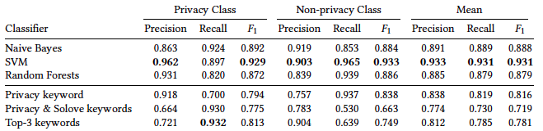
Example accuracy
w/ Pradeep Murukannaiah, Chinmaya Dabral, Karthik Sheshadri and Esha Sharma
Notes:
8192 TF unigrams
Top 3 keywords are just in terms of frequency (privacy, security, datum)

Slide 25
This talk
Privacy Incidents Database
  Vision and status
  Vetting the definition and data
  Partially-automating database maintenance
Privacy News
  Trends in sentiment, entities and keywords

Slide 26
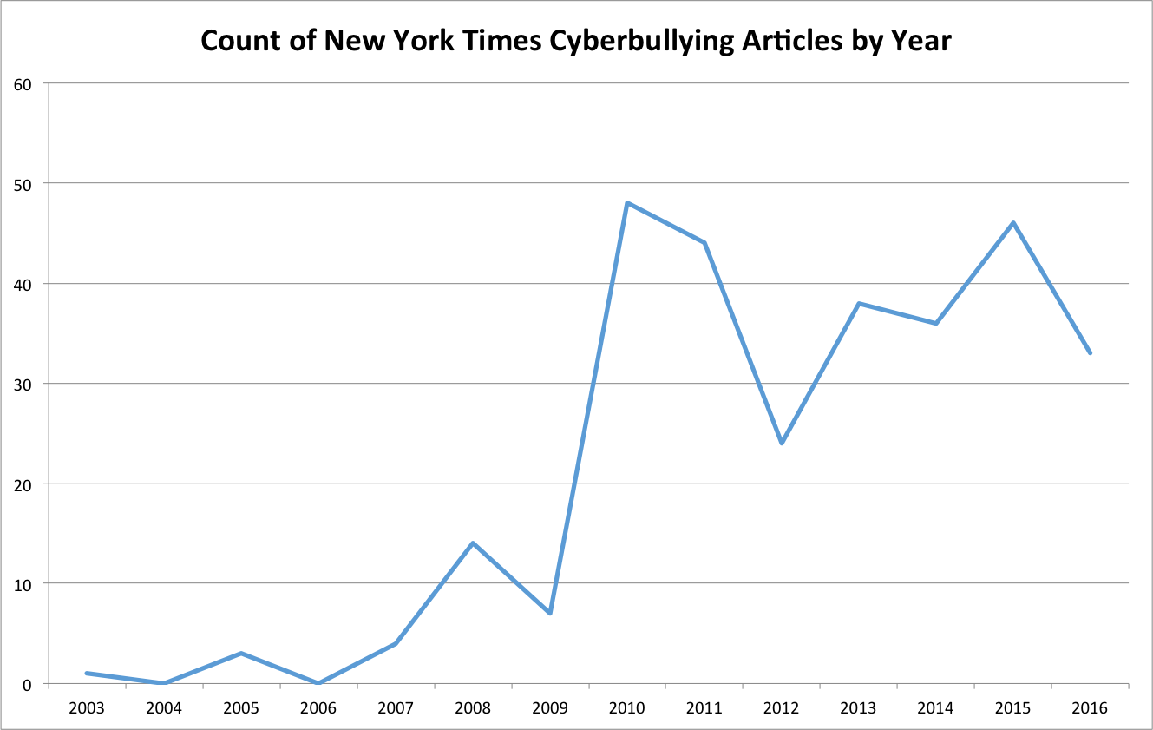
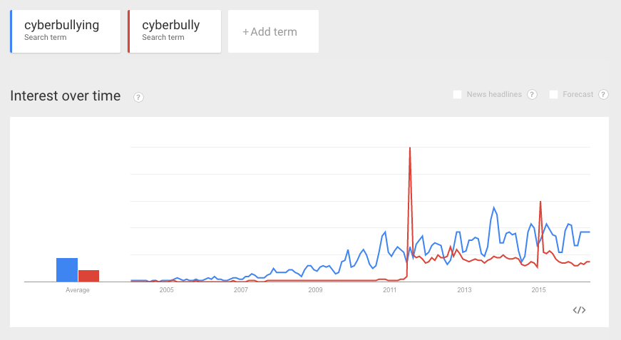
News: risky source
Decline in Reporting Decline in Rate

Slide 27

News Influences Product
August 2012
1
5
10
15
20
25
Quora releases “Views”
Quora shuts down “Views”
Notes:
Quora is a question answering service
Anyone can ask a question and people in the Quora community will answer it

Slide 28
News influences policy
Companies
Company privacy info through the press
Regulator guidance: drones
End-Users
Press: drone incidents
Regulators
Opinion on privacy and data protection issues relating to the utilisation of drones
January 2015, Article 29 Working Party

Slide 29
News influences Users
User concern
  E.g. Facebook News Feed launch (Hoadley, et al, 2010)
User behavior
  E.g. ``Fear appeals’’ (Johnston & Warkentin, 2016)
Perceptions of public opinion
  Driven by prominence and volume (Smith et al, 2008)

Slide 30
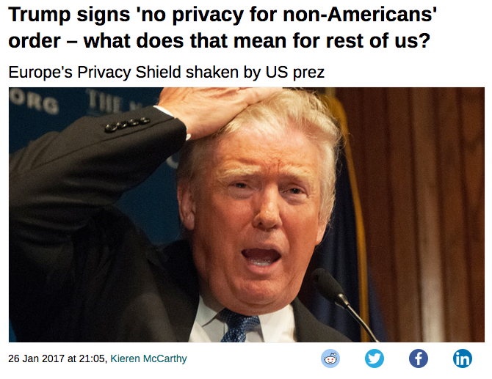
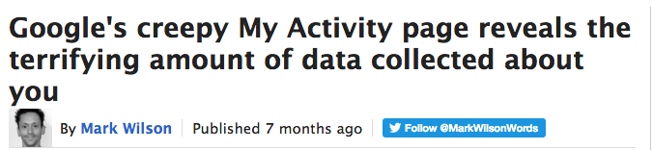
Research questions
What characterizes privacy news?
  Is there selection/framing bias in privacy news?
Can automated news analysis enable incident aggregation & categorization?
w/ Karthik Sheshadri and Nirav Ajmeri

Slide 31
Privacy News data sets
682 New York Times articles, 2010-2015
  Manually tagged by NYT with “privacy”
  First paragraph + summary
  Restricted to news category (e.g. no OpEds)
  Precision of sample, 2 coders:
    Privacy precision: .96 and .929
    News precision: .9 and .898
1000 Guardian articles (UK publication), 2010-2016
  Manually tagged by Guardian with “privacy”
  Full article text
  Precision of sample, 2 coders:
    Privacy precision: .97 and .965
    News precision: .685
w/ Karthik Sheshadri and Nirav Ajmeri

Slide 32
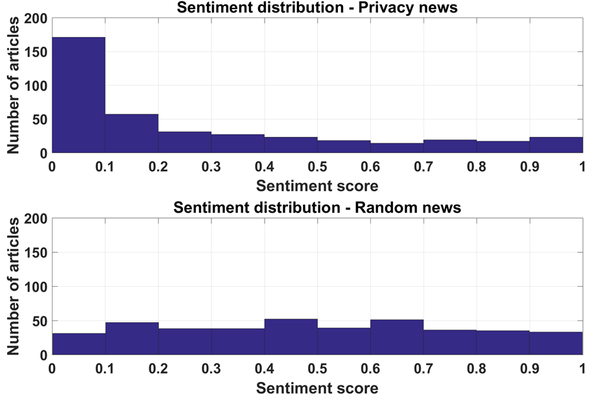
Negative sentiment
w/ Karthik Sheshadri and Nirav Ajmeri
Notes:
Sentiment score distribution from a Naive Bayes analyser for 400 privacy news articles and 400 randomly selected news articles, all from the New York Times. Measured sentiment increases in positivity as scores increase. Random news articles are almost uniformly distributed across the range of sentiment scores, but privacy news articles are heavily biased towards the negative end of the spectrum.

Slide 33
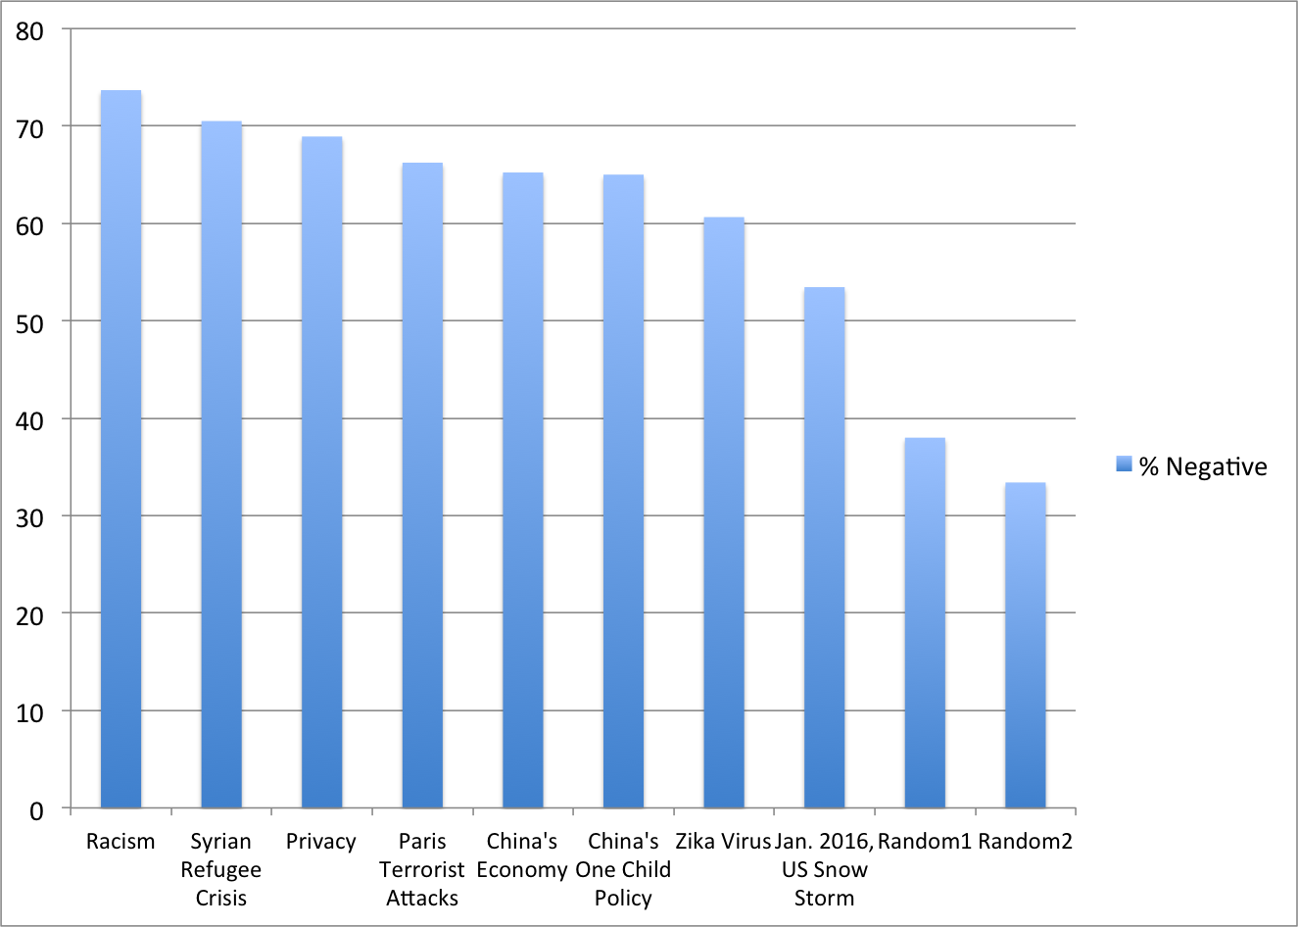
Negative sentiment
w/ Karthik Sheshadri and Nirav Ajmeri
Notes:
Effect sizes are small or negligible between privacy and other topics EXCEPT for the random samples
All diffs are significant
Classifier: Stanford Core NLP Parser

Slide 34
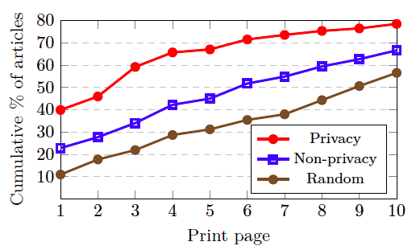
Selection bias
Negative privacy news appears more prominent than topics involving significant human suffering
w/ Karthik Sheshadri and Nirav Ajmeri
Notes:
Sentiment and print page of privacy related articles in NYT using the Stanford Core NLP parser
Difficult because we don't have a master list of privacy incidents, positive and negative (related to the DB effort)
but there are positive privacy events -- e.g. new privacy products and features

Slide 35
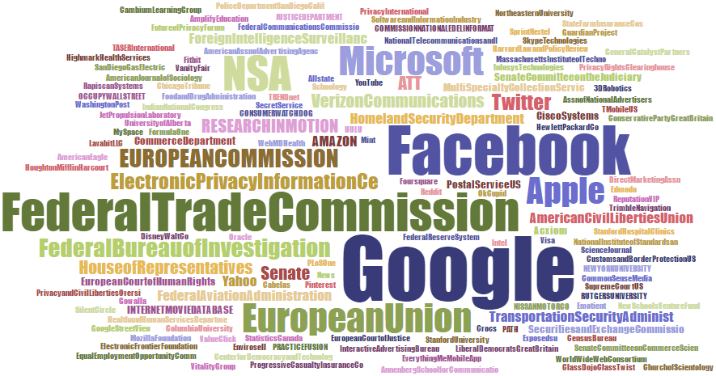
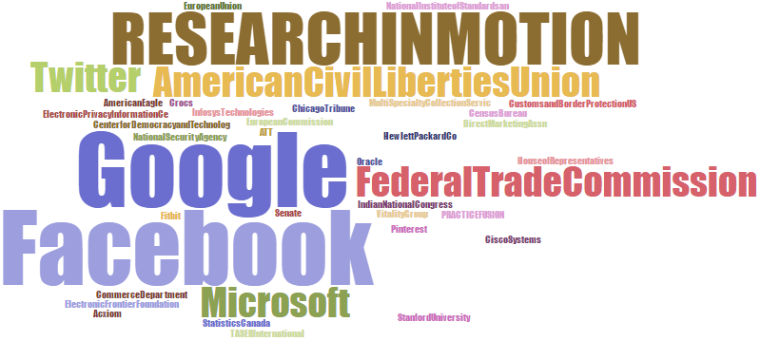
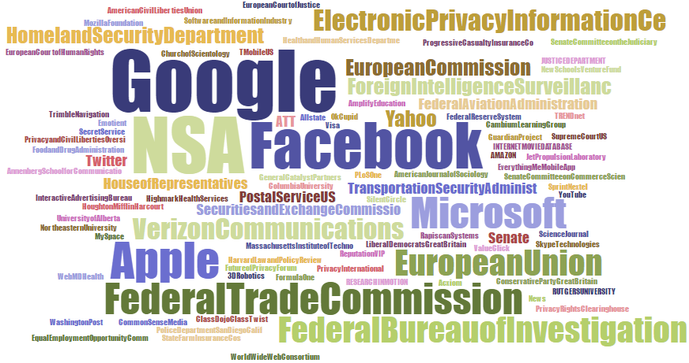
organizations
Overall Frequency
Positive Sentiment Articles
Negative Sentiment Articles
w/ Karthik Sheshadri and Nirav Ajmeri
Notes:
Using the NYT tags for the entities, classifier is Stanford sentiment parser
2011 – RIM resisted handing over user data to authorities

Slide 36
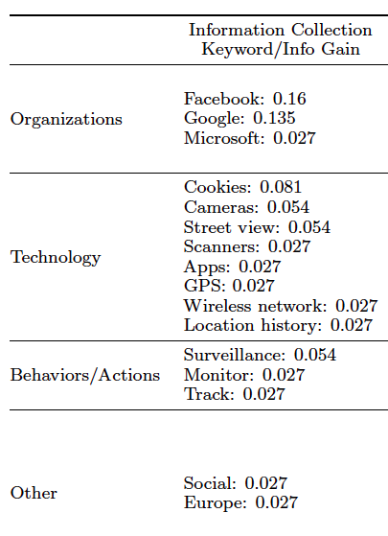
Information Collection
“A Taxonomy of Privacy”, Daniel Solove
Information Collection is 50% of NYT sample
w/ Karthik Sheshadri and Nirav Ajmeri
Notes:
Based on manual coding of 668 NYT articles

Slide 37
Next steps
Vet idea with more stakeholders
  Working with the Laboratory for Analytical Sciences
Continuing to grow the database
  Applying classifiers to new sources
    Privacy classifier for Tweets (Esha Sharma)
  Iterative user evaluation of data: interviews and surveys
Database analysis: identify trends
  Exploring visualizations to facilitate discovery of related incidents
Notes:
Plsc is supportive, sees it as a valuable training mechanism
Wants more information about legal side – cases brought, outcomes

Slide 38
Thank you!

