Slide 1
Tech Transfer of Software Tools
James Larus
Microsoft Research
HCSS
May 8, 2012

Slide 2
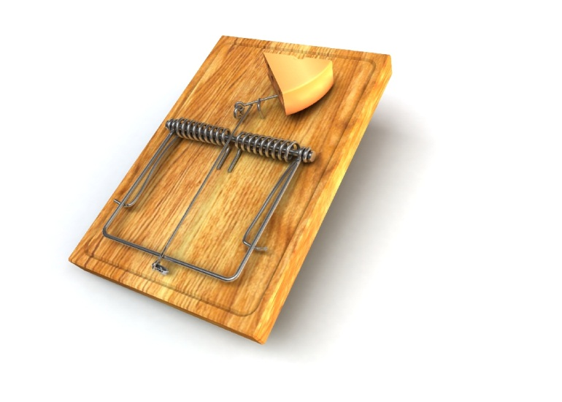
Better Mouse Trap
Fallacy
If a man has good corn or wood, or boards, or pigs, to sell, or can make better chairs or knives, crucibles or church organs, than anybody else, you will find a broad hard-beaten road to his house, though it be in the woods.
—Ralph Waldo Emerson
Wrong
Notes:
Hoary fantasy still taught to school children
Still not true if you replace “chairs or knives” with “software or hardware” and “house” with “office”

Slide 3
Observations Over 15 Years at MSR
Platitudes
Perspective
Customer
People
Tools

Slide 4
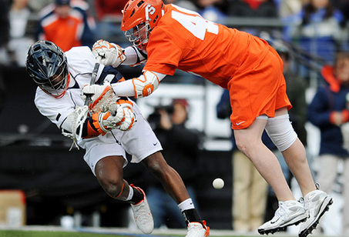
Tech Transfer is a Full Contact Sport*
If you aren’t bloody, you aren’t playing hard enough†
But, keep your eye on the ball
*Rick Rashid, Chief Research Officer, Microsoft
†Galen Hunt, Researcher
Notes:
Not a spectator sport
Researchers must be fully engaged in actively work with product group to transfer technology
They aren’t going to come to you
And, you cannot just “throw it over the fence”

Slide 5

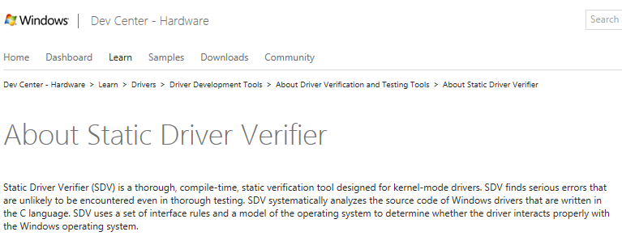
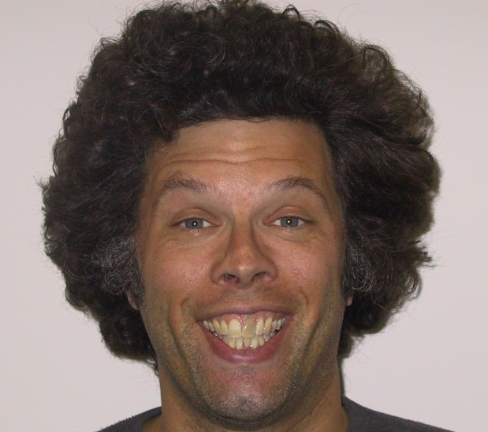
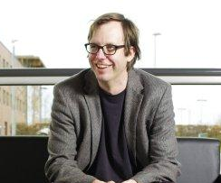
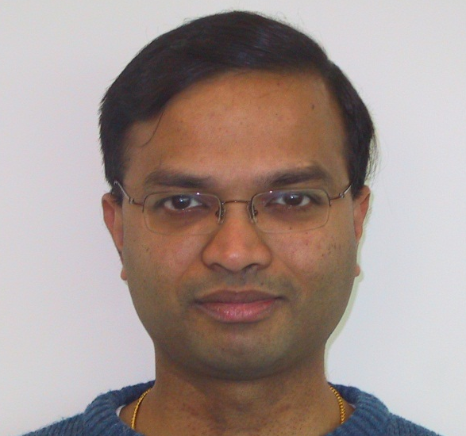
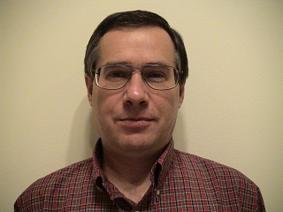
Tech Transfer Isn’t About Technology
But About People*
Notes:
Everyone knows Tom & Sriram, but Byron and Vlad are equally important
Story of Windows hiring 2 PhD in formal systems
Professors have known for years: students transfer ideas when they are hired

Slide 6
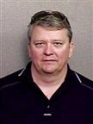
Right Place, Right Time
Windows 95
Windows 2000
Windows XP
How am I supposed to make drivers more reliable???
Device Drivers
Notes:
Eighty percent of success is showing up. – Woody Allen
Example: How did SLAM get adopted by Windows and become widely popular tool?
Bob Rinne given impossible task: improve Windows driver quality, willing (desperate enough) to bet on untried idea from MSR
Example: Ravi and Orleans product adoption

Slide 7
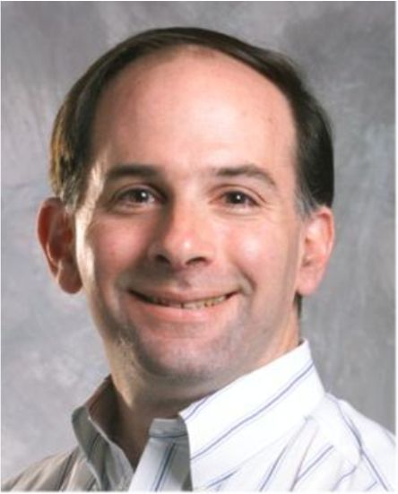
Luck Favors the Prepared
Windows 95
Windows 2000
Windows XP
Joins MSR to sets up SPT
Hires Tom & Sriram
This is GREAT!
Ah Device Drivers!
There are lots of them.
They are small.
We can analyze them.
And they are a big problem.
Notes:
Picking the right problem is the difference between good and great research
Device drivers were the right problem (still being intensively studied: cf Swift et. al. ASPLOS ‘12)
Counter-example: buffer overruns were not analyzed in early 2000s, then Code Red and Nimbda viruses

Slide 8
Perspective

Slide 9

Great Research Solves a Problem –
But a Solution is Not a Product
Notes:
Research does not produce a usable, saleable product
At best, it enables the construction of a product
It may only be a small part of the product, even if crucial or enabling
The other parts may matter more to customers than the new research

Slide 10
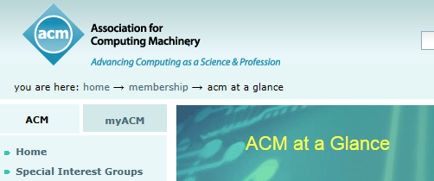
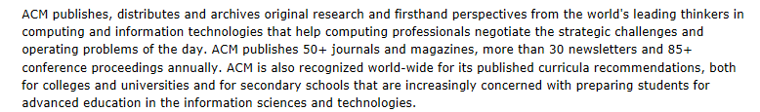
Lots of Clever Ideas
Notes:
Need to tie idea to problem that matters to (significant number of) people
Needs to be implementable
And implementable in existing code and constraints, manageable, predictable
Needs to be better than status quo
Not just in corner cases
Fully evaluate

Slide 11

Everyone Has Ideas –
Execution is Hard Work
Singularity
Notes:
Don’t be surprised if other aspects dominate

Slide 12

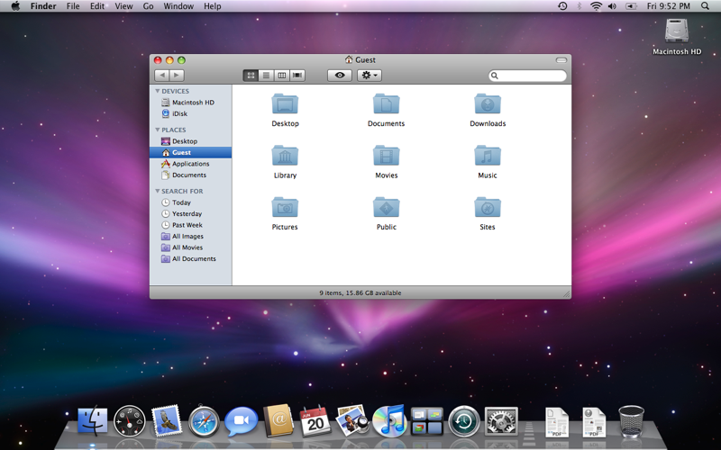
Mundane Matters
“We made the buttons on the screen look so good you’ll want to lick them.”
Notes:
Example of Prefast UI: prioritization, ordering, suppression

Slide 13
Bond Scale
 solves desired scenario with real users: random product group A shows up, your system is ready to ship, today, to be used in their scenarios.
 works in some scenario with real users: your system can be used in anger. Customers feel safe to use it in real usage on which their livelihoods depend. However, it hasn’t been shown to work in all scenarios that a potential product group cares about.
 works in constrained environment: people can use your system for some things other than the experiments described in your paper.
 a great paper: your system is in a published SOSP paper. It held together long enough to run the experiments needed for the paper. The features needed for the paper are implemented.
 a great repeatable demo: other people can download your system and run it, repeatedly and consistently, repeat the experiments described in your paper.
Notes:
Bond scale is logarithmic (although perhaps log 2, not log 10).
Very seldom should MSR push something to 4 or 5 stars, but there is great value in communicating (accurately) to each other (say for review calibration) and to product groups (for tech. transfer) the state of our technologies.

Slide 14
Customer

Slide 15
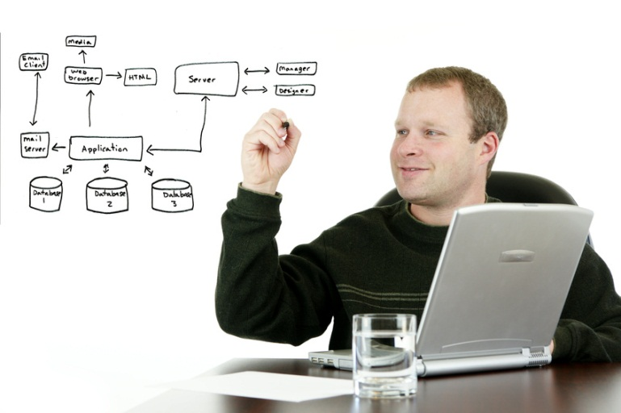
Put Yourself in Developer’s Shoes
System complexity
Bugs
Deadlines
Triage
Performance
New technologies
Meetings
Security
Email overload
Notes:
Already has too much to deal with
Skeptical of value of new, untested idea / tool
Should he spend X hours getting it working and trying it?
X hours lost
How much savings?
Does it solve the right problem?
Static analysis tools find bugs, but are they bugs that will be encountered in real world?
Example: Prefast (batch) vs Prefix (desktop)

Slide 16
What You Sound Like to a Developer
Researcher | Developer
“I have a new tool | “Oh no, not another one
that will save you time, | And how many hours will it take to find it doesn’t work?
improve your code quality, | What do you know about code quality?
make you more productive, | You leaving my office would improve my productivity
avoid security bugs, | You’re smarter than hackers?

Slide 17
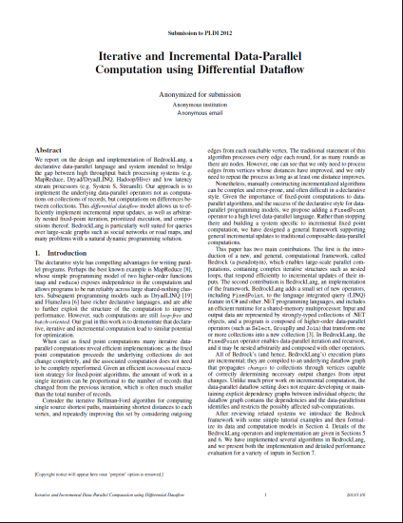
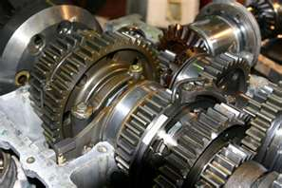
Which Is More Convincing?
(A)
(B)
Notes:
Robust prototype that can easily be applied to developer’s software is second best way of selling idea
Fragile research prototypes are difficult to evaluate
Example: Tom, Sriram, Vlad, Byron spent 2 years building SLAM prototype and running it on drivers

Slide 18

First Sale is the Hardest One
Notes:
Other successful customer is best way to sell an idea
Once you have successful and happy customer, it is far easier to get more
Have to have turned idea into useful product
Demonstrated its value
Customer testimonial more creditable
Example: Orleans

Slide 19
People

Slide 20

Politics is Real: NIH Happens
Notes:
Nothing good to say about this
Do it long enough, and this will happen to you
Helps to talk to around and understand why people make their decisions
Personal trust and deep engagement
Co-location (offices), regular meetings, joint activities, extra effort to help
Simple rule: project group is not engaged until they put their headcount in a project

Slide 21

Persistence
Notes:
Galen: Researchers complain to me that they’ve talked to 3 or 4 groups and no one has picked up their idea yet.
My response is to tell them about the first year of trying to sell Drawbridge.
I met with *75* different groups before we gained traction with xxx. Then I typically say, “so you’ve just got 72 meetings to go! :-)”.

Slide 22
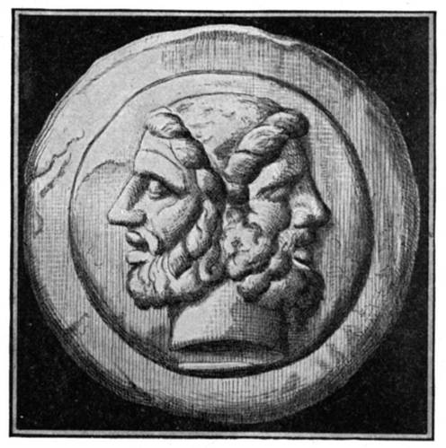
Right Incentives
Notes:
MSR: ½ based on scientific / academic contribution
½ based on contribution to MS
Flexible, recognizes work not spread evenly
Example: developing new idea, publishing papers => no transfer
Working with product groups => no papers
Big selling point for MSR

Slide 23
Software Tools

Slide 24



Software Tools Are a Difficult Business
Notes:
Need to understand the business dynamics of your competition
Software tools are not an area with many successful companies
Small, niche firms
Competition is “free”, good enough tools
Loss leader to support platform
Clear reluctance to pay for tools – productivity benefits not clear

Slide 25

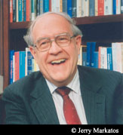
And, They Aren’t Going to Solve the Problem
Notes:
Keep in mind limitations of software tools

Slide 26
Conclusion
Tech transfer does not just happen; it requires effort
Understand what you have to offer
Understand the needs and requirements of customers
Build personal trust and engagement
Dive in; it is not a spectator sport
Good luck! It a lot of fun and very satisfying when it works

