Slide 1
UK Research Institute in Science of Cyber Security
M. Angela Sasse
Director, Research Institute in Science of Cyber Security
University College London, UK

Slide 2
Background: Cyber Security research in the UK
2011: UK Cyber Security Strategy
2012:
  8 Academic Centres of Excellence in Cyber Security Research: Belfast, Bristol, Lancaster, Imperial College, Oxford, Royal Holloway, Southampton, UCL
  Research Institute in Science of Cyber Security, 2012
  Centre for Capacity Building in Cyber Security announced
  2013: 2 Centres for Doctoral Training in Cyber Security

Slide 3
UK Research Institute in Cyber Security
Funded by GCHQ in partnership with the Research Councils’ Global Uncertainties Programme (RCUK) and the Department for Business Innovation and Skills (BIS)
£3.8 M over 3.5 years
Virtual Institute
  4 projects involving 7 universities
  coordination activity (Research Director Angela Sasse)

Slide 4
Goal of the RI
allow leading academics in the field of Cyber Security from across the UK
  to work together
  to connect them with the collective expertise of
    industry security experts, and
    international researchers
most emphatically multi-disciplinary research
Science of Cyber Security

Slide 5
Here comes the science bit …
“How secure is my organisation?”
“How do we make better security decisions?”
Evidence-based:
  Establish a map of substantive, empirically-based knowledge, and fill the gaps
  Identify/develop a set of suitable methods for cyber security research, and for companies
Shift from craft to science

Slide 6
Looking forward
Push for more cross-Atlantic collaboration
  Joint projects
  Particularly: projects involving companies that operate in both the US and UK
  Internships, exchange of Doctoral Students
Establishing
  A multi-disciplinary Science of Cyber Security Conference – first in London 2013
  A high-quality Open Access Journal
  Companion publication for decision-makers

Slide 7

Project: Cyber Security Cartographies
Partner: Royal Holloway, University of London (Dr Lizzie Coles-Kemp & colleagues)
Aim: explore how a security manager develops, maintains and uses visibility of both social and technical asset compliance behaviors for the management of cyber security risks
Notes:
With this understanding we are seeking to design visualisation tools which extend a security manager’s ability to select and deploy combinations of organisational and technical controls in the cyber context.

Slide 8
The scenario
“There is of course continuous pressure to extend BYOD (bring your own device to work) access across our estate and we are struggling to achieve an architecture which will allow us to deploy popular applications like Outlook Web Access for 3rd party devices whilst still achieving 2FA and without impinging on the integrity of our service platforms – not so much because of the technical challenges of slicing and dicing security configurations in vmware etc., as trying to second guess how the business and our other tenants will appropriate the processes we encourage them to implement.”
Conn Crawford, Sunderland City Council
Notes:
This quote from one of our case study partners shows the complexity of the scenario and the challenges that today’s CISOs have to face when tackling the cyber estate. The research is based on the following premise: The complexity of the cyber environment makes it difficult for the security manager to have sufficient visibility of the organisatonal, physical and technical compliance behaviours and controls. In essence, the security manager does not have a sufficiently detailed map, or cartography, of the estate to assure the security of the cyber environment. The research, therefore, has two hypothesis: 1) An informal approach to combining technical, physical and organisational controls and influencing the appropriation of those controls can not scale to the complexity of the cyber environment 2) Introducing a visualisation approach into the risk management process which enables the security manager to visualize compliance behavior and controls at both organisational and physical asset levels will enable a security manager to influence and enforce compliance across the more complex and dynamic cyber estate.

Slide 9
The research questions
How does a security manager know when to combine specific technical, physical and organizational controls?
How does a security manager differentiate between effective and ineffective control combinations?
How does a security manager influence the appropriation of controls, and what makes this influence effective?
Does the use of visualizations affect a security manager’s ability to select effective control combinations?
Notes:
In order to test our hypothesis we set out to work on the following research questions.

Slide 10
Expected output
A method for combining and evaluating combinations of technical and organizational security controls
Methods and design principles for visualizing and analyzing combined organizational and technical compliance behaviors
Use cases and case study reports
Notes:
How we envisage the outputs being used: Using the cyber security cartography visualisations a security manager would build an asset register that visualises organizational, physical and technical controls and compliance behaviours. The security manager can then query the organisational compliance behaviours for a particular target group, the human networks who influence compliance behaviours of this group, the information shared within the human networks and techniques used to influence compliance. The visualisation shows the spectrum of perception with regard to data value, the spectrum of perception with regard to compliance and the spectrum of perception with regard to perception of damage to brand if data is disclosed. The visualisation at the physical asset level shows the technology use in the different parts of the network, the degree of compliance behavior visibility of physical asset clusters that the security manager has, the dependencies between assets and the type of behaviour clusters of devices typically exhibit. The research will also develop methods for combining the two visualisations so that the security manager is able to combine hard and soft measurements. For example, the security manager can calculate the numbers of different data disclosure types, the frequency with which each data is communicated between clusters end-users and between clusters of physical assets and the path a data type is likely to take between nodes. For each hard calculation, the security manager can also query the typical compliance profile of the clusters of end-users using these nodes and the typical extent and type resistance to or engagement with countermeasure combination.

Slide 11
Project: Games and Abstraction for Cyber Security
Partners:
Imperial College London (Prof. Chris Hankin)
Royal Holloway, Unversity of London (Prof. Dusko Pavlovic)
Queen Mary, University of London (Dr Pasquale Malacaria)

Slide 12
Our Proposition
Game Theory can help Systems Administrators make better
decisions about how to defend their systems.
The “Cyber Security Problem” can be seen as a two player game consisting of an Attacker who wants to maximise damage and a Defender who wants to minimise downtime and protect resources.
For example, once an http server has been compromised the likely next steps of the attacker would be to deface the website or install a sniffer. Defences include re-installing the compromised account or installing a sniffer detector.
Attackers are far more likely to just deface the website and so the best defence is therefore to re-install the compromised account.
We have designed a scientific programme to make this kind of analysis a robust and tractable problem.

Slide 13
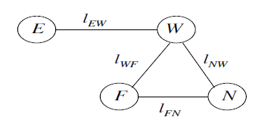
The Approach
Stochastic Game Theory has been studied as a basis for decision support systems for cyber security for about 10 years.
For example, even quite simple systems:
are intractable – this example has over 4 billion states.
E is the environment, W is a web-server,
F is file server and N is the collection of networked computers

Slide 14
The Approach, contd...
Previous work takes an ad hoc approach to ignoring detail.
If we abstract, what happens to the equilibria, etc? – what is the justification for making operational decisions on these simplified models?
Abstract Interpretation – a technique for abstracting program behaviours, used in program verification - provides a systematic approach.

Slide 15
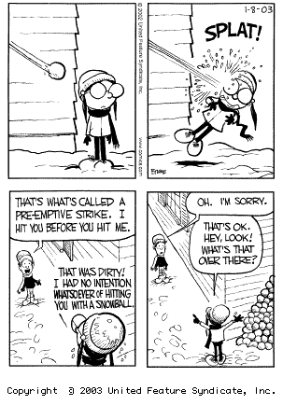
Refinements
In order to deal with Incomplete games (where the players do not know each others’ strategies), we will combine machine learning with abstraction.
Games with imperfect information arise when players do not know each others’ state – we will develop a model that can deal with such situations.

Slide 16

Expected outcomes
New theory and understanding of game theory
and its application to cyber defence.
Proof-of-concept implementation of a decision
support tool based on adaptive, imperfect information
stochastic games – with intermediate results relating to simpler systems.
Empirical evaluation of the implementation against data sets from real stakeholders.
Policy advice on cyber security strategy.

Slide 17
Project: Choice Architecture for Information Security
Aims: How to achieve strong cyber security decisions and operations
Partners:
University of Newcastle (Prof. Aad Van Moorsel)
University of Northumbria (Prof. Pam Briggs)

Slide 18
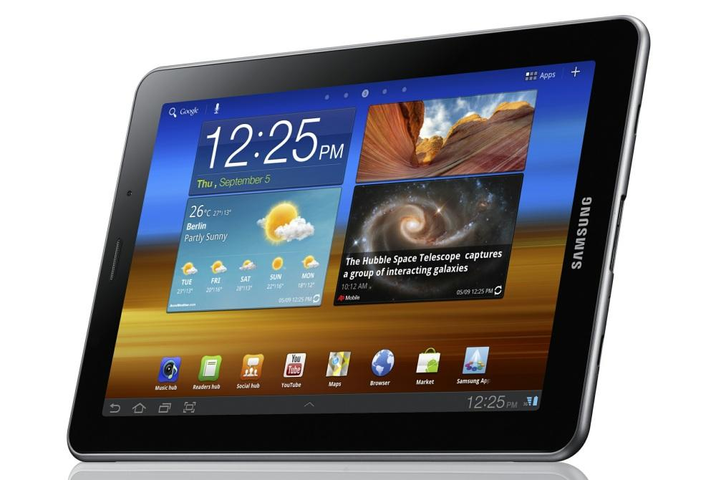

Bring-Your-Own-Device (BYOD)
BYOD:
higher productivity
but with risks:
losing it in the train
the children use it too
can we ‘nudge’ employees to exhibit effective security behaviour?
[ Image: DigitTrends ]
Notes:
Importance:
Human decision making under uncertainty and operations impact cyber security.
Background:
Tversky and Kahneman showed that human decisions under uncertainty are biased.
Rigorous decision making tools (e.g., statistical forms) can help, but are affected by biases in turn. In Bring-Your-Own-Device users have much freedom of choice, therefore we need to create a choice architecture to help them making good decisions, good for the entire organization.
Contributions:
Research choice architecture for information and cyber security
Deploy in bring-your-own-device SME environment, particularly challenging to enforce sound security policies.
Partners:
Newcastle (Van Moorsel + Gross), Northumbria (Briggs + Coventry)
Also with UCL, Imperial College and Royal Holloway
With HEFCE/JISC funded Iridium project (research in data governance practices)
With NUWARP: Northumbria University Warning Advice and Reporting Point
Grant support:
EPSRC/GCHQ-funded Research Institute
£880K full economic costing, equally split between Newcastle and Northumbria
Additional partnership funding (2 years RA) from SiDE Digital Economy Hub
3 RAs for 3.5 years

Slide 19

Choice Architecture for Information Security
How to achieve strong cyber security decisions and operations?
No Spy Apps
Choice Architecture
Inhibit
Biases
User decision
Ensure
Encrypted
Storage
Encourage
Free Choice
Loss Handling
Operational
Policy
Bring-Your-Own-Device (BYOD)
[ Image: DigitTrends ]
Notes:
Importance:
Human decision making under uncertainty and operations impact cyber security.
Background:
Tversky and Kahneman showed that human decisions under uncertainty are biased.
Rigorous decision making tools (e.g., statistical forms) can help, but are affected by biases in turn. In Bring-Your-Own-Device users have much freedom of choice, therefore we need to create a choice architecture to help them making good decisions, good for the entire organization.
Contributions:
Research choice architecture for information and cyber security
Deploy in bring-your-own-device SME environment, particularly challenging to enforce sound security policies.
Partners:
Newcastle (Van Moorsel + Gross), Northumbria (Briggs + Coventry)
Also with UCL, Imperial College and Royal Holloway
With HEFCE/JISC funded Iridium project (research in data governance practices)
With NUWARP: Northumbria University Warning Advice and Reporting Point
Grant support:
EPSRC/GCHQ-funded Research Institute
£880K full economic costing, equally split between Newcastle and Northumbria
Additional partnership funding (2 years RA) from SiDE Digital Economy Hub
3 RAs for 3.5 years

Slide 20

Choice Architecture for Information Security
How to achieve strong cyber security decisions and operations?
Work plan:
use HEFCE/JISC Iridium findings about data use (iridiummrd.wordpress.com)
gain understanding in the psychology of ownership and citizenship
establish quantitative decision models (leading to ‘nudging’)
apply to Iridium and SME case studies
BYOD
[ Image: DigitTrends ]
Notes:
Iridium:
http://iridiummrd.wordpress.com/

Slide 21
Project: Productive Security
Partners:
University College London (Prof. Angela Sasse)
University of Aberdeen (Prof. David Pym)
Aim: to assist information security decision-makers in with science to make better choices for both their organization’s security and productivity
Notes:
With this understanding we are seeking to design visualisation tools which extend a security manager’s ability to select and deploy combinations of organisational and technical controls in the cyber context.

Slide 22
Hypothesis: Cause of non-compliance
10%
Staff who think they know better, or don’t care
80%
Staff who know what they should do, but feel they can’t comply without failing their job responsibilities
10%
Staff who don’t know policy

Slide 23
Empirical studies
Multi-national energy company wishing to “change security culture”
118 semi-structured interviews with staff on (non)compliance, to identify areas and reasons
Online survey asking staff about security behaviour and attitudes
  1256 valid completed survey
  800+ free text responses

Slide 24
Interview Results
Good awareness of corporate security policies
But: every single interviewee reported not complying with at least one policy
  Hotspots include bypassing access control, not encrypting files, password sharing, tailgaiting
Main drivers for non-compliance
  Time and performance pressures
  Compliance impossible - inconvenient
  Compliance would damager individual/business performance

Slide 25
Survey of staff behavior and attitudes
10 scenarios describing employee having to make a decision about compliance
Each employee presented with 4 scenarios
  clear company policy, but “no easy answers” – dilemma between business and security
  range of non-compliant options to deal with dilemma
  participants ranked the options in order of preference
  rated severity of security issue created by non-compliance in each scenario

Slide 26
“Jason is an XY Commercial Analyst and is currently involved in an important project that requires him to present progress updates to clients, often in offsite locations. He would normally use his laptop to take presentations to clients, but his laptop developed a problem and is currently with maintenance.
He decides to use an encrypted USB memory stick to transfer the required files to the client site. Shortly before he is due to leave for the meeting, Jason realises he lent his encrypted USB stick to a colleague. He knows he will not get a replacement at such short notice, but needs some way to transfer information. The presentation includes embedded media and is too large to email, and he cannot access the internal network from the client’s site.”

Slide 27
Option A: Take the required data on an unencrypted USB stick - you have one to hand.
Option B: Borrow an encrypted stick from a colleague. You would have to also make a note of their password so you can access the data at the client's site. The colleague had asked that you do not share / erase the confidential data already on the stick.
Option C: An employee of the client has been visiting XY and is due to travel back with you. Use the available unencrypted USB stick to put a copy of the data onto their laptop and ask them to take it to the client's site.
Option D: Upload the files to a public online data storage service and recover them at the client's site.

Slide 28
Behavior Types
Type 1: Least compliant – disregard policy to maximize productivity in case of any friction
Type 2: Partly compliant - condone insecure behavior in case of friction, expect others “to take care of security”
Type 3: Largely compliant – try to comply, but occasionally prioritize productivity over security; prepared to take action if cost to themselves is low
Type 4: Mostly compliant – try to put security first, prepared to take action themselves
Most frequent behaviour types were 3 and 4

Slide 29
Attitude types
Type 1: Discount suspicions, cause no bother, passive
Type 2: Report suspicions if easy to do, take no direct personal action
Type 3: Report suspicions through prescribed channels, take no personal direct action
Type 4: Take direct personal action against the threat
Most frequent attitude types were 2 and 3

Slide 30
Analysis of free-text responses
Overwhelming number suggested “more secure” workarounds (alternatives to options offered) – but 99% of suggestions were not secure
Large number of justifications for workarounds
Less than 10% mentioned benefits of security policies and mechanisms

Slide 31
Managing Non-Compliance
Compliance requires ability and willingness
Can’t comply, won’t comply
Security asks that are impossible to complete. Must remove – security hygiene
Could comply, don’t comply
Tasks that can be completed in theory, but require high level of effort and/or reduces productivity. Re—design or SEAT
Can comply, do comply
Security tasks that are routinely completed.
Provide initial baseline.

Slide 32
Way forward – participating company
Security hygiene
  Staff encourage to report workarounds
  Security staff discuss with line management and respond with action plan
Targeted security awareness, education and training
  Max. 3-4 priority policies at the time
  Different messages to different business areas and job roles
Repeat measurements - also of productivity

Slide 33
… and with the ‘science bit’
accompany with field and lab measurements of actual effort expended on security → build database of actual effort
Developing ‘measurement toolbox’ for measuring perceived effort
Modeling the cost and benefits of changes for risk management and productivity
Develop decision-support tool for security decision-makers

