Slide 1
Reinforcement Learning for Autonomous Cyber Defense
Dr. Ahmad Ridley
Department of Defense
University of Maryland-College Park
ACES
April 24, 2019

Slide 2
Cyber Resilience Research
Problem: Develop an autonomous cyber defense system that reasons and responds to improve the resilience of enterprise networks to advanced cyber-threats
System should:
Enable network, and dependent missions/services, to anticipate, withstand, recover, and evolve from cyber attacks
Perform automated, real-time reasoning and response
Be adaptive to changing contexts and learn from past actions
Key Questions:
When should system respond?
Which responses most appropriate for current situation?
What was actual effect of response?
How can impact of responses be improved?

Slide 3
Cyber Defense
Notes:
Now let’s talk about cyber security.

Slide 4
Cyber Defense Challenges
Complexity and speed of Attacks
  Ransomware disabling vast number of machines in seconds
  File-less malware residing only in memory
  Leveraging common tools for attacks (i.e., Windows PowerShell and WMI)
Large scale required to mitigate attacks in real-time
  Insufficient numbers of highly-skilled cyber-experts
  Increasing number of machines, and associated data, requiring continuous monitoring

Slide 5
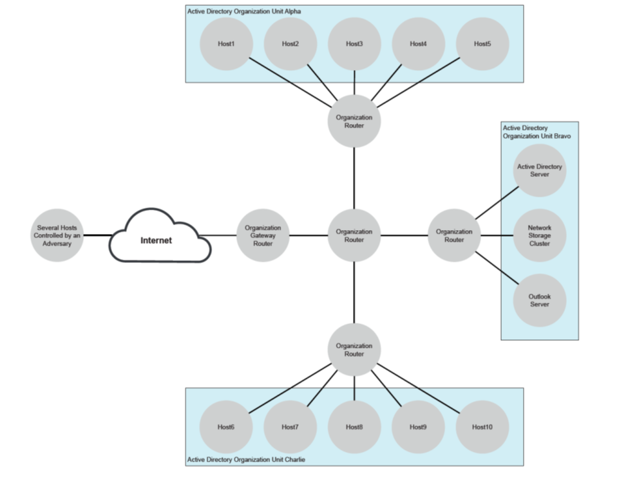
Cyber-Defense Scenario - Motivation

Slide 6
Cyber-Defense Scenario
Multi-Phase Attack:
  Phase 1: Infiltrate network with a phishing attack
  Phase 2: Spread laterally on the network
  Phase 3: Gain access to an Active Directory server
  Phase 4: Collection and exfiltration of selected data
Admin Accounts:
  Local Admin – Account for only one machine, which can not be used to manage any other machine
  Organizational Unit (OU) Admin – Account allows admin to login to and modify resources on any machine assigned to an entire OU section of network
  Domain Admin – Most powerful account, allowing admin to manage any machine on the entire network

Slide 7
Cyber-Attack: Phase One

Slide 8
Cyber-Attack: Phase Two

Slide 9
Cyber-Attack: Phase Three

Slide 10
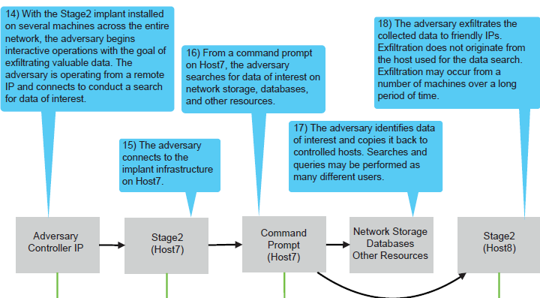
Cyber-Attack: Phase Four

Slide 11
Collection of Observed Sensor Data and Possible Actions

Slide 12
Potential Math APPLICATION to cyber-defense

Slide 13
Autonomous Cyber Defense:
Feedback Loop
External Reference Data
S
Fusion, Contextualization,
Enrichment
Analytics, Understanding
S
S
Actual
Network
S
Knowledge Model,
State Model
S
S
Reasoning
A
A
A
A
A
Response Orchestration
Decision Making
Available Responses & Impacts
Goals
Notes:
We need to bring in external reference data, understand it and represented in in our knowledge model.
We have to represent out goals in a way that our decision algorithm can understand.
And we have to have some measures of how we are doing on our goals.
We have to have a representation of the responses or actions that are available to the decision engine.
And we need to somehow be able to forecast what the effects of these responses will be and how the will affect our goals.
Also, if I want to test whether the system can defend against real attacks, I need an attacker. This adds another layer of complexity…

Slide 14
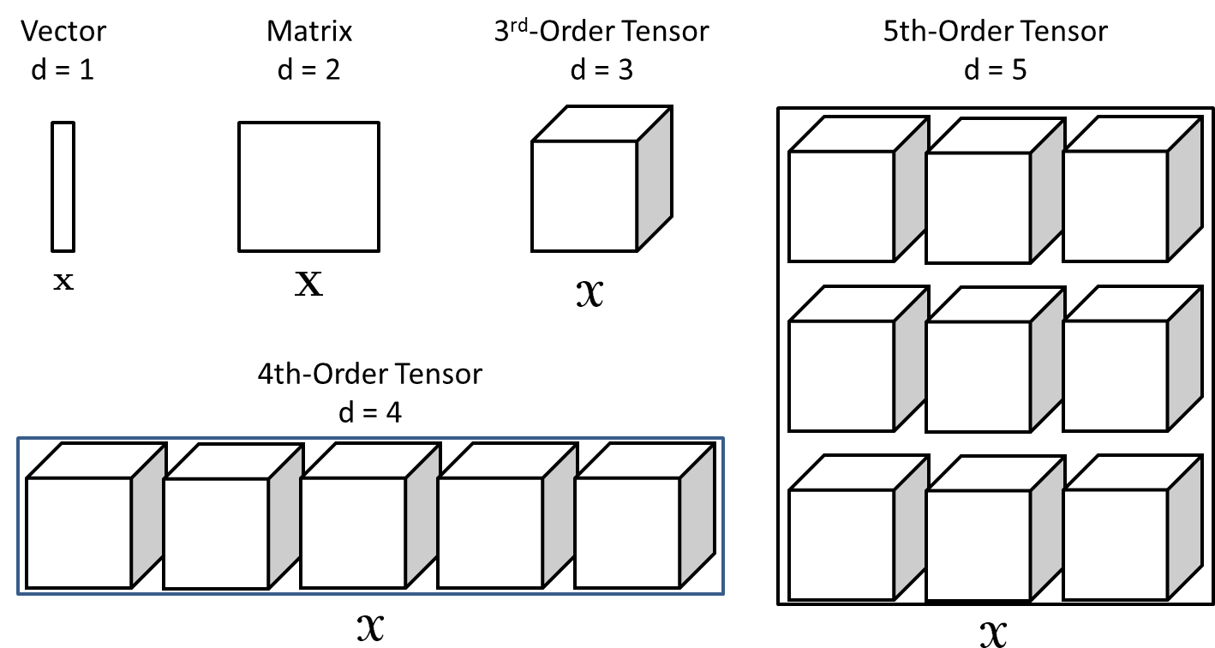
Tensors: A D-Way Array
Tensor Decompositions and Applications, Tamara G. Kolda & Brett W. Bader, Sandia National Labs, 2009

Slide 15
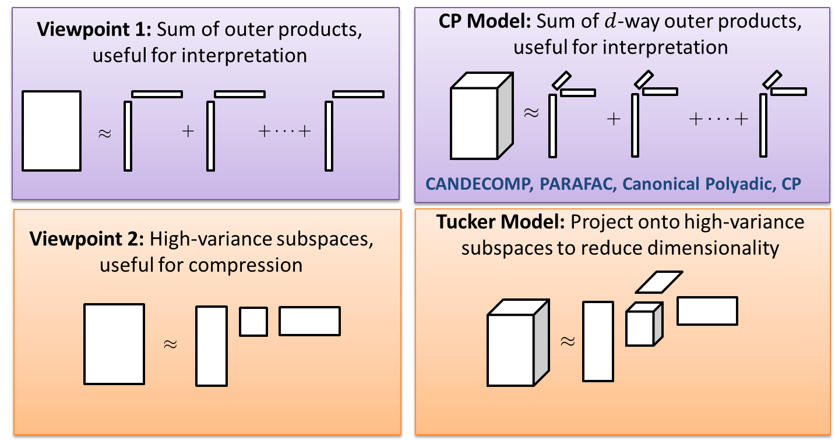
Matrices to Tensors: Two Viewpoints
Tammy Kolda, et. al., Sandia National Laboratories

Slide 16
Tensor Application: Data Fusion, Analytics
Reduce high dimension of cyber-security data being monitored
  Large amount of bandwidth and storage required to simultaneously collect process, memory, network traffic, registry, etc. from every machine
  Improve probability of detection of cyber attacks
Potential useful interpretation of low-order tensor decomposition
  Simultaneous correlation of multiple cyber-security features
  Some cyber-security features, observed in isolation, not good indictors of compromise

Slide 17
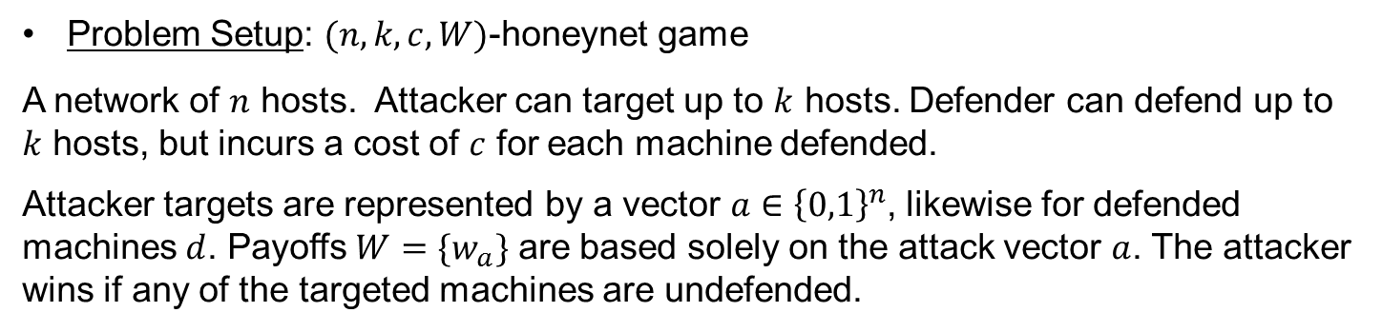
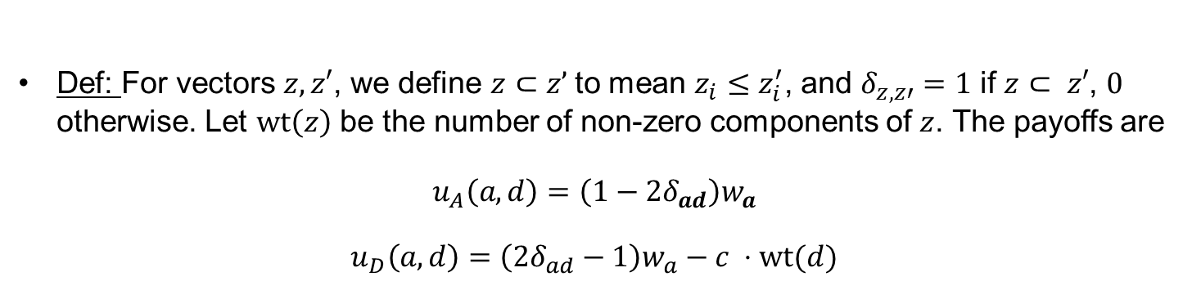
Game Theory¹
Problem Setup: $(n,k,c,W)$-honeynet game
A network of $n$ hosts. Attacker can target up to $k$ hosts. Defender can defend up to $k$ hosts, but incurs a cost of $c$ for each machine defended.
Attacker targets are represented by a vector $a∈{\left\{0,1\right\}}^{n}$, likewise for defended machines $d$. Payoffs $W=\{w_{a}\}$ are based solely on the attack vector $a$. The attacker wins if any of the targeted machines are undefended.
Def: For vectors $z,z′$, we define $z⊂z’$to mean $z_{i}≤z_{i}^{′}$, and $δ_{z,z′}=1$ if $z⊂ z′$, $0$ otherwise. Let $\text{wt}\left(z\right)$ be the number of non-zero components of $z$. The payoffs are
$$u_{A}\left(a,d\right)=\left(1−2δ_{ad}\right)w_{a}$$
$$u_{D}\left(a,d\right)=\left(2δ_{ad}−1\right)w_{a}−c ⋅\text{wt}(d)$$
¹Mark Bilinski, Ryan Gabrys, Justin Mauger, Optimal Placement of Honeypots for Network Defense, 2018 GAMSEC Conference Poster

Slide 18
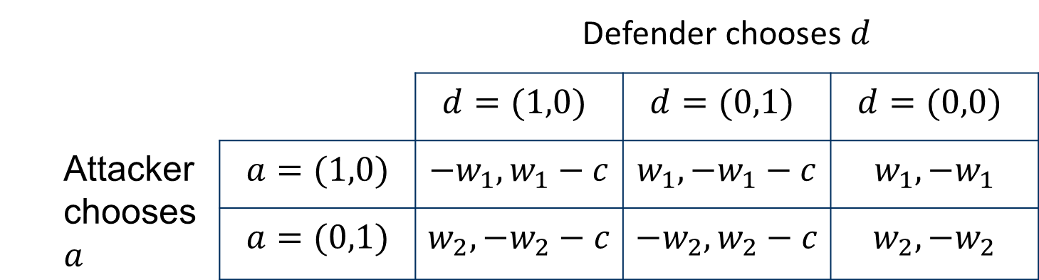
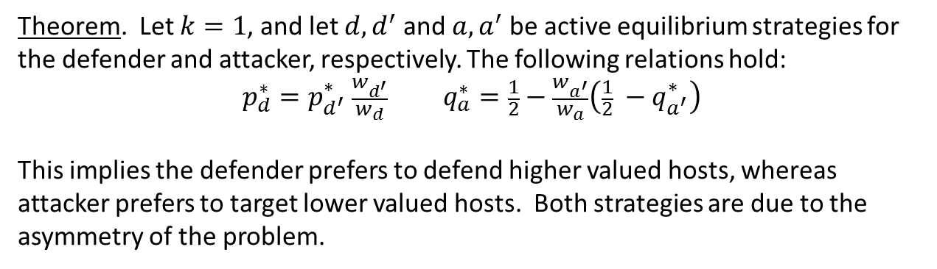
Game Theory Application: Decision-Making¹
Theorem. Let $k=1$, and let $d,d^{′}$ and $a,a^{′}$ be active equilibrium strategies for the defender and attacker, respectively. The following relations hold:
$$p_{d}^{∗}=p_{d^{′}}^{∗} \frac{w_{d^{′}}}{w_{d}} q_{a}^{∗}=\frac{1}{2}−\frac{w_{a^{′}}}{w_{a}}\left(\frac{1}{2} −q_{a^{′}}^{∗}\right)$$
This implies the defender prefers to defend higher valued hosts, whereas attacker prefers to target lower valued hosts. Both strategies are due to the asymmetry of the problem.
¹Mark Bilinski, Ryan Gabrys, Justin Mauger, Optimal Placement of Honeypots for Network Defense, 2018 GAMSEC Conference Poster

Slide 19
REINFORCEMENT learning (RL)

Slide 20
Why Reinforcement Learning (RL)?
  Cyber-Defense solution requires fundamentally different class of algorithms than
  just supervised or unsupervised machine learning ones
  Solve sequential decision-making , or control, problem for cyber
  defense domain
    Achieve directed goal in adversarial cyber environment
    Outcome of actions are unpredictable
    Feedback, i.e., reward signal, from environment required
  Training sets are either not available or difficult and expensive to
  obtain
  Challenge to accurately label situations to effectively predict labels
  for new situations in cyber defense (Supervised Learning)
  Difficult to learn structure from cyber data in a dynamic environment
  (Unsupervised Learning)

Slide 21
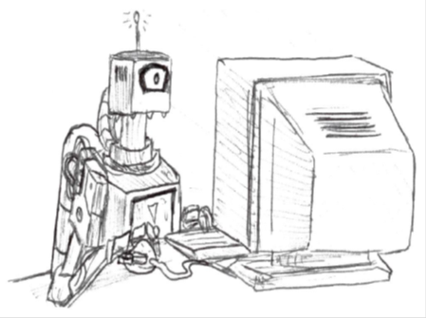
Reinforcement Learning (RL) Overview ²
  RL agents learn to map situations to actions to maximize numerical reward
    Agent must be able to learn from own experience
    Trial-and-error search
    Tradeoff between exploitation and exploration
    Delayed reward
  RL policy maps perceived situations, i.e., states, to
  actions
    Probability distribution across actions
  Reward function defines the RL problem goal
    Function assigns each state-action pair a numerical reward
    Indicates intrinsic, immediate desirability of state
  Value function indicates long-term reward
    Cumulative, expected discounted reward for each state
    Allows agent to reason about long-term consequences of actions
  Agent learns (near) optimal policy that maximizes expected long-term reward from a given state
²Sutton and Barto, “Reinforcement Learning: An Introduction,” The MIT Press, 2nd Edition, 2012

Slide 22
RL Agent-Environment Interaction²
Agent
State
S_{t}
Reward R_{t}
Action
A_{t}
R_{t+1}
Environment
S_{t+1}
²Sutton and Barto, “Reinforcement Learning: An Introduction,” The MIT Press, 2nd Edition, 2012

Slide 23
Science of Decision-Making
  Computer Science
  (Machine Learning)
  Engineering Neuroscience
  (Optimal Control) (Reward System)
  Reinforcement Learning
  Mathematics Psychology
(Operations Research) (Classical/Operant Conditioning)
Economics
(Bounded Rationality)

Slide 24
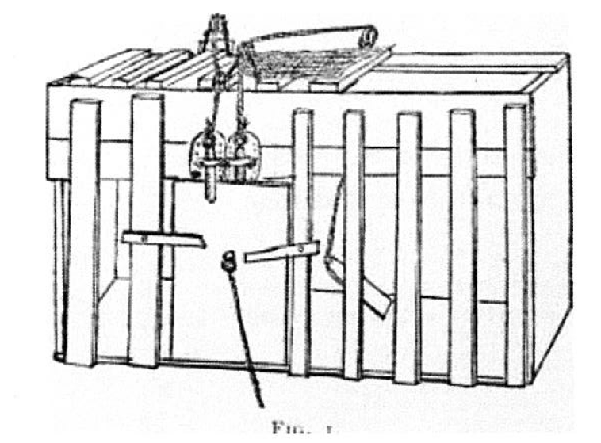
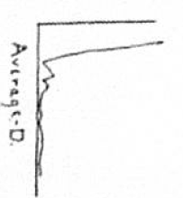
Law of Effect – Edward Thorndike - 1898
“In a situation, behaviors followed by satisfying consequences tend to be repeated and those that produce unpleasant consequences are less likely to be repeated.”
*Images from Thorndike, E.L. (1898) Animal Intelligence: An experimental study of the associative process in animals, The Psychological Review, II (4), The MacMillan Co., NY, NY.
Notes:
(U) Reinforcement Learning (RL) frequently cites its relationship to behavioral psychology’s Law of Effect advanced by Edward Thorndike in 1898 which states that in a situation, behaviors followed by satisfying consequences (positive rewards) tend to be repeated and those that produce unpleasant consequences (negative rewards) are less likely to be repeated. Research leading to this law involved experiments with hungry cats placed in a box in which there was a loop of string, a ring, a button or panel to be pressed, only one of which would be connected to the latch that would open the door of the box and lead to food. The cats would struggle to escape until they randomly found the method to escape. After multiple trials, cats placed in the box learned to press the lever quickly as freedom and food was more satisfying than confinement and hunger. Similarly, the reward function in RL defines for a given state the consequences that follow an action, either positive reward (satisfying) or negative reward (unpleasant). Just like the cat, after multiple trials, the program eventually produces the actions that maximize the reward.
(You may not want to use any of this)
Behavioral psychology has advanced since 1905 with refinements in the definition of the components of behavior development. One of the most influential researchers was B. F. Skinner who advanced his theory of radical behaviorism with the publication of Behavior of Organisms in 1938. He defined reinforcement as the primary process that shapes behavior. Positive reinforcement strengthens behavior by the occurrence of some event (praise for a job well done) following a behavior and negative reinforcement strengthens behavior by the removal of an aversive event (holding umbrella over your head stops rain from hitting you) following a behavior. Punishment temporarily suppresses behavior. Positive punishment suppresses behavior by the occurrence an aversive event (slapping hand away from stove) and negative punishment suppresses behavior by removing a positive event (taking dessert away). He advocated the use of reinforcement with minimal use of punishment and described the theory of successive approximations to shape desired behaviors by reinforcing incremental steps to the end goal. He continued to refine his theory eventually applying his theories to the design of a utopian society in his novel, Walden Two.

Slide 25
Sequential Decision-Making
Goal: Select actions to maximize total, future reward
  Maximize: E [Σ_{t} γ^{t} R_{t}(s, a,s’) | S_{t} = s]
Actions might have long term consequences
Reward might be delayed
Sometimes better to sacrifice immediate reward for more long-term reward (Greedy not always better)
Examples:
  Financial investment may take months to mature
  Refueling helicopter might prevent future crash
  Sub-optimal blocking of opponent move in chess

Slide 26
Dynamic Programming and Q-Learning
State-action value function Q(s, a) where:
Q(s, a) = (1 - α) * Q(s, a) + α ∗ [R(s, a, s’) + γ ∗ max_{a’εA} Q(s’, a’) ],
where α is some pre-determined step size. Common α-values used in practice
chosen such that α_{k} → 0 as k → 1.
Iterated Q(s, a) values converge to optimal Q*(s, a) values w.p. 1
assuming:
Σ_{k} α_{k} diverges and,
Σ_{k} α_{k}² converges for k =1,…,infinity.

Slide 27
Q-Learning
“Quality” learning of different state-action pairs
Developed by Christopher J.C.H. Watkins, 1989
One of most popular reinforcement learning (RL) algorithms
Has been adapted and used in combinations with other techniques to solve a broad range of problems

Slide 28
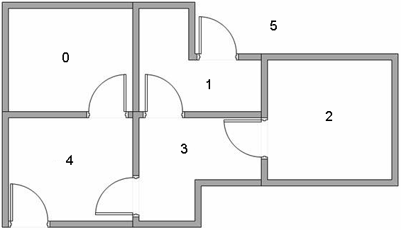
Q-Learning Example
The Five Room Maze: Five rooms in building connected by doors. Rooms numbered 0 through 4. Outside of building is room 5. Goal is to get to room 5, i.e., outside of maze.
Example by Kardi Teknomo, 2005, “Q-learning by Examples” http://mnemstudio.org/path-finding-q-learning-tutorial.htm

Slide 29
Graph Representation
Each room is a node, and each door is an edge:

Slide 30
RL Agent Goal
Find shortest path, from initial starting room, to room 5, i.e., the goal state, to reach outside of maze.

Slide 31
Rewards
Each door is assigned a reward w/ reward of 100 for exiting rooms that lead directly to room 5
Reward of 0 for passing through doors not directly connected to room 5
Reward of -1 represent no door between rooms, or edge between graph nodes, e.g., agent cannot move from node 0 to node 1.

Slide 32
Corresponding Reward Matrix, R

Slide 33
Q-Function, Q(s,a)
Discount factor g normally set to 0.8
Make random choice to move to room 1 or room 5
Q(s,a) = R(s,a) + γ * max ( Q(next state, all actions) )
  Q(1,5) = R(1,5) + g * max (Q(5,1), Q(5,4), Q(5,5))
  = 100 + 0.8*0 = 100
  Update Q(1,5) to 100

Slide 34
Optimal Q-Values and Optimal Solution

Slide 35
History and State³
  History is sequence of observations, actions, and rewards
    Ht = {A₁, O₁, R₁, …, A_{t}, O_{t}, R_{t}}
  RL algorithms build a mapping from observations to actions
    Agent selects actions
    Environment selects observations/rewards
  State summarizes history into useful information to determine “what happens next”
    State is a function of history
    S_{t} = f(H_{t})
    Whatever agent uses to choose next action
  Examples of State:
    Last three observations
    Last observation
  ³Daniel Silver, Introduction to Reinforcement Learning Course (YouTube), Deepmind, 2015

Slide 36
Information State (Markov State)
  State S_{t} is Markov iff:
      P(S_{t+1}|S_{t}) = P(S_{t+1}|S₁, …, S_{t})
  “The future is independent of the past, given the present”
  Once state is known, history no longer required → state is sufficient statistic of future
  Environment state, different from agent state, is Markov

Slide 37
Markov Decision Process
Def: Markov Decision Process (MDP) is formally characterized as a 5-tuple,
        M = (S, A, R, P, γ), where:
  S is set of states, created based on full observations, and A is set of actions,
  R is reward function, written as R(S, A, S’) to indicate the reward gained from being in state S, taking action a, and moving directly to state S’,
  P is a transition probability function, written as P(S’|S, a) to represent probability of being in state S’, after starting in state s and taking action A,
  γ is discount factor, which represents how much future rewards are valued, γ has value in interval [0,1] . If g is close to 1, then future rewards are highly-valued. If γ is close to zero, then future rewards are not valued at all.

Slide 38
Bellman Optimality Criterion
  V(s) is expected sum of discounted rewards for achieving goal starting from state s:
  V(s) = E [Σ_{t} γ^{t} R_{t}(s, a,s’) | S_{t} = s]
  Q(s, a) is expected sum of discounted rewards R after taking action a in state s:
    Q(s, a) = E [Σ_{t} γ^{t} R_{t}(s, a,s’) | S_{t} = s, A_{t} = a],
Optimal policy π* is one that, if followed, maximizes the following expected sum of discounted rewards:
π*(s) = arg_{aεA} max Q*(s, a)
= arg_{aεA} max E_{π} [Σ_{t} γ^{t} R_{t}(s, a,s’) | S_{t} = s, A_{t} = a]
= arg_{aεA} max E_{π} [R_{t+1} + γ * V(S_{t+1}) | S_{t} = s, A_{t} = a],
  Bellman Optimality Criterion: V*(s) and Q*(s, a) satisfies following equations,
  respectively, i.e., are fixed points:
  V_{π}(s) = Σ_{a} π (a|s) Σ_{s’} P(s|a) * [R(s,a,s’) + γ*V_{π}(s’)], or
  Q*(s, a) = Σ_{a} π (a|s) Σ_{s’} P(s|a) * [R(s,a,s’) + γ*Q_{π}(s’, a’)],

Slide 39
References (Textbooks)
  Daniel Silver, Introduction to Reinforcement Learning Course (YouTube), Deepmind, 2015
  An Introduction to Reinforcement Learning, 1998
    Richard Sutton and Andrew Barto,
    MIT Press publishing
    Available online (second edition in progress?)
    http://webdocs.cs.ualberta.ca/~sutton/book/the-book.html
  Algorithms for Reinforcement Learning, 2010
    Csaba Szepesavari
    Morgan and Claypool publishing
    Available online
    http://www.ualberta.ca/~szepesvari/papers/RLAlgsInMDPs.pdf
  Dynamic Programming and Optimal Control, 3rd Edition, Volume II
    Dimitri P. Bertsekas, MIT
    Chapter 6 – Approximate Dynamic Programming

Slide 40
Autonomous Cyber Defense

Slide 41
Autonomous Cyber Defense:
Feedback Loop
External Reference Data
S
Fusion, Contextualization,
Enrichment
Analytics, Understanding
S
S
Actual
Network
S
Knowledge Model,
State Model
S
S
Reasoning
A
A
A
A
A
Response Orchestration
Decision Making
Available Responses & Impacts
Goals
Notes:
We need to bring in external reference data, understand it and represented in in our knowledge model.
We have to represent out goals in a way that our decision algorithm can understand.
And we have to have some measures of how we are doing on our goals.
We have to have a representation of the responses or actions that are available to the decision engine.
And we need to somehow be able to forecast what the effects of these responses will be and how the will affect our goals.
Also, if I want to test whether my system can defend against real attacks, I need an attacker. This adds another layer of complexity…

Slide 42
Autonomous Cyber Defense
  Intuition: System performs reasoning and response, where goals are well defined by human and some bounded range of actions is available.
Features:
  Automated reasoning, and
  Adaptive response
  Automated reasoning and adaptive response needed to mitigate damage from attacks at machine speed and enterprise scale.
  Automated responses can also reduce uncertainty and increase situational awareness

Slide 43
Autonomous Cyber Defense Challenges
  Cyber training data and realistic testbed for
  repeatable, interactive experiments
  Speed and scalability of reasoning methods, esp.
  over large state spaces
  Decisions made on uncertain and incomplete data
    Adversary influence on computer network
    Users, admins, and defenders influence on computer network and adversary
  Reasoning across different time scales (e.g., correlation among historical, current, and future decisions and responses)
  Interactions between global and local decisions and responses (e.g., central vs. distributed system)

Slide 44
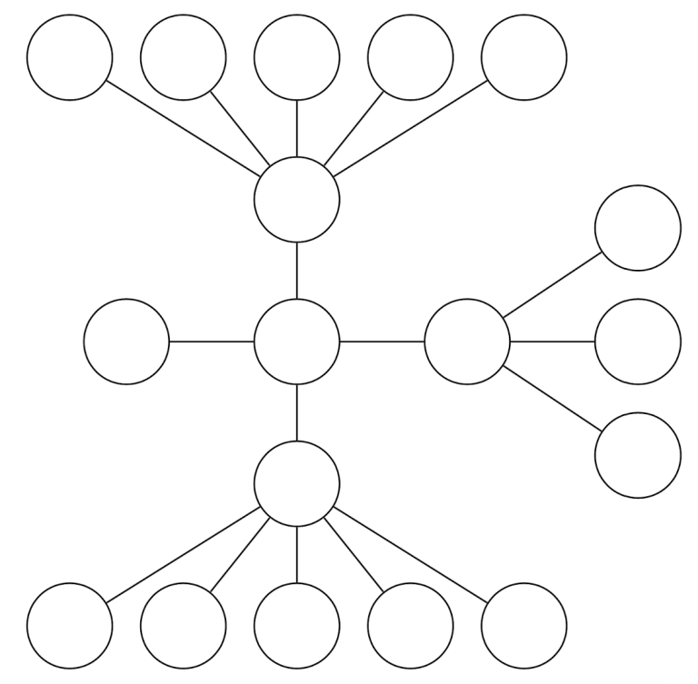
RL Cyber-Defense Scenario
Given possible cyber-attack conditions, train RL agent to mitigate attack while maintaining network performance level (preferably high)
Network of eighteen (18) equally valuable nodes
Node types:
  Assigned 0: Safe
  Assigned 1: Unsafe & not isolated
  Assigned 2: Unsafe & and isolated
State of system (i.e., network) = total number
of safe nodes => 3¹⁸ possible states

Slide 45
RL Cyber-Defense Scenario
Attacker can compromise any node and spread to nodes connected to compromised nodes
RL agent actions:
  Do nothing,
  Patch node , or
  Isolate & patch node
Reward function : R = Benefit of action – Cost of action:
  Benefit = no. of safe nodes
  Do nothing action has zero cost
  Isolate action costs more than patch action
  Use a tunable parameter to adjust cost

Slide 46
Experiment Details
Train/test with 10k/1k episodes, with 100 turns per episode.
Each episode starts from a clean slate.
Use greedy-epsilon policy.
  Train: start with epsilon = 1.0, decrease to 0.1
  Test: fix epsilon = 0.05
Evaluate RL agent performance based on:
  Average over the number of safe nodes each turn to get episode's performance.
  Average over episodes to get one scalar score for experiment

Slide 47
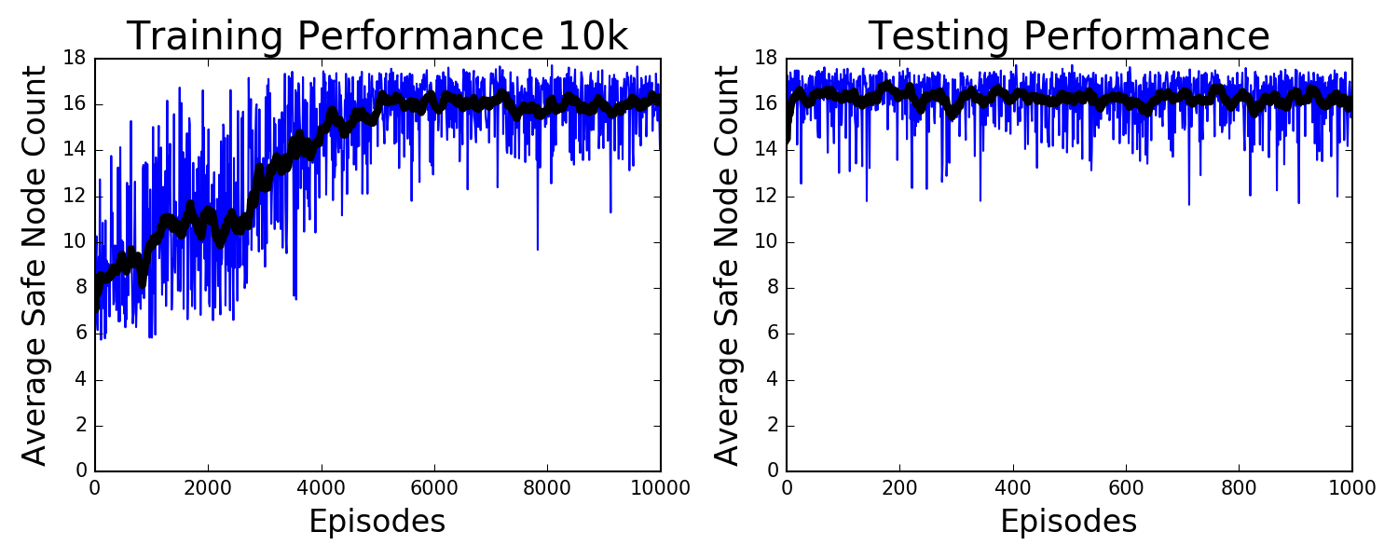
First Experiment Results
Trained RL agent for 10,000 episodes
Evaluate results based on number of safe nodes
Results are good:
  Agent with epsilon = 0.05:
    Mean no. of safe nodes =16.3, Median no. of safe nodes =16.6
  Agent with epsilon =1.00 (i.e., random policy):
    Mean no. of safe nodes =9.1, Median no. of safe nodes= 8.9

Slide 48
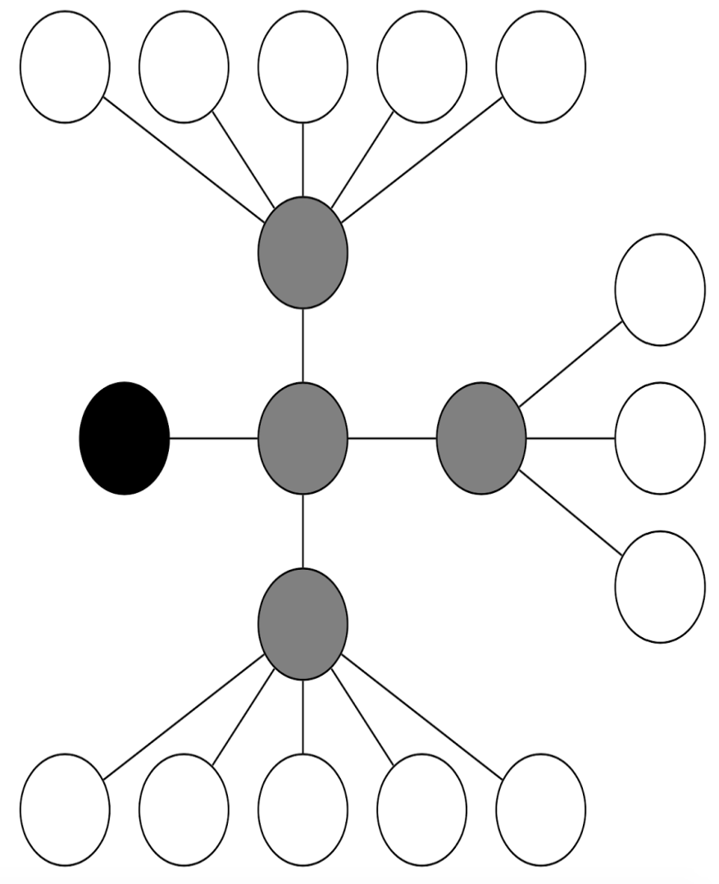
(U) Distribution of Actions
(U) ISOLATE actions primarily applied to central nodes
(U) Central nodes have ISOLATE and PATCH applied to them in similar proportions
(U) PATCH action, not ISOLATE action, applied to perimeter nodes when compromised
(U) Large number of DO-NOTHING actions.

Slide 49
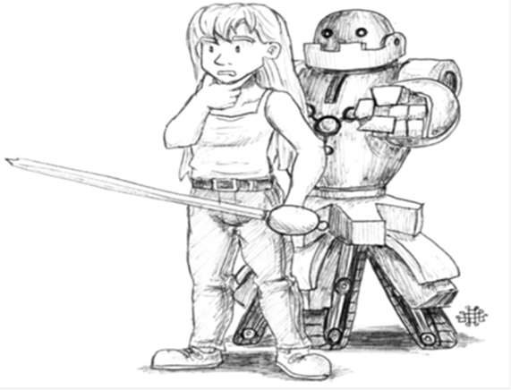
Autonomous Cyber Defense Research Impacts
  Efficient, scalable cyber defense system to mitigate
  impact of cyber-attacks
    Is RL effective in training agents at required speed and scale?
    How does performance vary as attacker complexity increases?
    How transferrable is the learning between environments?
  Improve understanding of response effects on:
    Mission/services,
    Performance of network, and
    Cyber-attackers
  Path towards improved trust in, and acceptance of,
  autonomous cyber defense systems

Slide 50
Questions ???
Contact Info: Dr. Ahmad Ridley, adridle@tycho.ncsc.mil

Slide 51
BackUP SLIDES

Slide 52
Cyber Resilience Challenges
  Real-time fusion of events from diverse and disparate data sources
  State representation and reasoning over state to choose
  defensive actions
  Developing secure design methodology for cyber
  defense systems
  Building human trust in autonomy of cyber defense system
  Creating metrics and experiments to measure impact of
  of defensive actions on systems and adversaries

Slide 53
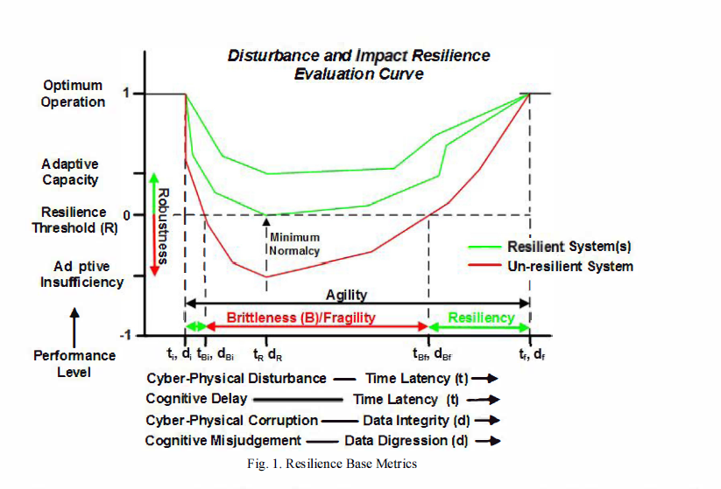
Cyber-Resilience Concepts
⁷Reiger, Craig C., Resilient Control Systems, Idaho National Laboratory, 2014

Slide 54
Rewards
R_{t} is scalar, feedback signal
Indicates how well agent is performing at step t
Agent attempts to maximize cumulative reward
Reward Hypothesis: All goals can be described by maximization of expected cumulative reward

Slide 55
RL Existing Theory and Applications
  Theory:
    RL Algorithms (Value iteration, policy iteration, Deep Q-learning)
    Markov Decision Processes (MDPs)
    Optimization (Deterministic and Stochastic)
    Dynamic Programming
  Practical applications:
    Robotics
    Autonomous Vehicles
    Airline flight scheduling
    Maintenance and repair planning
    Games (backgammon, checkers, AlphaGo)
    Limited cyber applications:
      Cyber-analyst scheduling,
      Distributed Denial of Service (DDOS)/DNS attacks on availability

Slide 56
Examples of RL Applications
  Train an agent to:
    Fly stunt maneuvers in a helicopter
    Defeat Backgammon world champion
    Manage an investment portfolio
    Control a power station
    Train a humanoid robot to walk
  Each example above requires sequence of decisions in real-time with different types of reward signals

Slide 57
Machine Learning
Unsupervised Learning: Group like things together. Hope that this likeness helps solve a problem.
Supervised Learning: Try to identify observations according to some pre-specified class label.
Goal: Automate decision making based on input data.
Notes:
We’re going to focus on machine learning because it’s the most mature of these. Not unrelatedly, it’s also the most easily applicable to cyber-security, and it’s the one I have the most experience with.
There are two predominate schools of Machine Learning. Unsupervised and Supervised Learning. In unsupervised learning, one takes a collection of data where nothing is known about it and attempts to use some measure of likeness to group things. The hope is that this will be useful to solve some problem.
For instance, some researchers were clustering mushrooms by various properties: where they grow, how tall, their color, etc. and they found that using properties like this, they could predict whether a mushroom was poisonous very well.
In supervised learning, you know ahead of time what output you want from the machine, and you try to give it examples of the various outputs in hopes that the machine can learn to produce this output quickly.
Unsupervised learning is mostly useful for helping to explore a data set about which you don’t know much. For most practical applications where you want to field something that is going to be useful to a lot of people, you want a supervised algorithm.

Slide 58
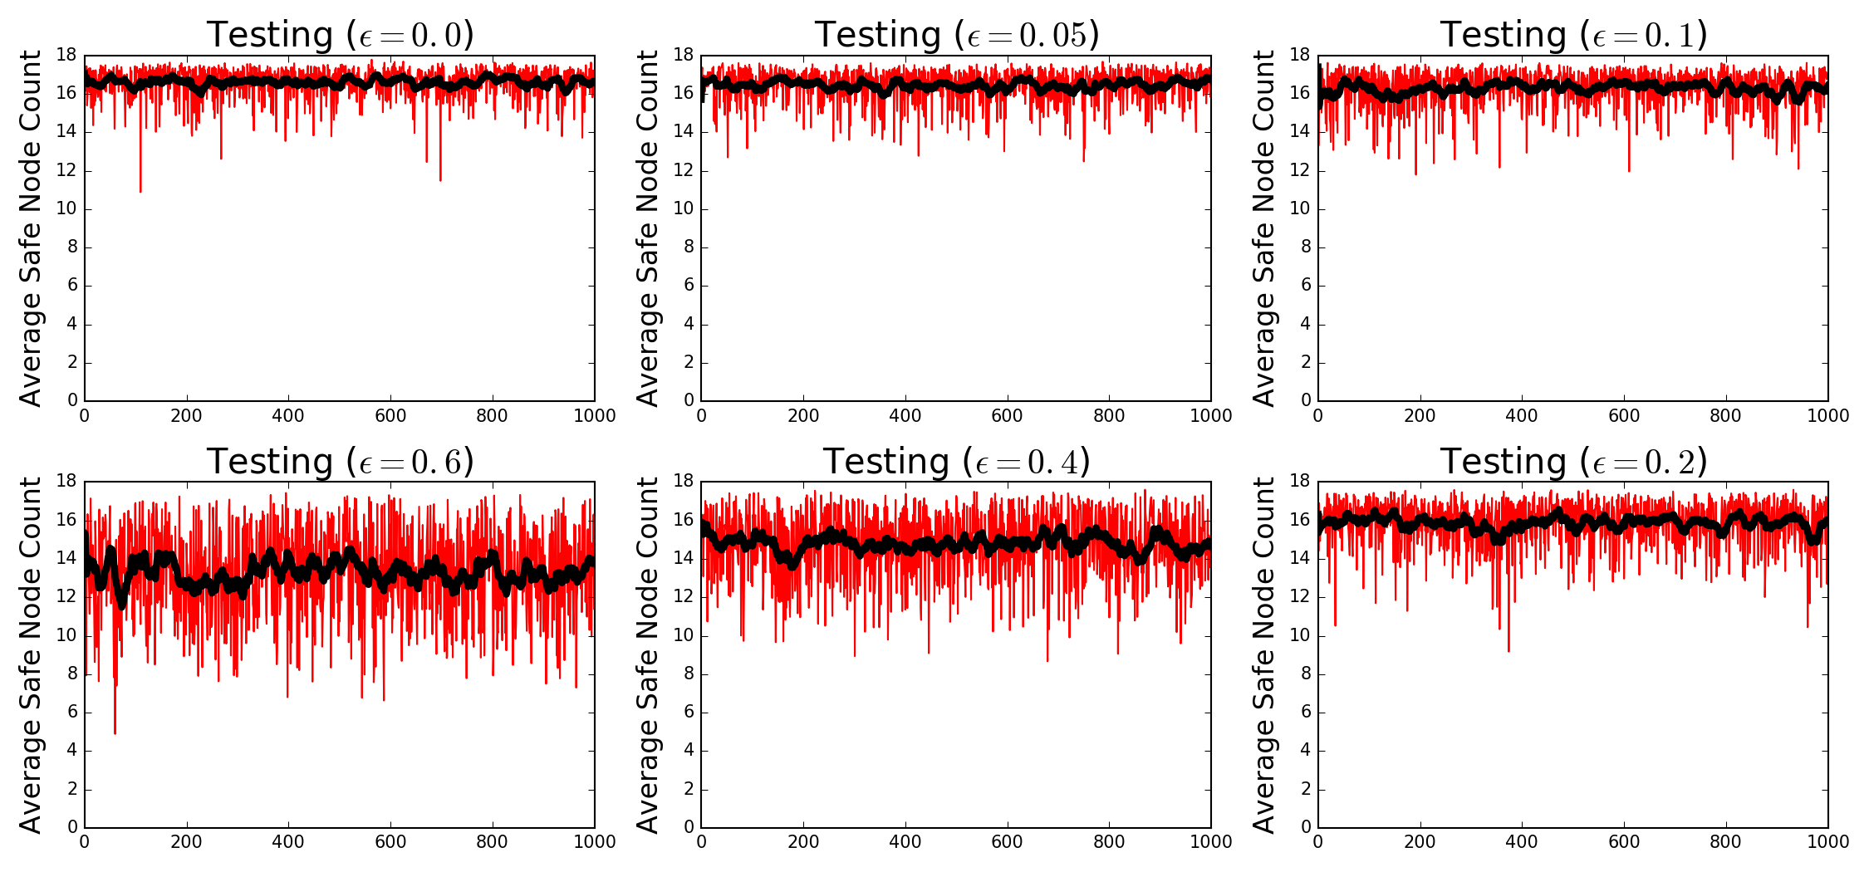
Effect of Greedy-Epsilon Policy
Epsilon (ε) indicates probability of taking random action, instead of greedy (best) action
Increasing epsilon results in worse performance
Best is ε = 0.0 with Mean=16.6 & Median = 16.8
But ε = 0.05, which we use, is almost as good with Mean = 16.4 and Median = 16.7

Slide 59
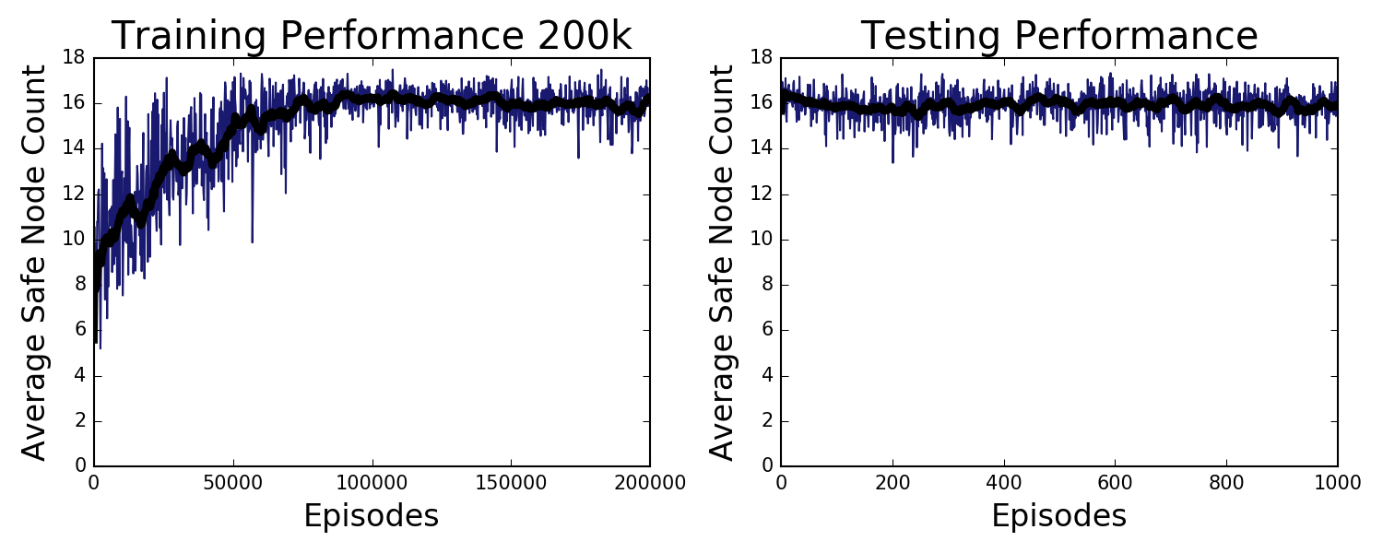
Effect of Scaling Up Training
Increased number of training episodes to 200k
Results still good but not better:
  Mean no. of safe nodes = 15.9,
  Median no. of safe nodes = 16.0,
  Only slightly worse than 10k trials.
RL agent learns well enough with 10k trials.

Slide 60
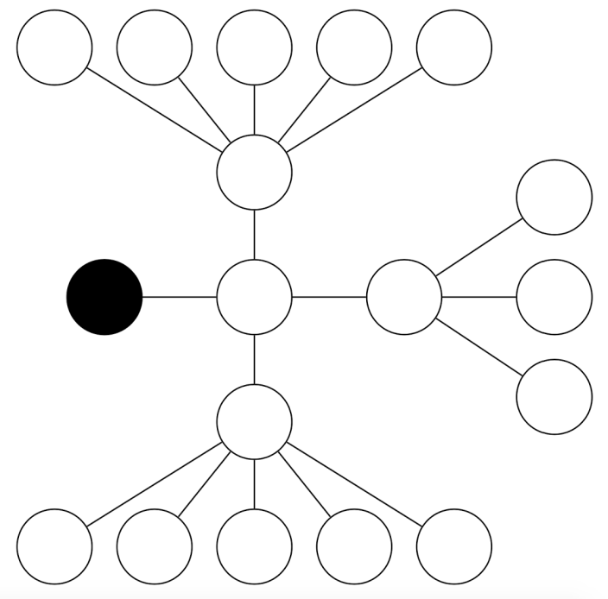
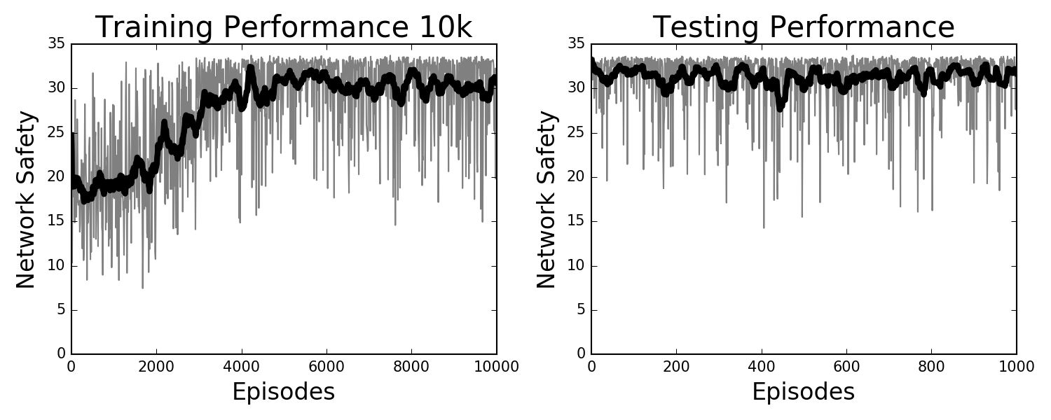
Second Experiment Results
Introduce: Critical Node
Critical node has value of 17, other nodes have
value 1
Score over 10,000 episodes:
  Mean = 31.26,
  Median = 32.63

