Slide 1
Venus
Venus
To make Canada a global leader in Cybersecurity
Tony Bailetti, Dan Craigen,
David Hudson, Renaud Levesque, Stuart McKeen, D’Arcy Walsh

Slide 2
Outline
Motivation, challenges & doctrines
Goals of Venus Cybersecurity Corporation
Innovation engine for Cybersecurity
Progress of Task Group
Seeding of Cybersecurity challenges
Content – TIM Review, courses, conference …

Slide 3
Motivation
Sense of urgency for industry, government, universities, not-for-profits, and individuals to work together to ensure Canadians can benefit from a secure cyber space
Action on a number of fronts is needed
Development of a Canadian “Innovation Engine” in Cybersecurity

Slide 4
Challenges
Uncoordinated industry, academia and government approaches
Daunting and fractured list of R&D requirements
Silo mentality of research disciplines
Chasm between classified and unclassified domains
Lack of education and training programs in cyber security
Paucity of Canadian companies operating in the global cyber security space
Under investment in cyber-related research compared to other jurisdictions
Contracting process and procedural requirements of governments (e.g., $25,000 contract limits)

Slide 5
Doctrines
Schneider/Mulligan: Doctrine for Cyber Security
Cyber security as a “public good”
Cyber security through unified research and social enterprise
Richard Florida: The Rise of the Creative Class
  Technology, Talent, Tolerance
  Ottawa #1 in Canada
Bailetti, et al.: Innovation Engines
  Converting innovation into global leadership in specific product markets

Slide 6
Goals
Build engine to:
  provide competitive advantages to Canadian companies
  better protect Canada’s critical infrastructure
Become a focal point for cybersecurity projects
  R&D, ventures, infrastructure, content
Become self-sustaining

Slide 7
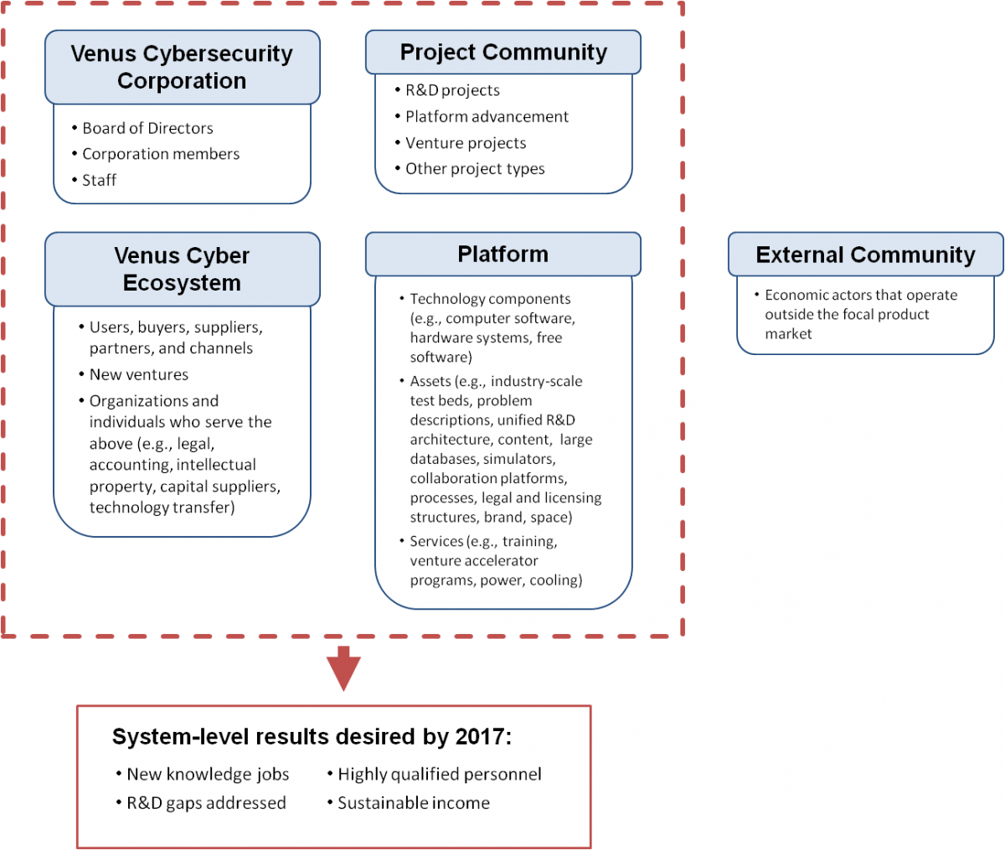
Engine’s five elements
Linked by strategic intent, governance, resource flows and organizational agreements
http://timreview.ca/article/711

Slide 8
Innovation focal points
Project community
  Innovation in R&D
Venus Cyber Ecosystem
  Innovation in factors that determine outcomes in global competition
External community
  Innovation in resources produced and used by actors outside of the Cybersecurity market

Slide 9
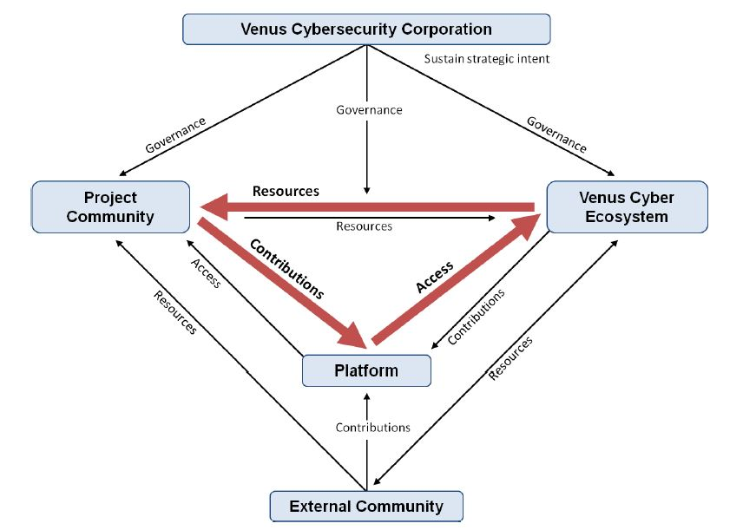
Innovation Engine

Slide 10
Desired results – Dec 2017
2,800 new knowledge jobs in Canada
20 R&D gaps and operational limitations in cybersecurity addressed
500 new highly qualified people operating in the cybersecurity space
$5M/year sustainable income

Slide 11
Project portfolios – near term
R&D
  Near-, mid-, long-term
Ventures
  Accelerator
  New corporate ventures
  Technology transfer
Infrastructure
  Lab complex
  Problems
  DB
  Simulators
  1000+ machines test bed
Content
  Journal articles
  International conference
  Courseware

Slide 12
Nov 1 Deliverables
Develop organization
Develop infrastructure
Establish presence
6 Strategic Founding Members
Funnels with members and project sponsors from all Canadian regions
Not-for-profit incorporated
Contractors in place
Lab 1 operational
Plan for lab complex
Community anchored around a Web presence
Press release
Operate venture accelerator
Unified R&D program
Contribute to science and practice
Global leadership
1st venture cohort launched
Venture program launched
R&D projects launched
Version 1 unified R&D
July & August articles published
Authors/topics of Feb 2014 articles identified
“Man on moon” opportunity to lead globally

Slide 13
Not-for-profit by March 31, 2014
Executive Director
Projects & Working Groups
Global leadership plan
R&D
Accelerator
Corporate new ventures & tech transfer
Lab 1
Content
Lab complex & infrastructure
Membership and recruitment
Publicity
National community
Strategic Founding Members
Federal agency of DND
Federal agency of Industry
Internet service provider
Large bank or utility
Provincial government
Municipal government
2 Program Managers
Class A, B, C & Individual Class members
Level 1, 2, 3, 4 & Individual Sponsors
3 contractors
3 students
1 admin
University’s back office support

Slide 14
Focus areas of Cybersecurity Research
Improve the management and quality of signatures
Increase efforts on anomaly detection and support discovery of new threats
Reduce time to action through streaming and event driven analytics
Prove dynamic defence at the network edge and beyond

Slide 15
Focus areas of Cybersecurity Research
Investigate secure cloud-based systems including virtualization
Investigate secure supply chains
Investigate practical enterprise-level metrics
Investigate secure mobility (including wireless)
Continuously leverage research related to the science of Cybersecurity

Slide 16
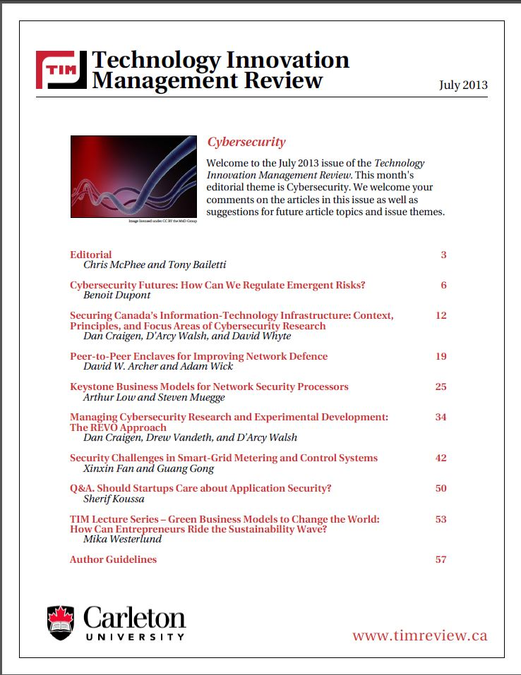
Content

Slide 17
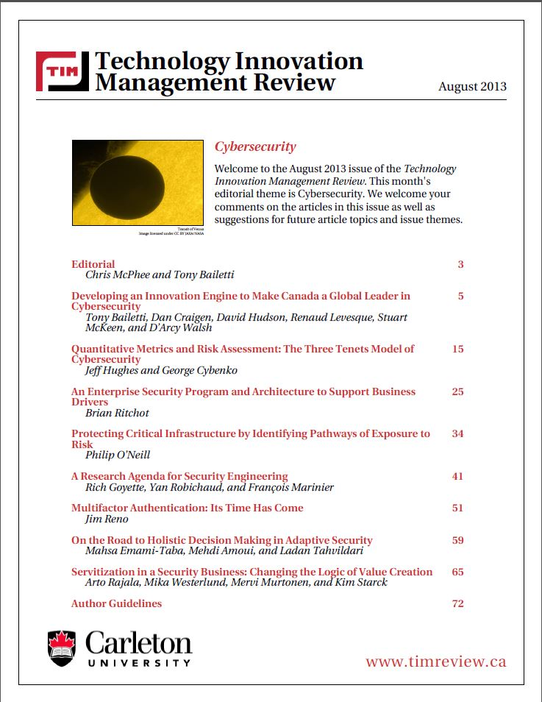
Content

Slide 18
Content/Interaction
Special issues February/March 2014
Cybersecurity conference Summer 2014 (Ottawa)
Cybersecurity course Summer 2014 (Graduate level)
Venus-perspective that Cybersecurity is largely a-theoretical: hence, importance of Science of Cybersecurity

